Slide 1
Sinto Project
Quan Xiao
9/20/2019

Slide 2
Tag | DateTime | Length | Baseline | Model | Tag | DateTime | Length | Baseline | Model
MOLD PUSH OUT RET SINGLE COMP. | 8/28/2019 5:46 | 0 | 2.5 | Single | MOLD PUSH OUT RET SINGLE COMP. | 8/28/2019 5:46 | 0 | 2.5 | HI-MED
CHAPLET SETTING COMPLETED | 8/28/2019 5:46 | 0 | 25 | Single | CHAPLET SETTING COMPLETED | 8/28/2019 5:46 | 0 | 25 | HI-MED
COPE PATTERN SPRAY COMP | 8/28/2019 5:46 | 0.409 | 1 | Single | COPE PATTERN SPRAY COMP | 8/28/2019 5:46 | 0.41 | 1 | HI-MED
DRAG PATTERN SPRAY COMP | 8/28/2019 5:46 | 0.515 | 1 | Single | DRAG PATTERN SPRAY COMP | 8/28/2019 5:46 | 0.513 | 1 | HI-MED
INFLATE GATE SEAL COMP | 8/28/2019 5:46 | 0.534 | 0.5 | Single | INFLATE GATE SEAL COMP | 8/28/2019 5:46 | 0.521 | 0.5 | HI-MED
STRIP FLASK DOWN SET COMP | 8/28/2019 5:46 | 0.02 | 1 | Single | STRIP FLASK DOWN SET COMP | 8/28/2019 5:46 | 0.02 | 0.1 | HI-MED
SQUEEZE ADV SET COMP | 8/28/2019 5:46 | 1.201 | 1.7 | Single | SQUEEZE ADV SET COMP | 8/28/2019 5:46 | 1.209 | 1.5 | HI-MED
MOLD PUSH OUT ADV COMP | 8/28/2019 5:46 | 5.928 | 6.6 | Single | MOLD PUSH OUT ADV COMP | 8/28/2019 5:46 | 5.934 | 6.6 | HI-MED
... | ... | ... | ... | ... | ... | ... | ... | ... | ...
COPE STOPPER OUT COMP | 8/28/2019 6:11 | 0.38 | 0.5 | Single | DRAG FLASK SLD RET COMP | 8/28/2019 5:46 | 1.583 | 2 | HI-MED
DRAG FLASK SLD RET COMP | 8/28/2019 6:11 | 1.591 | 2 | Single | SAND FILL COMP. | 8/28/2019 5:46 | 14.535 | 15 | HI-MED
COPE FLASK LIFTER DWN FOR STRIP COMP | 8/28/2019 6:11 | 1.512 | 1.5 | Single | COPE FLASK LIFTER DWN FOR STRIP COMP | 8/28/2019 5:46 | 1.453 | 1.5 | HI-MED
MOLD RECEIVER UP COMP | 8/28/2019 6:11 | 2.853 | 2.6 | Single | MOLD RECEIVER UP COMP | 8/28/2019 5:46 | 2.854 | 2.6 | HI-MED
STRIP FLASK DOWN STRIP | 8/28/2019 6:11 | 2.012 | 1.7 | Single | STRIP FLASK DOWN STRIP | 8/28/2019 5:46 | 2.011 | 2 | HI-MED
MOLD RECEIVER DOWN COMP | 8/28/2019 6:11 | 1.503 | 1.2 | Single | MOLD RECEIVER DOWN COMP | 8/28/2019 5:46 | 1.451 | 1.2 | HI-MED
CYCLE TIME | 8/28/2019 6:11 | 1515.737 | 34.5 | Single | CYCLE TIME | 8/28/2019 5:46 | 32.836 | 24.25 | HI-MED

Slide 3
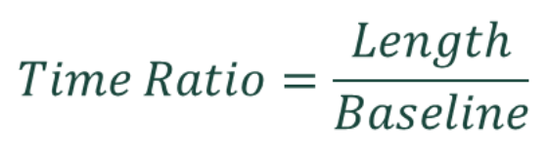
We can gain several time series according to Tags
Time Ratio
Cycle Time

Slide 4
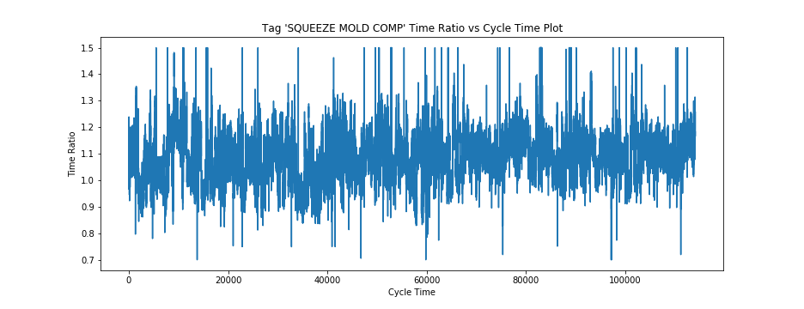
The time series plot of Tag 'SQUEEZE MOLD COMP'
Note: The value of this plot is restricted from 0.7 to 1.5.

Slide 5
Sharp Break
We want to prevent this breakdown before it happens.
How to do this?

Slide 6
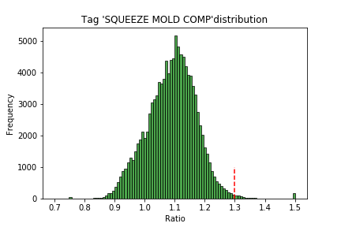

The first thing we need to is to define a threshold for outliers.
In order to do this, we draw the distribution of each Tag, eg. Tag 'SQUEEZE MOLD COMP'
Since ,
then we use to be our threshold.
i.e. 1.3 in this Tag.

Slide 7
Related Problems

Slide 8
Problem Set-up
With thresholds for anomalies => the labels => Classification.
Challenges:
Unbalanced Data: The positively labeled data are less than 1%.
In this situation, if we still use classification techniques, it's difficult to learn the positive labeled data well.

Slide 9
Anomaly Detection
Unsupervised learning:
Dataset is extremely unbalanced => only use normal data points to learn the normal patterns and reconstruct them.
Feed another test data and calculate reconstruction error.
Large error = Anomaly
Caveat:
This detection technique can only tell us whether the points are outliers rather than predict them.

Slide 10
Proposed Method

Slide 11
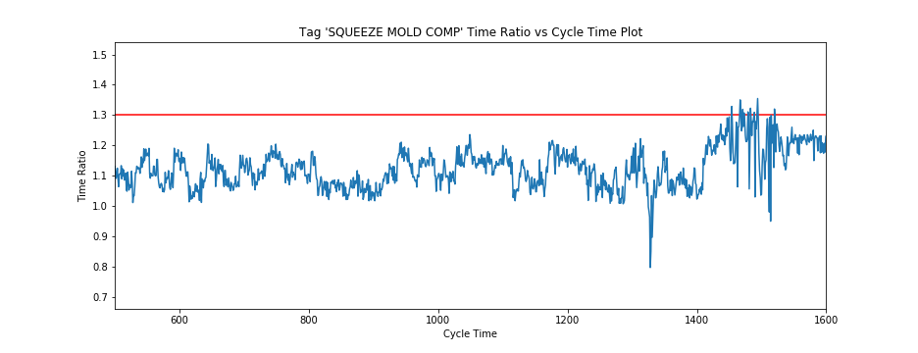
The pattern before the outlier is clearly different from the patterns before the normal points => Signal
How to verify?

Slide 12
Problem Setup
Goal: Predict anomaly before it occurs.
Baseline model: Verify the feasibility of this hypothesis.
Verify the areas before anomalies are also abnormal
Predict the anomalies
Detect the area before anomalies

Slide 13
Baseline Model

Slide 14
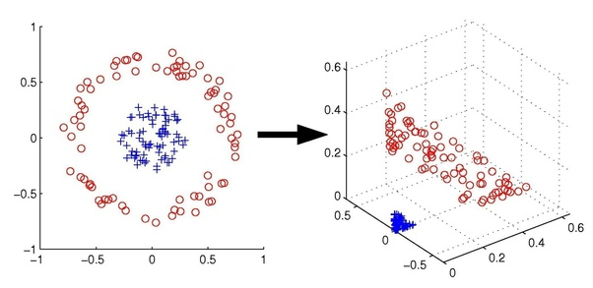
Baseline Model
kernel SVM (Support Vector Machine)

Slide 15
Intuition
We use the features of observational Windows to predict if there are outliers in prediction windows.
Prediction Time
Observation Window
Prediction Window

Slide 16
Intuition
We use the features of observational Windows to predict if there are outliers in prediction windows.
Prediction Time
Observation Window
Prediction Window

Slide 17
Intuition
We use the features of observational Windows to predict if there are outliers in prediction windows.
Prediction Time
Observation Window
Prediction Window

Slide 18
Intuition
We use the features of observational Windows to predict if there are outliers in prediction windows.
Prediction Time
Observation Window
Prediction Window

Slide 19
Intuition
We use the features of observational Windows to predict if there are outliers in prediction windows.
Prediction Time
Observation Window
Prediction Window

Slide 20
Feature Selection
Features and Description
Feature | Description
Mean | The DC component (average value) of the signal over the window
Median | The median signal value over the window
Standard Deviation | Measure of the spreadness of the signal over the window
Variance | The square of standard deviation
Root Mean Square | The quadratic mean value of the signal over the window
Averaged derivatives | The mean value of the first order derivatives of the signal over the window
Skewness | The degree of asymmetry of the sensor signal distribution
Kurtosis | The degree of peakedness of the sensor signal distribution
Interquartile Range | Measure of the statistical dispersion, being equal to the difference between the 75th and the 25th percentiles of the signal over the window
Mean Crossing Rate | The total number of times the signal changes from below average to above average or vice versa normalized by the window length
Spectral Entropy | Measure of the distribution of frequency components
Model (one-hot encoded) | The model which the signal over the window belong to

Slide 21
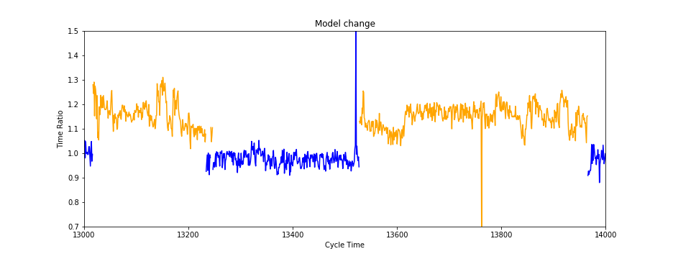
Model Change
We add Model types as features since the time ratio changes largely when change models

Slide 22
Feature Selection Method
Why perform feature selection?
Data interpretation discovery (insights into which factors which are most representative of our problem)
Method: Sequential Forward Selection
Greedy search algorithm
How to assess the performance?

Slide 23
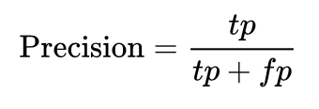
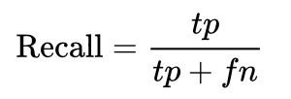

Selection criterion
We use F1 score which is defined as follows to be our selection criterion since it earns a trade-off between precision and recall.
 | true condition
Prediction condition | True positive (TP) | False positive (FP)
 | False negative (FN) | True negative (TN)

Slide 24
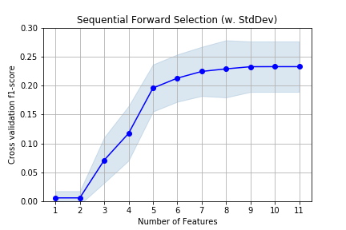
Selection Results
Selected Features:
Mean
Standard Deviation
Root Mean Square
Kurtosis
Mean Crossing Rate
Model 0,1,3,4,7,10

Slide 25
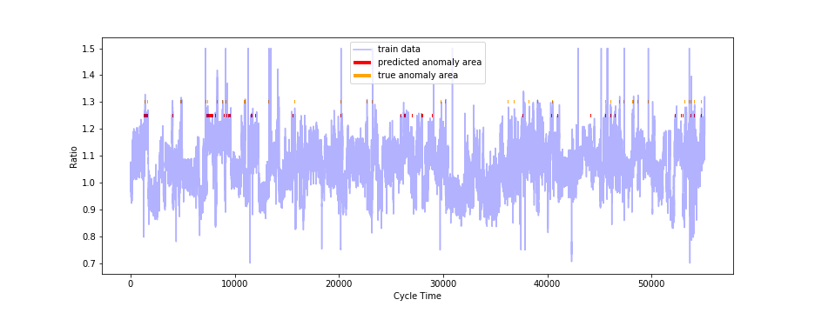
Fitting Result
Train set

Slide 26
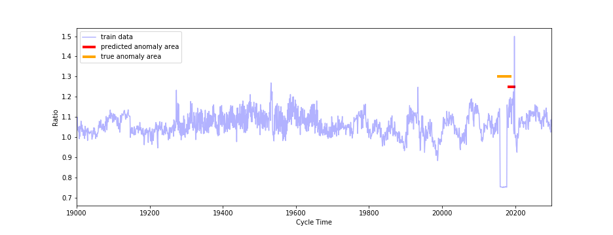
Fitting Result (Zoom in)
Train set

Slide 27
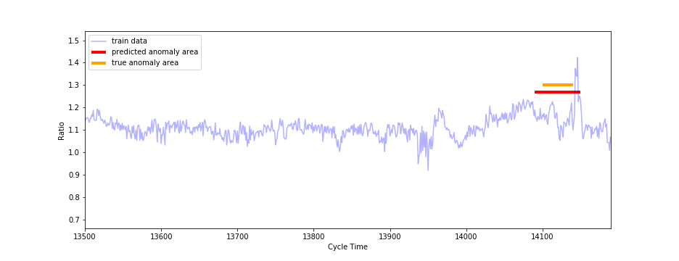
Fitting Result (Zoom in)
Train set

Slide 28
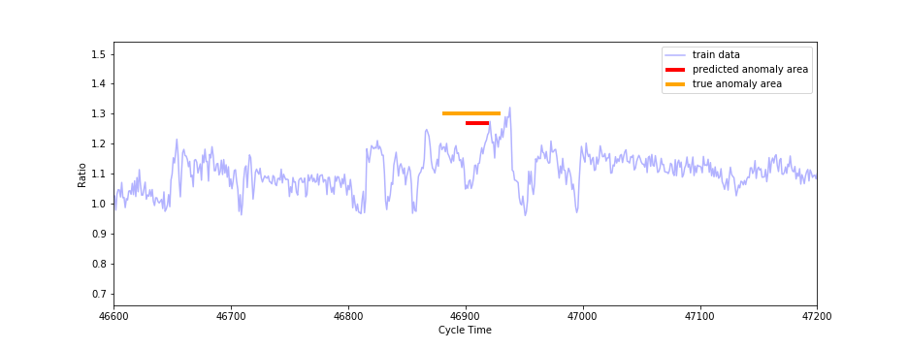
Fitting Result (Zoom in)
Train set

Slide 29
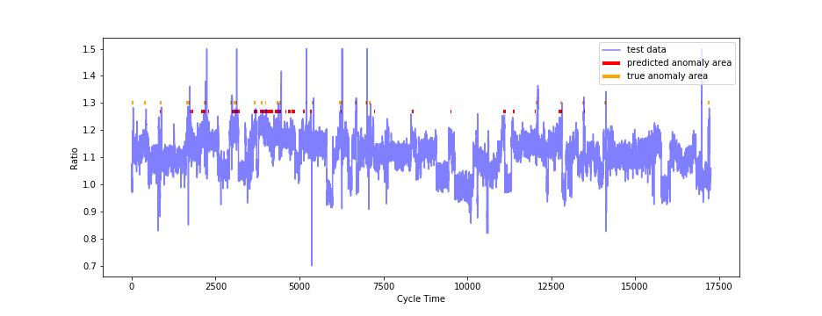
Prediction Result
Test set

Slide 30
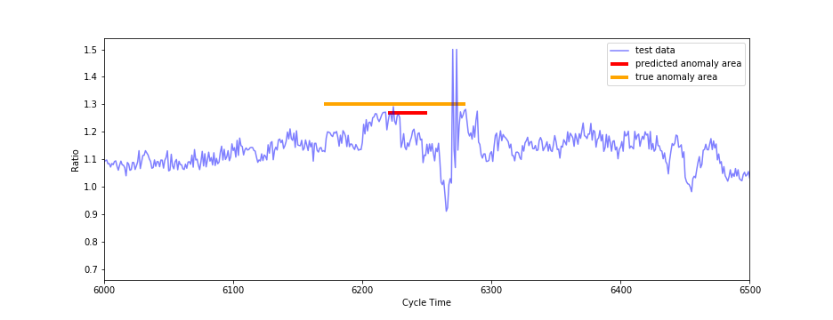
Prediction Result (Zoom in)
Test set

Slide 31
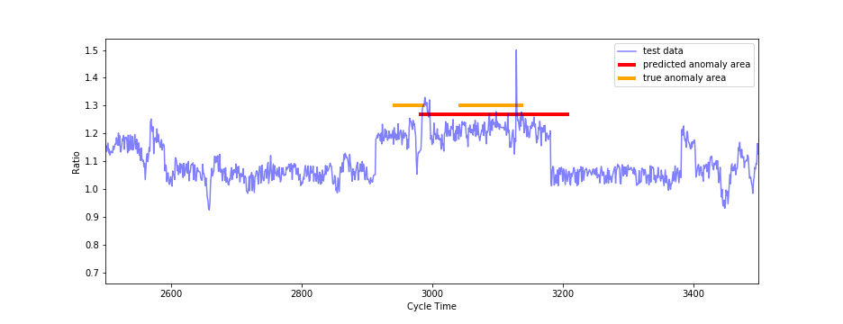
Prediction Result (Zoom in)
Test set

Slide 32
Observation

Slide 33
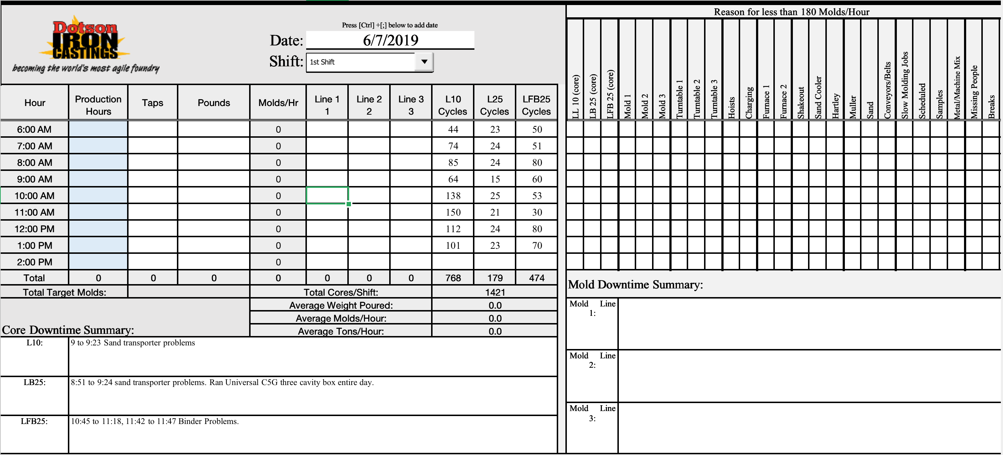
Sand Problem

Slide 34
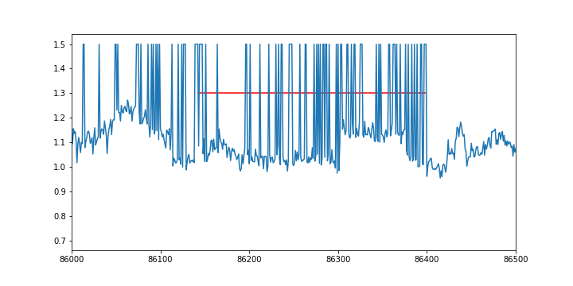
Sand Problem
Sand problem condition is the same as those of anomalies

Slide 35
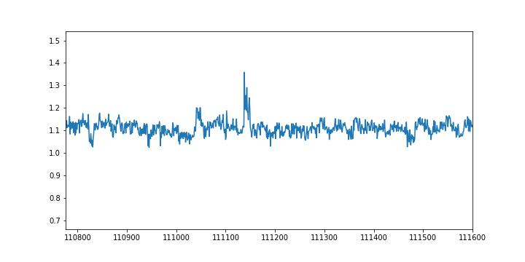
Service and Maintenance
Existing maintenances in the report are always after the breakdown
That's too late.
Maintenance
Anomalies

Slide 36
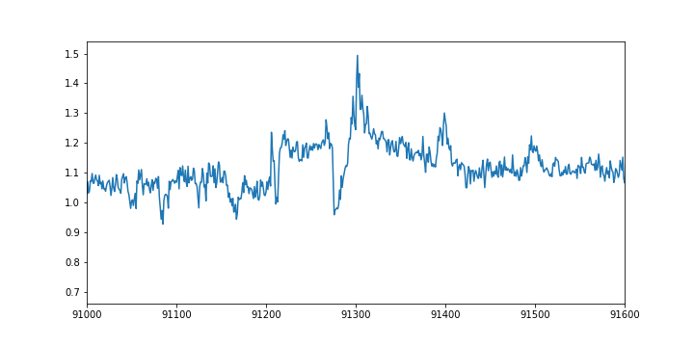
Patterns before breakdown
6/17/2019
Pattern before breakdown
Anomalies

Slide 37
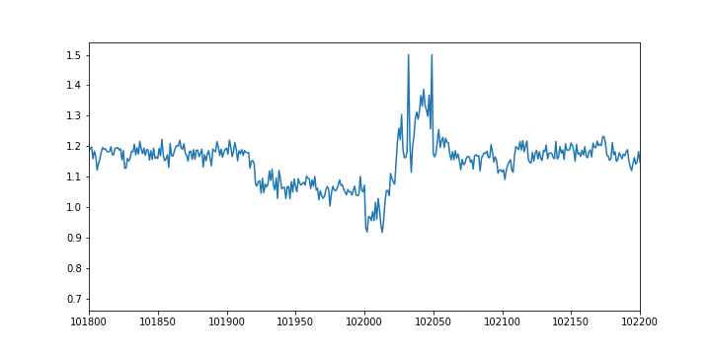
Patterns before breakdown
8/5/2019
Pattern before breakdown
Anomalies

Slide 38
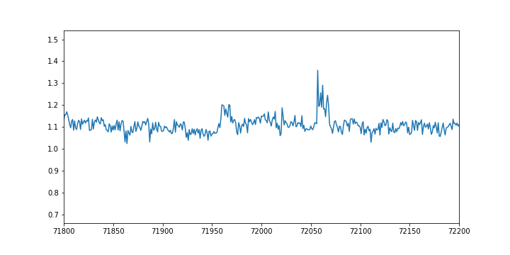
Patterns before breakdown
8/20/2019
Pattern before breakdown
Anomalies

Slide 39
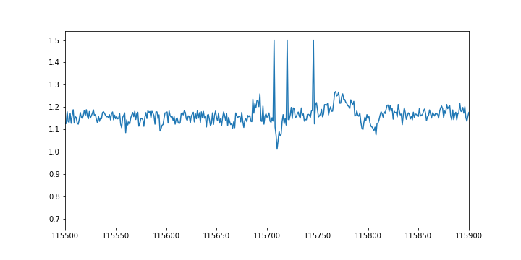
Patterns before breakdown
8/26/2019
Pattern before breakdown
Anomalies

Slide 40
Data
The data of July only contains that on July 31st.

Slide 41
Deep Learning Method

Slide 42
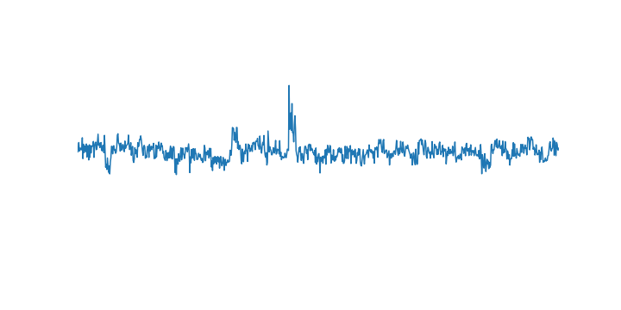
LSTM autoencoder
X1
X2
Xn
Reconstructed normal pattern
Decoder
LSTM
LSTM
LSTM
Reconstruction
Error
Encoded Feature
LSTM
LSTM
LSTM
Encoder
X2
time
Xn
X1
Normal pattern

Slide 43
Choose thresholds
Use the normal and abnormal data in validation set to determine the thresholds of reconstruction errors.

Slide 44
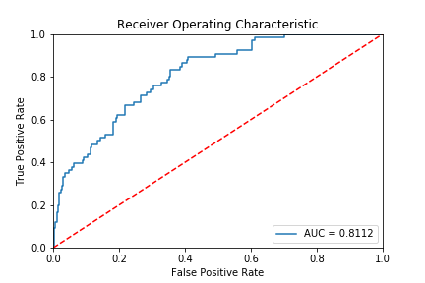
Preliminary Result

Slide 45
Future Work

Slide 46
Future work
Model Types
More metrics to assess the reconstruction error
Maintenance
Extreme value theory => test outliers
Varing the time-steps of the inputs
Use different Tags together to obtain better results
...
We wish to have more accurate labels for anomalies

Slide 47
Thank you!

