Slide 1
Scaling Laws for Transformer Architecture Variants
By Jennifer Oyedele
April 2021
Notes:
In the following slides, this section contains the script that was presented with this presentation. The original presentation was put together for a 10 minute talk (realistically 15+). I started each slide repeating the title out loud before speaking what is included in the script section. While I deviated from the script while speaking (often to reference graphs and explain them in further detail), this script paired with the presentation should enable any reader of this presentation to understand the key points of the research.

Slide 2
Agenda
Problem
Experiments
Future
Existing Research
Motivation
Background
Hypothesis
Methodology
Preliminary Findings
Research Limitations
Why It Matters
What’s Next
Thank you
Notes:
AGENDA
Script
Today’s talk is broken down into three main sections:
discussion of the problem and context behind pursuing this research,
an overview of the research and any findings found from the experiments,
and an overview of the future opportunities available for research on this topic.
Up first, we’re going to dive into the problem statement behind my research project. Specifically, I want to chat about research that’s already been done in the space to provide context on this research project. I also want to discuss some of my motivations for studying this before discussing the specifics of the research problem.

Slide 3
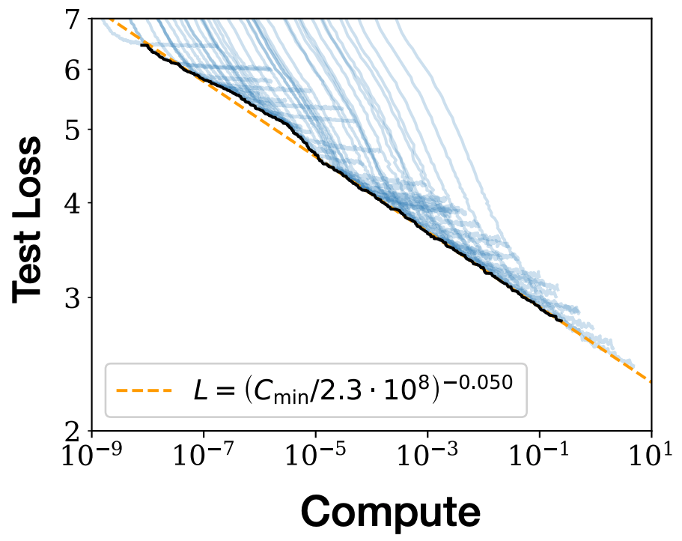
Scaling Laws for language model performance show that loss scales
as a power-law with model size, dataset size, and compute.
L = ( k C ) ^{m}
Constant term controls tradeoff between
loss and compute
Compute
Constant
Figure from Kaplan & McCandlish et al.
* Compute is measured in PFs-days (Petaflop-second per day)
Notes:
PRIOR WORK
Script
Let’s set the context. Scaling Laws for Neural Language Models was a recent paper that came out of OpenAI. I imagine most people in the room are familiar with this research so I’ll try to keep my comments brief.
This paper, Scaling Laws for Neural Language Models, introduced empirical scaling laws for the performance of machine learning models as a function of a number of key attributes: model size (which is defined by the number of model parameters), dataset size, and compute (the total compute budget used to train the model). As defined in the paper, the total amount of non-embedding compute used during training can be estimated as C = 6NBS, where B is the batch size, S is the number of parameter updates, and the factor of 6 accounts for the forward and backward passes.
The graph to the left is from the original paper and illustrates how language modeling performance improves smoothly as we increase model size, dataset size, and compute. With optimal performance being gained when all three factors are scaled in tandem.
Given that L(C) is it’s own function for every model, I considered lines within 5% of one another to be within a margin of uncertainty. The further away L(C) was, the more significant I considered it’s results. L(C) can be calculated with irreducible loss or without but in my experiments, I exclusively calculated it without for simplicity. It should be noted that the exponent (m) is the most important term because it controls the speed of the tradeoff between loss and compute.
This is the existing research work that lead to my research project. While the original paper studies scaling laws on on decoder-only transformers, I wanted to understand how these laws trend among the different transformer architectures.
Before we get into more background, let’s talk about motivations!

Slide 4
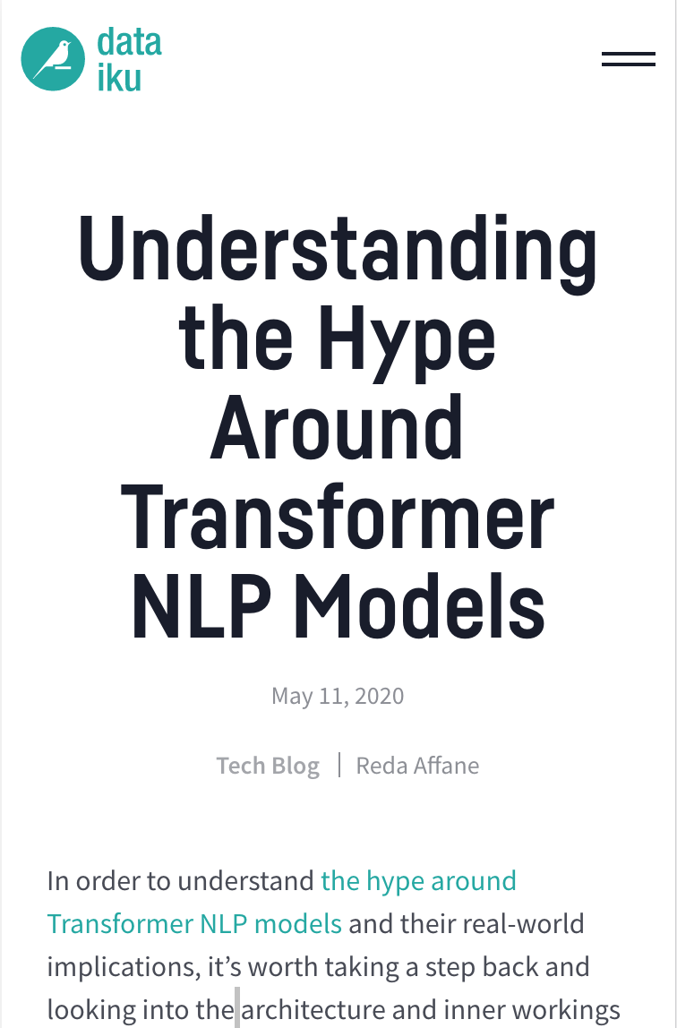
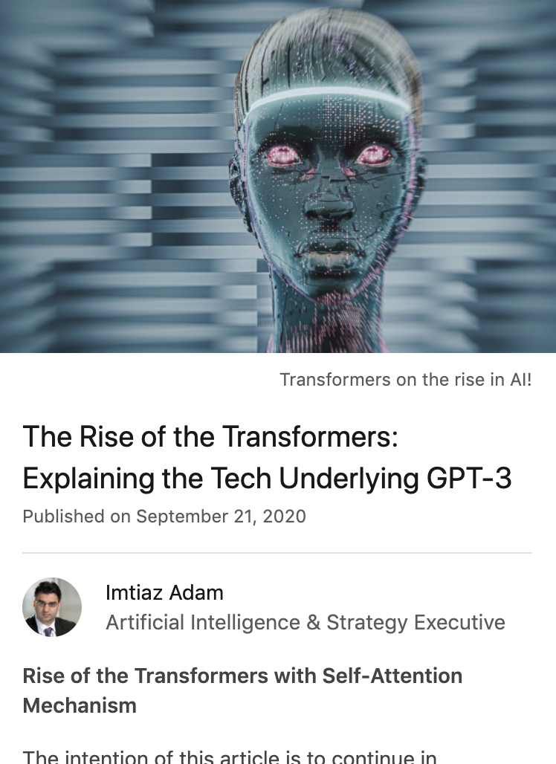

thesequence.substack.com/
blog.dataiku.com/
linkedin.com/pulse/rise-transformers-imtiaz-adam/
Notes:
MOTIVATIONS
Script
I was interested in working with transformers because of their impact on the NLP space. When you add scaling laws, which introduced the ability to forecast loss with respect to compute, I was curious to know how these scaling laws could generalize among different types of transformer architectures. I was also curious to explore the constraints of scaling laws and I thought trying to reproduce these them but on different types of transformers, could tell us more about what generalizes among the different algorithms versus being a stand alone feature of the original decoder only transformer.
At best, it would be an opportunity to understand the connection between transformer architecture components and model performance.
At worst, it would be an opportunity to understand the constraints of scaling laws, particularly when exploring more models.
Next, I’ll discuss the types of architectures I experimented on, why I choose them, their differences, and then what I think we can expect from the resulting scaling laws.

Slide 5
The young boy ate an ______
Causal Language Modeling
(decoder)
The ______
The young ______
The young boy ______
The young boy ate ______
The young boy ate an ______
The young ______ ate an apple.
Masked Language Modeling
(encoder)
______ young boy ate an apple.
The young boy ______ an apple.
The young boy ate ______ apple.
The ______ boy ate an apple.
Notes:
MODEL CATEGORIES
Script
So the transformer architectures I studied fall into two categories: causal language models, which attempt to predict the next token in a sequence, and masked language models, which attempt to predict the masked word, which can be any word within the sentence.
The only difference between causal language models and masked language models is in the way the model is pretrained, so the same architecture can be used for both types of language modeling. We’ll see this later on with BERT. Although it was original released as a masked language model, there are causal implementations of it and I ran my experiments on both types.

Slide 6
The variants were picked based on their architecture and
access to an open sourced implementation of the algorithm.
GPT 2 | causal | Scaled decoder-only transformer
Transformer XL | causal | Recurrence mechanism, positional relative encodings
Reformer | causal | Reduced memory footprint. Compute reducing techniques (axial position encoding, local sensitive hashing attention)
BERT | Masked | Random masking, next sentence prediction
BERT | causal* | a causal implementation of this is now available
FlauBERT | Masked | Similar to BERT but no sentence ordering prediction
RoBERTa | Masked | Dynamic masking, no next sentence prediction, uses BPE
Notes:
VARIANTS BACKGROUND
Script
The architectures I experimented with are shown here. They were picked based on their architecture and ease of implementation.
[ IF TIME LIMITED, QUICKLY NOTE INFO ON SLIDE AND SKIP THE FOLLOWING ]
In the interest of time, I’ll try to be brief and highlight only the main architectural differences between these.
As I mentioned earlier in the presentation, scaling laws were studied on a decoder only transformer. Since the dataset, dataset size, and machine I used are all different from the original paper, I needed to experiment on a transformer similar to what was used in the original paper.
I chose GPT2 for that because it had the closest architecture to the original used in the scaling laws paper. I thought it would be a good reference point to put the results in context.
The two other causal language models I experimented with are Transformer XL and Reformer.
Transformer XL leverages a recurrence mechanism, which essentially allows the model to pay attention to information that was in the previous and current segment, lengthening the sequences that can be evaluated.
Reformer uses quite a few techniques to reduce it’s memory footprint and decrease its overall compute time. Prior to starting my experiments, I was interested in exploring how the scaling laws for this model would compare given it’s architectural advantages directly connect to reducing compute.
BERT is masked language model that uses random masking and next sentence prediction. As I mentioned earlier, the only difference between causal language models and masked language models is in the way the model is trained, meaning that the same architecture can be used for both types of modeling. That is true for BERT and as you’ll see later in this presentation, I generated learning curves using both methods of training to understand how the scaling laws would change if at all.
FlauBERT (Flow-bear) doesn’t include the sentence ordering prediction, speeding up it’s compute time. While RoBERTa leverages more pre training tricks, like dynamic masking, to do it’s language modeling.

Slide 7
The impact of architecture on scaling laws depends on
how significantly it impacts compute.
Reformer’s scaling law (SL) should have a noticeably lower slope
We should see no change in BERT’s SL when trained using
causal or masked language modeling.
BERT, FlauBERT, and RoBERTa should have SLs within a
reasonable margin of uncertainty between each other.
Notes:
HYPOTHESIS
Script
So my hypothesis is that the impact of transformer architecture on scaling laws depends on how significantly that architecture impacts model size, dataset size, or most likely, compute.
Given reformer’s focus on reducing it’s memory and compute during training, my prediction was that we’d see the reformer architecture outperform the other models.
Given the insight from the original paper on how weakly performance trends with model shape, I predict that BERT’s scaling laws should have little to no change, given that the overall architecture is the same.
Lastly, I’m expecting to see that the masked language models have scaling laws that are either within a margin of uncertainty between one another, or that their scaling laws are the same with possibly only a small difference in it’s constant prefactor.
Overall, I wasn’t too confident with these predictions due to how little is known about scaling laws on different architectures.

Slide 8
Agenda
Problem
Experiments
Future
Existing Research
Motivation
Background
Hypothesis
Methodology
Preliminary Findings
Research Limitations
Why It Matters
What’s Next
Thank you
Notes:
FINDINGS AGENDA
Script
Next, I want to discuss my experiment methodology, what my preliminary findings are, and the limitations I observed during research.

Slide 9
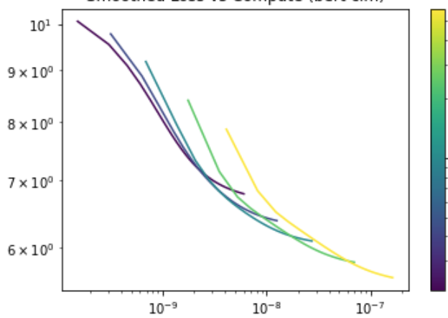
Experiments were done using model size scans to
calculate and compare L(C)* among the variants.
test loss
model size (model parameter #)
estimated compute
Loss vs Estimated Compute
(dashed line - pareto frontier)
* L(C) is the Compute Efficient Frontier Fit.
Notes:
METHODOLOGY
Script
One of the key tasks of my research project was to calculate the Compute Efficient Frontier Fit - L(C) - on transformer architectures doing language modeling to understand how L(C) changes, with respect to algorithmic changes within an architectural family.
So once I decided which models to study, I proposed several model sizes to train and produced a learning curve for each run. Ideally training at least 4-5 sizes for every model. The number of parameters ranged between 2M and 350M with some variation between the different architectures.
[ MOTIONS TO GRAPH ]
This graph highlights loss vs estimated compute, and here we can see the formation of a pareto frontier. The line tangent to this curve effectively represents the scaling law that we’re looking to find for these transformers. The idea being that if we were to increase or decrease the model size, it’s performance would follow this particular pattern. So if we were to extend this imaginary line, we would expect subsequent model sizes to perform better than it’s previous model size but predictably plateau in this same pattern.

Slide 10
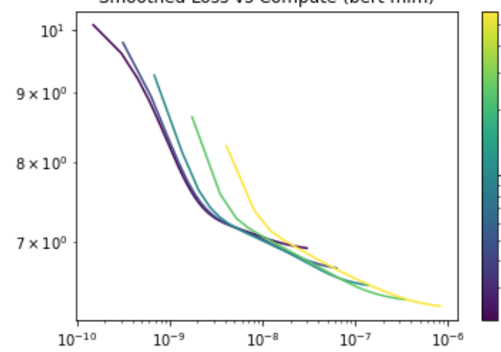
The same architecture using a different method of training
can produce different L(C)s.
BERT (CLM)
BERT (MLM)
model size (model parameter #)
test loss
test loss
model size (model parameter #)
estimated compute
estimated compute
-0.062
-0.03
L(C) = (2.521 * C )
L(C) = (4.008 * C )
Notes:
PRELIMINARY FINDINGS
Script
In the interest of time, I’m going to discuss only the most interesting findings of my research. I also want to add that these are preliminary results. I also wouldn’t look at these numbers as precise figures but more so as a guide to understand what they reveal about the relationships of the scaling laws with respect to one another.
So on this slide, we can see that the same architecture using a different method of training can produce different L(C)s.
This result was initially surprising because I had initially assumed we’d see the same L(C) because they have the same architecture. But this actually makes sense conceptually, once you consider that while the same architecture when trained differently, processes data very differently.
So in the case of BERT, when it’s trained as a masked language model, the context is encoded bidirectionally (essentially we incorporation semantic information from both the left and right context). However, when BERT is trained as a causal language model (that’s next word prediction), it’s only ever considering the left context. This means that the same architectures can be treated as two different architectures if the way the data being trained within it is also different.
[ MOTIONS TO GRAPH ]
As you can see by two L(C), BERT CLM has a larger exponent value, which means that loss decreases substantially faster when BERT is used as a causal language model than as a masked language model (on the specific dataset it was trained on). As I didn’t account for this type of finding before the experiment phase, I didn’t test this sort of behavior on multiple models. In the next phase of testing, I’d want to expand these types of experiments and understand if there is a pattern among the L(C) being produced or if this simply increases the number of distinct architectures to experiment with.

Slide 11
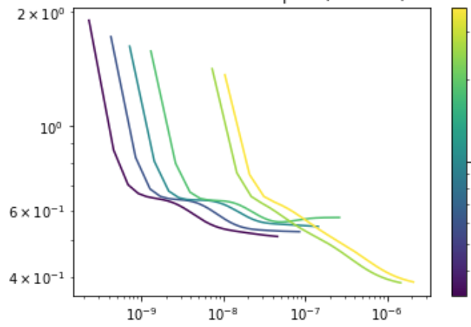
Reformer formed a tiered pareto frontier, meaning that some of the larger models don’t perform any better than the smallest within the same tier but used more compute.
-0.0734
Reformer’s L(C) = (0.149 * C)
Would want to observe if this pattern persists on other transformers whose architectures directly affect compute
Potential Causes:
Limited hyperparameter tuning
Architectural structure
test loss
model size (model parameter #)
estimated compute
Notes:
PRELIMINARY FINDINGS
Script
[ MOTIONS TO GRAPH - explain what’s happening ]
This was probably one of the more interesting findings of this research, due to the tiered structure of the results. It’s likely that this is occurring due to the lack of hyperparameter tuning. My other hypothesis though is that this might be a side effect from the architecture itself. Reformer, also called the efficient transformer, uses many math tricks to reduce memory footprint and speed up compute time. Some of these tricks include axial position encoding (to avoid having a huge positional encoding matrix) or using local-sensitive hashing attention instead of regular attention (to avoid computing a full product query-key in the attention layers of the architecture).
Basically, this means that the hyperparameters for the Reformer model have a more direct impact on compute than other models due to its structure, which means it’s possible that these tiers are a consequence of the resulting attention length, etc, etc. Since it’s not possible for these parameters to be any number (some attributes are dependent on the value of others), it’s possible that even when properly tuned that the model will still form a tiered pareto frontier, but likely with “smaller” tiers or “fewer” models between each tier.
Regardless, I’d want to observe how this pattern persists on other transformers when tested and narrow down how much of what we’re seeing will persist versus what could change once more exhaustive experimentation is done.

Slide 12
Experiment Limitations
Limited hyperparameter sweeps
Scaling laws were calculated without irreducible loss
Models weren’t tested with component isolation
(i.e. hard to isolate which specific parts of training impacted loss)
Too much variability among the models
(i.e. the architectures can’t be directly compared to one another)
Notes:
FINDINGS
Script
As I mentioned earlier, the experiment methodology was fairly limited to began with.
Not enough hyperparameter tuning was done to ensure that these experiments were run on the most optimized models. Scaling laws can also be calculated with or without irreducible loss and in all of the experiments, we only looked at L(C) without irreducible loss to simplify the experiments. If I were to expand the research, I would calculate L(C) with its irreducible loss term as that would give the most precise numbers (esp once tested and normalized on multiple datasets).
This research was lacked architectural component isolation. In some cases, comparing two architectures, even when you consider a distinct numerical value like its L(C), is still comparing apples to oranges, especially once you consider that each architecture has a slightly different accuracy and loss value. While the time constraints on this research made it more difficult to build a transformer from scratch, I’d probably try to componentize more of the transformer model and/or find ways to test independent components of each transformer model so each component’s effect on L(C) is understood in isolation.

Slide 13
Agenda
Problem
Findings
Future
Existing Research
Motivation
Background
Hypothesis
Methodology
Preliminary Findings
Research Limitations
Why It Matters
What’s Next
Thank you
Notes:
FUTURE AGENDA
Script
Next, I want to discuss the importance of this research product, what I’d like to work on next, and give thanks to the people who helped make this happen.

Slide 14
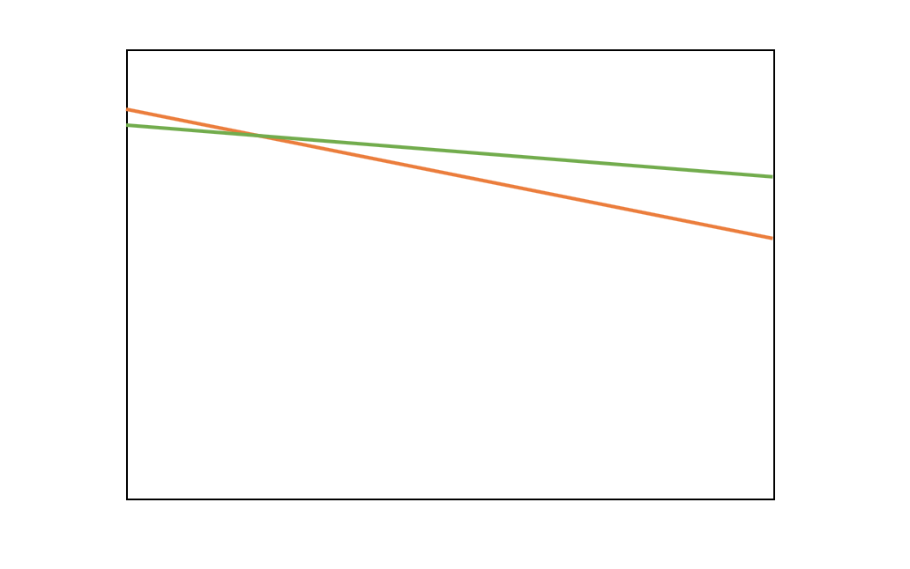
The architecture that scales best is the most cost effective model to use.
loss
estimated compute
Notes:
SUMMARY
Script
The architecture that scales the best is the most cost effective model to use. That is why is this research matters because it allows us to find that architecture, and potentially use our findings to understand what future architectures should look like to continue optimizing cost.

Slide 15
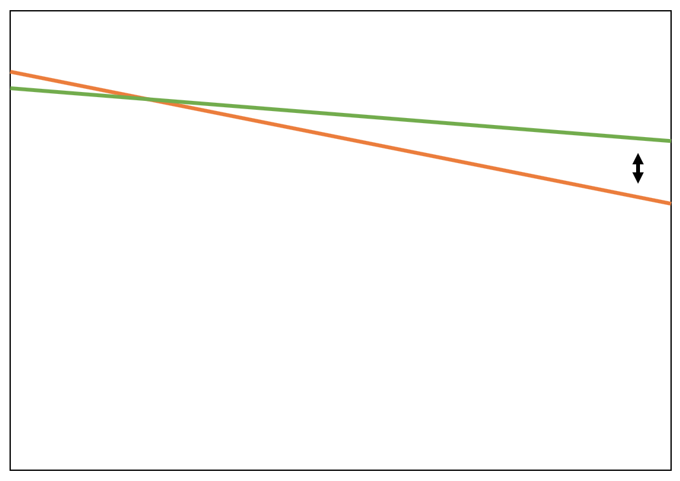
The architecture that scales best is the most cost effective model to use.
gap widens as
compute grows
loss
estimated compute
Notes:
SUMMARY
Script
If these two lines represented two different scaling laws, then it becomes clear that there is always an architecture, if tuned properly, that performs best. And we can see that as compute grows, the gap widens on the model performance you receive for the same amount of compute spent.

Slide 16
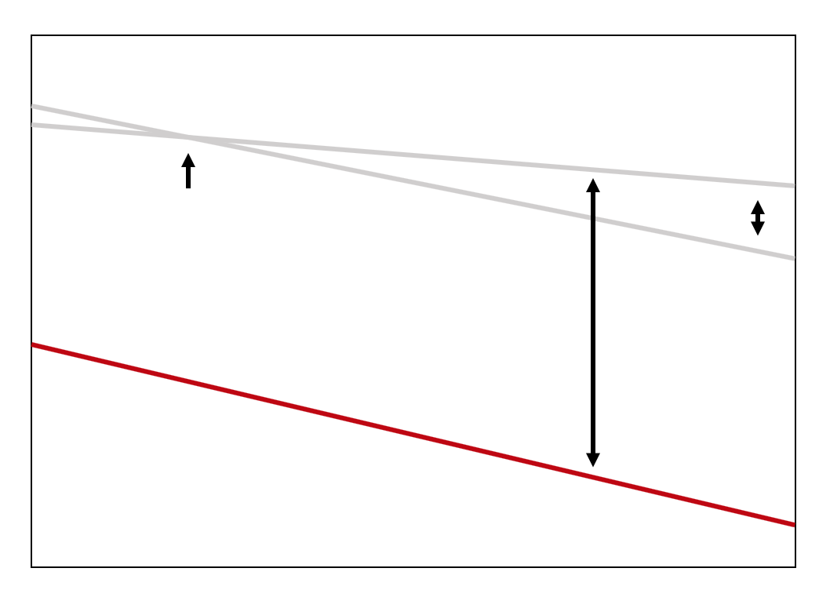
The architecture that scales best is the most cost effective model to use.
gap widens as
compute grows
loss
if the slope is steep enough,
an architecture can consistently outpace others within the
expected range of compute
estimated compute
Notes:
SUMMARY
Script
And if the slope is steep enough, an architecture can consistently begin to outpace other architectures within the expected range of compute.
So, why does this matter?
Currently, we're seeing ever increasing amounts of compute being used in the industry. These scaling laws allow for us to optimize large compute regimes and choose the best architecture and model size that helps reach this aim.
In my experiments, the Reformer model was the architecture that produced the best power laws in comparison to the others. The Reformer model was designed to be an efficient transformer and utilizes several techniques to reduce memory footprint and compute time. I think this direct impact on compute time is likely why we see such improved performance with Reformer.
Unfortunately, it was the only transformer architecture I experimented with that had this property. In my next experiments, I’d like to expand the architectures I consider to include transformers with this similar property.

Slide 17
Continuing the study of the model performance of
different transformer architectures at scale.
More hyperparameter tuning
Extend the list of models to
Universal Transformer, Compressive Transformer, and Evolved Transformer
Experiment with a wider range of
datasets, dataset sizes, tasks, and learning rate schedules
Track more eval metrics and recalculate scaling laws with and w/o irreducible loss
More runs and extended model scans to better reduce variability in testing
Notes:
FUTURE WORK
Script
I plan to continue studying the model performance of transformer architectures at scale. I think there is a particular opportunity to study models such as Longformer, Universal Transformer, Compressive Transformer, and Evolved Transformer as their architectures are designed in such a way that it impacts compute in the way that could affect their scaling laws more significantly.
Much of the results I have so far are preliminary so I’d like to spend more time strengthening those findings. To do that, I would do more hyperparameter tuning and testing to see how they affect L(C). I’d also vary the data and dataset size I used to track how performance changes with respect to changes in data.
Beyond that, we could also begin to explore questions that are more focused on model architecture.
This includes:
Is it possible to infer which structures should have a
better compute and performance gain based on their structure alone?
How do different architectural components affect the
compute and performance expectations of a transformer model?
Can we learn which attributes or model structures will become
necessary as improvements for the future of language models?
I think there is a lot of potential experiments that could be run, it would just depend on which question one wanted to explore in more depth.

Slide 18
Thank You!
Open AI
Nick Joseph
Hugging Face
Deep Speed
Azure
Notes:
THANK YOU
Script
Before I conclude,
I wanted to thank the team at OpenAI. It’s been an incredible opportunity to spend dedicated time working on AI and learn from some of the brightest minds on the topic. Special thank you to my mentors, Aray and Nick. I’m fortunate to have had the guidance of two mentors and everyone else at Open AI (Muraya, Christina, Pamela, Cathy, Alethea, the other scholars, and everyone) that supported me along my journey.
I’d also like to acknowledge the tools that supported my research project. Studying scalings laws on transformers is both compute heavy and takes quite a bit of coding infrastructure to set up, particularly in 6 months. I would not have been able to accomplish nearly as much as I have without the Hugging Face transformer library, the performance speed ups from Deep Speed, and the amount of Azure credits ($30k) I used to make this happen.
Thanks again!

Slide 19
Q&A
Don’t be shy!
Notes:
Script
Any questions?
--
Note to Visitors - If got this far, send me a message! I’d love to hear your thoughts on this research.
--
Notes to Self
When taking questions, repeat the question before asking.
Here is an additional list of material that wasn’t fully explained in the presentation but would be interesting to dive further into.
Additional Talking Points
Define compute in more detail.
Discuss how the process used to smooth the lines (gaussian filter).
Only the Reformer model showed the tiered pareto frontier. Discuss why.
Reformer showed the best power laws in the comparison.
Discuss some of the theories why and other transformers you’d like to experiment with to test this theory.
L(C) scaling laws assume you are not data limited, discuss the amount of data that was trained on.
Discuss why the curvature (of the intermediate size models of reformer) changes 2x instead of the usual 1x.

