Slide 1




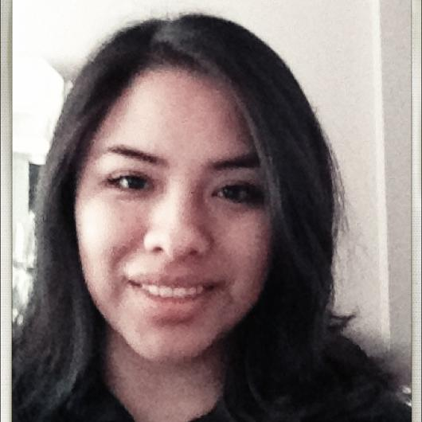


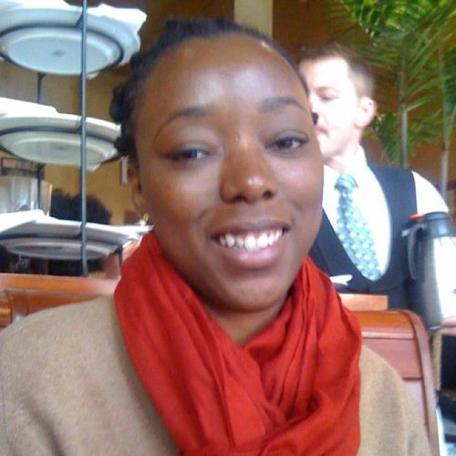
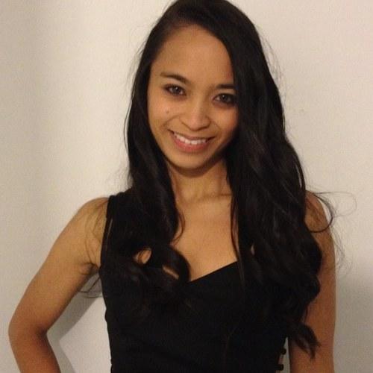
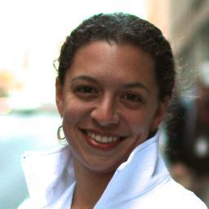
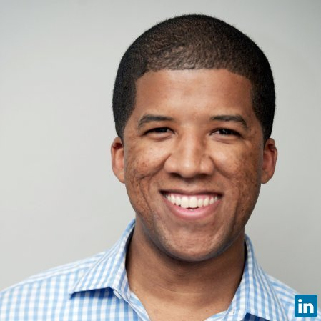
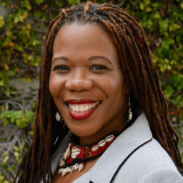
Insider
Contacts
TODAY
Janeth Moran
Janeth Moran
Hacker & CODE2040 Fellow
Hacker & CODE2040 Fellow
Omoju Miller PhD
Erin Parker
CODE2040 Mentor
Favorite Hacker
Amy Schapiro
UPCOMING
Amy Schapiro
CODE2040 Operations Manager
CODE2040 Operations Manager
Tyler Scriven
Tyler Scriven
CODE2040 Mentor
CODE2040 Mentor
Tracy Gray
Race & Technology Mentor
Erin Parker
Favorite Hacker

Slide 2






Personal Contact
New Contact
Omoju Miller
Full Name
CODE2040 Mentor
Connection/Company Title
Last Contact:
July 31
Last Contact:
Date
1 Month Reminder
1 Month Reminder
555-555-5555
Phone
fake@gmail.com
Email
PhD Candidate in CS Education at Berkeley. Met Thru CODE2040.
What most inspires you about this person?

Slide 3
Timeline
New Interaction
Omoju Miller
Omoju Miller
Connected me to X Company. Remember to say thank you
June 21, 2013 12:04pm
Email Exchange
July 1, 2013 5pm
What’d you talk about? You have 140 characters. Go!
Collaborated new ideas for the Hack4Diversity hackathon
June 21, 2013 12:04pm
Discussed creating new projects on github for resume
June 6, 2013 2pm
~ Met Omoju Miller on June 15, 2013

Slide 4
