Slide 1
Lectures 5 & 7: Design Theory
Lectures 5 & 7

Slide 2
Announcements
Lecture 5
Homework #1 due today! Homework was not easy
You learned a new, declarative way of programming!
Hope: you got the concept, so you can pick up a book on SQL whenever you need.
Some issues with iPython+SQLite versions. Ugh!
You were great about this issues! Constructive questions and feedback! Thanks!
You will never need iPython to submit homework
Setting Expectations: cf. simply text assignments with no expected output.
Searching on piazza is problem, we’ll try to do a better job aggregating posts…
Lots of stuff was there, but hard to find!
Thank you to those who aggregated posts! (Candy?)

Slide 3
Announcements #2
Lecture 5
Office hours last night was filled with nice people!
Queue management had a hiccup (our mistake?) Resulted in “fake” long queue times... Don’t be scared away!
We need a better way to group and identify problems (Luke is on it! Thanks!)
We will be better about triaging issues to get help and make groups quickly.
Thanks to CAs who came in for extra time!

Slide 4
Announcements #3
Lecture 5
How to use activity time: Review slides, ask questions, or do the activity!
We designed these to cope with different backgrounds and pace requirements. If you don’t get the activity in class YOU ARE DOING FINE!
Thank you! We appreciate the “thank you”s for new material!
Be aggressive about giving feedback, we want you to have best class possible!
There will be hiccups in new material, please start early.
We’re trying to make class more fun and `teach you more material!!!
Guest lecture on Thursday from GOOGLE. HAVE FUN!

Slide 5
Lecture 5: Design Theory I
Lecture 5

Slide 6
Today’s Lecture
Lecture 5
Normal forms & functional dependencies
ACTIVITY: Finding FDs
Finding functional dependencies
ACTIVITY: Compute the closures
Closures, superkeys & keys
ACTIVITY: The key or a key?

Slide 7
1. Normal forms & functional dependencies
Lecture 5 > Section 1

Slide 8
What you will learn about in this section
Lecture 5 > Section 1
Overview of design theory & normal forms
Data anomalies & constraints
Functional dependencies
ACTIVITY: Finding FDs

Slide 9
Design Theory
Lecture 5 > Section 1 > Overview
Design theory is about how to represent your data to avoid anomalies.
It is a mostly mechanical process
Tools can carry out routine portions
We have a notebook implementing all algorithms!
We’ll play with it in the activities!

Slide 10
Normal Forms
Lecture 5 > Section 1 > Overview
1st Normal Form (1NF) = All tables are flat
2nd Normal Form = disused
Boyce-Codd Normal Form (BCNF)
3rd Normal Form (3NF)
4th and 5th Normal Forms = see text books
DB designs based on functional dependencies, intended to prevent data anomalies
Our focus in this lecture + next one

Slide 11
1st Normal Form (1NF)
Lecture 5 > Section 1 > Overview
Student | Courses
Mary | CS145
Mary | CS229
Joe | CS145
Joe | CS106
Student | Courses
Mary | {CS145,CS229}
Joe | {CS145,CS106}
… | …
Violates 1NF.
In 1st NF
1NF Constraint: Types must be atomic!

Slide 12
Data Anomalies & Constraints
Lecture 5 > Section 1 > Data anomalies & constraints

Slide 13
Constraints Prevent (some) Anomalies in the Data
Lecture 5 > Section 1 > Data anomalies & constraints
A poorly designed database causes anomalies:
Student | Course | Room
Mary | CS145 | B01
Joe | CS145 | B01
Sam | CS145 | B01
.. | .. | ..
If every course is in only one room, contains redundant information!

Slide 14
Constraints Prevent (some) Anomalies in the Data
Lecture 5 > Section 1 > Data anomalies & constraints
A poorly designed database causes anomalies:
Student | Course | Room
Mary | CS145 | B01
Joe | CS145 | C12
Sam | CS145 | B01
.. | .. | ..
If we update the room number for one tuple, we get inconsistent data = an update anomaly

Slide 15
Constraints Prevent (some) Anomalies in the Data
Lecture 5 > Section 1 > Data anomalies & constraints
A poorly designed database causes anomalies:
Student | Course | Room
.. | .. | ..
If everyone drops the class, we lose what room the class is in! = a delete anomaly

Slide 16
Constraints Prevent (some) Anomalies in the Data
Lecture 5 > Section 1 > Data anomalies & constraints
A poorly designed database causes anomalies:
Student | Course | Room
Mary | CS145 | B01
Joe | CS145 | B01
Sam | CS145 | B01
.. | .. | ..
Similarly, we can’t reserve a room without students = an insert anomaly
… | CS229 | C12

Slide 17
Constraints Prevent (some) Anomalies in the Data
Lecture 5 > Section 1 > Data anomalies & constraints
Is this form better?
Redundancy?
Update anomaly?
Delete anomaly?
Insert anomaly?
Student | Course
Mary | CS145
Joe | CS145
Sam | CS145
.. | ..
Course | Room
CS145 | B01
CS229 | C12
Today: develop theory to understand why this design may be better and how to find this decomposition…

Slide 18
Functional Dependencies
Lecture 5 > Section 1 > Functional dependencies

Slide 19
Functional Dependency
Lecture 5 > Section 1 > Functional dependencies
Def: Let A,B be sets of attributes
We write A → B or say A functionally determines B if, for any tuples t₁ and t₂:
t₁[A] = t₂[A] implies t₁[B] = t₂[B]
and we call A → B a functional dependency
A->B means that
“whenever two tuples agree on A then they agree on B.”

Slide 20
A Picture Of FDs
Lecture 5 > Section 1 > Functional dependencies
Defn (again):
Given attribute sets A={A₁,…,A_{m}} and B = {B₁,…B_{n}} in R,
 | A₁ | … | A_{m} |  | B₁ | … | B_{n}

Slide 21
A Picture Of FDs
Lecture 5 > Section 1 > Functional dependencies
Defn (again):
Given attribute sets A={A₁,…,A_{m}} and B = {B₁,…B_{n}} in R,
The functional dependency A→ B on R holds if for any t_{i},t_{j} in R:
 | A₁ | … | A_{m} |  | B₁ | … | B_{n}
t_{i}
t_{j}

Slide 22
A Picture Of FDs
Lecture 5 > Section 1 > Functional dependencies
Defn (again):
Given attribute sets A={A₁,…,A_{m}} and B = {B₁,…B_{n}} in R,
The functional dependency A→ B on R holds if for any t_{i},t_{j} in R:
t_{i}[A₁] = t_{j}[A₁] AND t_{i}[A₂]=t_{j}[A₂] AND … AND t_{i}[A_{m}] = t_{j}[A_{m}]
 | A₁ | … | A_{m} |  | B₁ | … | B_{n}
t_{i}
t_{j}
If t1,t2 agree here..

Slide 23
A Picture Of FDs
Lecture 5 > Section 1 > Functional dependencies
Defn (again):
Given attribute sets A={A₁,…,A_{m}} and B = {B₁,…B_{n}} in R,
The functional dependency A→ B on R holds if for any t_{i},t_{j} in R:
if t_{i}[A₁] = t_{j}[A₁] AND t_{i}[A₂]=t_{j}[A₂] AND … AND t_{i}[A_{m}] = t_{j}[A_{m}]
then t_{i}[B₁] = t_{j}[B₁] AND t_{i}[B₂]=t_{j}[B₂] AND … AND t_{i}[B_{n}] = t_{j}[B_{n}]
 | A₁ | … | A_{m} |  | B₁ | … | B_{n}
t_{i}
t_{j}
If t1,t2 agree here..
…they also agree here!

Slide 24
FDs for Relational Schema Design
Lecture 5 > Section 1 > Functional dependencies
High-level idea: why do we care about FDs?
Start with some relational schema
Find out its functional dependencies (FDs)
Use these to design a better schema
One which minimizes the possibility of anomalies

Slide 25
Functional Dependencies as Constraints
Lecture 5 > Section 1
Student | Course | Room
Mary | CS145 | B01
Joe | CS145 | B01
Sam | CS145 | B01
.. | .. | ..
A functional dependency is a form of constraint
Holds on some instances not others.
Part of the schema, helps define a valid instance.
Note: The FD {Course} -> {Room} holds on this instance
Recall: an instance of a schema is a multiset of tuples conforming to that schema, i.e. a table

Slide 26
Functional Dependencies as Constraints
Lecture 5 > Section 1
Note that:
You can check if an FD is violated by examining a single instance;
However, you cannot prove that an FD is part of the schema by examining a single instance.
This would require checking every valid instance
Student | Course | Room
Mary | CS145 | B01
Joe | CS145 | B01
Sam | CS145 | B01
.. | .. | ..
However, cannot prove that the FD {Course} -> {Room} is part of the schema

Slide 27
More Examples
Lecture 5 > Section 1 > Functional dependencies
An FD is a constraint which holds, or does not hold on an instance:
EmpID | Name | Phone | Position
E0045 | Smith | 1234 | Clerk
E3542 | Mike | 9876 | Salesrep
E1111 | Smith | 9876 | Salesrep
E9999 | Mary | 1234 | Lawyer

Slide 28
More Examples
Lecture 5 > Section 1 > Functional dependencies
EmpID | Name | Phone | Position
E0045 | Smith | 1234 | Clerk
E3542 | Mike | 9876 ← | Salesrep
E1111 | Smith | 9876 ← | Salesrep
E9999 | Mary | 1234 | Lawyer
{Position} → {Phone}

Slide 29
More Examples
Lecture 5 > Section 1 > Functional dependencies
EmpID | Name | Phone | Position
E0045 | Smith | 1234 → | Clerk
E3542 | Mike | 9876 | Salesrep
E1111 | Smith | 9876 | Salesrep
E9999 | Mary | 1234 → | Lawyer
but not {Phone} → {Position}

Slide 30
ACTIVITY
Lecture 5 > Section 1 > ACTIVITY
Find at least three FDs which hold on this instance:
A | B | C | D | E
1 | 2 | 4 | 3 | 6
3 | 2 | 5 | 1 | 8
1 | 4 | 4 | 5 | 7
1 | 2 | 4 | 3 | 6
3 | 2 | 5 | 1 | 8
{ } → { }
{ } → { }
{ } → { }

Slide 31
2. Finding functional dependencies
Lecture 5 > Section 2

Slide 32
What you will learn about in this section
Lecture 5 > Section 2
“Good” vs. “Bad” FDs: Intuition
Finding FDs
Closures
ACTIVITY: Compute the closures

Slide 33
“Good” vs. “Bad” FDs
Lecture 5 > Section 2 > Good vs. Bad FDs
We can start to develop a notion of good vs. bad FDs:
EmpID | Name | Phone | Position
E0045 | Smith | 1234 | Clerk
E3542 | Mike | 9876 | Salesrep
E1111 | Smith | 9876 | Salesrep
E9999 | Mary | 1234 | Lawyer
Intuitively:
EmpID -> Name, Phone, Position is “good FD”
Minimal redundancy, less possibility of anomalies

Slide 34
“Good” vs. “Bad” FDs
Lecture 5 > Section 2 > Good vs. Bad FDs
We can start to develop a notion of good vs. bad FDs:
EmpID | Name | Phone | Position
E0045 | Smith | 1234 | Clerk
E3542 | Mike | 9876 | Salesrep
E1111 | Smith | 9876 | Salesrep
E9999 | Mary | 1234 | Lawyer
Intuitively:
EmpID -> Name, Phone, Position is “good FD”
But Position -> Phone is a “bad FD”
Redundancy! Possibility of data anomalies

Slide 35
“Good” vs. “Bad” FDs
Lecture 5 > Section 2 > Good vs. Bad FDs
Student | Course | Room
Mary | CS145 | B01
Joe | CS145 | B01
Sam | CS145 | B01
.. | .. | ..
Returning to our original example… can you see how the “bad FD” {Course} -> {Room} could lead to an:
Update Anomaly
Insert Anomaly
Delete Anomaly
…
Given a set of FDs (from user) our goal is to:
Find all FDs, and
Eliminate the “Bad Ones".

Slide 36
FDs for Relational Schema Design
Lecture 5 > Section 2 > Finding FDs
High-level idea: why do we care about FDs?
Start with some relational schema
Find out its functional dependencies (FDs)
Use these to design a better schema
One which minimizes possibility of anomalies
This part can be tricky!

Slide 37
Finding Functional Dependencies
Lecture 5 > Section 2 > Finding FDs
There can be a very large number of FDs…
How to find them all efficiently?
We can’t necessarily show that any FD will hold on all instances…
How to do this?
We will start with this problem:
Given a set of FDs, F, what other FDs must hold?

Slide 38
Finding Functional Dependencies
Lecture 5 > Section 2 > Finding FDs
Equivalent to asking: Given a set of FDs, F = {f₁,…f_{n}}, does an FD g hold?
Inference problem: How do we decide?

Slide 39
Finding Functional Dependencies
Lecture 5 > Section 2 > Finding FDs
Example:
Products
Provided FDs:
Name | Color | Category | Dep | Price
Gizmo | Green | Gadget | Toys | 49
Widget | Black | Gadget | Toys | 59
Gizmo | Green | Whatsit | Garden | 99
1. {Name} → {Color}
2. {Category} → {Department}
3. {Color, Category} → {Price}
Given the provided FDs, we can see that {Name, Category} → {Price} must also hold on any instance…
Which / how many other FDs do?!?

Slide 40
Finding Functional Dependencies
Lecture 5 > Section 2 > Finding FDs
Equivalent to asking: Given a set of FDs, F = {f₁,…f_{n}}, does an FD g hold?
Inference problem: How do we decide?
Answer: Three simple rules called Armstrong’s Rules.
Split/Combine,
Reduction, and
Transitivity… ideas by picture

Slide 41
1. Split/Combine
Lecture 5 > Section 2 > Finding FDs
 | A₁ | … | A_{m} |  | B₁ | … | B_{n}
A₁, …, A_{m} → B₁,…,B_{n}

Slide 42
1. Split/Combine
Lecture 5 > Section 2 > Finding FDs
 | A₁ | … | A_{m} |  | B₁ | … | B_{n}
A₁, …, A_{m} → B₁,…,B_{n}
… is equivalent to the following n FDs…
A₁,…,A_{m} → B_{i} for i=1,…,n

Slide 43
1. Split/Combine
Lecture 5 > Section 2 > Finding FDs
 | A₁ | … | A_{m} |  | B₁ | … | B_{n}
And vice-versa, A₁,…,A_{m} → B_{i} for i=1,…,n
… is equivalent to …
A₁, …, A_{m} → B₁,…,B_{n}

Slide 44
Reduction/Trivial
Lecture 5 > Section 2 > Finding FDs
 | A₁ | … | A_{m}
A₁,…,A_{m} → A_{j} for any j=1,…,m

Slide 45
3. Transitive Closure
Lecture 5 > Section 2 > Finding FDs
 | A₁ | … | A_{m} |  | B₁ | … | B_{n} |  | C₁ | … | C_{k}
A₁, …, A_{m} → B₁,…,B_{n} and
B₁,…,B_{n} → C₁,…,C_{k}

Slide 46
3. Transitive Closure
Lecture 5 > Section 2 > Finding FDs
 | A₁ | … | A_{m} |  | B₁ | … | B_{n} |  | C₁ | … | C_{k}
A₁, …, A_{m} → B₁,…,B_{n} and
B₁,…,B_{n} → C₁,…,C_{k}
implies
A₁,…,A_{m} → C₁,…,C_{k}

Slide 47
Finding Functional Dependencies
Lecture 5 > Section 2 > Finding FDs
Example:
Products
Provided FDs:
Name | Color | Category | Dep | Price
Gizmo | Green | Gadget | Toys | 49
Widget | Black | Gadget | Toys | 59
Gizmo | Green | Whatsit | Garden | 99
1. {Name} → {Color}
2. {Category} → {Department}
3. {Color, Category} → {Price}
Which / how many other FDs hold?

Slide 48
Finding Functional Dependencies
Lecture 5 > Section 2 > Finding FDs
Example:
Inferred FDs:
Provided FDs:
Inferred FD | Rule used
4. {Name, Category} -> {Name} | ?
5. {Name, Category} -> {Color} | ?
6. {Name, Category} -> {Category} | ?
7. {Name, Category -> {Color, Category} | ?
8. {Name, Category} -> {Price} | ?
1. {Name} → {Color}
2. {Category} → {Dept.}
3. {Color, Category} → {Price}
Which / how many other FDs hold?

Slide 49
Finding Functional Dependencies
Lecture 5 > Section 2 > Finding FDs
Example:
Inferred FDs:
Provided FDs:
Inferred FD | Rule used
4. {Name, Category} -> {Name} | Trivial
5. {Name, Category} -> {Color} | Transitive (4 -> 1)
6. {Name, Category} -> {Category} | Trivial
7. {Name, Category -> {Color, Category} | Split/combine (5 + 6)
8. {Name, Category} -> {Price} | Transitive (7 -> 3)
1. {Name} → {Color}
2. {Category} → {Dept.}
3. {Color, Category} → {Price}
Can we find an algorithmic way to do this?

Slide 50
Closures
Lecture 5 > Section 2 > Closures

Slide 51
Closure of a set of Attributes
Lecture 5 > Section 2 > Closures
Given a set of attributes A₁, …, A_{n} and a set of FDs F:
Then the closure, {A₁, …, A_{n}}⁺ is the set of attributes B s.t. {A₁, …, A_{n}} → B
Example: F =
{name} → {color}
{category} → {department}
{color, category} → {price}
Example Closures:
{name}⁺ = {name, color}
{name, category}⁺ =
{name, category, color, dept, price}
{color}⁺ = {color}

Slide 52
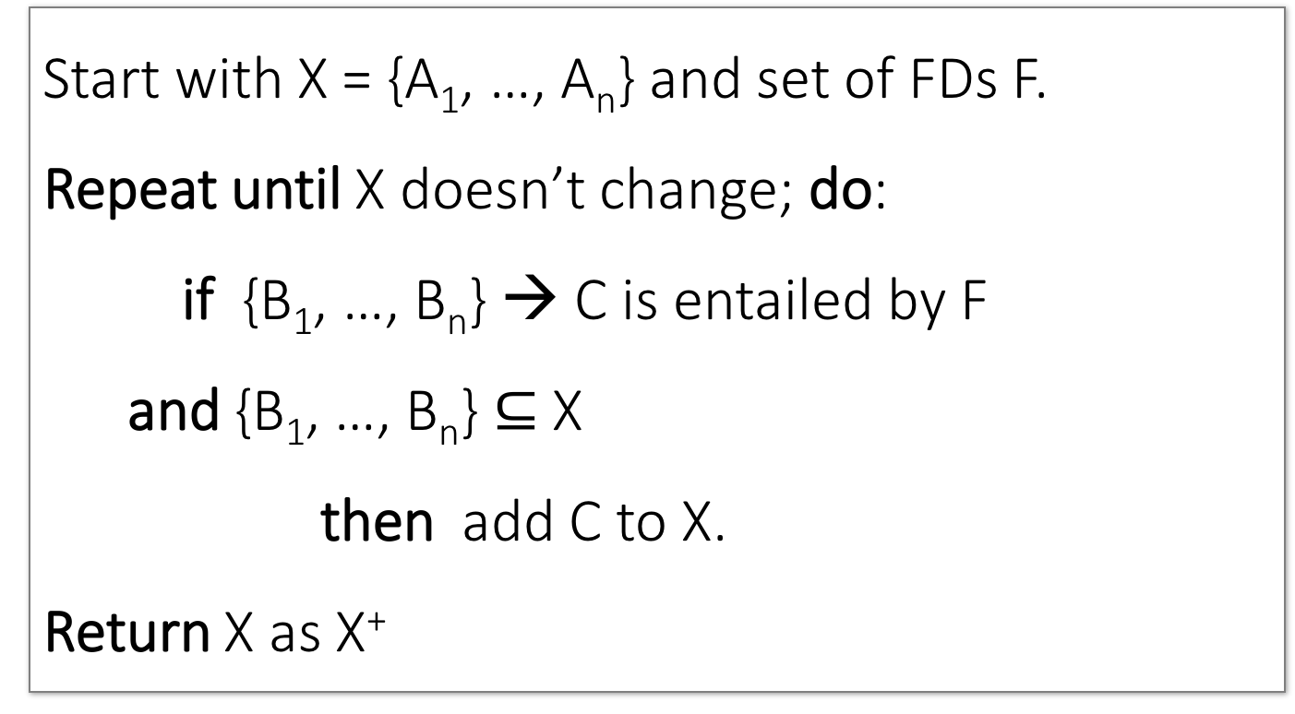
Closure Algorithm
Lecture 5 > Section 2 > Closures
Start with X = {A₁, …, A_{n}} and set of FDs F.
Repeat until X doesn’t change; do:
if {B₁, …, B_{n}} → C is entailed by F
and {B₁, …, B_{n}} $⊆$ X
then add C to X.
Return X as X⁺

Slide 53
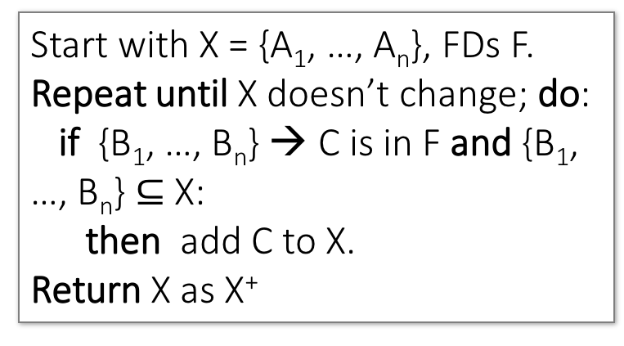
Closure Algorithm
Lecture 5 > Section 2 > Closures
Start with X = {A₁, …, A_{n}}, FDs F.
Repeat until X doesn’t change; do:
if {B₁, …, B_{n}} → C is in F and {B₁, …, B_{n}} $⊆$ X:
then add C to X.
Return X as X⁺
{name, category}⁺ =
{name, category}
F =
{name} → {color}
{category} → {dept}
{color, category} → {price}

Slide 54
Closure Algorithm
Lecture 5 > Section 2 > Closures
Start with X = {A₁, …, A_{n}}, FDs F.
Repeat until X doesn’t change; do:
if {B₁, …, B_{n}} → C is in F and {B₁, …, B_{n}} $⊆$ X:
then add C to X.
Return X as X⁺
{name, category}⁺ =
{name, category}
{name, category}⁺ =
{name, category, color}
F =
{name} → {color}
{category} → {dept}
{color, category} → {price}

Slide 55
Closure Algorithm
Lecture 5 > Section 2 > Closures
Start with X = {A₁, …, A_{n}}, FDs F.
Repeat until X doesn’t change; do:
if {B₁, …, B_{n}} → C is in F and {B₁, …, B_{n}} $⊆$ X:
then add C to X.
Return X as X⁺
{name, category}⁺ =
{name, category}
{name, category}⁺ =
{name, category, color}
F =
{name, category}⁺ =
{name, category, color, dept}
{name} → {color}
{category} → {dept}
{color, category} → {price}

Slide 56
Closure Algorithm
Lecture 5 > Section 2 > Closures
Start with X = {A₁, …, A_{n}}, FDs F.
Repeat until X doesn’t change; do:
if {B₁, …, B_{n}} → C is in F and {B₁, …, B_{n}} $⊆$ X:
then add C to X.
Return X as X⁺
{name, category}⁺ =
{name, category}
{name, category}⁺ =
{name, category, color}
F =
{name, category}⁺ =
{name, category, color, dept}
{name} → {color}
{category} → {dept}
{color, category} → {price}
{name, category}⁺ =
{name, category, color, dept, price}

Slide 57
Example
Lecture 5 > Section 2 > Closures
R(A,B,C,D,E,F)
{A,B} → {C}
{A,D} → {E}
{B} → {D}
{A,F} → {B}
Compute {A,B}⁺ = {A, B, }
Compute {A, F}⁺ = {A, F, }

Slide 58
Example
Lecture 5 > Section 2 > Closures
R(A,B,C,D,E,F)
{A,B} → {C}
{A,D} → {E}
{B} → {D}
{A,F} → {B}
Compute {A,B}⁺ = {A, B, C, D }
Compute {A, F}⁺ = {A, F, B }

Slide 59
Example
Lecture 5 > Section 2 > Closures
R(A,B,C,D,E,F)
{A,B} → {C}
{A,D} → {E}
{B} → {D}
{A,F} → {B}
Compute {A,B}⁺ = {A, B, C, D, E}
Compute {A, F}⁺ = {A, B, C, D, E, F}

Slide 60
Activity-5-2.ipynb
Lecture 5 > Section 2 > ACTIVITY

Slide 61
3. Closures, Superkeys & Keys
Lecture 5 > Section 3

Slide 62
What you will learn about in this section
Lecture 5 > Section 3
Closures Pt. II
Superkeys & Keys
ACTIVITY: The key or a key?

Slide 63
Why Do We Need the Closure?
Lecture 5 > Section 3 > Closures Pt. II
With closure we can find all FD’s easily
To check if X → A
Compute X⁺
Check if A ∈ X⁺
Note here that X is a set of attributes, but A is a single attribute. Why does considering FDs of this form suffice?
Recall the Split/combine rule:
X → A₁, …, X → A_{n}
implies
X → {A₁, …, A_{n}}

Slide 64
Using Closure to Infer ALL FDs
Lecture 5 > Section 3 > Closures Pt. II
Example:
Given F =
{A,B} → C {A,D} → B
{B} → D
Step 1: Compute X⁺, for every X:
{A}⁺ = {A}
{B}⁺ = {B,D}
{C}⁺ = {C}
{D}⁺ = {D}
{A,B}⁺ = {A,B,C,D}
{A,C}⁺ = {A,C}
{A,D}⁺ = {A,B,C,D}
{A,B,C}⁺ = {A,B,D}⁺ = {A,C,D}⁺ = {A,B,C,D} {B,C,D}⁺ = {B,C,D}
{A,B,C,D}⁺ = {A,B,C,D}
No need to compute these- why?

Slide 65
Using Closure to Infer ALL FDs
Lecture 5 > Section 3 > Closures Pt. II
Example:
Given F =
{A,B} → C {A,D} → B
{B} → D
Step 1: Compute X⁺, for every X:
{A}⁺ = {A}, {B}⁺ = {B,D}, {C}⁺ = {C}, {D}⁺ = {D}, {A,B}⁺ = {A,B,C,D}, {A,C}⁺ = {A,C}, {A,D}⁺ = {A,B,C,D}, {A,B,C}⁺ = {A,B,D}⁺ = {A,C,D}⁺ = {A,B,C,D}, {B,C,D}⁺ = {B,C,D}, {A,B,C,D}⁺ = {A,B,C,D}
Step 2: Enumerate all FDs X → Y, s.t. Y ⊆ X⁺ and X ∩ Y = ∅:
{A,B} → {C,D}, {A,D} → {B,C},
{A,B,C} → {D}, {A,B,D} → {C},
{A,C,D} → {B}

Slide 66
Using Closure to Infer ALL FDs
Lecture 5 > Section 3 > Closures Pt. II
Example:
Given F =
{A,B} → C {A,D} → B
{B} → D
Step 1: Compute X⁺, for every X:
{A}⁺ = {A}, {B}⁺ = {B,D}, {C}⁺ = {C}, {D}⁺ = {D}, {A,B}⁺ = {A,B,C,D}, {A,C}⁺ = {A,C}, {A,D}⁺ = {A,B,C,D}, {A,B,C}⁺ = {A,B,D}⁺ = {A,C,D}⁺ = {A,B,C,D}, {B,C,D}⁺ = {B,C,D}, {A,B,C,D}⁺ = {A,B,C,D}
Step 2: Enumerate all FDs X → Y, s.t. Y ⊆ X⁺ and X ∩ Y = ∅:
“Y is in the closure of X”
{A,B} → {C,D}, {A,D} → {B,C},
{A,B,C} → {D}, {A,B,D} → {C},
{A,C,D} → {B}

Slide 67
Using Closure to Infer ALL FDs
Lecture 5 > Section 3 > Closures Pt. II
Example:
Given F =
{A,B} → C {A,D} → B
{B} → D
Step 1: Compute X⁺, for every X:
{A}⁺ = {A}, {B}⁺ = {B,D}, {C}⁺ = {C}, {D}⁺ = {D}, {A,B}⁺ = {A,B,C,D}, {A,C}⁺ = {A,C}, {A,D}⁺ = {A,B,C,D}, {A,B,C}⁺ = {A,B,D}⁺ = {A,C,D}⁺ = {A,B,C,D}, {B,C,D}⁺ = {B,C,D}, {A,B,C,D}⁺ = {A,B,C,D}
Step 2: Enumerate all FDs X → Y, s.t. Y ⊆ X⁺ and X ∩ Y = ∅:
The FD X → Y is non-trivial
{A,B} → {C,D}, {A,D} → {B,C},
{A,B,C} → {D}, {A,B,D} → {C},
{A,C,D} → {B}

Slide 68
Superkeys and Keys
Lecture 5 > Section 3 > Superkeys & Keys

Slide 69
Keys and Superkeys
Lecture 5 > Section 3 > Superkeys & Keys
A superkey is a set of attributes A₁, …, A_{n} s.t.
for any other attribute B in R,
we have {A₁, …, A_{n}} → B
I.e. all attributes are functionally determined by a superkey
A key is a minimal superkey
Meaning that no subset of a key is also a superkey

Slide 70
Finding Keys and Superkeys
Lecture 5 > Section 3 > Superkeys & Keys
For each set of attributes X
Compute X⁺
If X⁺ = set of all attributes then X is a superkey
If X is minimal, then it is a key
Do we need to check all sets of attributes? Which sets?

Slide 71
Example of Finding Keys
Lecture 5 > Section 3 > Superkeys & Keys
Product(name, price, category, color)
{name, category} → price
{category} → color
What is a key?

Slide 72
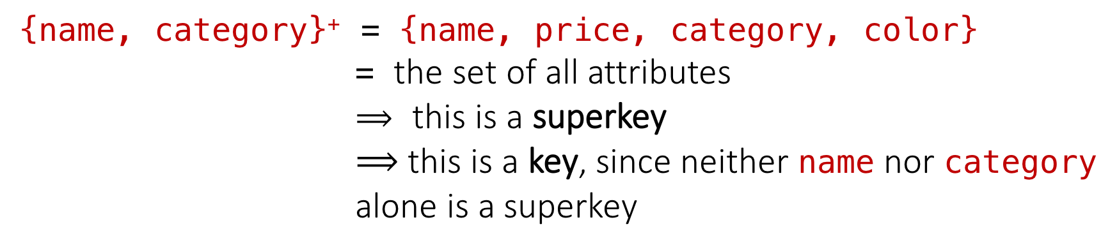
Example of Keys
Lecture 5 > Section 3 > Superkeys & Keys
Product(name, price, category, color)
{name, category} → price
{category} → color
{name, category}⁺ = {name, price, category, color}
= the set of all attributes
$⟹$ this is a superkey
$⟹$ this is a key, since neither name nor category alone is a superkey

Slide 73
Activity-5-3.ipynb
Lecture 5 > Section 3 > ACTIVITY

Slide 74
Lecture 7: Design Theory II
Lecture 7

Slide 75
Today’s Lecture
Lecture 7
Boyce-Codd Normal Form
ACTIVITY
Decompositions & 3NF
ACTIVITY
MVDs
ACTIVITY

Slide 76
1. Boyce-Codd Normal Form
Lecture 7 > Section 1

Slide 77
What you will learn about in this section
Lecture 7 > Section 1
Conceptual Design
Boyce-Codd Normal Form
The BCNF Decomposition Algorithm
ACTIVITY

Slide 78
Conceptual Design
Lecture 7 > Section 1 > Conceptual Design

Slide 79
Back to Conceptual Design
Lecture 7 > Section 1 > Conceptual Design
Now that we know how to find FDs, it’s a straight-forward process:
Search for “bad” FDs
If there are any, then keep decomposing the table into sub-tables until no more bad FDs
When done, the database schema is normalized
Recall: there are several normal forms…

Slide 80
Boyce-Codd Normal Form (BCNF)
Lecture 7 > Section 1 > BCNF
Main idea is that we define “good” and “bad” FDs as follows:
X → A is a “good FD” if X is a (super)key
In other words, if A is the set of all attributes
X → A is a “bad FD” otherwise
We will try to eliminate the “bad” FDs!

Slide 81
Boyce-Codd Normal Form (BCNF)
Lecture 7 > Section 1 > BCNF
Why does this definition of “good” and “bad” FDs make sense?
If X is not a (super)key, it functionally determines some of the attributes
Recall: this means there is redundancy
And redundancy like this can lead to data anomalies!
EmpID | Name | Phone | Position
E0045 | Smith | 1234 | Clerk
E3542 | Mike | 9876 | Salesrep
E1111 | Smith | 9876 | Salesrep
E9999 | Mary | 1234 | Lawyer

Slide 82
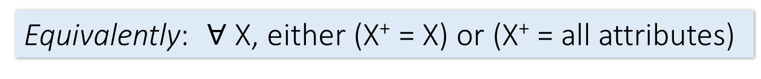
Boyce-Codd Normal Form
Lecture 7 > Section 1 > BCNF
BCNF is a simple condition for removing anomalies from relations:
A relation R is in BCNF if:
if {A₁, ..., A_{n}} → B is a non-trivial FD in R
then {A₁, ..., A_{n}} is a superkey for R
Equivalently: $∀$ X, either (X⁺ = X) or (X⁺ = all attributes)
In other words: there are no “bad” FDs

Slide 83
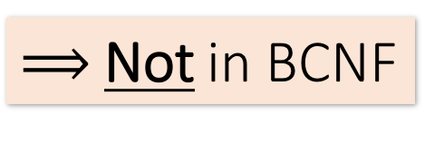
Example
Lecture 7 > Section 1 > BCNF
Name | SSN | PhoneNumber | City
Fred | 123-45-6789 | 206-555-1234 | Seattle
Fred | 123-45-6789 | 206-555-6543 | Seattle
Joe | 987-65-4321 | 908-555-2121 | Westfield
Joe | 987-65-4321 | 908-555-1234 | Westfield
{SSN} → {Name,City}
This FD is bad because it is not a superkey
What is the key?
{SSN, PhoneNumber}
$⟹$Not in BCNF

Slide 84
Example
Lecture 7 > Section 1 > BCNF
Name | SSN | City
Fred | 123-45-6789 | Seattle
Joe | 987-65-4321 | Madison
{SSN} → {Name,City}
This FD is now good because it is the key
SSN | PhoneNumber
123-45-6789 | 206-555-1234
123-45-6789 | 206-555-6543
987-65-4321 | 908-555-2121
987-65-4321 | 908-555-1234
Let’s check anomalies:
Redundancy ?
Update ?
Delete ?
Now in BCNF!

Slide 85
BCNF Decomposition Algorithm
Lecture 7 > Section 1 > BCNF
BCNFDecomp(R): Find X s.t.: X⁺ ≠ X and X⁺ ≠ [all attributes]
if (not found) then Return R
let Y = X⁺ - X, Z = (X⁺)^{C} decompose R into R1(X ∪ Y) and R2(X ∪ Z)
Return BCNFDecomp(R1), BCNFDecomp(R2)

Slide 86
BCNF Decomposition Algorithm
Lecture 7 > Section 1 > BCNF
BCNFDecomp(R): Find X s.t.: X⁺ ≠ X and X⁺ ≠ [all attributes]
if (not found) then Return R
let Y = X⁺ - X, Z = (X⁺)^{C} decompose R into R1(X ∪ Y) and R2(X ∪ Z)
Return BCNFDecomp(R1), BCNFDecomp(R2)
Find a set of attributes X which has non-trivial “bad” FDs, i.e. is not a superkey, using closures

Slide 87
BCNF Decomposition Algorithm
Lecture 7 > Section 1 > BCNF
BCNFDecomp(R): Find X s.t.: X⁺ ≠ X and X⁺ ≠ [all attributes]
if (not found) then Return R
let Y = X⁺ - X, Z = (X⁺)^{C} decompose R into R1(X ∪ Y) and R2(X ∪ Z)
Return BCNFDecomp(R1), BCNFDecomp(R2)
If no “bad” FDs found, in BCNF!

Slide 88
BCNF Decomposition Algorithm
Lecture 7 > Section 1 > BCNF
BCNFDecomp(R): Find X s.t.: X⁺ ≠ X and X⁺ ≠ [all attributes]
if (not found) then Return R
let Y = X⁺ - X, Z = (X⁺)^{C} decompose R into R1(X ∪ Y) and R2(X ∪ Z)
Return BCNFDecomp(R1), BCNFDecomp(R2)
Let Y be the attributes that X functionally determines (+ that are not in X)
And let Z be the other attributes that it doesn’t

Slide 89
BCNF Decomposition Algorithm
Lecture 7 > Section 1 > BCNF
BCNFDecomp(R): Find X s.t.: X⁺ ≠ X and X⁺ ≠ [all attributes]
if (not found) then Return R
let Y = X⁺ - X, Z = (X⁺)^{C} decompose R into R₁(X ∪ Y) and R₂(X ∪ Z)
Return BCNFDecomp(R1), BCNFDecomp(R2)
Split into one relation (table) with X plus the attributes that X determines (Y)…
Y
X
Z
R₁
R₂

Slide 90
BCNF Decomposition Algorithm
Lecture 7 > Section 1 > BCNF
BCNFDecomp(R): Find X s.t.: X⁺ ≠ X and X⁺ ≠ [all attributes]
if (not found) then Return R
let Y = X⁺ - X, Z = (X⁺)^{C} decompose R into R₁(X ∪ Y) and R₂(X ∪ Z)
Return BCNFDecomp(R1), BCNFDecomp(R2)
And one relation with X plus the attributes it does not determine (Z)
Y
X
Z
R₁
R₂

Slide 91
BCNF Decomposition Algorithm
Lecture 7 > Section 1 > BCNF
BCNFDecomp(R): Find X s.t.: X⁺ ≠ X and X⁺ ≠ [all attributes]
if (not found) then Return R
let Y = X⁺ - X, Z = (X⁺)^{C} decompose R into R₁(X ∪ Y) and R₂(X ∪ Z)
Return BCNFDecomp(R₁), BCNFDecomp(R₂)
Proceed recursively until no more “bad” FDs!

Slide 92
Lecture 7 > Section 1 > BCNF
Example
BCNFDecomp(R): Find X s.t.: X⁺ ≠ X and X⁺ ≠ [all attributes]
if (not found) then Return R
let Y = X⁺ - X, Z = (X⁺)^{C} decompose R into R₁(X ∪ Y) and R₂(X ∪ Z)
Return BCNFDecomp(R₁), BCNFDecomp(R₂)
R(A,B,C,D,E)
{A} → {B,C}
{C} → {D}

Slide 93
Example
Lecture 7 > Section 1 > BCNF
R(A,B,C,D,E)
{A} → {B,C}
{C} → {D}
R(A,B,C,D) {A}⁺ = {A,B,C} ≠ {A,B,C,D}
R₁(A,B,C) {B}⁺ = {B,C} ≠ {A,B,C}
R₁₁(B,C)
R₁₂(A,B)
R₂(A,D)

Slide 94
Activity-7-1.ipynb
Lecture 7 > Section 1 > ACTIVITY

Slide 95
2. Decompositions & 3NF
Lecture 7 > Section 2

Slide 96
What you will learn about in this section
Lecture 7 > Section 2
Lossy & Lossless Decompositions
3rd Normal Form
ACTIVITY

Slide 97
Decompositions
Lecture 7 > Section 2 > Decompositions

Slide 98
Decompositions in General
Lecture 7 > Section 2 > Decompositions
R(A₁,...,A_{n},B₁,...,B_{m},C₁,...,C_{p})
R₁(A₁,...,A_{n},B₁,...,B_{m})
R₂(A₁,...,A_{n},C₁,...,C_{p})
R₁ = the projection of R on A₁, ..., A_{n}, B₁, ..., B_{m}
R₂ = the projection of R on A₁, ..., A_{n}, C₁, ..., C_{p}

Slide 99
Theory of Decomposition
Lecture 7 > Section 2 > Decompositions
Sometimes a decomposition is “correct”
Name | Price | Category
Gizmo | 19.99 | Gadget
OneClick | 24.99 | Camera
Gizmo | 19.99 | Camera
I.e. it is a Lossless decomposition
Name | Price
Gizmo | 19.99
OneClick | 24.99
Gizmo | 19.99
Name | Category
Gizmo | Gadget
OneClick | Camera
Gizmo | Camera

Slide 100
Lossy Decomposition
Lecture 7 > Section 2 > Decompositions
Name | Price | Category
Gizmo | 19.99 | Gadget
OneClick | 24.99 | Camera
Gizmo | 19.99 | Camera
However sometimes it isn’t
What’s wrong here?
Name | Category
Gizmo | Gadget
OneClick | Camera
Gizmo | Camera
Price | Category
19.99 | Gadget
24.99 | Camera
19.99 | Camera

Slide 101
Lossless Decompositions
Lecture 7 > Section 2 > Decompositions
R(A₁,...,A_{n},B₁,...,B_{m},C₁,...,C_{p})
R₁(A₁,...,A_{n},B₁,...,B_{m})
R₂(A₁,...,A_{n},C₁,...,C_{p})
What (set) relationship holds between R1 Join R2 and R if lossless?
Hint: Which tuples of R will be present?
It’s lossless if we have equality!

Slide 102
Lossless Decompositions
Lecture 7 > Section 2 > Decompositions
R(A₁,...,A_{n},B₁,...,B_{m},C₁,...,C_{p})
R₁(A₁,...,A_{n},B₁,...,B_{m})
R₂(A₁,...,A_{n},C₁,...,C_{p})
A decomposition R → R1, R2 is lossless if R = R1 Join R2

Slide 103
Lossless Decompositions
Lecture 7 > Section 2 > Decompositions
R(A₁,...,A_{n},B₁,...,B_{m},C₁,...,C_{p})
R₁(A₁,...,A_{n},B₁,...,B_{m})
R₂(A₁,...,A_{n},C₁,...,C_{p})
If {A₁, ..., A_{n}} → {B₁, ..., B_{m}}
Then the decomposition is lossless
Note: don’t need
{A₁, ..., A_{n}} → {C₁, ..., C_{p}}
BCNF decomposition is always lossless. Why?

Slide 104
A problem with BCNF
Lecture 7 > Section 2 > 3NF
Problem: To enforce a FD, must reconstruct original relation—on each insert!
Note: This is historically inaccurate, but it makes it easier to explain

Slide 105
A Problem with BCNF
Lecture 7 > Section 2 > 3NF
Unit | Company | Product
… | … | …
{Unit} → {Company} {Company,Product} → {Unit}
We do a BCNF decomposition on a “bad” FD:
{Unit}⁺ = {Unit, Company}
Unit | Company
… | …
Unit | Product
… | …
{Unit} → {Company}
We lose the FD {Company,Product} → {Unit}!!

Slide 106
So Why is that a Problem?
Lecture 7 > Section 2 > 3NF
Unit | Company
Galaga99 | UW
Bingo | UW
Unit | Product
Galaga99 | Databases
Bingo | Databases
No problem so far. All local FD’s are satisfied.
{Unit} → {Company}
Unit | Company | Product
Galaga99 | UW | Databases
Bingo | UW | Databases
Let’s put all the data back into a single table again:
Violates the FD {Company,Product} → {Unit}!!

Slide 107
The Problem
Lecture 7 > Section 2 > 3NF
We started with a table R and FDs F
We decomposed R into BCNF tables R₁, R₂, … with their own FDs F₁, F₂, …
We insert some tuples into each of the relations—which satisfy their local FDs but when reconstruct it violates some FD across tables!
Practical Problem: To enforce FD, must reconstruct R—on each insert!

Slide 108
Solution: 3NF Called “Dependency Preserving”
Lecture 7 > Section 2 > 3NF

Slide 109
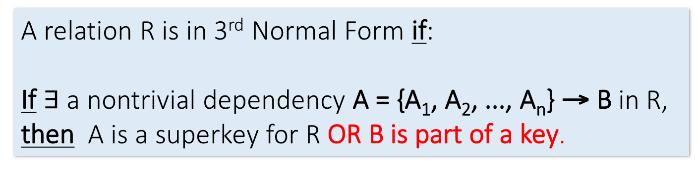
Solution: 3rd Normal Form (3NF)
Lecture 7 > Section 2 > 3NF
Another simple condition for removing anomalies from relations:
A relation R is in 3rd Normal Form if:
If $∃$ a nontrivial dependency A = {A₁, A₂, ..., A_{n}} → B in R, then A is a superkey for R OR B is part of a key.
Tradeoff:
BCNF = no anomalies, but may lose some FDs
3NF = keeps all FDs, but may have some anomalies

Slide 110
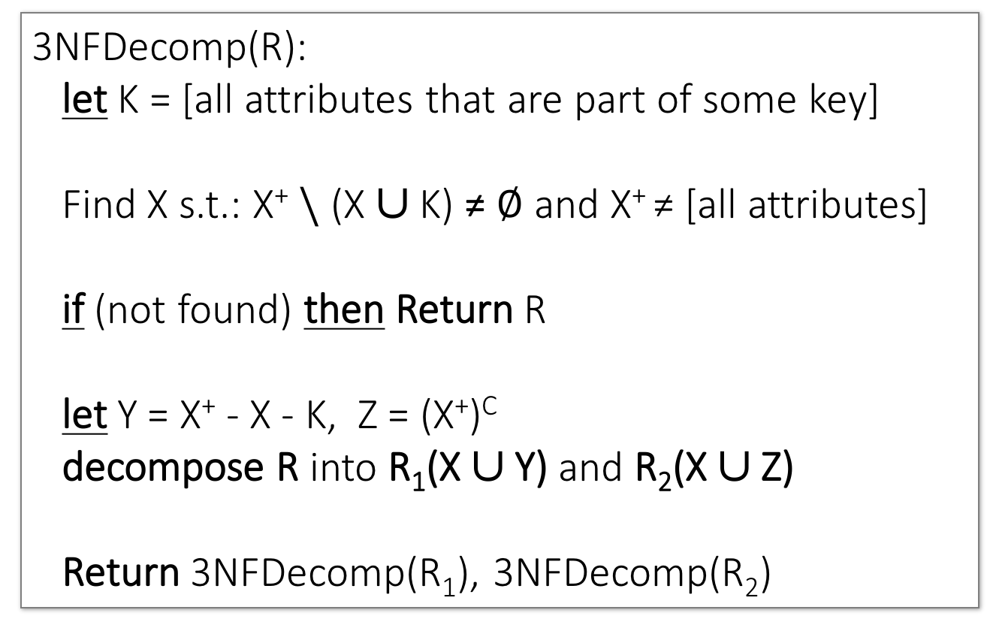
3NF Decomposition Algorithm
Lecture 7 > Section 2 > 3NF
3NFDecomp(R): let K = [all attributes that are part of some key]
Find X s.t.: X⁺ $\backslash$ (X ∪ K) ≠ $∅$ and X⁺ ≠ [all attributes]
if (not found) then Return R
let Y = X⁺ - X - K, Z = (X⁺)^{C} decompose R into R₁(X ∪ Y) and R₂(X ∪ Z)
Return 3NFDecomp(R₁), 3NFDecomp(R₂)

Slide 111
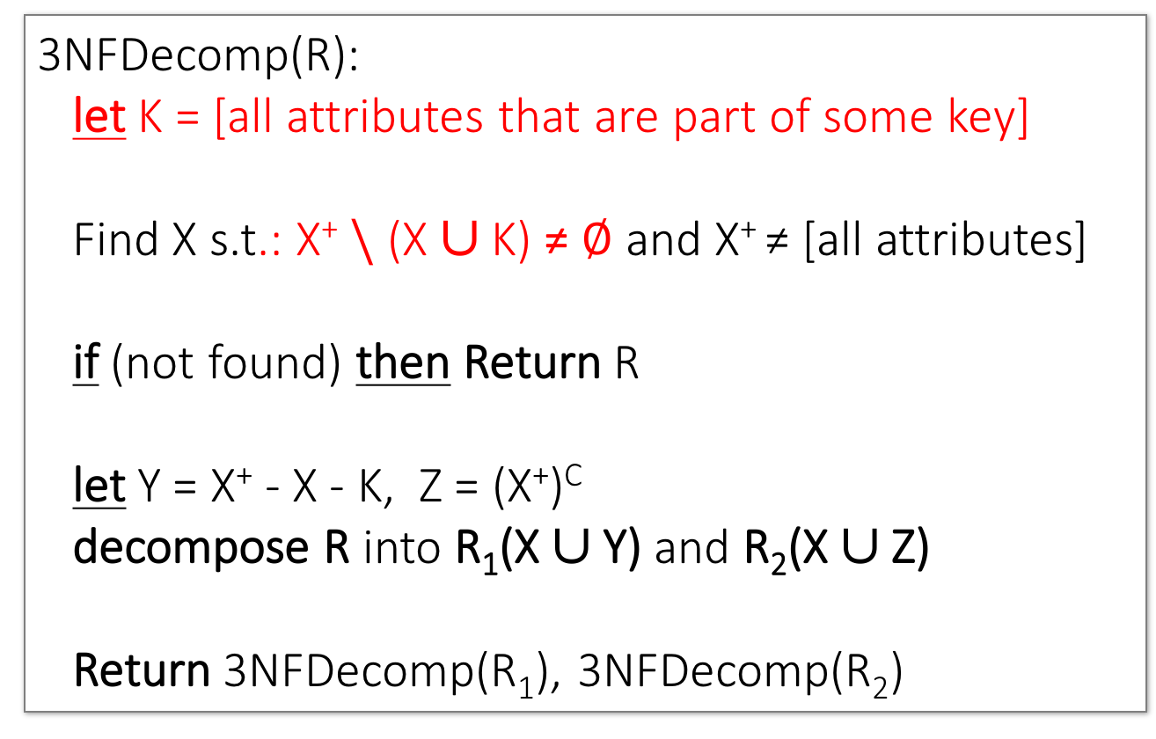
3NF Decomposition Algorithm
Lecture 7 > Section 2 > 3NF
3NFDecomp(R): let K = [all attributes that are part of some key]
Find X s.t.: X⁺ $\backslash$ (X ∪ K) ≠ $∅$ and X⁺ ≠ [all attributes]
if (not found) then Return R
let Y = X⁺ - X - K, Z = (X⁺)^{C} decompose R into R₁(X ∪ Y) and R₂(X ∪ Z)
Return 3NFDecomp(R₁), 3NFDecomp(R₂)
Says: “Look for X such that X is not a superkey and X+ has attributes that are not part of some key”
Slight changes from BCNF only…

Slide 112
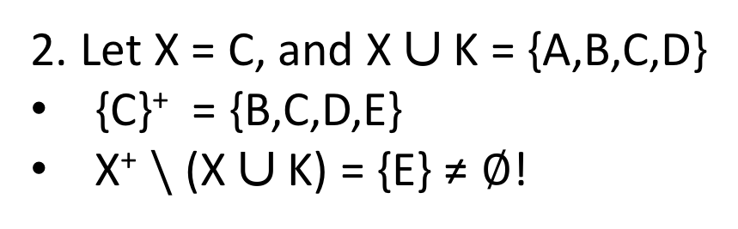
Example of 3NF decomposition
Lecture 7 > Section 2 > 3NF
R(A,B,C,D,E)
1. Keys are {A,B}, {A,C} and {A,D}
→ K = {A,B,C,D}
We get the keys by computing the closure X⁺ of several X’s
{A,B} → {C}
{C} → {D}
{D} → {B}
{D} → {E}
2. Let X = C, and X ∪ K = {A,B,C,D}
{C}⁺ = {B,C,D,E}
X⁺ $\backslash$ (X ∪ K) = {E} ≠ $∅$!
3. Decompose:
Y = X⁺ \ X ∪ K = {E}, Z = {A,B,C,D}
→ R1(C, E), R2(A,B,C,D)
R1 is in 3NF
R2 is in 3NF (because its keys are {A,B}, {A,C}, {A,D})

Slide 113
3NF v.s. BCNF Decomposition
Lecture 7 > Section 2 > 3NF
3NF decomposition has an extra condition in its inner loop, so it stops early.
A | B | C | D | E | F | G | H | K
A | B | C | D | E
E | F | G | H | K
3NF
A | B | C
C | D | E
E | F | G
G | H | K
BCNF
A | B
A | B
A | B
A | B
A | B
A | B
A | B
A | B

Slide 114
Activity-7-2.ipynb
Lecture 7 > Section 2 > ACTIVITY

Slide 115
3. MVDs
Lecture 7 > Section 3

Slide 116
What you will learn about in this section
Lecture 7 > Section 3
MVDs
ACTIVITY

Slide 117
Multiple Value Dependencies (MVDs)
Lecture 7 > Section 3 > MVDs
Course | Staff | Student
CS949 | Amy | Bob
CS145 | Chris | Deb
CS145 | Chris | Eli
CS145 | Firas | Deb
CS145 | Firas | Eli
MVD Ex: For each fixed course (e.g. CS145),
Every staff member in that course and every student in that course occur in a tuple in that table.
Write: Course ↠ Staff or Course ↠ Student

Slide 118
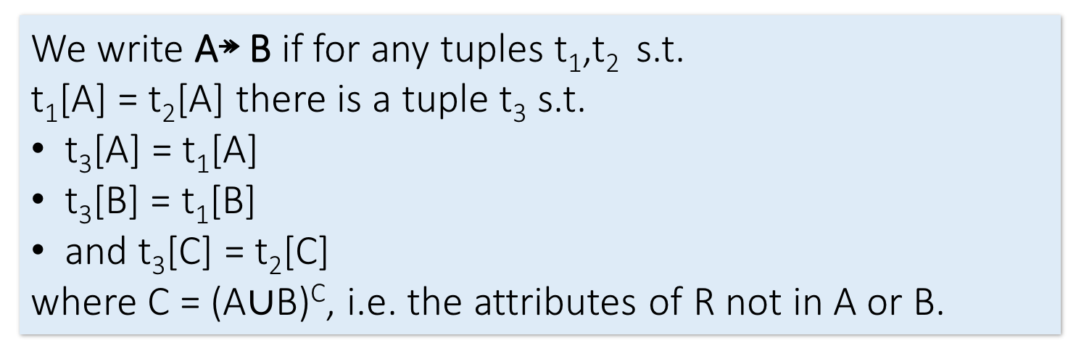
Formal Definition of MVD
Lecture 7 > Section 3 > MVDs
Course ↠ Staff
Course | Staff | Student
CS949 | Amy | Bob
CS145 | Chris | Deb
CS145 | Chris | Eli
CS145 | Firas | Deb
CS145 | Firas | Eli
t₁
t₃
t₂
We write A↠ B if for any tuples t₁,t₂ s.t.
t₁[A] = t₂[A] there is a tuple t₃ s.t.
t₃[A] = t₁[A]
t₃[B] = t₁[B]
and t₃[C] = t₂[C]
where C = (A$∪$B)^{C}, i.e. the attributes of R not in A or B.

Slide 119
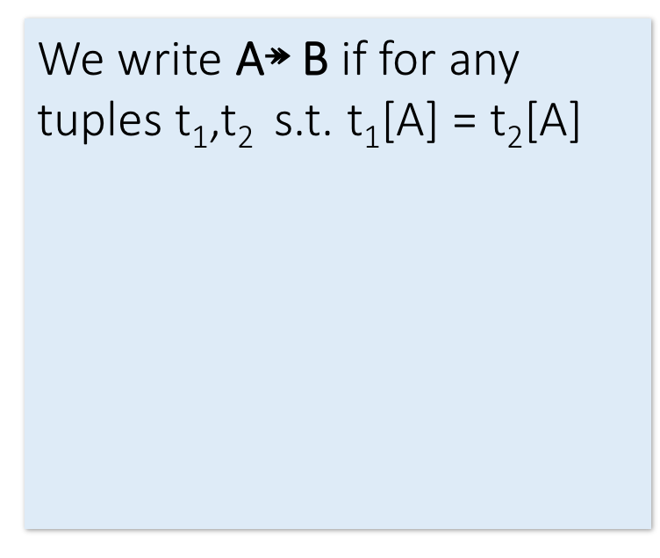
Formal Definition of MVD
Lecture 7 > Section 3 > MVDs
Course ↠ Staff
We write A↠ B if for any tuples t₁,t₂ s.t. t₁[A] = t₂[A] there is a tuple t₃ s.t.
t₃[A] = t₁[A]
t₃[B] = t₁[B]
and t₃[C] = t₂[C]
where C = (A$∪$B)^{C}, i.e. the attributes of R not in A or B.
Course | Staff | Student
CS949 | Amy | Bob
CS145 | Chris | Deb
CS145 | Chris | Eli
CS145 | Firas | Deb
CS145 | Firas | Eli
t₁
t₂
A

Slide 120
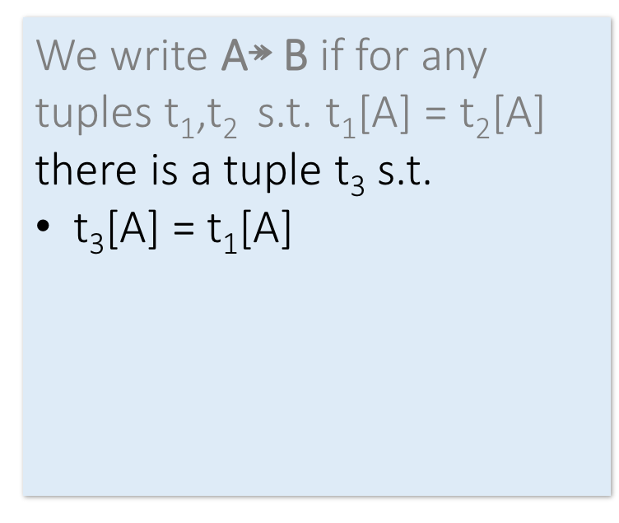
Formal Definition of MVD
Lecture 7 > Section 3 > MVDs
Course ↠ Staff
We write A↠ B if for any tuples t₁,t₂ s.t. t₁[A] = t₂[A] there is a tuple t₃ s.t.
t₃[A] = t₁[A]
t₃[B] = t₁[B]
and t₃[C] = t₂[C]
where C = (A$∪$B)^{C}, i.e. the attributes of R not in A or B.
Course | Staff | Student
CS949 | Amy | Bob
CS145 | Chris | Deb
CS145 | Chris | Eli
CS145 | Firas | Deb
CS145 | Firas | Eli
t₁
t₃
t₂
A

Slide 121
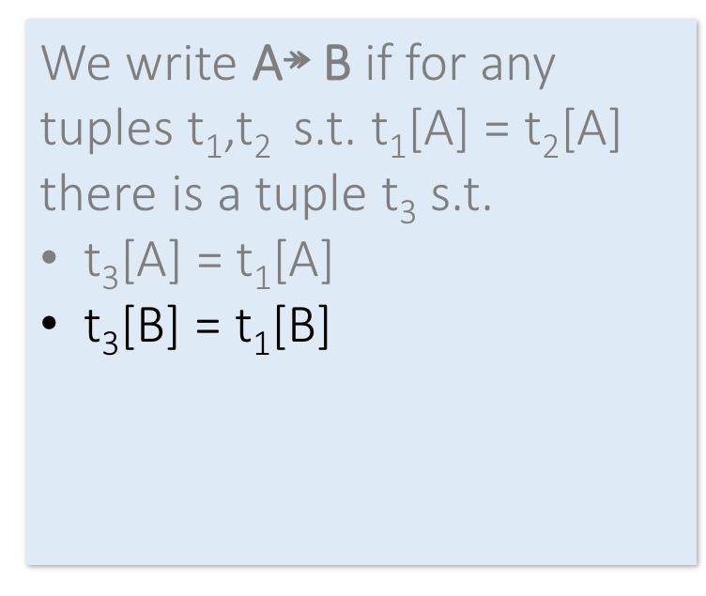
Formal Definition of MVD
Lecture 7 > Section 3 > MVDs
Course ↠ Staff
We write A↠ B if for any tuples t₁,t₂ s.t. t₁[A] = t₂[A] there is a tuple t₃ s.t.
t₃[A] = t₁[A]
t₃[B] = t₁[B]
and t₃[C] = t₂[C]
where C = (A$∪$B)^{C}, i.e. the attributes of R not in A or B.
Course | Staff | Student
CS949 | Amy | Bob
CS145 | Chris | Deb
CS145 | Chris | Eli
CS145 | Firas | Deb
CS145 | Firas | Eli
t₁
t₃
t₂
A
B

Slide 122
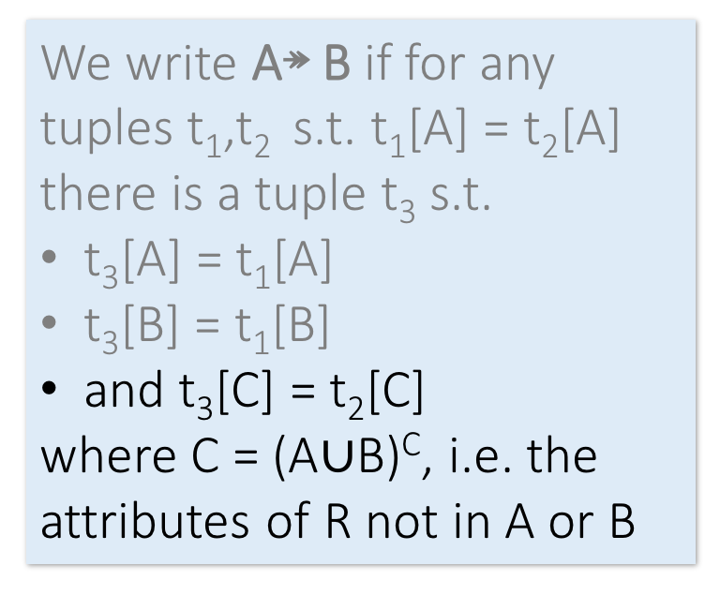
Formal Definition of MVD
Lecture 7 > Section 3 > MVDs
Course ↠ Staff
We write A↠ B if for any tuples t₁,t₂ s.t. t₁[A] = t₂[A] there is a tuple t₃ s.t.
t₃[A] = t₁[A]
t₃[B] = t₁[B]
and t₃[C] = t₂[C]
where C = (A$∪$B)^{C}, i.e. the attributes of R not in A or B.
Course | Staff | Student
CS949 | Amy | Bob
CS145 | Chris | Deb
CS145 | Chris | Eli
CS145 | Firas | Deb
CS145 | Firas | Eli
t₁
t₃
t₂
A
B
C

Slide 123
Does Course ↠ Staff hold now?
Lecture 7 > Section 3 > MVDs
Course | Staff | Student
CS949 | Amy | Bob
CS145 | Chris | Deb
CS145 | Chris | Eli
CS145 | Firas | Eli

Slide 124
Connection to FDs
Lecture 7 > Section 3 > MVDs
If A → B does A↠ B ?
Hint: sort of like multiplying by one…

Slide 125
Comments on MVDs
Lecture 7 > Section 3 > MVDs
MVDs have “rules” too!
Experts: Axiomatizable
4th Normal Form is “non-trivial MVD”
For AI weenies: MVD is conditional independence in graphical models!

Slide 126
Activity-7-3.ipynb
Lecture 7 > Section 3 > ACTIVITY

Slide 127
Summary
Lectures 5,7 > SUMMARY
Constraints allow one to reason about redundancy in the data
Normal forms describe how to remove this redundancy by decomposing relations
Elegant—by representing data appropriately certain errors are essentially impossible
For FDs, BCNF is the normal form.
A tradeoff for insert performance: 3NF

