Slide 1
B+ Trees: An IO-Aware Index Structure
Lecture 13

Slide 2
“If you don’t find it in the index, look very carefully through the entire catalog”
Lecture 13
- Sears, Roebuck and Co., Consumers Guide, 1897

Slide 3
Today’s Lecture
Lecture 13
[Moved from 12-3]: External Merge Sort & Sorting Optimizations
Indexes: Motivations & Basics
B+ Trees

Slide 4
1. External Merge Sort
Lecture 13 > Section 1

Slide 5
What you will learn about in this section
Lecture 13 > Section 1
External merge sort
External merge sort on larger files
Optimizations for sorting

Slide 6
Recap: External Merge Algorithm
Lecture 13 > Section 1 > External Merge Sort
Suppose we want to merge two sorted files both much larger than main memory (i.e. the buffer)
We can use the external merge algorithm to merge files of arbitrary length in 2*(N+M) IO operations with only 3 buffer pages!
Our first example of an “IO aware” algorithm / cost model
Notes:
4

Slide 7
External Merge Sort
Lecture 13 > Section 1 > External Merge Sort

Slide 8
Why are Sort Algorithms Important?
Lecture 13 > Section 1 > External Merge Sort
Data requested from DB in sorted order is extremely common
e.g., find students in increasing GPA order
Why not just use quicksort in main memory??
What about if we need to sort 1TB of data with 1GB of RAM…
A classic problem in computer science!
Notes:
4

Slide 9
More reasons to sort…
Lecture 13 > Section 1 > External Merge Sort
Sorting useful for eliminating duplicate copies in a collection of records (Why?)
Sorting is first step in bulk loading B+ tree index.
Sort-merge join algorithm involves sorting
Coming up…
Next lecture

Slide 10

Do people care?
Lecture 13 > Section 1 > External Merge Sort
http://sortbenchmark.org
Sort benchmark bears his name

Slide 11
So how do we sort big files?
Lecture 13 > Section 1 > External Merge Sort
Split into chunks small enough to sort in memory (“runs”)
Merge pairs (or groups) of runs using the external merge algorithm
Keep merging the resulting runs (each time = a “pass”) until left with one sorted file!

Slide 12
External Merge Sort Algorithm
Lecture 13 > Section 1 > External Merge Sort
Example:
3 Buffer pages
6-page file
Disk
Main Memory
Buffer
F₁
44,10
33,12
55,31
Orange file = unsorted
F₂
18,22
27,24
3,1
Split into chunks small enough to sort in memory

Slide 13
External Merge Sort Algorithm
Lecture 13 > Section 1 > External Merge Sort
Example:
3 Buffer pages
6-page file
Disk
Main Memory
Buffer
F₁
44,10
33,12
55,31
Orange file = unsorted
F₂
18,22
27,24
3,1
Split into chunks small enough to sort in memory

Slide 14
External Merge Sort Algorithm
Lecture 13 > Section 1 > External Merge Sort
Example:
3 Buffer pages
6-page file
Disk
Main Memory
Buffer
F₁
44,10
33,12
55,31
Orange file = unsorted
F₂
18,22
27,24
3,1
Split into chunks small enough to sort in memory

Slide 15
External Merge Sort Algorithm
Lecture 13 > Section 1 > External Merge Sort
Example:
3 Buffer pages
6-page file
Disk
Main Memory
Buffer
F₁
10,12
31,33
44,55
Orange file = unsorted
F₂
18,22
27,24
3,1
Split into chunks small enough to sort in memory

Slide 16
External Merge Sort Algorithm
Lecture 13 > Section 1 > External Merge Sort
Example:
3 Buffer pages
6-page file
Disk
Main Memory
Buffer
F₁
10,12
31,33
44,55
Each sorted file is a called a run
1,3
18,22
24,27
F₂
18,22
27,24
3,1
And similarly for F₂
Split into chunks small enough to sort in memory

Slide 17
External Merge Sort Algorithm
Lecture 13 > Section 1 > External Merge Sort
Example:
3 Buffer pages
6-page file
Disk
Main Memory
Buffer
F₁
10,12
31,33
44,55
F₂
1,3
18,22
24,27
2. Now just run the external merge algorithm & we’re done!

Slide 18
Calculating IO Cost
Lecture 13 > Section 1 > External Merge Sort
For 3 buffer pages, 6 page file:
Split into two 3-page files and sort in memory
= 1 R + 1 W for each file = 2*(3 + 3) = 12 IO operations
Merge each pair of sorted chunks using the external merge algorithm
= 2*(3 + 3) = 12 IO operations
Total cost = 24 IO

Slide 19
Running External Merge Sort on Larger Files
Lecture 13 > Section 1 > External Merge Sort: Larger files
Assume we still only have 3 buffer pages (Buffer not pictured)
Disk
10,12
31,33
44,55
45,38
18,43
24,27
10,12
31,33
47,55
41,3
18,22
23,20
42,46
31,33
39,55
1,3
18,23
24,27
10,12
48,33
44,40
16,31
18,22
24,27

Slide 20
Running External Merge Sort on Larger Files
Lecture 13 > Section 1 > External Merge Sort: Larger files
Assume we still only have 3 buffer pages (Buffer not pictured)
Disk
1. Split into files small enough to sort in buffer…
10,12
31,33
44,55
45,38
18,43
24,27
10,12
31,33
47,55
41,3
18,22
23,20
42,46
31,33
39,55
1,3
18,23
24,27
10,12
48,33
44,40
16,31
18,22
24,27

Slide 21
Running External Merge Sort on Larger Files
Lecture 13 > Section 1 > External Merge Sort: Larger files
Assume we still only have 3 buffer pages (Buffer not pictured)
Disk
1. Split into files small enough to sort in buffer… and sort
10,12
31,33
44,55
18,24
27,38
43,45
10,12
31,33
47,55
3,18
20,22
23,41
31,33
39,42
46,55
1,3
18,23
24,27
10,12
33,40
44,48
Call each of these sorted files a run
16,18
22,24
27,31

Slide 22
Running External Merge Sort on Larger Files
Lecture 13 > Section 1 > External Merge Sort: Larger files
Assume we still only have 3 buffer pages (Buffer not pictured)
Disk
Disk
10,12
31,33
44,55
10,12
18,24
27,31
18,24
27,38
43,45
33,38
43,44
45,55
2. Now merge pairs of (sorted) files… the resulting files will be sorted!
10,12
31,33
47,55
3,10
12,18
20,22
3,18
20,22
23,41
23,31
33,41
47,55
31,33
39,42
46,55
1,3
18,23
24,27
1,3
18,23
24,27
31,33
39,42
46,55
10,12
33,40
44,48
10,12
16,18
22,24
16,18
22,24
27,31
27,31
33,40
44,48

Slide 23
Running External Merge Sort on Larger Files
Lecture 13 > Section 1 > External Merge Sort: Larger files
Assume we still only have 3 buffer pages (Buffer not pictured)
Disk
Disk
Disk
10,12
31,33
44,55
10,12
18,24
27,31
3,10
10,12
12,18
18,24
27,38
43,45
33,38
43,44
45,55
18,20
22,23
24,27
10,12
31,33
47,55
3,10
12,18
20,22
31,31
33,33
38,41
3. And repeat…
3,18
20,22
23,41
23,31
33,41
47,55
43,44
45,47
55,55
31,33
39,42
46,55
1,3
18,23
24,27
1,3
10,12
16,18
1,3
18,23
24,27
31,33
39,42
46,55
18,22
23,24
24,27
Call each of these steps a pass
10,12
33,40
44,48
10,12
16,18
22,24
27,31
31,33
33,39
16,18
22,24
27,31
27,31
33,40
44,48
40,42
44,46
48,55

Slide 24
Running External Merge Sort on Larger Files
Lecture 13 > Section 1 > External Merge Sort: Larger files
Disk
Disk
Disk
Disk
10,12
31,33
44,55
10,12
18,24
27,31
3,10
10,12
12,18
1,3
3,10
10,10
18,24
27,38
43,45
33,38
43,44
45,55
18,20
22,23
24,27
12,12
12,16
18,18
10,12
31,33
47,55
3,10
12,18
20,22
31,31
33,33
38,41
18,18
20,22
22,23
3,18
20,22
23,41
23,31
33,41
47,55
43,44
45,47
55,55
23,24
24,24
27,27
31,33
39,42
46,55
1,3
18,23
24,27
1,3
10,12
16,18
27,31
31,31
31,33
1,3
18,23
24,27
31,33
39,42
46,55
18,22
23,24
24,27
33,33
33,38
39,40
10,12
33,40
44,48
10,12
16,18
22,24
27,31
31,33
33,39
41,42
43,44
44,45
16,18
22,24
27,31
27,31
33,40
44,48
40,42
44,46
48,55
46,47
48,55
55,55
4. And repeat!

Slide 25
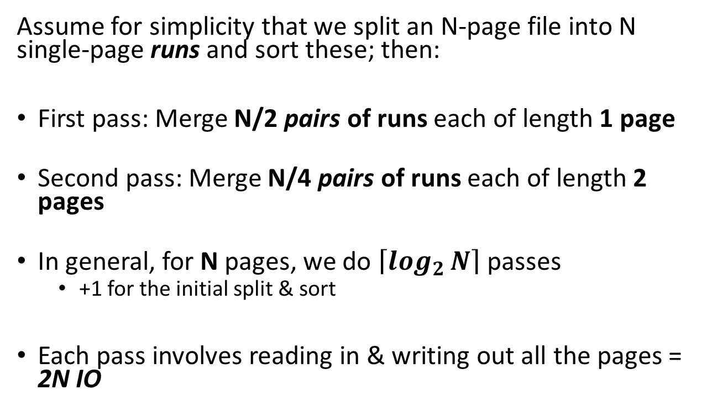

Simplified 3-page Buffer Version
Lecture 13 > Section 1 > External Merge Sort: Larger files
Unsorted input file
Assume for simplicity that we split an N-page file into N single-page runs and sort these; then:
First pass: Merge N/2 pairs of runs each of length 1 page
Second pass: Merge N/4 pairs of runs each of length 2 pages
In general, for N pages, we do $\left\lceil \log_{2}{N}\right\rceil$ passes
+1 for the initial split & sort
Each pass involves reading in & writing out all the pages = 2N IO
Split & sort
Merge
Merge
Sorted!
→ 2N*($\left\lceil \log_{2}{N}\right\rceil$+1) total IO cost!

Slide 26
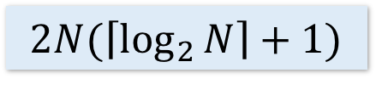
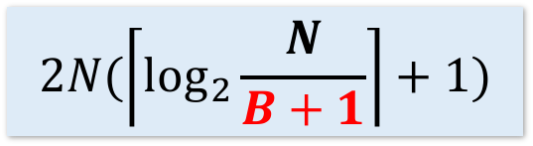
Using B+1 buffer pages to reduce # of passes
Lecture 13 > Section 1 > Optimizations for sorting
Suppose we have B+1 buffer pages now; we can:
Increase length of initial runs. Sort B+1 at a time!
At the beginning, we can split the N pages into runs of length B+1 and sort these in memory
IO Cost:
$$2N(\left\lceil \log_{2}{\frac{N}{B+1}}\right\rceil +1)$$
$$2N(\left\lceil \log_{2}{N}\right\rceil +1)$$
Starting with runs of length 1
Starting with runs of length B+1

Slide 27
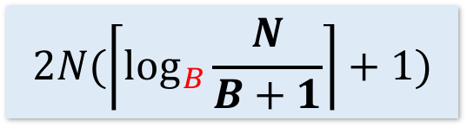
Using B+1 buffer pages to reduce # of passes
Lecture 13 > Section 1 > Optimizations for sorting
Suppose we have B+1 buffer pages now; we can:
2. Perform a B-way merge.
On each pass, we can merge groups of B runs at a time (vs. merging pairs of runs)!
IO Cost:
$$2N(\left\lceil \log_{2}{\frac{N}{B+1}}\right\rceil +1)$$
$$2N(\left\lceil \log_{B}{\frac{N}{B+1}}\right\rceil +1)$$
$$2N(\left\lceil \log_{2}{N}\right\rceil +1)$$
Starting with runs of length 1
Starting with runs of length B+1
Performing B-way merges

Slide 28
Repacking
Lecture 13 > Section 1 > Optimizations for sorting

Slide 29
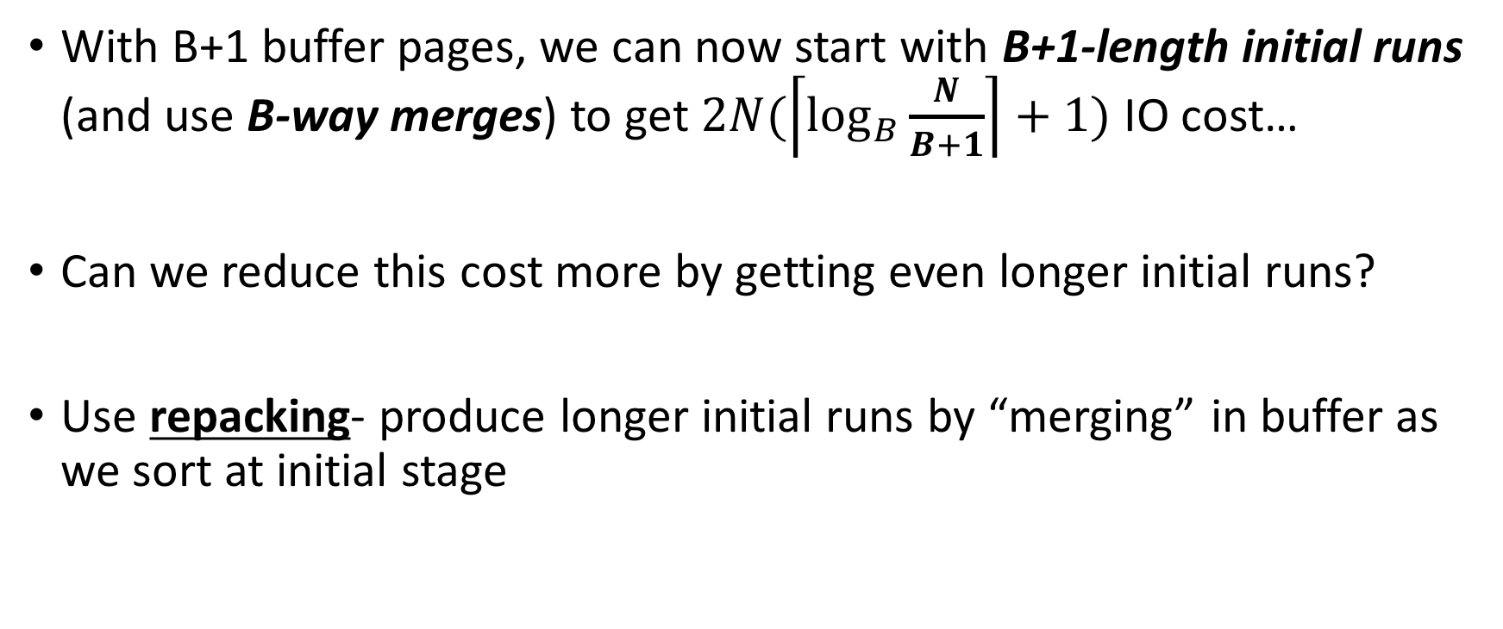
Repacking for even longer initial runs
Lecture 13 > Section 1 > Optimizations for sorting
With B+1 buffer pages, we can now start with B+1-length initial runs (and use B-way merges) to get $2N(\left\lceil \log_{B}{\frac{N}{B+1}}\right\rceil +1)$ IO cost…
Can we reduce this cost more by getting even longer initial runs?
Use repacking- produce longer initial runs by “merging” in buffer as we sort at initial stage

Slide 30
Repacking Example: 3 page buffer
Lecture 13 > Section 1 > Optimizations for sorting
Start with unsorted single input file, and load 2 pages
Disk
Main Memory
31,12
10,33
44,55
F₁
Buffer
18,22
57,24
3,98
F₂

Slide 31
Repacking Example: 3 page buffer
Lecture 13 > Section 1 > Optimizations for sorting
Also keep track of max (last) value in current run…
Take the minimum two values, and put in output page
Disk
Main Memory
m=12
44,55
F₁
Buffer
18,22
57,24
3,98
31,12
10,33
10,12
F₂
31
33

Slide 32
Repacking Example: 3 page buffer
Lecture 13 > Section 1 > Optimizations for sorting
Next, repack
Disk
Main Memory
m=12
44,55
F₁
Buffer
18,22
57,24
3,98
31
33
F₂
10,12
31,33

Slide 33
Repacking Example: 3 page buffer
Lecture 13 > Section 1 > Optimizations for sorting
Next, repack, then load another page and continue!
Disk
Main Memory
m=33
m=12
44,55
F₁
Buffer
18,22
57,24
3,98
F₂
10,12
31,33

Slide 34
Repacking Example: 3 page buffer
Lecture 13 > Section 1 > Optimizations for sorting
Now, however, the smallest values are less than the largest (last) in the sorted run…
Disk
Main Memory
m=33
F₁
Buffer
57,24
3,98
44,55
18,22
F₂
10,12
31,33
18,22
We call these values frozen because we can’t add them to this run…

Slide 35
Repacking Example: 3 page buffer
Lecture 13 > Section 1 > Optimizations for sorting
Now, however, the smallest values are less than the largest (last) in the sorted run…
Disk
Main Memory
m=55
F₁
Buffer
3,98
F₂
10,12
31,33
44,55
57,24
18,22

Slide 36
Repacking Example: 3 page buffer
Lecture 13 > Section 1 > Optimizations for sorting
Now, however, the smallest values are less than the largest (last) in the sorted run…
Disk
Main Memory
m=55
F₁
Buffer
F₂
10,12
31,33
44,55
57,24
18,22
3,98

Slide 37
Repacking Example: 3 page buffer
Lecture 13 > Section 1 > Optimizations for sorting
Now, however, the smallest values are less than the largest (last) in the sorted run…
Disk
Main Memory
m=55
F₁
Buffer
F₂
10,12
31,33
44,55
3,24
18,22
57,98

Slide 38
Repacking Example: 3 page buffer
Lecture 13 > Section 1 > Optimizations for sorting
Once all buffer pages have a frozen value, or input file is empty, start new run with the frozen values
Disk
Main Memory
m=0
F₁
Buffer
F₂
10,12
31,33
44,55
3,24
18,22
57,98
F₃

Slide 39
Repacking Example: 3 page buffer
Lecture 13 > Section 1 > Optimizations for sorting
Once all buffer pages have a frozen value, or input file is empty, start new run with the frozen values
Disk
Main Memory
m=0
F₁
Buffer
F₂
10,12
31,33
44,55
3,18
22,24
57,98
F₃

Slide 40
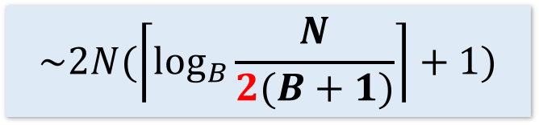
Repacking
Lecture 13 > Section 1 > Optimizations for sorting
Note that, for buffer with B+1 pages:
If input file is sorted → nothing is frozen → we get a single run!
If input file is reverse sorted (worst case) → everything is frozen → we get runs of length B+1
In general, with repacking we do no worse than without it!
What if the file is already sorted?
Engineer’s approximation: runs will have ~2(B+1) length
$$\sim 2N(\left\lceil \log_{B}{\frac{N}{2(B+1)}}\right\rceil +1)$$

Slide 41
Summary
Lecture 13 > Section 1 > SUMMARY
Basics of IO and buffer management.
See notebook for more fun! (Learn about sequential flooding)
We introduced the IO cost model using sorting.
Saw how to do merges with few IOs,
Works better than main-memory sort algorithms.
Described a few optimizations for sorting

Slide 42
2. Indexes
Lecture 13 > Section 2

Slide 43
What you will learn about in this section
Lecture 13 > Section 2
Indexes: Motivation
Indexes: Basics
ACTIVITY: Creating indexes

Slide 44
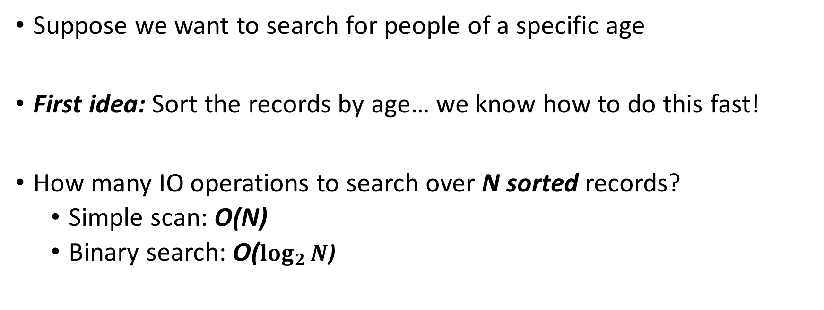
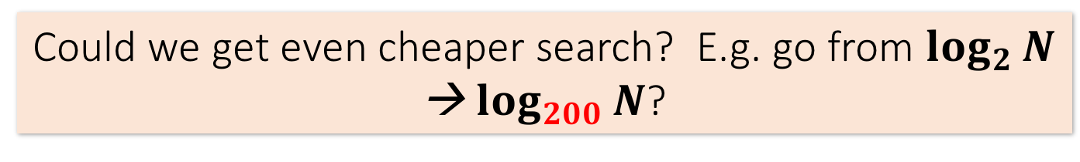
Index Motivation
Lecture 13 > Section 2 > Indexes: Motivation
Person(name, age)
Suppose we want to search for people of a specific age
First idea: Sort the records by age… we know how to do this fast!
How many IO operations to search over N sorted records?
Simple scan: O(N)
Binary search: O($\log_{2}{N}$)
Could we get even cheaper search? E.g. go from $\log_{2}{N}$ → $\log_{200}{N}$?

Slide 45
Index Motivation
Lecture 13 > Section 2 > Indexes: Motivation
What about if we want to insert a new person, but keep the list sorted?
We would have to potentially shift N records, requiring up to ~ 2*N/P IO operations (where P = # of records per page)!
We could leave some “slack” in the pages…
2
1,3
4,5
6,7
1,2
3,4
5,6
7,
Could we get faster insertions?

Slide 46
Index Motivation
Lecture 13 > Section 2 > Indexes: Motivation
What about if we want to be able to search quickly along multiple attributes (e.g. not just age)?
We could keep multiple copies of the records, each sorted by one attribute set… this would take a lot of space
Can we get fast search over multiple attribute (sets) without taking too much space?
We’ll create separate data structures called indexes to address all these points

Slide 47
Further Motivation for Indexes: NoSQL!
Lecture 13 > Section 2 > Indexes: Motivation
NoSQL engines are (basically) just indexes!
A lot more is left to the user in NoSQL… one of the primary remaining functions of the DBMS is still to provide index over the data records, for the reasons we just saw!
Sometimes use B+ Trees (covered next), sometimes hash indexes (not covered here)
Indexes are critical across all DBMS types

Slide 48
Indexes: High-level
Lecture 13 > Section 2 > Indexes: Basics
An index on a file speeds up selections on the search key fields for the index.
Search key properties
Any subset of fields
is not the same as key of a relation
Example:
On which attributes would you build indexes?
Product(name, maker, price)
Notes:
7

Slide 49
More precisely
Lecture 13 > Section 2 > Indexes: Basics
An index is a data structure mapping search keys to sets of rows in a database table
Provides efficient lookup & retrieval by search key value- usually much faster than searching through all the rows of the database table
An index can store the full rows it points to (primary index) or pointers to those rows (secondary index)
We’ll mainly consider secondary indexes
Notes:
7

Slide 50
Operations on an Index
Lecture 13 > Section 2 > Indexes: Basics
Search: Quickly find all records which meet some condition on the search key attributes
More sophisticated variants as well. Why?
Insert / Remove entries
Bulk Load / Delete. Why?
Indexing is one the most important features provided by a database for performance

Slide 51
Conceptual Example
Lecture 13 > Section 2 > Indexes: Basics
Russian_Novels
What if we want to return all books published after 1867? The above table might be very expensive to search over row-by-row…
BID | Title | Author | Published | Full_text
001 | War and Peace | Tolstoy | 1869 | …
002 | Crime and Punishment | Dostoyevsky | 1866 | …
003 | Anna Karenina | Tolstoy | 1877 | …
SELECT *
FROM Russian_Novels WHERE Published > 1867

Slide 52
Conceptual Example
Lecture 13 > Section 2 > Indexes: Basics
By_Yr_Index
Russian_Novels
Published | BID
1866 | 002
1869 | 001
1877 | 003
BID | Title | Author | Published | Full_text
001 | War and Peace | Tolstoy | 1869 | …
002 | Crime and Punishment | Dostoyevsky | 1866 | …
003 | Anna Karenina | Tolstoy | 1877 | …
Maintain an index for this, and search over that!
Why might just keeping the table sorted by year not be good enough?

Slide 53
Conceptual Example
Lecture 13 > Section 2 > Indexes: Basics
By_Yr_Index
Russian_Novels
Published | BID
1866 | 002
1869 | 001
1877 | 003
BID | Title | Author | Published | Full_text
001 | War and Peace | Tolstoy | 1869 | …
002 | Crime and Punishment | Dostoyevsky | 1866 | …
003 | Anna Karenina | Tolstoy | 1877 | …
By_Author_Title_Index
Can have multiple indexes to support multiple search keys
Author | Title | BID
Dostoyevsky | Crime and Punishment | 002
Tolstoy | Anna Karenina | 003
Tolstoy | War and Peace | 001
Indexes shown here as tables, but in reality we will use more efficient data structures…

Slide 54
Covering Indexes
Lecture 13 > Section 2 > Indexes: Basics
We say that an index is covering for a specific query if the index contains all the needed attributes- meaning the query can be answered using the index alone!
By_Yr_Index
Published | BID
1866 | 002
1869 | 001
1877 | 003
The “needed” attributes are the union of those in the SELECT and WHERE clauses…
Example:
SELECT Published, BID
FROM Russian_Novels WHERE Published > 1867

Slide 55
High-level Categories of Index Types
Lecture 13 > Section 2 > Indexes: Basics
B-Trees (covered next)
Very good for range queries, sorted data
Some old databases only implemented B-Trees
We will look at a variant called B+ Trees
Hash Tables (not covered)
There are variants of this basic structure to deal with IO
Called linear or extendible hashing- IO aware!
The data structures we present here are “IO aware”
Real difference between structures: costs of ops determines which index you pick and why

Slide 56
Activity-13.ipynb
Lecture 13 > Section 2 > ACTIVITY

Slide 57
2. B+ Trees
Lecture 13 > Section 3

Slide 58
What you will learn about in this section
Lecture 13 > Section 3
B+ Trees: Basics
B+ Trees: Design & Cost
Clustered Indexes

Slide 59
B+ Trees
Lecture 13 > Section 3 > B+ Tree basics
Search trees
B does not mean binary!
Idea in B Trees:
make 1 node = 1 physical page
Balanced, height adjusted tree (not the B either)
Idea in B+ Trees:
Make leaves into a linked list (for range queries)

Slide 60
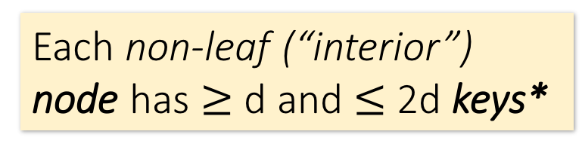
B+ Tree Basics
Lecture 13 > Section 3 > B+ Tree basics
Parameter d = the degree
10 |  | 20 |  | 30
Each non-leaf (“interior”) node has $≥$ d and $≤$2d keys*
*except for root node, which can have between 2 and 2d keys

Slide 61
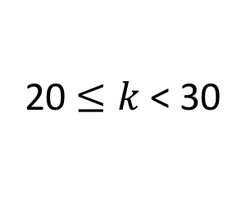
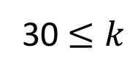
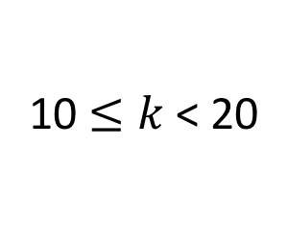
B+ Tree Basics
Lecture 13 > Section 3 > B+ Tree basics
10 |  | 20 |  | 30
The n keys in a node define n+1 ranges
k < 10
20 $≤k$< 30
30 $≤k$
10 $≤k$< 20

Slide 62
B+ Tree Basics
Lecture 13 > Section 3 > B+ Tree basics
Non-leaf or internal node
10 |  | 20 |  | 30
For each range, in a non-leaf node, there is a pointer to another node with keys in that range
22 |  | 25 |  | 28

Slide 63
B+ Tree Basics
Lecture 13 > Section 3 > B+ Tree basics
Leaf nodes also have between d and 2d keys, and are different in that:
Non-leaf or internal node
10 |  | 20 |  | 30
Leaf nodes
12 |  | 17
22 |  | 25 |  | 28 |  | 29
32 |  | 34 |  | 37 |  | 38

Slide 64
B+ Tree Basics
Lecture 13 > Section 3 > B+ Tree basics
Leaf nodes also have between d and 2d keys, and are different in that:
Non-leaf or internal node
10 |  | 20 |  | 30
Their key slots contain pointers to data records
Leaf nodes
12 |  | 17
22 |  | 25 |  | 28 |  | 29
32 |  | 34 |  | 37 |  | 38
11
15
19
22
27
28
30
33
35
37

Slide 65
B+ Tree Basics
Lecture 13 > Section 3 > B+ Tree basics
Leaf nodes also have between d and 2d keys, and are different in that:
Non-leaf or internal node
10 |  | 20 |  | 30
Their key slots contain pointers to data records
Leaf nodes
12 |  | 17
22 |  | 25 |  | 28 |  | 29
32 |  | 34 |  | 37 |  | 38
They contain a pointer to the next leaf node as well, for faster sequential traversal
11
15
19
22
27
28
30
33
35
37

Slide 66
B+ Tree Basics
Lecture 13 > Section 3 > B+ Tree basics
Non-leaf or internal node
Note that the pointers at the leaf level will be to the actual data records (rows).
We might truncate these for simpler display (as before)…
10 |  | 20 |  | 30
Leaf nodes
12 |  | 17
22 |  | 25 |  | 28 |  | 29
32 |  | 34 |  | 37 |  | 38
Name: Jake
Age: 15
Name: Bess
Age: 22
Name: Sally
Age: 28
Name: Sue
Age: 33
Name: Jess
Age: 35
Name: Alf
Age: 37
Name: Joe
Age: 11
Name: John
Age: 19
Name: Bob
Age: 27
Name: Sal
Age: 30

Slide 67
Some finer points of B+ Trees
Lecture 13 > Section 3 > B+ Tree design & cost

Slide 68
Searching a B+ Tree
Lecture 13 > Section 3 > B+ Tree design & cost
For exact key values:
Start at the root
Proceed down, to the leaf
For range queries:
As above
Then sequential traversal
SELECT name
FROM people
WHERE age = 25
SELECT name
FROM people
WHERE 20 <= age
AND age <= 30
Notes:
FOR

Slide 69
B+ Tree Exact Search Animation
Lecture 13 > Section 3 > B+ Tree design & cost
K = 30?
30 < 80
80
30 in [20,60)
20 |  | 60
100 |  | 120 |  | 140
30 in [30,40)
10 |  | 15 |  | 18
20 |  | 30 |  | 40 |  | 50
60 |  | 65
80 |  | 85 |  | 90
Not all nodes pictured
To the data!
9
12
15
19
28
30
40
59
63
78
84
89

Slide 70
B+ Tree Range Search Animation
Lecture 13 > Section 3 > B+ Tree design & cost
K in [30,85]?
30 < 80
80
30 in [20,60)
20 |  | 60
100 |  | 120 |  | 140
30 in [30,40)
10 |  | 15 |  | 18
20 |  | 30 |  | 40 |  | 50
60 |  | 65
80 |  | 85 |  | 90
Not all nodes pictured
To the data!
9
12
15
19
28
30
40
59
63
78
84
89

Slide 71
B+ Tree Design
Lecture 13 > Section 3 > B+ Tree design & cost
How large is d?
Example:
Key size = 4 bytes
Pointer size = 8 bytes
Block size = 4096 byes
We want each node to fit on a single block/page
2d x 4 + (2d+1) x 8 <= 4096 → d <= 170
NB: Oracle allows 64K blocks
→ d <= 2666

Slide 72
B+ Tree: High Fanout = Smaller & Lower IO
Lecture 13 > Section 3 > B+ Tree design & cost
As compared to e.g. binary search trees, B+ Trees have high fanout (= 2d)
This means that the depth of the tree is small → getting to any element requires very few IO operations!
Also can often store most or all of the B+ Tree in main memory!
A TiB = 2⁴⁰ Bytes. What is the height of a B+ Tree that indexes it (with 64K pages)?
(2*2666)^{h} = 2⁴⁰ → h = 4
The fanout is defined as the maximum number of pointers to child nodes per node
The known universe contains ~10⁸⁰ particles… what is the height of a B+ Tree that indexes these?

Slide 73
B+ Trees in Practice
Lecture 13 > Section 3 > B+ Tree design & cost
Typical order: d=100. Typical fill-factor: 67%.
average fanout = 133
Typical capacities:
Height 4: 133⁴ = 312,900,700 records
Height 3: 133³ = 2,352,637 records
Top levels of tree sit in the buffer pool:
Level 1 = 1 page = 8 Kbytes
Level 2 = 133 pages = 1 Mbyte
Level 3 = 17,689 pages = 133 MBytes
Fill-factor is the percent of available slots in the B+ Tree that are filled; is usually < 1 to leave slack for (quicker) insertions
Typically, only pay for one IO!

Slide 74
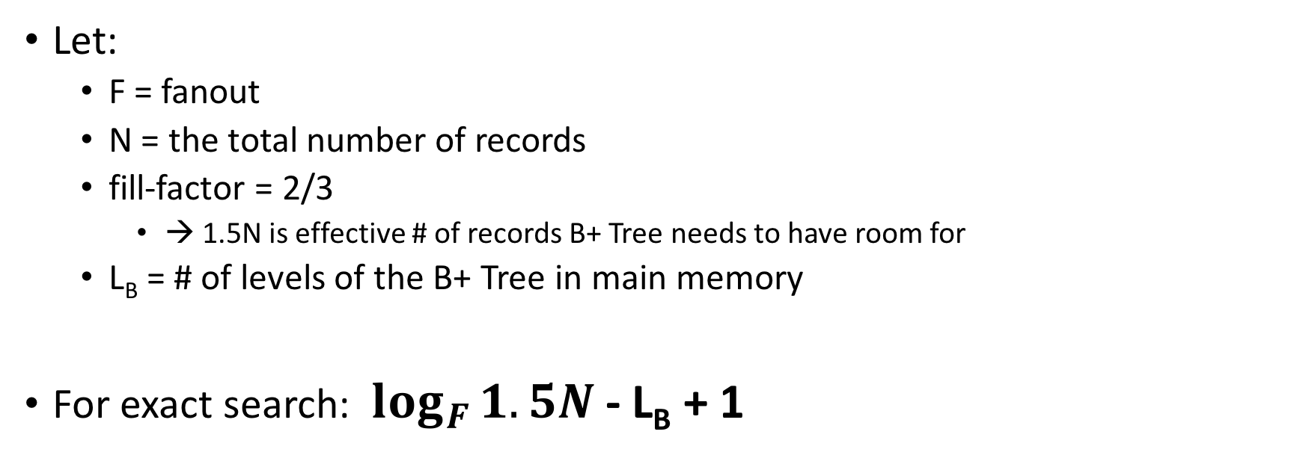
Simple Cost Model for Search
Lecture 13 > Section 3 > B+ Tree design & cost
Let:
F = fanout
N = the total number of records
fill-factor = 2/3
→ 1.5N is effective # of records B+ Tree needs to have room for
L_{B} = # of levels of the B+ Tree in main memory
For exact search: $\log_{F}{1.5N}$ - L_{B} + 1
Only pay for reading from B+ Tree nodes on disk (plus reading the actual record)

Slide 75
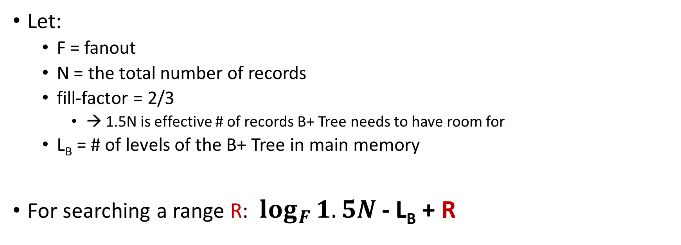
Simple Cost Model for Search
Lecture 13 > Section 3 > B+ Tree design & cost
Let:
F = fanout
N = the total number of records
fill-factor = 2/3
→ 1.5N is effective # of records B+ Tree needs to have room for
L_{B} = # of levels of the B+ Tree in main memory
For searching a range R: $\log_{F}{1.5N}$ - L_{B} + R

Slide 76
Fast Insertions & Self-Balancing
Lecture 13 > Section 3 > B+ Tree design & cost
We won’t go into specifics of B+ Tree insertion algorithm, but has several attractive qualities:
~ Same cost as exact search
Self-balancing: B+ Tree remains balanced (with respect to height) even after insert
B+ Trees also (relatively) fast for insertions!

Slide 77
Clustered Indexes
Lecture 13 > Section 3 > Clustered Indexes
An index is clustered if the underlying data is ordered in the same way as the index’s data entries.
Notes:
11

Slide 78
Clustered vs. Unclustered Index
Lecture 13 > Section 3 > Clustered Indexes
30
30
Index Entries
22 |  | 25 |  | 28 |  | 29
32 |  | 34 |  | 37 |  | 38
22 |  | 25 |  | 28 |  | 29
32 |  | 34 |  | 37 |  | 38
19
22
27
28
30
33
35
37
19
33
27
22
37
28
35
30
Data Records
Clustered
Unclustered

Slide 79
Clustered vs. Unclustered Index
Lecture 13 > Section 3 > Clustered Indexes
Recall that for a disk with block access, sequential IO is much faster than random IO
For exact search, no difference between clustered / unclustered
For range search over R values: difference between 1 random IO + R sequential IO, and R random IO:
For 100,000 records- difference between ~10ms and ~10min!

Slide 80
Summary
Lecture 13 > SUMMARY
We covered an algorithm + some optimizations for sorting larger-than-memory files efficiently
An IO aware algorithm!
We create indexes over tables in order to support fast (exact and range) search and insertion over multiple search keys
B+ Trees are one index data structure which support very fast exact and range search & insertion via high fanout
Clustered vs. unclustered makes a big difference for range queries too

