Slide 1
The Relational Model
Lecture 16

Slide 2
Today’s Lecture
Lecture 16
The Relational Model & Relational Algebra
Plan Optimization
Relational Algebra Pt. II [Optional: may skip]

Slide 3
1. The Relational Model & Relational Algebra
Lecture 16 > Section 1

Slide 4
What you will learn about in this section
Lecture 16 > Section 1
The Relational Model
Relational Algebra: Basic Operators
Execution
ACTIVITY: From SQL to RA & Back

Slide 5
Motivation
Lecture 16 > Section 1 > The Relational Model
The Relational model is precise, implementable, and we can operate on it (query/update, etc.)
Database maps internally into this
procedural language.

Slide 6

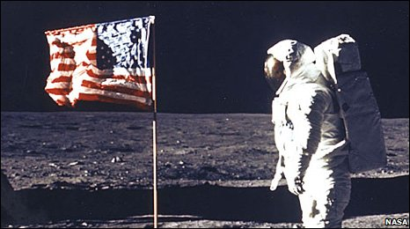
A Little History
Lecture 16 > Section 1 > The Relational Model
Relational model due to Edgar “Ted” Codd, a mathematician at IBM in 1970
A Relational Model of Data for Large Shared Data Banks". Communications of the ACM 13 (6): 377–387
IBM didn’t want to use relational model (take money from IMS)
Apparently used in the moon landing…
Won Turing award 1981
Notes:
IMS apparently used in the moonshot (http://www-01.ibm.com/software/data/ims/benchmark.html) and still boasts high #s

Slide 7
The Relational Model: Schemata
Lecture 16 > Section 1 > The Relational Model
Relational Schema:
Students(sid: string, name: string, gpa: float)
Relation name
String, float, int, etc. are the domains of the attributes
Attributes

Slide 8
The Relational Model: Data
Lecture 16 > Section 1 > The Relational Model
Student
An attribute (or column) is a typed data entry present in each tuple in the relation
sid | name | gpa
001 | Bob | 3.2
002 | Joe | 2.8
003 | Mary | 3.8
004 | Alice | 3.5
The number of attributes is the arity of the relation

Slide 9
The Relational Model: Data
Lecture 16 > Section 1 > The Relational Model
Student
sid | name | gpa
001 | Bob | 3.2
002 | Joe | 2.8
003 | Mary | 3.8
004 | Alice | 3.5
The number of tuples is the cardinality of the relation
A tuple or row (or record) is a single entry in the table having the attributes specified by the schema

Slide 10
The Relational Model: Data
Lecture 16 > Section 1 > The Relational Model
Student
sid | name | gpa
001 | Bob | 3.2
002 | Joe | 2.8
003 | Mary | 3.8
004 | Alice | 3.5
Recall: In practice DBMSs relax the set requirement, and use multisets.
A relational instance is a set of tuples all conforming to the same schema

Slide 11
To Reiterate
Lecture 16 > Section 1 > The Relational Model
A relational schema describes the data that is contained in a relational instance
Let R(f₁:Dom₁,…,f_{m}:Dom_{m}) be a relational schema then,
an instance of R is a subset of Dom₁ x Dom₂ x … x Dom_{n}
In this way, a relational schema R is a total function from attribute names to types

Slide 12
One More Time
Lecture 16 > Section 1 > The Relational Model
A relational schema describes the data that is contained in a relational instance
A relation R of arity t is a function: R : Dom₁ x … x Dom_{t} → {0,1}
I.e. returns whether or not a tuple of matching types is a member of it
Then, the schema is simply the signature of the function
Note here that order matters, attribute name doesn’t…
We’ll (mostly) work with the other model (last slide) in which attribute name matters, order doesn’t!

Slide 13
A relational database
Lecture 16 > Section 1 > The Relational Model
A relational database schema is a set of relational schemata, one for each relation
A relational database instance is a set of relational instances, one for each relation
Two conventions:
We call relational database instances as simply databases
We assume all instances are valid, i.e., satisfy the domain constraints

Slide 14
Remember the CMS
Lecture 16 > Section 1 > The Relational Model
Note that the schemas impose effective domain / type constraints, i.e. Gpa can’t be “Apple”
Relation DB Schema
Students(sid: string, name: string, gpa: float)
Courses(cid: string, cname: string, credits: int)
Enrolled(sid: string, cid: string, grade: string)
Sid | Name | Gpa
101 | Bob | 3.2
123 | Mary | 3.8
Relation Instances
cid | cname | credits
564 | 564-2 | 4
308 | 417 | 2
Students
sid | cid | Grade
123 | 564 | A
Courses
Enrolled

Slide 15
2nd Part of the Model: Querying
Lecture 16 > Section 1 > The Relational Model
SELECT S.name
FROM Students S
WHERE S.gpa > 3.5;
We don’t tell the system how or where to get the data- just what we want, i.e., Querying is declarative
“Find names of all students with GPA > 3.5”
To make this happen, we need to translate the declarative query into a series of operators… we’ll see this next!
Actually, I showed how to do this translation for a much richer language!

Slide 16

Virtues of the model
Lecture 16 > Section 1 > The Relational Model
Physical independence (logical too), Declarative
Simple, elegant clean: Everything is a relation
Why did it take multiple years?
Doubted it could be done efficiently.

Slide 17
Relational Algebra
Lecture 16 > Section 1 > Relational Algebra

Slide 18
RDBMS Architecture
Lecture 16 > Section 1 > Relational Algebra
How does a SQL engine work ?
SQL Query
Relational Algebra (RA) Plan
Optimized RA Plan
Execution
Declarative query (from user)
Translate to relational algebra expresson
Find logically equivalent- but more efficient- RA expression
Execute each operator of the optimized plan!

Slide 19
RDBMS Architecture
Lecture 16 > Section 1 > Relational Algebra
How does a SQL engine work ?
SQL Query
Relational Algebra (RA) Plan
Optimized RA Plan
Execution
Relational Algebra allows us to translate declarative (SQL) queries into precise and optimizable expressions!

Slide 20
Lecture 16 > Section 1 > Relational Algebra
Relational Algebra (RA)
Five basic operators:
Selection: σ
Projection: Π
Cartesian Product: ×
Union: ∪
Difference: -
Derived or auxiliary operators:
Intersection, complement
Joins (natural,equi-join, theta join, semi-join)
Renaming: ρ
Division
We’ll look at these first!
And also at one example of a derived operator (natural join) and a special operator (renaming)

Slide 21
Keep in mind: RA operates on sets!
Lecture 16 > Section 1 > Relational Algebra
RDBMSs use multisets, however in relational algebra formalism we will consider sets!
Also: we will consider the named perspective, where every attribute must have a unique name
→attribute order does not matter…
Now on to the basic RA operators…

Slide 22
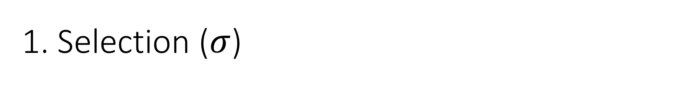

Lecture 16 > Section 1 > Relational Algebra
1. Selection ($σ$)
Students(sid,sname,gpa)
SQL:
Returns all tuples which satisfy a condition
Notation: σ_{c}(R)
Examples
σ_{Salary > 40000} (Employee)
σ_{name = “Smith”} (Employee)
The condition c can be =, <, ≤, >, ≥, <>
SELECT *
FROM Students
WHERE gpa > 3.5;
RA:
$$σ_{gpa >3.5}(Students)$$

Slide 23
Lecture 16 > Section 1 > Relational Algebra
Another example:
SSN | Name | Salary
1234545 | John | 200000
5423341 | Smith | 600000
4352342 | Fred | 500000
σ_{Salary > 40000} (Employee)
SSN | Name | Salary
5423341 | Smith | 600000
4352342 | Fred | 500000

Slide 24
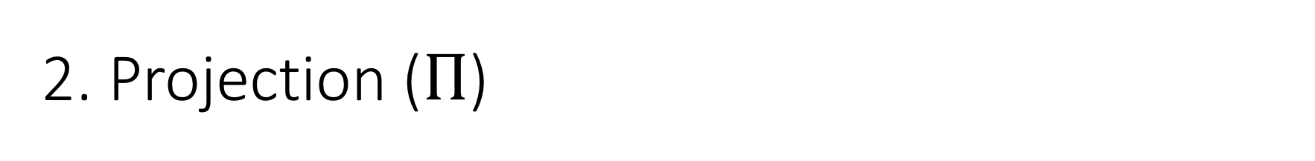

Lecture 16 > Section 1 > Relational Algebra
2. Projection ($Π$)
Students(sid,sname,gpa)
SQL:
Eliminates columns, then removes duplicates
Notation: Π _{A1,…,An} (R)
Example: project social-security number and names:
Π _{SSN, Name} (Employee)
Output schema: Answer(SSN, Name)
SELECT DISTINCT
sname,
gpa
FROM Students;
RA:
$$Π_{sname,gpa}(Students)$$

Slide 25
Lecture 16 > Section 1 > Relational Algebra
SSN | Name | Salary
1234545 | John | 200000
5423341 | John | 600000
4352342 | John | 200000
Another example:
Π _{Name,Salary} (Employee)
Name | Salary
John | 200000
John | 600000

Slide 26
Note that RA Operators are Compositional!
Lecture 16 > Section 1 > Relational Algebra
Students(sid,sname,gpa)
SELECT DISTINCT
sname,
gpa
FROM Students
WHERE gpa > 3.5;
$$Π_{sname,gpa}(σ_{gpa>3.5}(Students))$$
$${σ_{gpa>3.5}(Π}_{sname,gpa}( Students))$$
How do we represent this query in RA?
Are these logically equivalent?

Slide 27


Lecture 16 > Section 1 > Relational Algebra
3. Cross-Product ($×$)
Students(sid,sname,gpa)
People(ssn,pname,address)
SQL:
Each tuple in R1 with each tuple in R2
Notation: R1 × R2
Example:
Employee × Dependents
Rare in practice; mainly used to express joins
SELECT *
FROM Students, People;
RA:
$$Students × People$$

Slide 28


Lecture 16 > Section 1 > Relational Algebra
Another example:
People
Students
ssn | pname | address
1234545 | John | 216 Rosse
5423341 | Bob | 217 Rosse
sid | sname | gpa
001 | John | 3.4
002 | Bob | 1.3
$$×$$
$$Students × People$$
ssn | pname | address | sid | sname | gpa
1234545 | John | 216 Rosse | 001 | John | 3.4
5423341 | Bob | 217 Rosse | 001 | John | 3.4
1234545 | John | 216 Rosse | 002 | Bob | 1.3
5423341 | Bob | 216 Rosse | 002 | Bob | 1.3

Slide 29


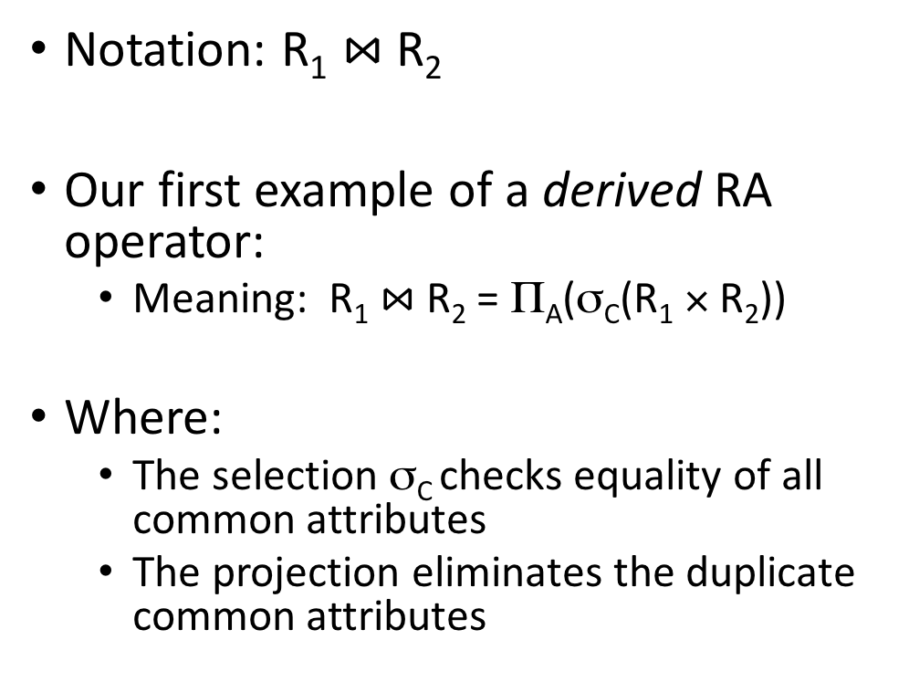
Lecture 16 > Section 1 > Relational Algebra
Natural Join ($⋈$)
Students(sid,name,gpa)
People(ssn,name,address)
SQL:
Notation: R₁ $⋈$R₂
Our first example of a derived RA operator:
Meaning: R₁ $⋈$ R₂ = Π_{A}(σ_{C}(R₁ × R₂))
Where:
The selection σ_{C} checks equality of all common attributes
The projection eliminates the duplicate common attributes
SELECT DISTINCT
ssid, S.name, gpa,
ssn, address
FROM
Students S,
People P
WHERE S.name = P.name;
RA:
$$Students ⋈ People$$

Slide 30


Lecture 16 > Section 1 > Relational Algebra
Another example:
Students S
People P
sid | S.name | gpa
001 | John | 3.4
002 | Bob | 1.3
$$⋈$$
ssn | P.name | address
1234545 | John | 216 Rosse
5423341 | Bob | 217 Rosse
$$Students ⋈People$$
sid | S.name | gpa | ssn | address
001 | John | 3.4 | 1234545 | 216 Rosse
002 | Bob | 1.3 | 5423341 | 216 Rosse

Slide 31
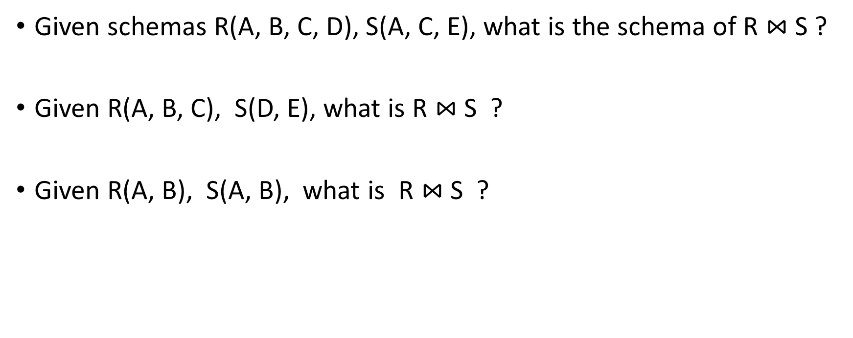
Natural Join
Lecture 16 > Section 1 > Relational Algebra
Given schemas R(A, B, C, D), S(A, C, E), what is the schema of R $⋈$S ?
Given R(A, B, C), S(D, E), what is R $⋈$S ?
Given R(A, B), S(A, B), what is R $⋈$S ?

Slide 32


Lecture 16 > Section 1 > Relational Algebra
Renaming ($ρ$)
Students(sid,sname,gpa)
SQL:
Changes the schema, not the instance
A ‘special’ operator- neither basic nor derived
Notation: ρ _{B1,…,Bn} (R)
Note: this is shorthand for the proper form (since names, not order matters!):
ρ _{A1→B1,…,An→Bn} (R)
SELECT
sid AS studId,
sname AS name,
gpa AS gradePtAvg
FROM Students;
RA:
$$ρ_{studId,name,gradePtAvg}(Students)$$
We care about this operator because we are working in a named perspective

Slide 33
Lecture 16 > Section 1 > Relational Algebra
Another example:
Students
sid | sname | gpa
001 | John | 3.4
002 | Bob | 1.3
$$ρ_{studId,name,gradePtAvg}(Students)$$
Students
studId | name | gradePtAvg
001 | John | 3.4
002 | Bob | 1.3

Slide 34

Example: Converting SFW Query -> RA
Lecture 16 > Section 1 > Relational Algebra
Students(sid,sname,gpa)
People(ssn,sname,address)
SELECT DISTINCT
gpa,
address
FROM Students S,
People P
WHERE gpa > 3.5 AND
sname = pname;
$$Π_{gpa,address}(σ_{gpa>3.5}(S⋈P))$$
How do we represent this query in RA?

Slide 35
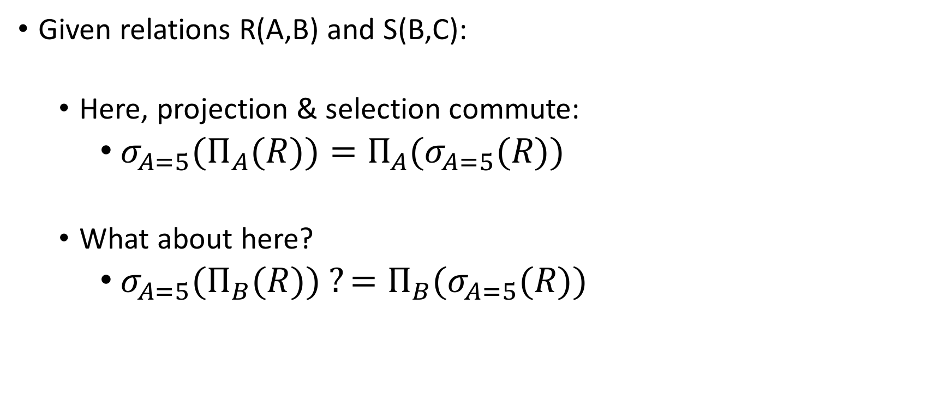
Logical Equivalece of RA Plans
Lecture 16 > Section 1 > Relational Algebra
Given relations R(A,B) and S(B,C):
Here, projection & selection commute:
${σ_{A=5}(Π}_{A}(R))=Π_{A}(σ_{A=5}(R))$
What about here?
${σ_{A=5}(Π}_{B}(R)) ?=Π_{B}(σ_{A=5}(R))$
We’ll look at this in more depth later in the lecture…

Slide 36
RDBMS Architecture
Lecture 16 > Section 1 > Relational Algebra
How does a SQL engine work ?
SQL Query
Relational Algebra (RA) Plan
Optimized RA Plan
Execution
We saw how we can transform declarative SQL queries into precise, compositional RA plans

Slide 37
RDBMS Architecture
Lecture 16 > Section 1 > Relational Algebra
How does a SQL engine work ?
SQL Query
Relational Algebra (RA) Plan
Optimized RA Plan
Execution
We’ll look at how to then optimize these plans later in this lecture

Slide 38
RDBMS Architecture
Lecture 16 > Section 1 > Relational Algebra
How is the RA “plan” executed?
SQL Query
Relational Algebra (RA) Plan
Optimized RA Plan
Execution
We already know how to execute all the basic operators!

Slide 39
RA Plan Execution
Lecture 16 > Section 1 > Relational Algebra
Natural Join / Join:
We saw how to use memory & IO cost considerations to pick the correct algorithm to execute a join with (BNLJ, SMJ, HJ…)!
Selection:
We saw how to use indexes to aid selection
Can always fall back on scan / binary search as well
Projection:
The main operation here is finding distinct values of the project tuples; we briefly discussed how to do this with e.g. hashing or sorting
We already know how to execute all the basic operators!

Slide 40
Activity-16-1.ipynb
Lecture 16 > Section 1 > ACTIVITY

Slide 41
2. Optimization of RA Plans
Lecture 16 > Section 2

Slide 42
What you will learn about in this section
Lecture 16 > Section 2
Optimization of RA Plans
ACTIVITY: RA Plan Optimization

Slide 43
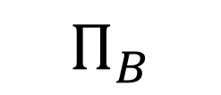

Note: We can visualize the plan as a tree
Lecture 16 > Section 2 > Optimization of RA plans
$Π_{B}$
$$Π_{B}(R\left(A,B\right)⋈S\left(B,C\right))$$
R(A,B)
S(B,C)
“bottom-up evaluation”

Slide 44
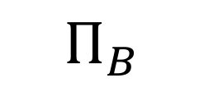
A simple plan
Lecture 16 > Section 2 > Optimization of RA plans
$Π_{B}$
What SQL query does this correspond to?
Are there any logically equivalent RA expressions?
R(A,B)
S(B,C)

Slide 45
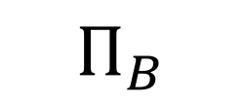
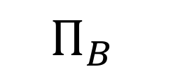
“Pushing down” projection
Lecture 16 > Section 2 > Optimization of RA plans
$Π_{B}$
$Π_{B}$
$$Π_{B}$$
R(A,B)
S(B,C)
R(A,B)
S(B,C)
Why might we prefer this plan?

Slide 46
Takeaways
Lecture 16 > Section 2 > Optimization of RA plans
This process is called logical optimization
Many equivalent plans used to search for “good plans”
Relational algebra is an important abstraction.

Slide 47
RA commutators
Lecture 16 > Section 2 > Optimization of RA plans
The basic commutators:
Push projection through (1) selection, (2) join
Push selection through (3) selection, (4) projection, (5) join
Also: Joins an be re-ordered!
Note that this is not an exhaustive set of operations
This covers local re-writes; global re-writes possible but much harder
This simple set of tools allows us to greatly improve the execution time of queries by optimizing RA plans!

Slide 48
Optimizing the SFW RA Plan
Lecture 16 > Section 2 > Optimization of RA plans

Slide 49

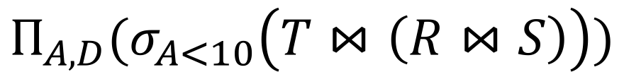
Translating to RA
Lecture 16 > Section 2 > Optimization of RA plans
R(A,B) S(B,C) T(C,D)
$$Π_{A,D}$$
SELECT DISTINCT R.A,S.D
FROM R,S,T
WHERE R.B = S.B
AND S.C = T.C
AND R.A < 10;
σ_{Α<10}
T(C,D)
R(A,B)
S(B,C)
$$Π_{A,D}(σ_{A<10}\left(T⋈\left(R⋈S\right)\right))$$

Slide 50
Logical Optimization
Lecture 16 > Section 2 > Optimization of RA plans
Heuristically, we want selections and projections to occur as early as possible in the plan
Terminology: “push down selections” and “pushing down projections.”
Intuition: We will have fewer tuples in a plan.
Could fail if the selection condition is very expensive (say runs some image processing algorithm).
Projection could be a waste of effort, but more rarely.

Slide 51
Optimizing RA Plan
Lecture 16 > Section 2 > Optimization of RA plans
Push down selection on A so it occurs earlier
R(A,B) S(B,C) T(C,D)
$$Π_{A,D}$$
SELECT DISTINCT R.A,S.D
FROM R,S,T
WHERE R.B = S.B
AND S.C = T.C
AND R.A < 10;
σ_{Α<10}
T(C,D)
R(A,B)
S(B,C)
$$Π_{A,D}(σ_{A<10}\left(T⋈\left(R⋈S\right)\right))$$

Slide 52

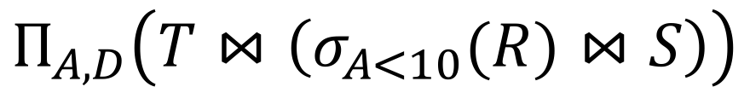
Optimizing RA Plan
Lecture 16 > Section 2 > Optimization of RA plans
Push down selection on A so it occurs earlier
R(A,B) S(B,C) T(C,D)
SELECT DISTINCT R.A,S.D
FROM R,S,T
WHERE R.B = S.B
AND S.C = T.C
AND R.A < 10;
$$Π_{A,D}$$
T(C,D)
σ_{Α<10}
S(B,C)
$$Π_{A,D}\left(T⋈\left(σ_{A<10}(R)⋈S\right)\right)$$
R(A,B)

Slide 53
Optimizing RA Plan
Lecture 16 > Section 2 > Optimization of RA plans
Push down projection so it occurs earlier
R(A,B) S(B,C) T(C,D)
SELECT DISTINCT R.A,S.D
FROM R,S,T
WHERE R.B = S.B
AND S.C = T.C
AND R.A < 10;
$$Π_{A,D}$$
T(C,D)
σ_{Α<10}
S(B,C)
$$Π_{A,D}\left(T⋈\left(σ_{A<10}(R)⋈S\right)\right)$$
R(A,B)

Slide 54
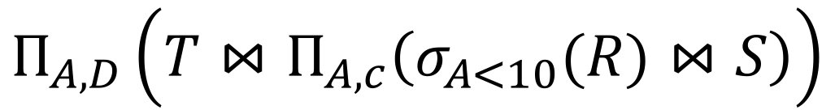


Optimizing RA Plan
Lecture 16 > Section 2 > Optimization of RA plans
We eliminate B earlier!
R(A,B) S(B,C) T(C,D)
In general, when is an attribute not needed…?
$$Π_{A,D}$$
SELECT DISTINCT R.A,S.D
FROM R,S,T
WHERE R.B = S.B
AND S.C = T.C
AND R.A < 10;
$$Π_{A,C}$$
T(C,D)
$$Π_{A,D}\left(T⋈Π_{A,c}\left(σ_{A<10}(R)⋈S\right)\right)$$
σ_{Α<10}
S(B,C)
R(A,B)

Slide 55
Activity-16-2.ipynb
Lecture 16 > Section 3 > ACTIVITY

Slide 56
3. Adv. Relational Algebra
Lecture 16 > Section 3

Slide 57
What you will learn about in this section
Lecture 16 > Section 3
Set Operations in RA
Fancier RA
Extensions & Limitations

Slide 58
Lecture 16 > Section 3
Relational Algebra (RA)
Five basic operators:
Selection: σ
Projection: Π
Cartesian Product: ×
Union: ∪
Difference: -
Derived or auxiliary operators:
Intersection, complement
Joins (natural,equi-join, theta join, semi-join)
Renaming: ρ
Division
We’ll look at these
And also at some of these derived operators

Slide 59
1. Union (∪) and 2. Difference (–)
Lecture 16 > Section 3 > Set Operations
R1 ∪ R2
Example:
ActiveEmployees ∪ RetiredEmployees
R1 – R2
Example:
AllEmployees -- RetiredEmployees
R₁
R₂
R₁
R₂

Slide 60
What about Intersection (∩) ?
Lecture 16 > Section 3 > Set Operations
It is a derived operator
R1 ∩ R2 = R1 – (R1 – R2)
Also expressed as a join!
Example
UnionizedEmployees ∩ RetiredEmployees
R₁
R₂

Slide 61
Fancier RA
Lecture 16 > Section 3 > Fancier RA

Slide 62



Theta Join ($⋈$_{θ})
Lecture 16 > Section 3 > Fancier RA
Students(sid,sname,gpa)
People(ssn,pname,address)
SQL:
A join that involves a predicate
R1 $⋈$_{θ} R2 = σ _{θ} (R1 × R2)
Here θ can be any condition
SELECT *
FROM
Students,People
WHERE θ;
Note that natural join is a theta join + a projection.
RA:
$$Students ⋈_{θ} People$$

Slide 63


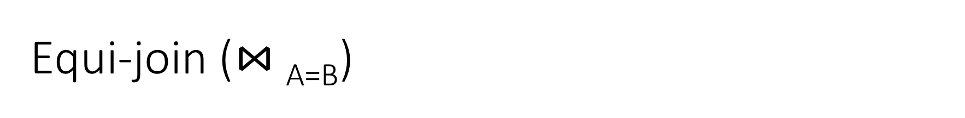
Equi-join ($⋈$_{A=B})
Lecture 16 > Section 3 > Fancier RA
Students(sid,sname,gpa)
People(ssn,pname,address)
SQL:
A theta join where θ is an equality
R1 $⋈$_{A=B} R2 = σ _{A=B} (R1 × R2)
Example:
Employee $⋈$_{SSN=SSN} Dependents
SELECT *
FROM
Students S,
People P
WHERE sname = pname;
Most common join in practice!
RA:
$$S ⋈_{sname=pname} P$$

Slide 64



Semijoin ($⋉$)
Lecture 16 > Section 3 > Fancier RA
Students(sid,sname,gpa)
People(ssn,pname,address)
SQL:
R $⋉$ S = Π _{A1,…,An} (R $⋈$ S)
Where A₁, …, A_{n} are the attributes in R
Example:
Employee $⋉$Dependents
SELECT DISTINCT
sid,sname,gpa
FROM
Students,People
WHERE
sname = pname;
RA:
$$Students⋉People$$

Slide 65
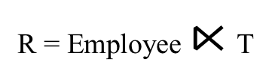
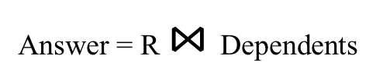
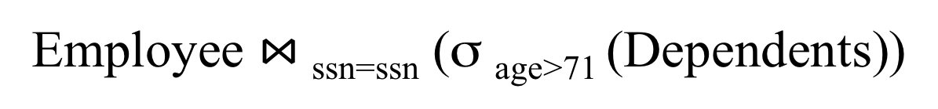
Semijoins in Distributed Databases
Lecture 16 > Section 3 > Fancier RA
Semijoins are often used to compute natural joins in distributed databases
Dependents
Employee
SSN | Dname | Age
. . . |  | . . .
SSN | Name
. . . | . . .
network
Employee $⋈$_{ssn=ssn} (σ _{age>71} (Dependents))
Send less data to reduce network bandwidth!
T = Π _{SSN} σ _{age>71} (Dependents)
R = Employee $⋉$T
Answer = R $⋈$Dependents

Slide 66
RA Expressions Can Get Complex!
Lecture 16 > Section 3 > Fancier RA
Π _{name}
buyer-ssn=ssn
pid=pid
seller-ssn=ssn
Π _{ssn}
Π _{pid}
σ_{name=fred}
σ_{name=gizmo}
Person Purchase Person Product

Slide 67
Multisets
Lecture 16 > Section 3 > Extensions & Limitations

Slide 68

Recall that SQL uses Multisets
Lecture 16 > Section 3 > Extensions & Limitations
$λ\left(X\right)$= “Count of tuple in X”
(Items not listed have implicit count 0)
Multiset X
Tuple
(1, a)
(1, a)
(1, b)
(2, c)
(2, c)
(2, c)
(1, d)
(1, d)
Multiset X
Tuple | $$λ(X)$$
(1, a) | 2
(1, b) | 1
(2, c) | 3
(1, d) | 2
Equivalent Representations of a Multiset
Note: In a set all counts are {0,1}.

Slide 69
Generalizing Set Operations to Multiset Operations
Lecture 16 > Section 3 > Extensions & Limitations
Multiset X
Multiset Y
Multiset Z
Tuple | $$λ(X)$$
(1, a) | 2
(1, b) | 0
(2, c) | 3
(1, d) | 0
Tuple | $$λ(Y)$$
(1, a) | 5
(1, b) | 1
(2, c) | 2
(1, d) | 2
Tuple | $$λ(Z)$$
(1, a) | 2
(1, b) | 0
(2, c) | 2
(1, d) | 0
$$∩$$
$$=$$
For sets, this is intersection
$$λ\left(Z\right)=min(λ\left(X\right),λ\left(Y\right))$$

Slide 70

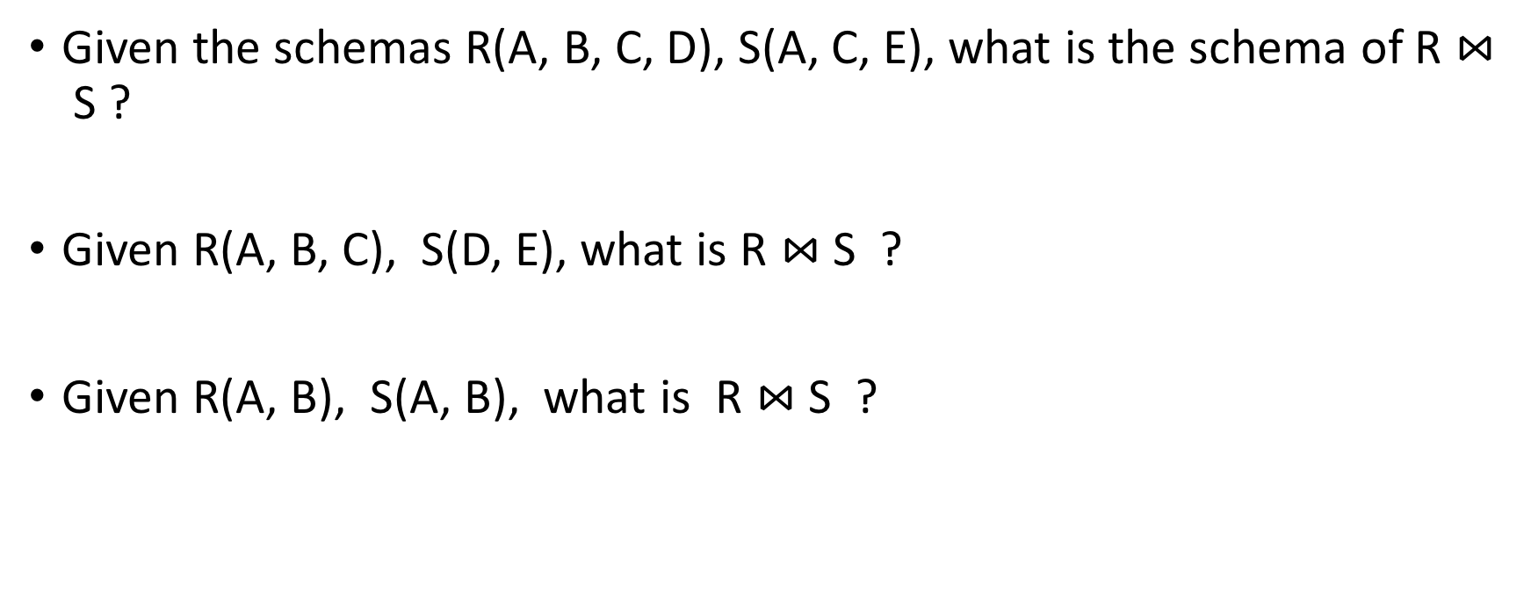
Generalizing Set Operations to Multiset Operations
Lecture 16 > Section 3 > Extensions & Limitations
Multiset X
Multiset Y
Multiset Z
Tuple | $$λ(X)$$
(1, a) | 2
(1, b) | 0
(2, c) | 3
(1, d) | 0
Tuple | $$λ(Y)$$
(1, a) | 5
(1, b) | 1
(2, c) | 2
(1, d) | 2
Tuple | $$λ(Z)$$
(1, a) | 7
(1, b) | 1
(2, c) | 5
(1, d) | 2
$$∪$$
$$=$$
For sets,
this is union
$$λ\left(Z\right)=λ\left(X\right)+ λ\left(Y\right)$$

Slide 71
Operations on Multisets
Lecture 16 > Section 3 > Extensions & Limitations
All RA operations need to be defined carefully on bags
σ_{C}(R): preserve the number of occurrences
Π_{A}(R): no duplicate elimination
Cross-product, join: no duplicate elimination
This is important- relational engines work on multisets, not sets!

Slide 72
RA has Limitations !
Lecture 16 > Section 3 > Extensions & Limitations
Cannot compute “transitive closure”
Find all direct and indirect relatives of Fred
Cannot express in RA !!!
Need to write C program, use a graph engine, or modern SQL…
Name1 | Name2 | Relationship
Fred | Mary | Father
Mary | Joe | Cousin
Mary | Bill | Spouse
Nancy | Lou | Sister

