Slide 1
Lectures 5 & 7: Design Theory
Lectures 5 & 7

Slide 2
Lecture 5: Design Theory I
Lecture 5

Slide 3
Today’s Lecture
Lecture 5
Normal forms & functional dependencies
ACTIVITY: Finding FDs
Finding functional dependencies
ACTIVITY: Compute the closures
Closures, superkeys & keys
ACTIVITY: The key or a key?

Slide 4
1. Normal forms & functional dependencies
Lecture 5 > Section 1

Slide 5
What you will learn about in this section
Lecture 5 > Section 1
Overview of design theory & normal forms
Data anomalies & constraints
Functional dependencies
ACTIVITY: Finding FDs

Slide 6
Design Theory
Lecture 5 > Section 1 > Overview
Design theory is about how to represent your data to avoid anomalies.
It is a mostly mechanical process
Tools can carry out routine portions
We have a notebook implementing all algorithms!
We’ll play with it in the activities!

Slide 7
Normal Forms
Lecture 5 > Section 1 > Overview
1st Normal Form (1NF) = All tables are flat
2nd Normal Form = disused
Boyce-Codd Normal Form (BCNF)
3rd Normal Form (3NF)
4th and 5th Normal Forms = see text books
DB designs based on functional dependencies, intended to prevent data anomalies
Our focus in this lecture + next one

Slide 8
1st Normal Form (1NF)
Lecture 5 > Section 1 > Overview
Student | Courses
Mary | CS145
Mary | CS229
Joe | CS145
Joe | CS106
Student | Courses
Mary | {CS145,CS229}
Joe | {CS145,CS106}
… | …
Violates 1NF.
In 1st NF
1NF Constraint: Types must be atomic!

Slide 9
Data Anomalies & Constraints
Lecture 5 > Section 1 > Data anomalies & constraints

Slide 10
Constraints Prevent (some) Anomalies in the Data
Lecture 5 > Section 1 > Data anomalies & constraints
A poorly designed database causes anomalies:
Student | Course | Room
Mary | CS145 | B01
Joe | CS145 | B01
Sam | CS145 | B01
.. | .. | ..
If every course is in only one room, contains redundant information!

Slide 11
Constraints Prevent (some) Anomalies in the Data
Lecture 5 > Section 1 > Data anomalies & constraints
A poorly designed database causes anomalies:
Student | Course | Room
Mary | CS145 | B01
Joe | CS145 | C12
Sam | CS145 | B01
.. | .. | ..
If we update the room number for one tuple, we get inconsistent data = an update anomaly

Slide 12
Constraints Prevent (some) Anomalies in the Data
Lecture 5 > Section 1 > Data anomalies & constraints
A poorly designed database causes anomalies:
Student | Course | Room
.. | .. | ..
If everyone drops the class, we lose what room the class is in! = a delete anomaly

Slide 13
Constraints Prevent (some) Anomalies in the Data
Lecture 5 > Section 1 > Data anomalies & constraints
A poorly designed database causes anomalies:
Student | Course | Room
Mary | CS145 | B01
Joe | CS145 | B01
Sam | CS145 | B01
.. | .. | ..
Similarly, we can’t reserve a room without students = an insert anomaly
… | CS229 | C12

Slide 14
Constraints Prevent (some) Anomalies in the Data
Lecture 5 > Section 1 > Data anomalies & constraints
Student | Course
Mary | CS145
Joe | CS145
Sam | CS145
.. | ..
Is this form better?
Redundancy?
Update anomaly?
Delete anomaly?
Insert anomaly?
Course | Room
CS145 | B01
CS229 | C12
Today: develop theory to understand why this design may be better and how to find this decomposition…

Slide 15
Functional Dependencies
Lecture 5 > Section 1 > Functional dependencies

Slide 16
Functional Dependency
Lecture 5 > Section 1 > Functional dependencies
Def: Let A,B be sets of attributes
We write A → B or say A functionally determines B if, for any tuples t₁ and t₂:
t₁[A] = t₂[A] implies t₁[B] = t₂[B]
and we call A → B a functional dependency
A->B means that
“whenever two tuples agree on A then they agree on B.”

Slide 17
A Picture Of FDs
Lecture 5 > Section 1 > Functional dependencies
Defn (again):
Given attribute sets A={A₁,…,A_{m}} and B = {B₁,…B_{n}} in R,
 | A₁ | … | A_{m} |  | B₁ | … | B_{n}

Slide 18
A Picture Of FDs
Lecture 5 > Section 1 > Functional dependencies
Defn (again):
Given attribute sets A={A₁,…,A_{m}} and B = {B₁,…B_{n}} in R,
The functional dependency A→ B on R holds if for any t_{i},t_{j} in R:
 | A₁ | … | A_{m} |  | B₁ | … | B_{n}
t_{i}
t_{j}

Slide 19
A Picture Of FDs
Lecture 5 > Section 1 > Functional dependencies
Defn (again):
Given attribute sets A={A₁,…,A_{m}} and B = {B₁,…B_{n}} in R,
The functional dependency A→ B on R holds if for any t_{i},t_{j} in R:
t_{i}[A₁] = t_{j}[A₁] AND t_{i}[A₂]=t_{j}[A₂] AND … AND t_{i}[A_{m}] = t_{j}[A_{m}]
 | A₁ | … | A_{m} |  | B₁ | … | B_{n}
t_{i}
t_{j}
If t1,t2 agree here..

Slide 20
A Picture Of FDs
Lecture 5 > Section 1 > Functional dependencies
Defn (again):
Given attribute sets A={A₁,…,A_{m}} and B = {B₁,…B_{n}} in R,
The functional dependency A→ B on R holds if for any t_{i},t_{j} in R:
if t_{i}[A₁] = t_{j}[A₁] AND t_{i}[A₂]=t_{j}[A₂] AND … AND t_{i}[A_{m}] = t_{j}[A_{m}]
then t_{i}[B₁] = t_{j}[B₁] AND t_{i}[B₂]=t_{j}[B₂] AND … AND t_{i}[B_{m}] = t_{j}[B_{n}]
 | A₁ | … | A_{m} |  | B₁ | … | B_{n}
t_{i}
t_{j}
If t1,t2 agree here..
…they also agree here!

Slide 21
FDs for Relational Schema Design
Lecture 5 > Section 1 > Functional dependencies
High-level idea: why do we care about FDs?
Start with some relational schema
Find out its functional dependencies (FDs)
Use these to design a better schema
One which minimizes possibility of anomalies

Slide 22
Functional Dependencies as Constraints
Lecture 5 > Section 1
Student | Course | Room
Mary | CS145 | B01
Joe | CS145 | B01
Sam | CS145 | B01
.. | .. | ..
A functional dependency is a form of constraint
Holds on some instances not others.
Part of the schema, helps define a valid instance.
Note: The FD {Course} -> {Room} holds on this instance
Recall: an instance of a schema is a multiset of tuples conforming to that schema, i.e. a table

Slide 23
Functional Dependencies as Constraints
Lecture 5 > Section 1
Note that:
You can check if an FD is violated by examining a single instance;
However, you cannot prove that an FD is part of the schema by examining a single instance.
This would require checking every valid instance
Student | Course | Room
Mary | CS145 | B01
Joe | CS145 | B01
Sam | CS145 | B01
.. | .. | ..
However, cannot prove that the FD {Course} -> {Room} is part of the schema

Slide 24
More Examples
Lecture 5 > Section 1 > Functional dependencies
An FD is a constraint which holds, or does not hold on an instance:
EmpID | Name | Phone | Position
E0045 | Smith | 1234 | Clerk
E3542 | Mike | 9876 | Salesrep
E1111 | Smith | 9876 | Salesrep
E9999 | Mary | 1234 | Lawyer

Slide 25
More Examples
Lecture 5 > Section 1 > Functional dependencies
EmpID | Name | Phone | Position
E0045 | Smith | 1234 | Clerk
E3542 | Mike | 9876 ← | Salesrep
E1111 | Smith | 9876 ← | Salesrep
E9999 | Mary | 1234 | Lawyer
{Position} → {Phone}

Slide 26
More Examples
Lecture 5 > Section 1 > Functional dependencies
EmpID | Name | Phone | Position
E0045 | Smith | 1234 → | Clerk
E3542 | Mike | 9876 | Salesrep
E1111 | Smith | 9876 | Salesrep
E9999 | Mary | 1234 → | Lawyer
but not {Phone} → {Position}

Slide 27
ACTIVITY
Lecture 5 > Section 1 > ACTIVITY
Student ID | Last Name | First Name | Dorm | Year | SSN | Birth Year
0001 | Smith | Bob | Rains | I | 1234 | 1997
0002 | Bobson | Sally | Lomeda | II | 2367 | 1998
0003 | Smith | John | Rains | III | 1235 | 1999
0004 | Martin | Sally | Escondido | IV | 2345 | 2000
Which FDs do not hold (i.e. are violated)?
Which FDs hold on this instance?
Which FDs might you expect to hold in general?

Slide 28
2. Finding functional dependencies
Lecture 5 > Section 2

Slide 29
What you will learn about in this section
Lecture 5 > Section 2
“Good” vs. “Bad” FDs: Intuition
Finding FDs
Closures
ACTIVITY: Compute the closures

Slide 30
“Good” vs. “Bad” FDs
Lecture 5 > Section 2 > Good vs. Bad FDs
We can start to develop a notion of good vs. bad FDs:
EmpID | Name | Phone | Position
E0045 | Smith | 1234 | Clerk
E3542 | Mike | 9876 | Salesrep
E1111 | Smith | 9876 | Salesrep
E9999 | Mary | 1234 | Lawyer
Intuitively:
EmpID -> Name, Phone, Position is “good FD”
Minimal redundancy, less possibility of anomalies

Slide 31
“Good” vs. “Bad” FDs
Lecture 5 > Section 2 > Good vs. Bad FDs
We can start to develop a notion of good vs. bad FDs:
EmpID | Name | Phone | Position
E0045 | Smith | 1234 | Clerk
E3542 | Mike | 9876 | Salesrep
E1111 | Smith | 9876 | Salesrep
E9999 | Mary | 1234 | Lawyer
Intuitively:
EmpID -> Name, Phone, Position is “good FD”
But Position -> Phone is a “bad FD”
Redundancy! Possibility of data anomalies

Slide 32
“Good” vs. “Bad” FDs
Lecture 5 > Section 2 > Good vs. Bad FDs
Student | Course | Room
Mary | CS145 | B01
Joe | CS145 | B01
Sam | CS145 | B01
.. | .. | ..
Returning to our original example… can you see how the “bad FD” {Course} -> {Room} could lead to an:
Update Anomaly
Insert Anomaly
Delete Anomaly
…
Given a set of FDs (from user) our goal is to:
Find all FDs, and
Eliminate the “Bad Ones".

Slide 33
FDs for Relational Schema Design
Lecture 5 > Section 2 > Finding FDs
High-level idea: why do we care about FDs?
Start with some relational schema
Find out its functional dependencies (FDs)
Use these to design a better schema
One which minimizes possibility of anomalies
This part can be tricky!

Slide 34
Finding Functional Dependencies
Lecture 5 > Section 2 > Finding FDs
There can be a very large number of FDs…
How to find them all efficiently?
We can’t necessarily show that any FD will hold on all instances…
How to do this?
We will start with this problem:
Given a set of FDs, F, what other FDs must hold?

Slide 35
Finding Functional Dependencies
Lecture 5 > Section 2 > Finding FDs
Equivalent to asking: Given a set of FDs, F = {f₁,…f_{n}}, does an FD g hold?
Inference problem: How do we decide?

Slide 36
Finding Functional Dependencies
Lecture 5 > Section 2 > Finding FDs
Example:
Products
Provided FDs:
Name | Color | Category | Dep | Price
Gizmo | Green | Gadget | Toys | 49
Widget | Black | Gadget | Toys | 59
Gizmo | Green | Whatsit | Garden | 99
1. {Name} → {Color}
2. {Category} → {Department}
3. {Color, Category} → {Price}
Given the provided FDs, we can see that {Name, Category} → {Price} must also hold on any instance…
Which / how many other FDs do?!?

Slide 37
Finding Functional Dependencies
Lecture 5 > Section 2 > Finding FDs
Equivalent to asking: Given a set of FDs, F = {f₁,…f_{n}}, does an FD g hold?
Inference problem: How do we decide?
Answer: Three simple rules called Armstrong’s Rules.
Split/Combine,
Reduction, and
Transitivity… ideas by picture

Slide 38
1. Split/Combine
Lecture 5 > Section 2 > Finding FDs
 | A₁ | … | A_{m} |  | B₁ | … | B_{n}
A₁, …, A_{m} → B₁,…,B_{n}

Slide 39
1. Split/Combine
Lecture 5 > Section 2 > Finding FDs
 | A₁ | … | A_{m} |  | B₁ | … | B_{n}
A₁, …, A_{m} → B₁,…,B_{n}
… is equivalent to the following n FDs…
A₁,…,A_{m} → B_{i} for i=1,…,n

Slide 40
1. Split/Combine
Lecture 5 > Section 2 > Finding FDs
 | A₁ | … | A_{m} |  | B₁ | … | B_{n}
And vice-versa, A₁,…,A_{m} → B_{i} for i=1,…,n
… is equivalent to …
A₁, …, A_{m} → B₁,…,B_{n}

Slide 41
Reduction/Trivial
Lecture 5 > Section 2 > Finding FDs
 | A₁ | … | A_{m}
A₁,…,A_{m} → A_{j} for any j=1,…,m

Slide 42
3. Transitive Closure
Lecture 5 > Section 2 > Finding FDs
 | A₁ | … | A_{m} |  | B₁ | … | B_{n} |  | C₁ | … | C_{k}
A₁, …, A_{m} → B₁,…,B_{n} and
B₁,…,B_{n} → C₁,…,C_{k}

Slide 43
3. Transitive Closure
Lecture 5 > Section 2 > Finding FDs
 | A₁ | … | A_{m} |  | B₁ | … | B_{n} |  | C₁ | … | C_{k}
A₁, …, A_{m} → B₁,…,B_{n} and
B₁,…,B_{n} → C₁,…,C_{k}
implies
A₁,…,A_{m} → C₁,…,C_{k}

Slide 44
Finding Functional Dependencies
Lecture 5 > Section 2 > Finding FDs
Example:
Products
Provided FDs:
Name | Color | Category | Dep | Price
Gizmo | Green | Gadget | Toys | 49
Widget | Black | Gadget | Toys | 59
Gizmo | Green | Whatsit | Garden | 99
1. {Name} → {Color}
2. {Category} → {Department}
3. {Color, Category} → {Price}
Which / how many other FDs hold?

Slide 45
Finding Functional Dependencies
Lecture 5 > Section 2 > Finding FDs
Example:
Inferred FDs:
Provided FDs:
Inferred FD | Rule used
4. {Name, Category} -> {Name} | ?
5. {Name, Category} -> {Color} | ?
6. {Name, Category} -> {Category} | ?
7. {Name, Category -> {Color, Category} | ?
8. {Name, Category} -> {Price} | ?
1. {Name} → {Color}
2. {Category} → {Dept.}
3. {Color, Category} → {Price}
Which / how many other FDs hold?

Slide 46
Finding Functional Dependencies
Lecture 5 > Section 2 > Finding FDs
Example:
Inferred FDs:
Provided FDs:
Inferred FD | Rule used
4. {Name, Category} -> {Name} | Trivial
5. {Name, Category} -> {Color} | Transitive (4 -> 1)
6. {Name, Category} -> {Category} | Trivial
7. {Name, Category -> {Color, Category} | Split/combine (5 + 6)
8. {Name, Category} -> {Price} | Transitive (7 -> 3)
1. {Name} → {Color}
2. {Category} → {Dept.}
3. {Color, Category} → {Price}
Can we find an algorithmic way to do this?

Slide 47
Closures
Lecture 5 > Section 2 > Closures

Slide 48
Closure of a set of Attributes
Lecture 5 > Section 2 > Closures
Given a set of attributes A₁, …, A_{n} and a set of FDs F:
Then the closure, {A₁, …, A_{n}}⁺ is the set of attributes B s.t. {A₁, …, A_{n}} → B
Example: F =
{name} → {color}
{category} → {department}
{color, category} → {price}
Example Closures:
{name}⁺ → {name, color}
{name, category}⁺ →
{name, category, color, dept, price}
{color}⁺ → {color}

Slide 49
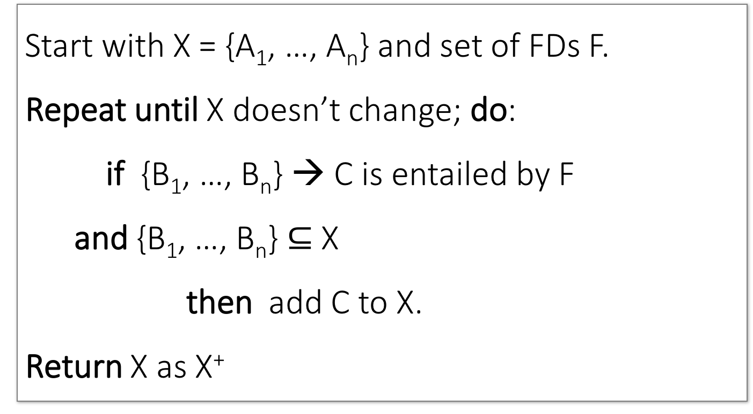
Closure Algorithm
Lecture 5 > Section 2 > Closures
Start with X = {A₁, …, A_{n}} and set of FDs F.
Repeat until X doesn’t change; do:
if {B₁, …, B_{n}} → C is entailed by F
and {B₁, …, B_{n}} $⊆$ X
then add C to X.
Return X as X⁺

Slide 50
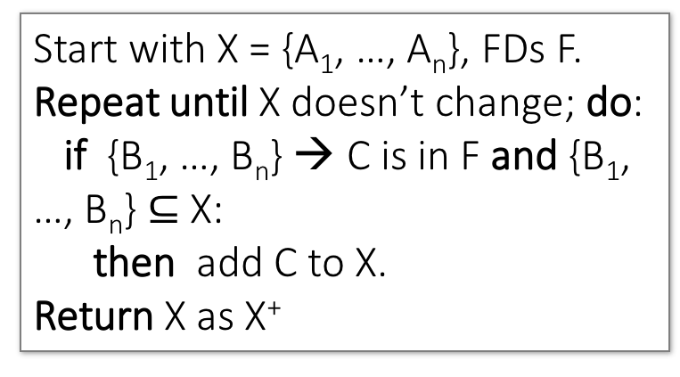
Closure Algorithm
Lecture 5 > Section 2 > Closures
Start with X = {A₁, …, A_{n}}, FDs F.
Repeat until X doesn’t change; do:
if {B₁, …, B_{n}} → C is in F and {B₁, …, B_{n}} $⊆$ X:
then add C to X.
Return X as X⁺
{name, category}⁺ →
{name, category}
F =
{name} → {color}
{category} → {dept}
{color, category} → {price}

Slide 51
Closure Algorithm
Lecture 5 > Section 2 > Closures
Start with X = {A₁, …, A_{n}}, FDs F.
Repeat until X doesn’t change; do:
if {B₁, …, B_{n}} → C is in F and {B₁, …, B_{n}} $⊆$ X:
then add C to X.
Return X as X⁺
{name, category}⁺ →
{name, category}
{name, category}⁺ →
{name, category, color}
F =
{name} → {color}
{category} → {dept}
{color, category} → {price}

Slide 52
Closure Algorithm
Lecture 5 > Section 2 > Closures
Start with X = {A₁, …, A_{n}}, FDs F.
Repeat until X doesn’t change; do:
if {B₁, …, B_{n}} → C is in F and {B₁, …, B_{n}} $⊆$ X:
then add C to X.
Return X as X⁺
{name, category}⁺ →
{name, category}
{name, category}⁺ →
{name, category, color}
F =
{name, category}⁺ →
{name, category, color, dept}
{name} → {color}
{category} → {dept}
{color, category} → {price}

Slide 53
Closure Algorithm
Lecture 5 > Section 2 > Closures
Start with X = {A₁, …, A_{n}}, FDs F.
Repeat until X doesn’t change; do:
if {B₁, …, B_{n}} → C is in F and {B₁, …, B_{n}} $⊆$ X:
then add C to X.
Return X as X⁺
{name, category}⁺ →
{name, category}
{name, category}⁺ →
{name, category, color}
F =
{name, category}⁺ →
{name, category, color, dept}
{name} → {color}
{category} → {dept}
{color, category} → {price}
{name, category}⁺ →
{name, category, color, dept, price}

Slide 54
Example
Lecture 5 > Section 2 > Closures
R(A,B,C,D,E,F)
{A,B} → {C}
{A,D} → {E}
{B} → {D}
{A,F} → {B}
Compute {A,B}⁺ = {A, B, }
Compute {A, F}⁺ = {A, F, }

Slide 55
Example
Lecture 5 > Section 2 > Closures
R(A,B,C,D,E,F)
{A,B} → {C}
{A,D} → {E}
{B} → {D}
{A,F} → {B}
Compute {A,B}⁺ = {A, B, C, D }
Compute {A, F}⁺ = {A, F, B }

Slide 56
Example
Lecture 5 > Section 2 > Closures
R(A,B,C,D,E,F)
{A,B} → {C}
{A,D} → {E}
{B} → {D}
{A,F} → {B}
Compute {A,B}⁺ = {A, B, C, D, E}
Compute {A, F}⁺ = {A, B, C, D, E, F}

Slide 57
Activity-5-2.ipynb
Lecture 5 > Section 2 > ACTIVITY

Slide 58
3. Closures, Superkeys & Keys
Lecture 5 > Section 3

Slide 59
What you will learn about in this section
Lecture 5 > Section 3
Closures Pt. II
Superkeys & Keys
ACTIVITY: The key or a key?

Slide 60
Why Do We Need the Closure?
Lecture 5 > Section 3 > Closures Pt. II
With closure we can find all FD’s easily
To check if X → A
Compute X⁺
Check if A ∈ X⁺
Note here that X is a set of attributes, but A is a single attribute. Why does considering FDs of this form suffice?
Recall the Split/combine rule:
X → A₁, …, X → A_{n}
implies
X → {A₁, …, A_{n}}

Slide 61
Using Closure to Infer ALL FDs
Lecture 5 > Section 3 > Closures Pt. II
Example:
Given F =
{A,B} → C {A,D} → B
{B} → D
Step 1: Compute X⁺, for every X:
{A}⁺ = {A}
{B}⁺ = {B,D}
{C}⁺ = {C}
{D}⁺ = {D}
{A,B}⁺ = {A,B,C,D}
{A,C}⁺ = {A,C}
{A,D}⁺ = {A,B,C,D}
{A,B,C}⁺ = {A,B,D}⁺ = {A,C,D}⁺ = {A,B,C,D} {B,C,D}⁺ = {B,C,D}
{A,B,C,D}⁺ = {A,B,C,D}
No need to compute these- why?

Slide 62
Using Closure to Infer ALL FDs
Lecture 5 > Section 3 > Closures Pt. II
Example:
Given F =
{A,B} → C {A,D} → B
{B} → D
Step 1: Compute X⁺, for every X:
{A}⁺ = {A}, {B}⁺ = {B,D}, {C}⁺ = {C}, {D}⁺ = {D}, {A,B}⁺ = {A,B,C,D}, {A,C}⁺ = {A,C}, {A,D}⁺ = {A,B,C,D}, {A,B,C}⁺ = {A,B,D}⁺ = {A,C,D}⁺ = {A,B,C,D}, {B,C,D}⁺ = {B,C,D}, {A,B,C,D}⁺ = {A,B,C,D}
Step 2: Enumerate all FDs X → Y, s.t. Y ⊆ X⁺ and X ∩ Y = ∅:
{A,B} → {C,D}, {A,D} → {B,C},
{A,B,C} → {D}, {A,B,D} → {C},
{A,C,D} → {B}

Slide 63
Using Closure to Infer ALL FDs
Lecture 5 > Section 3 > Closures Pt. II
Example:
Given F =
{A,B} → C {A,D} → B
{B} → D
Step 1: Compute X⁺, for every X:
{A}⁺ = {A}, {B}⁺ = {B,D}, {C}⁺ = {C}, {D}⁺ = {D}, {A,B}⁺ = {A,B,C,D}, {A,C}⁺ = {A,C}, {A,D}⁺ = {A,B,C,D}, {A,B,C}⁺ = {A,B,D}⁺ = {A,C,D}⁺ = {A,B,C,D}, {B,C,D}⁺ = {B,C,D}, {A,B,C,D}⁺ = {A,B,C,D}
Step 2: Enumerate all FDs X → Y, s.t. Y ⊆ X⁺ and X ∩ Y = ∅:
“Y is in the closure of X”
{A,B} → {C,D}, {A,D} → {B,C},
{A,B,C} → {D}, {A,B,D} → {C},
{A,C,D} → {B}

Slide 64
Using Closure to Infer ALL FDs
Lecture 5 > Section 3 > Closures Pt. II
Example:
Given F =
{A,B} → C {A,D} → B
{B} → D
Step 1: Compute X⁺, for every X:
{A}⁺ = {A}, {B}⁺ = {B,D}, {C}⁺ = {C}, {D}⁺ = {D}, {A,B}⁺ = {A,B,C,D}, {A,C}⁺ = {A,C}, {A,D}⁺ = {A,B,C,D}, {A,B,C}⁺ = {A,B,D}⁺ = {A,C,D}⁺ = {A,B,C,D}, {B,C,D}⁺ = {B,C,D}, {A,B,C,D}⁺ = {A,B,C,D}
Step 2: Enumerate all FDs X → Y, s.t. Y ⊆ X⁺ and X ∩ Y = ∅:
The FD X → Y is non-trivial
{A,B} → {C,D}, {A,D} → {B,C},
{A,B,C} → {D}, {A,B,D} → {C},
{A,C,D} → {B}

Slide 65
Superkeys and Keys
Lecture 5 > Section 3 > Superkeys & Keys

Slide 66
Keys and Superkeys
Lecture 5 > Section 3 > Superkeys & Keys
A superkey is a set of attributes A₁, …, A_{n} s.t.
for any other attribute B in R,
we have {A₁, …, A_{n}} → B
I.e. all attributes are functionally determined by a superkey
A key is a minimal superkey
Meaning that no subset of a key is also a superkey

Slide 67
Finding Keys and Superkeys
Lecture 5 > Section 3 > Superkeys & Keys
For each set of attributes X
Compute X⁺
If X⁺ = set of all attributes then X is a superkey
If X is minimal, then it is a key
Do we need to check all sets of attributes? Which sets?

Slide 68
Example of Finding Keys
Lecture 5 > Section 3 > Superkeys & Keys
Product(name, price, category, color)
{name, category} → price
{category} → color
What is a key?

Slide 69
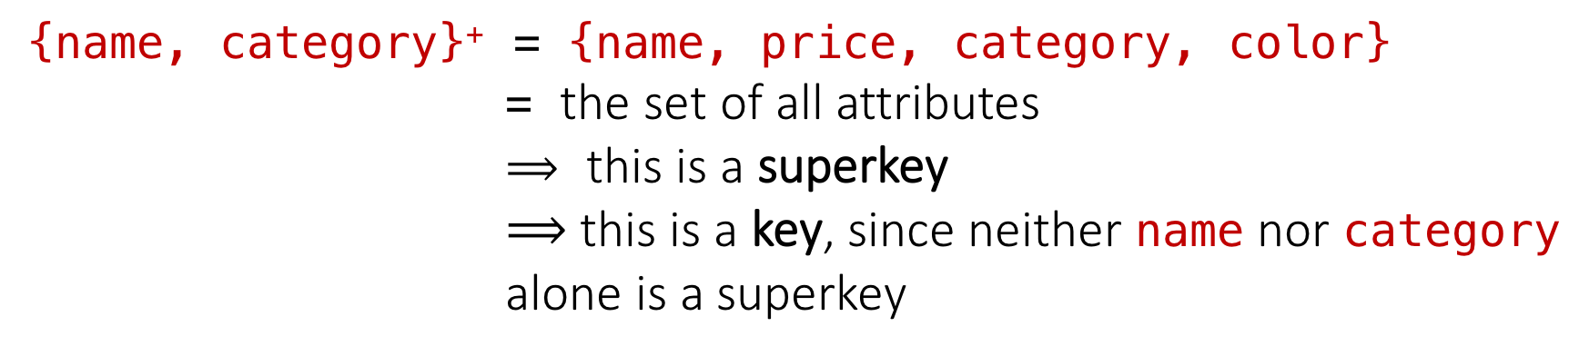
Example of Keys
Lecture 5 > Section 3 > Superkeys & Keys
Product(name, price, category, color)
{name, category} → price
{category} → color
{name, category}⁺ = {name, price, category, color}
= the set of all attributes
$⟹$ this is a superkey
$⟹$ this is a key, since neither name nor category alone is a superkey

Slide 70
Activity-5-3.ipynb
Lecture 5 > Section 3 > ACTIVITY

Slide 71
Lecture 7: Design Theory II
Lecture 7

Slide 72
Today’s Lecture
Lecture 7
Boyce-Codd Normal Form
ACTIVITY
Decompositions & 3NF
ACTIVITY
MVDs
ACTIVITY

Slide 73
1. Boyce-Codd Normal Form
Lecture 7 > Section 1

Slide 74
What you will learn about in this section
Lecture 7 > Section 1
Conceptual Design
Boyce-Codd Normal Form
The BCNF Decomposition Algorithm
ACTIVITY

Slide 75
Conceptual Design
Lecture 7 > Section 1 > Conceptual Design

Slide 76
Back to Conceptual Design
Lecture 7 > Section 1 > Conceptual Design
Now that we know how to find FDs, it’s a straight-forward process:
Search for “bad” FDs
If there are any, then keep decomposing the table into sub-tables until no more bad FDs
When done, the database schema is normalized
Recall: there are several normal forms…

Slide 77
Boyce-Codd Normal Form (BCNF)
Lecture 7 > Section 1 > BCNF
Main idea is that we define “good” and “bad” FDs as follows:
X → A is a “good FD” if X is a (super)key
In other words, if A is the set of all attributes
X → A is a “bad FD” otherwise
We will try to eliminate the “bad” FDs!

Slide 78
Boyce-Codd Normal Form (BCNF)
Lecture 7 > Section 1 > BCNF
Why does this definition of “good” and “bad” FDs make sense?
If X is not a (super)key, it functionally determines some of the attributes
Recall: this means there is redundancy
And redundancy like this can lead to data anomalies!
EmpID | Name | Phone | Position
E0045 | Smith | 1234 | Clerk
E3542 | Mike | 9876 | Salesrep
E1111 | Smith | 9876 | Salesrep
E9999 | Mary | 1234 | Lawyer

Slide 79
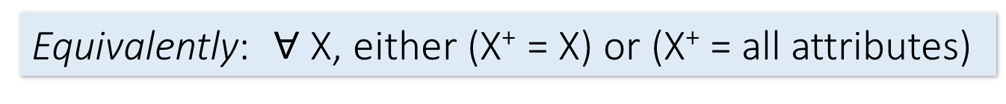
Boyce-Codd Normal Form
Lecture 7 > Section 1 > BCNF
BCNF is a simple condition for removing anomalies from relations:
A relation R is in BCNF if:
if {A₁, ..., A_{n}} → B is a non-trivial FD in R
then {A₁, ..., A_{n}} is a superkey for R
Equivalently: $∀$ X, either (X⁺ = X) or (X⁺ = all attributes)
In other words: there are no “bad” FDs

Slide 80
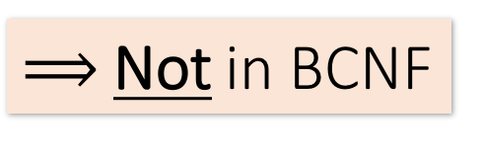
Example
Lecture 7 > Section 1 > BCNF
Name | SSN | PhoneNumber | City
Fred | 123-45-6789 | 206-555-1234 | Seattle
Fred | 123-45-6789 | 206-555-6543 | Seattle
Joe | 987-65-4321 | 908-555-2121 | Westfield
Joe | 987-65-4321 | 908-555-1234 | Westfield
{SSN} → {Name,City}
This FD is bad because it is not a superkey
What is the key?
{SSN, PhoneNumber}
$⟹$Not in BCNF

Slide 81
Example
Lecture 7 > Section 1 > BCNF
Name | SSN | City
Fred | 123-45-6789 | Seattle
Joe | 987-65-4321 | Madison
{SSN} → {Name,City}
This FD is now good because it is the key
SSN | PhoneNumber
123-45-6789 | 206-555-1234
123-45-6789 | 206-555-6543
987-65-4321 | 908-555-2121
987-65-4321 | 908-555-1234
Let’s check anomalies:
Redundancy ?
Update ?
Delete ?
Now in BCNF!

Slide 82
BCNF Decomposition Algorithm
Lecture 7 > Section 1 > BCNF
BCNFDecomp(R): Find X s.t.: X⁺ ≠ X and X⁺ ≠ [all attributes]
if (not found) then Return R
let Y = X⁺ - X, Z = (X⁺)^{C} decompose R into R1(X ∪ Y) and R2(X ∪ Z)
Return BCNFDecomp(R1), BCNFDecomp(R2)

Slide 83
BCNF Decomposition Algorithm
Lecture 7 > Section 1 > BCNF
BCNFDecomp(R): Find X s.t.: X⁺ ≠ X and X⁺ ≠ [all attributes]
if (not found) then Return R
let Y = X⁺ - X, Z = (X⁺)^{C} decompose R into R1(X ∪ Y) and R2(X ∪ Z)
Return BCNFDecomp(R1), BCNFDecomp(R2)
Find a set of attributes X which has non-trivial “bad” FDs, i.e. is not a superkey, using closures

Slide 84
BCNF Decomposition Algorithm
Lecture 7 > Section 1 > BCNF
BCNFDecomp(R): Find X s.t.: X⁺ ≠ X and X⁺ ≠ [all attributes]
if (not found) then Return R
let Y = X⁺ - X, Z = (X⁺)^{C} decompose R into R1(X ∪ Y) and R2(X ∪ Z)
Return BCNFDecomp(R1), BCNFDecomp(R2)
If no “bad” FDs found, in BCNF!

Slide 85
BCNF Decomposition Algorithm
Lecture 7 > Section 1 > BCNF
BCNFDecomp(R): Find X s.t.: X⁺ ≠ X and X⁺ ≠ [all attributes]
if (not found) then Return R
let Y = X⁺ - X, Z = (X⁺)^{C} decompose R into R1(X ∪ Y) and R2(X ∪ Z)
Return BCNFDecomp(R1), BCNFDecomp(R2)
Let Y be the attributes that X functionally determines (+ that are not in X)
And let Z be the other attributes that it doesn’t

Slide 86
BCNF Decomposition Algorithm
Lecture 7 > Section 1 > BCNF
BCNFDecomp(R): Find X s.t.: X⁺ ≠ X and X⁺ ≠ [all attributes]
if (not found) then Return R
let Y = X⁺ - X, Z = (X⁺)^{C} decompose R into R₁(X ∪ Y) and R₂(X ∪ Z)
Return BCNFDecomp(R1), BCNFDecomp(R2)
Split into one relation (table) with X plus the attributes that X determines (Y)…
Y
X
Z
R₁
R₂

Slide 87
BCNF Decomposition Algorithm
Lecture 7 > Section 1 > BCNF
BCNFDecomp(R): Find X s.t.: X⁺ ≠ X and X⁺ ≠ [all attributes]
if (not found) then Return R
let Y = X⁺ - X, Z = (X⁺)^{C} decompose R into R₁(X ∪ Y) and R₂(X ∪ Z)
Return BCNFDecomp(R1), BCNFDecomp(R2)
And one relation with X plus the attributes it does not determine (Z)
Y
X
Z
R₁
R₂

Slide 88
BCNF Decomposition Algorithm
Lecture 7 > Section 1 > BCNF
BCNFDecomp(R): Find X s.t.: X⁺ ≠ X and X⁺ ≠ [all attributes]
if (not found) then Return R
let Y = X⁺ - X, Z = (X⁺)^{C} decompose R into R₁(X ∪ Y) and R₂(X ∪ Z)
Return BCNFDecomp(R₁), BCNFDecomp(R₂)
Proceed recursively until no more “bad” FDs!

Slide 89
Lecture 7 > Section 1 > BCNF
Example
BCNFDecomp(R): Find X s.t.: X⁺ ≠ X and X⁺ ≠ [all attributes]
if (not found) then Return R
let Y = X⁺ - X, Z = (X⁺)^{C} decompose R into R₁(X ∪ Y) and R₂(X ∪ Z)
Return BCNFDecomp(R₁), BCNFDecomp(R₂)
R(A,B,C,D,E)
{A} → {B,C}
{C} → {D}

Slide 90
Example
Lecture 7 > Section 1 > BCNF
R(A,B,C,D,E)
{A} → {B,C}
{C} → {D}
R(A,B,C,D) {A}⁺ = {A,B,C} ≠ {A,B,C,D}
R₁(A,B,C) {B}⁺ = {B,C} ≠ {A,B,C}
R₁₁(B,C)
R₁₂(A,B)
R₂(A,D)

Slide 91
Activity-7-1.ipynb
Lecture 7 > Section 1 > ACTIVITY

Slide 92
2. Decompositions & 3NF
Lecture 7 > Section 2

Slide 93
What you will learn about in this section
Lecture 7 > Section 2
Lossy & Lossless Decompositions
3rd Normal Form
ACTIVITY

Slide 94
Decompositions
Lecture 7 > Section 2 > Decompositions

Slide 95
Decompositions in General
Lecture 7 > Section 2 > Decompositions
R(A₁,...,A_{n},B₁,...,B_{m},C₁,...,C_{p})
R₁(A₁,...,A_{n},B₁,...,B_{m})
R₂(A₁,...,A_{n},C₁,...,C_{p})
R₁ = the projection of R on A₁, ..., A_{n}, B₁, ..., B_{m}
R₂ = the projection of R on A₁, ..., A_{n}, C₁, ..., C_{p}

Slide 96
Theory of Decomposition
Lecture 7 > Section 2 > Decompositions
Sometimes a decomposition is “correct”
Name | Price | Category
Gizmo | 19.99 | Gadget
OneClick | 24.99 | Camera
Gizmo | 19.99 | Camera
I.e. it is a Lossless decomposition
Name | Price
Gizmo | 19.99
OneClick | 24.99
Gizmo | 19.99
Name | Category
Gizmo | Gadget
OneClick | Camera
Gizmo | Camera

Slide 97
Lossy Decomposition
Lecture 7 > Section 2 > Decompositions
Name | Price | Category
Gizmo | 19.99 | Gadget
OneClick | 24.99 | Camera
Gizmo | 19.99 | Camera
However sometimes it isn’t
What’s wrong here?
Name | Category
Gizmo | Gadget
OneClick | Camera
Gizmo | Camera
Price | Category
19.99 | Gadget
24.99 | Camera
19.99 | Camera

Slide 98
Lossless Decompositions
Lecture 7 > Section 2 > Decompositions
R(A₁,...,A_{n},B₁,...,B_{m},C₁,...,C_{p})
R₁(A₁,...,A_{n},B₁,...,B_{m})
R₂(A₁,...,A_{n},C₁,...,C_{p})
What (set) relationship holds between R1 Join R2 and R if lossless?
Hint: Which tuples of R will be present?
It’s lossless if we have equality!

Slide 99
Lossless Decompositions
Lecture 7 > Section 2 > Decompositions
R(A₁,...,A_{n},B₁,...,B_{m},C₁,...,C_{p})
R₁(A₁,...,A_{n},B₁,...,B_{m})
R₂(A₁,...,A_{n},C₁,...,C_{p})
A decomposition R → R1, R2 is lossless if R = R1 Join R2

Slide 100
Lossless Decompositions
Lecture 7 > Section 2 > Decompositions
R(A₁,...,A_{n},B₁,...,B_{m},C₁,...,C_{p})
R₁(A₁,...,A_{n},B₁,...,B_{m})
R₂(A₁,...,A_{n},C₁,...,C_{p})
If {A₁, ..., A_{n}} → {B₁, ..., B_{m}}
Then the decomposition is lossless
Note: don’t need
{A₁, ..., A_{n}} → {C₁, ..., C_{p}}
BCNF decomposition is always lossless. Why?

Slide 101
A problem with BCNF
Lecture 7 > Section 2 > 3NF
Problem: To enforce a FD, must reconstruct original relation—on each insert!
Note: This is historically inaccurate, but it makes it easier to explain

Slide 102
A Problem with BCNF
Lecture 7 > Section 2 > 3NF
Unit | Company | Product
… | … | …
{Unit} → {Company} {Company,Product} → {Unit}
We do a BCNF decomposition on a “bad” FD:
{Unit}⁺ = {Unit, Company}
Unit | Company
… | …
Unit | Product
… | …
{Unit} → {Company}
We lose the FD {Company,Product} → {Unit}!!

Slide 103
So Why is that a Problem?
Lecture 7 > Section 2 > 3NF
Unit | Company
Galaga99 | UW
Bingo | UW
Unit | Product
Galaga99 | Databases
Bingo | Databases
No problem so far. All local FD’s are satisfied.
{Unit} → {Company}
Unit | Company | Product
Galaga99 | UW | Databases
Bingo | UW | Databases
Let’s put all the data back into a single table again:
Violates the FD {Company,Product} → {Unit}!!

Slide 104
The Problem
Lecture 7 > Section 2 > 3NF
We started with a table R and FDs F
We decomposed R into BCNF tables R₁, R₂, … with their own FDs F₁, F₂, …
We insert some tuples into each of the relations—which satisfy their local FDs but when reconstruct it violates some FD across tables!
Practical Problem: To enforce FD, must reconstruct R—on each insert!

Slide 105
Solution: 3NF Called “Dependency Preserving”
Lecture 7 > Section 2 > 3NF

Slide 106
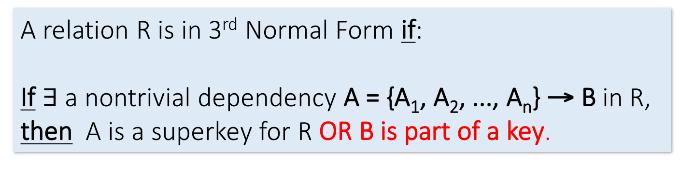
Solution: 3rd Normal Form (3NF)
Lecture 7 > Section 2 > 3NF
Another simple condition for removing anomalies from relations:
A relation R is in 3rd Normal Form if:
If $∃$ a nontrivial dependency A = {A₁, A₂, ..., A_{n}} → B in R, then A is a superkey for R OR B is part of a key.
Tradeoff:
BCNF = no anomalies, but may lose some FDs
3NF = keeps all FDs, but may have some anomalies

Slide 107
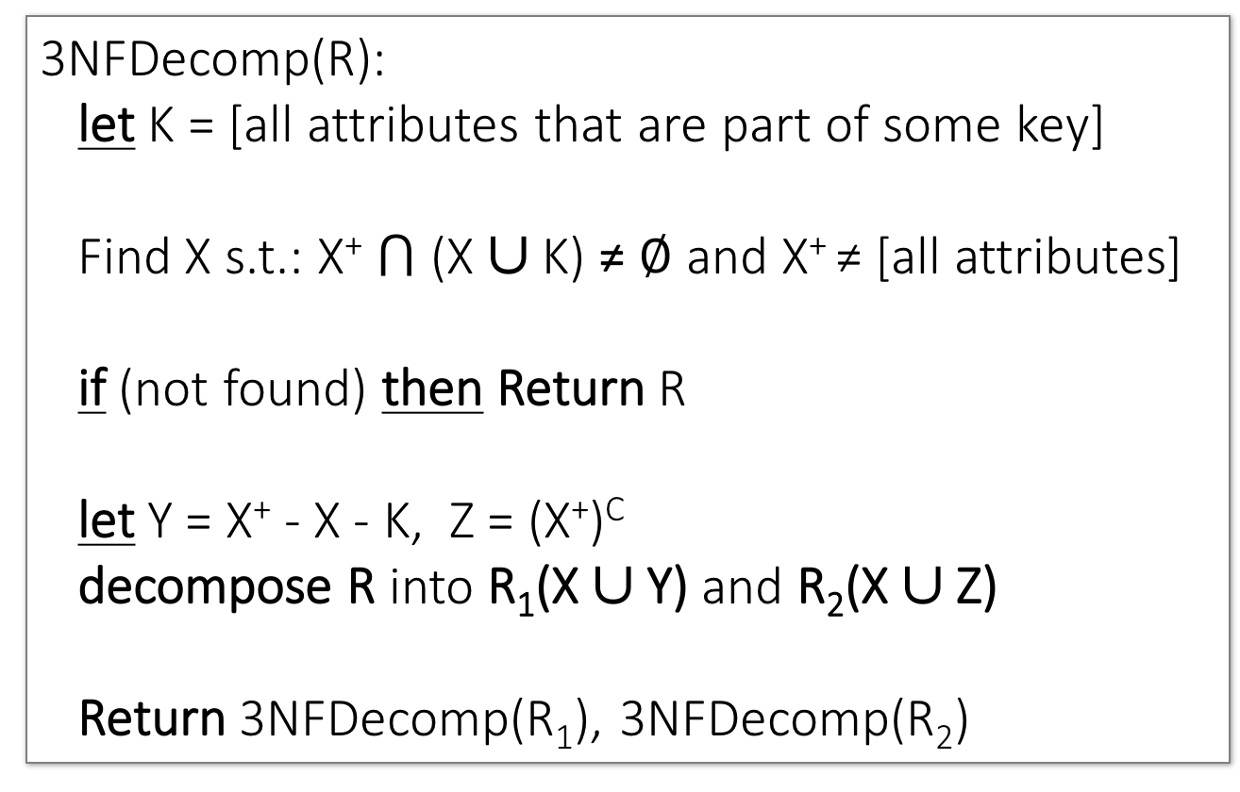
3NF Decomposition Algorithm
Lecture 7 > Section 2 > 3NF
3NFDecomp(R): let K = [all attributes that are part of some key]
Find X s.t.: X⁺ $⋂$ (X ∪ K) ≠ $∅$ and X⁺ ≠ [all attributes]
if (not found) then Return R
let Y = X⁺ - X - K, Z = (X⁺)^{C} decompose R into R₁(X ∪ Y) and R₂(X ∪ Z)
Return 3NFDecomp(R₁), 3NFDecomp(R₂)

Slide 108
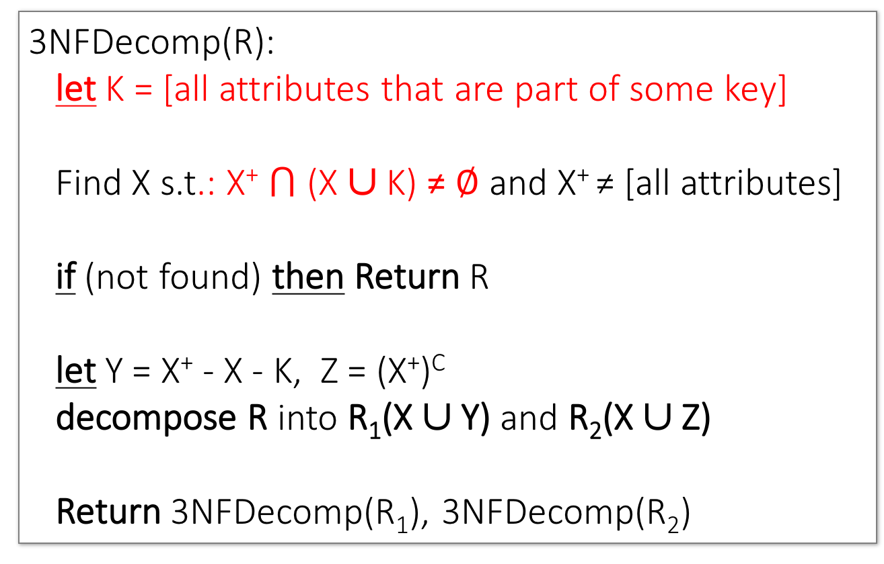
3NF Decomposition Algorithm
Lecture 7 > Section 2 > 3NF
3NFDecomp(R): let K = [all attributes that are part of some key]
Find X s.t.: X⁺ $⋂$ (X ∪ K) ≠ $∅$ and X⁺ ≠ [all attributes]
if (not found) then Return R
let Y = X⁺ - X - K, Z = (X⁺)^{C} decompose R into R₁(X ∪ Y) and R₂(X ∪ Z)
Return 3NFDecomp(R₁), 3NFDecomp(R₂)
Says: “Look for X such that X is not a superkey and X+ has attributes that are not part of some key”
Slight changes from BCNF only…

Slide 109
3NF v.s. BCNF Decomposition
Lecture 7 > Section 2 > 3NF
3NF decomposition has an extra condition in its inner loop, so it stops early.
A | B | C | D | E | F | G | H | K
A | B | C | D | E
E | F | G | H | K
3NF
A | B | C
C | D | E
E | F | G
G | H | K
BCNF
A | B
A | B
A | B
A | B
A | B
A | B
A | B
A | B

Slide 110
Activity-7-2.ipynb
Lecture 7 > Section 2 > ACTIVITY

Slide 111
Example of 3NF decomposition
Lecture 7 > Section 2 > 3NF
R(A,B,C,D,E)
Keys are {A,B}, {A,C} and {A,D}
→ K = {A,B,C,D}
We get the keys by computing the closure X⁺ of several X’s
{A,B} → {C}
{C} → {D}
{D} → {B}
{D} → {E}
Let X = C
{C}⁺ = {B,C,D,E} ≠ {C} ∪ K
{C} → {B,D,E} is a BCNF violation
Decompose: R1(C, E), R2(A,B,C,D)
R1 is in 3NF
R2 is in 3NF (because its keys are {A,B}, {A,C}, {A,D})

Slide 112
3. MVDs
Lecture 7 > Section 3

Slide 113
What you will learn about in this section
Lecture 7 > Section 3
MVDs
ACTIVITY

Slide 114
Multiple Value Dependencies (MVDs)
Lecture 7 > Section 3 > MVDs
Course | Staff | Student
CS949 | Amy | Bob
CS145 | Chris | Deb
CS145 | Chris | Eli
CS145 | Firas | Deb
CS145 | Firas | Eli
MVD Ex: For each fixed course (e.g. CS145),
Every staff member in that course and every student in that course occur in a tuple in that table.
Write: Course ↠ Staff or Course ↠ Student

Slide 115
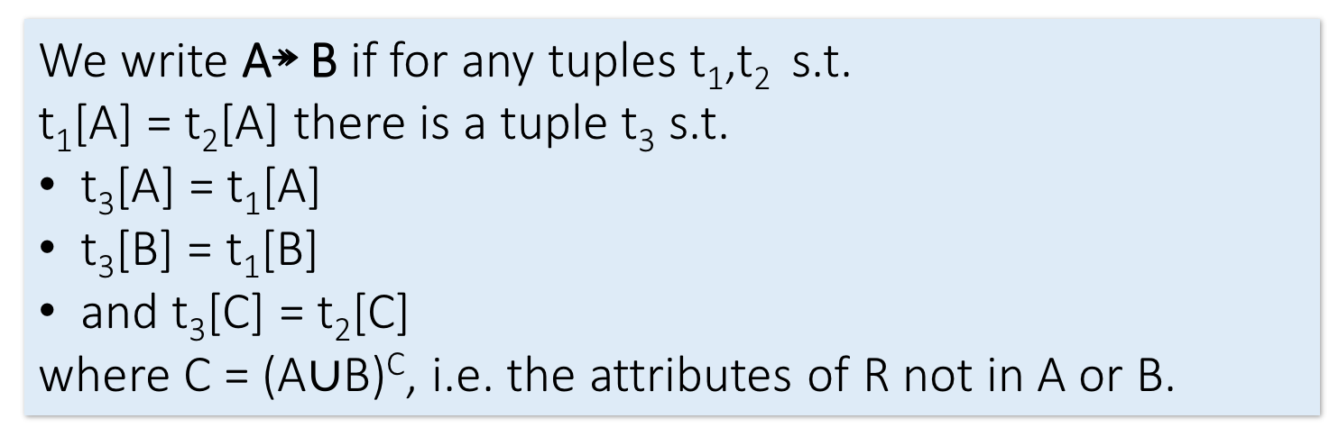
Formal Definition of MVD
Lecture 7 > Section 3 > MVDs
Course ↠ Staff
Course | Staff | Student
CS949 | Amy | Bob
CS145 | Chris | Deb
CS145 | Chris | Eli
CS145 | Firas | Deb
CS145 | Firas | Eli
t₁
t₃
t₂
We write A↠ B if for any tuples t₁,t₂ s.t.
t₁[A] = t₂[A] there is a tuple t₃ s.t.
t₃[A] = t₁[A]
t₃[B] = t₁[B]
and t₃[C] = t₂[C]
where C = (A$∪$B)^{C}, i.e. the attributes of R not in A or B.

Slide 116
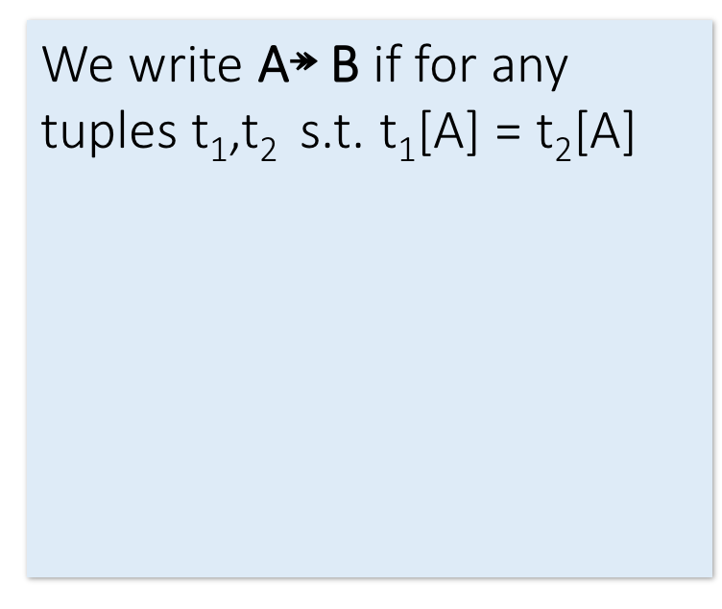
Formal Definition of MVD
Lecture 7 > Section 3 > MVDs
Course ↠ Staff
We write A↠ B if for any tuples t₁,t₂ s.t. t₁[A] = t₂[A] there is a tuple t₃ s.t.
t₃[A] = t₁[A]
t₃[B] = t₁[B]
and t₃[C] = t₂[C]
where C = (A$∪$B)^{C}, i.e. the attributes of R not in A or B.
Course | Staff | Student
CS949 | Amy | Bob
CS145 | Chris | Deb
CS145 | Chris | Eli
CS145 | Firas | Deb
CS145 | Firas | Eli
t₁
t₂
A

Slide 117
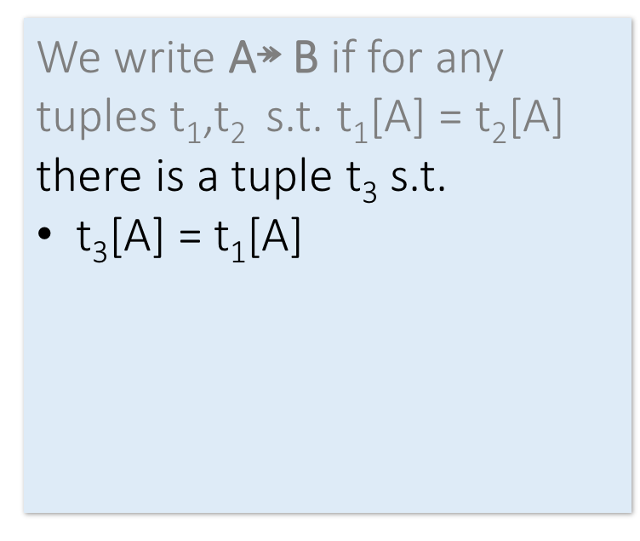
Formal Definition of MVD
Lecture 7 > Section 3 > MVDs
Course ↠ Staff
We write A↠ B if for any tuples t₁,t₂ s.t. t₁[A] = t₂[A] there is a tuple t₃ s.t.
t₃[A] = t₁[A]
t₃[B] = t₁[B]
and t₃[C] = t₂[C]
where C = (A$∪$B)^{C}, i.e. the attributes of R not in A or B.
Course | Staff | Student
CS949 | Amy | Bob
CS145 | Chris | Deb
CS145 | Chris | Eli
CS145 | Firas | Deb
CS145 | Firas | Eli
t₁
t₃
t₂
A

Slide 118
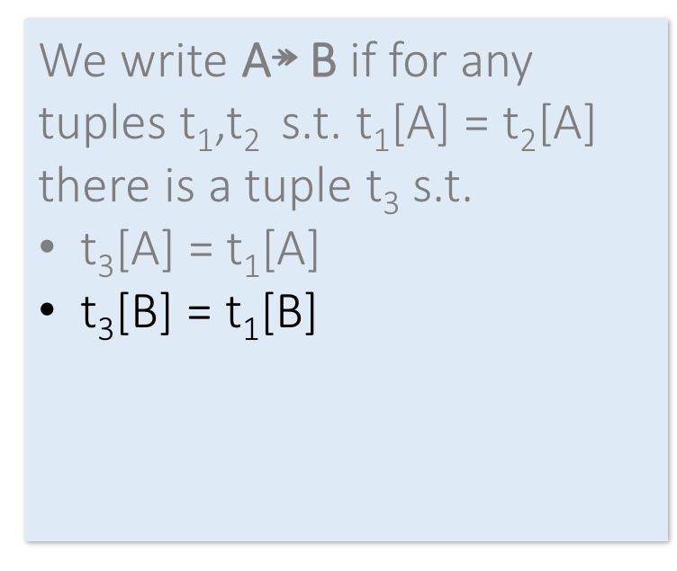
Formal Definition of MVD
Lecture 7 > Section 3 > MVDs
Course ↠ Staff
We write A↠ B if for any tuples t₁,t₂ s.t. t₁[A] = t₂[A] there is a tuple t₃ s.t.
t₃[A] = t₁[A]
t₃[B] = t₁[B]
and t₃[C] = t₂[C]
where C = (A$∪$B)^{C}, i.e. the attributes of R not in A or B.
Course | Staff | Student
CS949 | Amy | Bob
CS145 | Chris | Deb
CS145 | Chris | Eli
CS145 | Firas | Deb
CS145 | Firas | Eli
t₁
t₃
t₂
A
B

Slide 119
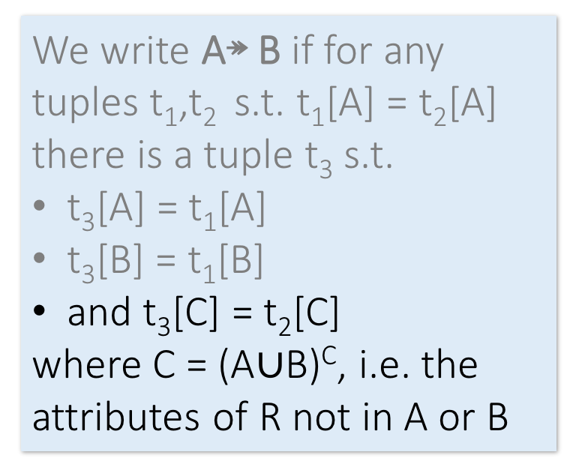
Formal Definition of MVD
Lecture 7 > Section 3 > MVDs
Course ↠ Staff
We write A↠ B if for any tuples t₁,t₂ s.t. t₁[A] = t₂[A] there is a tuple t₃ s.t.
t₃[A] = t₁[A]
t₃[B] = t₁[B]
and t₃[C] = t₂[C]
where C = (A$∪$B)^{C}, i.e. the attributes of R not in A or B.
Course | Staff | Student
CS949 | Amy | Bob
CS145 | Chris | Deb
CS145 | Chris | Eli
CS145 | Firas | Deb
CS145 | Firas | Eli
t₁
t₃
t₂
A
B
C

Slide 120
Does Course ↠ Staff hold now?
Lecture 7 > Section 3 > MVDs
Course | Staff | Student
CS949 | Amy | Bob
CS145 | Chris | Deb
CS145 | Chris | Eli
CS145 | Firas | Eli

Slide 121
Connection to FDs
Lecture 7 > Section 3 > MVDs
If A → B does A↠ B ?
Hint: sort of like multiplying by one…

Slide 122
Comments on MVDs
Lecture 7 > Section 3 > MVDs
MVDs have “rules” too!
Experts: Axiomatizable
4th Normal Form is “non-trivial MVD”
For AI weenies: MVD is conditional independence in graphical models!

Slide 123
Activity-7-3.ipynb
Lecture 7 > Section 3 > ACTIVITY

Slide 124
Summary
Lectures 5,7 > SUMMARY
Constraints allow one to reason about redundancy in the data
Normal forms describe how to remove this redundancy by decomposing relations
Elegant—by representing data appropriately certain errors are essentially impossible
For FDs, BCNF is the normal form.
A tradeoff for insert performance: 3NF

