Slide 1

CS 145 Final Review
Final Review
The Best Of Collection (Master Tracks), Vol. 2
= requested on piazza / in linked voting spreadsheet (@1253)

Slide 2
High-Level: Lecture 12
Final Review > Lecture 12
Note: Content from 12-1 (conflict serializability, deadlock, etc) will NOT be covered on the final
The buffer & simplified filesystem model
Shift to IO Aware algorithms
The external merge algorithm

Slide 3
High-level: Disk vs. Main Memory
Final Review > Lecture 12
Cylinder
Spindle
Disk head
Tracks
Sector
Arm movement
Platters
Arm assembly
Disk:
Slow: Sequential block access
Read a blocks (not byte) at a time, so sequential access is cheaper than random
Disk read / writes are expensive!
Durable: We will assume that once on disk, data is safe!
Cheap
Random Access Memory (RAM) or Main Memory:
Fast: Random access, byte addressable
~10x faster for sequential access
~100,000x faster for random access!
Volatile: Data can be lost if e.g. crash occurs, power goes out, etc!
Expensive: For $100, get 16GB of RAM vs. 2TB of disk!

Slide 4
The Buffer
Final Review > Lecture 12
Main Memory
Buffer
A buffer is a region of physical memory used to store temporary data
Key Idea: Reading / writing to disk is SLOW, need to cache data in main memory
Can read into buffer, flush back to disk, release from buffer
DBMS manages its own buffer for various reasons (better control of eviction policy, force-write log, etc.)
We use a simplified model:
A page is a fixed-length array of memory; pages are the unit that is read from / written to disk
A file is a variable-length list of pages on disk
1,0,3
Disk
File
1,0,3
1,0,3
Page

Slide 5
IO Aware
Final Review > Lecture 12
Key idea: Reading from / writing to disk- e.g. IO operations- is thousands of times slower than any operation in memory
→ We consider a class of algorithms which try to minimize IO, and effectively ignore cost of operations in main memory
“IO aware” algorithms!

Slide 6
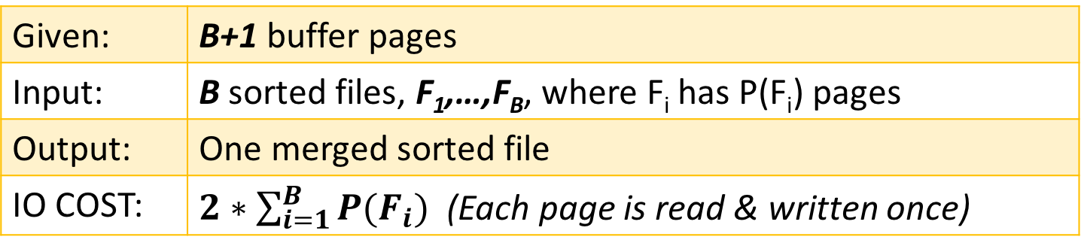
External Merge Algorithm
Final Review > Lecture 12
See L12:54-66!
Goal: Merge sorted files that are much bigger than buffer
Key idea: Since the input files are sorted, we always know which file to read from next!
Details:
Given: | B+1 buffer pages
Input: | B sorted files, F₁,…,F_{B}, where F_{i} has P(F_{i}) pages
Output: | One merged sorted file
IO COST: | $2∗\sum_{i=1}^{B}{P(F_{i})}$ (Each page is read & written once)

Slide 7
High-Level: Lecture 13
Final Review > Lecture 13
External Merge Sort Algorithm
Basic algorithm (including (B+1)-length initial runs & B-way merging)
Repacking optimization for longer initial runs
Indexes Part I: Basics

Slide 8
External Merge Sort Algorithm
Final Review > Lecture 13
See L13:11-27!
Goal: Sort a file that is much bigger than the buffer
Key idea:
Phase 1: Split file into smaller chunks (“initial runs”) which can be sorted in memory
Phase 2: Keep merging (do “passes”) using external merge algorithm until one sorted file!
Unsorted input file
Phase 1
Sorted initial runs
Merge pass
Phase 2
Merge pass
Sorted!

Slide 9
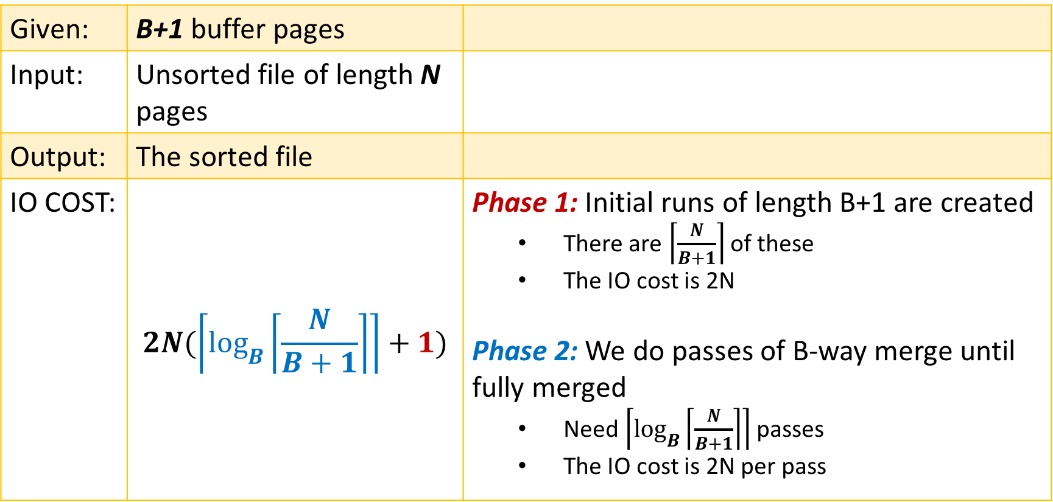
External Merge Sort Algorithm
Final Review > Lecture 13
See L13:11-27!
Given: | B+1 buffer pages
Input: | Unsorted file of length N pages
Output: | The sorted file
IO COST: | $$2N(\left\lceil \log_{B}\left\lceil \frac{N}{B+1}\right\rceil \right\rceil +1)$$ | Phase 1: Initial runs of length B+1 are created There are $\left\lceil \frac{N}{B+1}\right\rceil$ of these The IO cost is 2N Phase 2: We do passes of B-way merge until fully merged Need $\left\lceil \log_{B}\left\lceil \frac{N}{B+1}\right\rceil \right\rceil$ passes The IO cost is 2N per pass

Slide 10
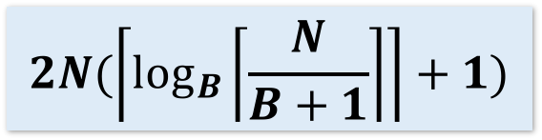
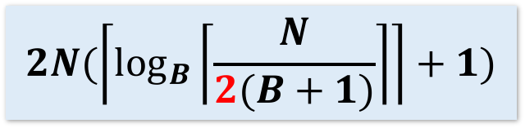
Repacking Optimization for Ext. Merge Sort
Final Review > Lecture 13
See L13:28-40!
Goal: Create larger initial runs
Key Idea: Keep loading unsorted pages, writing out next-largest values, and “repacking” for as long as possible!
Guaranteed to do at least as well as our previous method of loading & doing quicksort
IO Cost: On average, we will create initial runs of size ~2(B+1)
$$2N(\left\lceil \log_{B}\left\lceil \frac{N}{B+1}\right\rceil \right\rceil +1)$$
$$2N(\left\lceil \log_{B}\left\lceil \frac{N}{2(B+1)}\right\rceil \right\rceil +1)$$

Slide 11
Indexes
Final Review > Lecture 13
An index on a file speeds up selections on the search key fields for the index.
Where the search key could be any subset of fields, and does not need to be the same as key of a relation
By_Yr_Index
Russian_Novels
Published | BID
1866 | 002
1869 | 001
1877 | 003
BID | Title | Author | Published | Full_text
001 | War and Peace | Tolstoy | 1869 | …
002 | Crime and Punishment | Dostoyevsky | 1866 | …
003 | Anna Karenina | Tolstoy | 1877 | …
By_Author_Title_Index
Note this is the logical setup, not how data is actually stored!
Author | Title | BID
Dostoyevsky | Crime and Punishment | 002
Tolstoy | Anna Karenina | 003
Tolstoy | War and Peace | 001
An index is covering for a specific query if the index contains all the needed attributes
Notes:
7

Slide 12
High-Level: Lectures 14-15
Final Review > Lectures 14-15
Indexes Pt. 2:
B+ Trees
Clustered vs. unclustered
Join Algorithms:
Nested Loop Join Variants: NLJ, BNLJ, INLJ
SMJ
Hash Join

Slide 13
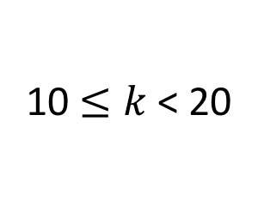
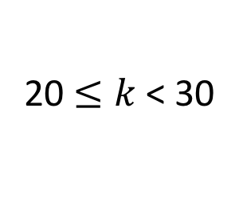
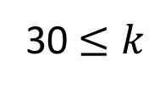
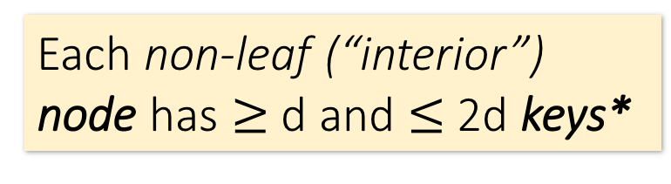
B+ Tree Basics
Final Review > Lectures 14-15
Parameter d = the degree
Non-leaf or internal node
Each non-leaf (“interior”) node has $≥$ d and $≤$2d keys*
10 |  | 20 |  | 30
30 $≤k$
The n keys in a node define n+1 ranges
k < 10
20 $≤k$< 30
10 $≤k$< 20
22 |  | 25 |  | 28
*except for root node, which can have between 2 and 2d keys
For each range, in a non-leaf node, there is a pointer to another node with keys in that range

Slide 14
B+ Tree Basics
Final Review > Lectures 14-15
Leaf nodes also have between d and 2d keys, and are different in that:
Non-leaf or internal node
Their key slots contain pointers to data records
10 |  | 20 |  | 30
They contain a pointer to the next leaf node as well, for faster sequential traversal
Leaf nodes
12 |  | 17
22 |  | 25 |  | 28 |  | 29
32 |  | 34 |  | 37 |  | 38
Name: Jake
Age: 15
Name: Bess
Age: 22
Name: Sally
Age: 28
Name: Sue
Age: 33
Name: Jess
Age: 35
Name: Alf
Age: 37
Name: Joe
Age: 11
Name: John
Age: 21
Name: Bob
Age: 27
Name: Sal
Age: 30

Slide 15
Searching a B+ Tree
Final Review > Lectures 14-15
See L14-15:17-18!
SELECT name
FROM people
WHERE age = 27
10 |  | 20 |  | 30
SELECT name
FROM people
WHERE 27 <= age
AND age <= 35
12 |  | 17
22 |  | 25 |  | 28 |  | 29
32 |  | 34 |  | 37 |  | 38
Name: Jake
Age: 15
Name: Bess
Age: 22
Name: Sally
Age: 28
Name: Sue
Age: 33
Name: Jess
Age: 35
Name: Alf
Age: 37
Name: Joe
Age: 11
Name: John
Age: 21
Name: Bob
Age: 27
Name: Sal
Age: 30

Slide 16
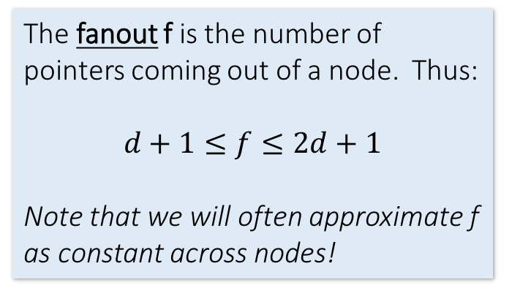
B+ Tree Range Search
Final Review > Lectures 14-15
Note that exact search is just a special case of range search (R = 1)
Goal: Get the results set of a range (or exact) query with minimal IO
Key idea:
A B+ Tree has high fanout (d ~= 10²-10³), which means it is very shallow → we can get to the right root node within a few steps!
Then just traverse the leaf nodes using the horizontal pointers
Details:
One node per page (thus page size determines d)
Fill only some of each node’s slots (the fill-factor) to leave room for insertions
We can keep some levels of the B+ Tree in memory!
The fanout f is the number of pointers coming out of a node. Thus:
$$d+1≤f≤2d+1$$
Note that we will often approximate f as constant across nodes!
We define the height of the tree as counting the root node. Thus, given constant fanout f, a tree of height h can index f^{h} pages and has f^{h-1} leaf nodes

Slide 17
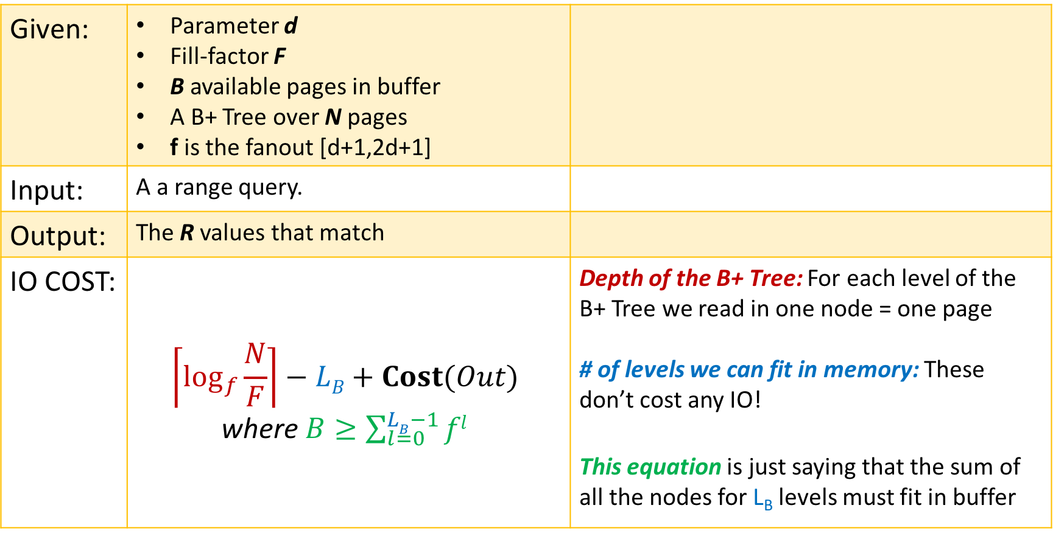
B+ Tree Range Search
Final Review > Lectures 14-15
See L14-15:22-24!
Given: | Parameter d Fill-factor F B available pages in buffer A B+ Tree over N pages f is the fanout [d+1,2d+1]
Input: | A a range query.
Output: | The R values that match
IO COST: | $$\left\lceil \log_{f}{\frac{N}{F}}\right\rceil −LB+Cost(Out)$$ where $B≥\sum_{l=0}^{LB−1}{fl}$ | Depth of the B+ Tree: For each level of the B+ Tree we read in one node = one page # of levels we can fit in memory: These don’t cost any IO! This equation is just saying that the sum of all the nodes for L_{B} levels must fit in buffer

Slide 18
Clustered vs. Unclustered Index
Final Review > Lectures 14-15
30
30
Index Entries
22 |  | 25 |  | 28 |  | 29
32 |  | 34 |  | 37 |  | 38
22 |  | 25 |  | 28 |  | 29
32 |  | 34 |  | 37 |  | 38
19
22
27
28
30
33
35
37
19
33
27
22
37
28
35
30
Data Records
Clustered
Unclustered
1 Random Access IO + Sequential IO
(# of pages of answers)
Random Access IO for each value (i.e. # of tuples in answer)
Clustered can make a huge difference for range queries!

Slide 19
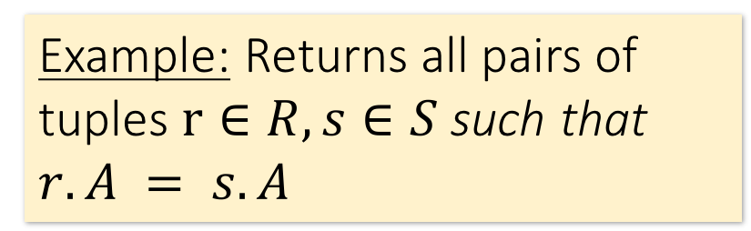
Joins: Example
Final Review > Lectures 14-15
$R⋈S$
SELECT R.A,B,C,D FROM R, S
WHERE R.A = S.A
Example: Returns all pairs of tuples $r∈R, s∈S$such that $r.A = s.A$
R
S
A | B | C
1 | 0 | 1
2 | 3 | 4
2 | 5 | 2
3 | 1 | 1
A | D
3 | 7
2 | 2
2 | 3
A | B | C | D
2 | 3 | 4 | 2
2 | 3 | 4 | 3
2 | 5 | 2 | 2
2 | 5 | 2 | 3
3 | 1 | 1 | 7

Slide 20
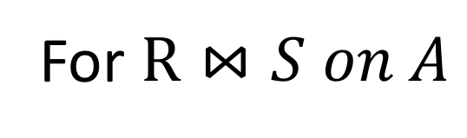
Join Algorithms: Overview
Final Review > Lectures 14-15
For $R⋈S on A$
NLJ: An example of a non-IO aware join algorithm
BNLJ: Big gains just by being IO aware & reading in chunks of pages!
SMJ: Sort R and S, then scan over to join!
HJ: Partition R and S into buckets using a hash function, then join the (much smaller) matching buckets
Quadratic in P(R), P(S)
I.e. O(P(R)*P(S))
Given sufficient buffer space, linear in P(R), P(S)
I.e. ~O(P(R)+P(S))
By only supporting equijoins & taking advantage of this structure!

Slide 21
Nested Loop Join (NLJ)
Final Review > Lectures 14-15
Cost:
Compute $R⋈S on A$:
for r in R:
for s in S:
if r[A] == s[A]:
yield (r,s)
P(R) + T(R)*P(S) + OUT
Loop over the tuples in R
For every tuple in R, loop over all the tuples in S
Check against join conditions
Write out (to page, then when page full, to disk)
Note that IO cost based on number of pages loaded, not number of tuples!
Have to read all of S from disk for every tuple in R!

Slide 22
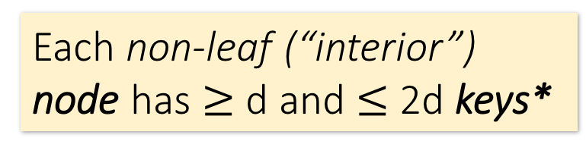
Block Nested Loop Join (BNLJ)
Final Review > Lectures 14-15
Given B+1 pages of memory
Cost:
Compute $R⋈S on A$:
for each B-1 pages pr of R:
for page ps of S:
for each tuple r in pr:
for each tuple s in ps:
if r[A] == s[A]:
yield (r,s)
$P\left(R\right)+ \frac{P\left(R\right)}{B−1}P(S)$ + OUT
Load in B-1 pages of R at a time (leaving 1 page each free for S & output)
For each (B-1)-page segment of R, load each page of S
Check against the join conditions
Write out
Again, OUT could be bigger than P(R)*P(S)… but usually not that bad

Slide 23
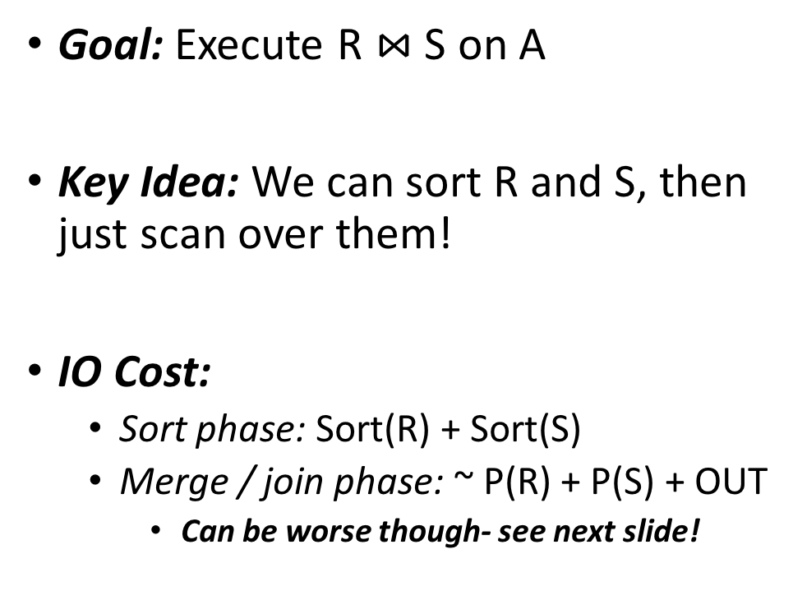
Sort Merge Join (SMJ)
Final Review > Lectures 14-15
See L14-15:63-69!
Unsorted input relations
Goal: Execute R $⋈$ S on A
Key Idea: We can sort R and S, then just scan over them!
IO Cost:
Sort phase: Sort(R) + Sort(S)
Merge / join phase: ~ P(R) + P(S) + OUT
Can be worse though- see next slide!
R
S
Split & sort
Merge
Merge
R
S

Slide 24
SMJ: Backup
Final Review > Lectures 14-15
See L14-15:70-75!
Without any duplicates:
We just scan over R and S once each → P(R) + P(S)
However, if there are duplicates, we may have to back up and re-read parts of the file
In worst case, O(P(R)*T(S))!
Usually not that bad…
(1,b)
(1,a)
(5,c)
(1,a)
(1,d)
(3,d)
Buffer
(1,b,a)
(1,b,d)
(1,a,a)
(1,a,d)

Slide 25
Simple SMJ Optimization
Final Review > Lectures 14-15
See L14-15:78-81!
Given B+1 buffer pages
Unsorted input relations
Sort Phase
(Ext. Merge Sort)
R
S
Split & sort
Split & sort
Merge
Merge
<= B total runs
B-Way Merge / Join
Merge / Join Phase
This allows us to “skip” the last sort & save 2(P(R) + P(S))!

Slide 26
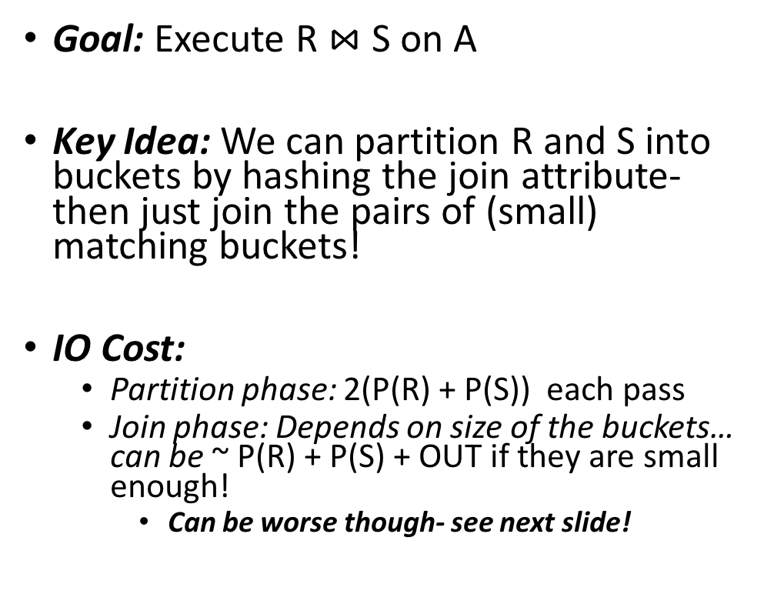
Hash Join
Final Review > Lectures 14-15
See L14-15:88-!
Goal: Execute R $⋈$ S on A
Key Idea: We can partition R and S into buckets by hashing the join attribute- then just join the pairs of (small) matching buckets!
IO Cost:
Partition phase: 2(P(R) + P(S)) each pass
Join phase: Depends on size of the buckets… can be ~ P(R) + P(S) + OUT if they are small enough!
Can be worse though- see next slide!
Unsorted input relations
R
S
Partition
h
h
1
2
1
2
Partition
h'
h'
1
2
3
4
1
2
3
4
Join matching buckets

Slide 27
HJ: Skew
Final Review > Lectures 14-15
See L14-15:109-112!
Ideally, our hash functions will partition the tuples uniformly
However, hash collisions and duplicate join key attributes can cause skew
For hash collisions, we can just partition again with a new hash function
Duplicates are just a problem… (Similar to in SMJ!)
R
1
2
3
4
R
1
2
3
4

Slide 28

Overview: SMJ vs. HJ
Final Review > Lectures 14-15
R $⋈$ S on A
SMJ
HJ
Note:
Ext. Merge Sort!
We create initial sorted runs
We keep merging these runs until we have one sorted merged run for R, S
We scan over R and S to complete the join
We keep partitioning R and S into progressively smaller buckets using hash functions h, h’, h’’…
We join matching pairs of buckets (using BNLJ)
How many of these passes do we need to do?

Slide 29
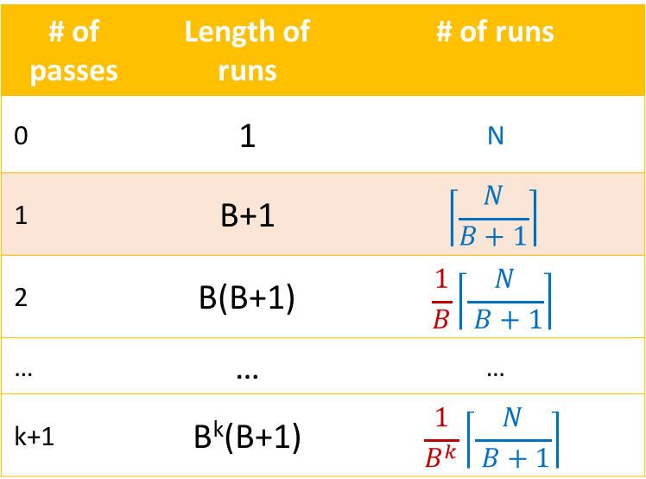
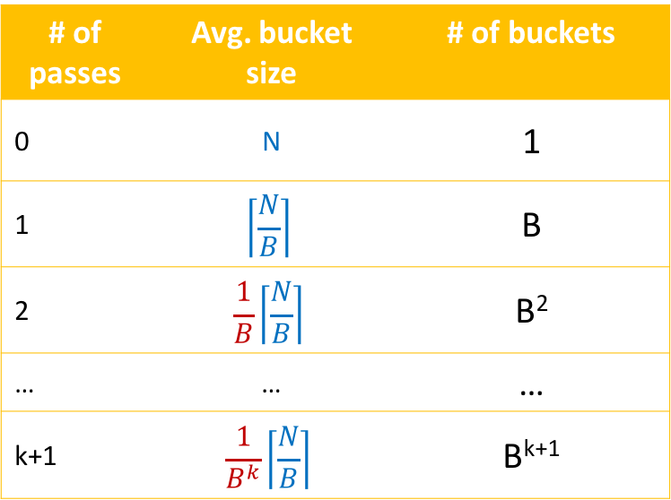
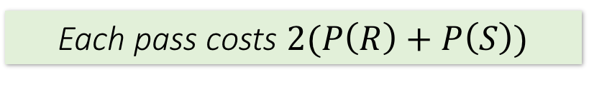
How many passes do we need?
Final Review > Lectures 14-15
R $⋈$ S on A
SMJ
HJ
# of passes | Length of runs | # of runs
0 | 1 | N
1 | B+1 | $$\left\lceil \frac{N}{B+1}\right\rceil$$
2 | B(B+1) | $$\frac{1}{B}\left\lceil \frac{N}{ B+1}\right\rceil$$
… | … | …
k+1 | B^{k}(B+1) | $$\frac{1}{B^{k}}\left\lceil \frac{N}{ B+1}\right\rceil$$
# of passes | Avg. bucket size | # of buckets
0 | N | 1
1 | $$\left\lceil \frac{N}{B}\right\rceil$$ | B
2 | $$\frac{1}{B}\left\lceil \frac{N}{B}\right\rceil$$ | B²
… | … | …
k+1 | $$\frac{1}{B^{k}}\left\lceil \frac{N}{B}\right\rceil$$ | B^{k+1}
Initial sorted runs
Each pass, we get:
Fewer, longer runs by a factor of B
More, smaller buckets by a factor of B
Each pass costs $2(P\left(R\right)+P\left(S\right))$
Notes:
We’re being slightly sloppy here- the exponent in length of runs for k+1 passes should be (k-1)_+

Slide 30
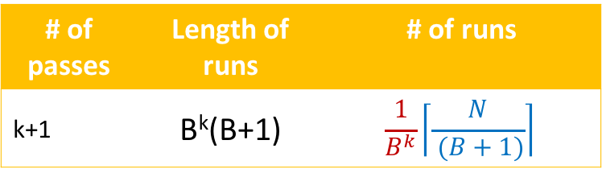
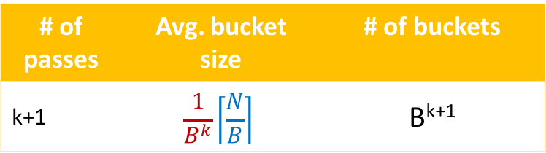
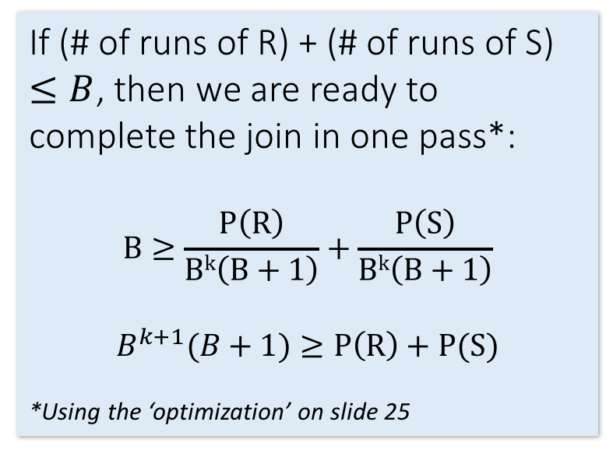
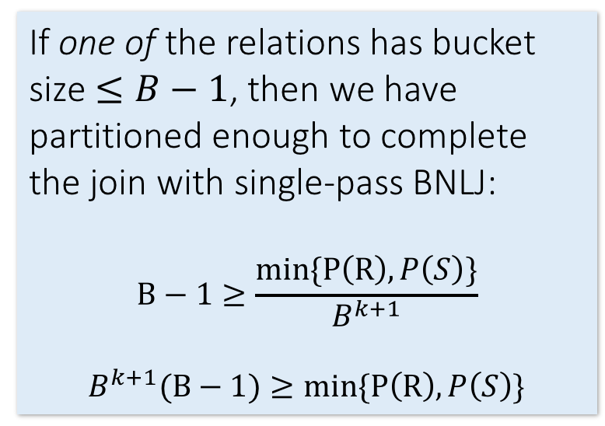
How many passes do we need?
Final Review > Lectures 14-15
R $⋈$ S on A
SMJ
HJ
# of passes | Length of runs | # of runs
k+1 | B^{k}(B+1) | $$\frac{1}{B^{k}}\left\lceil \frac{N}{ (B+1)}\right\rceil$$
# of passes | Avg. bucket size | # of buckets
k+1 | $$\frac{1}{B^{k}}\left\lceil \frac{N}{B}\right\rceil$$ | B^{k+1}
If (# of runs of R) + (# of runs of S) $≤B$, then we are ready to complete the join in one pass*:
$$B≥\frac{P\left(R\right)}{Bk\left(B+1\right)}+\frac{P\left(S\right)}{Bk\left(B+1\right)}$$
$$B^{k+1}(B+1)≥P\left(R\right)+P(S)$$
*Using the ‘optimization’ on slide 25
If one of the relations has bucket size $≤B−1$, then we have partitioned enough to complete the join with single-pass BNLJ:
$$B−1≥\frac{min\{P\left(R\right),P\left(S\right)\}}{B^{k+1}}$$
$$B^{k+1}(B−1)≥min\{P\left(R\right),P\left(S\right)\}$$
Notes:
In the SMJ calculation, we simplified B^{k+1}(B+1) ~= B^{k+2}, and similarly with the HJ equation

Slide 31
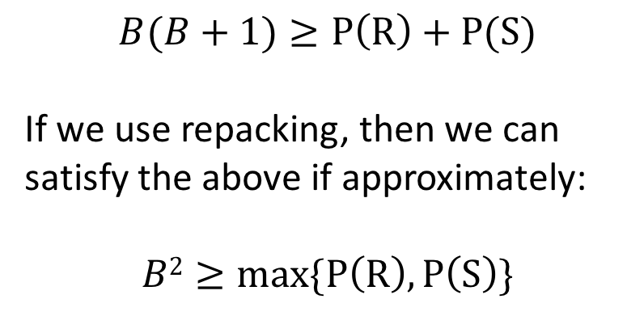
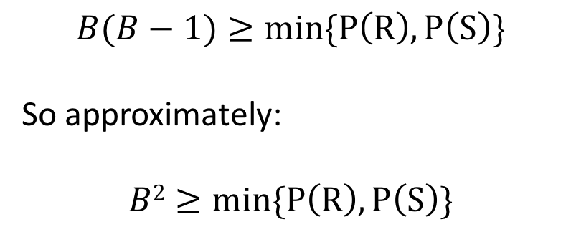
How many buffer pages for nice behavior?
Final Review > Lectures 14-15
R $⋈$ S on A
Let’s consider what B we’d need for k+1 = 1 passes (plus the final join):
SMJ
HJ
$$B(B+1)≥P\left(R\right)+P(S)$$
If we use repacking, then we can satisfy the above if approximately:
$$B2≥max\{P\left(R\right),P\left(S\right)\}$$
$$B(B−1)≥min\{P\left(R\right),P\left(S\right)\}$$
So approximately:
$$B2≥min\{P\left(R\right),P\left(S\right)\}$$
→ Total IO Cost = 3(P(R) + P(S)) + OUT!

Slide 32
Overview: SMJ vs. HJ
Final Review > Lectures 14-15
HJ:
PROS: Nice linear performance is dependent on the smaller relation
CONS: Skew!
SMJ:
PROS: Great if relations are already sorted; output is sorted either way!
CONS:
Nice linear performance is dependent on the larger relation
Backup!

Slide 33
High-Level: Lecture 16
Final Review > Lectures 16
Check out the Relational Algebra practice exercises notebook!!
Overall RDBMS architecture
The Relational Model
Relational Algebra

Slide 34
RDBMS Architecture
Final Review > Lectures 16
How does a SQL engine work ?
SQL Query
Relational Algebra (RA) Plan
Optimized RA Plan
Execution
Declarative query (from user)
Translate to relational algebra expression
Find logically equivalent- but more efficient- RA expression
Execute each operator of the optimized plan!

Slide 35
The Relational Model: Data
Final Review > Lectures 16
The number of tuples is the cardinality of the relation
Student
An attribute (or column) is a typed data entry present in each tuple in the relation
sid | name | gpa
001 | Bob | 3.2
002 | Joe | 2.8
003 | Mary | 3.8
004 | Alice | 3.5
A tuple or row (or record) is a single entry in the table having the attributes specified by the schema
The number of attributes is the arity of the relation
A relational instance is a set of tuples all conforming to the same schema

Slide 36
Final Review > Lectures 16
Relational Algebra (RA)
Five basic operators:
Selection: σ
Projection: Π
Cartesian Product: ×
Union: ∪
Difference: -
Derived or auxiliary operators:
Intersection, complement
Joins (natural,equi-join, theta join, semi-join)
Renaming: ρ
Division

Slide 37
Final Review > Lectures 16
1. Selection ($σ$)
Students(sid,sname,gpa)
SQL:
Returns all tuples which satisfy a condition
Notation: σ_{c}(R)
The condition c can be =, <, ≤, >, ≥, <>
SELECT *
FROM Students
WHERE gpa > 3.5;
RA:
$$σ_{gpa >3.5}(Students)$$

Slide 38
Final Review > Lectures 16
2. Projection ($Π$)
Students(sid,sname,gpa)
SQL:
Eliminates columns, then removes duplicates
Notation: Π _{A1,…,An} (R)
SELECT DISTINCT
sname,
gpa
FROM Students;
RA:
$$Π_{sname,gpa}(Students)$$

Slide 39

Final Review > Lectures 16
3. Cross-Product ($×$)
Students(sid,sname,gpa)
People(ssn,pname,address)
SQL:
Each tuple in R1 with each tuple in R2
Notation: R1 × R2
Rare in practice; mainly used to express joins
SELECT *
FROM Students, People;
RA:
$$Students × People$$

Slide 40

Final Review > Lectures 16
Renaming ($ρ$)
Students(sid,sname,gpa)
SQL:
Changes the schema, not the instance
A ‘special’ operator- neither basic nor derived
Notation: ρ _{B1,…,Bn} (R)
Note: this is shorthand for the proper form (since names, not order matters!):
ρ _{A1→B1,…,An→Bn} (R)
SELECT
sid AS studId,
sname AS name,
gpa AS gradePtAvg
FROM Students;
RA:
$$ρ_{studId,name,gradePtAvg}(Students)$$
We care about this operator because we are working in a named perspective

Slide 41


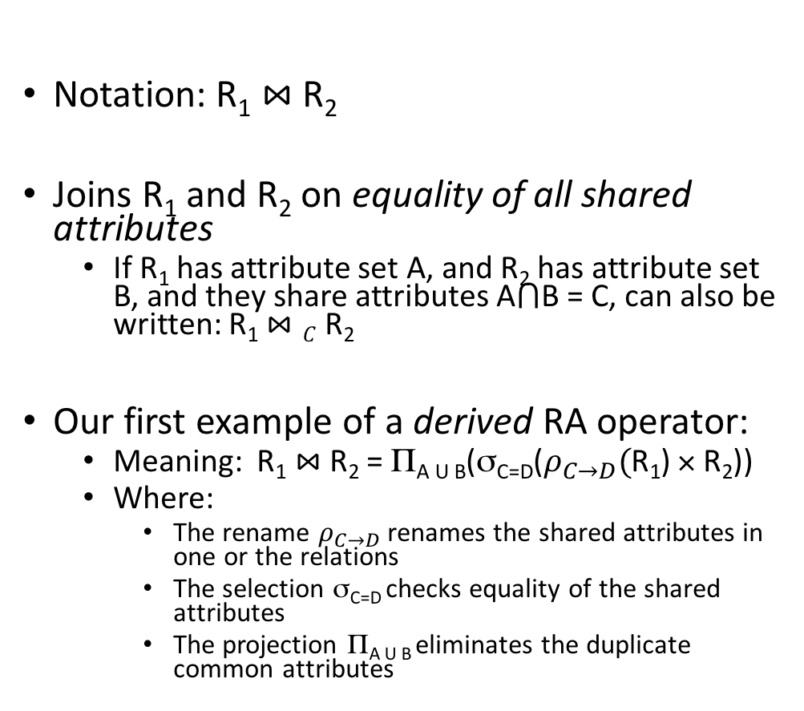
Final Review > Lectures 16
Natural Join ($⋈$)
Students(sid,name,gpa)
People(ssn,name,address)
SQL:
Notation: R₁ $⋈$R₂
Joins R₁ and R₂ on equality of all shared attributes
If R₁ has attribute set A, and R₂ has attribute set B, and they share attributes A$⋂$B = C, can also be written: R₁ $⋈C$R₂
Our first example of a derived RA operator:
Meaning: R₁ $⋈$ R₂ = Π_{A U B}(σ_{C=D}($ρ_{C→D}($R₁) × R₂))
Where:
The rename $ρ_{C→D}$ renames the shared attributes in one or the relations
The selection σ_{C=D} checks equality of the shared attributes
The projection Π_{A U B} eliminates the duplicate common attributes
SELECT DISTINCT
ssid, S.name, gpa,
ssn, address
FROM
Students S,
People P
WHERE S.name = P.name;
RA:
$$Students ⋈ People$$

Slide 42
Converting SFW Query -> RA
Final Review > Lectures 16
SELECT DISTINCT A₁,…,A_{n}
FROM R₁,…,R_{m}
WHERE c₁ AND … AND c_{k};
$$Π_{A1,…,An}(σ_{c1}…σ_{ck}(R1⋈…⋈Rm))$$
Why must the selections “happen before” the projections?

Slide 43
High-Level: Lecture 17
Final Review > Lecture 17
Logical optimization
Physical optimization
Index selections
IO cost estimation

Slide 44
Logical vs. Physical Optimization
Final Review > Lecture 17
SQL Query
Relational Algebra (RA) Plan
Logical optimization:
Find equivalent plans that are more efficient
Intuition: Minimize # of tuples at each step by changing the order of RA operators
Physical optimization:
Find algorithm with lowest IO cost to execute our plan
Intuition: Calculate based on physical parameters (buffer size, etc.) and estimates of data size (histograms)
Optimized RA Plan
Execution

Slide 45
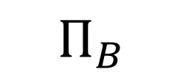
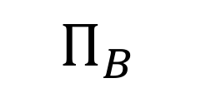
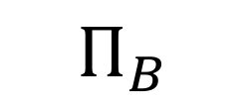
Logical Optimization: “Pushing down” projection
Final Review > Lecture 17
$Π_{B}$
$Π_{B}$
$$Π_{B}$$
R(A,B)
S(B,C)
R(A,B)
S(B,C)
Why might we prefer this plan?

Slide 46
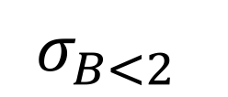
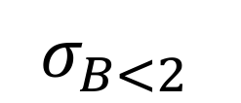
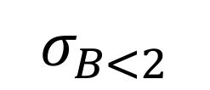
Logical Optimization: “Pushing down” selection
Final Review > Lecture 17
$σ_{B<2}$
$$σ_{B<2}$$
$$σ_{B<2}$$
R(A,B)
S(B,C)
R(A,B)
S(B,C)
Why might we prefer this plan?

Slide 47
RA commutators
Final Review > Lecture 17
The basic commutators:
Push projection through (1) selection, (2) join
Push selection through (3) selection, (4) projection, (5) join
Also: Joins can be re-ordered!
Note that this is not an exhaustive set of operations
This covers local re-writes; global re-writes possible but much harder
This simple set of tools allows us to greatly improve the execution time of queries by optimizing RA plans!

Slide 48
Index Selection
Final Review > Lecture 17
Input:
Schema of the database
Workload description: set of (query template, frequency) pairs
Goal: Select a set of indexes that minimize execution time of the workload.
Cost / benefit balance: Each additional index may help with some queries, but requires updating
This is an optimization problem!

Slide 49
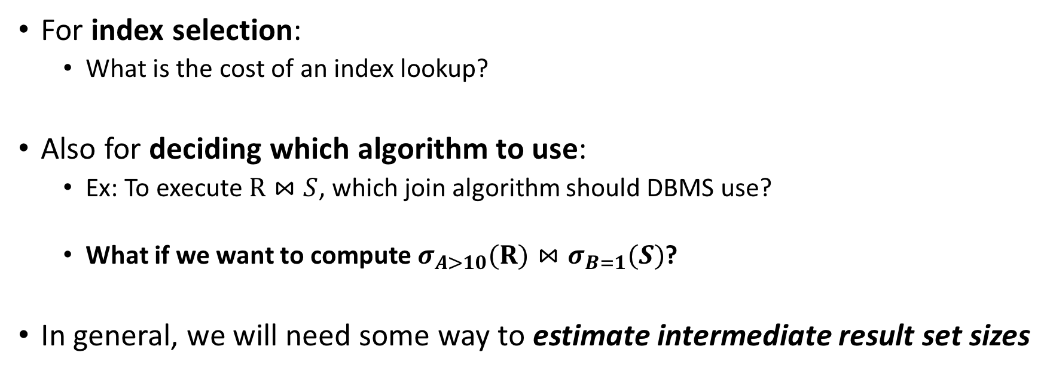
IO Cost Estimation via Histograms
Final Review > Lecture 17
For index selection:
What is the cost of an index lookup?
Also for deciding which algorithm to use:
Ex: To execute $R⋈S$, which join algorithm should DBMS use?
What if we want to compute $σ_{A>10}(R)⋈σ_{B=1}(S)$?
In general, we will need some way to estimate intermediate result set sizes
Histograms provide a way to efficiently store estimates of these quantities

Slide 50
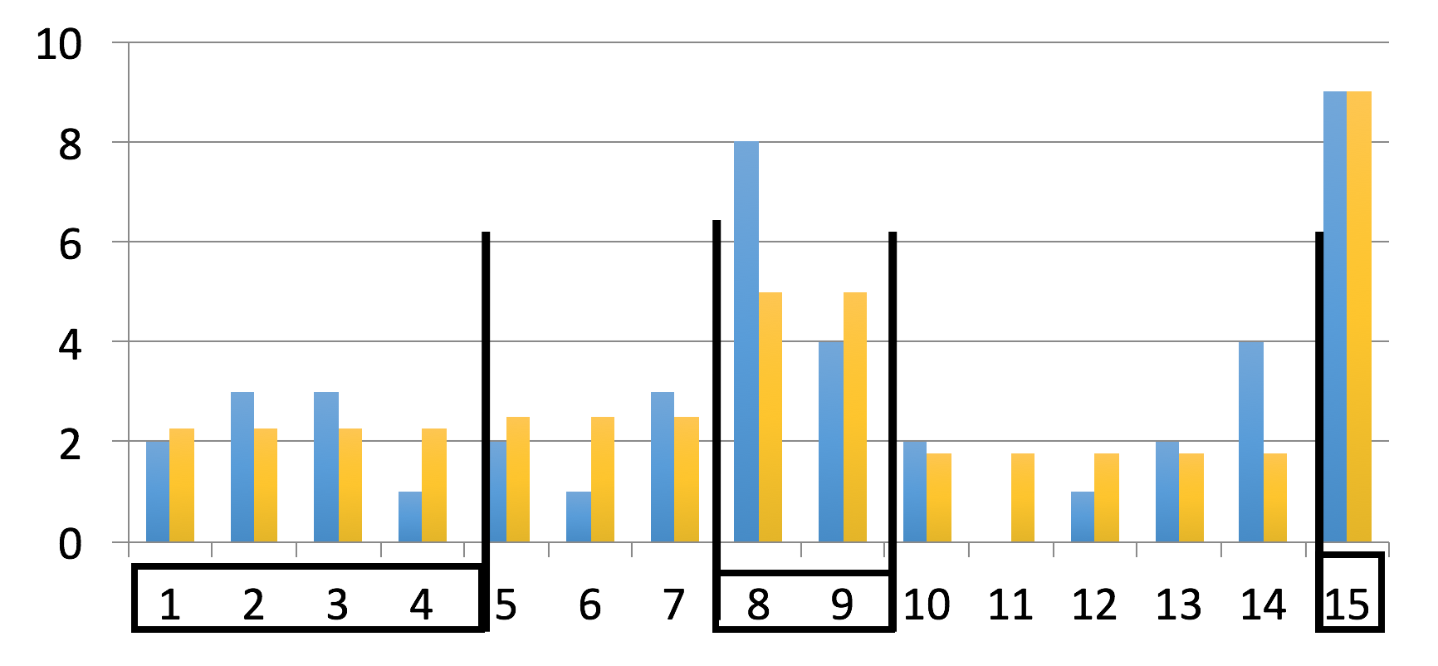
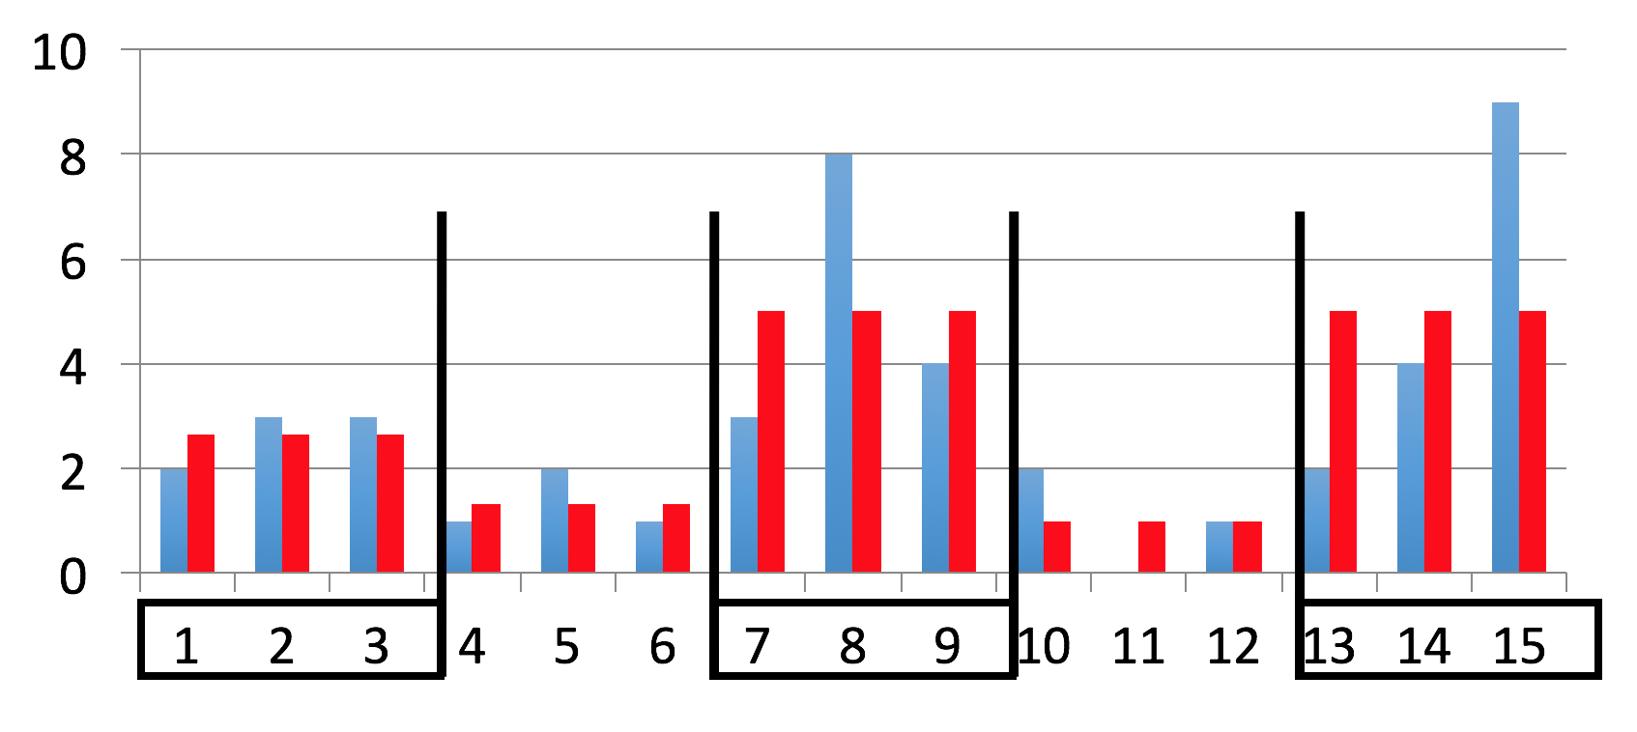
Histogram types
Final Review > Lecture 17
Equi-depth
All buckets contain roughly the same number of items (total frequency)
Equi-width
All buckets roughly the same width

