Slide 1


Web (React) Course
Polaris Studio
Lecturer: XIE Guochao (David)
SHI Xiaoyu (Ivy)

Slide 2
Course Outline
1. Introduction to HTML5 and styling skills
2. CSS3 and basic UI design
3. CDN, using libraries (Bootstrap), JavaScript Level 1
4. JavaScript Level 2
5. DOM and JavaScript Level 3
6. Introduction to React
7. React Level 1
8. React Level 2
9. React Level 3
10. React UI Examples
11. Conclusion and further study 😀

Slide 3

What is HTML5?
HTML: 超文本标记语言
超文本：不仅能显示文本，还能显示图片、视频，实现交互……
标记语言：通过特定的标记格式描述并储存网页。
HTML5: HTML的第五版，于2014年修订完成。
现在的网页基本上都是HTML5！

Slide 4

Why learn HTML5?
All platforms: Windows/ MacOS/ Linux/ Android/ iOS . . . As long as it has a browser(浏览器)
Easy to learn!
Powerful!
Open source! (You can get the source code(HTML) from any website.)

Slide 5

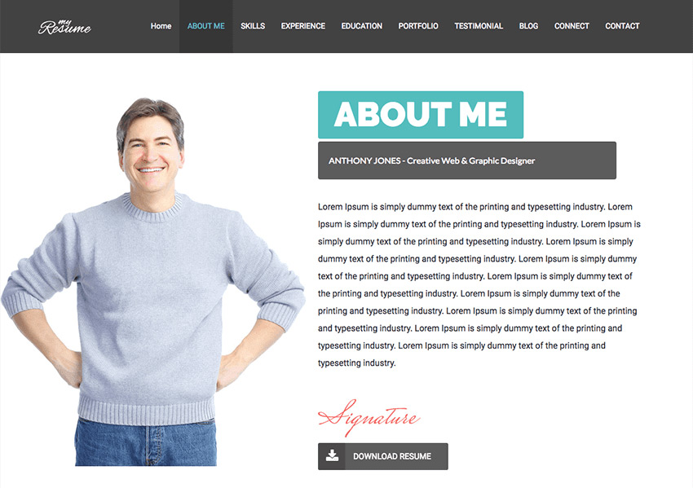
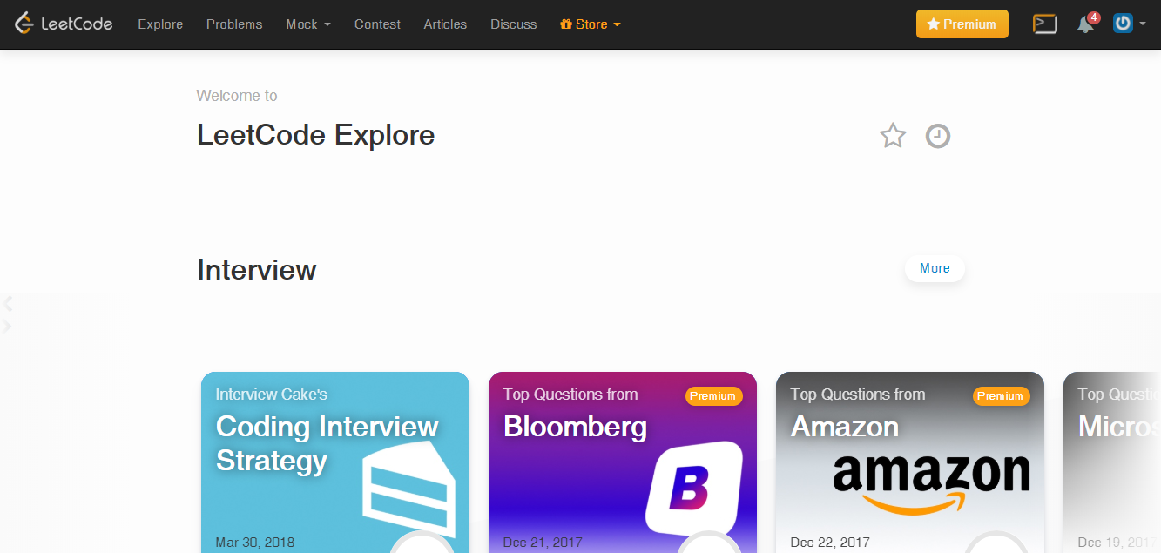
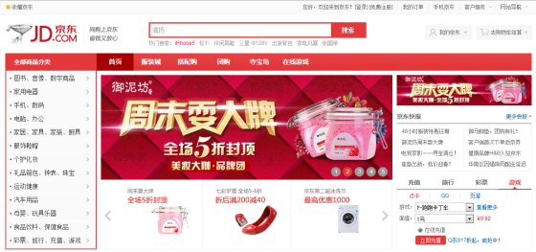
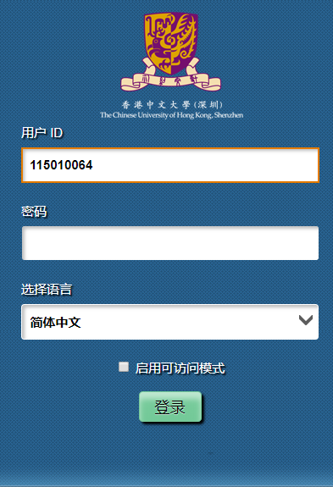

What can we do with HTML5?
Personal Website
Enterprise(Business) Website
Admin Website
Online-coding (leetcode, CodePen, Jupyter Notebook)
Mobile Apps(Facebook, Instagram, 知乎)
Desktop Apps(Visual Studio Code)

Slide 6
HTML5 – Basic Format: tags
< tag attr1=“. . .” attr2=“. . .” . . . > text & inner HTML </tag>
Or < tag atrr1=“. . .” . . . /> (without text & inner HTML)
<!-- something --> (annotation 注释）
E.g.
<text>Hello World</text> (Show Hello World on screen)
<img src=“https://www.google.com.hk/images/branding/googlelogo/2x/googlelogo_color_120x44dp.png” height=“44” width=“120”/> (Show Google icon, height = 44px, width = 120px, px:像素)

Slide 7
HTML5 – Basic Structure
<!DOCTYPE html> (Show that it is an HTML file)
<html>
<head>
Some metadata and links here.
</head>
<body>
The main part of our programming!
</body>
</html>

Slide 8
HTML5 – Useful tags
Essential tags: html, head, body
Very useful tags:
div: 容器，用于排版
h1~h6: 标题，1号最大（最重要），6号最小
text: 普通的文字
p: (paragraph) 文字段落
img: 图片
video: 视频
a: 链接
button: 按钮
main: 主要部分
Reference: http://www.w3school.com.cn/html5/html5_reference.asp
https://www.runoob.com/html/html-tutorial.html

Slide 9
HTML5 – Complex usages
How to involve one tag inside another?
<div>
<h1> Title </h1>
<p> Introduction </p>
<p> Main content </p>
</div>

Slide 10
HTML5 – Complex usages
A list 列表
<ul>
<li> <a href=“https://www.baidu.com”>百度</a> </li>
<li> <a href=“https://www.google.com.hk”>Google</a> </li>
<li> <a href=“https://github.com”>Github</a> </li>
</ul>

Slide 11
HTML5 – Complex usages
A table 表格 （tr: table row; th: table head; td: table data cell 单元格)
<table border="1">
<tr>
<th>月份</th>
<th>存款</th>
</tr>
<tr>
<td>一月</td>
<td>1000 元</td>
</tr>
</table>

Slide 12
HTML5 – Common attributions
id :可以没有，但不能重复的一个属性。
class 类：用于归类以方便设定样式。
style 样式：针对此模块特定的样式。
href 引用：对于a（超链接），设定链接的地址。
src （source）来源： 对于图片img，视频video，样式表style等设定多媒体来源。
type 类型

Slide 13
HTML5 – Short Conclusion about HTML5
HTML5 是一种标记语言
HTML5的基本单位是 tag
<tag attrs>text/inner HTML</tag> or <tag attrs/> or <!-- . . . -->
Useful tags
Useful attributions
Examples

Slide 14
HTML5 – Simple quizzes

Slide 15
HTML5 - Break

Slide 16
HTML5 – Programming demo
HTML initialization
Hello World

Slide 17
HTML5 – Styling
Why do we need styling?
To make your HTML more beautiful & user-friendly.

Slide 18
HTML5 – Styling format
key: value;
key: value;
key: value;
1. key有固定的内容；
2. 记得每个属性value之后半角（英文）分号
（回车是可选的。在HTML5中，一般不用回车；在CSS中（下节课将会讲），一般用回车分隔）

Slide 19
HTML5 – Styling keys
位置：height, width, position
边框：border, border-radius, border-width, border-style, box-shadow
边距：margin(外边距), padding(内边距)
文字：color, font-size, font-family, line-height
背景：background, background-color, background-image
透明度：opacity
Reference： https://www.runoob.com/css/css-tutorial.html
https://www.runoob.com/css3/css3-tutorial.html

Slide 20
HTML5 – Styling Examples
<div style=“border:2px solid gray; border-radius: 1rem;”>
<h1 style=“color:red”> Hello World</h1>
<img src=“https://www.google.com.hk/images/branding/googlelogo/2x/googlelogo_color_120x44dp.png” style=“height: 40px; width: 80px; box-shadow: 2px 2px 5px rgba(0, 0, 0, 0.1);” />
</div>

Slide 21

HTML5 – Group Work
Discuss about the sample personal profile.
Modify it to a group profile.

Slide 22

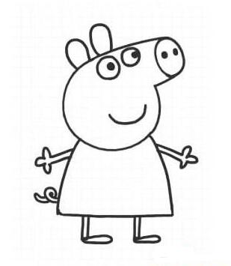
HTML5 – After class group work
Play with more tags, attributions and styles.
Use what you try to make your profile better!
Next class: each group should show their profiles, and make a short pre about what skills have been used.

