Slide 1


Web (React) Course 2 CSS & UI design
Polaris Studio
Lecturer: XIE Guochao (David)
SHI Xiaoyu (Ivy)

Slide 2
Course Outline
1. Introduction to HTML5 and styling skills
2. CSS3 and basic UI design
3. CDN, using libraries (Bootstrap), JavaScript Level 1
4. JavaScript Level 2
5. DOM and JavaScript Level 3
6. Introduction to React
7. React Level 1
8. React Level 2
9. React Level 3
10. React UI Examples
11. Conclusion and further study 😀

Slide 3
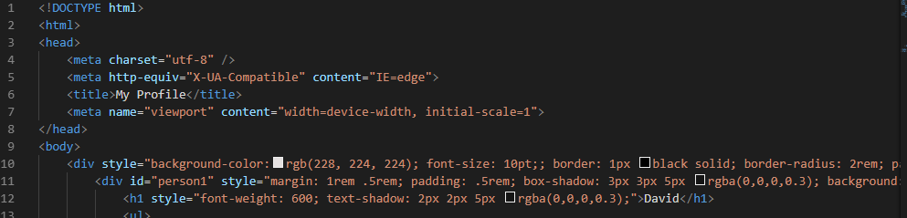
Problem
If you put styles all in your HTML file…
Unclear
Cumbersome

Slide 4
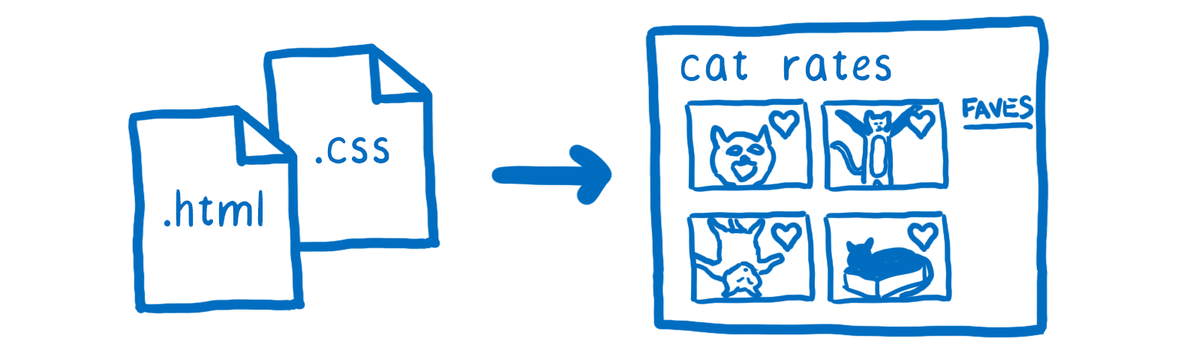
An Introduction to CSS
What is CSS?
Cascading Style Sheets
Why we use CSS?
Enable the separation of presentation and content, including layout, colors, and fonts.
简洁 美观 易读
Style可被多个页面调用
<link rel="stylesheet" type="text/css" href="style.css"/>

Slide 5
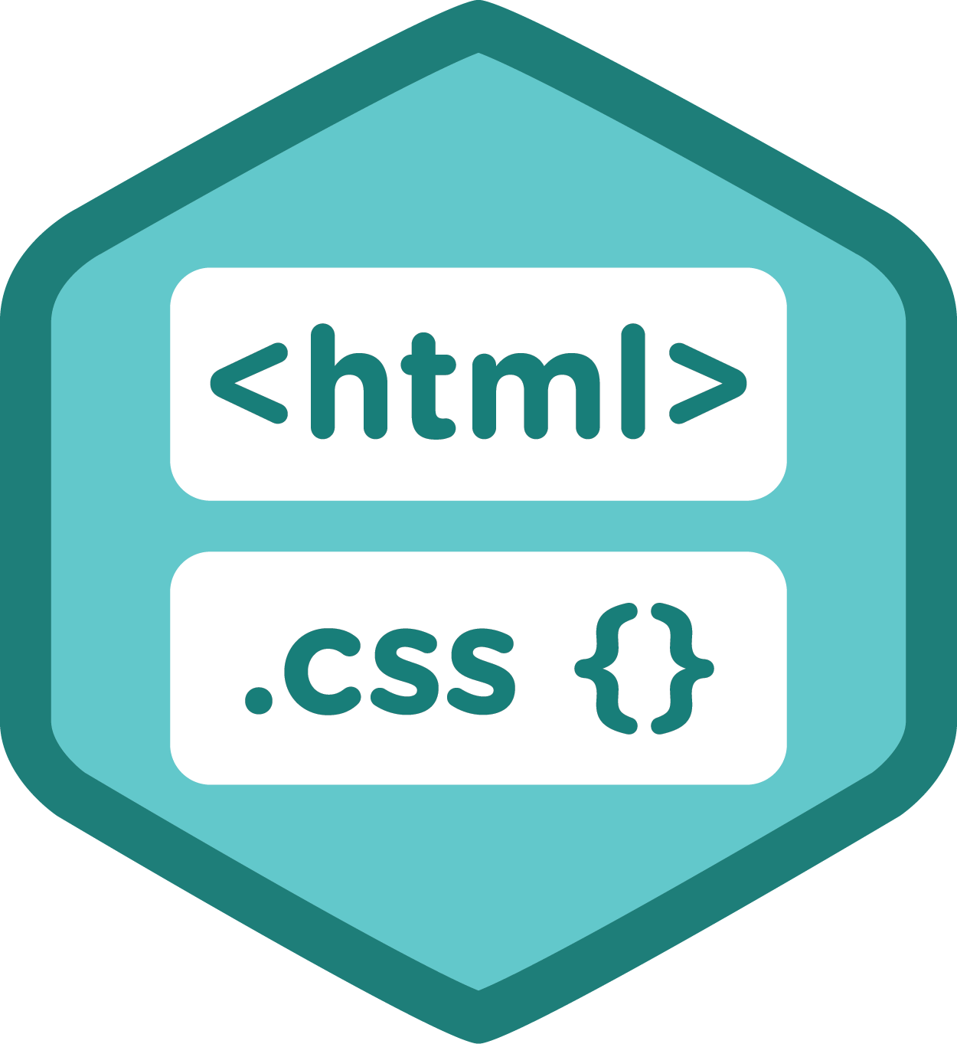
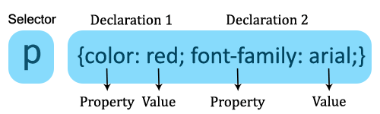
How to use CSS?
CSS Basic grammar
selector {
Declaration 1;
Declaration 2;
….
Declaration N;
}
; 分隔property
/*…*/ 加注释

Slide 6
How to use CSS?
CSS Selectors – add the style to the right element
The element Selector
The id Selector
The class Selector
Grouping Selectors
More…
http://www.w3school.com.cn/css/

Slide 7
Selectors
The element Selector
Select by tags
p { text-align: center; color: red; }
h1, h2, p, div, body, html…

Slide 8
Selectors
The id Selector
HTML:
<p id=“para1”>Show red color</p>
<p id=“para2”>Show blue color</p>
CSS:
#para1 {
color: red;
}
#para2 {
color: blue;
}
The class Selector
HTML:
<h1 class=“para”>Colorbox</p>
<p class=“para”>Show red color</p>
CSS:
.para {
text-align: center;
}
p.para {
color: red;
}

Slide 9
Selectors
Differences
一个id只可在同一个HTML文档中表示一个元素，
class可包含多个元素。
一个元素可存在于多个class中，关键词用空格隔开。
<p class=”hightlight bold”></p> selector: .highlight{} .bold{} .highlight.bold{}
id不支持这种操作。
Grouping selectors
h1, h2, p {
font-family: sans-serif;
color: yellow;
}

Slide 10
Inheritance
Children inherits their parent’s property.
HTML: <p>Hello <em>World</em>!</p>
CSS:
p {
color: purple;
}
Result: Hello World!
If we want to add different or extra properties to
the child element <em>…
CSS:
p {
color: purple;
}
em {
color: goldenrod;
font-style: bold;
}
Result: Hello World!
Cascading style sheet 层叠样式表
Inline style>id selector > class selector > tags > *
> inheritance > browser default settings

Slide 11
Review
Q1. True or False?
td.fancy {
color: #f60,
background: #666
}
HTML:
<div class="padding_" style="height:200px">
<h1 id=‘p1'>1cm</div>
<p id=‘p1'>20%</div>
</div>
CSS:
div.p1 {
color: brown;
width = 1cm;
}
Notes:
Selector错误示范

Slide 12
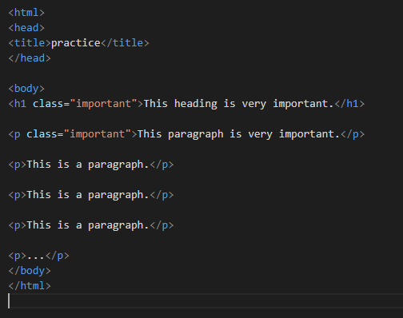
Review
Q2.
How to
set h1 and 1st paragraph:
font-color: red
set h1:
font-style: bold

Slide 13
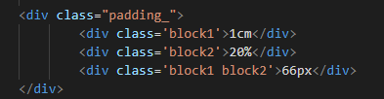
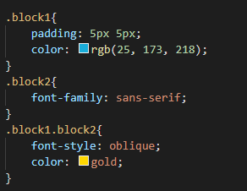
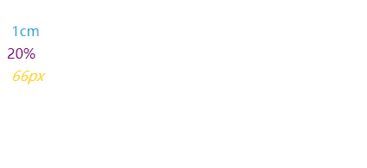
Review
Q3. What does the “66px” look like?

Slide 14
Take a break!
Next class:
Examples of selector usage（profile）
Layout：
rem, px, vh, vw,..
Flex layout
More references..
Practice:
Design a group profile~

Slide 15
To design a layout…
Layout：
Some basic properties: color, font, align…
rem, px, vh, vw,..
Flex layout
More references..
Notes:
Rem—相对于根元素
Em--相对于父元素
vw逻辑非常清晰，"1vw ＝ 1/100th viewport width"，用viewport width的百分比来设置element width。
Vh 视窗高度1%
一般默认像素为16px
Flex：https://www.runoob.com/w3cnote/flex-grammar.html

Slide 16
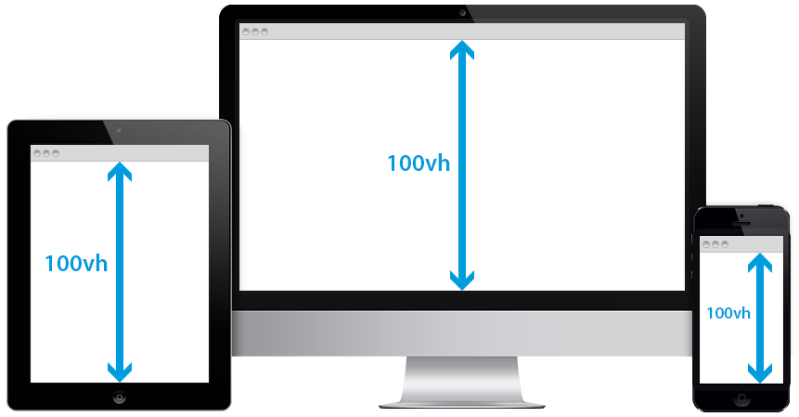
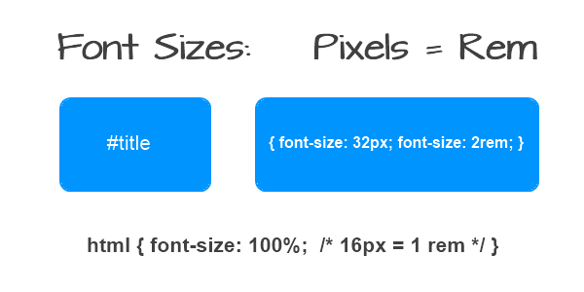
To design a layout…
Relative：rem, vh(view height), vw(view width), %
Absolute：px
0.5 rem = 0.5 * size of the root element
10 view width = 10% width of the window
Notes:
Rem—相对于根元素
Em--相对于父元素
vw逻辑非常清晰，"1vw ＝ 1/100th viewport width"，用viewport width的百分比来设置element width。
Vh 视窗高度1%
一般默认像素为16px
Flex：https://www.runoob.com/w3cnote/flex-grammar.html

Slide 17
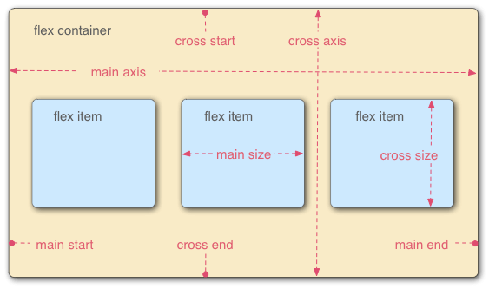

To design a layout…
Flex: a type of flexible layout
All children elements become the items in the layout
Notes:
Rem—相对于根元素
Em--相对于父元素
vw逻辑非常清晰，"1vw ＝ 1/100th viewport width"，用viewport width的百分比来设置element width。
Vh 视窗高度1%
一般默认像素为16px
Flex：https://www.runoob.com/w3cnote/flex-grammar.html

Slide 18
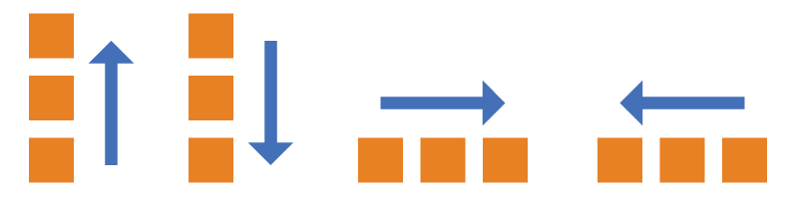
Flex
flex-direction: row | column | row-reverse | column-reverse;
PS: Main axis has the same direction as flex-direction.
Notes:
Rem—相对于根元素
Em--相对于父元素
vw逻辑非常清晰，"1vw ＝ 1/100th viewport width"，用viewport width的百分比来设置element width。
Vh 视窗高度1%
一般默认像素为16px
Flex：https://www.runoob.com/w3cnote/flex-grammar.html

Slide 19
Flex
flex-direction: row | column
| row-reverse | column-reverse;
Main axis has the same direction as flex-direction.
Notes:
Rem—相对于根元素
Em--相对于父元素
vw逻辑非常清晰，"1vw ＝ 1/100th viewport width"，用viewport width的百分比来设置element width。
Vh 视窗高度1%
一般默认像素为16px
Flex：https://www.runoob.com/w3cnote/flex-grammar.html

Slide 20
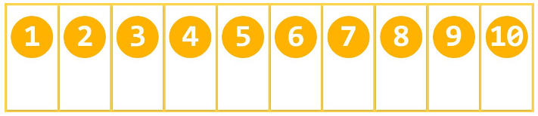
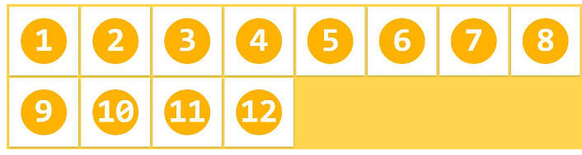
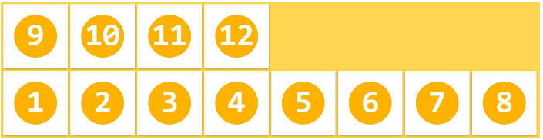

Flex
flex-wrap: nowrap | wrap | wrap-reverse;
换行方式：不换行/换行（向下排列）/换行（向上排列）
nowrap
wrap
wrap-reverse
flex-flow: 是flex-direction属性和flex-wrap属性的简写形式
default value: row || nowrap;
Notes:
Rem—相对于根元素
Em--相对于父元素
vw逻辑非常清晰，"1vw ＝ 1/100th viewport width"，用viewport width的百分比来设置element width。
Vh 视窗高度1%
一般默认像素为16px
Flex：https://www.runoob.com/w3cnote/flex-grammar.html

Slide 21
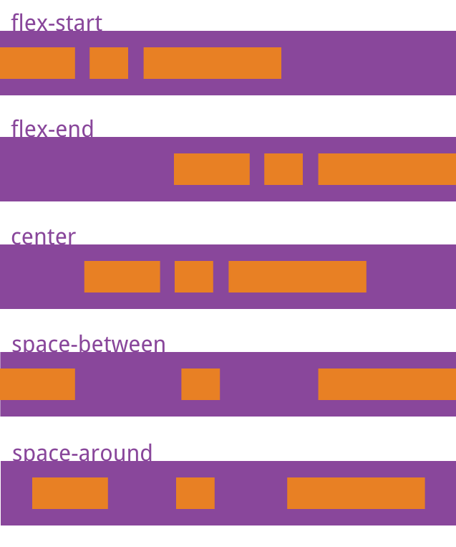
Flex
justify-content:
在主轴上的对齐方式
flex-start：左对齐(default)
flex-end：右对齐
center： 居中
space-between：两端对齐，项目之间的间隔都相等。
space-around：每个项目两侧的间隔相等。
所以，项目之间的间隔比项目与边框的间隔大一倍。
Main axis has the same direction as flex-direction.
Notes:
Rem—相对于根元素
Em--相对于父元素
vw逻辑非常清晰，"1vw ＝ 1/100th viewport width"，用viewport width的百分比来设置element width。
Vh 视窗高度1%
一般默认像素为16px
Flex：https://www.runoob.com/w3cnote/flex-grammar.html

Slide 22
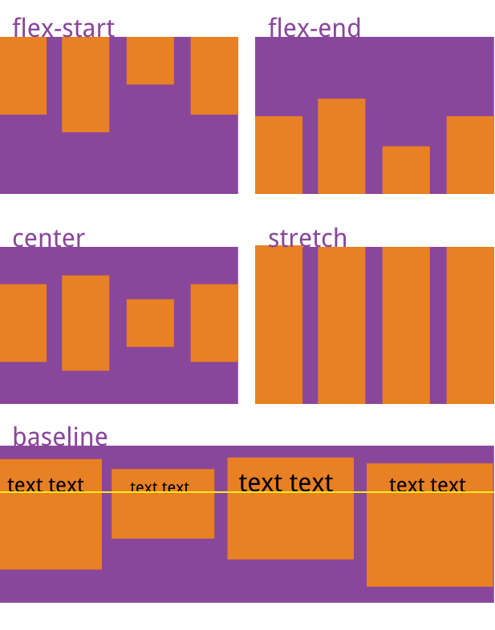
Flex
align-items
在交叉轴（垂直轴）上的对齐方式
stretch：如果项目未设置高度或设为auto，
将占满整个容器的高度(default)。
flex-start：交叉轴的起点对齐。
flex-end：交叉轴的终点对齐。
center：交叉轴的中点对齐。
baseline: 项目的第一行文字的基线对齐。
Notes:
Rem—相对于根元素
Em--相对于父元素
vw逻辑非常清晰，"1vw ＝ 1/100th viewport width"，用viewport width的百分比来设置element width。
Vh 视窗高度1%
一般默认像素为16px
Flex：https://www.runoob.com/w3cnote/flex-grammar.html

Slide 23
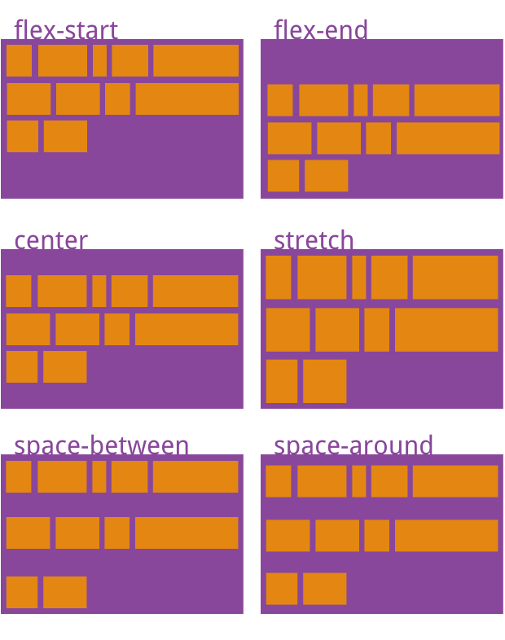
Flex
*align-content
多根轴线的对齐方式
Main axis has the same direction as flex-direction.
https://www.runoob.com/w3cnote/flex-grammar.html
Notes:
Rem—相对于根元素
Em--相对于父元素
vw逻辑非常清晰，"1vw ＝ 1/100th viewport width"，用viewport width的百分比来设置element width。
Vh 视窗高度1%
一般默认像素为16px
Flex：https://www.runoob.com/w3cnote/flex-grammar.html

Slide 24
Review
Q1. If we want to define the font with half of the default size, which unit can we use?
A. rem
B. %
C. em
D. px
The value is ___.

Slide 25
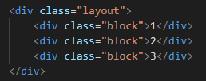


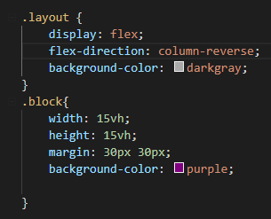

Review
Q2. Describe where do the blocks locate.
A
B
C

Slide 26
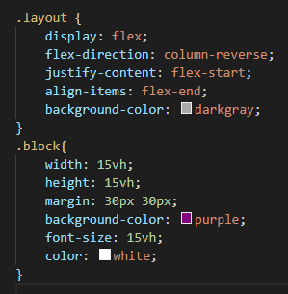
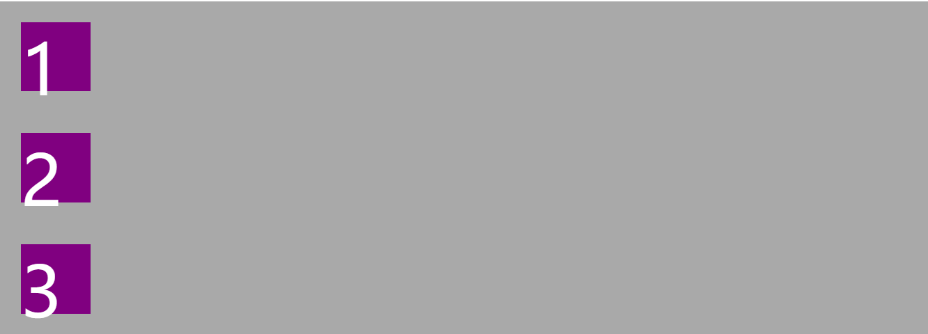
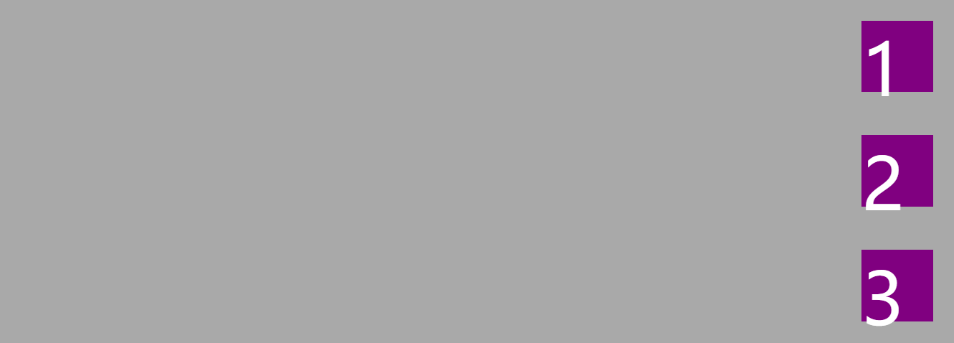
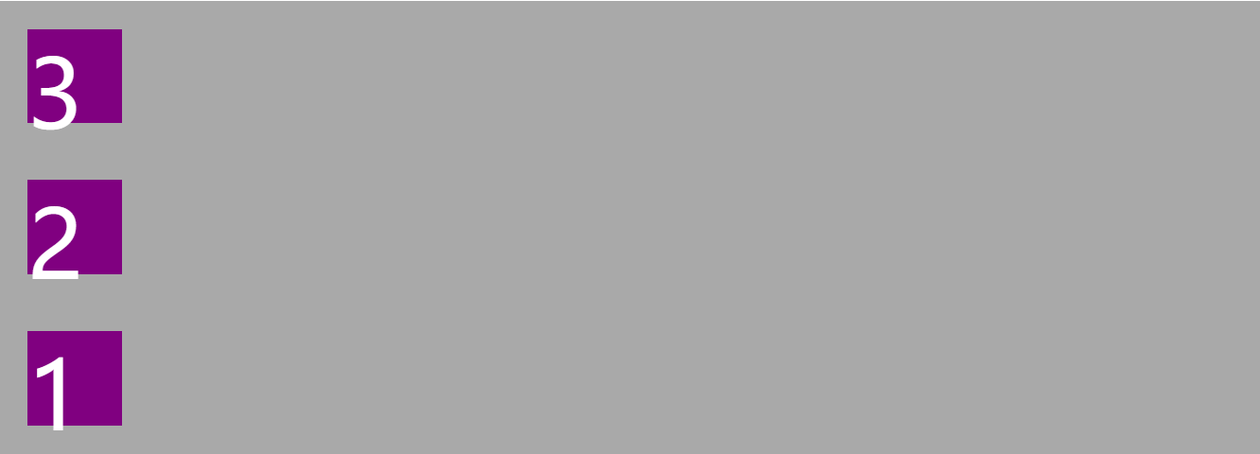
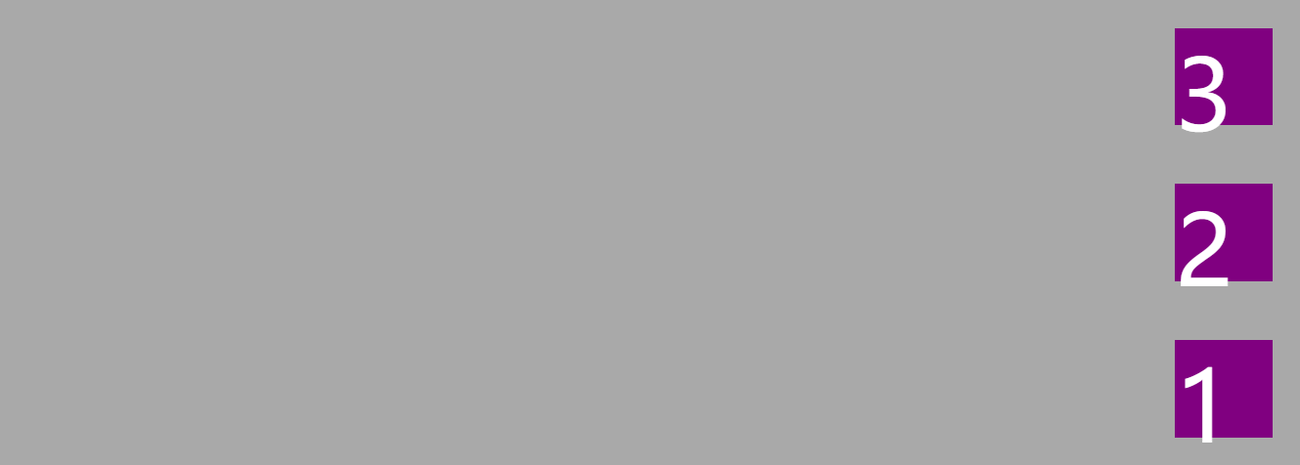
Review
Q3. Describe where do the blocks locate.
A C
B D

Slide 27

Practice: design your group profile!
You can change the
Content
Color, font
Layout
……
FYI：http://www.w3school.com.cn/css/index.asp

Slide 28
Group Work
Copy the bootstrap.css and bootstrap-grid.css （mycss.css is alternative）to your folder.
Add them to your link-stylesheet.
Try to use some fancy UI to develop your profile.
HOW to use? https://v4.bootcss.com/docs/4.0/getting-started/introduction/
Example: bootstrapExample.html

