Slide 1


Web (React) Course 2 CSS & UI design
Polaris Studio
Lecturer: XIE Guochao (David)
SHI Xiaoyu (Ivy)

Slide 2
Course Outline
1. Introduction to HTML5 and styling skills
2. CSS3 and basic UI design
3. CDN, using libraries (Bootstrap), JavaScript Level 1
4. JavaScript Level 2
5. DOM and JavaScript Level 3
6. Introduction to React
7. React Level 1
8. React Level 2
9. React Level 3
10. React UI Examples
11. Conclusion and further study 😀

Slide 3
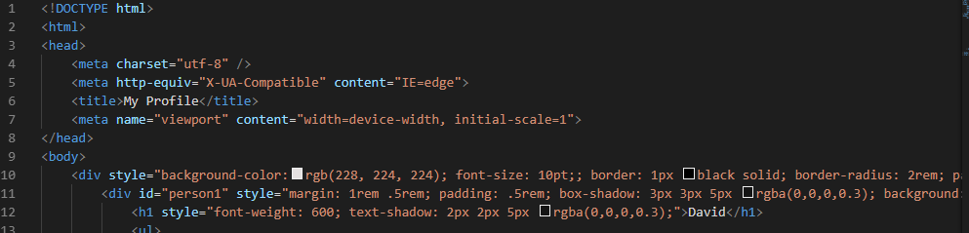
Problem
If you put styles all in your HTML file…
Unclear
Cumbersome

Slide 4
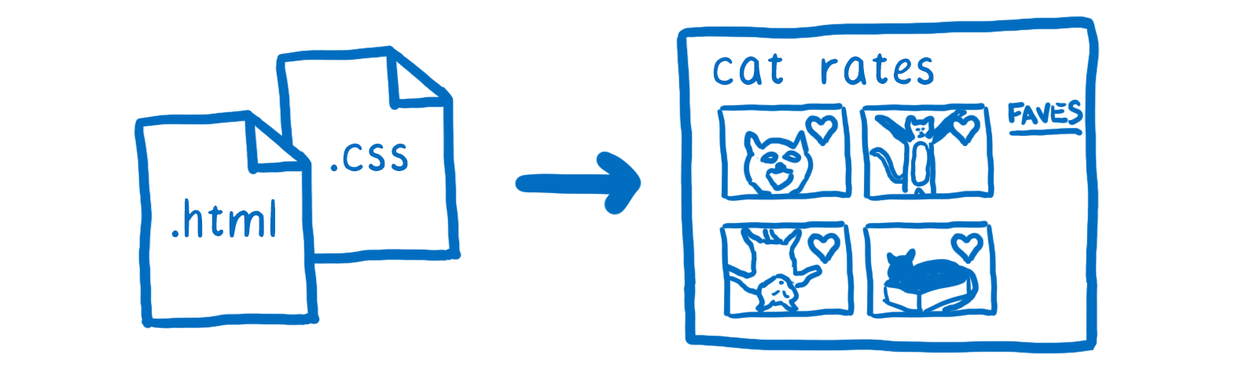
An Introduction to CSS
What is CSS?
Cascading Style Sheets
Why we use CSS?
Enable the separation of presentation and content, including layout, colors, and fonts.
简洁 美观 易读
Style可被多个页面调用
<link rel="stylesheet" type="text/css" href="style.css"/>

Slide 5

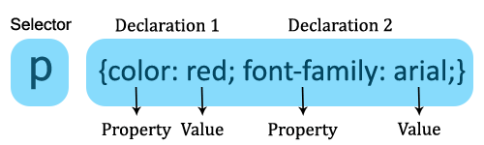
How to use CSS?
CSS Basic grammar
selector {
Declaration 1;
Declaration 2;
….
Declaration N;
}
; 分隔property
/*…*/ 加注释

Slide 6
How to use CSS?
CSS Selectors – add the style to the right element
The element Selector
The id Selector
The class Selector
Grouping Selectors
More…
http://www.w3school.com.cn/css/

Slide 7
Selectors
The element Selector
Select by tags
p { text-align: center; color: red; }
h1, h2, p, div, body, html…

Slide 8
Selectors
The id Selector
HTML:
<p id=“para1”>Show red color</p>
<p id=“para2”>Show blue color</p>
CSS:
#para1 {
color: red;
}
#para2 {
color: blue;
}
The class Selector
HTML:
<h1 class=“para”>Colorbox</p>
<p class=“para”>Show red color</p>
CSS:
.para {
text-align: center;
}
p.para {
color: red;
}

Slide 9
Selectors
Differences
一个id只可在同一个HTML文档中表示一个元素，
class可包含多个元素。
一个元素可存在于多个class中，关键词用空格隔开。
<p class=”hightlight bold”></p> selector: .highlight{} .bold{} .highlight.bold{}
id不支持这种操作。
Grouping selectors
h1, h2, p {
font-family: sans-serif;
color: yellow;
}

Slide 10
Inheritance
Children inherits their parent’s property.
HTML: <p>Hello <em>World</em>!</p>
CSS:
p {
color: purple;
}
Result: Hello World!
If we want to add different or extra properties to
the child element <em>…
CSS:
p {
color: purple;
}
em {
color: goldenrod;
font-style: bold;
}
Result: Hello World!
Cascading style sheet 层叠样式表
Inline style>id selector > class selector > tags > *
> inheritance > browser default settings

Slide 11
Anchor pseudo classes
a:link {color: #FF0000} /* 未访问的链接 */
a:visited {color: #00FF00} /* 已访问的链接 */
a:hover {color: #FF00FF} /* 鼠标移动到链接上 */
a:active {color: #0000FF} /* 选定的链接 */
transition: 产生动画过渡效果。
transition: property duration(time) timing-function delay(time);

Slide 12
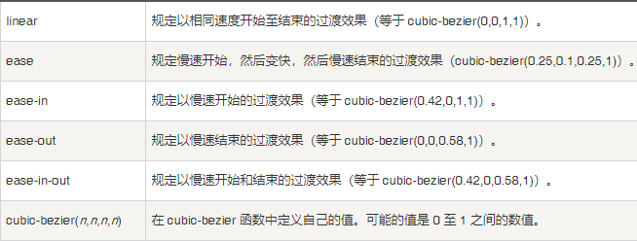
Anchor pseudo classes
transition: 产生动画过渡效果
transition: property duration(time) timing-function delay(time);
Property：需要过渡的样式属性（支持transition的任意属性）
Duration time：过渡时长
Timing-function：切换效果的速度
Delay time：延时过渡
FYI：http://www.runoob.com/cssref/css3-pr-transition.html 基础 https://www.cnblogs.com/cc156676/p/5785112.html 进阶

Slide 13
Review
Q1. True or False?
td.fancy {
color: #f60,
background: #666
}
HTML:
<div class="padding_" style="height:200px">
<h1 id=‘p1'>1cm</div>
<p id=‘p1'>20%</div>
</div>
CSS:
div.p1 {
color: brown;
width = 1cm;
}
Notes:
Selector错误示范

Slide 14
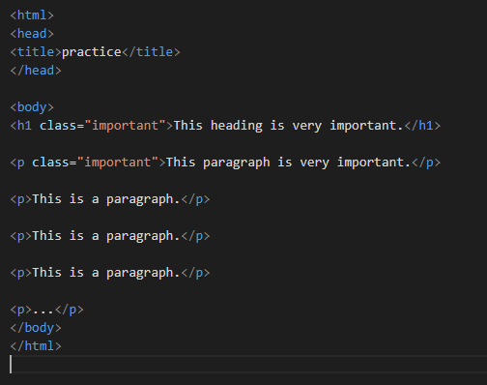
Review
Q2.
How to
set h1 and 1st paragraph:
font-color: red
set 1st paragraph:
font-style: bold

Slide 15
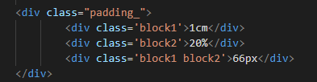
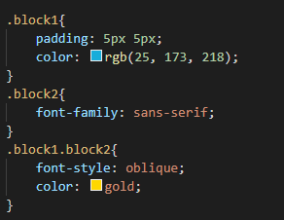
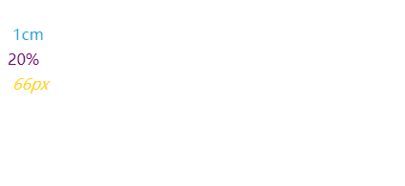
Review
Q3. What does the “66px” look like?

Slide 16
Take a break!
Next class:
Examples of selector usage（profile）
Layout：
rem, px, vh, vw,..
Flex layout
More references..
Practice:
Design a group profile~

Slide 17
To design a layout…
Layout：
Some basic properties: color, font, align…
rem, px, vh, vw,..
Flex layout
More references..
Notes:
Rem—相对于根元素
Em--相对于父元素
vw逻辑非常清晰，"1vw ＝ 1/100th viewport width"，用viewport width的百分比来设置element width。
Vh 视窗高度1%
一般默认像素为16px
Flex：https://www.runoob.com/w3cnote/flex-grammar.html

Slide 18
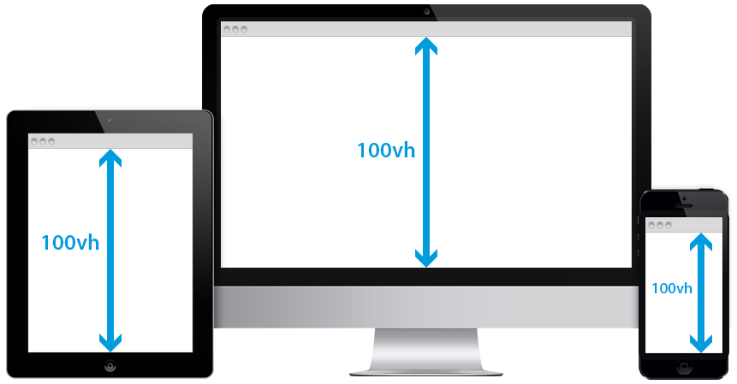
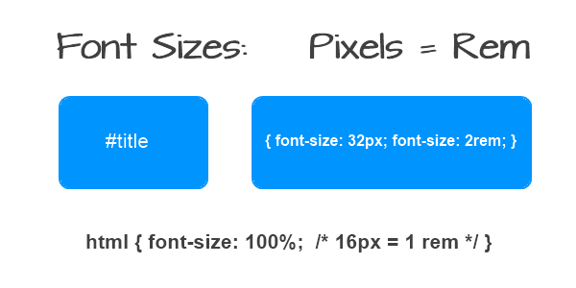
To design a layout…
Relative：rem, vh(view height), vw(view width), %
Absolute：px
0.5 rem = 0.5 * size of the root element
10 view width = 10% width of the window
Notes:
Rem—相对于根元素
Em--相对于父元素
vw逻辑非常清晰，"1vw ＝ 1/100th viewport width"，用viewport width的百分比来设置element width。
Vh 视窗高度1%
一般默认像素为16px
Flex：https://www.runoob.com/w3cnote/flex-grammar.html

Slide 19
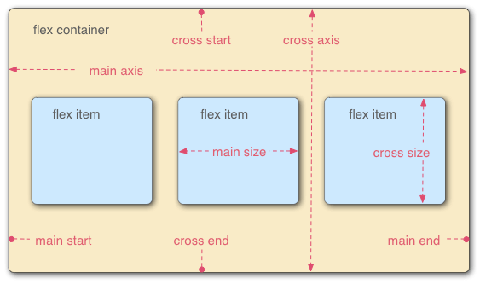

To design a layout…
Flex: a type of flexible layout
All children elements become the items in the layout
Notes:
Rem—相对于根元素
Em--相对于父元素
vw逻辑非常清晰，"1vw ＝ 1/100th viewport width"，用viewport width的百分比来设置element width。
Vh 视窗高度1%
一般默认像素为16px
Flex：https://www.runoob.com/w3cnote/flex-grammar.html

Slide 20
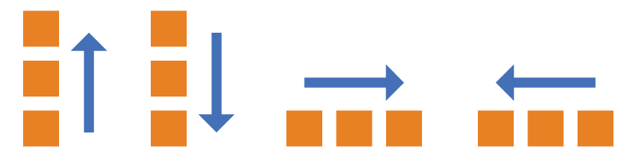
Flex
flex-direction: row | column | row-reverse | column-reverse;
PS: Main axis has the same direction as flex-direction.
Notes:
Rem—相对于根元素
Em--相对于父元素
vw逻辑非常清晰，"1vw ＝ 1/100th viewport width"，用viewport width的百分比来设置element width。
Vh 视窗高度1%
一般默认像素为16px
Flex：https://www.runoob.com/w3cnote/flex-grammar.html

Slide 21
Flex
flex-direction: row | column
| row-reverse | column-reverse;
Main axis has the same direction as flex-direction.
Notes:
Rem—相对于根元素
Em--相对于父元素
vw逻辑非常清晰，"1vw ＝ 1/100th viewport width"，用viewport width的百分比来设置element width。
Vh 视窗高度1%
一般默认像素为16px
Flex：https://www.runoob.com/w3cnote/flex-grammar.html

Slide 22
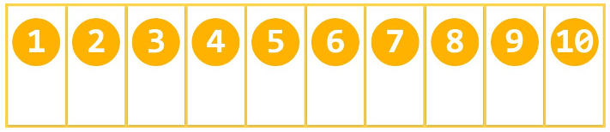
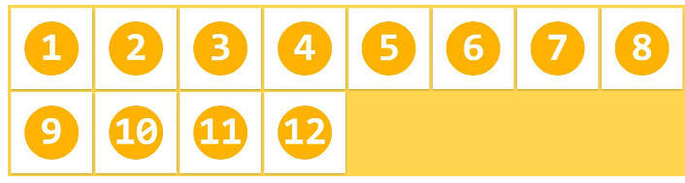
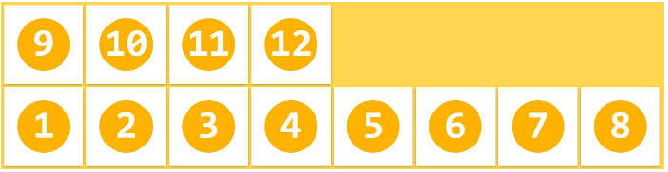

Flex
flex-wrap: nowrap | wrap | wrap-reverse;
换行方式：不换行/换行（向下排列）/换行（向上排列）
nowrap
wrap
wrap-reverse
flex-flow: 是flex-direction属性和flex-wrap属性的简写形式
default value: row nowrap;
Notes:
Rem—相对于根元素
Em--相对于父元素
vw逻辑非常清晰，"1vw ＝ 1/100th viewport width"，用viewport width的百分比来设置element width。
Vh 视窗高度1%
一般默认像素为16px
Flex：https://www.runoob.com/w3cnote/flex-grammar.html

Slide 23
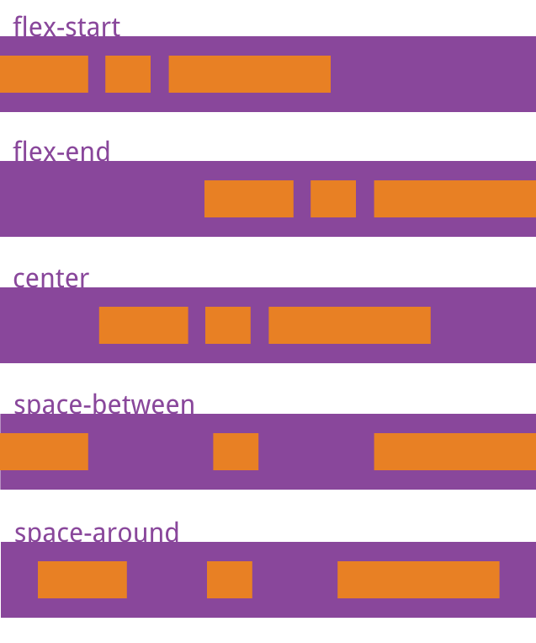
Flex
justify-content:
在主轴上的对齐方式
flex-start：左对齐(default)
flex-end：右对齐
center： 居中
space-between：两端对齐，项目之间的间隔都相等。
space-around：每个项目两侧的间隔相等。
所以，项目之间的间隔比项目与边框的间隔大一倍。
Main axis has the same direction as flex-direction.
Notes:
Rem—相对于根元素
Em--相对于父元素
vw逻辑非常清晰，"1vw ＝ 1/100th viewport width"，用viewport width的百分比来设置element width。
Vh 视窗高度1%
一般默认像素为16px
Flex：https://www.runoob.com/w3cnote/flex-grammar.html

Slide 24
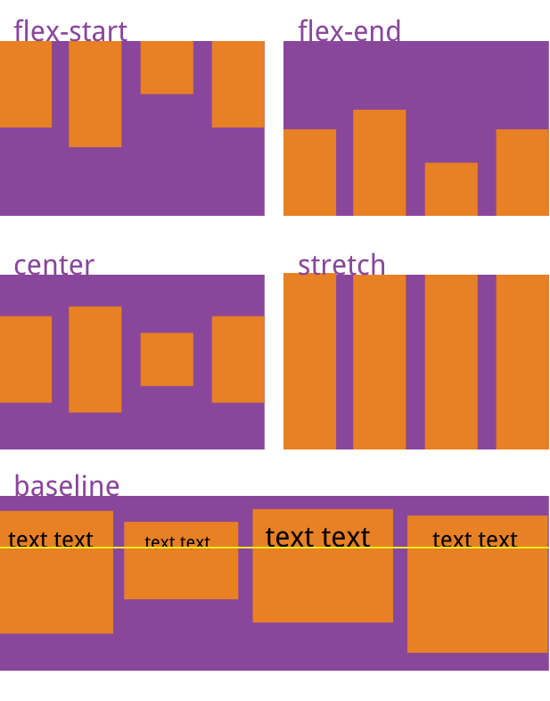
Flex
align-items
在交叉轴（垂直轴）上的对齐方式
stretch：如果项目未设置高度或设为auto，
将占满整个容器的高度(default)。
flex-start：交叉轴的起点对齐。
flex-end：交叉轴的终点对齐。
center：交叉轴的中点对齐。
baseline: 项目的第一行文字的基线对齐。
Notes:
Rem—相对于根元素
Em--相对于父元素
vw逻辑非常清晰，"1vw ＝ 1/100th viewport width"，用viewport width的百分比来设置element width。
Vh 视窗高度1%
一般默认像素为16px
Flex：https://www.runoob.com/w3cnote/flex-grammar.html

Slide 25
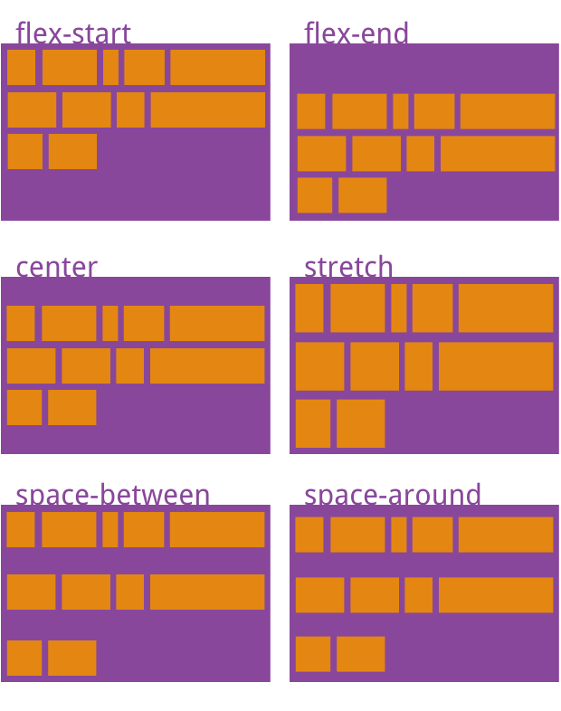
Flex
*align-content
多根轴线的对齐方式
Main axis has the same direction as flex-direction.
https://www.runoob.com/w3cnote/flex-grammar.html
Notes:
Rem—相对于根元素
Em--相对于父元素
vw逻辑非常清晰，"1vw ＝ 1/100th viewport width"，用viewport width的百分比来设置element width。
Vh 视窗高度1%
一般默认像素为16px
Flex：https://www.runoob.com/w3cnote/flex-grammar.html

Slide 26
Review
Q1. If we want to define the font with half of the default size, which unit can we use?
A. rem
B. %
C. em
D. px
The value is ___.

Slide 27
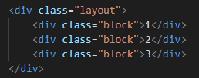

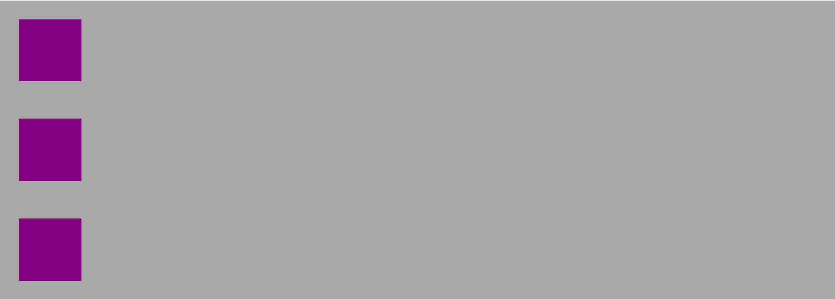
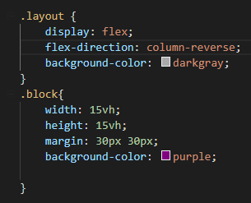

Review
Q2. Describe where do the blocks locate.
A
B
C

Slide 28
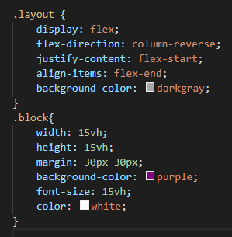
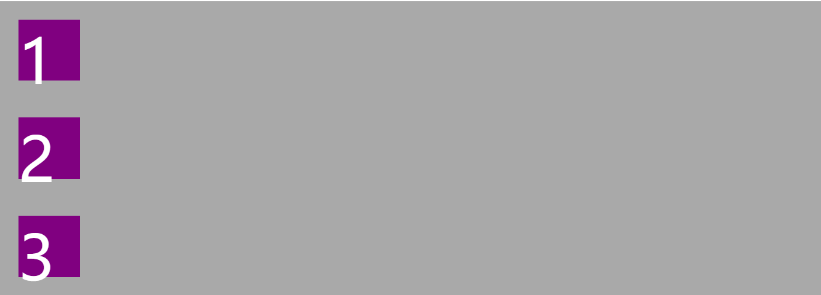
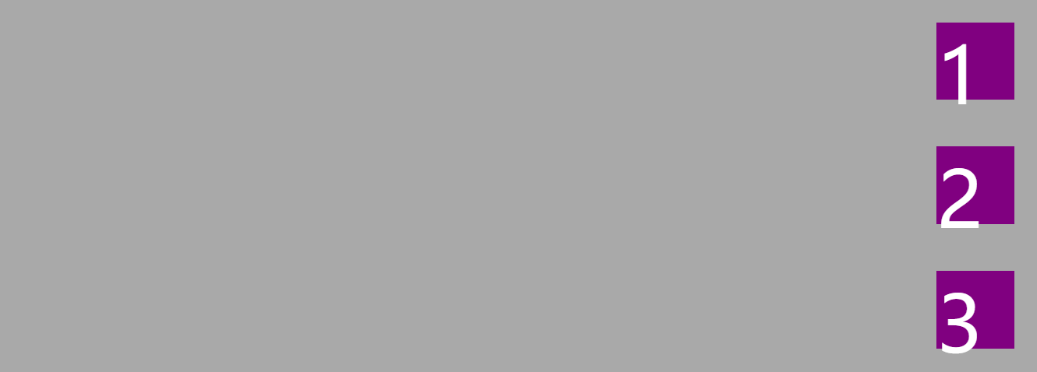
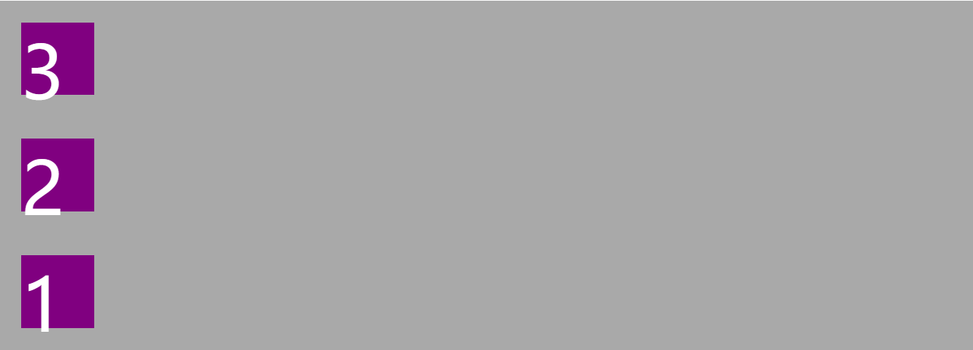
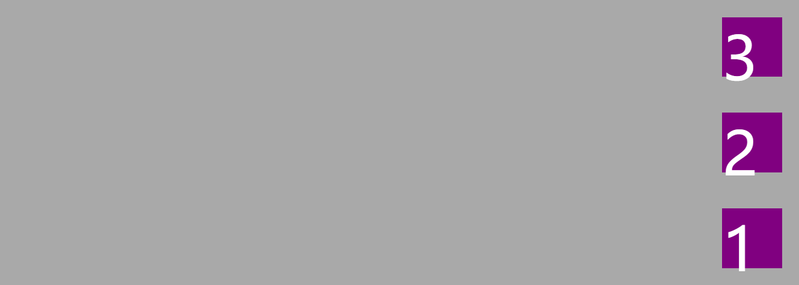
Review
Q3. Describe where do the blocks locate.
A C
B D

Slide 29

Practice: design your group profile!
You can change the
Content
Color, font
Layout
……
FYI：http://www.w3school.com.cn/css/index.asp

Slide 30
Group Work
Copy the bootstrap.css and bootstrap-grid.css （mycss.css is alternative）to your folder.
Add them to your link-stylesheet.
Try to use some fancy UI to develop your profile.
Because we haven’t learnt JavaScript, we may not be able to use the dynamic UI now. But don’t worry, we will cover it very soon!
HOW to use? https://v4.bootcss.com/docs/4.0/getting-started/introduction/
Example: bootstrapExample.html

