Slide 1
Blockchain Programing
Revision: 2025
Slides: Henri LIEUTAUD, reworked & updated by Nathan HERVIER

Slide 2

Wallet management
BIP 39
BIP 32
Today’s agenda+

Slide 3
BIP 39

Slide 4
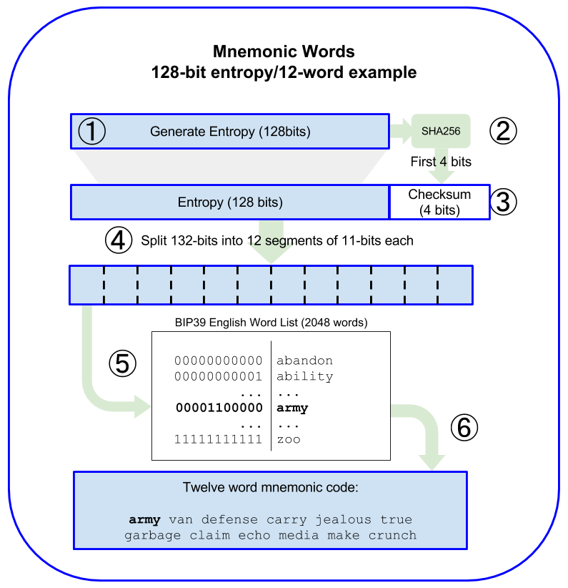
The seed of a wallet is a random number that allows the generation of the wallet's keys.
To facilitate the generation and storage of this seed, BIP39 specifies a mechanism to represent the seed with a set of specific words.
Different standards and dictionaries are used by different cryptocurrencies and wallets.
Seeds & Mnemonics BIP 39

Slide 5
Seeds & Mnemonics BIP 39
https://github.com/bitcoin/bips/blob/master/bip-0039.mediawiki
https://github.com/bitcoinbook/bitcoinbook/blob/develop/ch05.asciidoc

Slide 6
BIP 32

Slide 7
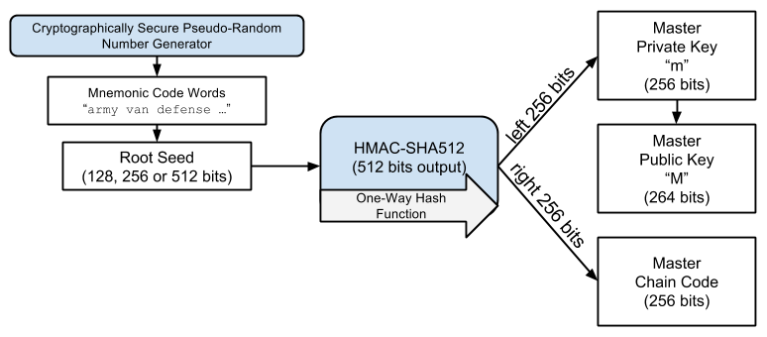
Recovery of a wallet from its seed:
Two pieces of information are generated:
Master private key, to manage funds with an initial address.
Master chain code, to introduce entropy and generate subsequent keys.
Extended public key: Private/public key + chain code.
Recovery of a wallet from its seed:
Two pieces of information are generated:
Master private key, to manage funds with an initial address.
Master chain code, to introduce entropy and generate subsequent keys.
- Extended public key: Private/public key + chain code.
HD Wallets structure BIP 43/44

Slide 8
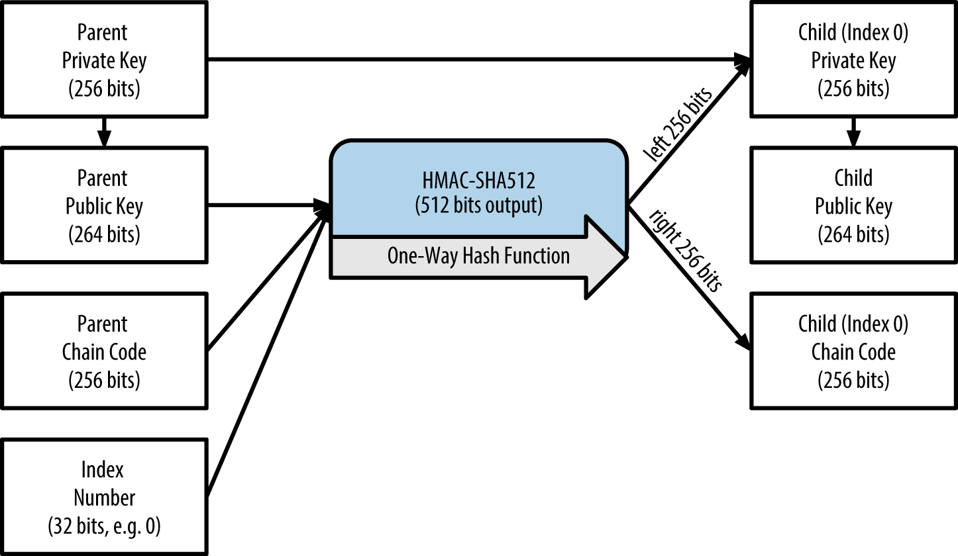
Child Key Generation
Each generation has attributes that allow for the creation of a subsequent generation.
It's possible to generate the tree from an Xpub, in a secure manner (only the pubKeys/addresses).
HD Wallets structure BIP 43/44

Slide 9
HD Wallets structure BIP 43/44
https://github.com/bitcoin/bips/blob/master/bip-0043.mediawiki
https://github.com/bitcoinbook/bitcoinbook/blob/develop/ch05.asciidoc

Slide 10
Tasks list

Slide 11
Create a GitHub repository and share it with me.
Create an interactive Python, Rust, TS or JS command-line program (2pts).
Generate a random integer that can serve as a safe seed for a wallet (2pts).
Represent this seed in binary/bytes/hex and divide it into lots of 11 bits (2pts).
Assign a word to each lot according to the BIP 39 list and display the seed in mnemonic form (2pts).
Allow the import of a mnemonic seed (2pts).
Verify the keys you generate on https://iancoleman.io/bip39/.
BIP 39

Slide 12
Extract the master private key and the chain code (2pts).
Extract the master public key (2pts).
Generate a child key (2pts).
Generate a child key at index N (2pts).
Generate a child key at index N at derivation level M (2pts).
BIP 32

Slide 13
You can do it in groups
Python, Rust, TS or JS
Code executable from the command line.
No precompiled imported libraries (e.g., Bitcoin lib), just math (HMAC 256, ECDSA, etc).
Importing libraries is ok to generate public keys from private keys, and for code verification.
Instructions to run you program in your readme.md.
write you report in the readme.md
Contraintes

Slide 14
Ressources utiles
https://github.com/bitcoinbook/bitcoinbook/blob/develop/ch06.asciidoc
Electrum

