Slide 1




NETFLIX
CAPSTONE PROJECT PRESENTATION
Exploratory Data Analysis of Netflix Catalog Trends: Geographical, Demographic, and Quality Insights
TEAM TECHNOVA

Slide 2
NETFLIX CONTENT ANALYSIS
Netflix Content Analysis: Trends, Success Drivers & Content Gaps
PROBLEM STATEMENT
Netflix has a huge global catalog, but it is not clear what actually makes a title successful or where the library falls short. This project uses Python-based statistical analysis and visualizations to study content trends, identify the factors behind successful shows and movies, and spot gaps in the content library.
OUR APPROACH
Data cleaning
→
Exploratory analysis
→
Statistical testing (Pearson)
→
Opportunity modelling
Notes:
Netflix has a huge global catalog, but it is not clear what makes a title successful or where the library falls short. We used Python-based statistical analysis and visualizations to study content trends, find the factors behind successful shows and movies, and spot gaps. Approach: clean the data, explore it, test relationships with Pearson correlation, then model opportunities.

Slide 3

Data Cleaning & Preparation
Load titles.csv
→
Drop missing scores
→
Fix list columns
→
Fill gaps
→
Load credits.csv
→
Ready
LOADED
titles.csv (titles)
credits.csv (cast & crew)
CLEANED
Dropped rows with no IMDb score
Fixed list columns: genres, production_countries → real Python lists
FILLED
Seasons → 0 (movies)
Age certification → "Unrated"
Runtime → median
TAKEAWAY Clean dataset, ready for analysis.

Slide 4
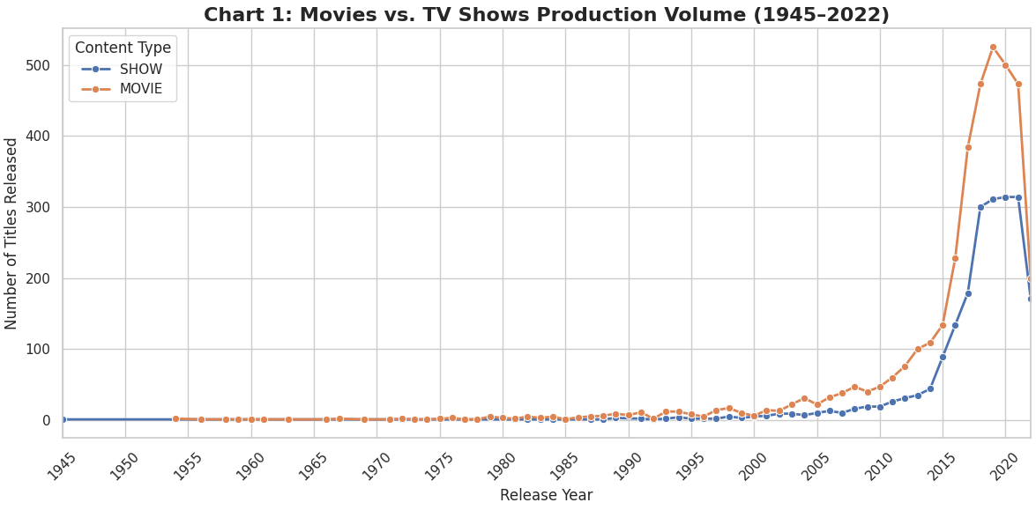
Movies vs TV Shows: Production 1945–2022
Very low and stable for both until 2000
After 2000, growth begins with Movies always above TV Shows
Huge boom after 2015, peaking around 2018–19 with 500+ Movies
Sharp drop in 2020–22, likely COVID-19 impact
Notes:
This graph shows Movie vs TV Show production from 1945 to 2022. From 1945 to 2000, production was very low and stable for both. After 2000, growth started, with Movies always higher than TV Shows. After 2015 there is a huge boom, especially for Movies. Production peaked around 2018-2019 with over 500 Movies. In 2020-2022 there is a sharp drop, likely due to COVID-19 impact.

Slide 5
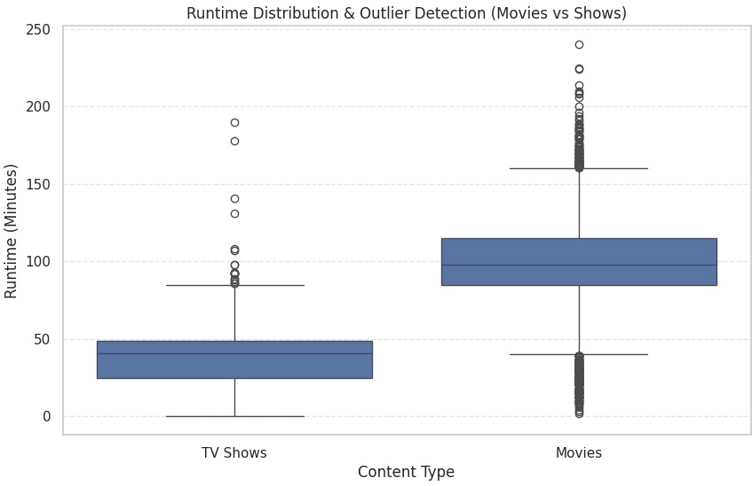
Runtime: TV Shows vs Movies
TV Shows are shorter: average about 40 min, mostly 25–50
Movies are longer: average about 100 min, mostly 85–115
The blue box shows where most content lies; dots are outliers
Movies have more outliers, up to 240 min, and some very short ones
Notes:
This graph compares the runtime of TV Shows vs Movies. TV Shows average around 40 minutes, mostly between 25 and 50. Movies average around 100 minutes, mostly between 85 and 115. The blue box shows where most of the content lies. The dots above and below are outliers, meaning unusual runtimes. Movies have more outliers, with some very long movies (up to 240 mins) and some very short ones.

Slide 6
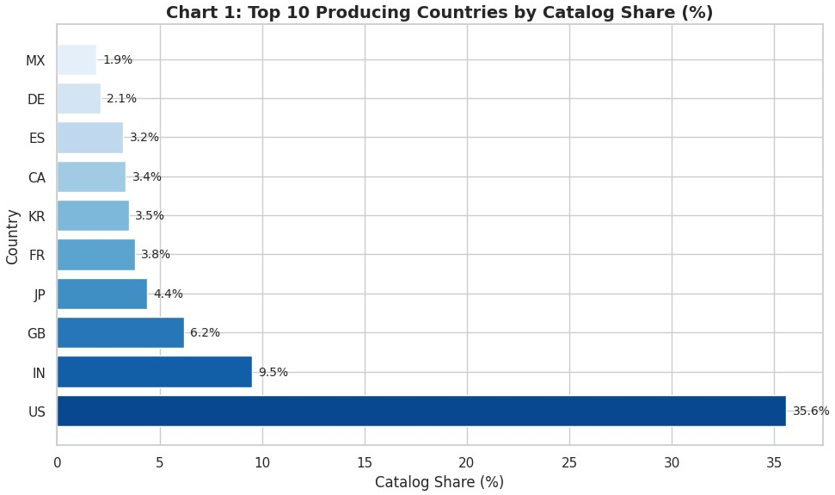
Where Does Netflix Content Come From?
The US leads by a huge margin with 35.6% of titles
India ranks second (9.5%), driven by Bollywood and Indian Originals
UK, Japan and South Korea form strong regional hubs
Local content strategy: produce in key markets to retain regional subscribers
TAKEAWAY Netflix is not dependent only on Hollywood.
Notes:
The United States leads by a huge margin, with nearly 35-40% of all Netflix titles originating from the US. India ranks second, driven by the massive Bollywood industry and Netflix's growing investment in Indian Originals. The UK, Japan and South Korea form strong regional hubs, reflecting Netflix's push for global, culturally diverse content. Netflix follows a local content strategy, producing in key markets to retain regional subscribers worldwide.

Slide 7
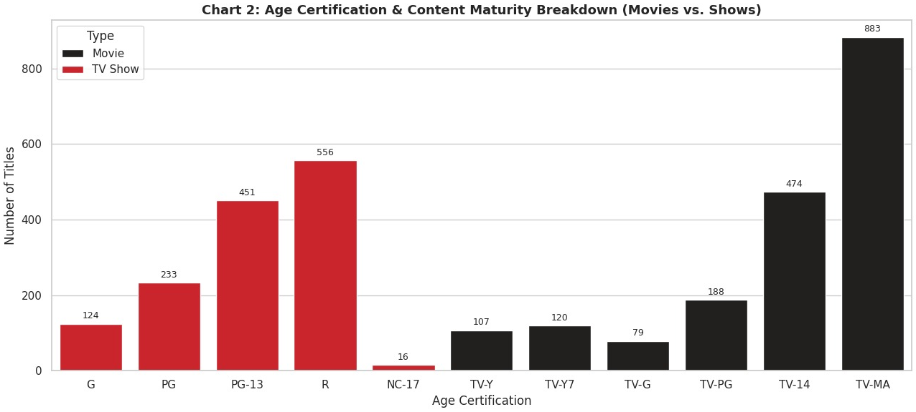
Who Is Netflix Really Making Content For?
TV-MA dominates TV Shows: most series are rated for mature audiences
For Movies, R and TV-14 are the top ratings
Very little G, PG or TV-Y: family and kids content is a small fraction
Core strategy targets adult viewers aged 18+
TAKEAWAY Netflix mainly targets teenagers and adults.
Notes:
TV-MA dominates TV Shows: the majority of Netflix series are rated for mature audiences only. For Movies, R and TV-14 are the top ratings, confirming adult-oriented storytelling across both formats. Very little content is rated G, PG or TV-Y, so family and children's content is a small fraction of the catalog. Netflix's core strategy is clearly targeted at adult viewers aged 18 and above.

Slide 8
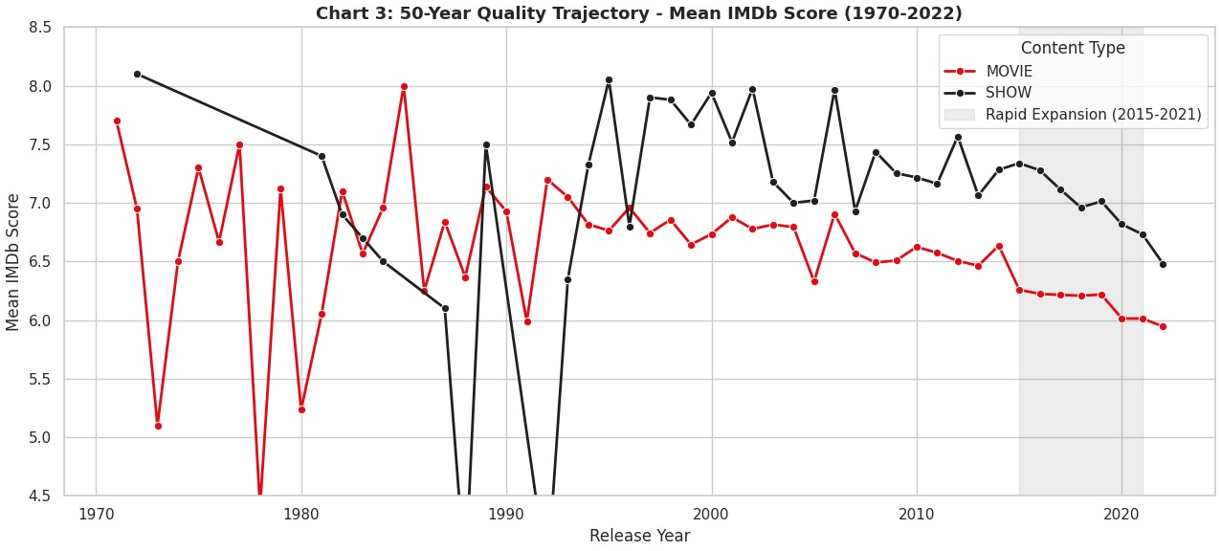
Did Netflix's Rapid Growth Hurt Content Quality?
TV Shows held a stable average IMDb score of 6.8–7.2
Movies dipped during 2015–2021, the expansion phase (grey band)
Volume over quality: thousands of films added rapidly, pulling the average down
After 2021, movie scores show signs of recovery as Originals took focus
TAKEAWAY Rapid growth may have affected movie ratings for some years.
Notes:
TV Shows maintained a stable average IMDb score of 6.8 to 7.2 across all years. Movies saw a visible dip in average ratings during 2015-2021, Netflix's aggressive catalog expansion phase (grey band). During this period Netflix prioritized volume over quality, adding thousands of films rapidly and pulling the average score down. Post-2021, movie scores show signs of recovering as Netflix began focusing on quality Originals over bulk licensing.

Slide 9
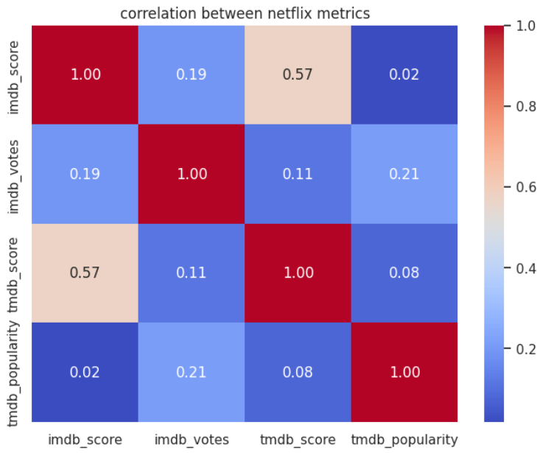
How Do Netflix Metrics Relate?
Pearson correlation across 4 metrics: IMDb score, IMDb votes, TMDB score, TMDB popularity
IMDb and TMDB scores show a moderate link (r = 0.57)
IMDb votes have a weak link with scores (r = 0.19)
TMDB popularity is nearly unrelated to scores (r = 0.02 and 0.08)
TAKEAWAY Quality metrics move together, but popularity is separate.
Notes:
We ran Pearson correlation across four metrics. IMDb and TMDB scores show a moderate link (r = 0.57), so quality ratings agree across platforms. IMDb votes have a weak link with scores (r = 0.19). TMDB popularity is nearly unrelated to scores (r = 0.02 and 0.08). Quality metrics move together, but popularity is separate.

Slide 10
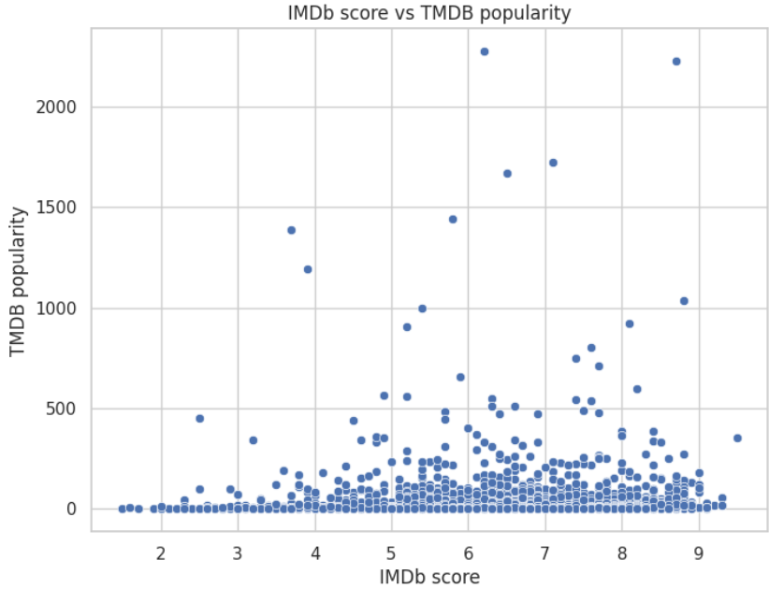
Does Popularity Mean Quality?
H₀: no linear relationship. H₁: a relationship exists
r = 0.02, p = 0.1986, so p > 0.05 and we fail to reject H₀
Flat trend: high popularity appears at every score level
Viral outliers (popularity above 1000) have mixed scores (about 3.7 to 8.8)
TAKEAWAY Popularity does not predict review quality.
Notes:
Null hypothesis: no linear relationship between IMDb score and TMDB popularity. Alternative: a relationship exists. We got r = 0.02 and p = 0.1986; since p is above 0.05 we fail to reject the null. The trend is flat and high popularity appears at every score level. A few viral outliers, with popularity above 1000, have mixed scores from about 3.7 to 8.8. Popularity does not predict review quality.

Slide 11
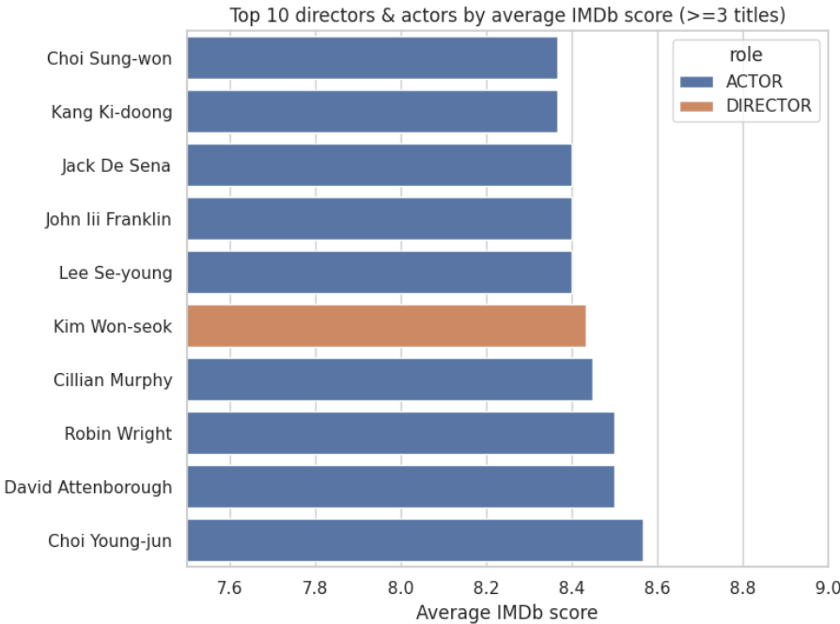
Top 10 Directors & Actors
Filter: at least 3 titles, which removes one-hit wonders
Top 10 average about 8.4 to 8.6 IMDb, led by Choi Young-jun
9 of 10 are actors; Kim Won-seok is the only director
Scores are tightly clustered, so quality is sustained across titles
TAKEAWAY Reliable, low-risk talent for Netflix to keep investing in.
Notes:
We filtered to talent with at least 3 titles, which removes one-hit wonders. The top 10 average about 8.4 to 8.6 IMDb, led by Choi Young-jun. Nine of the ten are actors and Kim Won-seok is the only director. Scores are tightly clustered, so quality is sustained across titles. These are reliable, low-risk talent for Netflix to keep investing in.

Slide 12
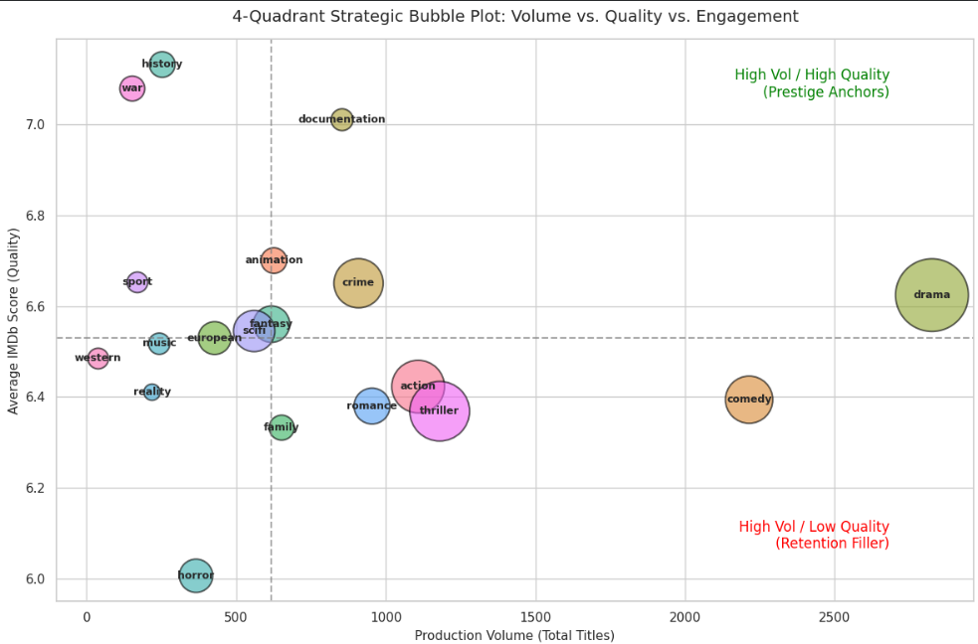
Genre Strategy: Volume vs Quality
Prestige Anchors: Drama (~2,800 titles), Crime, Documentary and Animation pair high volume with above-average scores
Retention Filler: Comedy, Thriller, Action and Romance have big catalogs but score below average
History and War score highest (~7.1) yet have under 300 titles each
Horror is the weakest genre, with the lowest average score (~6.0)
Bubble size = volume; dashed lines mark average volume and average score
TAKEAWAY Volume does not equal quality; scale the high-scoring niches.

Slide 13

NETFLIX
Thank You
Netflix Content Analysis: Trends, Success Drivers & Content Gaps
- TEAM TECHNOVA

