Slide 1
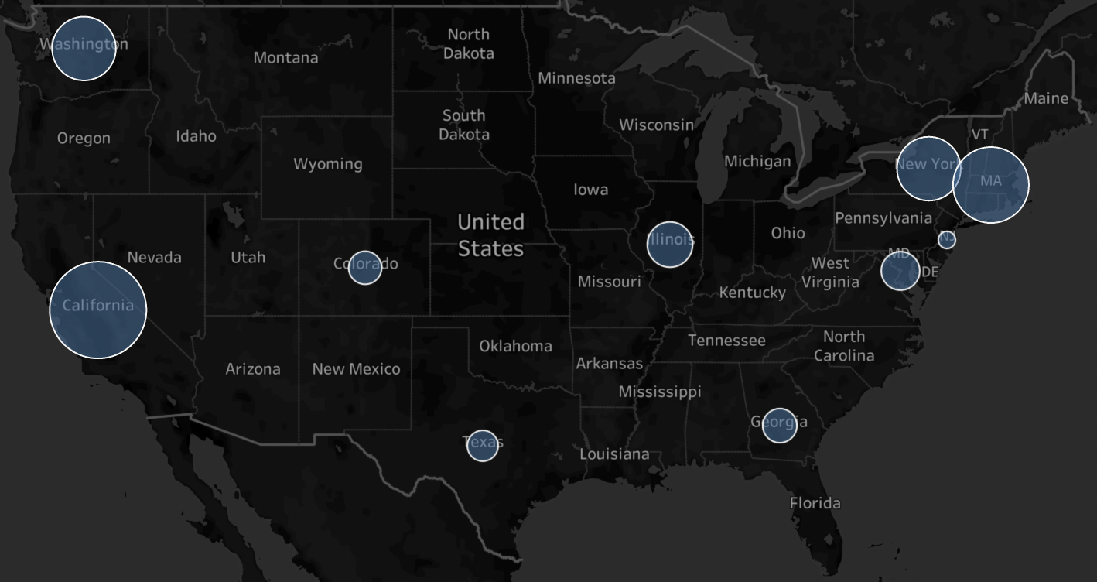




By
Data Wranglers
73% of data jobs in Massachusetts are data scientist positions
Colorado is mostly looking for people between 4-8 years experience
74% of jobs in Washington are data jobs
Hottest job markets for data analysists in the United States
Machine learning has been mentioned 8,46% in Texas
California has highest number of data science vacancies, 30% are data jobs
by
Data Wranglers

