Slide 1
Networking 1
CSC 3304 Introduction to Systems Programming
Instructor:
David Trammell, PhD

Slide 2
Socket Chapters in the Textbook: 56 to 61
Chapter 56: Sockets introduction
Basic functionality and system calls required
Chapter 57: UNIX domain sockets
Using sockets within a single system between processes (non-network sockets)
Chapter 58: Fundamentals of TCP/IP networks (i.e. the Internet)
OSI model and its various layers with practical examples
Chapter 59: Internet domain sockets
Sockets on the Internet (which also work between processes on the same system)
Chapter 60: server design
Chapter 61: advanced topics

Slide 3
56.1 Overview
Server: (passive socket)
socket() makes a new socket
bind() associates the socket with a well-known address so others can reach us
listen() causes a bound socket to begin queuing connection requests
accept() is used to process one queued request (in order)
Returns a new socket for the connection separate from the listening socket
Client (active socket)
socket() makes a new socket
connect() establishes a connection to a server on a socket we just created

Slide 4
56.1 Communication domains and socket types
Socket domain (AF stands for address family)
AF_UNIX: connections between processes on the same system
AF_INET: connections over IPv4
AF_INET6: connections over IPv6
Socket type
SOCK_DGRAM: transfer datagrams (UDP socket if Internet domain)
Read and write in units of "messages"
Unidirectional (send-only)
On Internet domain: unreliable (no automatic resends!)
SOCK_STREAM: transfers bytes (TCP socket if Internet domain)
Read and write bytes directly
Bidirectional and
On Internet domain: reliable (TCP checks for packet receipt; resends missing packets)

Slide 5
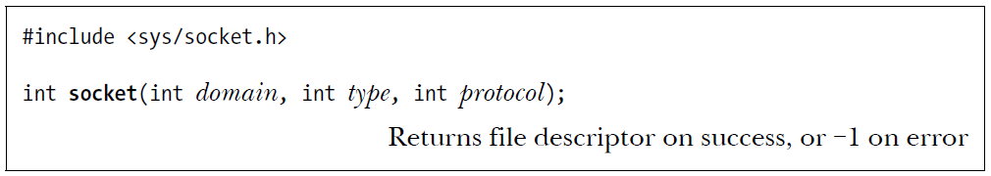
56.2 Creating a socket
domain: AF_UNIX, AF_INET or AF_INET6
type: SOCK_STREAM or SOCK_DGRAM
protocol: set to 0 (only in unusual cases are other settings available)
Example to create a Stream Socket
listen_fd = socket(AF_INET, SOCK_STREAM, 0);

Slide 6
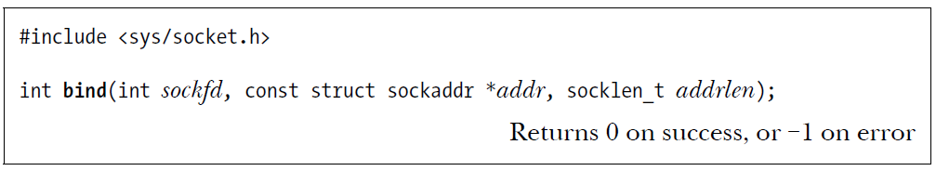
56.3 Binding a Socket to an Address (server)
sockfd: the file descriptor returned by the call to socket()
*addr: a pointer to a sockaddr structure (next slide)
addrlen: the size of the sockaddr structure we're using
The different structures for different address families have different sizes
The kernel must copy the structure data before it reads it, so you pass the size
Example:
bind(listen_fd, (struct sockaddr *)&addr, addrlen);

Slide 7
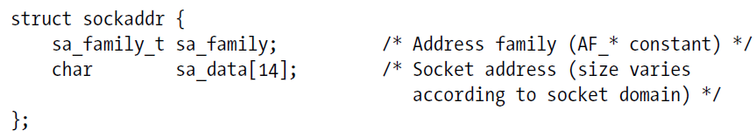
56.4 Generic Socket Address Structures
We never actually declare structure of this type:
Instead family specific structures are created such as sockaddr_in
We cast the family specific structure to use it with bind()
This is why there is a cast in the bind() example on the previous slide
First member is always sa_family_t which the kernel accesses before making assumptions about the rest of the structures layout and size

Slide 8
Internet domain addr: struct sockaddr_in
//Declare a structure named addr
struct sockaddr_in addr;
//Initialize the relevant fields
addr.sin_family = AF_INET;
addr.sin_addr.s_addr = INADDR_ANY; //bind to any local port
addr.sin_port = htons(port); //convert port to big endian

Slide 9
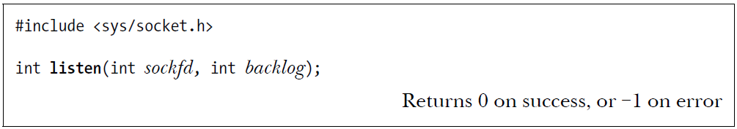
56.5.1 Listening for Connections (server)
sockfd: file descriptor of a bound socket
backlog: size of the pending connection queue (from 1 to SOMAXCONN)
Default maximum is 4096 on modern kernels (used to be much smaller)
The system will silently round your larger values down to SOMAXCONN
Clients trying to connect will block (wait) if the queue is full
Example: listen(listen_fd, 32);

Slide 10
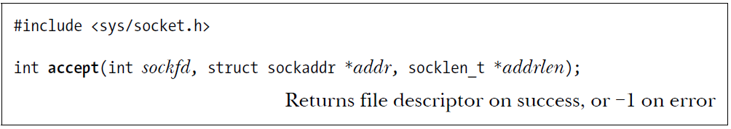
56.5.2 Accepting a Connection (server)
return: a NEW socket (the original one is listening for connections)
sockfd: file descriptor of a bound and listening socket
*addr: a pointer to a sockaddr: used to return client address info
*addrlen: a pointer to a socklen_t: used to return addr struct size
The last two args can be NULL if you don't need the client address
Example:
client_fd = accept(listen_fd, NULL, NULL);

Slide 11
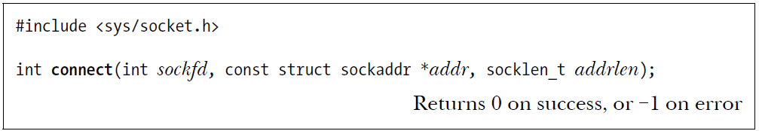
56.5.3 Connecting to a Socket (client)
sockfd: file descriptor of a socket (neither bound nor connected yet)
*addr: a pointer to a sockaddr of the server to connect to
addrlen: sockaddr struct size
Example:
server_fd = socket(AF_INET, SOCK_STREAM, 0);
connect(server_fd,(struct sockaddr *)&addr, addrlen);
If connect fails, close() the socket, create a new one and try again!

Slide 12
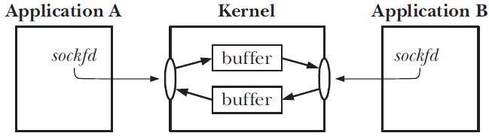
56.5.4 I/O on Stream Sockets
A pair of connected stream sockets provide bidirectional communication
Use standard I/O calls: read(), write(), close() or more specialized calls
What happens when connection is closed on one end unexpectedly?
Reads continue to succeed until all data is consumed at which point EOF is read
Writes fail immediately and generate signal SIGPIPE (terminates by default!)

Slide 13
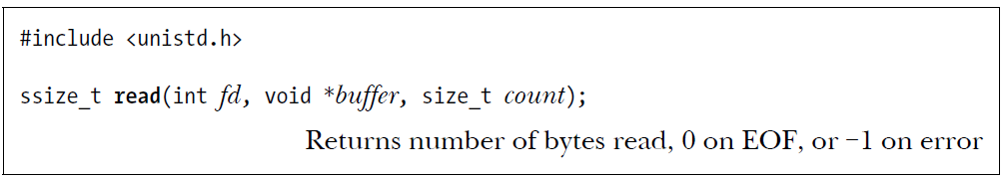
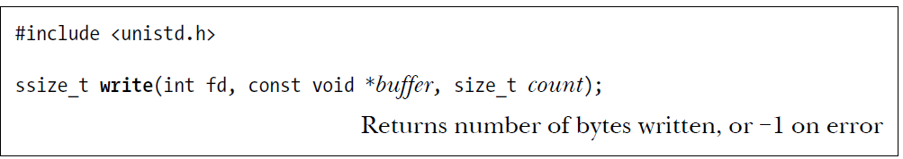
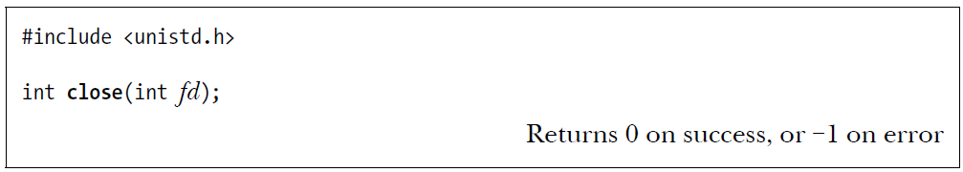
Basic File I/O for Reference (Chapter 4)

Slide 14
Example 18a-net1
Review example

Slide 15
56.6 Datagram Sockets (UDP)
Prior examples were for Stream Socket (TCP if Internet domain)
Ensures all data arrives and is ordered correctly (useful over networks)
Datagram sockets are the other option (UDP if Internet domain)
Prioritizes speed and efficiency (simplicity of implementation)
On networks, packets may arrive out of order, and may be absent or duplicated
Example: live streaming (audio/video)
Example: DNS requests
UDP is not reliable on its own, but applications can enhance reliability by sending additional requests when they don't get a reply

Slide 16
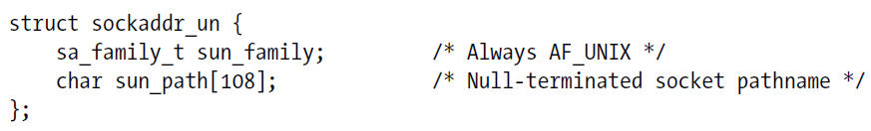
57 Unix Domain Sockets
Sockets don't have to be created as network sockets
int listen_fd = socket(AF_UNIX, SOCK_STREAM, 0);
When calling bind on a UNIX socket use sockaddr_un struct and use a file path instead of an IPv4 address and port (sun_ = socket-unix)
With Unix sockets, datagrams are just as reliable as streams. The difference is that streams send bytes and datagrams send messages.

Slide 17
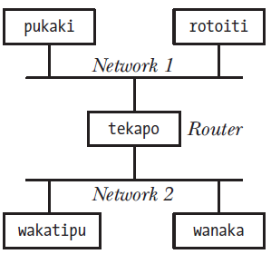
58.1 Fundamentals of TCP/IP Networks
internet (lower case) connects discrete computer networks allowing hosts on separate networks to communicate
The Internet (upper case) refers to the familiar global internet
A subnet is a network within an internet
Switches connect individual devices into a subnet
Routers connect subnets together within an internet

Slide 18
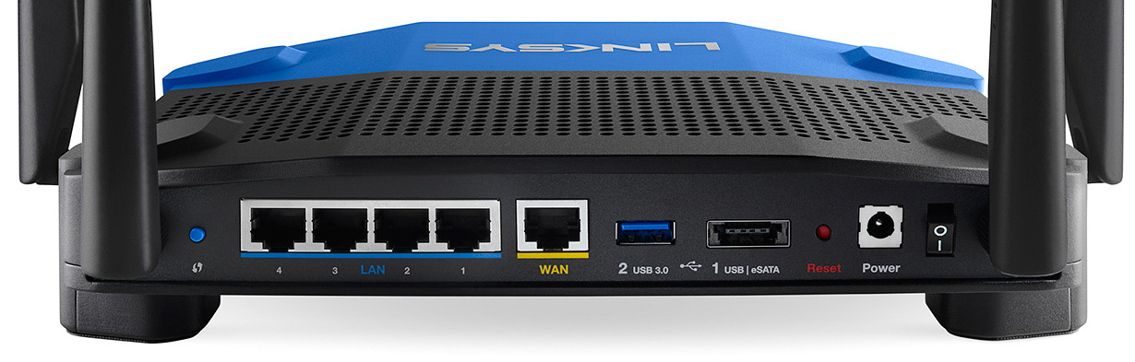
Router + Ethernet Switch + WiFi
The back side of typical consumer “Router” from Linksys:
Internet router (connects a layer 2 network to an internet)
Bridge (combines two layer 2 networks into another layer 2 network)
Ethernet switch (layer 2)
WiFi connectivity (layer 2)

Slide 19
TCP/IP Network Model
TCP/IP is the dominant protocol suite used on the Internet (and on internets)
Application -> anything
chat messages, a/v data, game state
Transport -> TCP: end-to-end comms
send packets and verify that they've been received. resend if needed
Internet -> IP: addressing and routing
route data across an internet to some addressable destination
Network Interface -> physical link
Gets your data to the router
Application
Transport
Internet
Network Interface

Slide 20
OSI Model: 7 layers
App, Presentation, Session
Encryption, compression, authentication
Transport: TCP or UDP
Network: IP
Data Link + Physical:
Direct transmission between nodes
Each subnet has a protocol; examples:
Ethernet
WiFi
Cell-network
Bluetooth
Application (7)
Presentation (6)
Session (5)
Transport (4)
Network (3)
Data Link (2)
Physical (1)

Slide 21
58.2 Networking Protocols and Layers
networking procotol rules defining how to transmit information
Each of the 7 layers has familiar protocols
Application: HTTP, FTP, DHCP, SSH, NFS, IMAP
Presentation: SSL/TLS (security
Session: NetBIOS (windows file sharing), RPC (remote procedure call),
Transport: TCP or UDP
Network: IP, ARP, ICMP
Data Link: Ethernet, IEEE 802.11 (WiFi), ARP
Physical: Ethernet, Fiber Optics, wireless

Slide 22
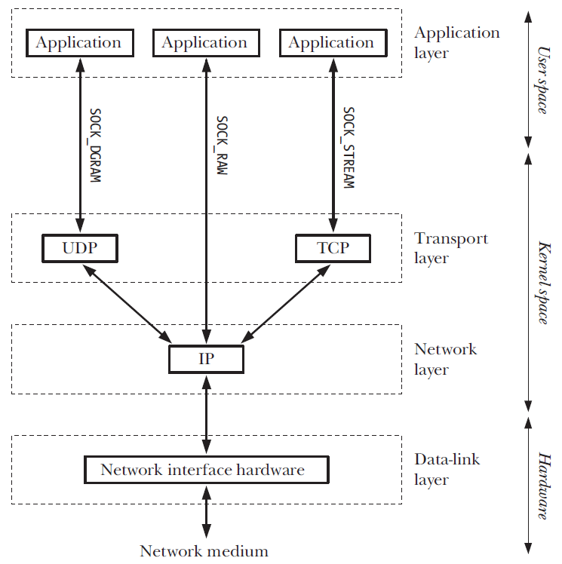

Slide 23
58.2 Encapsulation
Data can be encapsulated (meaning: placed in a virtual capsule)
We can use packet as a generic term for encapsulated data
Packets grow substantially as they pass down the network stack
Each layer adds and removes its own headers/data
Layer 2 data may be added/removed many times
A packet for each protocol layer usually
has a fancy name (don't memorize)
TCP: segment
IP: datagram
Ethernet: frame
Application Data
TCP header
Data
IP header
Data
Ethernet header
Data
CRC

Slide 24
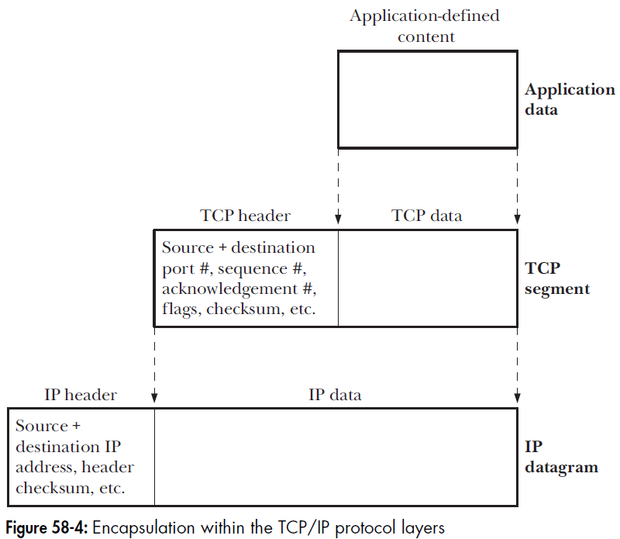
Encapsulation figure 58-4

Slide 25
58.3 Data-Link Layer (2) (Ethernet, wifi, etc.)
Physical delivery of a frame from one device directly to another device
Our network driver/hardware mostly takes care of this for us
Each Ethernet and WiFi device have a MAC address
MAC stands for medium access control
MACs are composed of 6 bytes and usually viewed in hexadecimal:
50-9A-4C-46-54-B0
50:9A:4C:46:54:B0
MACs were intended to be unique globally and are required to be unique in a subnet
First 2 or 3 bytes typically identify a specific hardware vendor such as Intel
Remaining bytes are allocated 1 number at a time to individual devices manufactured
Virtual hardware randomly generates a MAC
Physical hardware can present multiple MACs on the network if running a hypervisor

Slide 26
Next Week …
Final homework assignment will be assigned Tuesday
Similar “style” to the one I assigned this past Tuesday
We will continue Networking with a more detailed look at the IP Layer (3)

