Slide 1

Kiva
Micro-loans and Micro-lending
Kiva Welfare Loans
Notes:
Final IH Bootcamp Project
Presentation by Jennipher M. Kasemire

Slide 2
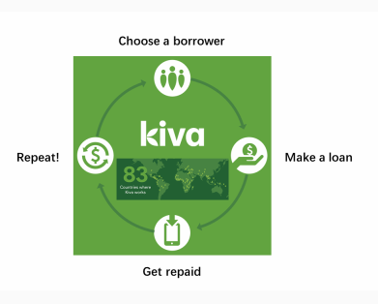
The Case study: Kiva Microloans
Goal was to predict if sector and gender are the major determinants for a project being funded?
If the above also the reaction speed of lenders.
Any way to measure impact?

Slide 3

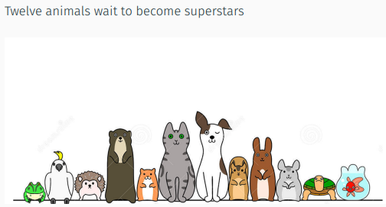



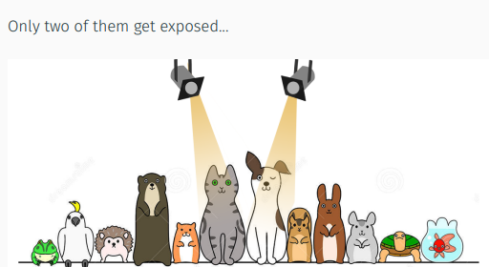
About Kiva
before
before
77
Countries
$1.6
Funded Loans
96% Repayment
after
after

Slide 4
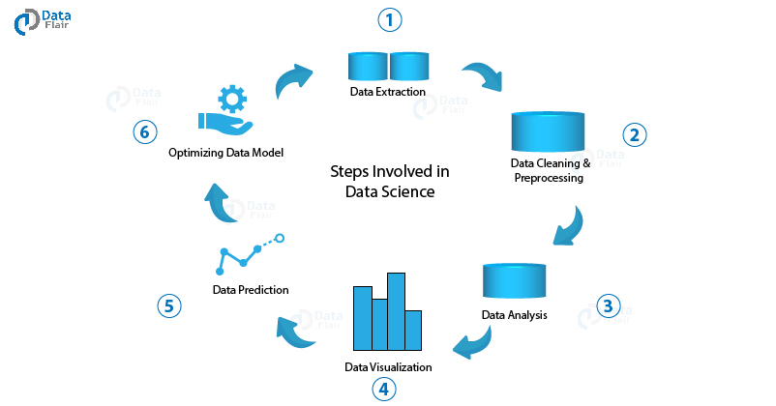
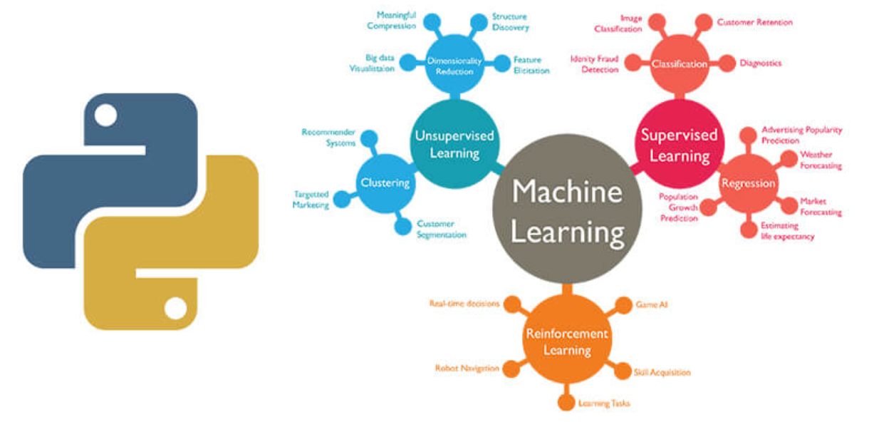

Tools Chosen to Analyze this case study.
Machine Learning
Tableau
The Data
Process
Logistic Regression: Process
Processes
Finding data
Wrangling and cleaning
EDA (Exploratory Data Analysis)
Split and Train Data
Generate a prediction to hypothesis
Evaluate model
Creating visualizations from the dataset to better understand the trends within

Slide 5
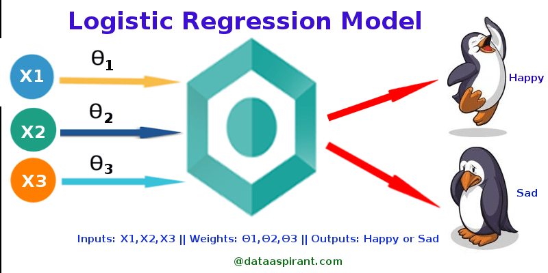
Logistic Regression

Slide 6
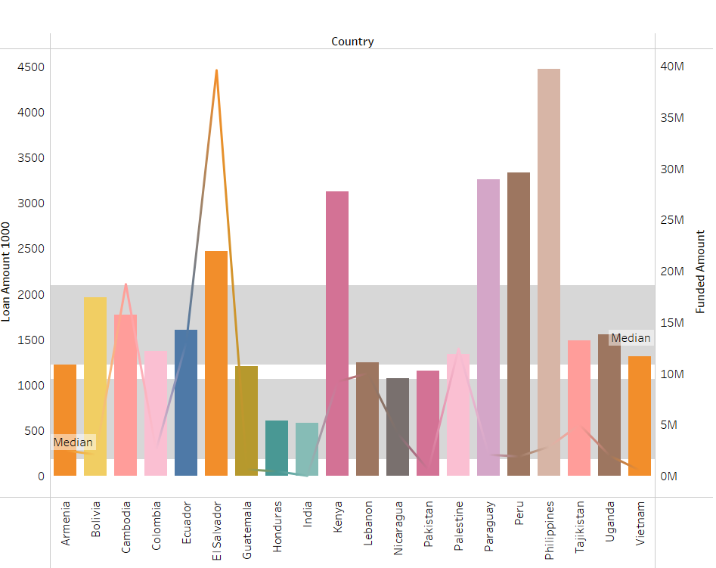
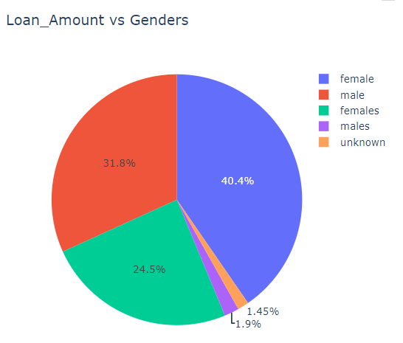
Top Crowd Funded Sectors and Genders
Findings

Slide 7
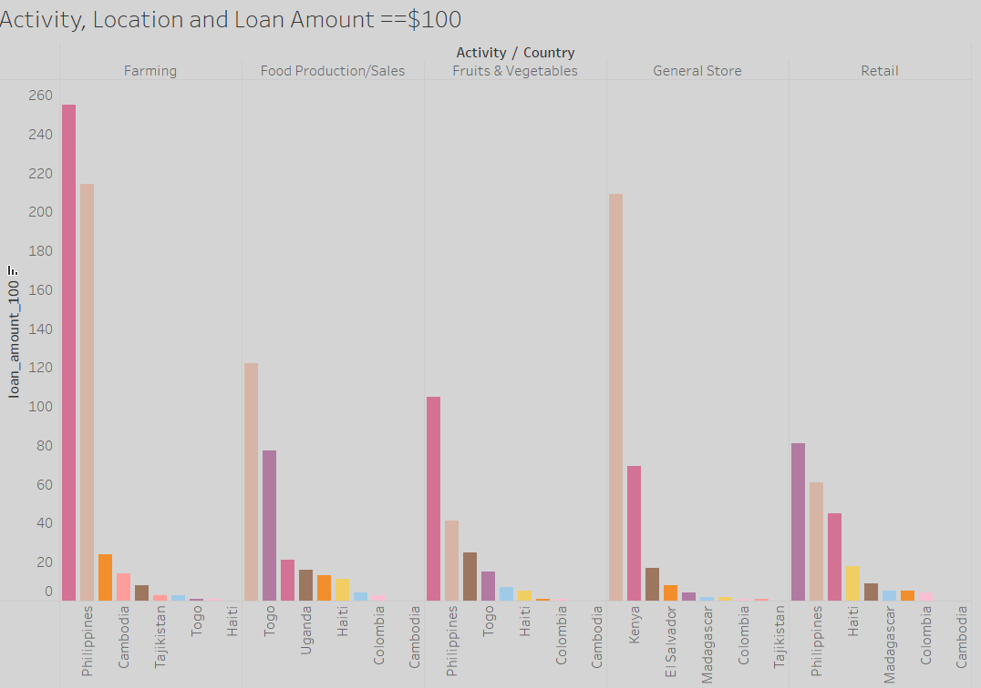

Slide 8

Insights
Females being the most funded gender
Group loan request (especially male gender) least favored
The Philippines agriculture sector has women as front liners
Loan applicant and lender location may have a high correlation(something for future study)
The dataset missed some important information for me so it is still a work in progress

Slide 9
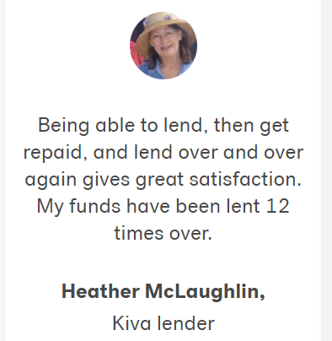
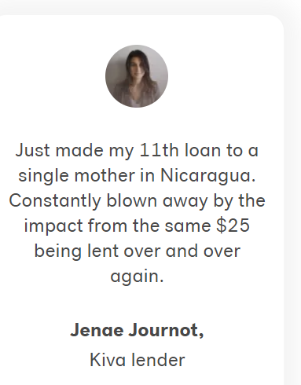

Happy Lenders

