Slide 1
Moneyball 2.0
Predicting Pitcher Salaries
TEAMSIX Final Project
Segment 2

Slide 2
Topic
The purpose of this project is to use machine learning and MLB pitcher statistics in order to predict MLB pitcher future salaries

Slide 3
Reasoning
Why this topic?
The abundance of baseball statistics currently available online
Ideal opportunity for machine learning
WE LOVE BASEBALL!

Slide 4
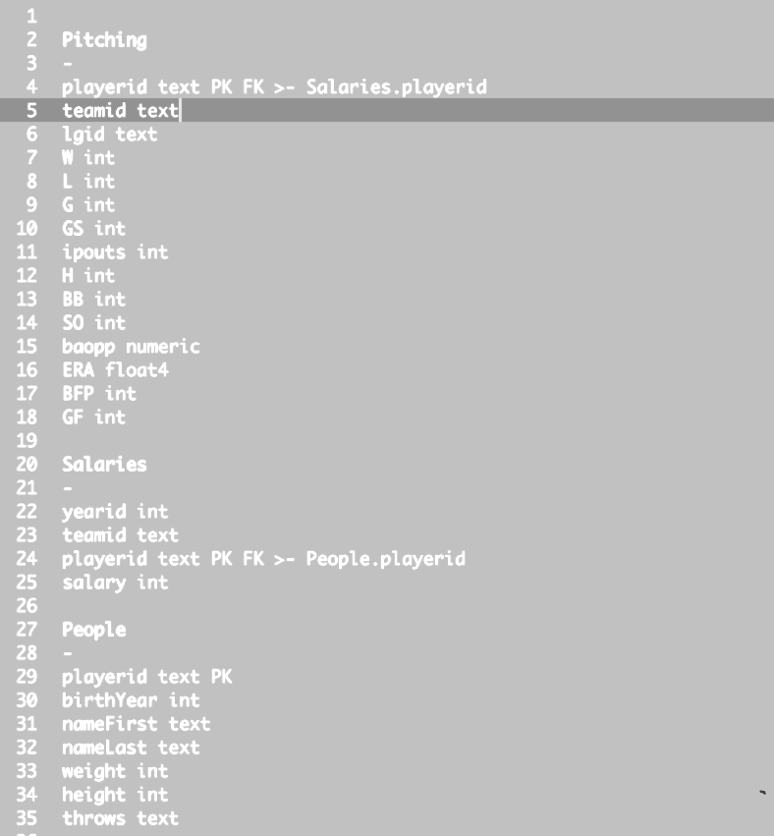
Data Source
The data source being used:
Lahman’s Baseball Database
MLB pitching statistics
Salary data
Player statistics
Notes:
Lahman’s Baseball Database is copyright 1996-2021 by Sean Lahman and licensed under a Creative Commons Attribution-ShareAlike 3.0 Unported License. It was created by Sean Lahman in 1994 and was made available to the public, on his website, in 1995. Sean Lahman is currently an investigative reporter for the Rochester Democrat and Chronicle (USA Today Network), but according to SeanLahman.com, before joining the USA Today Network, he was a sports reporter with the New York Sun. In addition, Mr. Lahman also serves as a data projects manager for SABR, the Society of American Baseball Research.
The Lahman Baseball Database is an open-source collection of batting and pitching statistics from 1871 to 2020 and also includes fielding statistics, standings, team statistics, managerial records, post-season and much more. The database includes data from the American and National leagues as well as the American Association, Union Association, Players League, Federal League, and the National Association of 1871-1875.
The data is available in Microsoft Access, SQL files, or a comma delimited format. Additionally, there is an R package and library available through github as well as MySQL, SQLite and a series of python scripts.
The database is free, but donations are accepted in order to help cover the costs associated with the maintenance and making it available for download. Donations can be made at seanlahman.com/support/

Slide 5

Data Years
The years being used:
Years 2010-2019
Needed large data set in order to test and train data
Did not use 2020-2021 due to the COVID-19 pandemic
Notes:
The COVID-19 pandemic impacted Major League Baseball finances, game schedules, and player salaries. Per MLB.com, the 2020 Major League Baseball season was delayed by almost 4 months and shortened to 60 games. Also, the playoffs were expanded from 10 to 16 teams. For this reason, the typical statistics would not be “apples to apples” when comparing other years to 2020 and could possibly skew the results.
Salary data was also impacted in 2020. Due to the quarantines in 2020, MLB the player’s union had agreed to take almost a 63% cut in base pay. forbes.com/Kurt Badenhausen August 7, 2020.

Slide 6
Why?
We are planning to use machine learning to answer the following questions:
Is there a correlation between various pitching statistics and salaries?
Which statistics?
Is a single statistic a good indicator or multiple in combination?
Which machine learning model creates the best prediction?
How precisely can salary be predicted using MLB statistics?
If this works, which MLB team will hire us?

Slide 7
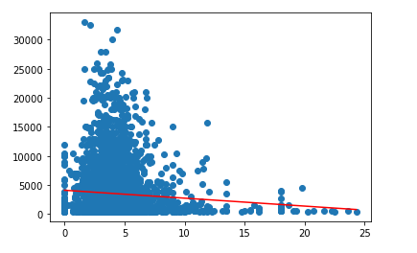
Our first model…
Our first model used linear regression and a very simple subset of our data:
Salary and earned run average (ERA) only
2010-2016
Linear regression
Removed outliers
Notes:
The first model we created used a simple linear regression model and just one statistic, earned run average (ERA). The years used were 2010 to 2016 and we eventually removed some of the outliers.
From the scatter plot graph, we observed that as the ERA decreased, the salary increased. Adding in our simple regression model, shown by the red line, we were able to create a very crude predictor. This model was okay for a start, but we need something better and more precise.

Slide 8
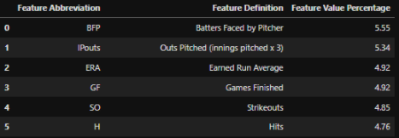
Data Exploration and Analysis
The Random Forest - A classification model that allows for the precise classification of observed results by using a large number of decision trees
Used Random Forest model to determine which key statistic would be the best predictor of pitcher salary
Batters faced by pitcher (BFP)
Outs pitched (innings pitched x 3)
Earned run average (ERA)
Notes:
The random forest model can be extremely effective because it will take a large number of low correlation models to create a total model that is highly impactful.
Based on the first model, using linear regression, it was evident that additional features were needed to come up with a more precise way of precise way of predicting salaries. Since there was so much data, and a wide range of salaries, we decided to use the random forest method (or a group of decision trees) and employ binning for the salaries.
This allowed for the top 5 features to be identified and used in later modeling.
Based on the random forest model, the top-five features that showed the most correlation were Batters faced by Pitcher (BFP), Outs pitched (at least 3 innings pitched - IPouts), Earned run average (ERA), Games finished (GF), Strikeouts (SO), and Hits (H).

Slide 9
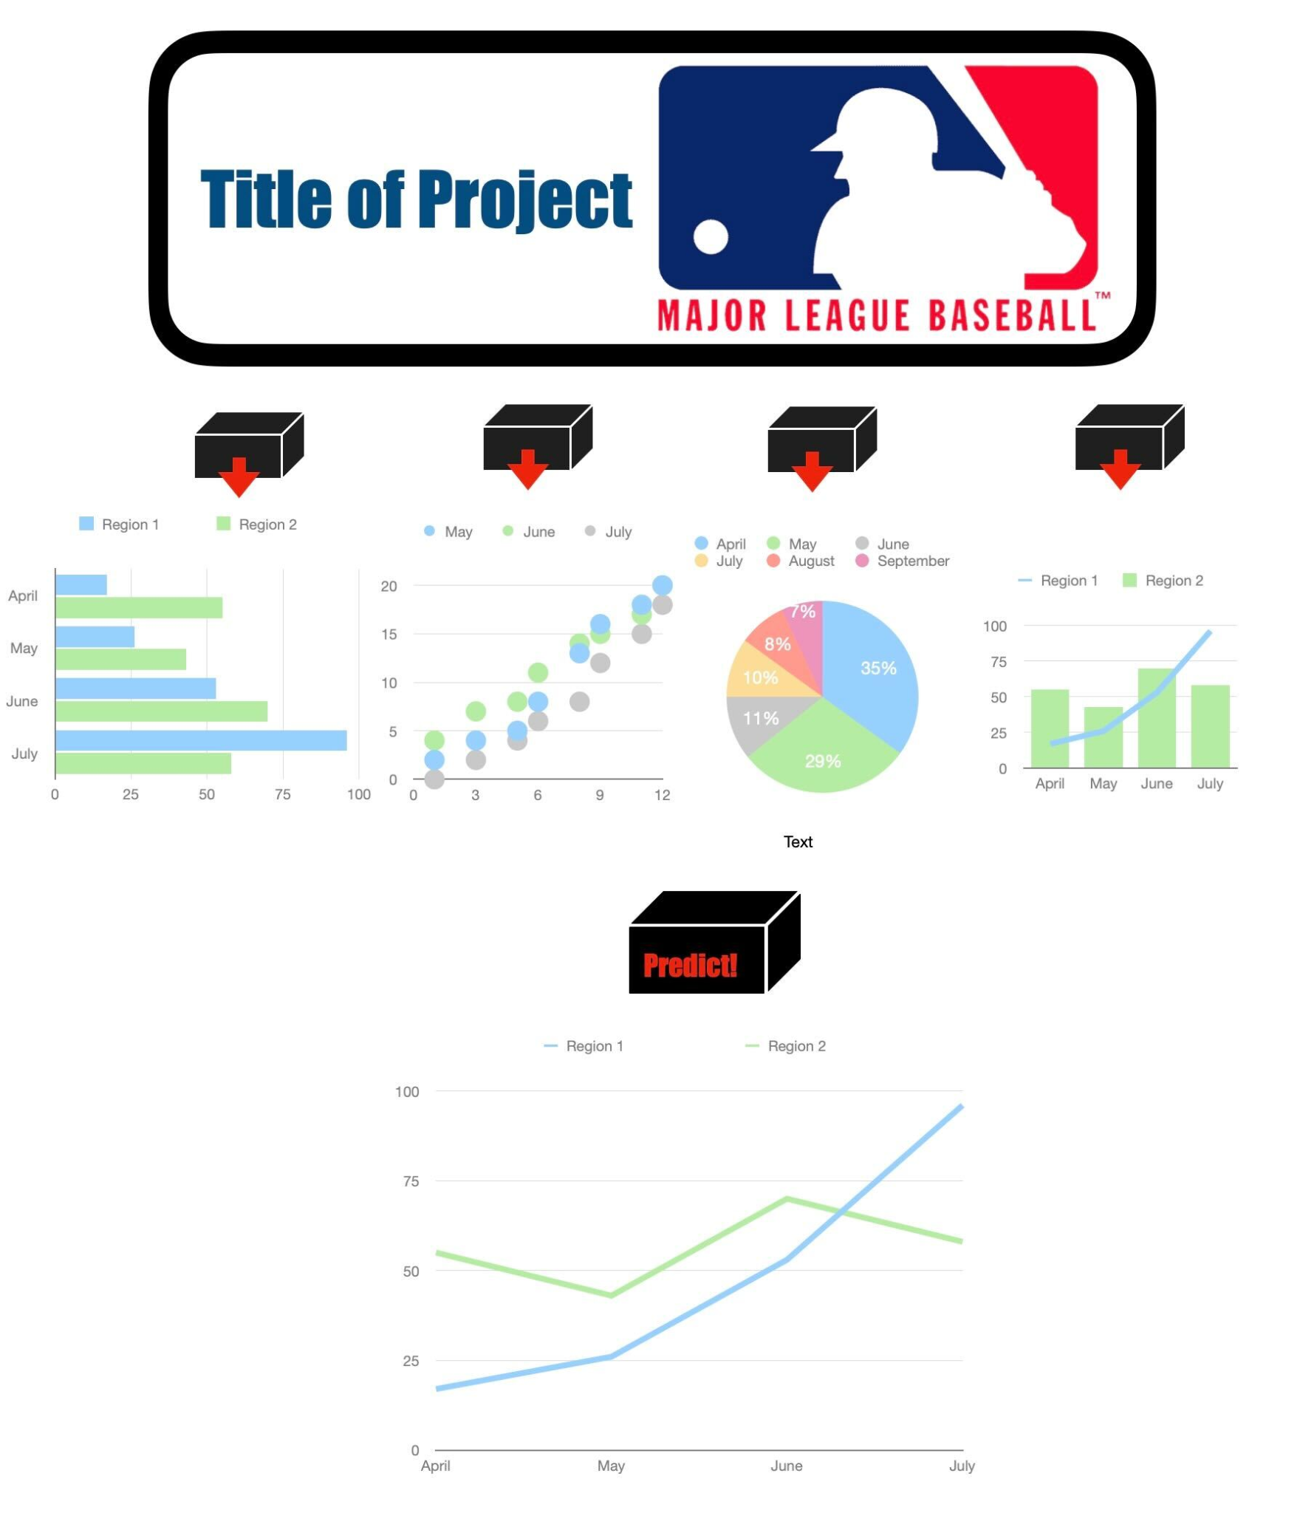
The Dashboard
Dashboard

Slide 10
Moneyball 2.0
Predicting Pitcher Salaries
TEAMSIX Final Project
Segment 2

Slide 11
Topic
The purpose of this project is to use machine learning and MLB pitcher statistics in order to predict MLB pitcher future salaries

Slide 12
Reasoning
Why this topic?
The abundance of baseball statistics currently available online
Ideal opportunity for machine learning
WE LOVE BASEBALL!

Slide 13
Data Source
The data source being used:
Lahman’s Baseball Database
MLB pitching statistics
Salary data
Player statistics
Notes:
Lahman’s Baseball Database is copyright 1996-2021 by Sean Lahman and licensed under a Creative Commons Attribution-ShareAlike 3.0 Unported License. It was created by Sean Lahman in 1994 and was made available to the public, on his website, in 1995. Sean Lahman is currently an investigative reporter for the Rochester Democrat and Chronicle (USA Today Network), but according to SeanLahman.com, before joining the USA Today Network, he was a sports reporter with the New York Sun. In addition, Mr. Lahman also serves as a data projects manager for SABR, the Society of American Baseball Research.
The Lahman Baseball Database is an open-source collection of batting and pitching statistics from 1871 to 2020 and also includes fielding statistics, standings, team statistics, managerial records, post-season and much more. The database includes data from the American and National leagues as well as the American Association, Union Association, Players League, Federal League, and the National Association of 1871-1875.
The data is available in Microsoft Access, SQL files, or a comma delimited format. Additionally, there is an R package and library available through github as well as MySQL, SQLite and a series of python scripts.
The database is free, but donations are accepted in order to help cover the costs associated with the maintenance and making it available for download. Donations can be made at seanlahman.com/support/

Slide 14
Data Years
The years being used:
Years 2010-2019
Needed large data set in order to test and train data
Did not use 2020-2021 due to the COVID-19 pandemic
Notes:
The COVID-19 pandemic impacted Major League Baseball finances, game schedules, and player salaries. Per MLB.com, the 2020 Major League Baseball season was delayed by almost 4 months and shortened to 60 games. Also, the playoffs were expanded from 10 to 16 teams. For this reason, the typical statistics would not be “apples to apples” when comparing other years to 2020 and could possibly skew the results.
Salary data was also impacted in 2020. Due to the quarantines in 2020, MLB the player’s union had agreed to take almost a 63% cut in base pay. forbes.com/Kurt Badenhausen August 7, 2020.

Slide 15
Why?
We are planning to use machine learning to answer the following questions:
Is there a correlation between various pitching statistics and salaries?
Which statistics?
Is a single statistic a good indicator or multiple in combination?
Which machine learning model creates the best prediction?
If this works, which MLB team will hire us?

Slide 16
Our first model…
Our first model used linear regression and a very simple subset of our data:
Salary and earned run average (ERA) only
2010-2016
Linear regression
Removed outliers
Notes:
The first model we created used a simple linear regression model and just one statistic, earned run average (ERA). The years used were 2010 to 2016 and we eventually removed some of the outliers.
From the scatter plot graph, we observed that as the ERA decreased, the salary increased. Adding in our simple regression model, shown by the red line, we were able to create a very crude predictor. This model was okay for a start, but we need something better and more precise.

Slide 17
Data Exploration and Analysis
The Random Forest - A classification model that allows for the precise classification of observed results by using a large number of decision trees
Used Random Forest model to determine which key statistic would be the best predictor of pitcher salary
Batters faced by pitcher (BFP)
Outs pitched (innings pitched x 3)
Earned run average (ERA)
Notes:
The random forest model can be extremely effective because it will take a large number of low correlation models to create a total model that is highly impactful.
Based on the first model, using linear regression, it was evident that additional features were needed to come up with a more precise way of precise way of predicting salaries. Since there was so much data, and a wide range of salaries, we decided to use the random forest method (or a group of decision trees) and employ binning for the salaries.
This allowed for the top 5 features to be identified and used in later modeling.
Based on the random forest model, the top-five features that showed the most correlation were Batters faced by Pitcher (BFP), Outs pitched (at least 3 innings pitched - IPouts), Earned run average (ERA), Games finished (GF), Strikeouts (SO), and Hits (H).

Slide 18
The Dashboard
Dashboard

Slide 19
Final Thoughts…
Add what could have been done differently.

Slide 20
Final Thoughts…
Add what could have been done differently.

