Slide 1





CAPSTONE PROJECT
SECURE DATA HIDING IN IMAGES USING STEGANOGRAPHY
Presented by: SHIRLYN JENITA JASPER
Submitted to: Edunet foundation IBM skillsbuild Internship
College Name: FATIMA COLLEGE
Department: Computer Applications
Student ID: STU667ed5e035cc71719588320

Slide 2


OUTLINE FOR PRESENTATION
  Problem Statement
  Technology used
  Wow factor
  End users
  Result
  Conclusion
  GitHub Link
  Future Scope

Slide 3
PROBLEM STATEMENT
  With the rise of digital communication, ensuring the confidentiality of sensitive information has become a critical challenge. Traditional encryption methods are often detectable, making them vulnerable to attacks.
  This project aims to develop a Python-based Image Steganography application that securely hides secret messages within image files using the Least Significant Bit (LSB) technique.
  The application provides a user-friendly GUI using Tkinter, allowing users to encrypt and decrypt messages seamlessly while maintaining the image's visual integrity.

Slide 4

TECHNOLOGY USED
  Programming Language: Python – The entire project is implemented using Python.
  Graphical User Interface (GUI): Tkinter – Used to create the user-friendly interface for selecting images, entering text, and performing encryption/decryption operations.
  Image Processing: Pillow (PIL) – Used for loading and displaying images in the GUI.
  Steganography Library: stegano (LSB - Least Significant Bit Method) – Used to hide and retrieve secret messages in images without significantly altering their visual appearance.
  File Handling & System Operations: os & filedialog – Used for browsing and selecting image files from the system.

Slide 5




WOW FACTORS
🎨 User-Friendly Graphical Interface
📜 Built-in Text Editor for Message
🔒 Secure Message Hiding with LSB Technique
📂 Seamless File Handling & Image Selection
Unlike command-line steganography tools, this project provides a Tkinter-based GUI, making it easy for users to select images, encrypt messages, and decrypt hidden data with simple button clicks.
Includes a scrollable text box where users can type or retrieve their hidden messages, making the process smooth and convenient.
Uses the Least Significant Bit (LSB) steganography method, which ensures that the hidden message is embedded without noticeable changes to the image, making it undetectable to the human eye.
Allows users to browse and select images directly from their system using the file dialog, providing an effortless user experience.

Slide 6
END USERS
🔐 Cybersecurity Enthusiasts & Ethical Hackers
🎓 Students & Researchers
🎮 Digital Artists & Content Creators
Individuals exploring secure communication techniques and cryptographic concepts can use this project to understand and experiment with covert data transmission.
Computer Science and Cybersecurity students studying steganography techniques can use this project as a learning tool or as part of research on data hiding and digital forensics.
Creators who want to embed watermarks, secret messages, or hidden metadata inside digital artwork or images can use this tool for creative and security purposes.
This project is useful for anyone who values privacy and secure communication. Whether it’s for learning, security, or creative purposes, the Image Steganography tool provides a simple yet powerful way to embed and retrieve hidden data within images.

Slide 7
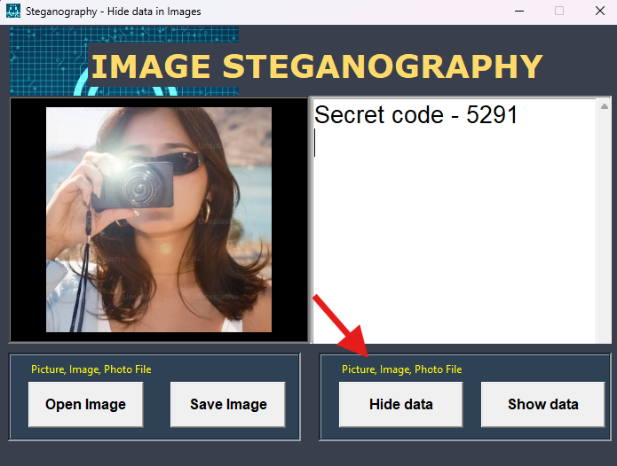
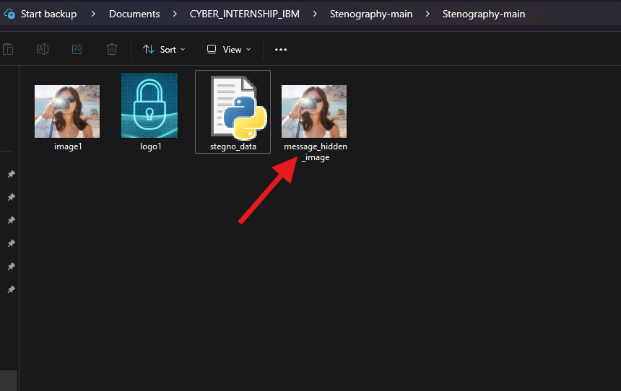
RESULTS
1) HIDING MESSAGE IN IMAGE
2) MESSAGE HIDDEN FILE CREATED
1) Open the image from files.
2) Type the secret message, click on “Hide data”
3) Click on “Save image”.
4) Image with hidden message created
Hidden message image file is created in the folder, with the name of “message_hidden_image”

Slide 8
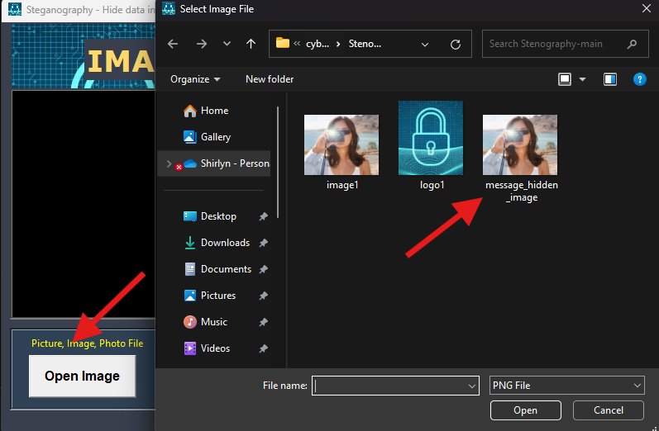
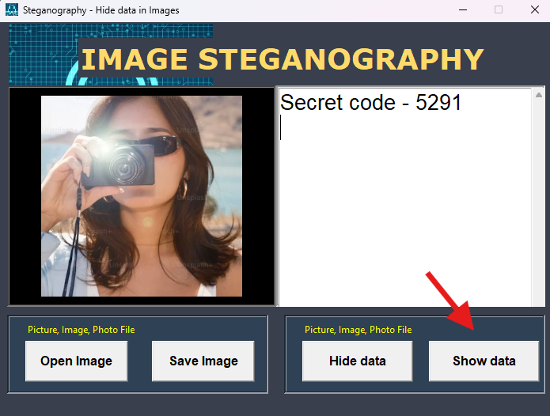
RESULTS
3) OPEN HIDDEN MESSAGE
4) VIEW HIDDEN MESSAGE FROM FILE
1) Open the image from files.
2) Select the “message_hidden_image” file
3) Click on Open
1) Click on “Show data”
2) View the hidden message in the image

Slide 9
CONCLUSION
  Image Steganography is a powerful technique for secure and covert communication, allowing users to embed hidden messages within digital images without altering their visual appearance. This project successfully demonstrates the use of Least Significant Bit (LSB) steganography, providing an efficient and user-friendly approach to hiding and retrieving sensitive information.
  With a graphical user interface (GUI) built using Tkinter, this application ensures ease of use while maintaining the integrity of both the message and the image. By leveraging Python libraries such as Pillow and Stegano, the project achieves seamless image processing and data encryption.
  This project has broad applications in cybersecurity, secure communication, and digital watermarking. Future enhancements could include password protection, support for multiple file formats, and advanced cryptographic techniques, making it even more robust and secure.
  Ultimately, this steganography tool serves as an innovative solution for data privacy and information security in the digital age. 🔐

Slide 10



GITHUB LINK FOR IMAGE STEGANOGRAPHY PROJECT
https://github.com/Jenny25G/Image-Steganography-using-Python

Slide 11




FUTURE SCOPE
📱 Mobile & Web Application Development
Converting this project into a mobile app (Android/iOS) or a web-based tool would improve accessibility and usability for a broader audience.
⚡ Performance Optimization & Large File Support
Optimizing the LSB embedding algorithm for handling high-resolution images and large files efficiently would make the application more practical for real-world scenarios.
📡 Embedding Messages in Other Media
Extending the project to audio and video steganography would make it useful for multimedia data protection and covert communication.

Slide 12
Thank you!
EDUNET FOUNDATION – AICTE INTERNSHIP
IBM Skillsbuild
BY SHIRLYN JENITA JASPER
FATIMA COLLEGE
Student ID: STU667ed5e035cc71719588320

