Slide 1

FLASK/REACT CRUD APP PROJECT
Presented By
Jenny Evanjiline

Slide 2
introduction
Objective of the project
To Build a centralized platform to track job applications
It helps users manage applied jobs efficiently
Reduces manual tracking using notes

Slide 3
Project description
Web based Job tracker application
Users can
Register and login securely
Add job applications
Edit application statuses
Delete or manage jobs
Includes AI chatbot assistance for users support

Slide 4
features
Key Features:
User Authentication (Login/Register)
Job Management (CRUD operations)
Interactive Dashboard UI
Status tracking (Applied / Interview / Rejected / Selected)
AI Chatbot integration (Groq API)
Responsive Bootstrap UI

Slide 5
Technologies used
Frontend:
React.js
Bootstrap
Backend:
Flask (Python)
REST APIs
Database:
PostgreSQL
Other Tools:
Groq API (AI Chatbot)
Postman (API Testing)

Slide 6
Future enhancements
Email notifications for job updates
Search by filter option
Notes feature
Advanced analytics dashboard
Mobile application version
AI based job recommendations

Slide 7
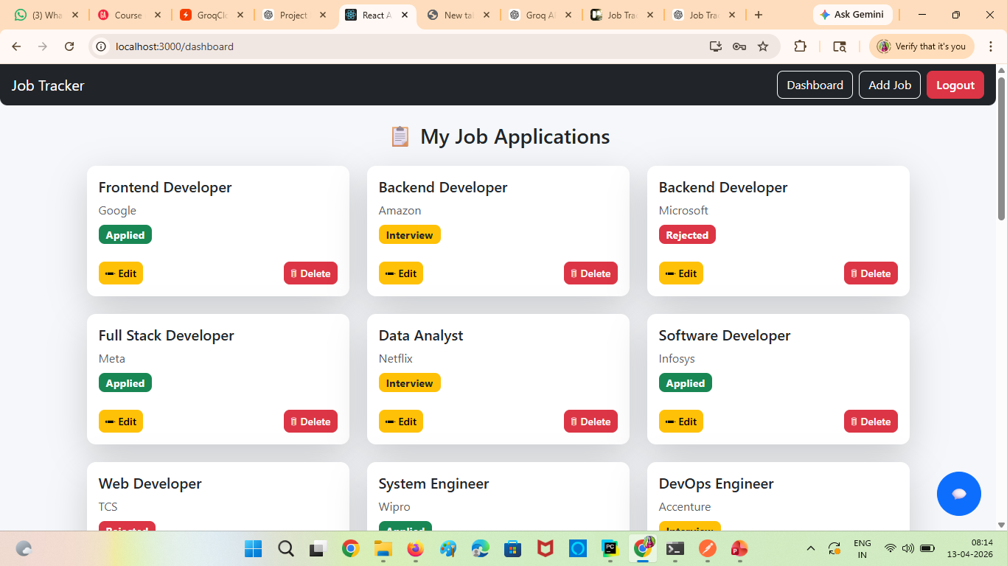
Dashboard ui

Slide 8
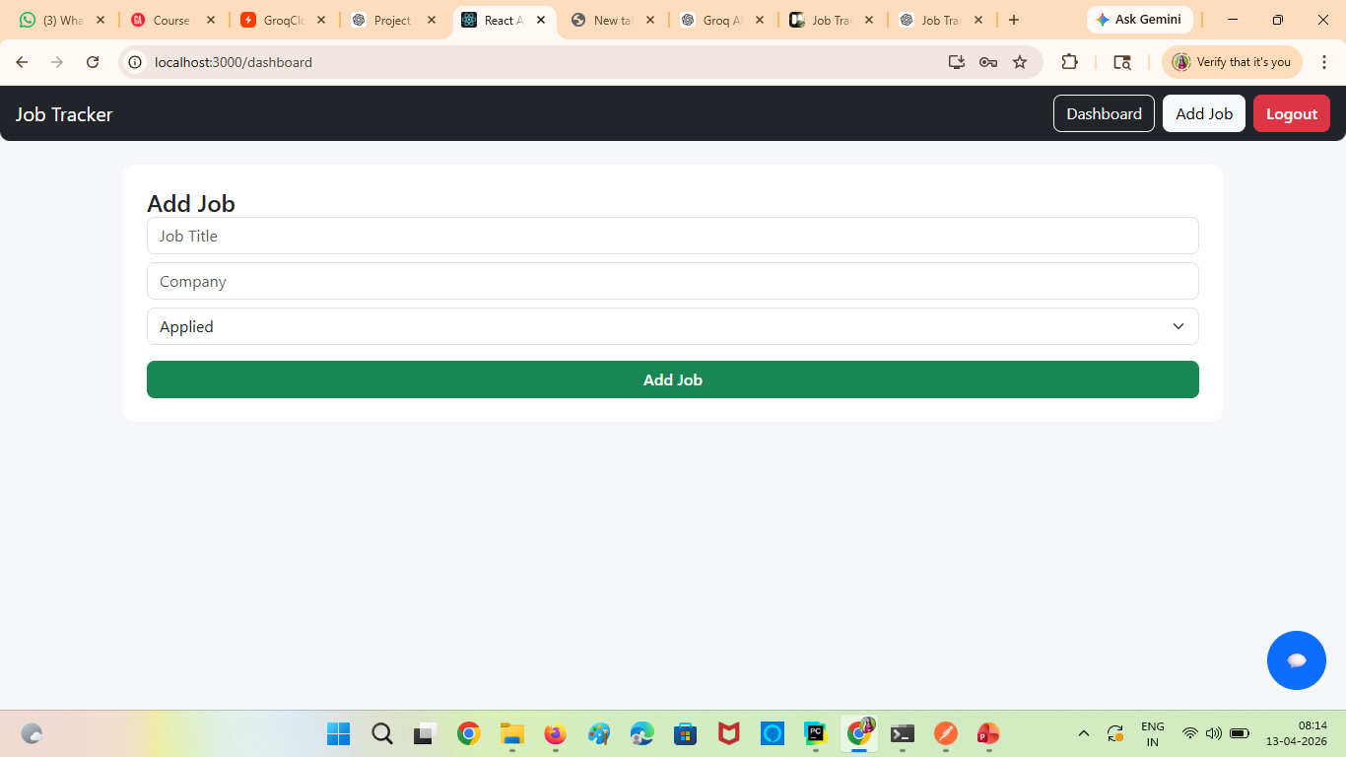
Add job ui, users can add new jobs

Slide 9
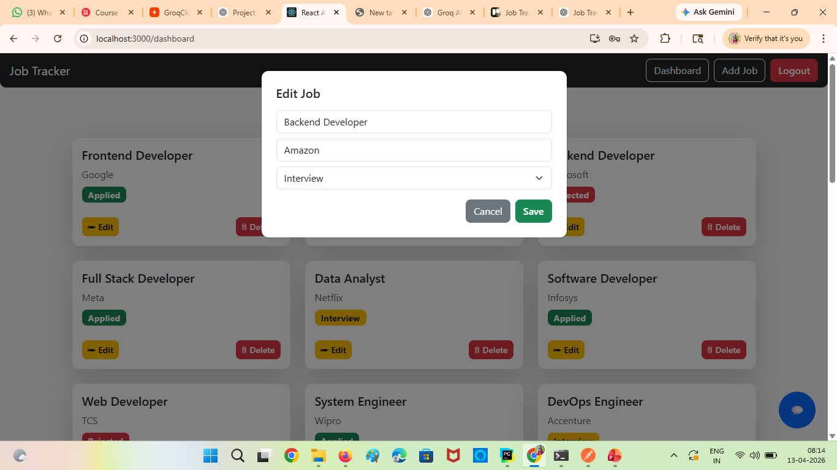
Users can make changes

Slide 10
Thank you

