Slide 1


Control of Covid-19: Vaccination Strategy over Networks
Date：2020 / 06 / 16

Slide 2

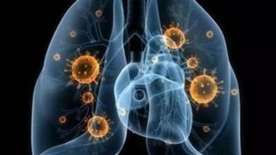

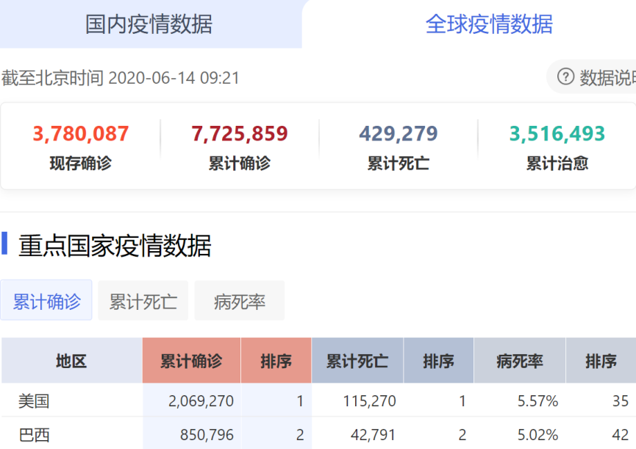
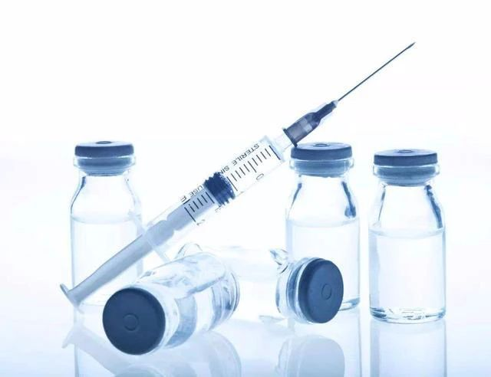
Topic Introduction

Slide 3
Topic Introduction: Why Vaccines?
Intervention | How they work | when used
vaccines | creates an immune memory of the pathogen; creates herd immunity at the population level | used widely for prevention and sometimes in response to outbreaks
antibiotic drugs, antiviral drugs | interferes with life cycle of virus or bacterium within the host | used widely to treat individual infected patients
social distancing | prevents transmission by limiting contact between susceptible and infectious individuals | used when other measures are not available and in a severe epidemic
case isolation | isolates infectious individuals so they do not transmit to others | used widely, especially for severe infectious
quarantine | isolates individuals who may have been exposed to infection, and therefore potentially infestious themselves | used for severe infections
barrier precautions | physically blocks infection sources | used widely
contact tracing | contracts can be found and treated, quarantined or isolated as needed | used widely during outbreaks for infections spread through identifiable contacts

Slide 4
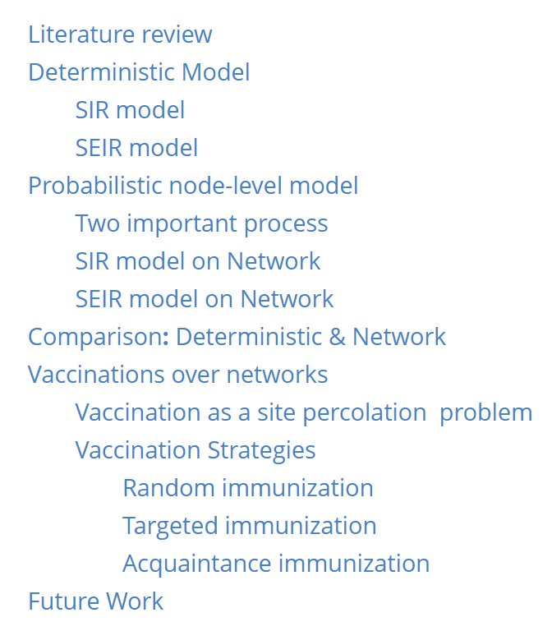
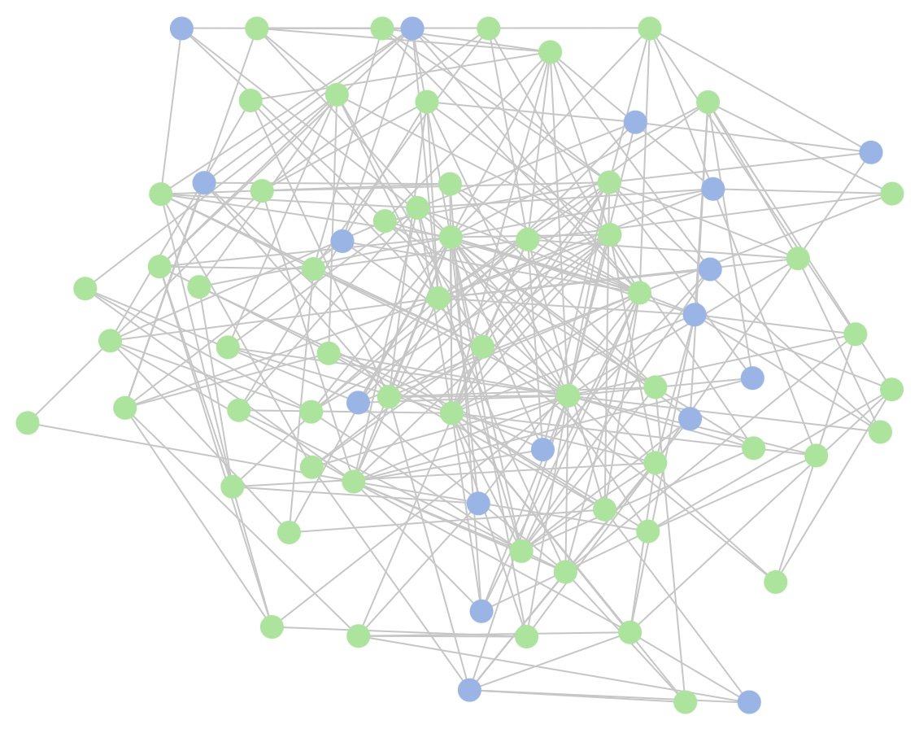
Content

Slide 5
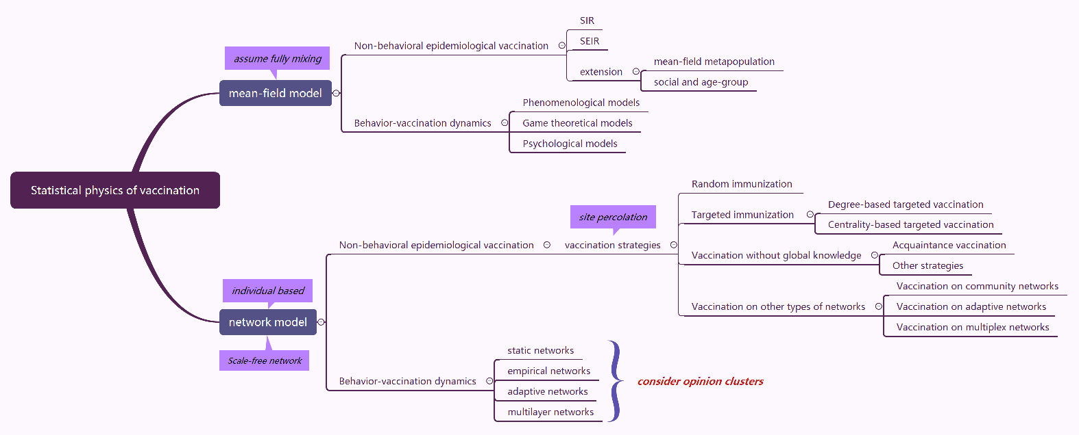


Literature Review
Assume perfect vaccination

Slide 6
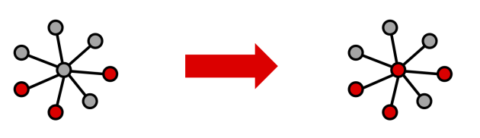
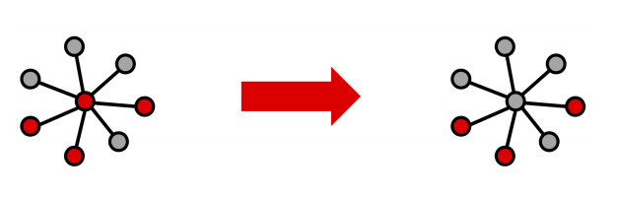
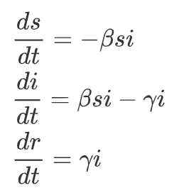
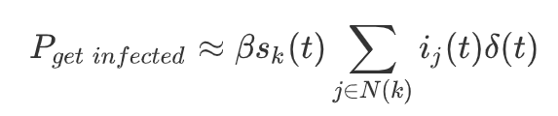

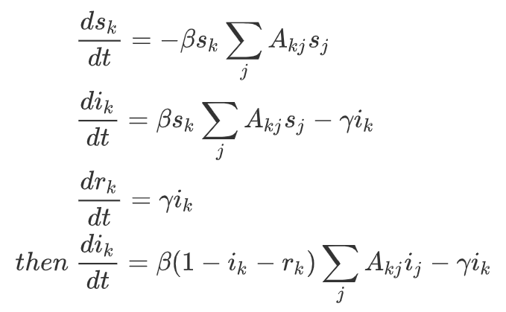

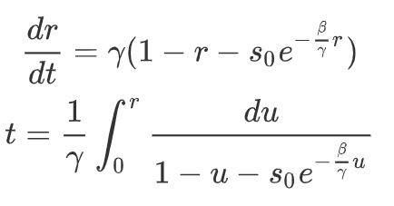
SIR Model: Deterministic & Network
Node infection
Node recovery
β
γ
S
I
R
Pictures from http://www.leonidzhukov.net/hse/2020/networks/lectures/lecture10.pdf

Slide 7
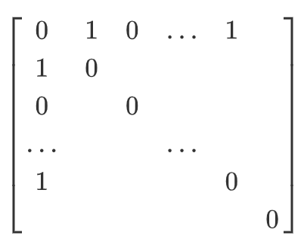
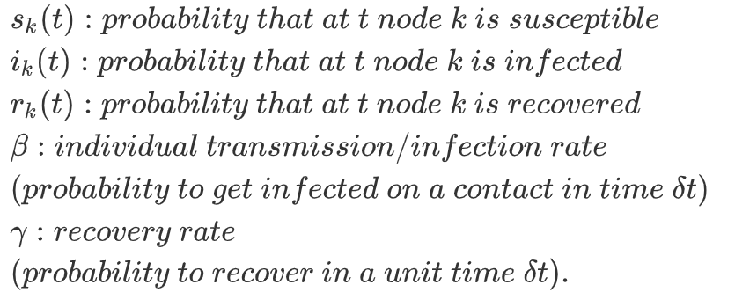
Probabilistic Node-level Model: SIR
For example:
We could use certain degree distribution to get matrix A
by python package networkx.
Consider the network of potential contacts using adjacency matrix A.
The network is undirected -> matrix A is symmetric
The diagonal elements are zeros.
Aij represents whether node i has contact with node j. If node i and node j are connected, Aij=1; otherwise, Aij=0.

Slide 8
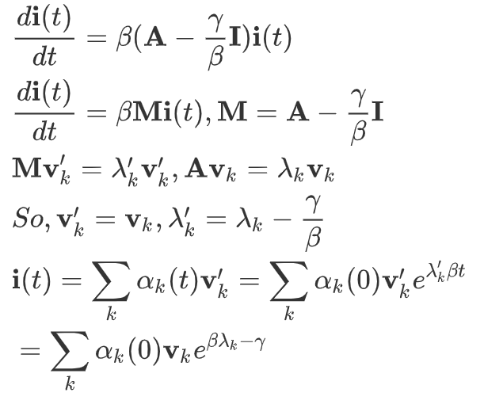

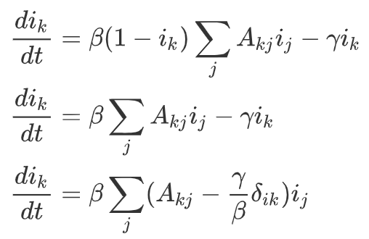


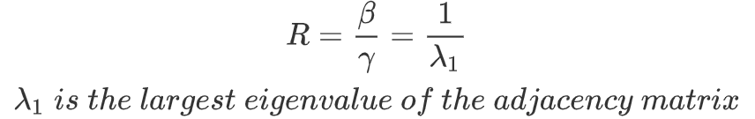
Probabilistic Node-level Model: SIR

Slide 9
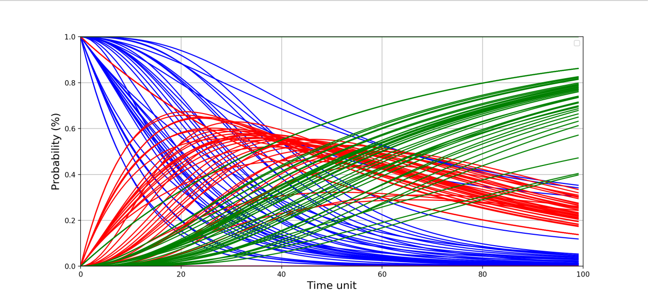
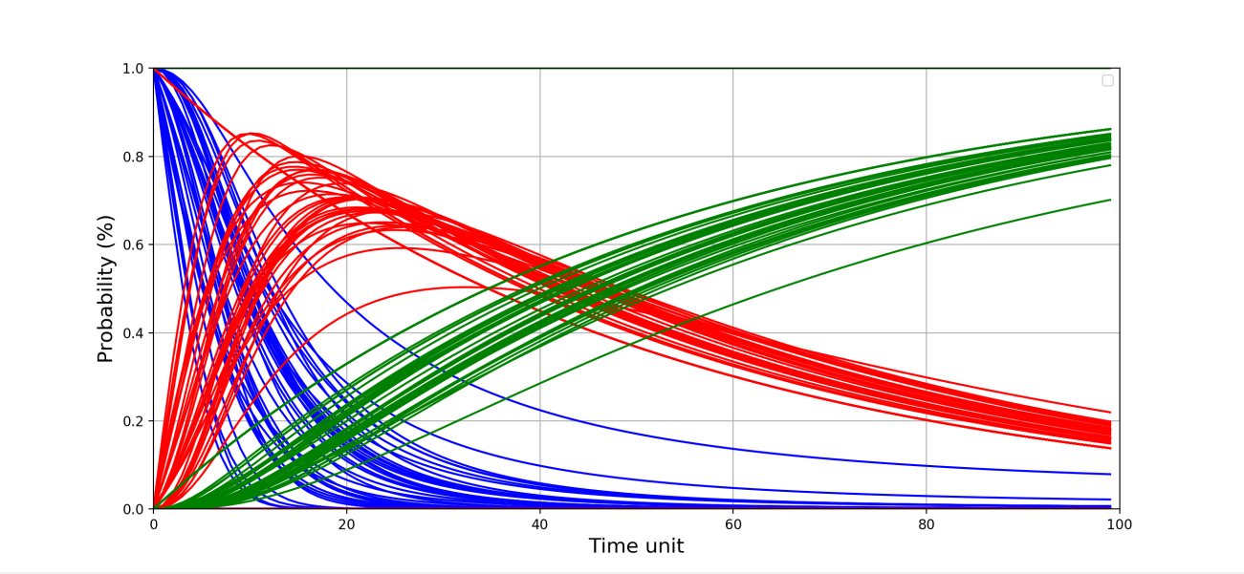
SIR on Network: Numerical Experiment
Numerical simulation assumptions:
Number of nodes n = 50
Number of random edges to add for each new node m = 5
Probability of adding a triangle after adding a random edge p = 0.4
Initial infected number of people I0 = 10
Initial recovered number of people R0 = 0
Transmission rate on a contact beta = 0.3
Recovery rate gamma = 0.2
Number of day max_day = 100
Step 1: Simulate the network by networkx
Step 2: Solve the SIR ODEs by scipy. odeint
Step 3: Update the model step by step according to its last state
Step 4: Get the probability of s, i, r for each node in each time step.
For small world network
For scale free network

Slide 10
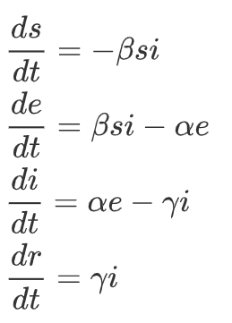
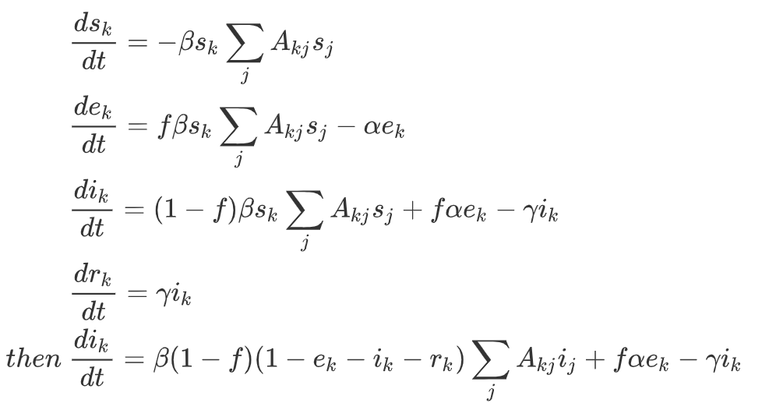

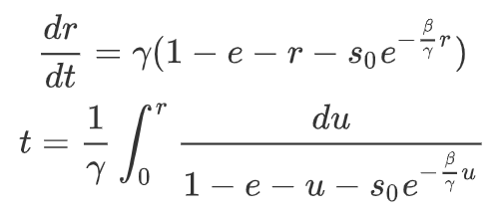
SEIR Model: Deterministic & Network
β
α
γ
Node exposed
Node infection
S
E
I
R
Node recovery

Slide 11
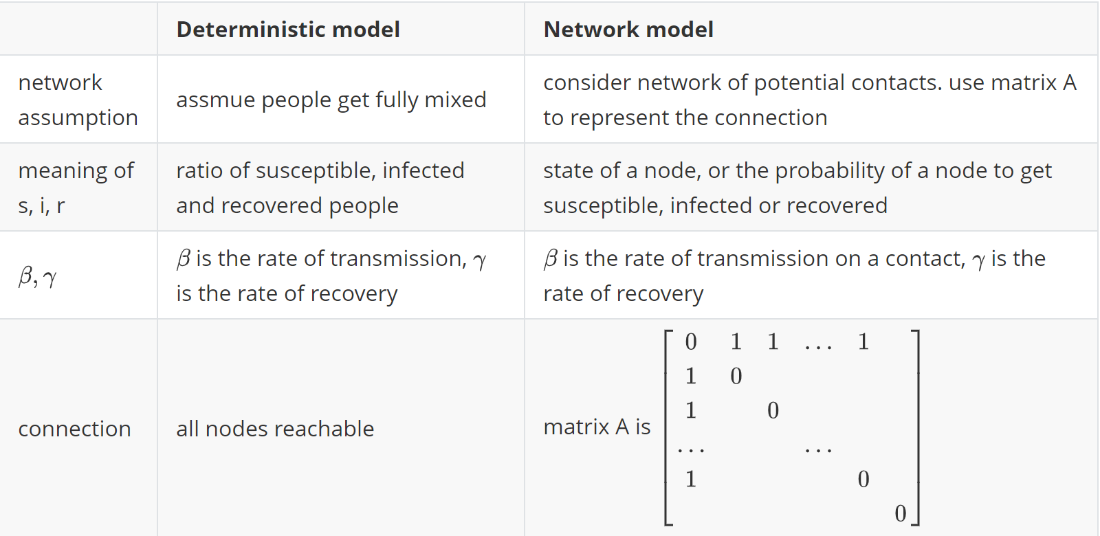
Comparison: Deterministic & Network

Slide 12





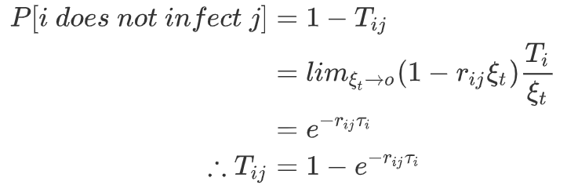
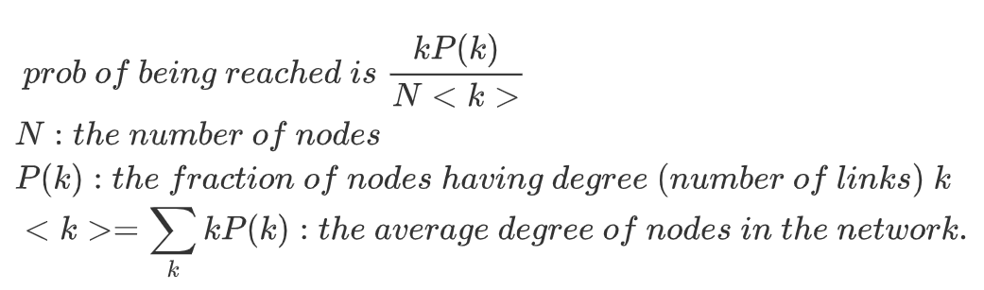
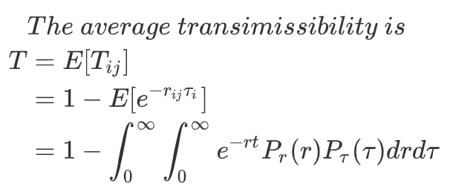
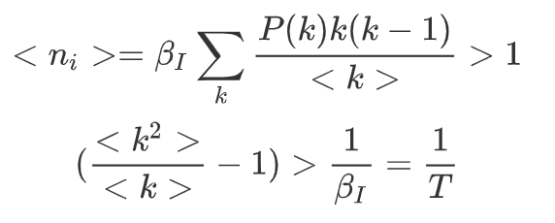
Vaccinations over Networks
The goal of the vaccination process:
to reduce the transmissibility
pass the percolation threshold (leads to minimization of the number of infected individuals in the network)
Assume and they are independent from each other. Within time interval, i does not inject j with probability . so in all time interval, the probability of Not getting the disease .
Take power law distribution as example

Slide 13
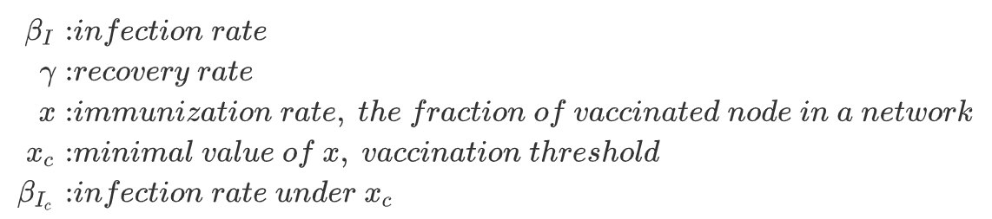
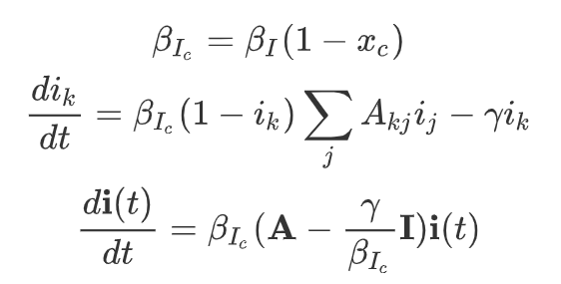
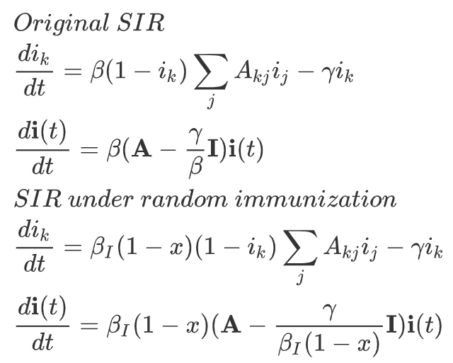
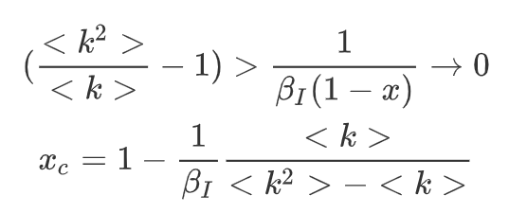
Random Immunization over Networks
Only the remaining 1 - x fraction of nodes contributes to the spreading of the disease
Recall percolation threshold
The epidemic will only be arrested if xc → 1.

Slide 14
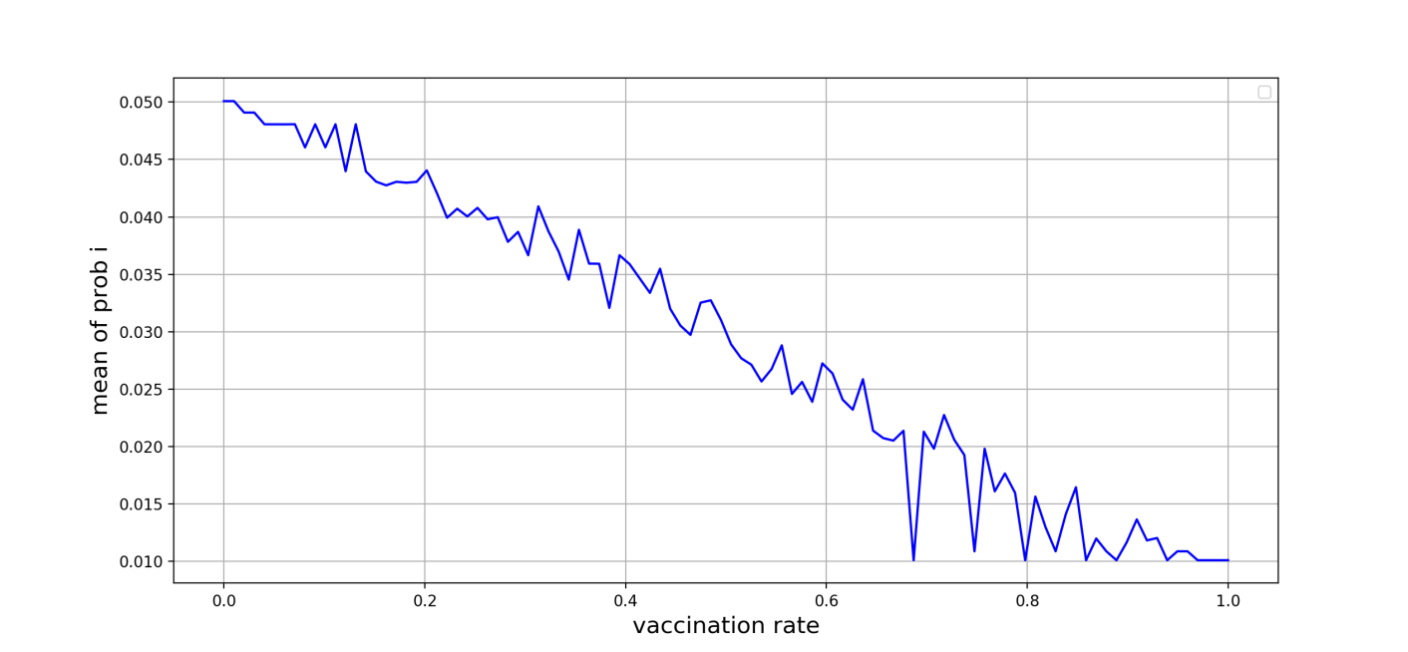
Random Immunization Simulation
Assumption:
Number of nodes n = 50
Number of random edges to add for each new node m = 5
Probability of adding a triangle after adding a random edge p = 0.4
Initial infected number of people I0 = 10
Initial recovered number of people R0 = 0
Transmission rate on a contact beta = 0.3
Recovery rate gamma = 0.2
Number of day max_day = 100
Random immunization principle:
Take x ratio of the total population randomly to get vaccinated.
Cut the selected vaccinated node’s links at once( vaccination doesn’t take any time)
Put the new network in to SIR network model.
Change x to see the effect of vaccination by looking at the average infectious probability in the final time step of all nodes.
The epidemic will only be arrested if xc → 1.
This correspond to the math part.

Slide 15
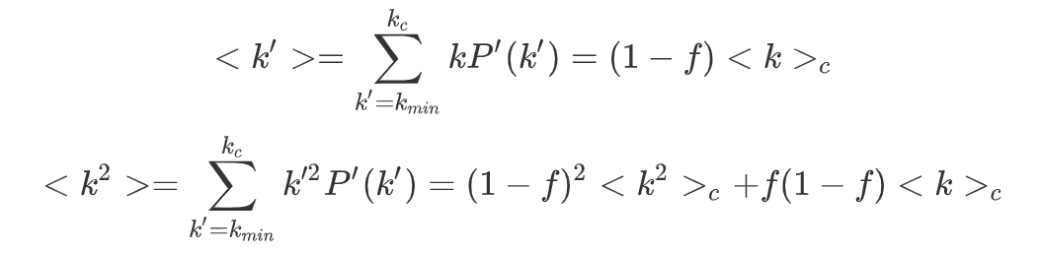
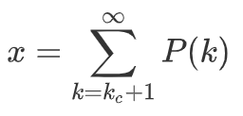
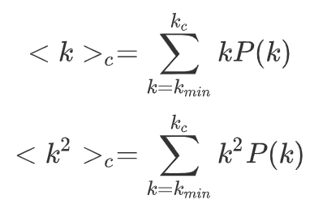
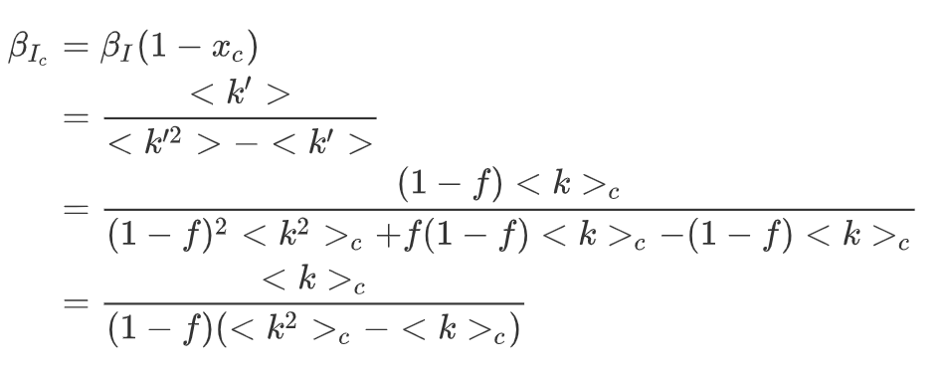
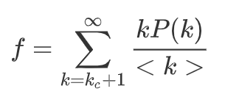
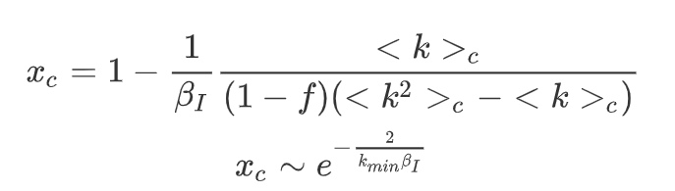
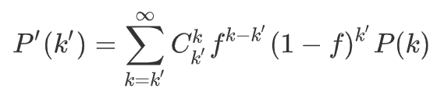
Targeted immunization over networks
Targeted immunization of the HUBs (the most highly connected nodes in the network)
For the immunization rate x:
For maximum degree ​ of the network:
The probability of link connection
The new degree distribution:

Slide 16
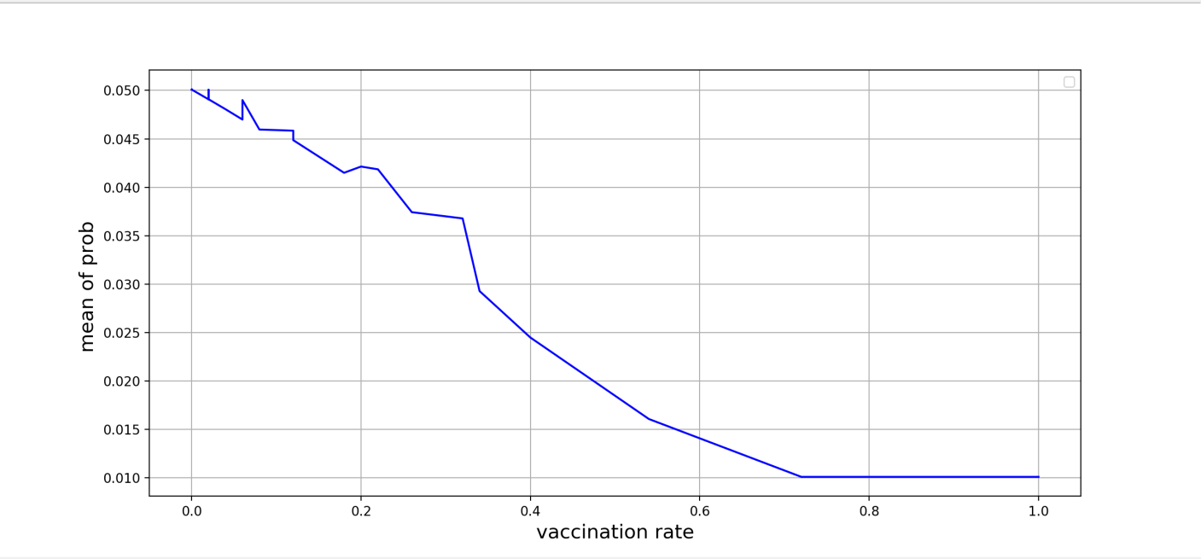
Targeted Immunization Simulation
Assumption:
Number of nodes n = 50
Number of random edges to add for each new node m = 5
Probability of adding a triangle after adding a random edge p = 0.4
Initial infected number of people I0 = 10
Initial recovered number of people R0 = 0
Transmission rate on a contact beta = 0.3
Recovery rate gamma = 0.2
Number of day max_day = 100
Targeted immunization principle:
Take the nodes whose degree is larger than kc.
Cut the selected vaccinated node’s links at once( vaccination doesn’t take any time)
Put the new network in to SIR network model.
Change kc to see the effect of vaccination by looking at the average infectious probability in the final time step of all nodes.
Random Immunization
Targeted Immunization

Slide 17
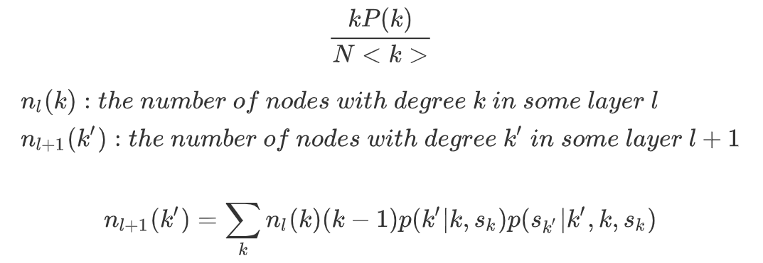
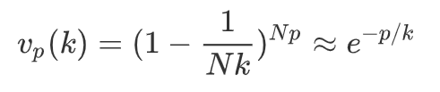

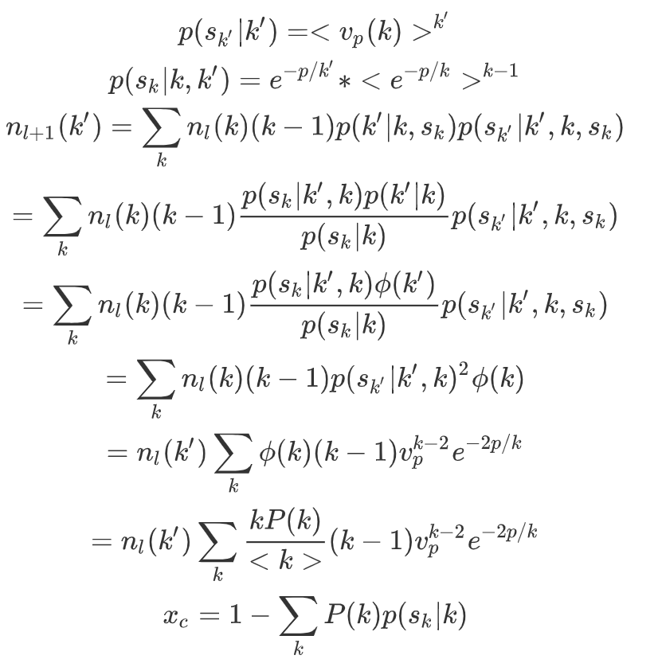
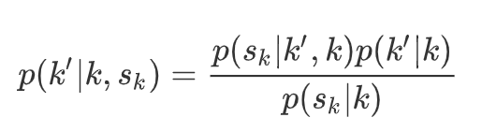
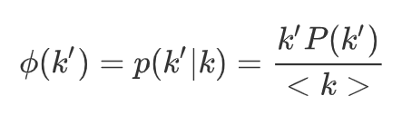
Acquaintance Immunization over Networks
Only requires knowledge of local information.
Selection of a fraction p of nodes with at least one connection at random and vaccine his or her neighbors
The probability that a node with degree k is selected for vaccination is
The probability that the acquaintance is not selected in Np vaccination attempt by a random node of degree k
The average probability that the acquaintance is not selected in one vaccination
Based on Bayes' rule
Assume the network is uncorrelated:

Slide 18
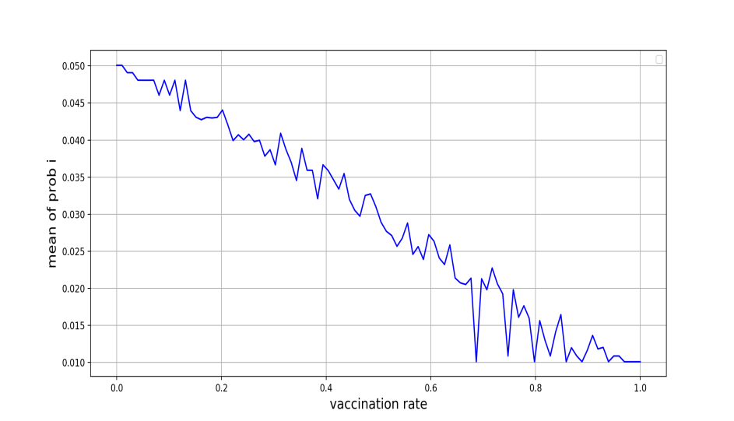

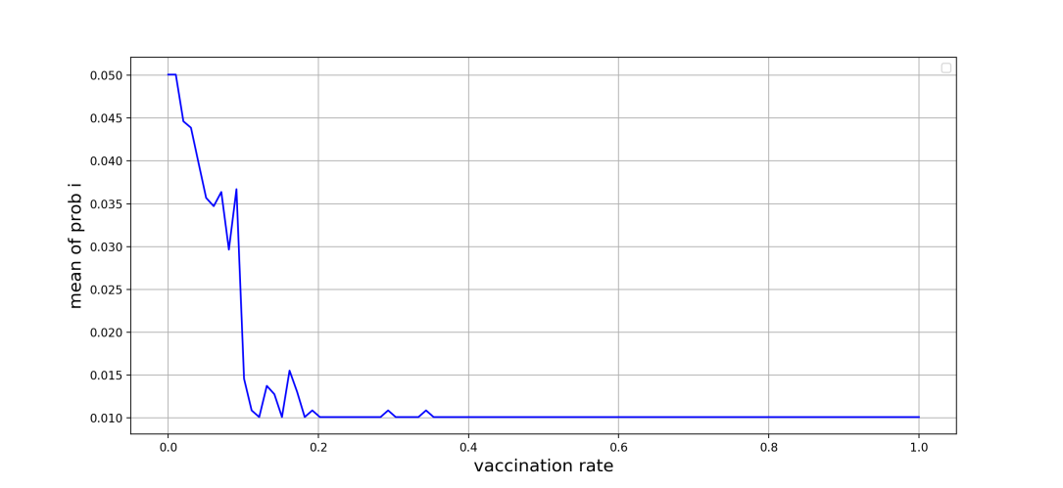
Acquaintance Immunization Simulation
Assumption:
Number of nodes n = 50
Number of random edges to add for each new node m = 5
Probability of adding a triangle after adding a random edge p = 0.4
Initial infected number of people I0 = 10
Initial recovered number of people R0 = 0
Transmission rate on a contact beta = 0.3
Recovery rate gamma = 0.2
Number of day max_day = 100
Acquaintance immunization principle:
Take x ratio of the total population randomly.
Find all of it’s neighbors.
Cut the selected node’s neighbor's link at once( vaccination doesn’t take any time)
Put the new network in to SIR network model.
Change x to see the effect of vaccination by looking at the average infectious probability in the final time step of all nodes.
Random Immunization
Targeted Immunization
Acquaintance Immunization

Slide 19
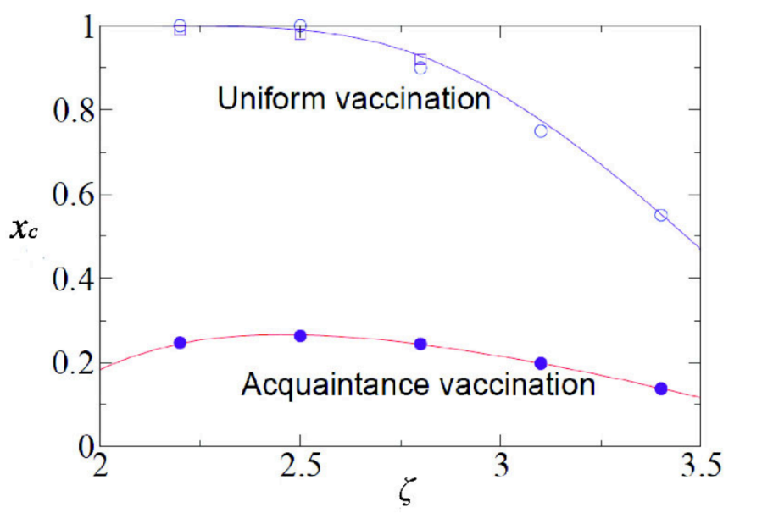
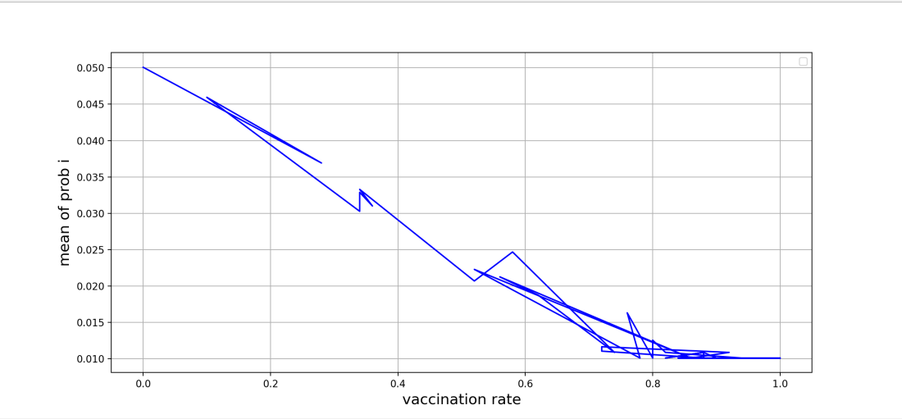
Acquaintance Immunization Simulation
Acquaintance Immunization
The effect of acquaintance immunization may be fake.
The rate to randomly choose some people is not equal to the vaccination rate iff the selected nodes have only one neighbor.
We have to further verify the graph shown in the paper about the effectiveness of acquaintance immunization.
Acquaintance Immunization for real x

Slide 20
Future Work: Try to Find Better Strategy
……
Research a group number of people and get them vaccinated according to their degrees.
Update our knowledge about the kc according to the result of the end of the last time period.
Conduct the vaccination at the beginning of every time period.
Why this strategy?
Get a large number of people vaccinated at once is not realistic.
We don’t know what’s the best degree threshold (kc).
In this strategy, we only need to research a group number of people and get part of them vaccinated according to the initial condition of vaccination and conduct the same process to the remaining groups according to the previous effect.
Still coding for this part…

Slide 21
Future Work
Conduct numerical simulation or agent-based simulation based on power-law distribution with estimated parameters.
Find data of Covid-19 for parameter estimation for power-law distribution.
Break the assumption of perfect vaccination. (consider the probability to get infected after being vaccinated).
Read more literature about non-behavior or behavior-vaccination dynamic and try to come up with better vaccination strategies.

