Slide 1
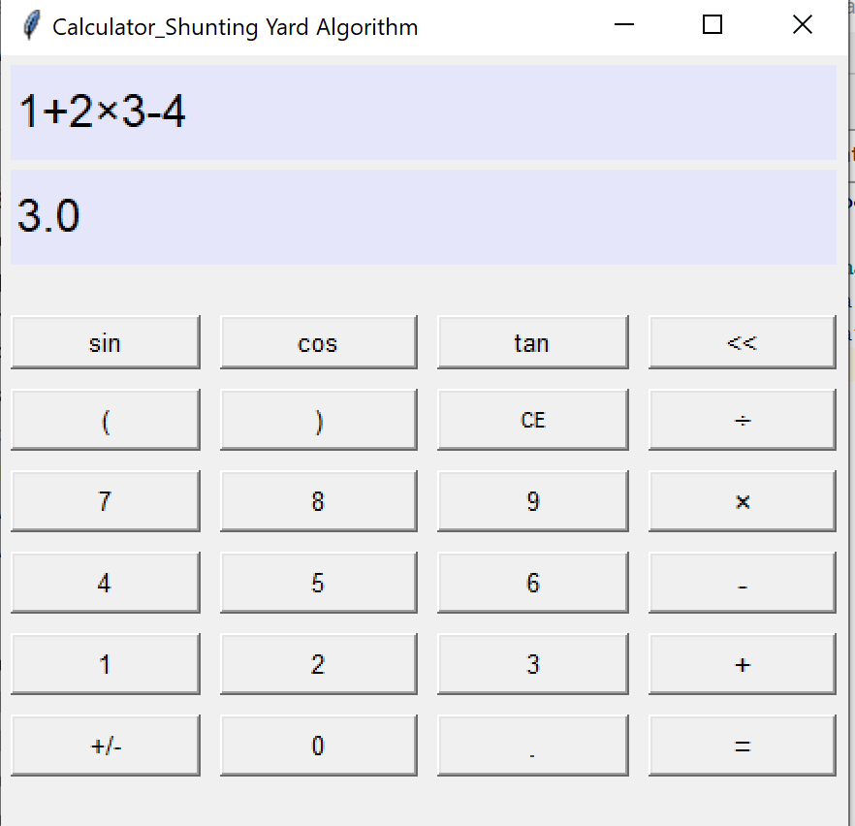
A calculator Implements The Shunting Yard Algorithm ( Python)
Jenny Chen
The shunting yard algorithm apply a scientific calculator that support
floating point numbers and trigonometric function
Use a single package GUI toolkit tkinter from Python and my internal modules

Slide 3
