Slide 1


BUSINESS EMAIL COMPROMISE TRAINING
Accounts Payable Team Edition
Detect → Verify → Contain
Invoices, bank details and payment approvals all pass through your desk. One habit protects them all.
Next

Slide 2
AGENDA
What business email compromise is, and why your desk is the target
Phase 1, Detect
Two email red flags, and the psychology behind them
Text messages, QR codes and ClickFix
AI-written emails
Phase 2, Verify
The one habit that stops it
Two scenarios: an AI cloned voice and an AI deepfake video
Phase 3, Contain
What to do if you suspect an attempt, and a knowledge check
Previous
Next
2

Slide 3
WHAT IS BUSINESS EMAIL COMPROMISE?
BEC, also called email account compromise, is a scam in which a criminal impersonates someone you trust, or breaks into their real email account, to trick you into redirecting a payment. Either way, the message looks completely legitimate and asks for something you would normally do.
From: Accounts, Stratton Supplies <accounts@stratton-supplies.co>
Subject: Updated Bank Details for Next Invoice
“We've changed banks recently, so please use the new account details attached for your next payment to us. Let us know if you have any questions. Regards, Stratton Supplies”
Sources: FBI IC3 PSA I-091124, I-061118; IC3 2025 Annual Report
Previous
Next
3

Slide 4
HOW A BEC ATTACK ACTUALLY FLOWS
1. RESEARCH
The attacker studies vendor names, invoice patterns, and who approves payments
2. SPOOF
A lookalike domain, or a real mailbox the attacker has broken into
3. URGENCY
A deadline or bank-change excuse, designed to make you skip verification
4. REDIRECT
Payment goes to the attacker's account, often before anyone notices
→
→
→
Previous
Next
4

Slide 5
YOUR DESK MOVES THE MONEY
You process invoices, change vendor bank details and release payments. That is exactly what BEC attackers try to redirect, so every request that touches a bank account deserves a second look.
United States
USD 3.05 billion in BEC losses reported to the FBI in 2025, from 24,768 complaints
Australia
15% of business cybercrime reports in 2024–25 were BEC fraud with a financial loss
Worldwide
USD 55.5 billion in exposed losses, 2013 to 2023, reported in 186 countries (FBI)
Sources: FBI IC3 2025 Annual Report; FBI IC3 PSA I-091124-PSA; Australian Signals Directorate Cyber Threat Report 2024–25
Previous
Next
5

Slide 6
PHASE 1
DETECT
Can you spot it before it costs anything?
Previous
Next
6

Slide 7
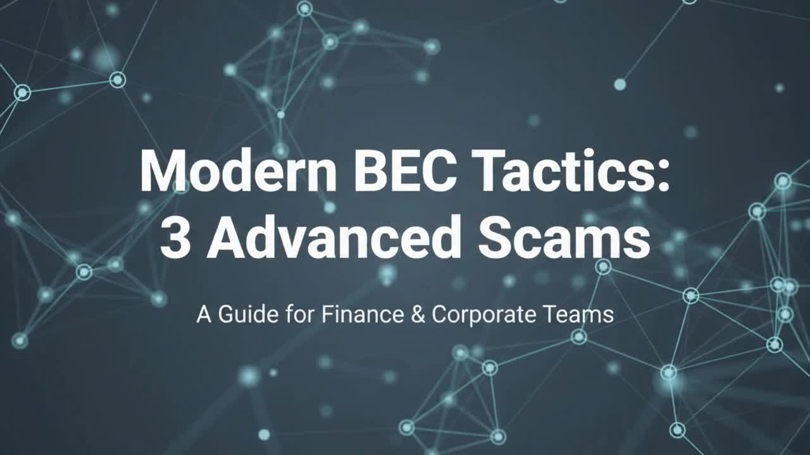
SCENARIO: THE REMITTANCE UPDATE
A vendor's bank details “change”, plus a bonus look at a second technique.
Click to play the video
Previous
Next
7

Slide 8
▶ GAME
SPOT THE RED FLAG
You have 30 seconds. Read this email and call out every red flag you can find.
From: Dana Whitfield <dana.whitfield@stratton-supplies.com>
Subject: Re: Invoice 20418 for September
Earlier in the thread: “Invoice 20418 for September is attached, due in 14 days.”
“Hi, thanks for confirming receipt. We changed banks last week, so please pay invoice 20418 to the new account below: BSB 000-000, account 00000000. A late fee of 5% applies if it isn't received today. Dana Whitfield, Accounts, Stratton Supplies, 07 5550 0142”
Answer is on the next slide
Previous
Next
8

Slide 9
▶ GAME
SPOT THE RED FLAG: REVEALED
🚩 A bank-detail change by email, inside a thread: a real thread proves nothing.
🚩 An ordinary reason: “we changed banks last week”.
🚩 A late-fee threat: “5% if it isn’t received today”.
🚩 A phone number in the signature: calling it checks nothing.
🚩 A familiar signature and invoice number, copied from earlier emails.
Check bank-detail changes through a number from your vendor master file.
LEVERS PULLED
Authority
A vendor’s name and signature make it feel safe to obey.
Scarcity
A deadline and a penalty make you skip the check.
Plus trust in a familiar thread.
Sources: FBI IC3 PSA I-091124-PSA; Cialdini, HBR (2001)
Previous
Next
9

Slide 10
▶ GAME
SPOT THE RED FLAG
You have 30 seconds. Read this email and call out every red flag you can find.
From: Accounts, Stratton Supplies <accounts@stratton-supplies.co>
Subject: Updated bank details: this month's invoice is overdue
“Hi, this month's invoice is now overdue. Our bank details changed after a system upgrade, so please pay it today to: BSB 000-000, account 00000000. Thanks, Accounts Team”
Answer is on the next slide
Previous
Next
10

Slide 11
▶ GAME
SPOT THE RED FLAG: REVEALED
🚩 New bank details by email only, with a “system upgrade” as the excuse.
🚩 Overdue and “today”: pressure to pay before you check.
🚩 A generic sign-off, “Accounts Team”, with no named contact.
🚩 A lookalike domain ending in .co, not the vendor's usual .com.
🚩 No invoice number or purchase order to match against your records.
When your usual check goes unanswered, the pressure peaks. Hold the new details and keep trying.
LEVERS PULLED
Scarcity
“Overdue” and “today” put a clock on you.
Plus a lookalike domain that is easy to miss.
Sources: FBI IC3 PSA I-091124-PSA; Cialdini, HBR (2001)
Previous
Next
11

Slide 12
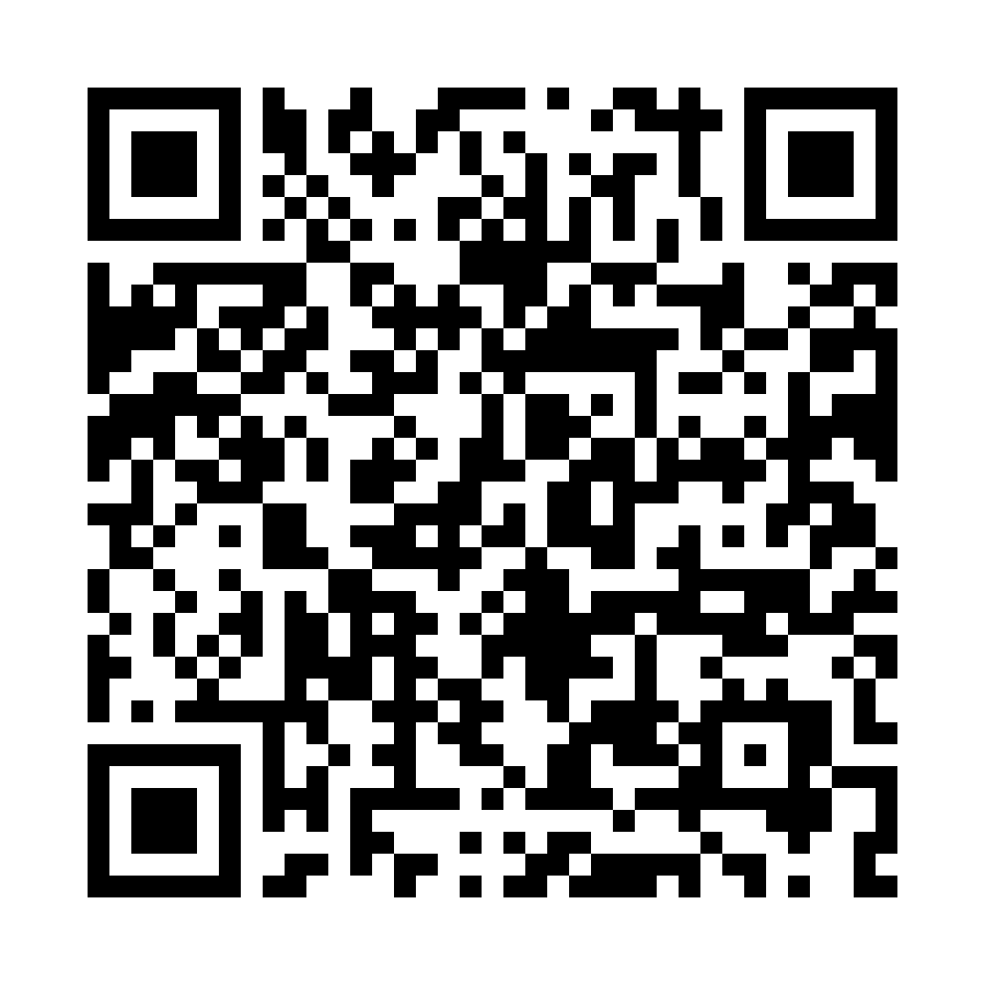
SAME LEVERS, OTHER CHANNELS
Text message: an “overdue invoice”
QR code: a “retired” payment portal
INVOICE #4471
Accounts Team
Invoice 20418 is overdue. A late fee applies from 5 pm today. Pay now to avoid it.
https://secure-invoice-pay.com/20418
Stratton Supplies, due today
Scan to pay or update banking details
Authority
Scarcity
Scarcity
Do not tap. Check the invoice in your system and through your vendor contact, then report it.
Do not scan. Use the vendor details in your master file, then report it.
Sources: Get Cyber Safe (smishing); ASD’s ACSC, Quishing; Cialdini, HBR (2001)
Previous
Next
12

Slide 13
CLICKFIX: HOW A REAL MAILBOX GETS TAKEN
1
A fake security check on a web page
2
You paste a command to “fix” it
3
It steals saved passwords and sessions
4
A real mailbox is taken over
5
The BEC message comes from a real address
Growing fast: the top way in during 2025 in Microsoft’s data (47%), and 52% of Push Security’s detections through Q2 2026, reaching 67% in August.
Most arrive through web search results and compromised sites, not email.
In Accounts Payable: bank-detail changes can then come from a genuine vendor address, inside a real thread, so every change needs a callback.
Already pasted something? Stop and tell IT at once. Do not try to clean it up.
Sources: Push Security, “The state of ClickFix” (Sep 2026), which cites Microsoft’s 2025 report
Previous
Next
13

Slide 14
ALSO WATCH FOR: AI-WRITTEN SUPPLIER EMAILS
What it looks like
A polished email in the vendor's usual tone that asks you to update bank details or pay a new invoice.
Why it works
AI tools help criminals write fluent, convincing messages, so spelling mistakes are no longer a reliable clue.
How to verify
Judge the request, not the writing. Call the vendor on a number from your vendor master file.
Judge the request, not the writing.
Source: FBI IC3 PSA I-120324-PSA (generative AI makes scam text convincing)
Previous
Next
14

Slide 15
PHASE 2
VERIFY
The one habit that would have stopped it.
Previous
Next
15

Slide 16
ALWAYS VERIFY: SOMEWHERE THE REQUEST CAN'T REACH
Known Contact
Call the vendor using a number from your vendor master file, never one the email gave you
System of Record
Check the vendor file directly for any real change request, not the inbox that received this one
Second Set of Eyes
For anything above threshold, get another person to confirm independently
Time to Verify
Invoice deadlines are the tactic, so slowing down is always allowed
If a change didn't come through your normal process, it isn't a change request. It's a test.
Previous
Next
16

Slide 17
▶ SCENARIO: PHONE CALL
THE VENDOR CALL
A call from “Mark” at TechSupply Corp, a supplier you pay every month. It sounds exactly like him. He says the old account is closed, he is travelling and can’t email, and he needs you to take the new bank details down now for this month’s payment. Your process: bank changes need a signed vendor change form, a callback to the contact on file, and a second approver.
Take the details down, and enter the change with a note that he confirmed it by phone.
Ask him to email the signed change form, then process it once the approver signs.
Tell him changes need the signed form, and call the contact on file before approving.
Click a card to choose.
Previous
17

Slide 18
PAYMENT SENT: FRAUD SUCCEEDED
The note tells the second approver the change was checked, so it is approved. The next payment goes to the new account. “Mark” was a voice clone, and the real vendor never called. The checker approved what the maker wrote.
Previous
Next
18

Slide 19
ATTEMPT STOPPED
You call the contact on file. The real vendor answers, never asked for a change, and the old account stays. You report the attempt, and the real Mark is warned that his voice is being cloned.
Previous
Next
19

Slide 20
PARTLY RIGHT
The form arrives and looks genuine. Nothing is paid yet, but nobody has called the vendor, and a signed form from the caller proves nothing. Whether this ends well now depends on the approver doing the callback you skipped.
Previous
Next
20

Slide 21
DEBRIEF
A cloned voice can sound exactly like a supplier you know. Writing “confirmed by phone” is the workaround that makes an unchecked change look checked, and the second approver can only approve what you wrote.
The signed form starts the process, and the callback to the contact already on file is what makes it a control. Never call a number the request gave you.
Sources: FBI IC3 PSA I-120324-PSA; Canadian Centre for Cyber Security
Previous
Next
21

Slide 22
▶ SCENARIO: VIDEO CALL
THE VIDEO CALL
A video call from the vendor’s finance director, with two colleagues. Her face and voice look right. She asks you to confirm new remittance details before the payment run closes at 3 pm. You try the contact in your master file, and it rings out. Your process: payments to changed details need an approved vendor change.
Pay the new details this run, and ask her to confirm in writing afterwards.
Pay the details already on file for this run, and tell your AP manager about the call.
Hold the payment until the vendor answers, and don't mention the call to anyone.
Click a card to choose.
Previous
22

Slide 23
PAYMENT SENT: FRAUD SUCCEEDED
The payment goes to the new account and is gone before the confirmation “arrives”. Everyone on the video was a deepfake, built from public footage of the vendor's team. “Pay now, paperwork later” moved the money first and the checks second.
Previous
Next
23

Slide 24
ATTEMPT STOPPED
The payment goes to the genuine account on file, on time. Your manager reaches the real vendor later and learns nobody asked for a change. The attempt is reported, and the vendor is warned about the fake call.
Previous
Next
24

Slide 25
PARTLY RIGHT
The payment is safe, but it misses the run and a late fee may apply. Nobody else in Accounts Payable has been warned, so the same caller can try the next clerk. Being cautious alone is not enough: report it.
Previous
Next
25

Slide 26
DEBRIEF
A video call with several familiar faces can still be fake. Seeing more than one person adds social proof, and a deadline makes you fix the problem on their terms.
When you cannot verify in time, the safe default is the details already on file. Then tell your manager, so the next clerk is not caught.
Sources: FBI IC3 PSA I-120324-PSA; CNN Business (Arup, 2024)
Previous
Next
26

Slide 27
PHASE 3
CONTAIN
You caught it, or you didn't. Either way, here's what happens next.
Previous
Next
27

Slide 28
CONTAIN: WHAT TO DO, IN ORDER
The order may change depending on the situation. Follow your organisation's incident procedure.
You suspect an attempt
Has money moved?
No: nothing paid yet
Yes: money already sent
1
Stop the payment
1
Call your bank now: request a recall
2
Verify through a known contact
2
Tell your manager and IT
3
Tell IT or Security
3
Tell the real vendor
Keep the evidence
Email, thread, call log
Report it
ReportCyber, IC3, Report Fraud, CAFC
Get support
Tell your team. IDCARE helps with identity.
Sources: FBI IC3 2025 Annual Report; ASD’s ACSC; Report Fraud; CAFC; IDCARE
Previous
Next
28

Slide 29
KNOWLEDGE CHECK: CONTAIN (Q1)
You released a payment this morning to new bank details and now suspect they were fake. Who do you call first?
A) The vendor, on their known number, to ask whether the money arrived
B) Your manager and IT, so the response is coordinated from the start
C) Your bank, to ask them to stop or recall the payment
Previous
29

Slide 30
NOT QUITE
The answer is C) Your bank, to ask them to stop or recall the payment. Once money has moved, speed matters most. Call the bank first, then your manager and IT.
Previous
Next
30

Slide 31
CORRECT!
Right. Once money has moved, speed matters most. Call the bank first, then your manager and IT.
Previous
Next
31

Slide 32
KNOWLEDGE CHECK: CONTAIN (Q2)
The bank says the recall failed and the money has been withdrawn. What do you do now?
A) Ask the vendor to return the money, and report it only if they refuse
B) Report it to the cybercrime service, tell IT, and keep working with your bank
C) Record the loss for the audit, and let the bank close the case
Previous
32

Slide 33
NOT QUITE
The answer is B) Report it to the cybercrime service, tell IT, and keep working with your bank. A failed recall is not the end. Reporting can still help the bank and the police trace and freeze funds, and IT needs to know how the attacker got in.
Previous
Next
33

Slide 34
CORRECT!
Right. A failed recall is not the end. Reporting can still help the bank and the police trace and freeze funds, and IT needs to know how the attacker got in.
Previous
Next
34

Slide 35
SUMMARY
DETECT
Urgency and a changed bank detail are the pattern
VERIFY
Check somewhere the request can't reach
CONTAIN
Bank first if money has moved, then report
Always verify somewhere the request can't reach.
Laws, contacts and reporting services differ by country and industry. Adapt this module before you use it.
Previous
Next
35

Slide 36
THANK YOU
Questions? Reach out to Jenny: s4927217@uq.edu.au
Prepared as part of the Role-Based BEC Competency Framework (RBCF)
Previous
Finish

