Slide 1


BUSINESS EMAIL COMPROMISE TRAINING
Administrative Staff Edition
Detect → Verify → Contain
You're trusted to just get things done. That's exactly what attackers count on.
Next

Slide 2
AGENDA
What business email compromise is, and why Administrative staff are targeted
Phase 1, Detect
Two email red flags, and the psychology behind them
Text messages, QR codes and ClickFix
Phase 2, Verify
The one habit that stops it
Two scenarios: an AI cloned voice and an AI deepfake video
Phase 3, Contain
What to do if you suspect an attempt, and a knowledge check
Previous
Next
2

Slide 3
WHAT IS BUSINESS EMAIL COMPROMISE?
BEC, also called email account compromise, is a scam in which a criminal impersonates someone you trust, or breaks into their real email account, to trick you into sending money or buying something you shouldn't. Either way, the message looks completely legitimate and asks for something you would normally do.
From: Marcus L., Regional Director <m.lawson@northridge-group.co>
Subject: Need a quick favour before 3pm
Are you at your desk? I need you to arrange a supplier payment today. Details to follow. Please keep this between us for now. Thanks, Marcus
Sources: FBI IC3 PSA I-091124, I-061118; IC3 2025 Annual Report
Previous
Next
3

Slide 4
HOW A BEC ATTACK ACTUALLY FLOWS
1. RESEARCH
The attacker studies who you report to and who approves spending
2. SPOOF
A lookalike address, or a real mailbox the attacker has taken over
3. URGENCY
A deadline plus secrecy: “don't tell your manager”
4. REDIRECT
Money or gift card codes go to the attacker, often unnoticed
→
→
→
Previous
Next
4

Slide 5
YOUR JOB IS TO SAY YES QUICKLY
That's not a flaw. It's what makes you good at your role, and it's what a BEC attacker tries to use against you when they ask you to skip a step.
United States
USD 3.05 billion in BEC losses reported to the FBI in 2025, from 24,768 complaints
Australia
15% of business cybercrime reports in 2024–25 were BEC fraud with a financial loss
Worldwide
USD 55.5 billion in exposed losses, 2013 to 2023, reported in 186 countries (FBI)
Sources: FBI IC3 2025 Annual Report; FBI IC3 PSA I-091124-PSA; Australian Signals Directorate Cyber Threat Report 2024–25
Previous
Next
5

Slide 6
PHASE 1
DETECT
Can you spot it before it costs anything?
Previous
Next
6

Slide 7

SCENARIO: THE ATTORNEY EMAIL
A legal-sounding email, demanding urgent action and total secrecy.
Click to play the video
Previous
Next
7

Slide 8
▶ GAME
SPOT THE RED FLAG
You have 30 seconds. Read this email and call out every red flag you can find.
From: Sarah Whitfield, Senior Partner <s.whitfield@caldwell-harrington-legal.com>
Subject: CONFIDENTIAL: Immediate Action Required
Attachment: Payment_Instructions.pdf
This matter is time-sensitive and strictly confidential. We require an urgent transfer of AUD 18,500 before end of business today. Please do not discuss this with anyone in your office, including your manager, until it is resolved.
(When you're ready, the flagged version is on the next slide.)
Previous
Next
8

Slide 9
▶ GAME
SPOT THE RED FLAG: REVEALED
🚩 “Do not discuss this, including your manager”: it isolates you from the one person who could catch it.
🚩 “Before end of business today”: a deadline designed to rush the decision.
🚩 Process bypass: payment details attached directly, with no invoice or purchase order to check against.
🚩 A law firm name that has never been independently confirmed.
🚩 Unexpected attachment: payment instructions arrive as a file, outside your normal process.
Criminals impersonate executives, law firms and trusted vendors to trigger payments.
LEVERS PULLED
Authority
A law firm’s name makes people comply.
Scarcity
Little time means little checking.
Plus secrecy, which stops anyone checking.
Sources: FBI IC3 PSA I-061118-PSA; Cialdini, HBR (2001)
Previous
Next
9

Slide 10
▶ GAME
SPOT THE RED FLAG
You have 30 seconds. Read this email and call out every red flag you can find.
From: Elena Park, CEO <elena.park@northridge-group.com>
Subject: Quick favour
“I’m in back-to-back meetings and can’t talk. I need 5 gift cards for a client by 3 pm. Buy them and email me the codes. I’ll reimburse you. Please keep this between us. Elena”
(When you're ready, the flagged version is on the next slide.)
Previous
Next
10

Slide 11
▶ GAME
SPOT THE RED FLAG: REVEALED
🚩 Gift cards by email: a request to buy them and send the codes.
🚩 “Can’t talk”: a reason that blocks the obvious check.
🚩 “By 3 pm”: a deadline that leaves no time to check.
🚩 “Keep this between us”: secrecy cuts you off from the people who would check.
🚩 “I’ll reimburse you”: a promise that makes the favour feel safe.
Only scammers ask for gift card numbers and PINs. Check through the CEO’s office, on a number from the directory.
LEVERS PULLED
Authority
People comply when the CEO asks.
Reciprocity
A promise to repay makes a favour feel fair.
Plus secrecy and a tight deadline.
Sources: FTC gift card alert; Cialdini, HBR (2001)
Previous
Next
11

Slide 12
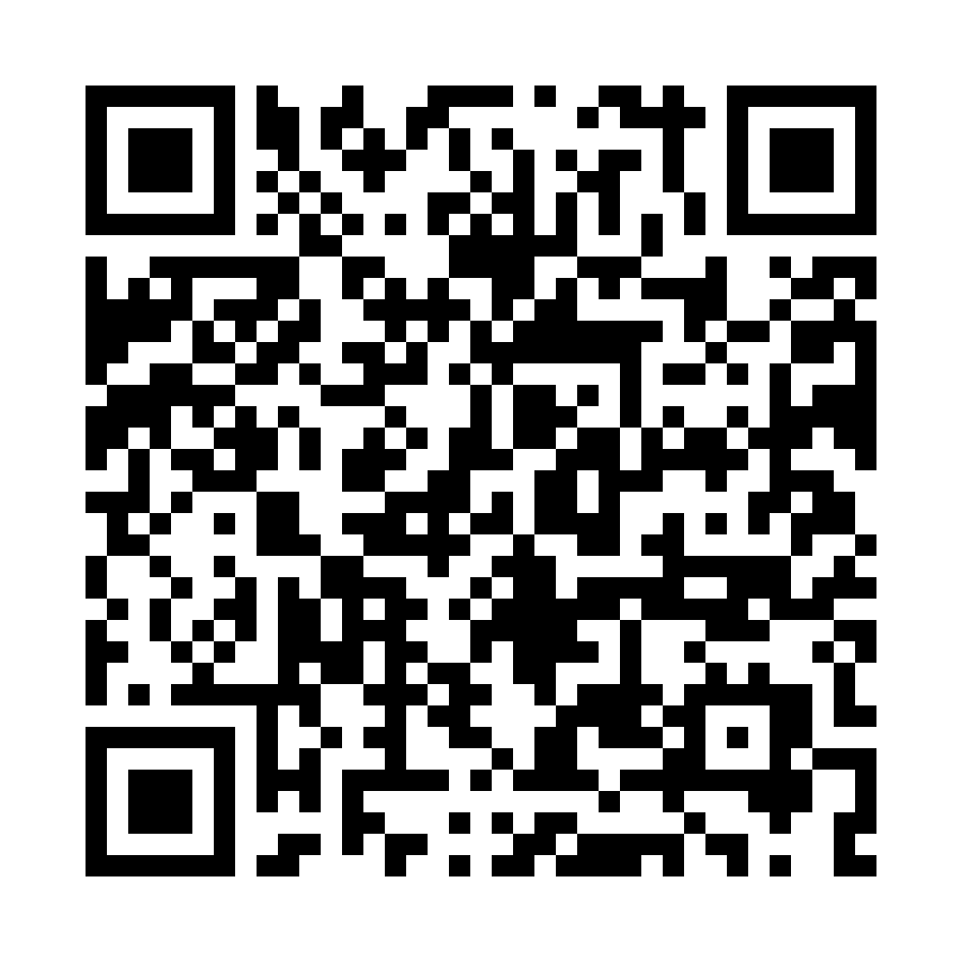
SAME LEVERS, OTHER CHANNELS
Text message: a “CEO” favour
QR code: a real Sophos case (2024)
SCANNED DOCUMENT
Text from “CEO”
“I’m in back-to-back meetings and can’t talk. I need 5 gift cards for a client by 3 pm. Buy them and text me the codes. I’ll reimburse you. Keep this between us.”
Employee benefits: scan to view
Scan to view your document
Authority
Reciprocity
Authority
Do not buy or reply. Check through the CEO’s office, then report it.
Do not scan. Open benefits and remittance documents through the official portal, then report it.
Sources: FTC gift card alert; Sophos, “From QR to compromise” (2024)
Previous
Next
12

Slide 13
CLICKFIX: HOW A REAL MAILBOX GETS TAKEN
1
A fake security check on a web page
2
You paste a command to “fix” it
3
It steals saved passwords and sessions
4
A real mailbox is taken over
5
The BEC message comes from a real address
Growing fast: the top way in during 2025 in Microsoft’s data (47%), and 52% of Push Security’s detections through Q2 2026, reaching 67% in August.
Most arrive through web search results and compromised sites, not email.
For Administrative staff: a request can then appear to come from your manager’s real mailbox, so the only safe check is a call on a number you already hold.
Already pasted something? Stop and tell IT at once. Do not try to clean it up.
Sources: Push Security, “The state of ClickFix” (Sep 2026), which cites Microsoft’s 2025 report
Previous
Next
13

Slide 14
PHASE 2
VERIFY
The one habit that would have stopped it.
Previous
Next
14

Slide 15
ALWAYS VERIFY: SOMEWHERE THE REQUEST CAN'T REACH
Official Contact Only
Verify law firms, vendors and callers through publicly listed details, never the message's own
The Person Directly
Contact the named person on a number or channel you already hold. For senior people, go through their office
Standard Process
Any financial or purchasing request still goes through the normal procurement steps
Time to Verify
Urgency is the tactic, so slowing down to check is always allowed
If a request asks you to stay quiet, that's the part to act on first.
Previous
Next
15

Slide 16
THE URGENT CALL
▶ SCENARIO: PHONE CALL
Your phone rings. It sounds exactly like your manager. She is stuck in meetings, needs 5 gift cards for a client by 3 pm, and asks you to buy them and read her the codes. She says she will reimburse you, and to keep it between you. Your process: gift cards are bought on a purchase request approved in the system.
Tell her you will raise a purchase request for her to approve in the system.
Tell her you will buy them once she emails the request to you and Finance.
Buy them on your corporate card, and claim it back once she approves the expense.
Click a card to choose.
Previous
16

Slide 17
CODES SENT: FRAUD SUCCEEDED
You buy the cards and read out the codes, and they are redeemed within minutes. The caller was not your manager: her voice was cloned from a recording of a company event. “Buy now, claim later” put the company's money, and your own card, at risk.
Previous
Next
17

Slide 18
ATTEMPT STOPPED
You raise the request. The real manager gets the approval notice, never asked for it, and says so. No cards are bought, and the attempt is reported.
Previous
Next
18

Slide 19
PARTLY RIGHT
You buy nothing for now, so the fraud fails. But the email arrives from a lookalike address and looks real, no purchase request exists, and your manager is still unaware. Nobody reports it, so the same caller can try the next assistant.
Previous
Next
19

Slide 20
DEBRIEF
Secrecy plus a deadline is a classic gift card lever. A cloned voice can ask in your manager's tone, and buying now to claim back later is the workaround that skips the approval.
Gift cards go through a purchase request approved in the system. A real manager can approve it in a minute, and a fake one cannot.
Sources: FBI IC3 PSA I-120324-PSA (AI-generated audio); FTC gift card alert
Previous
Next
20

Slide 21
THE VIDEO CALL
▶ SCENARIO: VIDEO CALL
A video call from the CEO. Her face and voice look right, and she says her phone is broken. She asks you to pay a new supplier invoice of AUD 18,500 today and not to tell anyone, because the deal is confidential. Your process: new suppliers are set up by Accounts Payable, with two approvals.
Pay it from the company bank portal with your own login, and send her the receipt.
Send the invoice to Accounts Payable as a new supplier, and tell the CEO's office.
Send it to Accounts Payable marked urgent, noting that the CEO has approved it.
Click a card to choose.
Previous
21

Slide 22
PAYMENT SENT: FRAUD SUCCEEDED
The payment goes out within the hour. The CEO was never on the call: the video was a deepfake built from recordings of her. Having portal access does not mean the process lets you pay, and the money was moved on before anyone noticed.
Previous
Next
22

Slide 23
ATTEMPT STOPPED
Accounts Payable starts the new-supplier checks, and the CEO's office says she made no such request. Nothing is paid, and the attempt is reported. “Tell no one” was the red flag; telling someone stopped it.
Previous
Next
23

Slide 24
PARTLY RIGHT
You used the right route, but you passed on an approval you never saw. Under pressure, Accounts Payable may skip the new-supplier checks because the CEO is said to have signed off. The unverified claim travels with the invoice.
Previous
Next
24

Slide 25
DEBRIEF
A deepfake video call from the CEO adds authority, secrecy and urgency at once. Paying it yourself is the workaround that skips the approvals, and “the CEO approved it” is a claim, not a record.
New suppliers go through Accounts Payable with two approvals. Tell the CEO's office, because a real CEO will not mind being checked.
Sources: FBI IC3 PSA I-120324-PSA; CNN Business (Arup, 2024)
Previous
Next
25

Slide 26
PHASE 3
CONTAIN
You caught it, or you didn't. Either way, here's what happens next.
Previous
Next
26

Slide 27
CONTAIN: WHAT TO DO, IN ORDER
The order may change depending on the situation. Follow your organisation's incident procedure.
You suspect an attempt
Has money or any codes moved?
No: nothing sent yet
Yes: money or codes sent
1
Refuse and don’t reply
1
Call your bank or card company now
2
Verify through a known contact
2
Ask for a recall or a freeze
3
Tell your manager and Security
3
Tell your manager and IT
Keep the evidence
Email, text, call log, receipts
Report it
ReportCyber, IC3, Report Fraud, CAFC
Tell your team
IT checks your mailbox. IDCARE helps with identity.
Sources: FBI IC3 2025 Annual Report; FTC; ASD’s ACSC; Report Fraud; CAFC; IDCARE
Previous
Next
27

Slide 28
KNOWLEDGE CHECK: CONTAIN (Q1)
You bought gift cards for an email from the CEO and sent the codes. Now you suspect it was fake. What do you do first?
A) Contact the gift card company at once, with the card numbers
B) Tell your manager and wait for instructions before doing anything else
C) Text the CEO on her mobile to check that she really asked
Previous
28

Slide 29
NOT QUITE
The answer is A) Contact the gift card company at once, with the card numbers. Gift card money can sometimes be frozen if the company is told fast. Call them first, then tell your manager and Security.
Previous
Next
29

Slide 30
CORRECT!
Right. Gift card money can sometimes be frozen if the company is told fast. Call them first, then tell your manager and Security.
Previous
Next
30

Slide 31
KNOWLEDGE CHECK: CONTAIN (Q2)
Your manager's email asks you to pay an invoice within the hour. She is travelling and her phone is off. What do you do?
A) Pay it now, because the invoice matches one you have paid before
B) Reply to the email, and pay if she answers within the hour
C) Hold the payment and ask the next approver through a known contact
Previous
31

Slide 32
NOT QUITE
The answer is C) Hold the payment and ask the next approver through a known contact. A real address can be taken over, and a reply goes to whoever controls it. Hold the payment and reach someone with authority through a contact you already hold.
Previous
Next
32

Slide 33
CORRECT!
Right. A real address can be taken over, and a reply goes to whoever controls it. Hold the payment and reach someone with authority through a contact you already hold.
Previous
Next
33

Slide 34
SUMMARY
DETECT
Secrecy plus urgency is the pattern
VERIFY
Contact the person directly, somewhere the request can't reach
CONTAIN
Bank or card company first, then report
If a request asks you to stay quiet, that's the part to act on first.
Laws, contacts and reporting services differ by country and industry. Adapt this module before you use it.
Previous
Next
34

Slide 35
THANK YOU
Questions? Reach out to Jenny: s4927217@uq.edu.au
Prepared as part of the Role-Based BEC Competency Framework (RBCF)
Previous
Finish

