Slide 1


BUSINESS EMAIL COMPROMISE TRAINING
Executive Edition
Detect → Verify → Contain
Your name carries weight. That's exactly why attackers borrow it.
Next

Slide 2
AGENDA
What business email compromise is, and the problem it creates
Phase 1, Detect
Three attack vectors: email, voice and video
Two email red flags, and the psychology behind them
Text messages, QR codes and ClickFix
Phase 2, Verify
Why verification fails, and a protocol built to hold
What only executives can do, and what they should not share
Two scenarios: an AI cloned voice and an AI deepfake video
Phase 3, Contain
What to do if you suspect an attempt, and a knowledge check
Previous
Next
2

Slide 3
WHAT IS BUSINESS EMAIL COMPROMISE?
BEC, also called email account compromise, is a scam in which a criminal impersonates someone you trust, or breaks into their real email account, to trick you into sending money or sensitive information. Either way, the message looks legitimate and asks for something you would normally do anyway.
Sources: FBI IC3 PSA I-091124, I-061118; IC3 2025 Annual Report
Previous
Next
3

Slide 4
THE PROBLEM
While you're busy running the business, someone impersonates you and convinces your employees to send them millions of dollars. This isn't hypothetical. It has already happened to major companies, and the cost can be enormous.
CFO
Deepfake
Colleague
Deepfake
Colleague
Deepfake
The employee
The only real person
Arup, 2024: HK$200 million (about US$25.6 million) sent in 15 transfers after a deepfake video call
Source: CNN Business, Arup deepfake fraud report (May 2024)
Previous
Next
4

Slide 5
HOW IS THIS EVEN POSSIBLE?
How does someone convince a trained employee, on a normal working day, to move that much money to a stranger? It's easier than you'd think, and the scale of it might surprise you.
A request from someone senior
Staff hesitate to question or slow it down
The usual check gets skipped
The money moves
BEC leans on authority: people hesitate to question someone senior.
Previous
Next
5

Slide 6
BY THE NUMBERS
United States
USD 3.05 billion in BEC losses reported to the FBI in 2025, from 24,768 complaints
Australia
15% of business cybercrime reports in 2024–25 were BEC fraud with a financial loss
Worldwide
USD 55.5 billion in exposed losses, 2013 to 2023, reported in 186 countries (FBI)
Sources: FBI IC3 2025 Annual Report; FBI IC3 PSA I-091124-PSA; Australian Signals Directorate Cyber Threat Report 2024–25
Previous
Next
6

Slide 7
HOW A BEC ATTACK ACTUALLY FLOWS
1. RESEARCH
The attacker studies names, roles, and relationships in your organisation
2. SPOOF
A lookalike domain, cloned voice, or deepfake face, built to mimic what you trust
3. URGENCY
Time pressure and authority, designed to make you act before you verify
4. REDIRECT
Money or data moves to the attacker, often before anyone notices
→
→
→
Previous
Next
7

Slide 8
PHASE 1
DETECT
Can you spot it before it costs anything?
Previous
Next
8

Slide 9
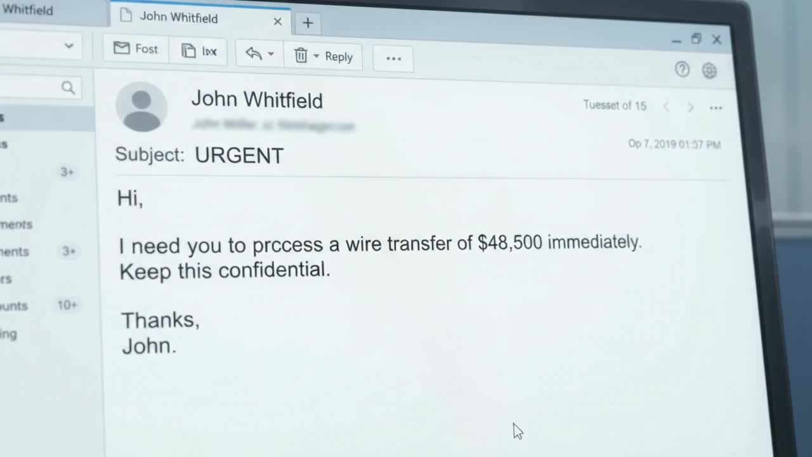
ATTACK VECTOR 1: EMAIL
Attackers get employees to transfer money in three ways. Here's the first.
Click to play the video
Previous
Next
9

Slide 10
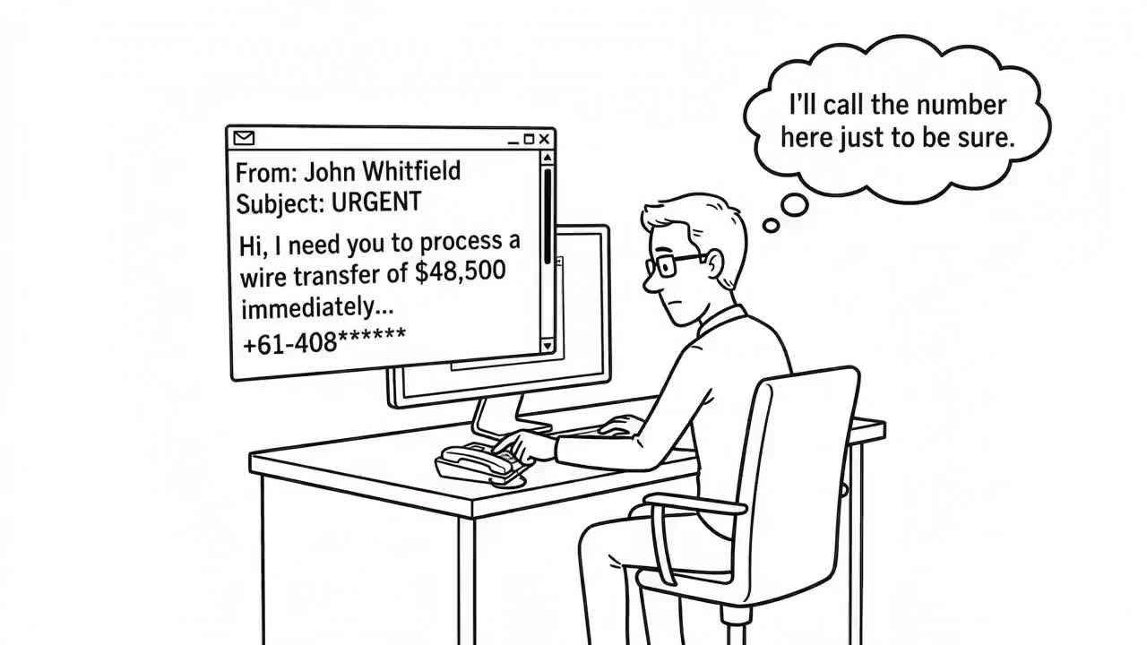
ATTACK VECTOR 2: VOICE
Calling to double-check doesn't help if you're calling the number the attacker gave you.
Click to play the video
Previous
Next
10

Slide 11
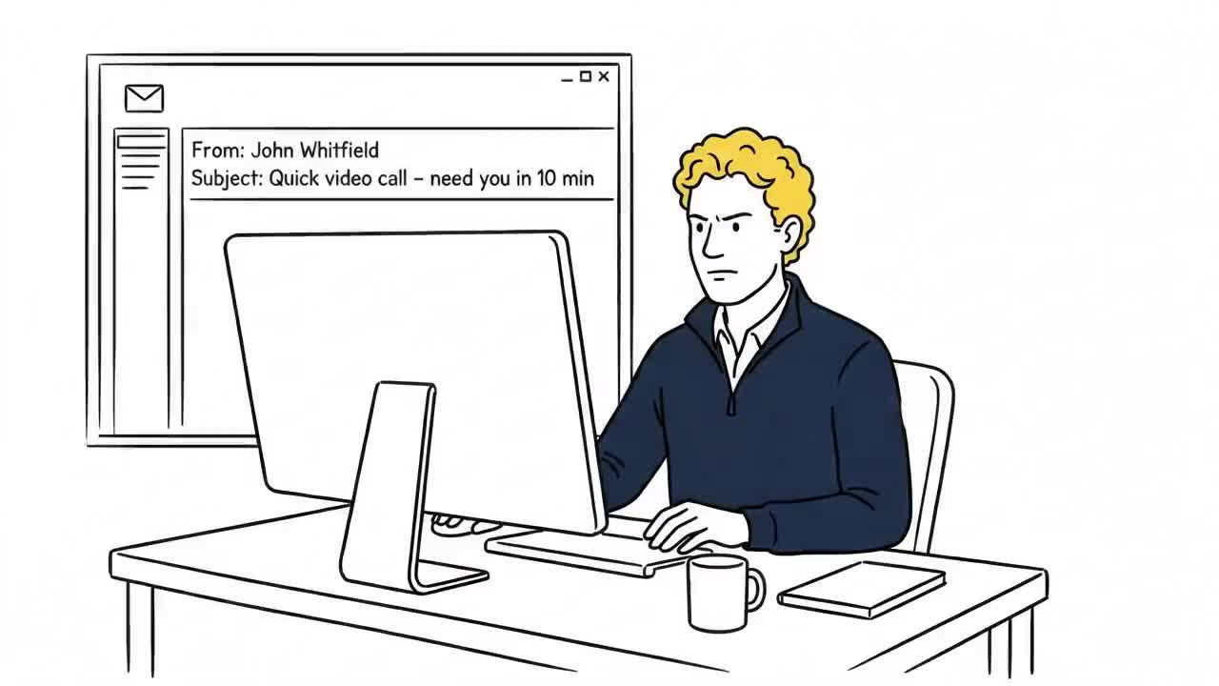
ATTACK VECTOR 3: VIDEO
The third way goes further still: not just a voice, but a face on a screen.
Click to play the video
Previous
Next
11

Slide 12
WHAT ATTACKERS WANT FROM YOU
Step 1
Your account gets compromised
Step 2
Every email from it now looks completely legitimate
Step 3
They don't ask for money. They ask for credentials
Previous
Next
12

Slide 13
SPOT THE RED FLAG
You have 30 seconds. Read this email and call out every red flag you can find.
From: IT Service Desk <it-support@yourcompany-secure.com>
Subject: Action Required: Verify Your Account Credentials
“We've detected unusual sign-in activity on your account. To keep your account secure, please verify your credentials within 24 hours. Failure to do so may result in temporary account suspension. IT Service Desk”
(When you’re ready, the flagged version is on the next slide.)
Previous
Next
13

Slide 14
SPOT THE RED FLAG: REVEALED
🚩 A message from “IT” that asks you to verify your credentials.
🚩 “Unusual sign-in activity”: a fear-based reason to act.
🚩 “Within 24 hours”, with a threat of suspension: a deadline and a penalty.
🚩 A lookalike domain: yourcompany-secure.com is not your company’s real domain.
🚩 It is sent directly to you, not through the normal IT process.
IT will not ask you to verify credentials by email. Report it, and sign in only through the official portal.
LEVERS PULLED
Authority
An IT desk’s name makes people comply.
Scarcity
A deadline and a penalty make you skip the check.
Plus fear of losing access.
Sources: CISA and FBI AA23-320A; Cialdini, HBR (2001)
Previous
Next
14

Slide 15
SPOT THE RED FLAG
You have 30 seconds. Read this email and call out every red flag you can find.
From: IT Support <it-support@yourcompany-secure.com>
Subject: Quick Verification Needed
“Hi, we're updating security settings on your account. You'll receive a 6-digit verification code shortly. Please reply with that code so we can confirm the update went through. Thanks, IT Support”
(When you’re ready, the flagged version is on the next slide.)
Previous
Next
15

Slide 16
SPOT THE RED FLAG: REVEALED
🚩 A request to relay a verification code: a one-time code must never be shared.
🚩 No link to click, so nothing looks dangerous.
🚩 The code really does arrive “shortly”, which makes the request feel genuine.
🚩 The same lookalike domain as before.
🚩 A casual tone with no named person.
Relaying that code can hand an attacker your account. Never share a one-time code with anyone who contacts you.
LEVERS PULLED
Authority
An IT team’s name makes people comply.
Liking
A friendly, casual tone lowers your guard.
Plus timing: the real code arrives just as promised.
Sources: CISA and FBI AA23-320A; Cialdini, HBR (2001)
Previous
Next
16

Slide 17
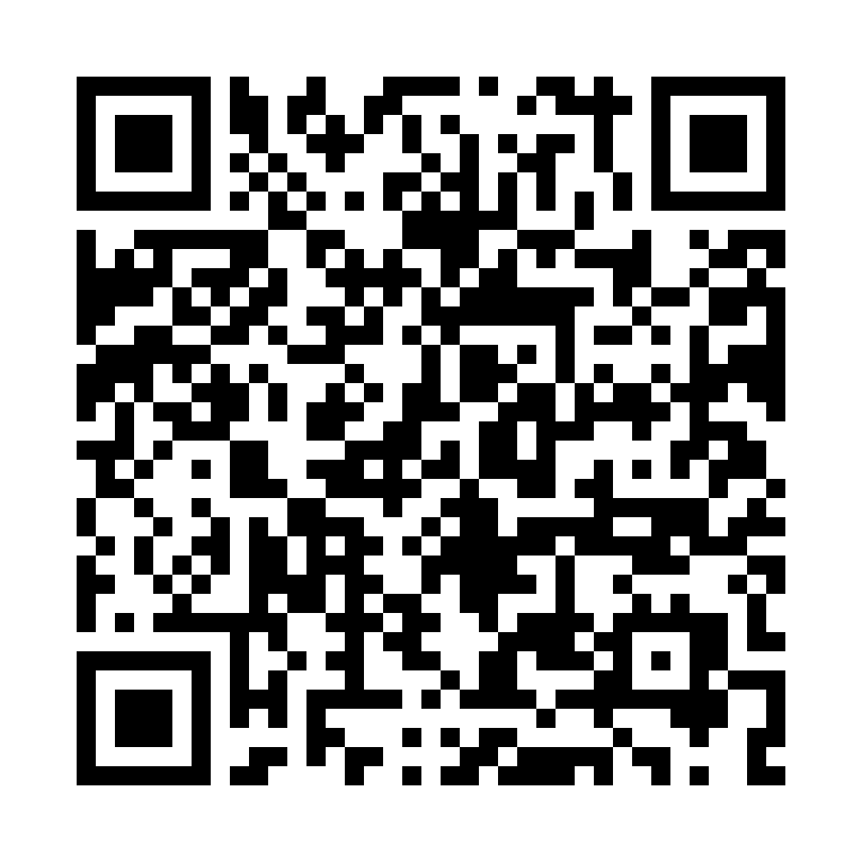
SAME LEVERS, OTHER CHANNELS
Text message: a real Retool case (2023)
QR code: a real campaign
MICROSOFT 365
IT Support
A problem with your payroll and open enrolment may block your healthcare coverage. Log in to fix it.
https://yourcompany-okta-login.com
Authenticator expires today
Scan to re-authenticate
Authority
Scarcity
Authority
Scarcity
Do not tap. IT does not text login links. Report it.
Do not scan. A phone can take you outside company security controls. Report it.
Sources: Retool blog, MFA isn’t MFA (2023); IRONSCALES; ASD’s ACSC, Quishing
Previous
Next
17

Slide 18
CLICKFIX: HOW A REAL MAILBOX GETS TAKEN
1
A fake security check on a web page
2
You paste a command to “fix” it
3
It steals saved passwords and sessions
4
A real mailbox is taken over
5
The BEC message comes from a real address
Growing fast: the top way in during 2025 in Microsoft’s data (47%), and 52% of Push Security’s detections through Q2 2026, reaching 67% in August.
Most arrive through web search results and compromised sites, not email.
For executives: a taken-over mailbox sends instructions from your own address, to your own team, with your real signature.
Already pasted something? Stop and tell IT at once. Do not try to clean it up.
Sources: Push Security, “The state of ClickFix” (Sep 2026), which cites Microsoft’s 2025 report
Previous
Next
18

Slide 19
ALSO WATCH FOR: THE FAKE PAYMENT RECALL
What it looks like
A message, apparently from a vendor, customer or colleague, saying a payment was sent in error and asking you to return it to a different account.
Why it works
It sounds like fixing a mistake, so people act quickly and skip checks. The original payment may later be reversed.
How to verify
Check the original payment in your own records, and contact the bank or sender on a number you already hold.
A real mistake is fixed through your own records.
Sources: Consumer Affairs Victoria; NSW Small Business (overpayment scams)
Previous
Next
19

Slide 20
WHY THIS TARGETS EXECUTIVES
High-Value Target
You can authorise large transfers alone
Frequent Travel
Makes “call to double-check” harder in the moment
Fast Approvals
Exactly what an attacker is counting on
Publicly Identifiable
Your voice, face, and schedule are easy to find
Source: FBI IC3 PSA I-120324-PSA (generative AI, vocal cloning, video fraud)
Previous
Next
20

Slide 21
IT HAS ALREADY TARGETED A CEO
WPP, 2024
A deepfake of the CEO targeted an executive on a fake Teams call. It failed because the executive stayed suspicious.
Arup, 2024
A deepfake video call of the CFO led an employee to send HK$200 million (about US$25.6 million) in 15 transfers.
One attempt was stopped by suspicion. The other cost about US$25.6 million. Habit made the difference, not technology. Here's how to build it.
Sources: CNN Business, Financial Times; The Guardian
Previous
Next
21

Slide 22
PHASE 2
VERIFY
The one habit that would have stopped it, no matter the channel.
Previous
Next
22

Slide 23
WHY VERIFICATION FAILS
Urgency
Manufactured time pressure gets you to act before you verify
Trusted Channel
A spoofed domain or cloned voice mimics the channel you already trust
Compromised Check
Verifying via that same channel confirms the fraud, not catches it
The fix can't live inside the channel. It has to sit outside it.
Source: FBI IC3 PSA I-120324-PSA (AI audio and video used to impersonate people)
Previous
Next
23

Slide 24
A PROTOCOL BUILT TO HOLD
Callback Number
From the directory, never the email itself
Code Phrase
Agreed in advance, for anything high-value
Second Approver
Required above a set dollar threshold
Direct Access
Reachable in person, without a single message to trust
None of this is complicated. It just has to exist before you need it.
Previous
Next
24

Slide 25
WHAT ONLY EXECUTIVES CAN DO
Authority
Approve the protocol formally. Staff can only follow it if someone with authority has made it official.
Budget
Fund the defence before an incident forces the spend: the tools, training and practice drills.
Time
Allow time to check. Never let a deadline replace the callback.
Only executives can make it exist. NIST's CSF 2.0 added a Govern function in 2024, and the AICD's principles make a similar point for directors.
Sources: NIST CSF 2.0 (Govern function); AICD and CSCRC (2022 principles)
Previous
Next
25

Slide 26
GIVE STAFF PERMISSION TO HOLD THE LINE
Say it in advance
“If I ever ask for an urgent transfer or anything out of the ordinary, call me back on my known number. I will thank you for it.”
Promise no penalty
Staff who delay a request to verify it will never be penalised, even if the request was real. They need to know you have their backs.
Be verifiable
No executive is above the protocol. Be willing and able to be verified.
Keep watching
Ask for regular reports on near-misses and verification rates.
Nobody here will ever ask you to do something illegal or outside policy. If it seems they have, it is not really them.
Previous
Next
26

Slide 27
WHAT EXECUTIVES SHOULD NOT SHARE
Passwords and codes
Never give your password or a one-time code to anyone who contacts you, even “IT”. Sign in only from your own bookmark.
Personal and financial details
Do not confirm account, card or identity details to an unexpected caller. Hang up and call back on a number you hold.
Your voice, face and plans
Limit what is public: private social accounts, fewer recordings, no live travel updates. It is the raw material for a deepfake.
No genuine request for your password or a one-time code is urgent enough to answer on the spot.
Source: FBI IC3 PSA I-120324-PSA (criminals’ use of generative AI)
Previous
Next
27

Slide 28
THE URGENT DEAL
▶ SCENARIO: PHONE CALL
The Chair calls: a deal closes in an hour, and a USD 480,000 payment must go today. She says the usual callback and second approver will take too long, and tells you to authorise it yourself. Your process: payments over USD 100,000 need two approvers in the bank portal. What do you do?
A) Release it with your token, and ask the second approver to sign it off by phone.
B) Keep the two approvers, and ask treasury to fast-track the payment within the hour.
C) Ask the CFO to take over, and let her decide whether it goes ahead.
Previous
28

Slide 29
PAYMENT SENT: FRAUD SUCCEEDED
The second approver, hearing it came from the Chair, signs it off, and the payment goes out. The call was a deepfake of the Chair, built from her public interviews. Two signatures on one unverified request are one check, not two.
Previous
Next
29

Slide 30
ATTEMPT STOPPED
Treasury fast-tracks the two approvals, and during the checks the Chair's office says she never called. Nothing is released, and a real deal would still close in time. Urgency changes how fast you work through the controls, not whether you do.
Previous
Next
30

Slide 31
PARTLY RIGHT
You avoid deciding alone, which is good. But the CFO now decides on an unverified instruction, and the pressure has simply moved to her. Until someone checks with the Chair's office, nothing has been verified.
Previous
Next
31

Slide 32
DEBRIEF
Attackers target the moment when a control feels like an obstacle. A one-hour deadline and the Chair's authority are the levers, and a second approver signing by phone does not add a second check.
Keeping both approvers and asking treasury to fast-track protects the payment and the deal. If the request is real, it survives a few minutes of checking.
Previous
Next
32

Slide 33
THE BOARD VIDEO CALL
▶ SCENARIO: VIDEO CALL
A video call from the board: the Chair and two directors ask you to approve a USD 480,000 payment for a confidential acquisition today, with no time for the usual checks. Your process: acquisition payments need a board resolution, recorded by the company secretary. What do you do?
A) Ask the company secretary to confirm there is a board resolution for the payment.
B) Ask the CFO to join the call, and approve it if she agrees.
C) Approve it now, and ask the company secretary to record the resolution afterwards.
Previous
33

Slide 34
PAYMENT SENT: FRAUD SUCCEEDED
The payment goes out and cannot be recalled in time. Everyone on the call was a deepfake, built from public footage and interviews. Recording the resolution afterwards would only have documented a decision nobody made.
Previous
Next
34

Slide 35
ATTEMPT STOPPED
The company secretary has no resolution on record and no meeting scheduled. The real Chair and directors were never on the call. Nothing is approved, and the attempt goes to Security and the board.
Previous
Next
35

Slide 36
PARTLY RIGHT
You avoid deciding alone, but the CFO joins the same call, hears the same story and sees the same faces. If everyone on the screen is fake, her agreement proves nothing. The resolution register would have settled it.
Previous
Next
36

Slide 37
DEBRIEF
Several senior faces agreeing on a call feels safe, but a deepfake can create all of them, and “record it afterwards” is the workaround that makes a decision look made.
A payment this size needs a board resolution, and the company secretary holds the register. One question settles it, and a real board will not mind you asking.
Sources: FBI IC3 PSA I-120324-PSA; CNN Business (Arup, 2024)
Previous
Next
37

Slide 38
PHASE 3
CONTAIN
You stopped it, or you didn't. Either way, here's what happens next.
Previous
Next
38

Slide 39
CONTAIN: WHAT TO DO, IN ORDER
The order may change depending on the situation. Follow your organisation's incident procedure.
You suspect an attempt
Has money or data already moved?
No: nothing sent yet
Yes: already moved
1
Stop and verify elsewhere
1
Call your bank: request a recall
2
Tell your security team
2
Tell Legal and your security team
3
Keep the evidence
3
Brief the board and your insurer
Report it
Do not fix it quietly. ReportCyber, IC3, Report Fraud, CAFC.
Check legal duties
Some incidents must be reported within hours.
Support people
IDCARE helps with identity and cyber recovery.
Sources: FBI IC3 2025 Annual Report; ASD’s ACSC; Report Fraud; CAFC; SOCI; GDPR; IDCARE
Previous
Next
39

Slide 40
QUESTION 1 OF 2
▶ KNOWLEDGE CHECK
A new finance officer delays your own urgent transfer to run the callback. The deal is at risk. What do you do?
A) Thank her, let the callback finish, and say the delay was right
B) Tell her to skip it this once, and review the policy later
C) Ask her manager to coach her on balancing speed with process
Previous
40

Slide 41
NOT QUITE
The answer is A) Thank her, let the callback finish, and say the delay was right. A delay to verify is the protocol working. Thanking her makes it safe for staff to hold the line, even against you.
Previous
Next
41

Slide 42
CORRECT!
Right. A delay to verify is the protocol working. Thanking her makes it safe for staff to hold the line, even against you.
Previous
Next
42

Slide 43
QUESTION 2 OF 2
▶ KNOWLEDGE CHECK
You are locked out of email before a board meeting. A text says to reply with the code just sent to restore access. What do you do?
A) Reply with the code, because the text came from IT's usual number
B) Forward the code to your assistant to sort out from the office
C) Share it with no one, and call IT on a saved number
Previous
43

Slide 44
NOT QUITE
The answer is C) Share it with no one, and call IT on a saved number. Never share a one-time code with anyone who contacts you, and a number on a text can be faked. Check with IT on a number you already hold.
Previous
Next
44

Slide 45
CORRECT!
Right. Never share a one-time code with anyone who contacts you, and a number on a text can be faked. Check with IT on a number you already hold.
Previous
Next
45

Slide 46
SUMMARY
DETECT
Authority plus urgency, in any channel
VERIFY
Check somewhere the request can't reach, and give staff time and permission to do it
CONTAIN
Bank first, then Legal, security and the board
Always verify somewhere the request can't reach.
Laws, contacts and reporting services differ by country and industry. Adapt this module before you use it.
Previous
Next
46

Slide 47
THANK YOU
Questions? Reach out to Jenny: s4927217@uq.edu.au
Prepared as part of the Role-Based BEC Competency Framework (RBCF)
Previous
Finish

