Slide 1


BUSINESS EMAIL COMPROMISE TRAINING
Payroll & HR Team Edition
Detect → Verify → Contain
Pay runs, bank details and staff records all pass through your desk. One habit protects them all.
Next

Slide 2
AGENDA
What business email compromise is, and why Payroll is a target
Phase 1, Detect
Two email red flags, and the psychology behind them
Text messages, QR codes and ClickFix
Phase 2, Verify
Practical payroll controls
Two scenarios: an AI cloned voice and an AI deepfake video
Phase 3, Contain
What to do if you suspect an attempt, and a knowledge check
Previous
Next
2

Slide 3
WHAT IS BUSINESS EMAIL COMPROMISE?
BEC, also called email account compromise, is a scam in which a criminal impersonates someone you trust, or breaks into their real email account, to trick you into changing where money gets sent. Either way, the message looks completely legitimate and asks you to update something you would normally update anyway.
From: Derek T. <d.thompson@brightpath-corp.com>
Subject: Bank Details Update: Urgent, Before Friday's Pay Run
“Hi Maya, my bank closed my old account. I need this Friday's pay to go to a new one, sorry for the late notice! Details attached. Thanks, Derek”
Sources: FBI IC3 PSA I-091124, I-061118; IC3 2025 Annual Report
Previous
Next
3

Slide 4
HOW A BEC ATTACK ACTUALLY FLOWS
1. RESEARCH
The attacker studies employee names, pay schedules, and who processes changes
2. SPOOF
A lookalike email, a cloned voice, or a real mailbox the attacker has taken over
3. URGENCY
A payday deadline, designed to make you skip verification and just update it
4. REDIRECT
Pay goes to the attacker's account, often not noticed until payday
→
→
→
Previous
Next
4

Slide 5
YOU PROCESS WHAT ATTACKERS WANT
The Payroll team actually moves the money, which makes you the last checkpoint, not a bystander. Attackers also ask for employees' personal information to break into other accounts.
United States
USD 3.05 billion in BEC losses reported to the FBI in 2025, from 24,768 complaints
Australia
15% of business cybercrime reports in 2024–25 were BEC fraud with a financial loss
Worldwide
USD 55.5 billion in exposed losses, 2013 to 2023, reported in 186 countries (FBI)
Sources: FBI IC3 2025 Annual Report; FBI IC3 PSA I-091124-PSA; Australian Signals Directorate Cyber Threat Report 2024–25
Previous
Next
5

Slide 6
PHASE 1
DETECT
Can you spot it before it costs anything?
Previous
Next
6

Slide 7

SCENARIO: THE DIRECT DEPOSIT SWITCH
A direct-deposit change arrives by email, just before pay day.
Click to play the video
Previous
Next
7

Slide 8
▶ GAME
SPOT THE RED FLAG
You have 30 seconds. Read this email and call out every red flag you can find.
From: Derek T. <d.thompson@brightpath-corp.com>
Subject: Bank Details Update: Urgent, Before Friday's Pay Run
Hi Maya, my bank closed my old account. I need this Friday's pay to go to a new one, sorry for the late notice! Details attached.
Thanks, Derek
Answer is on the next slide
Previous
Next
8

Slide 9
▶ GAME
SPOT THE RED FLAG: REVEALED
🚩 A deadline tied straight to Friday’s pay run, designed to rush the decision.
🚩 “Sorry for the late notice” makes the urgency feel considerate, not suspicious.
🚩 Bypass: bank-detail changes should go through HR's self-service system, not a casual email to Payroll.
🚩 No verification: nothing here actually proves it's Derek, just a name and a request.
🚩 Domain: brightpath-corp.com, where the real company domain has no hyphen (brightpathcorp.com), easy to miss at a glance.
LEVERS PULLED
Scarcity
A tight deadline makes you skip the check.
Liking
A polite, friendly tone lowers your guard.
Sources: FBI IC3 PSA I-091124-PSA (misspelled domain names); Cialdini, HBR (2001)
Previous
Next
9

Slide 10
▶ GAME
SPOT THE RED FLAG
You have 30 seconds. Read this email and call out every red flag you can find.
From: Priya Raman, Chief Financial Officer <p.raman@brightpathcorp.com>
Subject: URGENT and confidential: employee data for the audit
Maya, the auditors need the full employee list today: names, dates of birth, tax file numbers and bank details. Send it to me directly by 3 pm. Please do not copy anyone else in, this is confidential. Thanks, Priya
Answer is on the next slide
Previous
Next
10

Slide 11
▶ GAME
SPOT THE RED FLAG: REVEALED
🚩 Staff data by email: tax file numbers and bank details should never be sent on request.
🚩 The “CFO” asks directly, skipping HR and Privacy.
🚩 “By 3 pm” leaves no time to check.
🚩 “Do not copy anyone else in” cuts you off from the people who would check.
🚩 A vague reason: “the audit”, with no audit reference.
No executive request justifies emailing staff data. Confirm through a known contact and use only approved secure channels.
LEVERS PULLED
Authority
People comply when someone senior asks.
Scarcity
Little time means little checking.
Plus secrecy: nobody else sees it, so nobody can check.
Sources: IRS (W-2 scam warning); FBI IC3 PSA I-091124-PSA; Cialdini, HBR (2001)
Previous
Next
11

Slide 12
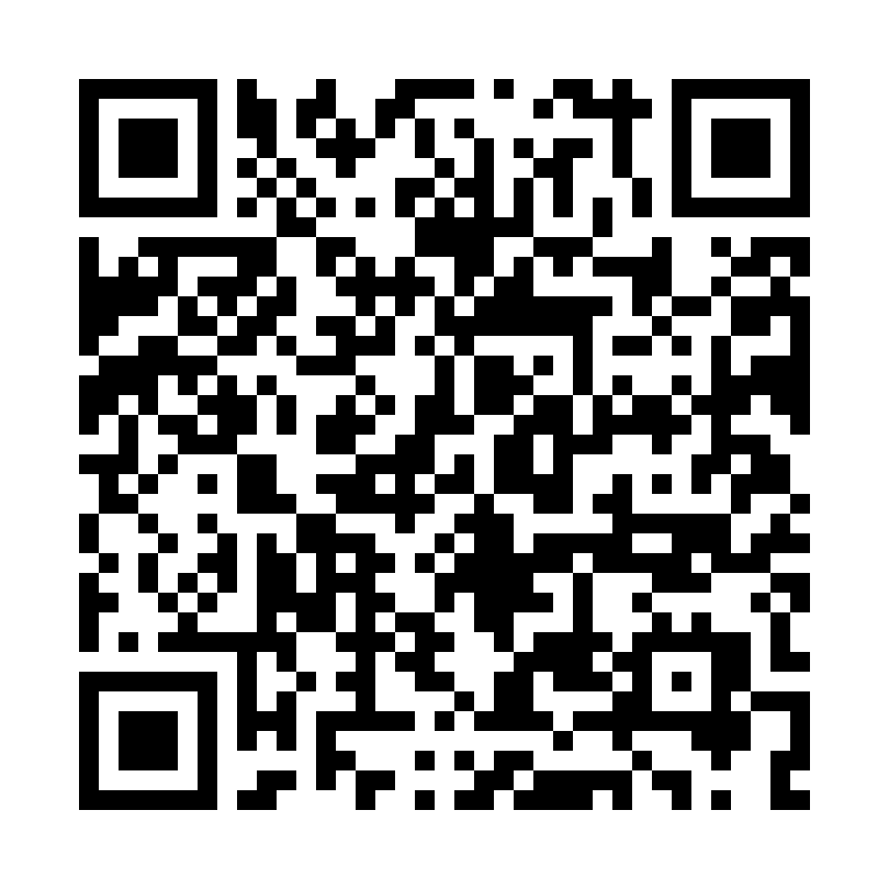
◆ LEARN
SAME LEVERS, OTHER CHANNELS
Text message: a real New York City case
QR code: a real “Enhanced Bonus” campaign
Payroll
Action required: activate multi-factor authentication for your payroll account.
https://payroll-mfa-activate.com
HR / PAYROLL
Document review
Scan with your phone camera
Authority
Scarcity
Authority
Reciprocity
Do not tap. Check in the payroll portal, then report it.
Do not scan. Open pay documents through the HR portal, then report it.
Sources: StateScoop (NYC payroll texts); ThreatDown (Enhanced Bonus QR phish)
Previous
Next
12

Slide 13
CLICKFIX: HOW A REAL MAILBOX GETS TAKEN
1
A fake security check on a web page
2
You paste a command to “fix” it
3
It steals saved passwords and sessions
4
A real mailbox is taken over
5
The BEC message comes from a real address
Growing fast: the top way in during 2025 in Microsoft’s data (47%), and 52% of Push Security’s detections through Q2 2026, reaching 67% in August.
Most arrive through web search results and compromised sites, not email.
In Payroll: pay changes can then come from a genuine staff address, so every change needs a second check.
Already pasted something? Stop and tell IT at once. Do not try to clean it up.
Sources: Push Security, “The state of ClickFix” (Sep 2026), which cites Microsoft’s 2025 report
Previous
Next
13

Slide 14
PHASE 2
VERIFY
The one habit that would have stopped it, no matter the channel.
Previous
Next
14

Slide 15
ALWAYS VERIFY: SOMEWHERE THE REQUEST CAN'T REACH
Known Contact
Call a number already on file, never one the message gave you
System of Record
Check HR/vendor systems directly, not the inbox that received the request
Second Set of Eyes
For anything above threshold, get another person to confirm independently
Time to Verify
Urgency is the tactic, so slowing down is always allowed, payday included
If a request didn't come through your normal process, it isn't a request. It's a test.
Previous
Next
15

Slide 16
BUILD THE CONTROLS IN
Self-service only
Bank details change only through the employee portal, protected by MFA.
Alert the employee
Every change sends an automatic alert to the contact details already on file.
Hold the first payment
A short hold on the first payment to a new account gives the alert time to reach the real employee.
Source: FBI IC3 PSA I-091124-PSA (verify changes by secondary channel or 2FA)
Previous
Next
16

Slide 17
THE DIRECT DEPOSIT CALL
▶ SCENARIO: PHONE CALL
Same request as before, but this time it is a phone call. A familiar voice says her bank account was frozen and she needs tomorrow's pay in a new account. The HR portal is down until Monday and the pay run locks at 2 pm. Your process: bank details change only through the portal, and urgent pay exceptions go to the HR manager.
Take the new details by phone, and enter them with a note that she confirmed.
Leave her account unchanged for this run, and pass the request to the HR manager.
Ask her to email a signed change form, and hold it until the portal is back.
Click a card to choose.
Previous
17

Slide 18
PAYMENT MISDIRECTED
The note makes the change look approved, and tomorrow's pay goes to the new account. On Monday the real employee calls, confused: she never asked for a change. The voice was cloned from a video interview posted months ago, and a note in the record is not verification.
Previous
Next
18

Slide 19
ATTEMPT STOPPED
Her pay goes to the existing account as normal. The HR manager checks the HR record and reaches the real employee, who never called. The attempt is reported, and any change waits for the portal. A pay run lock is pressure, not authority.
Previous
Next
19

Slide 20
PARTLY RIGHT
Nothing changes, so the fraud fails. But a signed form can be forged, nobody checked who was calling, and the HR manager never heard about it. The same caller can try a colleague on the next shift.
Previous
Next
20

Slide 21
DEBRIEF
A cloned voice can sound exactly like a colleague, so the call itself proves nothing. The pressure came from the pay run lock, and the note “she confirmed by phone” is the workaround that makes an unverified change look approved.
Bank details change through the portal. When someone needs pay urgently, the exception goes to the HR manager, who can check her identity through the HR record. Passing it on is the control working, not you being unhelpful.
Source: FBI IC3 PSA I-120324-PSA (AI-generated audio used to impersonate people)
Previous
Next
21

Slide 22
THE AUDIT REQUEST
▶ SCENARIO: VIDEO CALL
A video call from an external auditor, demanding immediate access to payroll records. You know him and have seen him before, and he is on camera. He says the audit closes today and your manager has already agreed. Your process: audit requests come from Finance, and records go only through the secure audit folder.
Put the records he names in the secure audit folder, and give him access.
Tell him you need his request in writing, then share the records when it arrives.
Ask Finance to confirm that the audit is scheduled, before you share anything.
Click a card to choose.
Previous
22

Slide 23
RECORDS EXPOSED
The folder is secure, but the person you gave access to is not the auditor. He downloads the payroll file within minutes and disappears. There is no audit on record, and the real auditor confirms he never called. A secure channel protects the delivery, not the request.
Previous
Next
23

Slide 24
ATTEMPT STOPPED
Finance has no audit scheduled for today, and the real auditor confirms he never called. He is annoyed on the call, but nothing was shared and the attempt is reported.
Previous
Next
24

Slide 25
PARTLY RIGHT
The request arrives within minutes from a lookalike address and reads like a real audit notice. Nothing is shared yet, but you still have not asked Finance whether an audit exists, and the pressure has simply moved to your inbox.
Previous
Next
25

Slide 26
DEBRIEF
A video call with a face you recognise can be a deepfake built from public footage, and “your manager already agreed” is a claim you cannot see. Using the secure folder looks like following the process, but the process starts with the request being real.
Audit requests come through Finance. Ask Finance whether the audit exists before you share anything, however familiar the face.
Source: FBI IC3 PSA I-120324-PSA (AI video in live chats with alleged executives)
Previous
Next
26

Slide 27
PHASE 3
CONTAIN
You caught it, or you didn't. Either way, here's what happens next.
Previous
Next
27

Slide 28
CONTAIN: WHAT TO DO, IN ORDER
The order may change depending on the situation. Follow your organisation's incident procedure.
You suspect an attempt
Has money or data moved?
No: nothing moved yet
Yes: already moved
1
Hold the change
1
Call your bank: ask for a recall
2
Verify through a known contact
2
Tell the real employee
3
Tell IT or Security
3
Tell your manager
Keep the evidence
Email, text, call log
Report it
ReportCyber, IC3, Report Fraud, CAFC
Check privacy duties
Rules differ by country; in Australia, the Notifiable Data Breaches scheme covers tax file numbers.
Sources: FBI IC3 2025 Annual Report; ASD’s ACSC; Report Fraud; CAFC; GDPR; OAIC; IDCARE
Previous
Next
28

Slide 29
KNOWLEDGE CHECK: CONTAIN (Q1)
It is Saturday. You now suspect Friday's bank-detail change was fake, and the pay has already gone out. What do you do first?
A) Email the employee to confirm her new details, then contact the bank on Monday
B) Call your bank's after-hours fraud line and ask them to recall the payment
C) Tell IT and your manager first, so that one person coordinates the response
Previous
29

Slide 30
NOT QUITE
The answer is B) Call your bank's after-hours fraud line and ask them to recall the payment. Once money has moved, speed matters most. The bank is the only one who can try to recall it, so call first, then tell the real employee, IT and your manager.
Previous
Next
30

Slide 31
CORRECT!
Right. Once money has moved, speed matters most. The bank is the only one who can try to recall it, so call first, then tell the real employee, IT and your manager.
Previous
Next
31

Slide 32
KNOWLEDGE CHECK: CONTAIN (Q2)
An employee tapped a text link and typed in her pay details. Your manager says to keep it quiet to avoid panic. What do you do?
A) Warn staff, tell IT, and have her contact her bank and change passwords
B) Tell IT quietly and watch her accounts, so staff are not alarmed
C) Ask her to contact her bank, and leave the wider response to IT
Previous
32

Slide 33
NOT QUITE
The answer is A) Warn staff, tell IT, and have her contact her bank and change passwords. Quiet fixes give attackers more time. Others may have received the same text, so warn staff and tell IT as well as protecting her accounts.
Previous
Next
33

Slide 34
CORRECT!
Right. Quiet fixes give attackers more time. Others may have received the same text, so warn staff and tell IT as well as protecting her accounts.
Previous
Next
34

Slide 35
SUMMARY
DETECT
Payday pressure is the pattern
VERIFY
Use the system of record, not the message
CONTAIN
Bank first, tell the employee, then report
Always verify somewhere the request can't reach.
Laws, contacts and reporting services differ by country and industry. Adapt this module before you use it.
Previous
Next
35

Slide 36
THANK YOU
Questions? Reach out to Jenny: s4927217@uq.edu.au
Prepared as part of the Role-Based BEC Competency Framework (RBCF)
Previous
Finish

