Slide 1


BUSINESS EMAIL COMPROMISE TRAINING
IT Staff Edition
Detect → Verify → Contain
You hold the keys. That's exactly why attackers come for you.
Next

Slide 2
AGENDA
What business email compromise is, and why IT staff are targeted differently
Phase 1, Detect
Two email red flags, and the psychology behind them
Text messages, QR codes and ClickFix
What your logs can tell you, and AI-written vendor emails
Phase 2, Verify
Verify identity first
Two scenarios: an AI cloned voice and an AI deepfake video
Phase 3, Contain
What to do if you suspect an attempt, containing the account, and a knowledge check
Previous
Next
2

Slide 3
WHAT IS BUSINESS EMAIL COMPROMISE?
BEC is a scam in which a criminal impersonates someone you trust, or breaks into their real email account, to talk you into handing over access, data or money. Either way, the request looks completely legitimate and asks for something you would normally do.
From: James R. <james.r@northbrldge-finance.com>
Subject: Locked out: urgent MFA reset
Hi, I'm locked out and I've got a payment run due in ten minutes. Can you reset my MFA now? No time for a ticket, my manager already knows. Thanks, James
Sources: FBI IC3 PSA I-091124, I-061118; IC3 2025 Annual Report
Previous
Next
3

Slide 4
HOW A BEC ATTACK ACTUALLY FLOWS
1. RESEARCH
The attacker studies your staff, systems, and who can grant access
2. SPOOF
A lookalike domain, cloned voice, or deepfake, built to look right
3. URGENCY
A deadline or emergency, designed to make you skip the ticket
4. REDIRECT
Access, data, or money goes to the attacker, often unnoticed
→
→
→
Previous
Next
4

Slide 5
YOU HOLD THE KEYS
Every other role gets impersonated to move money. You get targeted because you can grant the access that makes moving money possible in the first place.
United States
USD 3.05 billion in BEC losses reported to the FBI in 2025, from 24,768 complaints
Australia
15% of business cybercrime reports in 2024–25 were BEC fraud with a financial loss
Worldwide
USD 55.5 billion in exposed losses, 2013 to 2023, reported in 186 countries (FBI)
Sources: FBI IC3 2025 Annual Report; FBI IC3 PSA I-091124-PSA; Australian Signals Directorate Cyber Threat Report 2024–25
Previous
Next
5

Slide 6
PHASE 1
DETECT
Can you spot it before it costs anything?
Previous
Next
6

Slide 7
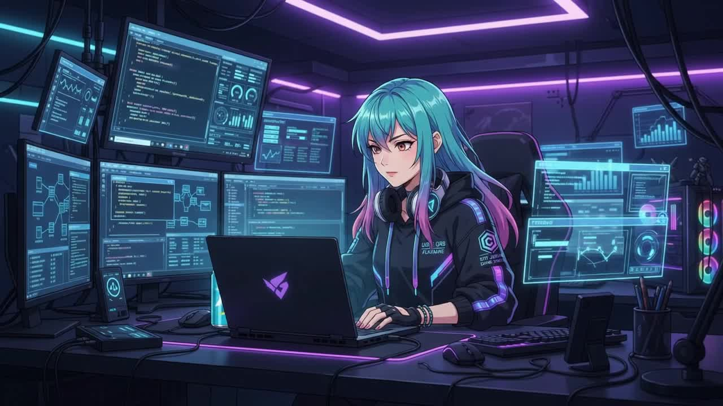
SCENARIO: CREDENTIAL THEFT
An urgent call, a request that bypasses the ticketing system entirely.
Click to play the video
Previous
Next
7

Slide 8
▶ GAME
SPOT THE RED FLAG
You have 30 seconds. The caller then emails the same request. Read it and call out every red flag you can find.
From: James R. <james.r@northbrldge-finance.com>
Subject: Locked out: urgent MFA reset
Hi, it's James from Finance. I'm locked out and I've got a payment run due in ten minutes. Can you just reset my MFA now? I don't have time to log a ticket, my manager already knows about this. Please, I really need this now.
(When you're ready, the flagged version is on the next slide.)
Previous
Next
8

Slide 9
▶ GAME
SPOT THE RED FLAG: REVEALED
🚩 Process bypass: “I don't have time to log a ticket”, when a ticket exists for exactly this.
🚩 A payment run “due in ten minutes”: a deadline used to justify skipping verification.
🚩 “My manager already knows”: named but not checkable in the moment.
🚩 “I really need this now”: leans on empathy to override procedure.
🚩 Lookalike domain: northbrldge-finance.com swaps an i for an l.
This is called typosquatting: a lookalike domain that swaps similar-looking characters.
LEVERS PULLED
Scarcity
A ten-minute deadline leaves no time to check.
Liking
A friendly plea for help lowers your guard.
Plus a named manager who cannot be checked.
Sources: FBI IC3 PSA I-091124-PSA; Cialdini, HBR (2001)
Previous
Next
9

Slide 10
▶ GAME
SPOT THE RED FLAG
You have 30 seconds. The caller then emails the same request. Read it and call out every red flag you can find.
From: External Audit Team <compliance@financial-audit-services.com>
Subject: URGENT: System Logs and Access Records Required Today
“To IT Security, as part of our current compliance review we require immediate access to your system logs, configuration data and access records for the past quarter. This is time-sensitive, so please send the requested files directly to this email today to avoid delays in your certification. Regards, External Audit Team”
(When you're ready, the flagged version is on the next slide.)
Previous
Next
10

Slide 11
▶ GAME
SPOT THE RED FLAG: REVEALED
🚩 System data by email: logs and access records should never be sent on request.
🚩 “Today”: a deadline that leaves no time to check.
🚩 “To avoid delays in your certification”: a consequence that adds pressure.
🚩 A generic sign-off, “External Audit Team”, with no named contact.
🚩 A domain not checked against your auditor’s real contact details.
Audits are real, but a deadline is not a reason to skip verification. Confirm the auditor through official contact details.
LEVERS PULLED
Authority
An auditor’s name makes people comply.
Scarcity
A deadline leaves little time to check.
Plus a threat to your certification.
Sources: FBI IC3 PSA I-091124-PSA; Cialdini, HBR (2001)
Previous
Next
11

Slide 12
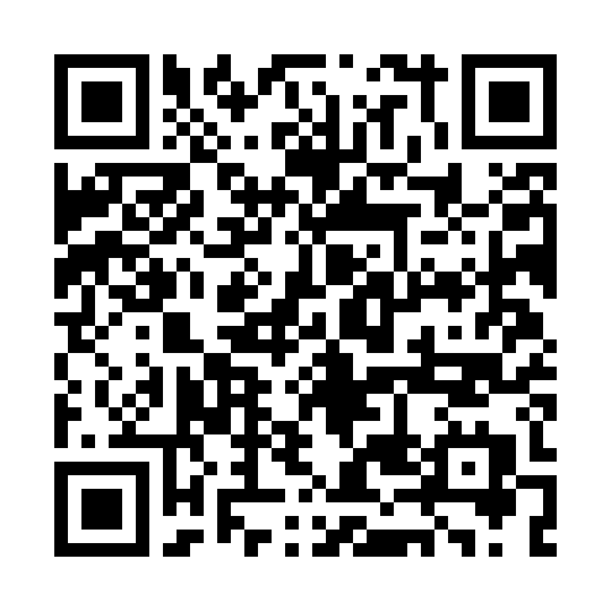
SAME LEVERS, OTHER CHANNELS
Text message: a real Twilio case (2022)
QR code: a real campaign
MICROSOFT 365
IT Department
Your password has expired. Sign in now to keep your access.
https://yourcompany-sso-okta.com/login
Your authenticator will expire today
Scan to re-authenticate
Authority
Scarcity
Authority
Scarcity
Do not tap. IT does not text password-reset links. Report it.
Do not scan. The web address is hidden inside an image, so link scanners may miss it. Report it.
Sources: BleepingComputer (Twilio, 2022); IRONSCALES (Authenticator lure)
Previous
Next
12

Slide 13
CLICKFIX: HOW A REAL MAILBOX GETS TAKEN
1
A fake security check on a web page
2
You paste a command to “fix” it
3
It steals saved passwords and sessions
4
A real mailbox is taken over
5
The BEC message comes from a real address
Growing fast: the top way in during 2025 in Microsoft’s data (47%), and 52% of Push Security’s detections through Q2 2026, reaching 67% in August.
Most arrive through web search results and compromised sites, not email.
In IT: you will be asked to investigate. Isolate the device, revoke sessions and tokens, reset credentials, and check for new mail rules.
Already pasted something? Stop and tell IT at once. Do not try to clean it up.
Sources: Push Security, “The state of ClickFix” (Sep 2026), which cites Microsoft’s 2025 report
Previous
Next
13

Slide 14
WHAT YOUR LOGS CAN TELL YOU
Mailbox rules
Hidden rules that forward or move mail, and forwarding added recently.
Sign-ins
A new device or country, or impossible travel between two sign-ins.
MFA and app grants
New MFA devices registered, and new OAuth consent grants to unfamiliar apps.
Email authentication
Mail that fails SPF, DKIM or DMARC checks while claiming to be from your domain.
You are the one role that can see these signs.
Sources: Microsoft Learn; CISA and FBI AA23-320A; ASD's ACSC
Previous
Next
14

Slide 15
ALSO WATCH FOR: AI-WRITTEN VENDOR EMAILS
What it looks like
A well-written message from a software or service vendor about an urgent update, renewal or access request, often with a link or attachment.
Why it works
AI tools help criminals write fluent, convincing messages, so spelling mistakes are no longer a reliable clue.
How to verify
Check the vendor through your contract or its official portal, and confirm access requests with the relationship owner before granting anything.
Judge the request, not the writing.
Source: FBI IC3 PSA I-120324-PSA (generative AI makes scam text convincing)
Previous
Next
15

Slide 16
PHASE 2
VERIFY
The one habit that would have stopped it.
Previous
Next
16

Slide 17
ALWAYS VERIFY: SOMEWHERE THE REQUEST CAN'T REACH
Verify Identity First
Log the ticket, but it only records a request. Confirm who is asking by a callback to a directory number, or through their manager
Official Contact Only
Verify auditors, vendors and callers through publicly listed details, never the ones they give you
Written Authorisation
Manager and legal sign-off before any system data or access leaves your hands
Time to Verify
A deadline is not a reason to skip the check. Urgency is the tactic, not the exception
If you can't verify it somewhere the request can't reach, it isn't a request. It's a test.
Previous
Next
17

Slide 18
▶ SCENARIO: PHONE CALL
THE URGENT RESET
The voice on the phone sounds exactly like your IT Director.
INCOMING CALL: IT Director (mobile)
“Hi, it's me. I'm locked out of my account and I've got a board presentation in twenty minutes. Can you reset my MFA right now?
I've already opened a ticket from my phone, so you can just approve it,
and I'll sort the paperwork after. Please, this can't wait.”
Previous
Next
18

Slide 19
THE URGENT RESET
▶ SCENARIO: PHONE CALL
Your process: MFA resets need identity verification and manager approval in the ticket.
What do you actually do?
Send the ticket to her manager for approval, and reset the MFA once they approve.
Tell her you can't reset it by phone, and ask her to visit the service desk.
Reset it now, and add a note to the ticket that it was an urgent exception.
Click a card to choose.
Previous
19

Slide 20
THE URGENT RESET
▶ SCENARIO: PHONE CALL
You sent the request to her manager. While you wait, check the system.
> search tickets --requestor="IT Director" --status=open
> _
● ● ● ticket-system.internal
🔍 Run the search
Previous
20

Slide 21
THE URGENT RESET
▶ SCENARIO: PHONE CALL
> search tickets --requestor="IT Director" --status=open
1 result found.
TICKET #8841 OPENED 4 MIN AGO: NEW DEVICE, IMPOSSIBLE TRAVEL.
● ● ● ticket-system.internal
Previous
Next
21

Slide 22
ACCESS GRANTED: FRAUD SUCCEEDED
The reset goes through, and the caller registers a new MFA device within minutes. The real IT Director never called; her voice was cloned from a recorded conference talk still online. A note on the ticket records the exception, but it does not make it approved.
Previous
Next
22

Slide 23
ATTEMPT STOPPED
Her manager replies within minutes: she never asked for a reset, and she is in back-to-back meetings. The ticket was raised from a new device in another country. You do not reset the MFA, the ticket is flagged, and you report it to Security.
Previous
Next
23

Slide 24
PARTLY RIGHT
Nobody is locked out by mistake and the MFA is not reset, so the attack fails here. But the caller is sent away unchecked, the real director may miss her presentation, and Security never hears about the call. The same caller can try another engineer.
Previous
Next
24

Slide 25
DEBRIEF
A ticket, a familiar voice and a deadline are three levers at once, and any of them can be faked: the ticket was raised from a compromised account, and the voice was cloned. “Urgent exception” is the note that makes a skipped check look planned.
An MFA reset is a change of identity. Route it through the manager approval in the ticket, because only the real manager can approve it from their own account.
Sources: CISA and FBI AA23-320A (help-desk MFA resets); FBI IC3 PSA I-120324-PSA
Previous
Next
25

Slide 26
▶ SCENARIO: VIDEO CALL
THE EMERGENCY ACCESS
A video call from your CISO, live on camera, approving an emergency access exception.
VIDEO CALL: CISO
“Hey, sorry to jump on camera for this. I need you to grant emergency access to the finance server for an external consultant right now.
We're mid-incident and can't wait for the emergency process. I'll take responsibility for this, just get it done quickly.”
Previous
Next
26

Slide 27
THE EMERGENCY ACCESS
▶ SCENARIO: VIDEO CALL
Your process: emergency access goes through break-glass, approved by the on-call security manager.
What do you actually do?
Add the consultant to the finance server group, and raise the change record after the incident.
Ask him to post the request in the incident channel, then grant the access.
Ask the on-call security manager to approve the access through the break-glass procedure.
Click a card to choose.
Previous
27

Slide 28
THE EMERGENCY ACCESS
▶ SCENARIO: VIDEO CALL
You chose the break-glass path. Check the emergency approvals before going further.
> verify emergency-access --approver="CISO" --channel=video
> _
● ● ● break-glass.internal
🔍 Run the search
Previous
28

Slide 29
THE EMERGENCY ACCESS
▶ SCENARIO: VIDEO CALL
> verify emergency-access --approver="CISO" --channel=video
PASS-PHRASE NOT PROVIDED.
NO BREAK-GLASS REQUEST ON RECORD.
● ● ● break-glass.internal
Previous
Next
29

Slide 30
ACCESS GRANTED: FRAUD SUCCEEDED
The consultant account has full access within minutes. The real CISO was in a different meeting the entire time, and the video was a real-time deepfake built from his public conference appearances. Raising the change record afterwards documented the breach, but did not prevent it.
Previous
Next
30

Slide 31
ATTEMPT STOPPED
The on-call security manager has no emergency on record, and the real CISO is reached in a different meeting. The break-glass procedure needs a pass-phrase and an approval the caller cannot provide. Access is not granted, and Security Operations is told.
Previous
Next
31

Slide 32
PARTLY RIGHT
You asked for a trail, which is the right instinct. But a message in a channel is not approval, and an attacker with a stolen account can post it too. Nobody with authority has approved the access, and nobody has been told.
Previous
Next
32

Slide 33
DEBRIEF
A real-time deepfake of a senior leader, urgency and “I'll take responsibility” are designed to make an emergency feel like an exception to the rules. Raising the change record later is the workaround that makes a breach look like paperwork.
Emergencies have their own procedure: break-glass, approved by the on-call security manager. It exists so that a fast decision is still a verified one.
Source: FBI IC3 PSA I-120324-PSA (AI video in live chats with alleged executives)
Previous
Next
33

Slide 34
PHASE 3
CONTAIN
You caught it, or you didn't. Either way, here's what happens next.
Previous
Next
34

Slide 35
CONTAIN: WHAT TO DO, IN ORDER
The order may change depending on the situation. Follow your organisation's incident procedure.
You suspect an attempt
Has access already been granted?
No: nothing granted yet
Yes: access granted
1
Stop and verify by callback
1
Revoke sessions and tokens
2
Do not process the ticket
2
Remove mailbox rules and new MFA devices
3
Tell Security Operations
3
Isolate it and tell Security Operations
Keep the evidence
Email, call log, tickets, sign-in logs
Report it
ReportCyber, IC3, Report Fraud, CAFC
Check privacy duties
Rules differ by country. Ask your privacy lead.
Sources: FBI IC3 2025 Annual Report; ASD’s ACSC; Report Fraud; CAFC; GDPR; OAIC; IDCARE
Previous
Next
35

Slide 36
CONTAIN THE ACCOUNT
Revoke sessions and tokens
Sign the user out everywhere, then reset the password and MFA.
Remove malicious rules
Delete hidden forwarding and mail rules the user did not create.
Check MFA and app grants
Remove MFA devices and OAuth grants that you don't recognise.
Keep the evidence
Keep sign-in logs, message headers, the call log and the ticket trail.
Source: Microsoft Learn, Responding to a compromised email account
Previous
Next
36

Slide 37
KNOWLEDGE CHECK: CONTAIN (Q1)
A user's mailbox sent phishing emails. She says she reset her password an hour ago. Is that enough?
A) No: revoke sessions and tokens, then check mailbox rules and MFA devices
B) Yes: a new password locks the attacker out of the mailbox
C) Mostly: also turn on MFA and watch the account for a week
Previous
37

Slide 38
NOT QUITE
The answer is A) No: revoke sessions and tokens, then check mailbox rules and MFA devices. Attackers often keep access through sessions, tokens, mailbox rules and new MFA devices that a password reset does not remove. MFA alone does not close those doors.
Previous
Next
38

Slide 39
CORRECT!
Right. Attackers often keep access through sessions, tokens, mailbox rules and new MFA devices that a password reset does not remove. MFA alone does not close those doors.
Previous
Next
39

Slide 40
KNOWLEDGE CHECK: CONTAIN (Q2)
A ticket asks you to reset a director's MFA. The director is on a flight and the CEO says it is urgent. What do you do?
A) Process it, because the ticket came through the approved queue
B) Confirm by a directory callback or the director's manager, then reset
C) Reply on the ticket and ask for the director's employee number
Previous
40

Slide 41
NOT QUITE
The answer is B) Confirm by a directory callback or the director's manager, then reset. A ticket records a request. It does not prove who made it, and an employee number is something an attacker may already know. Confirm identity somewhere the request cannot reach.
Previous
Next
41

Slide 42
CORRECT!
Right. A ticket records a request. It does not prove who made it, and an employee number is something an attacker may already know. Confirm identity somewhere the request cannot reach.
Previous
Next
42

Slide 43
SUMMARY
DETECT
Urgency plus a bypassed process is the pattern
VERIFY
Confirm identity somewhere the request can't reach
CONTAIN
Revoke, remove, report
A ticket records a request. It doesn't prove who made it.
Laws, contacts and reporting services differ by country and industry. Adapt this module before you use it.
Previous
Next
43

Slide 44
THANK YOU
Questions? Reach out to Jenny: s4927217@uq.edu.au
Prepared as part of the Role-Based BEC Competency Framework (RBCF)
Previous
Finish

