Slide 1
Results: primate-parasite interactions
Notes:
Results to share from the edge prediction project using the new latent factor model.
All results are uploaded on Github and should be reproducible, so it should be easy for someone to carry out this work in the future, as I don’t know how much time I’ll have going forward as I make the transition to another school.
Genera, SL (locations), parasite locations (rerun model)
Are our point estimate priors really accurate for the O_B prior?

Slide 2
Data
Citations: Host, Parasite, Citation, Location, TotalPrevalence.
Primate Traits: bodymass_kg, mean_groupsize, mean_dayrange_meters, homerange_ha, social_time, SSD, diel_activity, habitat_category, mating_system, trophic_folivore, trophic_Omnivore, realm, iucn.
Parasite Traits: parasite_type, transmission_type, life_cycle.
numStudies = 217, numPrimates = 93, numParasites = 157
Notes:
Data used:
parasite_traits_original <- read.csv("parasite_list.csv")
primate_traits_original <- read.csv("trait_parasite_species_cleaned.csv") # trophic category, group size, homerange.
host_parasite_interactions <- read.csv("GMPD_unique_parasite_sp.csv")
Citation count, body mass (+), arboreality/trees (-) on parasite species richness. (interesting in future variable importance visualizations).
Species that are more closely related can be expected to have more like interactions.
Primate correlation matrix: created based on a phylogenetic tree, “consensus_chronogram.nex”.
Parasite: genus 0.75 (0 occurrences) parasite type 0.25
Look at Github site.

Slide 3
Present at site
Primates
 | Present in study | Present in location | Present in realm | Present in habitat | Not present in habitat
Case 0 | 1 | 0.5 | 0.5 | 0.5 | 0.5
Case 1 | 1 | 0.85 | 0.5 | 0.25 | 0.10
Case 2 | 1 | 0.85 | 0.65 | 0.35 | 0.25
Case 3 | 1 | 0.75 | 0.50 | 0.20 | 0.00
Parasites
 | Present in study | Present in location | Not present in location
Case 0 | 1 | 0.5 | 0.5
Case 1 | 1 | 0.85 | 0.25
Case 2 | 1 | 0.85 | 0.25
Case 3 | 1 | 0.75 | 0.10
Notes:
The model tends to be sensitive to the prior we place on the probability a species is present at a study site. So we ran the model under a few different scenarios.
Not much location overlap (locations run from broad to specific) → prior set high.
I'd probably select Expert 1, with Expert 2, with Expert 4 as the next ranked options.
For most parasites, there is probably high site fidelity over time; most of these are endemic parasites. So, high probability of being present at site at a future time (0.75). I would also expect that there is a strong geographic signal - perhaps more so than habitat signal - and so 0.5 and 0.25.
I'm not sure how the "not present in habitat" works. I think that is only relevant if the dataset included "zero" prevalences. I didn't see any of those in the dataset, and probably they were stripped out (nulls are fine - the parasite was documented, but prevalence not available).

Slide 4
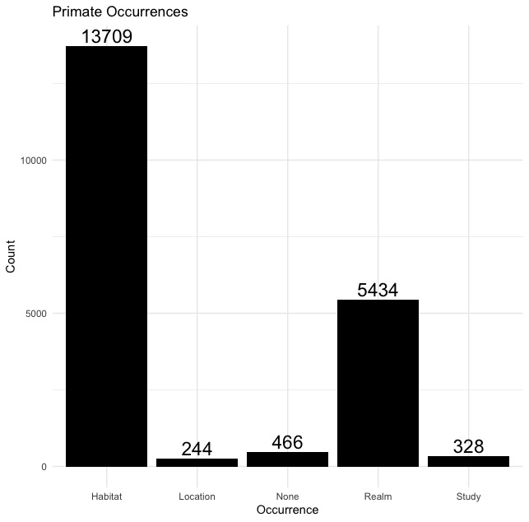
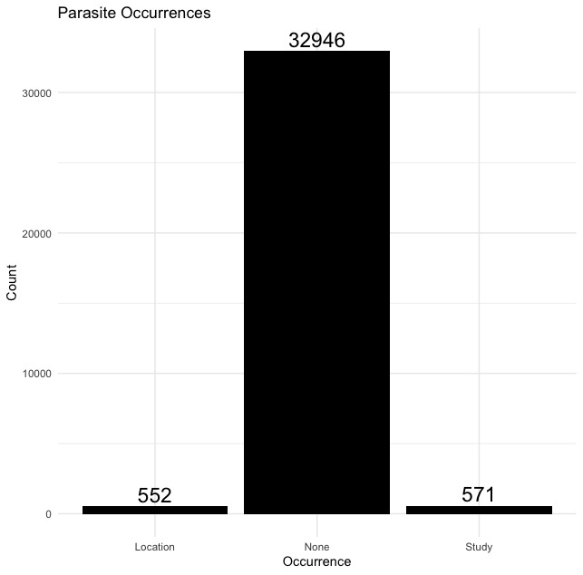
Occurrence Counts
Notes:
Counts of the number of (primate, study) pairs that fall under every category.
Ask about not present in habitat.

Slide 5
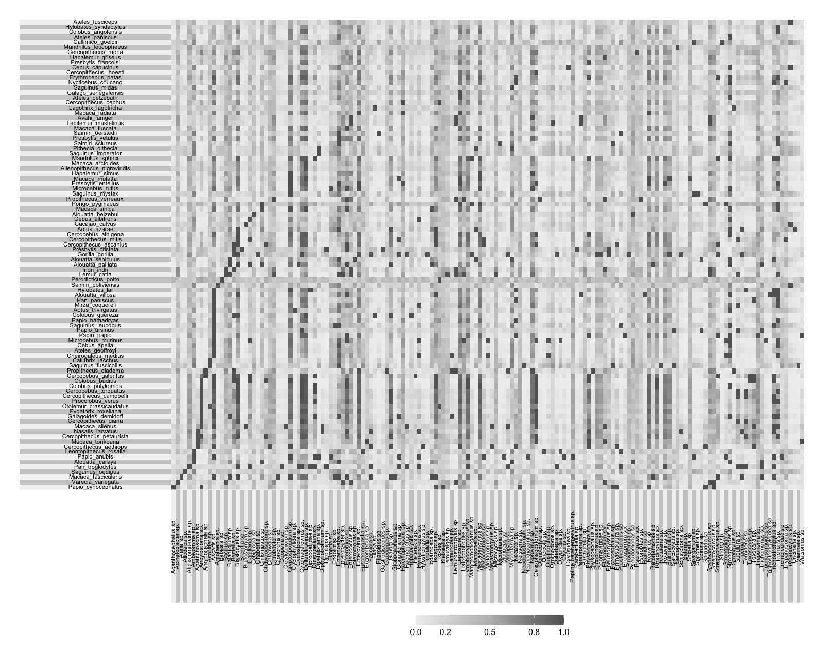
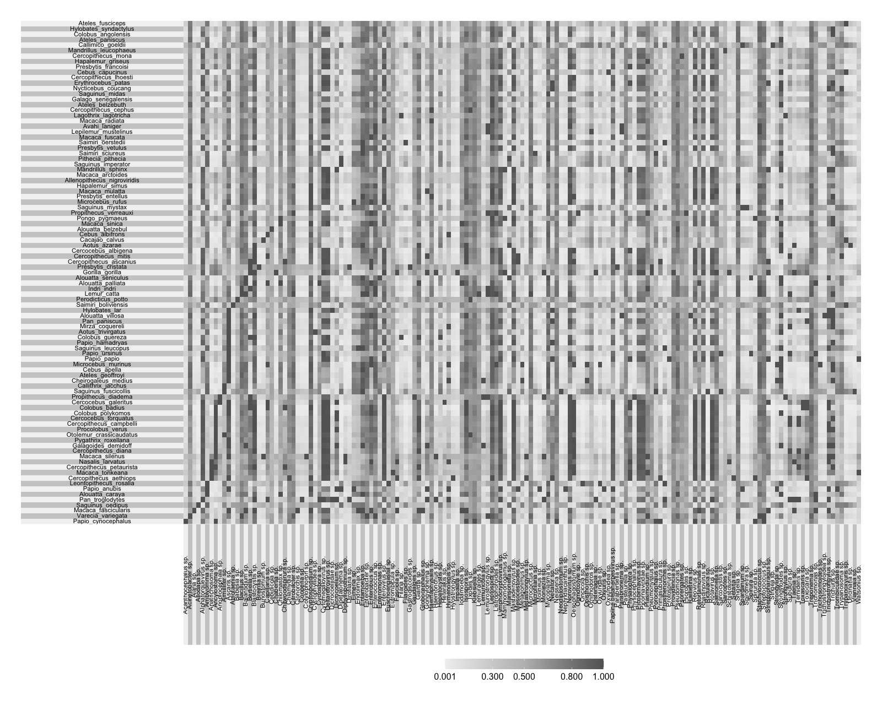
Posterior Probabilities of Interaction
a. Case 0.
a. Case 2.
Notes:
- Heatmaps of posterior probabilities of interactions between all primates and parasites. Hard to read, but we have a list of edges. Takeaway:
- Case 0: when you set occurrence probabilities high, it makes non-edges more informative, and overall interaction propensity will be lower.
- Case 2. Low Occurrence probabilities → non-edges non-informative → overall interaction propensity higher.
Any interaction that can occur (when both species are on site) will occur. Hence, the posterior probabilities of interaction are high.

Slide 6
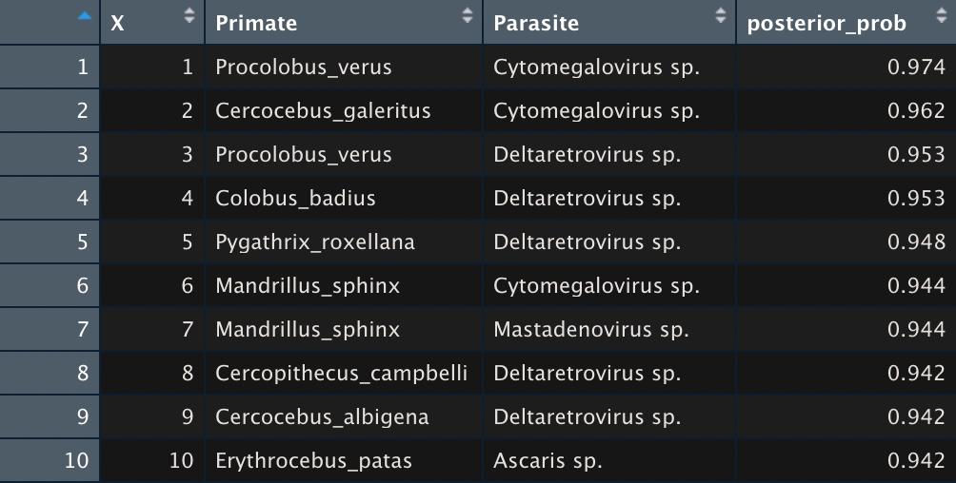
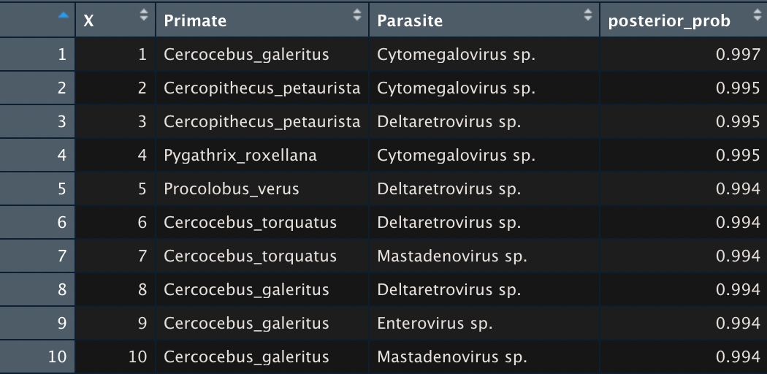
Summary Statistics
Observed Prevalence: 0.0312
Predicted Prevalence:
Case 0: 0.264
Case 2: 0.304
Table: Top 10 edges ranked by posterior probabilities
(left: 0.5 all. right: case 2.)
Notes:
- As a sanity check, we compared the observed prevalence (of an interaction) to the predicted prevalence.
# prevalence: mean(A | F = 1) = out of the pairs where focus = 1, how many pairs are observed?
List of edges in bipartitedf_may26th and bipartitedf_may29th. (posterior prob [0.5,1).
Sensitivity analysis (to occurrence): 57/100 top pairs in common.
Check whether these are present at a species level.

Slide 7
CV Results
a. Case 0
b. Case 1
c. Case 2
d. Case 3
Notes:
CV Interpretation: We can’t create a confusion matrix because we don’t have data on true negative (0s) and false positive (as it could be a true positive). Instead, Georgia looks at the prediction/overall mean for model performance. The overall mean should be much lower than the predicted mean (1s are held out). However, a simple ratio does not tell us if model is predicting unseen test cases accurately.
Model performs better when prior occurrence probabilities are set higher
Takeaway:
Model seems very sensitive to prior probabilities of occurrence.
CV results tend to be better with high prior probabilities. should we go after the high cv results (meaning that the model is predicting well) or should we rely on prior beliefs from common sense?
Took out 50 observations for the test set.
- look at how many true zeros (prevalence = 0).
- sampled occurrence vs. prior.
- proportions of known edges post. probabilities (>0.75).

Slide 8
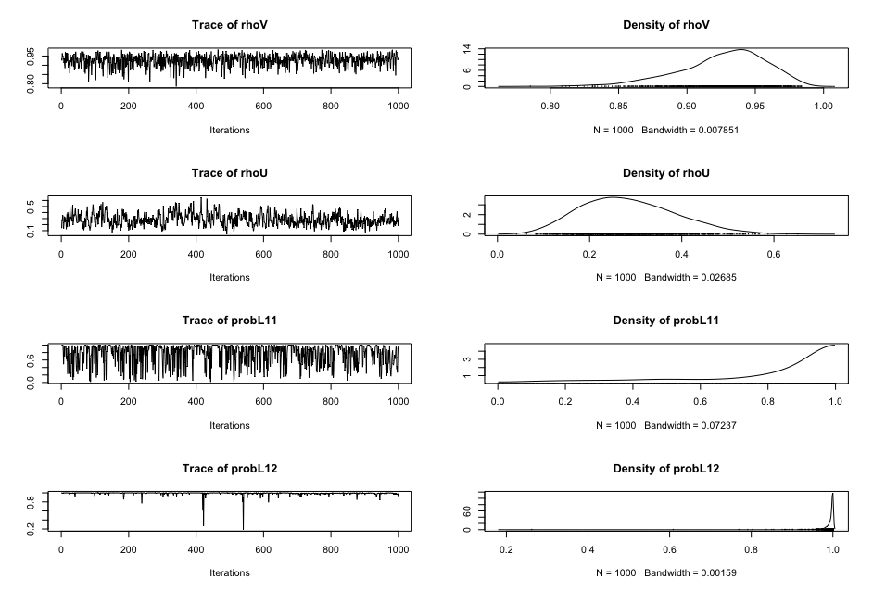
MCMC Diagnostics

