Slide 1
Email Campaigns Performance Review
Jenny Huang
11/26/24

Slide 2
Agenda
Campaign Performance Overview
Key Insights
Recommendation & Next Steps
Appendix

Slide 3
About the Campaign:
The e-mail marketing test included 64,000 customers who had purchased from the retailer in the past 12 months.
1/3 were randomly chosen to receive an e-mail featuring Men’s clothing (“Men’s E-mail”)
1/3 were randomly chosen to receive an e-mail featuring Women’s clothing (“Women’s E-mail”)
1/3 were randomly chosen to receive no e-mail in this campaign
Goals:
Evaluate metrics performance (visit, conversion, spend) across segments after two weeks of the campaign launched
Generate email leads if the retailer could only send an e-mail campaign to 10,000 customers given limited resources
Assumptions:
No other marketing initiatives conducted while rolling out email campaigns, avoid introducing confounding variables and threats to results validity
No spillover/interference across segments
All segments have similar behavioural attributes prior to the campaign
Campaign Performance Overview

Slide 4
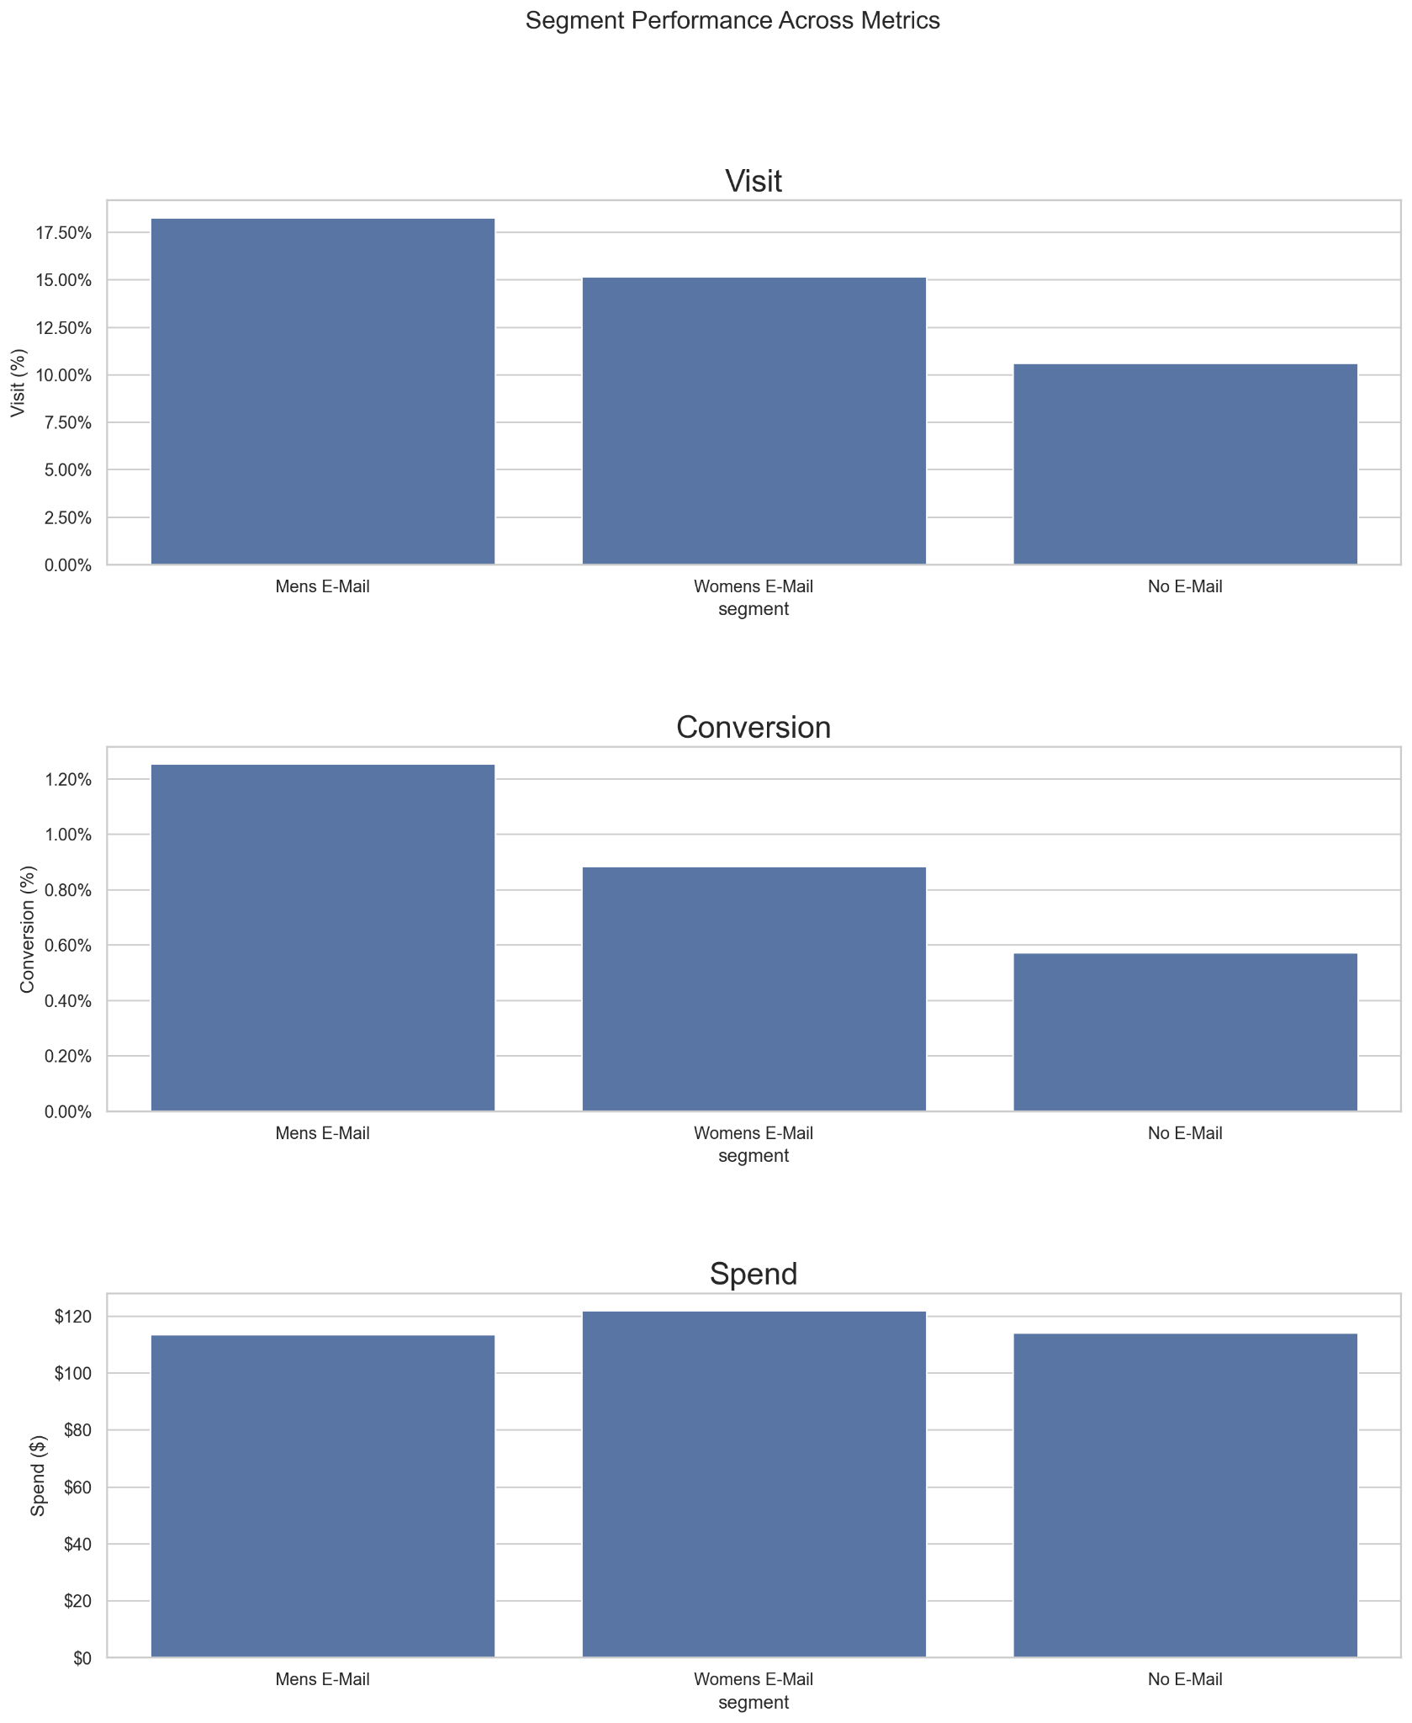
Campaign Performance Overview
Segment | Total Customers | Total Visit | Total Convert | Visit | Conversion | Total Spend | Avg Spend | Median Spend
Men’s E-Mail | 21,307 | 3,894 | 267 | 18.28% | 1.25% | $30,311.69 | $113.53 | $66.98
Women's E-Mail | 21,387 | 3,238 | 189 | 15.14% | 0.88% | $23,038.11 | $121.89 | $94.71
No E-Mail | 21,306 | 2,262 | 122 | 10.62% | 0.57% | $13,908.33 | $114.00 | $88.37
Men’s E-mail: high engagement (visit) and conversion, however, the segment tends to spend less per order
Women’s E-mail: The segment tends to have the highest value per order spending when convert. Slightly lower engagement and conversion than Men’s but still perform better than No E-Mail segment.
Notes: The result of Increased visit and conversion rate from Men’s and Women’s E-mail are statistically significant. (Please see appendix for details)

Slide 5
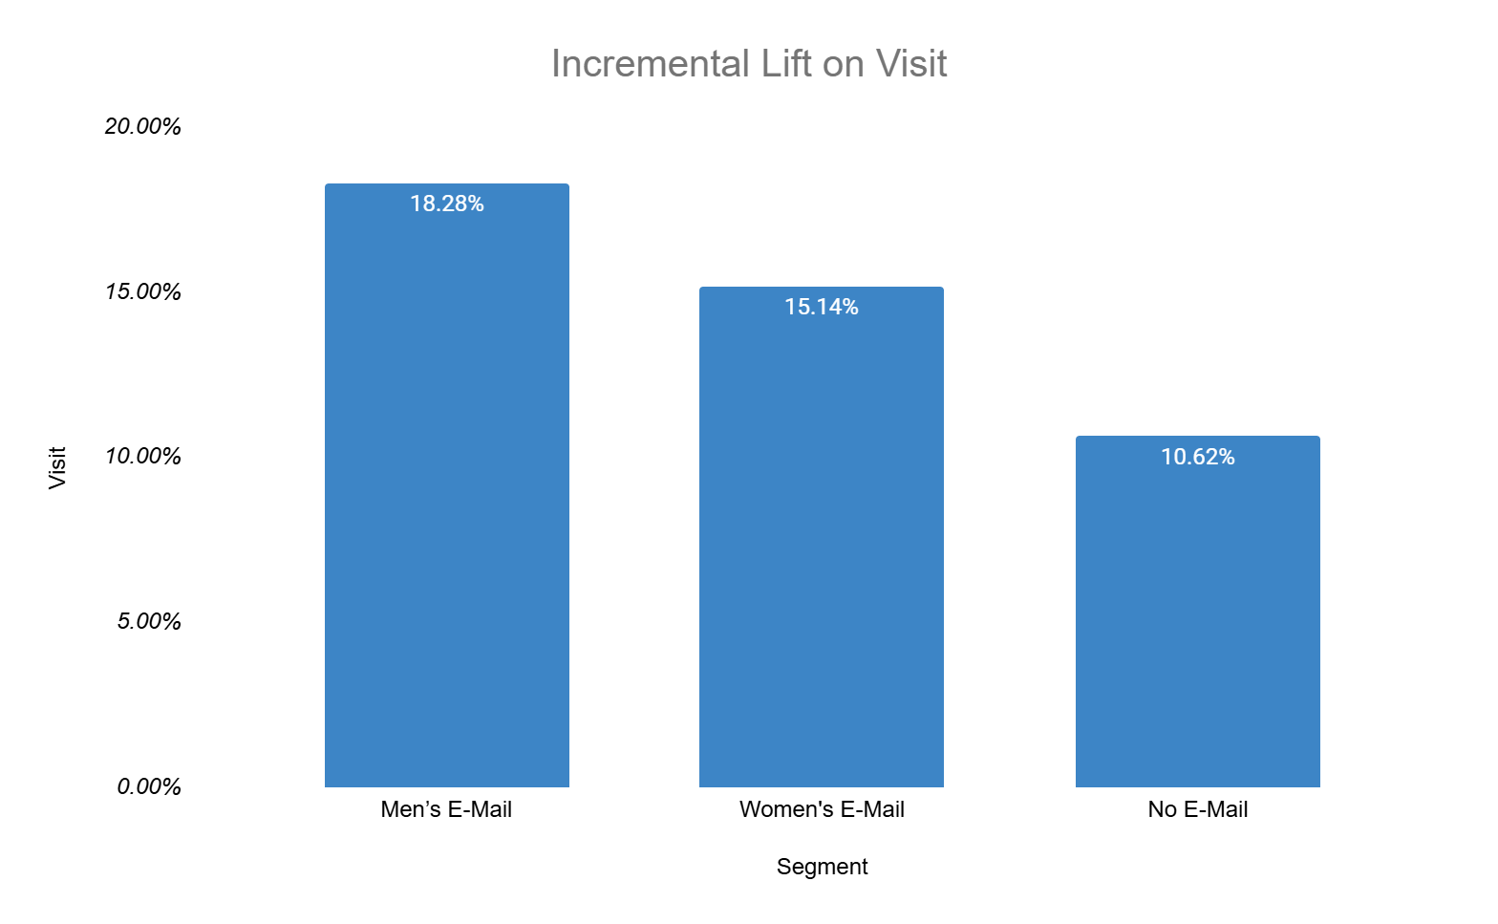
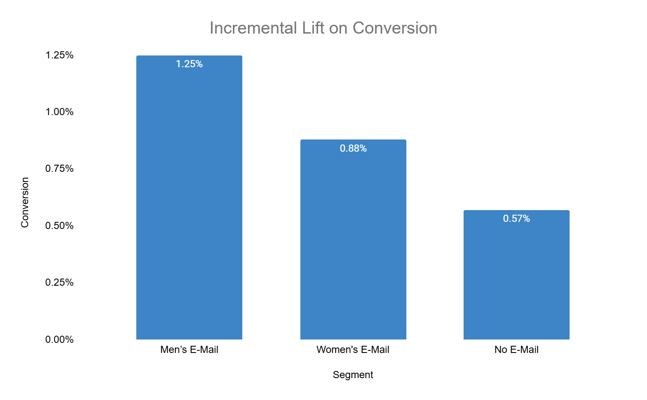
Campaign Performance Overview
43% Incremental Lift
119% Incremental Lift
72% Incremental Lift
54% Incremental Lift
Increased percentage of website visit by 72% with Men’s E-mail Vs 43 % with Women’s E-mail compared to baseline
Increased conversion rate by 119% with Men’s E-mail Vs 54% Women’s E-mail compared to baseline
Incremental Lift: (Treatment-Control)/Control
Notes:
Using lift as a metric to measure the performance, measure the percent improvement of the target metric, easy to understand, measure and explain, higher lift means better results
After looking at the high level performance across these segment, I want to dive into different attributes /dimensions and sse if we are seeing similar trends and performance across these segments

Slide 6
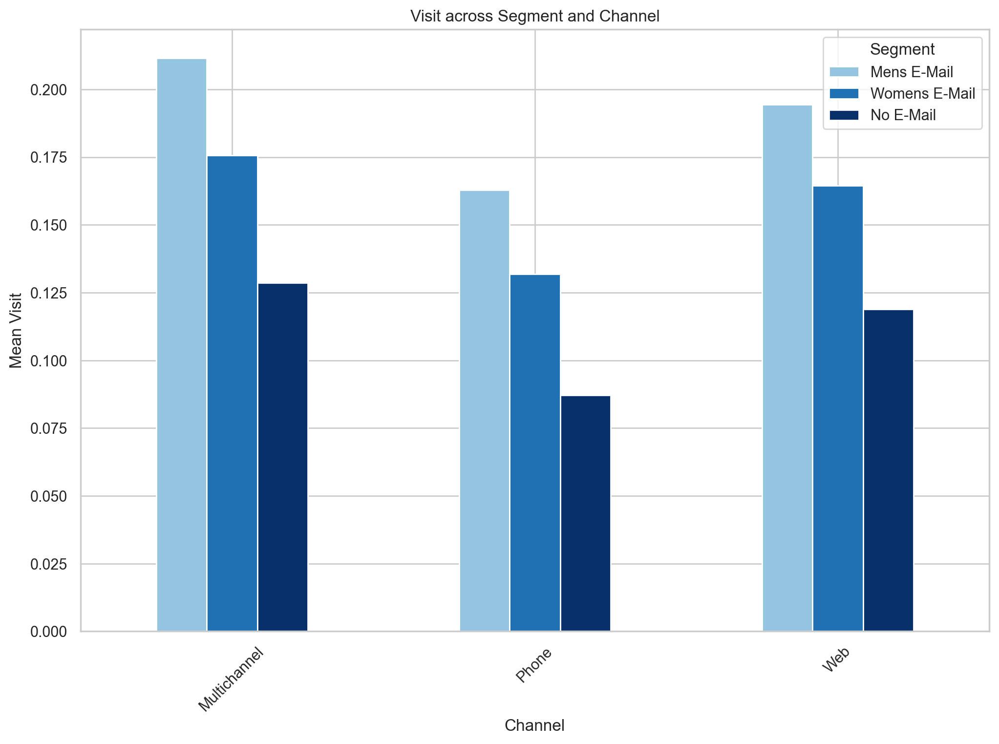
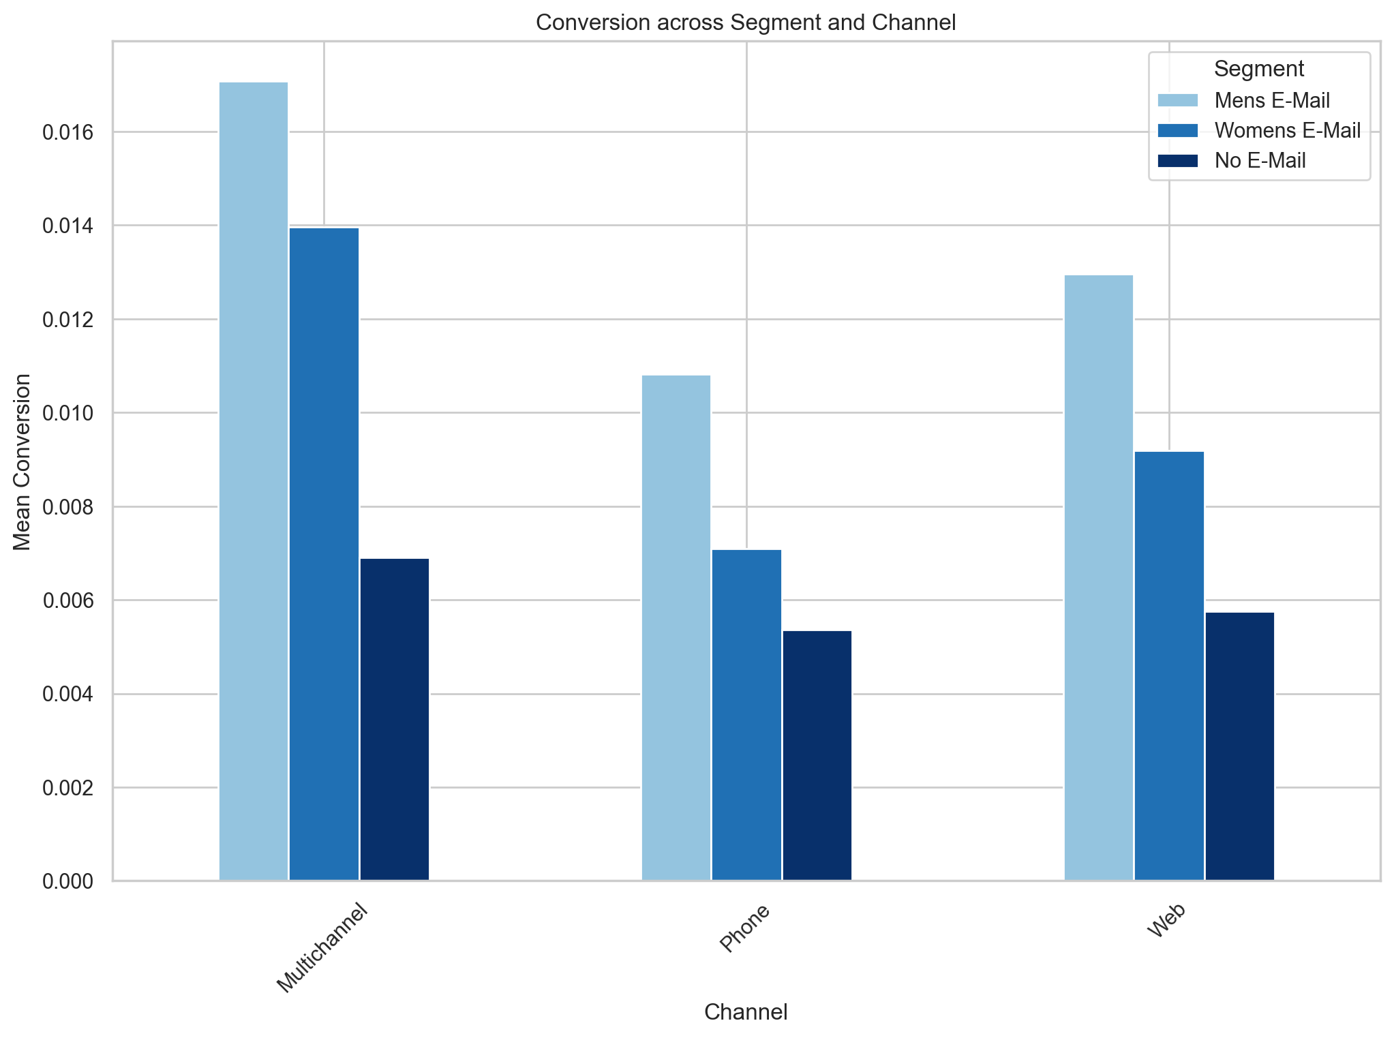
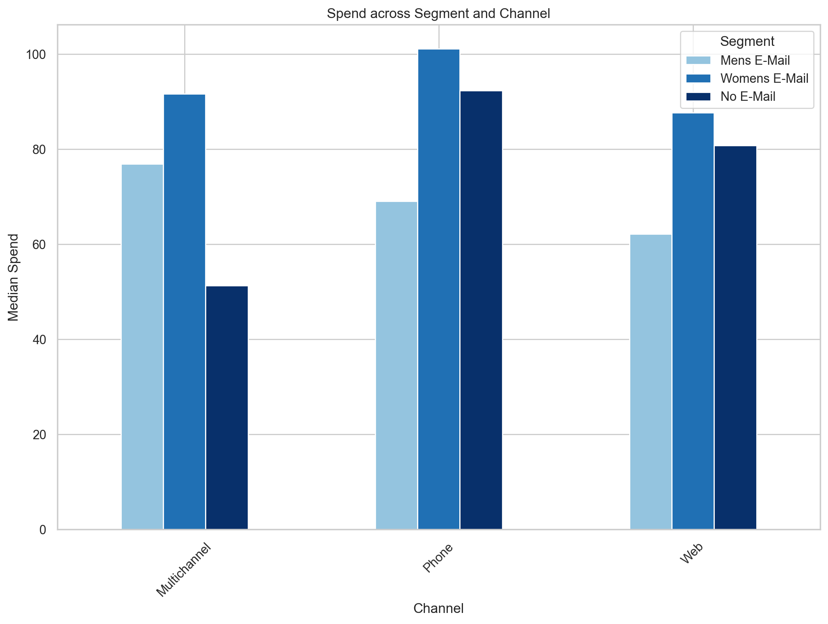
Campaign Performance Overview
Sales Channel
Men’s E-mail has shown a consistent high engagement (visit) and conversion across different sales channels compared to others
Women’s E-mail still had the highest median spend among the group
Stronger buying intent and conversion when customer interact with and purchased from multiple channels

Slide 7
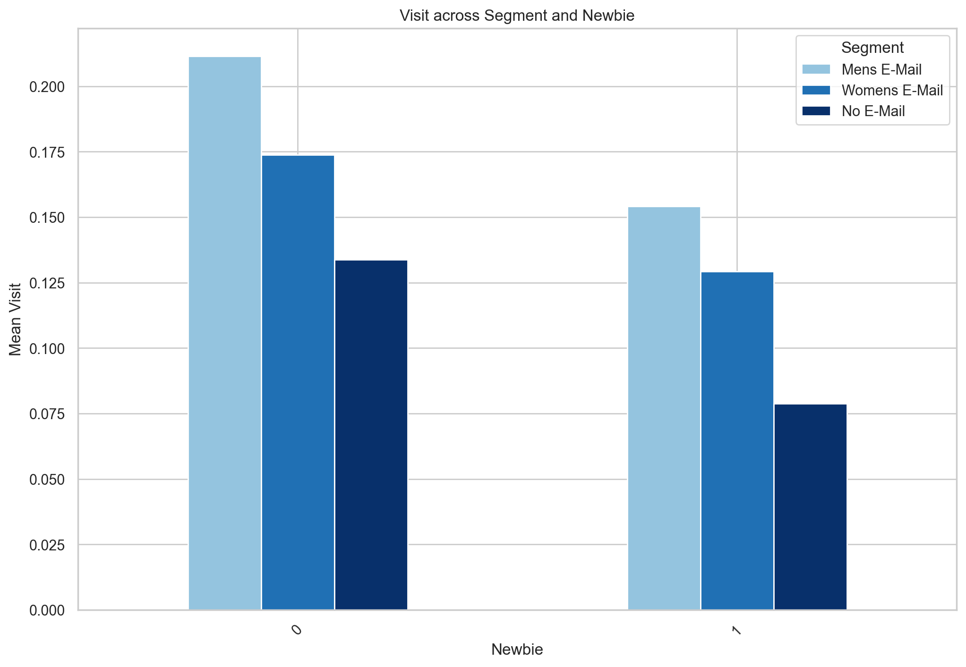
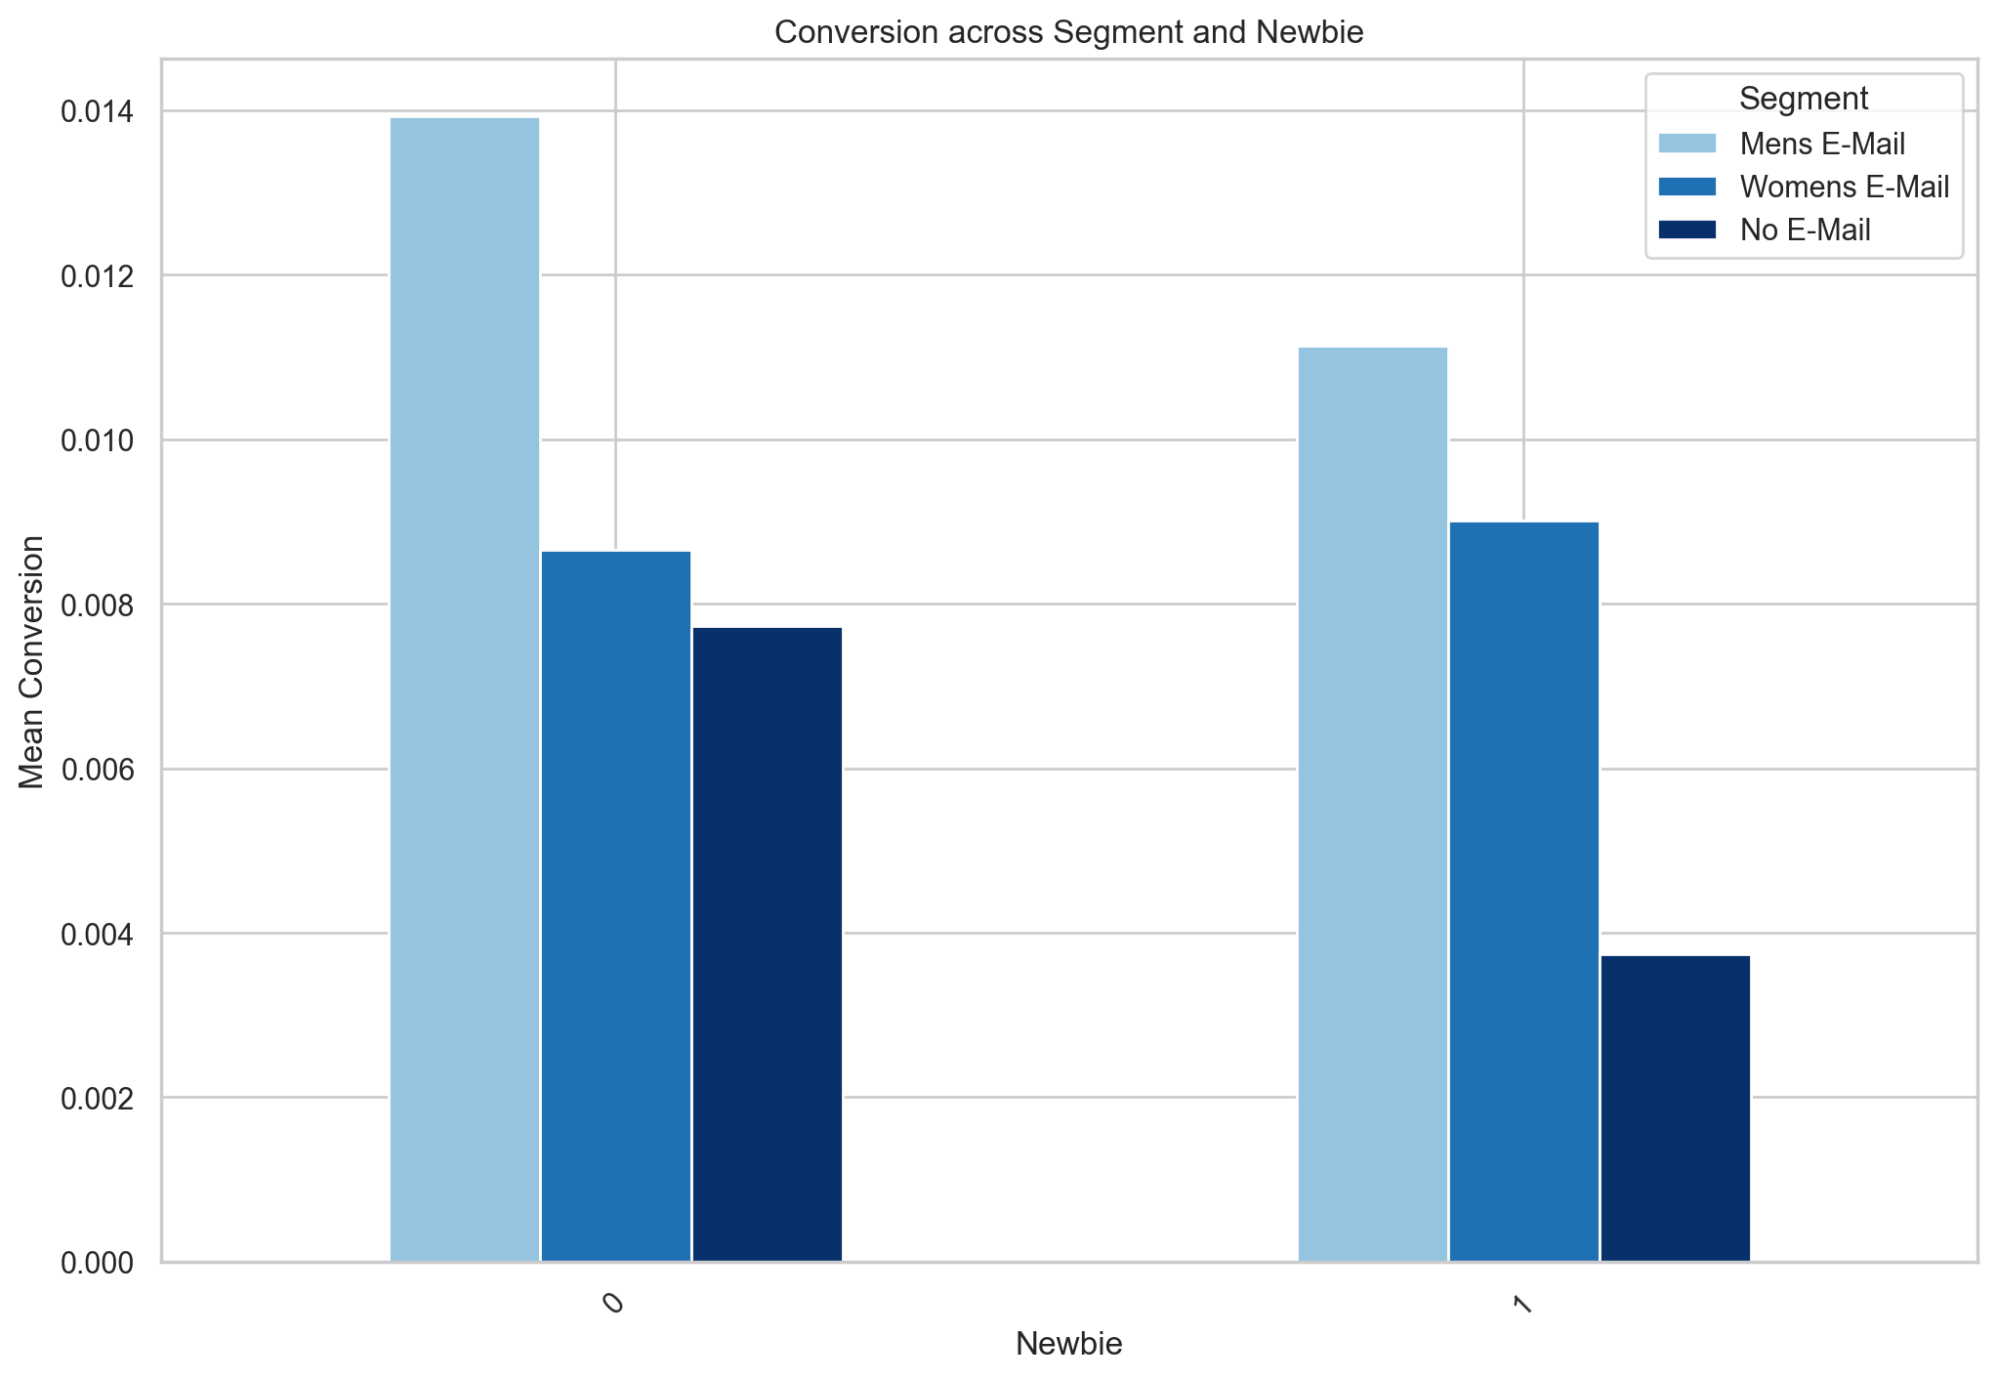
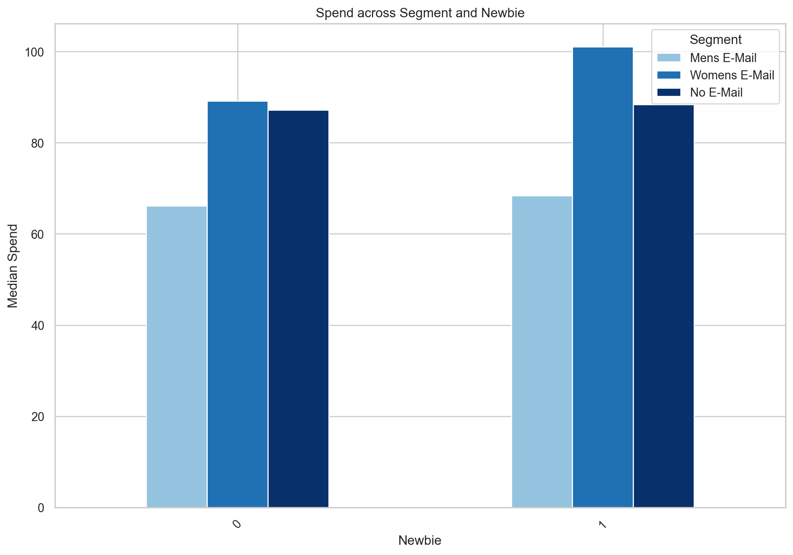
Campaign Performance Overview
New Vs Existing Customers
Existing customers reacted better to email campaigns than new customers, indicating familiarity with the brand and past positive shopping experience with the brand, more relevant content
New customers on average tend to spend more

Slide 8
Campaign Performance Overview
Incremental Spend
Segment | Conversion | Avg. Spend | Median Spend | Total Convert | Total Spend (Average) | Incremental Spend (Average) | Total Spend (Median) | Incremental Spend (Median)
Men’s E-Mail | 1.25% | $113.53 | $66.98 | 267 | $30,312.51 | $16,404.51 | $17,883.66 | $7,102.52
Women's E-Mail | 0.88% | $121.89 | $94.71 | 189 | $23,037.21 | $9,129.21 | $17,900.19 | $7,119.05
No E-Mail | 0.57% | $114.00 | $88.37 | 122 | $13,908.00 | - | $10,781.14 | -
Men’s E-mail appeared to be more effective in generating additional sales compared to others, capturing the total sales including all high value orders
However, since the spend is highly skewed, it’s worth to look at incremental median spend, as it reflected a slight different perspective of incremental sales, since it’s less influenced by the high value orders
Both formats delivered high incremental spend compared to No E-mail group

Slide 9
E-mail Leads
“REM” Model
Method 1:
$
Low Value
$$$$
High
Value
Create a customer value score through ‘REM’ to assess the future value of a customer
Recency (‘R’) - months since last purchase
Engagement (‘E’) - Visit (website visit, clicks)
Traditionally, we use frequency - how frequent customer make an order
Monetary (‘M’) - Spend history
Simple relative metric, yet powerful way to segment customers, and ensure to retain most valuable customers
Total Value Score
15
3
12 months since last purchase
1 month since last purchase
1
Low
Recency (‘R’)
High
5
Low
Engagement(‘E’)
High
+ 1
+ 5
Low
+ 5
+1
Monetary(‘M’)
High
3
15
Method 2 & 3:
Uplift Modelling that separate customers into groups
‘Persuadable’, ‘Sure Thing’ , ‘Lost Cause’, ‘Do Not Disturb’
Customer Lifetime Value (CLT): average spend * frequency * customer tenure
Notes:
Provide flexibility to define high/low cut value cutoff for different situation
Avoid unnecessary spend to groups will not respond to emails anyway

Slide 10
Recommendation & Next Steps
Focus on Men’s E mail targeting as it drives higher engagement and conversion
Try to upsell / cross-sell to increase average spend (promote high value items)
Continue to use multi-channel, and identify customer touchpoints throughout buying process
Interact with multiple touch points, more qualified leads, high potential to convert
Continue to build rapport with existing customers, promote loyalty program and personalized content, (easier to retain than attract)
Monitor guardrail metrics while optimizing metrics of interests, metrics help show customer engagement rate
Unscribribed rate
Open rate
Click Through rate
Look at customer acquisition costs (CAC) to determine cost of the campaigns to further evaluate effectiveness
CLT/CAC ratio
Include customer attributes, such as customer details to capture the ‘frequency’ of the traditional RFM framework complementing with secondary metrics for future leads targeting
Notes:
Attracting new customers

Slide 11
Thank You

Slide 12
Appendix

Slide 13
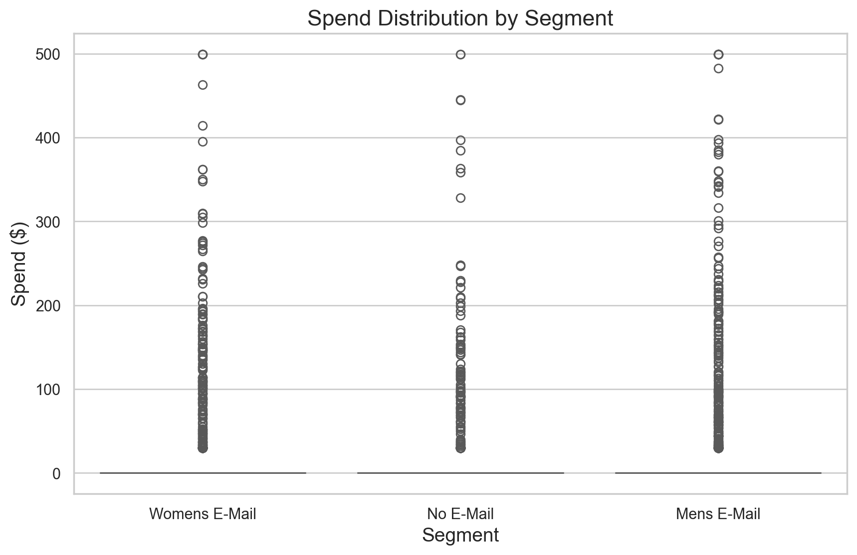
Spend is highly skewed across segment, therefore, using average spend may not be a good representation of data
Suggest to use median, as it is not affected by outliers (extreme values) and provide better measure of central tendency of the data

Slide 14
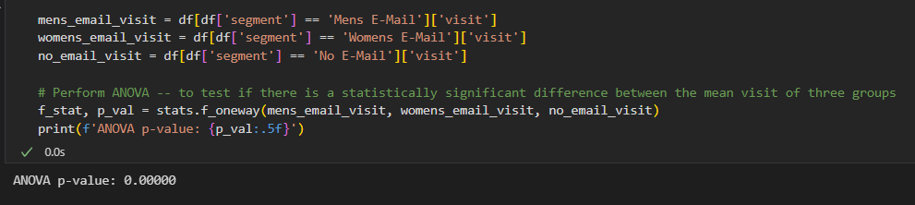
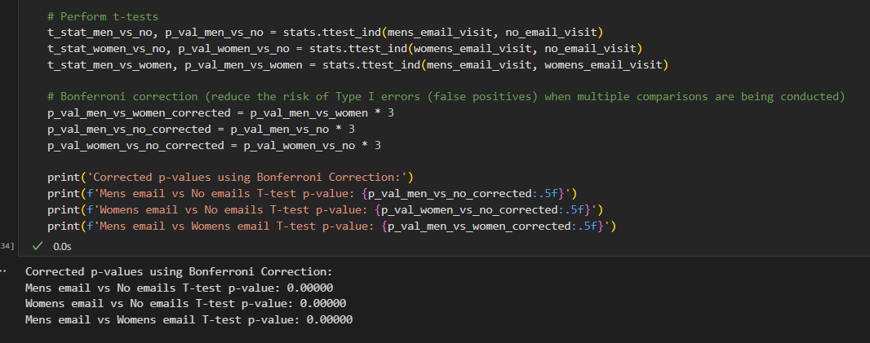
Campaign Performance Overview
Were the increased in visit/conversion rate from Men’s Email and Women’s Email result statistically significant or just due to randomness?
Yes, both visit and conversion results are statistically significant based on p-value
Steps:
Start with analysis of variance (ANOVA) and determine if there’s difference among the group
If so, then conduct post hoc two sample t tests to determine which group pair is statistically significant
The result is unlikely to have happened by chance.
Additionally, it might be worthwhile to look at Cohen’s D metric to quantify the statistical strength of the results by measuring standard deviation to determine the overall effect size of the E-mail campaigns

Slide 15
Campaign Performance Overview
Segment | Visit | Conversion | Lift on Visit | Lift on Conversion
Men’s E-Mail | 18.28% | 1.25% | 72% | 119%
Women's E-Mail | 15.14% | 0.88% | 43% | 54%
No E-Mail | 10.62% | 0.57% | 0% | 0%
43% Incremental Lift
54% Incremental Lift
72% Incremental Lift
119% Incremental Lift

Slide 16
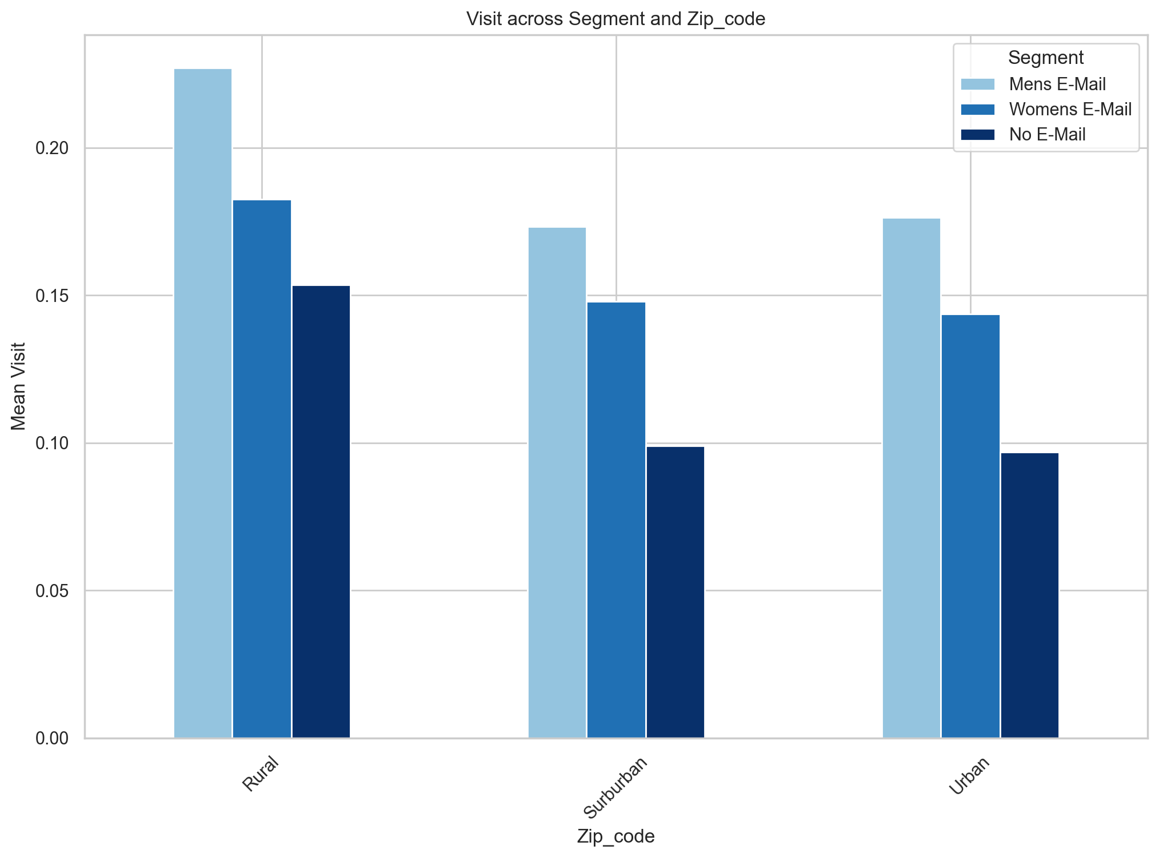
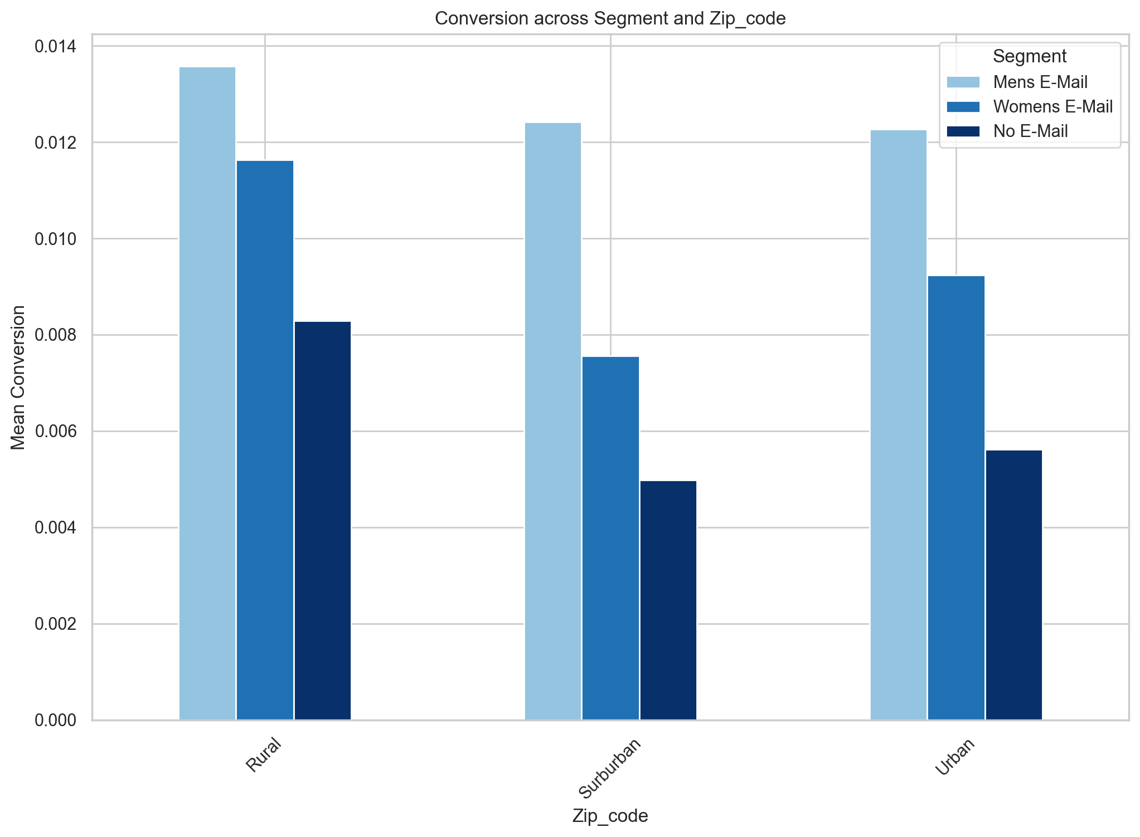
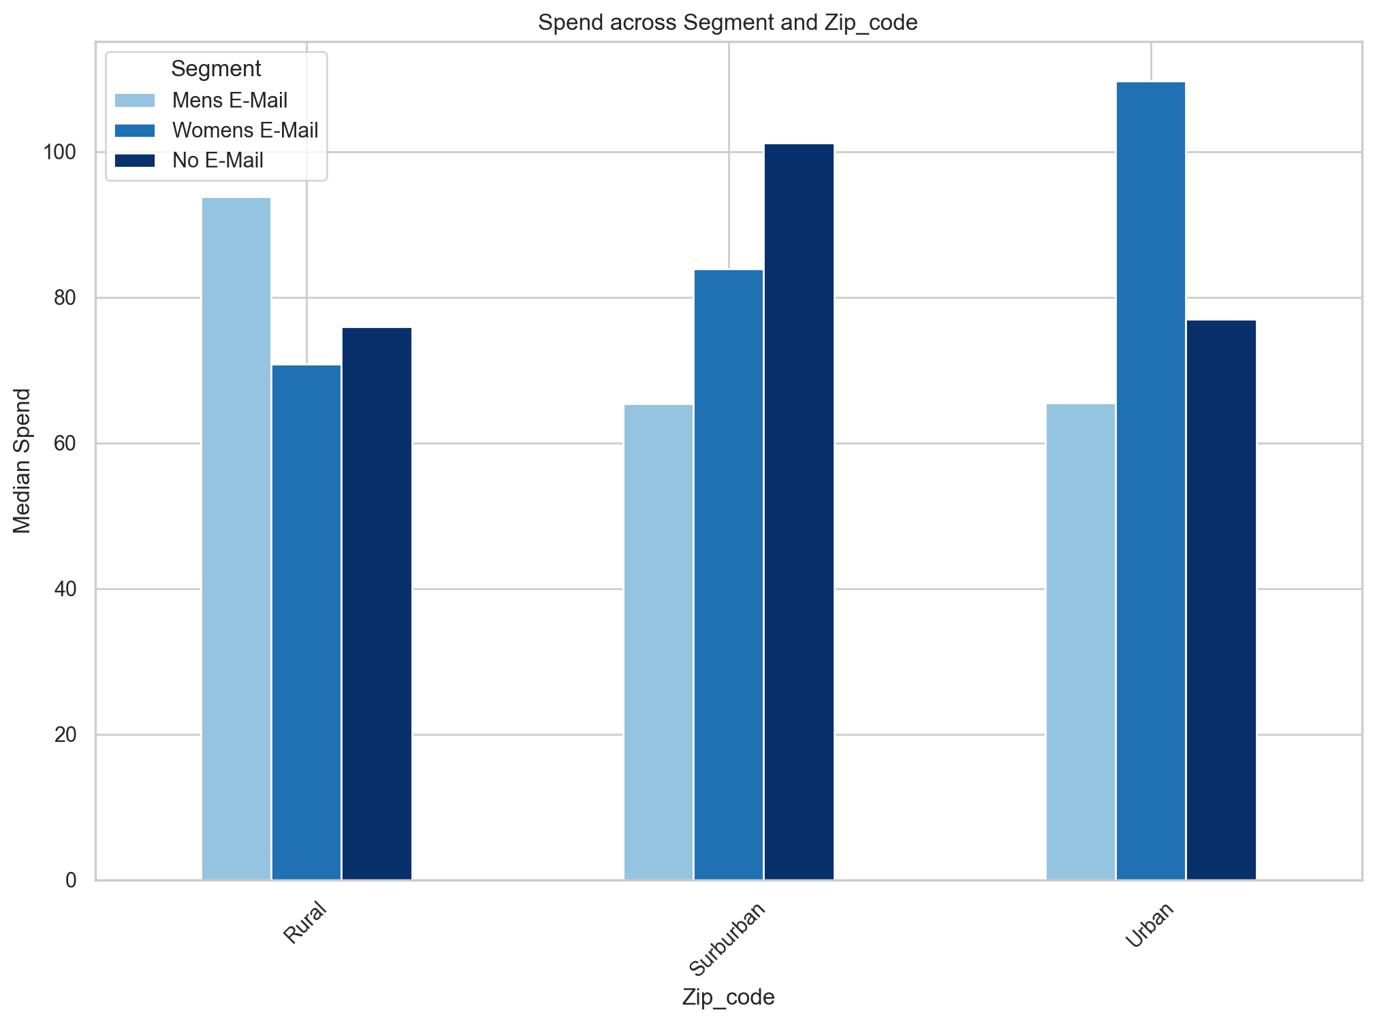
Campaign Performance Overview
Geographic Areas (Urban, Suburban, Rural)
Men’s Email group has shown a consistent high engagement (visit) and conversion across different geo areas
Women’s Email group who live in Urban area tend to spend more on average
Men’s Email group who live in rural area spend more than others

Slide 17
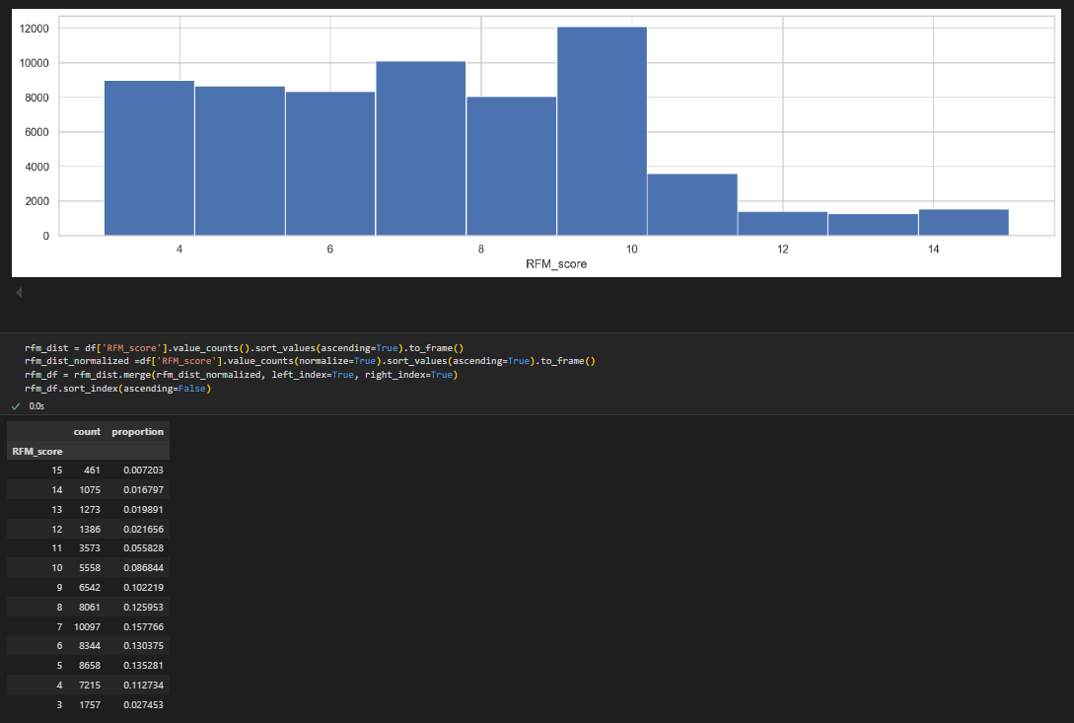
REM Model

