Slide 1

Does Retrieval-Augmented Generation Reduce Hallucinations in Medical QA?
CSPC 5770 Final Project
Hanfeng Fei, Yujie Wang, Sihan Jiang
Tue, April 22, 2026
Notes:
“Good afternoon, everyone. It‘s a great honor to have the opportunity to share my work with you today. I would like to extend my huge thanks to Dr. Xie for inviting me, as well as to Dr. Xu and Zach for their support.
I am a PhD student in the Computer Science department, about to enter my third year. My advisor is Professor Mark Gerstein.
The topic of my presentation is 'AIScientist: Empowering Biomedical Research with Large Language Models and AI Agents.'"

Slide 2
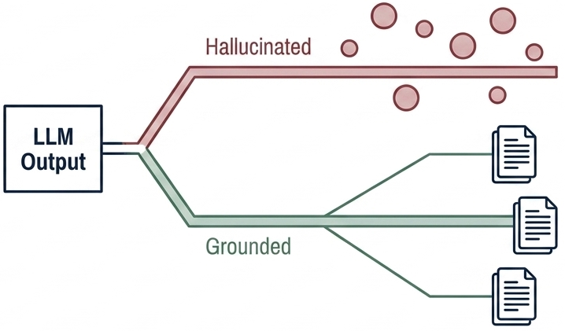
The Hallucination Gap in Medical QA
From hallucination-prone medical QA -> retrieval-grounded generation and answer-level evaluation
General-purpose LLMs can generate fluent medical answers, but those answers may still be factually incorrect or unsupported, which is risky in high-stakes clinical settings.
Core
Problem
RAG can improve factual grounding by bringing in external medical evidence, but hallucinations still persist, especially when retrieval is noisy or evidence is not tightly linked to the final answer.
Project Motivation
We build on MedRAG, a medical RAG framework that combines retrieval and generation for biomedical QA.
However, its default pipeline uses a fixed retrieval depth and does not explicitly adapt retrieval volume to question complexity.
Prior Work Synthesis
Notes:
We analyze risks from three angles: user intent (malicious purposes or unintended consequences), scientific domains (chemical weapons, biological hazards, nuclear radiation), and environmental impact (natural environment damage, human health risks).
We propose a triadic framework: Human Regulation - training and auditing AI developers and users; Agent Alignment - improving AI decision-making to understand and prevent risks; Agent Regulation and Environmental Feedback - monitoring AI behavior and using environmental feedback for timely correction. We emphasize prioritizing safety alongside AI scientist autonomy. Only through comprehensive oversight and feedback systems can these powerful tools truly benefit scientific research

Slide 3
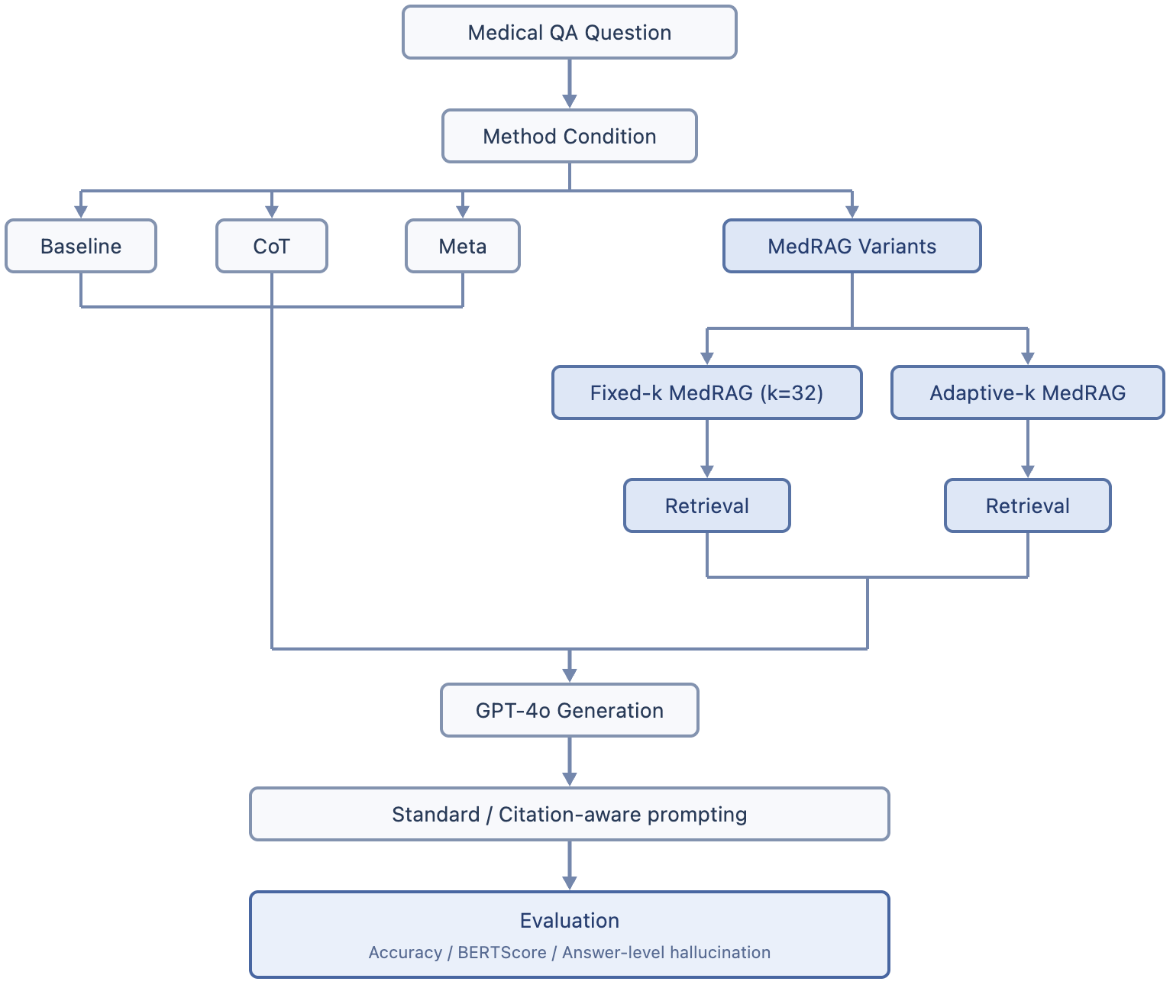
Methods and Approach
Methods Explored
Baseline prompting
Chain-of-Thought prompting
Meta prompting
MedRAG-based RAG
MedRAG Modifications
Adaptive-k retrieval based on query complexity
Citation-aware generation with structured prompting
Safer snippet extraction in the retrieval pipeline
Our Approach
Using GPT-4o, we evaluated all four conditions on four medical QA datasets—MedQA-US(options), PubMedQA(yes/no/maybe), BioASQ(factoids), and MediQA(open response style matching)—with about 250 questions per dataset (~1,000 total examples).
Evaluation
Objective QA: accuracy
Subjective QA: BERTScore F1
Hallucination: answer-level judgment
Notes:
We analyze risks from three angles: user intent (malicious purposes or unintended consequences), scientific domains (chemical weapons, biological hazards, nuclear radiation), and environmental impact (natural environment damage, human health risks).
We propose a triadic framework: Human Regulation - training and auditing AI developers and users; Agent Alignment - improving AI decision-making to understand and prevent risks; Agent Regulation and Environmental Feedback - monitoring AI behavior and using environmental feedback for timely correction. We emphasize prioritizing safety alongside AI scientist autonomy. Only through comprehensive oversight and feedback systems can these powerful tools truly benefit scientific research

Slide 4
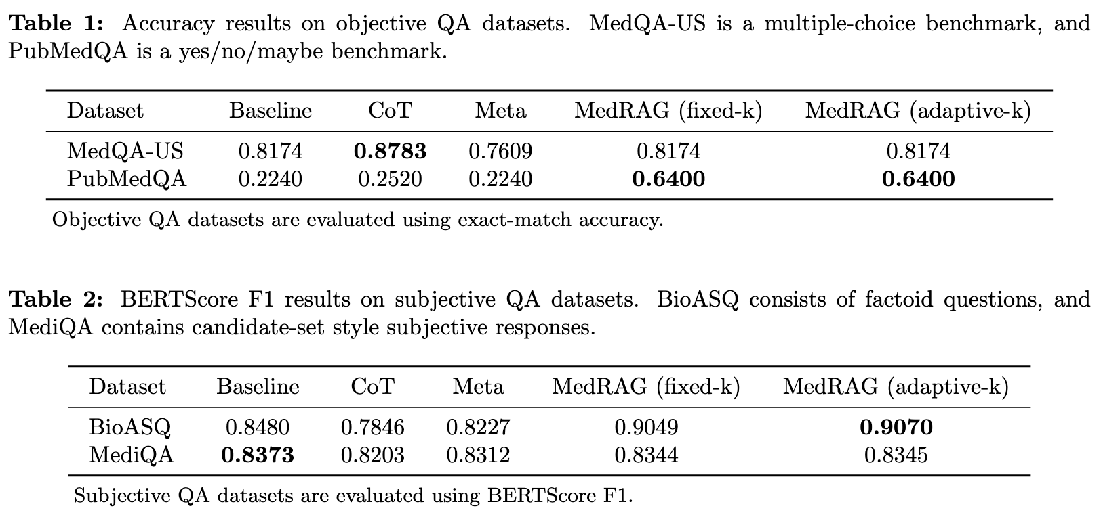
Results: Accuracy
Notes:
We analyze risks from three angles: user intent (malicious purposes or unintended consequences), scientific domains (chemical weapons, biological hazards, nuclear radiation), and environmental impact (natural environment damage, human health risks).
We propose a triadic framework: Human Regulation - training and auditing AI developers and users; Agent Alignment - improving AI decision-making to understand and prevent risks; Agent Regulation and Environmental Feedback - monitoring AI behavior and using environmental feedback for timely correction. We emphasize prioritizing safety alongside AI scientist autonomy. Only through comprehensive oversight and feedback systems can these powerful tools truly benefit scientific research

Slide 5
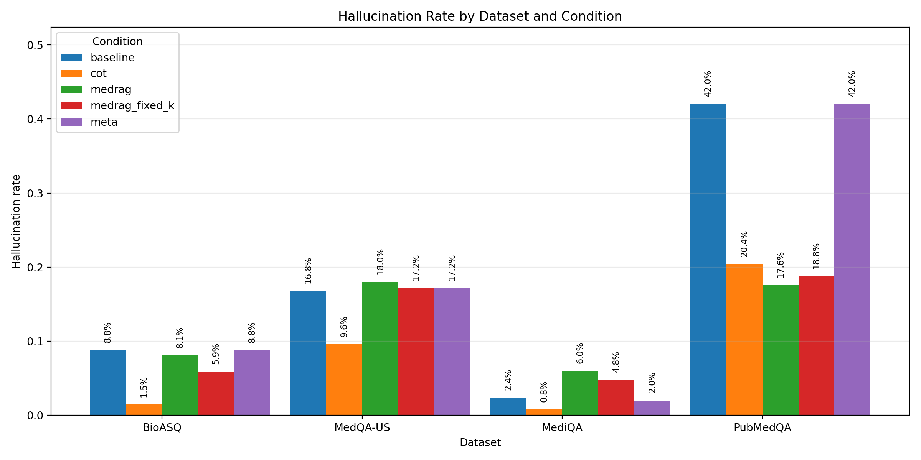
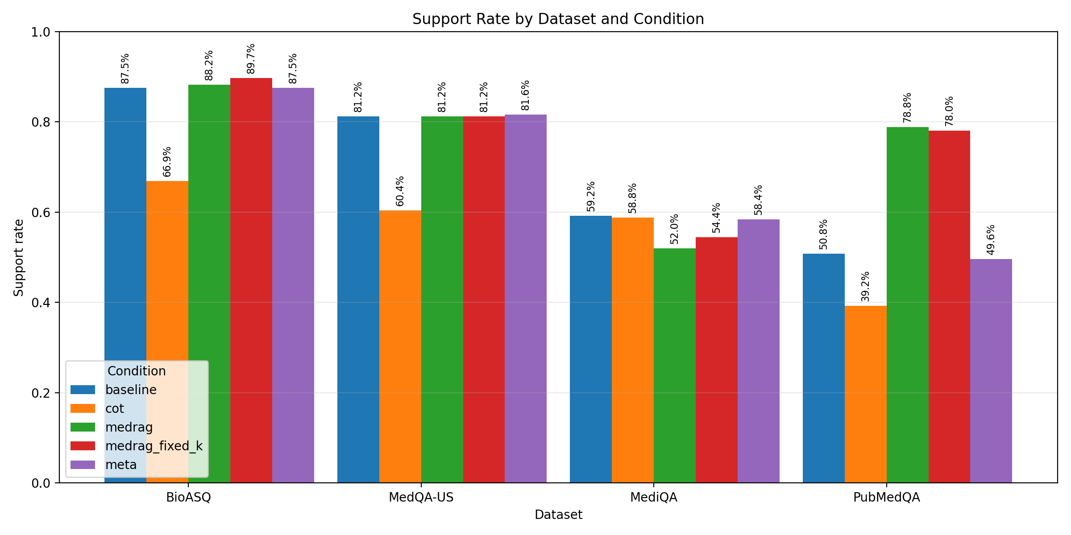
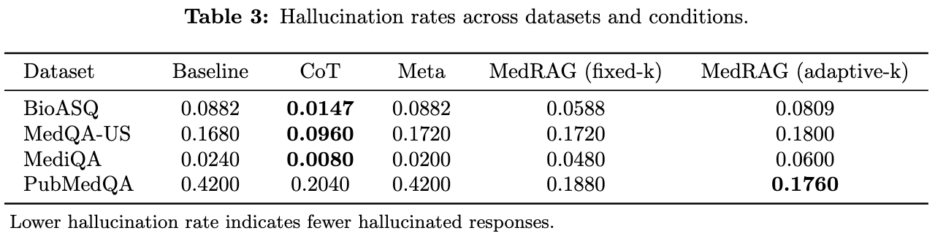
Results: Hallucination
Notes:
We analyze risks from three angles: user intent (malicious purposes or unintended consequences), scientific domains (chemical weapons, biological hazards, nuclear radiation), and environmental impact (natural environment damage, human health risks).
We propose a triadic framework: Human Regulation - training and auditing AI developers and users; Agent Alignment - improving AI decision-making to understand and prevent risks; Agent Regulation and Environmental Feedback - monitoring AI behavior and using environmental feedback for timely correction. We emphasize prioritizing safety alongside AI scientist autonomy. Only through comprehensive oversight and feedback systems can these powerful tools truly benefit scientific research

Slide 6
Conclusion
RAG does not consistently reduce hallucinations across all medical QA datasets.
Its effect is highly task-dependent: Both fixed-k and adaptive-k MedRAG are strongest on PubMedQA, improve BioASQ, and show only limited gains on MediQA.
Prompting and retrieval help in different ways:
CoT most reliably lowers hallucination, while MedRAG variants improve answer quality on retrieval-heavy tasks, with adaptive-k helping PubMedQA and fixed-k showing stronger grounding on BioASQ.
Notes:
We analyze risks from three angles: user intent (malicious purposes or unintended consequences), scientific domains (chemical weapons, biological hazards, nuclear radiation), and environmental impact (natural environment damage, human health risks).
We propose a triadic framework: Human Regulation - training and auditing AI developers and users; Agent Alignment - improving AI decision-making to understand and prevent risks; Agent Regulation and Environmental Feedback - monitoring AI behavior and using environmental feedback for timely correction. We emphasize prioritizing safety alongside AI scientist autonomy. Only through comprehensive oversight and feedback systems can these powerful tools truly benefit scientific research

