Slide 1


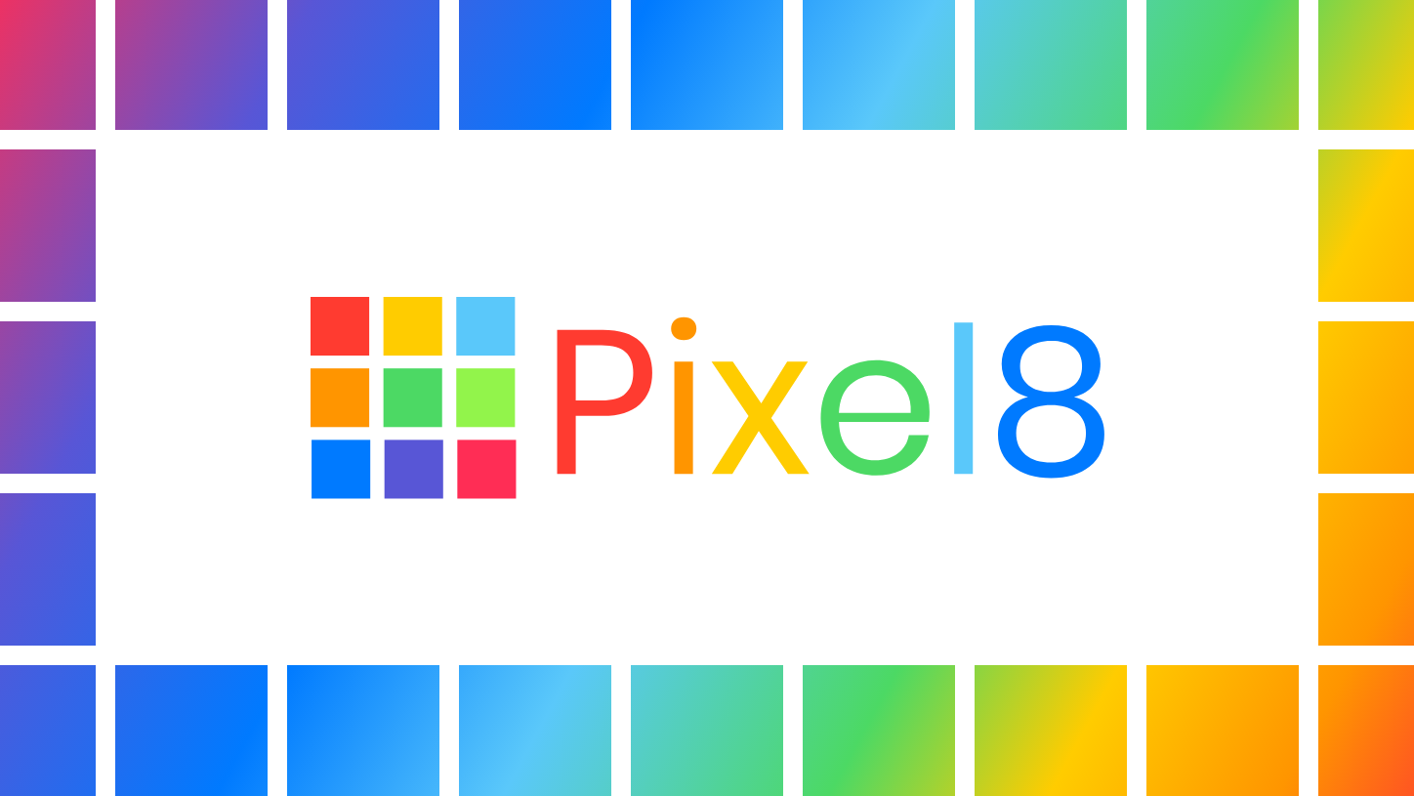
By Samuel MacLeod, Jenny Lin & Ryan Schuller

Slide 2
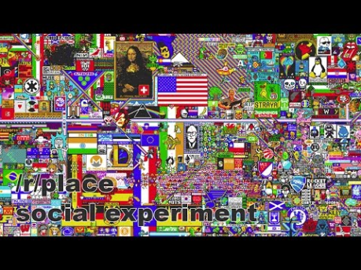
Inspiration
Notes:
Inspiration
We wanted to make a web site, with our domain: helloworldhack.com
We were initially inspired by the Reddit post, with the collaborative pixel art canvas timelapse, and wanted to make our own version. That all started on April Fools' Day 2017, in which a social experiment was launched in the form of a subreddit called "place". It featured a collaborative pixel art canvas, where a user could place a pixel every five minutes. The whole process was captured as a full 72 hours (90fps) timelapse.

Slide 3
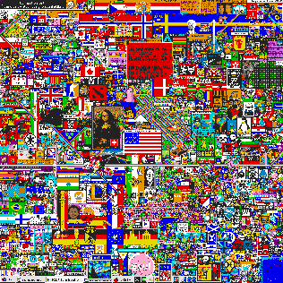
Final image
Notes:
What it does?
Pixel 8 is a real-time collaborative pixel art website. It allows the users to customise the canvas by editing each pixel of the canvas. This can be done by changing the red, green and blue sliders, to mix the colours. This is real-time, which means you can see other people who are also editing at the same time, and you collaborate on the same canvas.

Slide 4
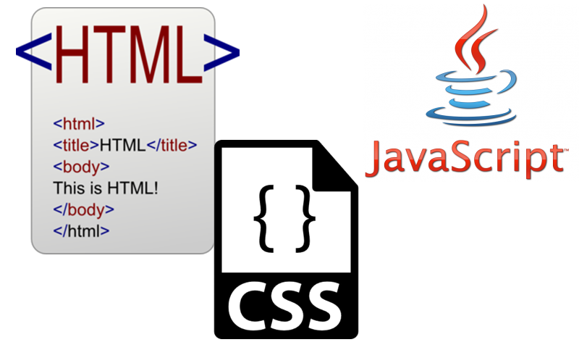
What we used:
HTML
CSS
Javascript
Notes:
How we built it?
We used HTML for the content of the web page. We used CSS for the formatting of the user interface. We used Javascript to add functionality to the web page, which allows the users to interact with the pixels.

Slide 5

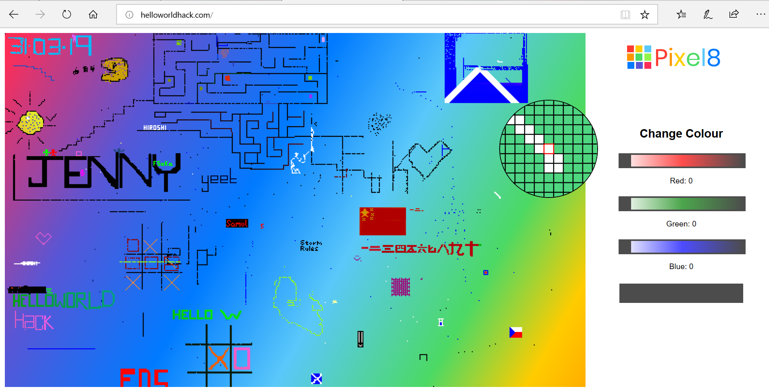
Designer helps you get your point across
PowerPoint Designer suggests professional designs for your presentation, based on the content in your slides.
Designer is a subscription-only feature. If you have an Office 365 subscription, the next slide shows you how it works in a new presentation.
Notes:
Challenges we ran into?
The main challenge was deciding what we wanted to display, and we wanted the pixels to change.

Slide 6
Thank you!
Notes:
What we learned?
We are now more confident in using HTML, CSS and Javascript. We understand more of the features and functionality of the languages.

Slide 7
Notes:
What’s next for Pixel8?
This is an ongoing project. So for the future, we are wanting to add new features and maintain this website. We would like to incorporate a timeline to give the option to go back and view the timelapse. We may incorporate a colour wheel to increase user functionality. We would also like a button to allow the users to download a snapshot of the image at that specific time. In addition, we would also like to add some features for more customization.

