Slide 1
Chapter 1 The PIC18 Microcontroller

Slide 2
Objective
Von Neumann and Harvard Architectures
Compare the contrasts in microprocessors and microcontrollers.
Explain the concept of embedded system.

Slide 3
Section 1.1 Von Neumann and Harvard Architectures

Slide 4
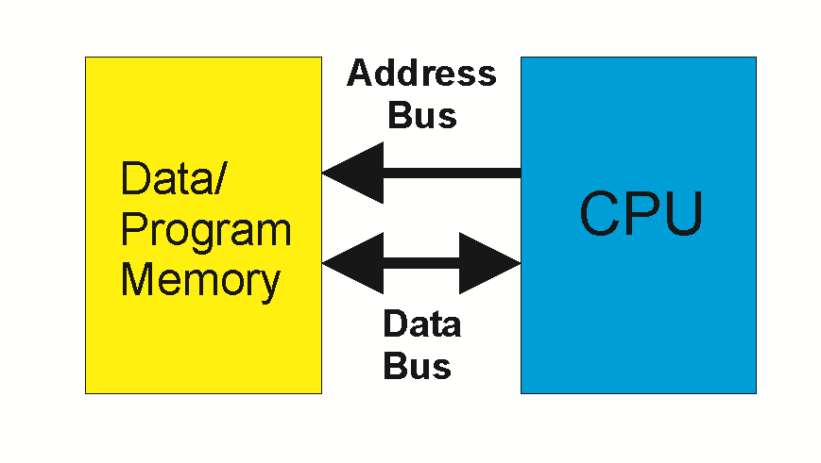
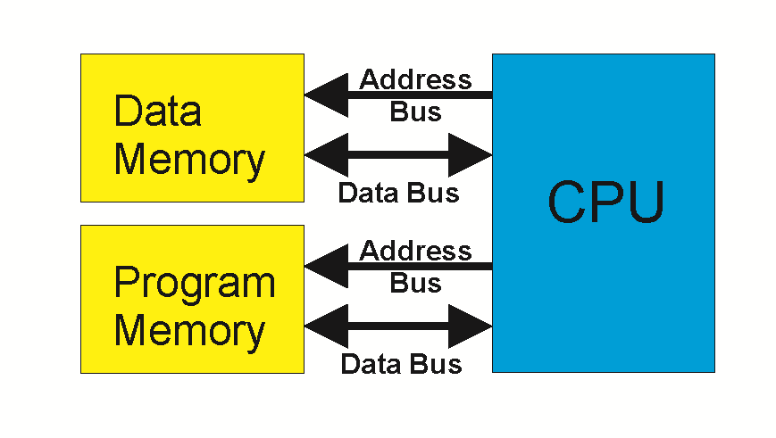
Harvard vs von Neumann Architecture
von Neumann – uses the same address and data bus for code ROM space and data RAM space.
Harvard – uses different address and data buses to access code ROM space and data RAM space.
von Neumann architecture is slow because ROM and RAM cannot be accessed simultaneously.
Implementing Harvard architecture is expensive.
von Neumann Harvard
Notes:
esp when the RAM and ROM space are external to the CPU.
e.g., Pentium μP with 64-bit data bus and 32-bit address bus needs about 100 wires. Number of wires is doubled for Harvard architecture.

Slide 5
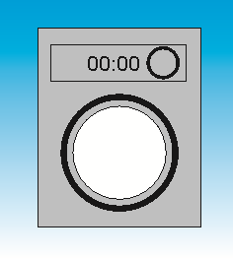
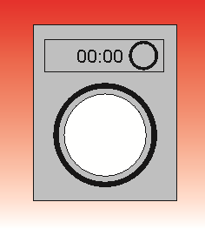
Von Neumann Architecture is Slow
 | 30 | 30 | 30 | 30 | 30 | 30 | 30 | 30




1
2
3
4

Slide 6
Advantage of Harvard Architecture (easy for pipeline implementation)
 | 30 | 30 | 30 | 30 | 30




1
2
3
4

Slide 7
Disadvantage of Harvard Architecture
μP 64-bit data bus and 32-bit address bus needs about 200 wires.
Notes:
More bus lines are needed
More cost

Slide 8
Section 1.2 microprocessors and microcontrollers

Slide 9
General-purpose microprocessor
CPU for Computers
No RAM, ROM, I/O on CPU chip itself
Example：Intel’s x86, Motorola’s 680x0
Many chips on mother’s board
Data Bus
CPU
General-Purpose Micro-processor
Serial COM Port
RAM
ROM
I/O Port
Timer
Address Bus
Figure 1-1 (a) General-Purpose Microprocessor System
9
Notes:
2019/1/29

Slide 10
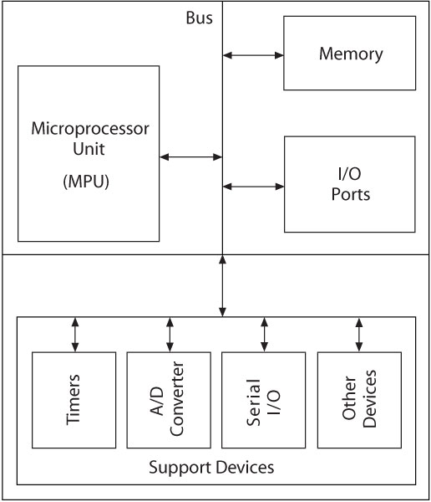
Microcontrollers
Embedded Systems
Operations managed behind the scenes by a microcontroller
Microcontroller (MCU)
An integrated electronic computing device that includes three major components on a single chip
Microprocessor (MPU)
Memory
I/O (Input/Output) ports
10
Notes:
10

Slide 11
Microcontrollers
11
Support Devices (peripheral)
a device attached to a computer
Timers (counting number of pulses)
A/D converter (Analog to Digital )
Serial I/O (example keyboard to main board)
All components connected by common communication lines called the system bus.
Notes:
11

Slide 12
Microcontroller
A smaller computer
On-chip RAM, ROM, I/O ports...
Example：Motorola’s 6811, Intel’s 8051, Zilog’s Z8 and PIC 18
CPU
RAM
ROM
A single chip
Serial COM Port
I/O Port
Timer
Figure 1-1 (b) Microcontroller
12
Notes:
2019/1/29
12

Slide 13
Microprocessor v.s. Microcontroller
Microprocessor
CPU is stand-alone, RAM, ROM, I/O, timer are separate
Designer can decide on the amount of ROM, RAM and I/O ports.
General-purpose
Expensive
Microcontroller
CPU, RAM, ROM, I/O and timer are all on a single chip
Fix amount of on-chip ROM, RAM, I/O ports
Single-purpose
Cheap
For applications in which cost, power and space are critical
13
Notes:
2019/1/29

Slide 14
Section 1.3 Embedded System

Slide 15
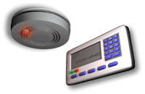

Embedded System
Embedded system means the processor is embedded into that application.
An embedded product uses a microprocessor or microcontroller to do specified tasks only.
In an embedded system, there is only one application software that is typically burned into ROM.
Some embedded products using microcontrollers. Example：printer, keyboard, video game player, door opener, copier, ABS,
fax machine, camera, cellular phone,
keyless entry, microwave...
15
Notes:
2019/1/29
Eg: mouse

Slide 16
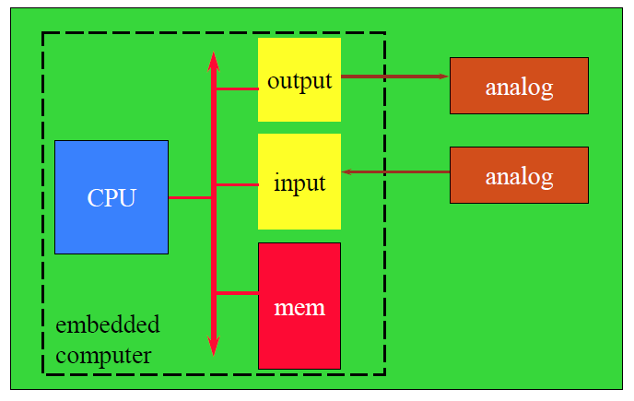
Embedded System
16
Notes:
2019/1/29

Slide 17
Processors in Embedded Systems
Which is your choice for an embedded product？
microcontroller
cost down
embedded processor ＝ microcontroller
In future, an entire computer on a chip
high-end embedded systems may use microprocessors

Slide 18
Three criteria in Choosing a Microcontroller
meeting the computing needs of the task efficiently and cost effectively
speed, the amount of ROM and RAM, the number of I/O ports and timers, size, packaging, power consumption
easy to upgrade
cost per unit
availability of software development tools
assemblers, debuggers, C compilers, emulator, simulator, technical support
wide availability and reliable sources of the microcontrollers.

Slide 19
Basic Data Format (8-bit)
330_01
19
Unsigned Integers: All eight bits (Bit7 to Bit0) represent the magnitude of a number
Range 00 to FF in Hex and 0 to 255 in decimal
Notes:
19

Slide 20
Basic Data Format (8-bit)
330_01
20
Signed Integers: Seven bits (Bit6 to Bit0) represent the magnitude of a number.
The eighth bit (Bit7) represents the sign of a number. The number is positive when Bit7 is zero and negative when Bit7 is one.
Positive numbers: 00 to 7F (0 to 127)
Negative numbers: 80 to FF (-1 to -128)
All negative numbers are represented in 2’s complement
Notes:
20

Slide 21
Basic Data Format (8-bit)
330_01
21
Binary Coded Decimal Numbers (BCD)
8 bits of a number divided into groups of four, and each group represents a decimal digit from 0 to 9
Four-bit combinations from A through F in Hex are invalid in BCD numbers
Example: 0010 0101 represents the binary coding of the decimal number 25 which is different in value from 25_{H}.
Notes:
21

Slide 22
Basic Data Format (8-bit)
330_01
22
American Standard Code for Information Interchange (ASCII)
Seven-bit alphanumeric code with 128 combinations (00 to 7F)
Represents English alphabet, decimal digits from 0 to 9, symbols, and commands
Notes:
22

Slide 23
Section 1.4 Overview of PIC18

Slide 24
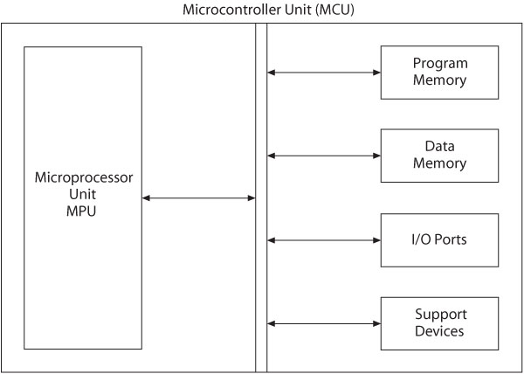
PIC18F Microcontroller Families
PIC microcontrollers are designed using the Harvard Architecture which includes:
Microprocessor unit (MPU)
Program memory for instructions
Data memory for data
I/O ports
Support devices such as timers

Slide 25
Microprocessor Unit
Includes Arithmetic Logic Unit (ALU), Registers, and Control Unit
Arithmetic Logic Unit (ALU)
Instruction decoder
16-bit instructions
Status register that stores flags
5-bits (refresh data)
WREG – working register
8-bit accumulator

Slide 26
Microprocessor Unit
Registers
Program Counter (PC)
21-bit register that holds the program memory address while executing programs
Bank Select Register (BSR) (PIC18F only)
4-bit register used in direct addressing the data memory
File Select Registers (FSRs)
12-bit registers used as memory pointers in indirect addressing data memory
Control unit
Provides timing and control signals to various Read and Write operations

Slide 27
PIC18F - Address Buses
Address bus
21-bit address bus for program memory addressing capacity: 2 MB of memory
12-bit address bus for data memory addressing capacity: 4 KB of memory

Slide 28
Data Bus and Control Signals
Data bus
16-bit instruction/data bus for program memory
8-bit data bus for data memory
Control signals
Read and Write

Slide 29
PIC18F452/4520 Memory
Program Memory: 32 K
Address range: 000000 to 007FFF_{H}
Data Memory: 4 K
Address range: 000 to FFF_{H}
Data EEPROM
Not part of the data memory space
Addressed through special function registers

Slide 30
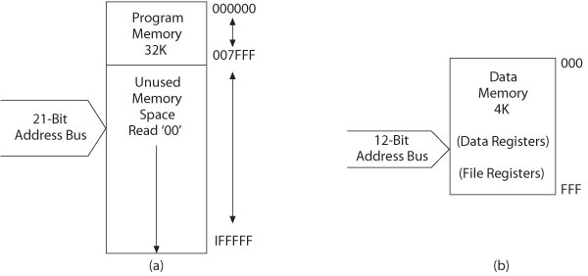
PIC18F452/4520 Memory
Program memory
Data memory

Slide 31
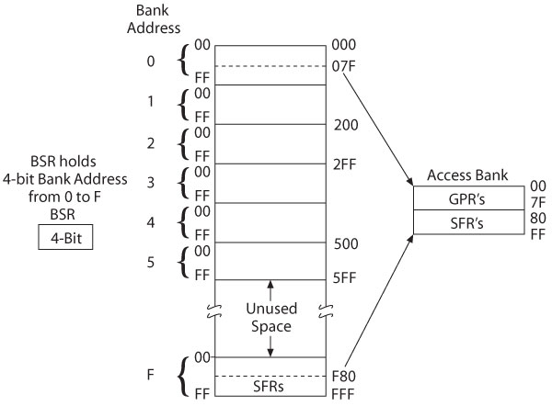
PIC18F452/4520 – Data Memory with Access Banks

Slide 32
PIC18F452 I/O Ports
Five I/O ports
Digital IO is the most fundamental mode of connecting a MCU to external world. The interface is done using what is called a PORT.
The IO ports can be programmed as input or output.
PORT A through PORT E
Most I/O pins are multiplexed
Generally have eight I/O pins with a few exceptions
Addresses already assigned to these ports in the design stage
Each port is identified by its assigned SFR

Slide 33
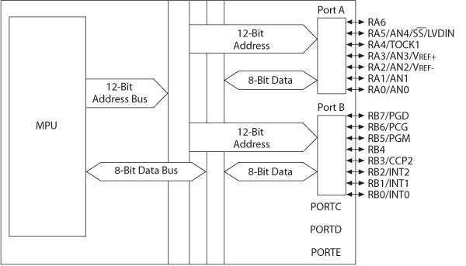
PIC18F452—I/O Ports A and B

Slide 34
MCU Support Devices
Timers
Capture, Compare and PWM (CCP Modules)
Serial Communications
Master Synchronous Serial Port (MSSP)
Addressable USART
A/D converter
Parallel Slave Port (PSP)
Data EEPROM

Slide 35
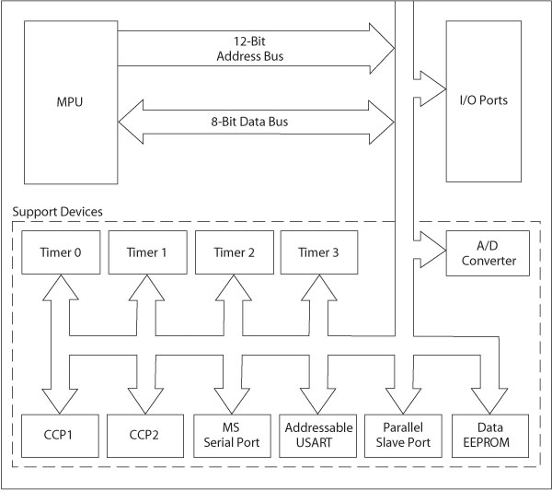
MCU Support Devices

Slide 36
PIC18F Special Features
Sleep mode
Watchdog timer (WDT)
Code protection
In-circuit serial programming
In-circuit debugger
Notes:
WDT : provide program from reset
PIC18F will auto reset itself, thus WDT is needed

Slide 37
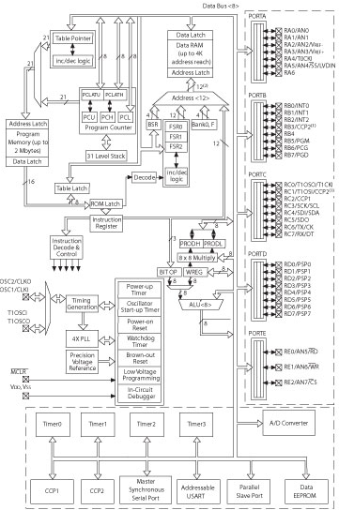
PIC18F4X2 Architecture Block Diagram

Slide 38
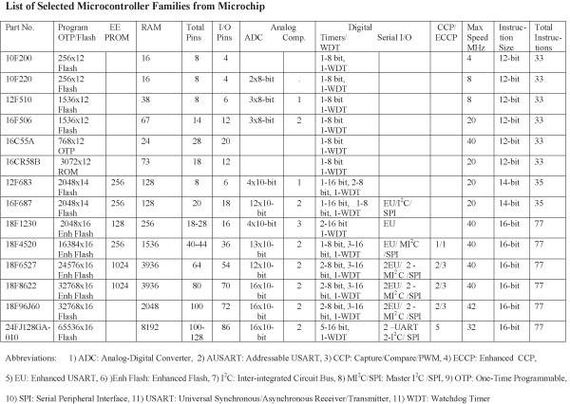

Slide 39
PIC18F Instructions and Assembly Language
Has 77 instructions
Earlier PIC family of microcontrollers have either 33 or 35 instructions
In PIC18F instruction set, all instructions are 16-bit word length except four instructions that are 32-bit length

Slide 40
Instruction Description and Illustrations
Copy (Move) 8-bit number (Literal) into W register
Mnemonics: MOVLW 8-bit
Binary format:
0000 1110 XXXX XXXX (any 8-bit number)
Copy (Move) contents of W register into PORTC (File)
Mnemonics: MOVWF PORTC, a
(‘a’ indicates that PORTC is in the Access Bank)
Binary format:
0110 1110 1000 0010 (82_{H} is PORTC address)
Notes:
Instruction: 2 bytes

Slide 41
Illustrative Program: Displaying a Byte at an I/O Port
Problem statement:
Write instructions to light up alternate LEDs at PORTC
Hardware:
PORTC
bidirectional (input or output) port; should be setup as output port for display
Logic 1 will turn on an LED

Slide 42
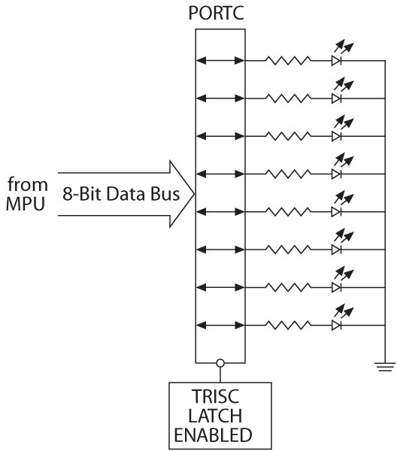
Illustration
Interfacing LEDs to PORTC

Slide 43
Illustration
Program (software)
Logic 0 to TRISC sets up PORTC as an output port
Byte 55_{H} turns on alternate LEDs
MOVLW 00 ;Load W register with 0
MOVWF TRISC,0 ;Set up PORTC as output
MOVLW 0x55 ;Byte 55_{H} to turn on LEDS
MOVWF PORTC,0 ;Turn on LEDs

Slide 44
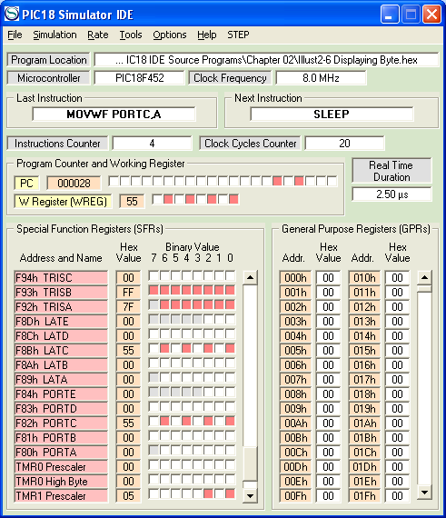
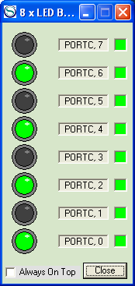
PIC18 Simulator IDE

Slide 45
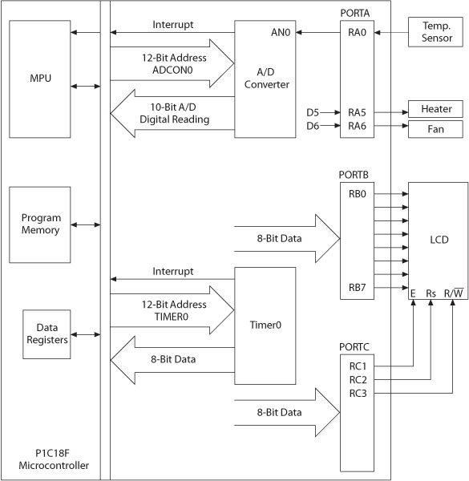
Embedded System
Microcontroller-based
Time and
Temperature
System

Slide 46
You are able to
Compare and contrast microprocessors and microcontrollers
Describe the advantages of microcontrollers for some applications
Explain the concept of embedded systems
Discuss criteria to consider in choosing a microcontroller
Explain the variations of speed, packaging, memory, and cost per unit and how these affect choosing a microcontroller
Some basic feature of PIC18

