Slide 1

Predicting Next-Day Stock Trends Using Machine Learning
Econ 6140 – Machine Learning and Data Science in Economics
Group member : Jianyi Wu 530569

Slide 2
PART ONE
01
Research Questions & Dataset

Slide 3
Research Questions
Motivation:
Daily stock movement prediction is crucial for traders and investors.
Combining quantitative fundamentals and qualitative sentiment adds predictive depth.
Main Question: Can we build a multiclass classification model to predict next-day stock trend (Bullish / Bearish / Stable) using:
Technical indicators
Financial metrics (e.g., P/E ratio, volatility)
Market sentiment scores

Slide 4
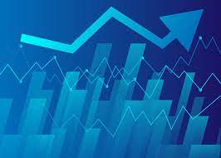
Dataset Description
This study utilizes a historical dataset of S&P 500 stocks from the Kaggle platform, covering the period from February 2013 to February 2018. The dataset includes daily trading information for hundreds of stocks, providing key technical indicators such as opening price, closing price, price volatility, and trading volume. These features form a solid foundation for model training.

Slide 5
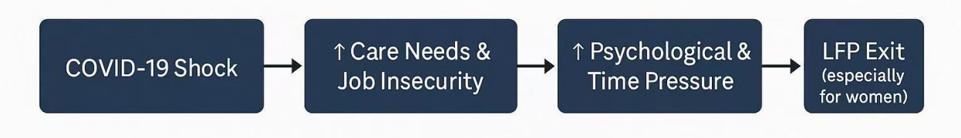
Conceptual Framework
Causal Pathway (Diagram)
Key Insight
The pandemic acted as both a direct shock and an amplifier of pre-existing gender inequalities in labor force attachment.
Mechanisms of Gendered Impact
Care burden: Women disproportionately shoulder caregiving responsibilities (e.g., childcare during school closures).
Sectoral vulnerability: Women are overrepresented in service and frontline sectors more sensitive to COVID-19 disruptions. → These combined factors made women more exposed to labor market exit risk.
.

Slide 6
PART TWO
02
EDA & Visualization

Slide 7
Exploratory Data Analysis
Dataset contains 619,040 observations across 7 columns.
Time range: February 2013 – February 2018
Key columns:
date, open, high, low, close, volume, Name (ticker symbol)
Metric | Mean | Std Dev | Min | 25% | 50% | 75% | Max
Open | 83.02 | 97.38 | 1.62 | 40.22 | 62.59 | 94.37 | 2044
Close | 83.04 | 97.39 | 1.59 | 40.25 | 62.62 | 94.41 | 2049
Volume | 4.32M | 8.69M | 0 | 1.07M | 2.08M | 4.28M | 618M

Slide 8
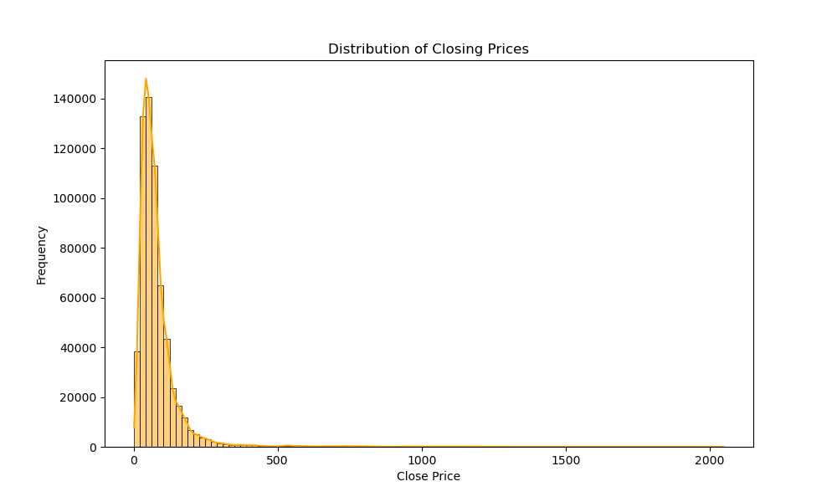
Visualization
The histogram shows a right-skewed distribution of stock closing prices.
Most prices are concentrated between $0 and $150, but a few stocks exceed $2000, indicating the presence of extreme outliers.
This long tail suggests log transformation or outlier clipping may help normalize features for modeling.

Slide 9
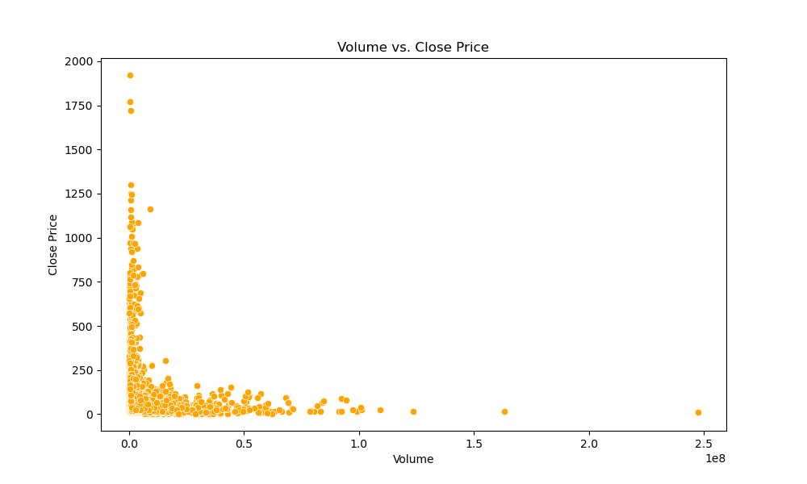
Visualization
A scatter plot of 10,000 sampled records illustrates a negative, non-linear trend.
Low-priced stocks tend to have higher trading volumes.
Highlights the need for normalization and possible segmentation by price category or sector.

Slide 10
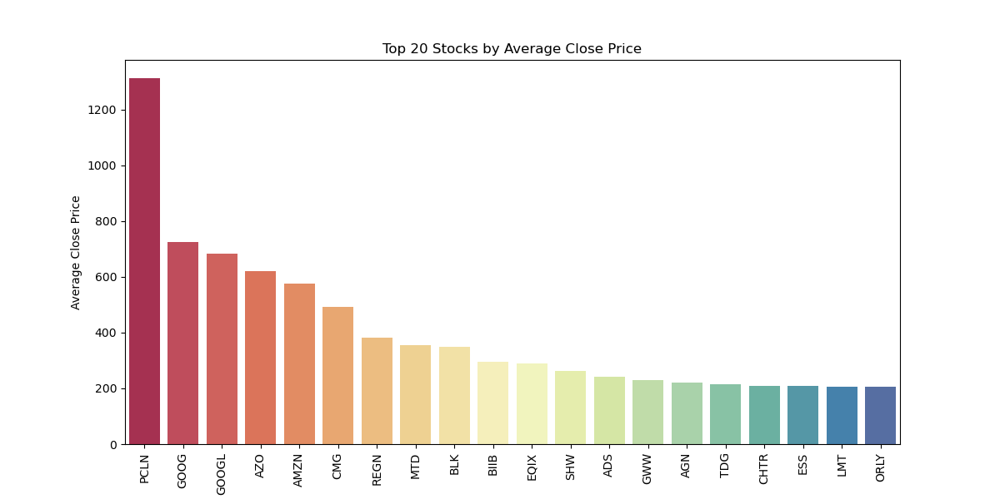
Visualization
The bar plot displays the top 20 stocks sorted by average closing price over five years.
Leaders : PCLN stands out with an average price over $1300.GOOG, GOOGL, and AMZN follow closely.
Indicates price scale varies greatly between companies; model may need stock-specific normalization or industry indicators.

Slide 11
PART THREE
03
Feature Selection & Model Choice

Slide 12
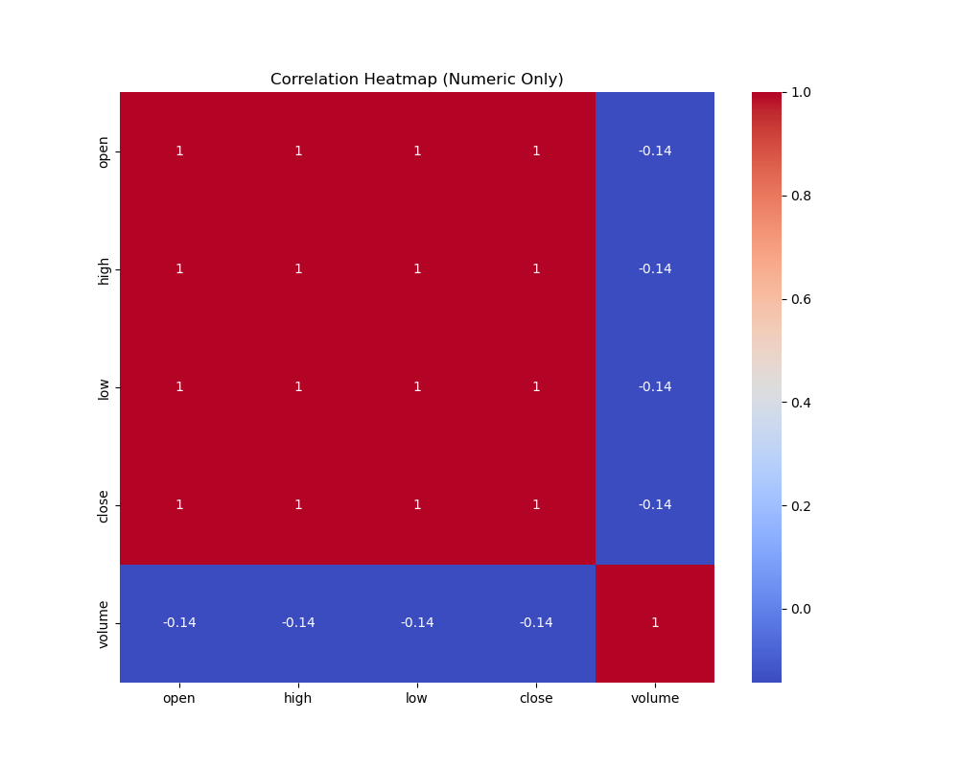
Feature Selection
The heatmap shows strong multicollinearity among price-related features : open, high, low, and close are perfectly correlated (correlation = 1).Including all four in the model would lead to redundant information and potential overfitting.

Slide 13
Feature Selection
Feature Reduction Decision: Retain only one representative price variable, such as:
close price (most commonly used in financial modeling and reflects market consensus).Remove open, high, and low from training set to:
Improve generalization
Reduce dimensionality
Avoid multicollinearity

Slide 14
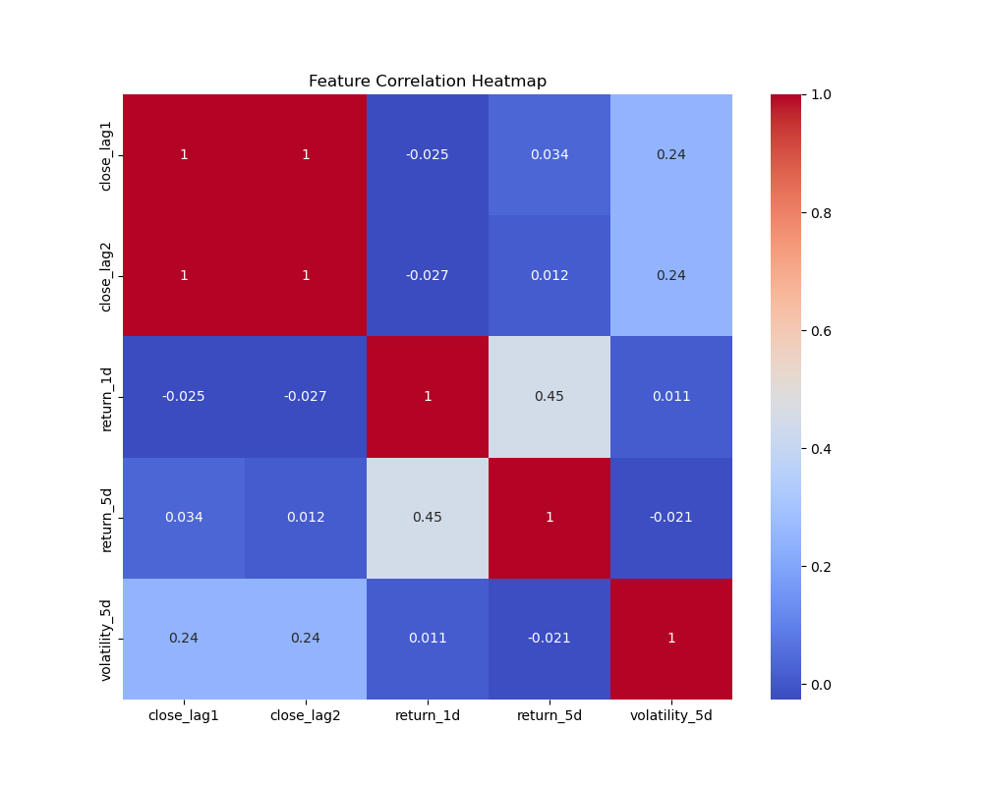
Feature Selection
This heatmap displays correlations among lagged prices, returns, and volatility features
Key Observations:
Perfect multicollinearity between close_lag1 and close_lag2:Correlation = 1 → these features are redundant.
Keep only one (e.g., close_lag1) to reduce overfitting risk.

Slide 15
Model Choice
Random Forest Classifier:
Robust performance on tabular data
Built-in handling of non-linear relationships
Feature importance output for interpretation
Trained on the training set using model. fit(X_train, y_train)
Why Random Forest?
Avoids overfitting better than basic decision trees
Works well with both continuous and categorical inputs
No scaling or normalization required

Slide 16
PART FOUR
04
Results & Conclusions

Slide 17
Results
Baseline Model Performance (Random Forest)
Accuracy: 43.2%
Precision: 48.9%
Recall: 48.2%
F1 Score: 48.6%
Interpretation : The baseline Random Forest model performs significantly better than random guessing (which would be ~33% for a 3-class problem), but still leaves room for improvement.

Slide 18
Results
Tuned Model (GridSearchCV)
Accuracy: 46.4%
Precision: 51.8%
Recall: 51.1%F1
Score: 51.4%
Interpretation:Hyperparameter tuning via GridSearchCV improved all metrics, especially precision and recall, indicating a better balance between false positives and false negatives.

Slide 19
Conclusion
1. Predictive Value ExistsEven with basic features (lagged price, return, volatility), the model achieved:F1 Score > 50% after tuningClear improvement over random guessing (33% baseline for 3 classes)
This shows that stock trend direction is partially predictable using engineered technical features.
2. Model Tuning MattersGridSearchCV enhanced all key metrics:F1 Score increased from 48.6% → 51.4%Accuracy improved from 43.2% → 46.4%
This highlights the importance of hyperparameter optimization even in classical models.

Slide 20
Conclusion
3. Limitations Results are stock-specific (e.g., AAPL);
generalization across sectors/stocks is untested.
Current features exclude news, macro data, and sentiment, which likely carry predictive value.
Class imbalance and market randomness limit achievable accuracy.
4. Future Enhancements
Add text-based features (e.g., sentiment from news or Twitter)
Try cross-stock or sector-specific models
Explore advanced models (e.g., LSTM, transformers for time series)

Slide 21
Thank you
Q & A

