Slide 1
COMP6710 Assignment2
Group Thu11d
Lei Huang u6041747 Wei Wei u6137273 Yuqiang Li u5693650

Slide 2
Summary of content
Use a waterfall methodology to develop our game:
Get the requirement first
Design the UML diagram
Implement the function
Develop our program from tests
Build game UI
Improve user experience

Slide 3
Class Diagram

Slide 4
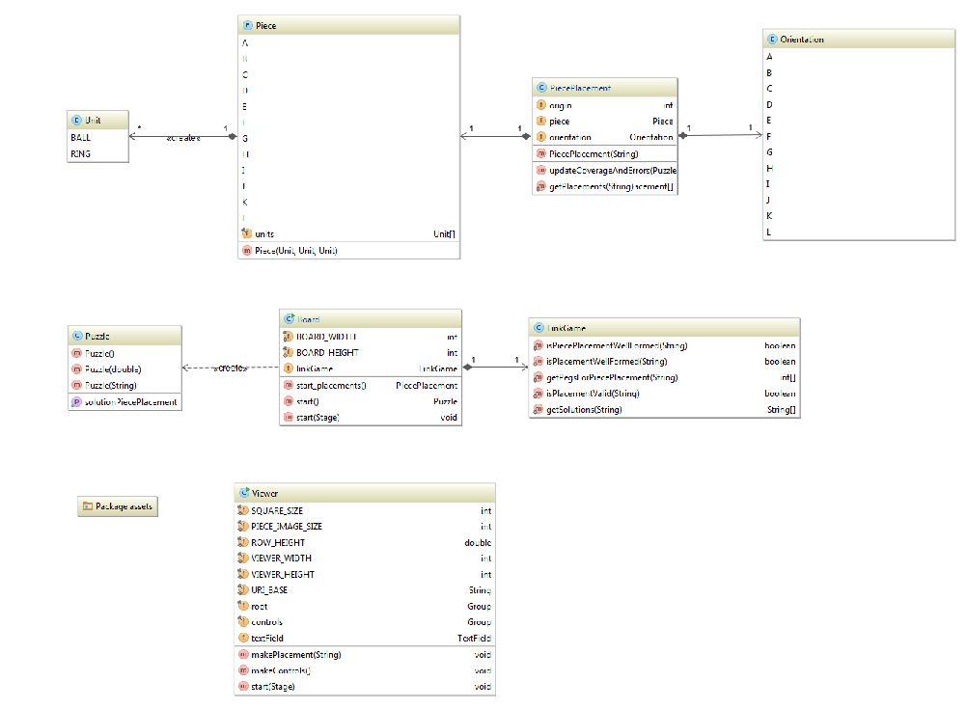

Slide 5
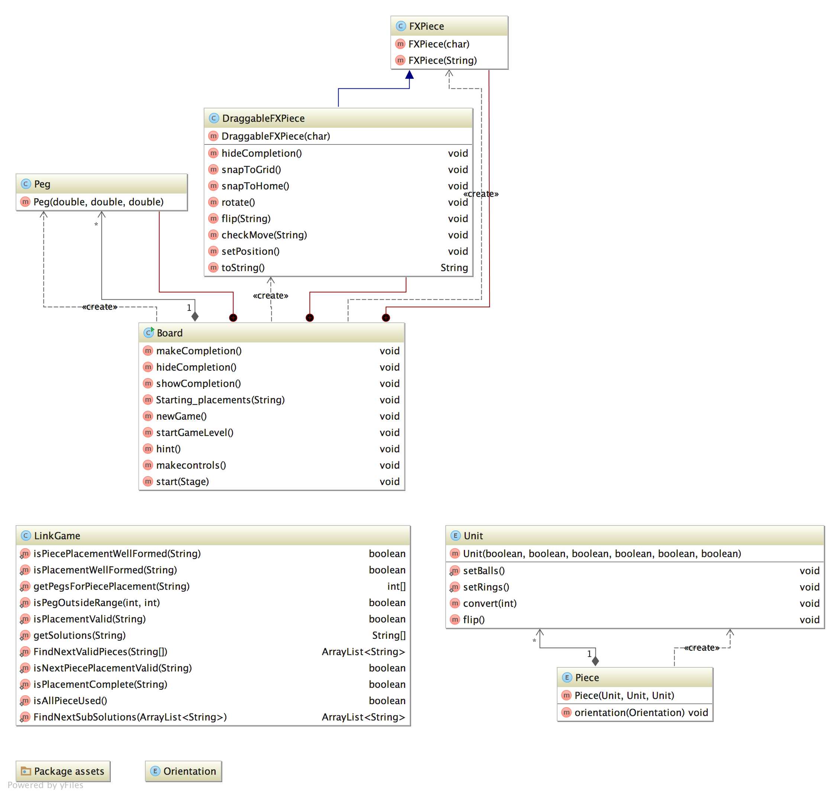

Slide 6
Screen of games

Slide 7
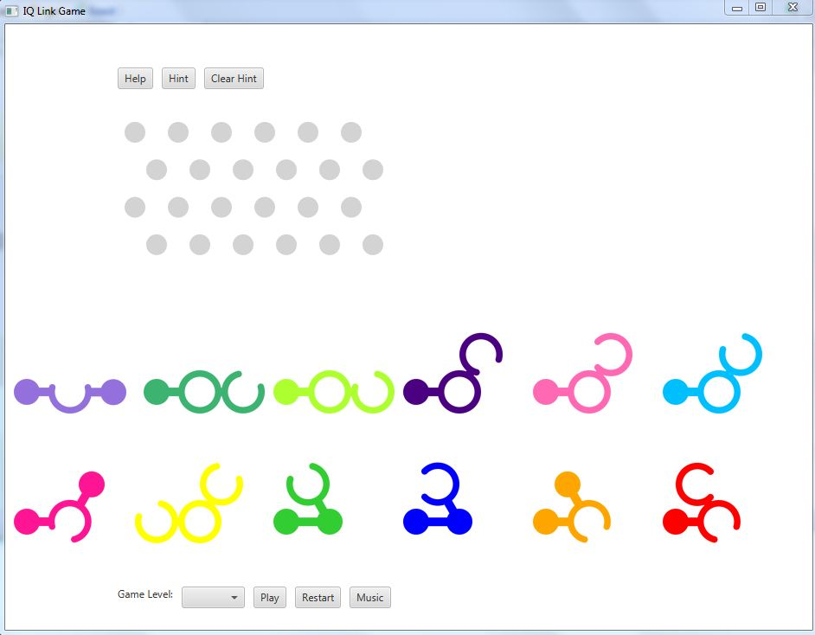

Slide 8
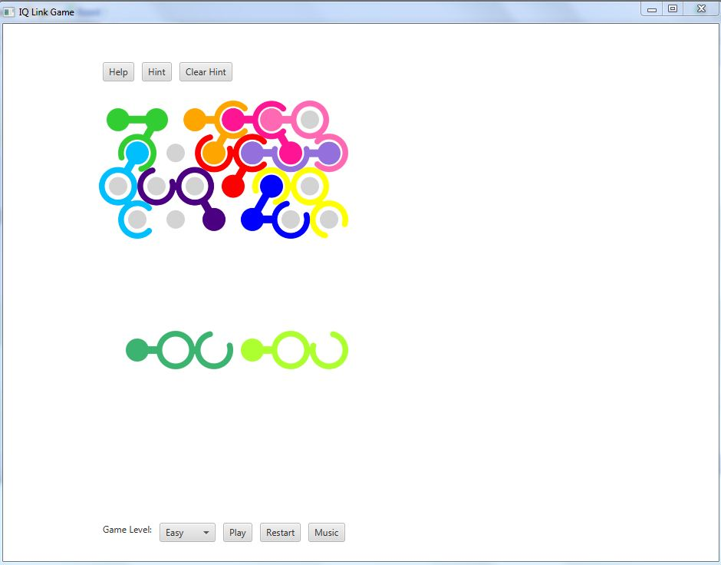

Slide 9
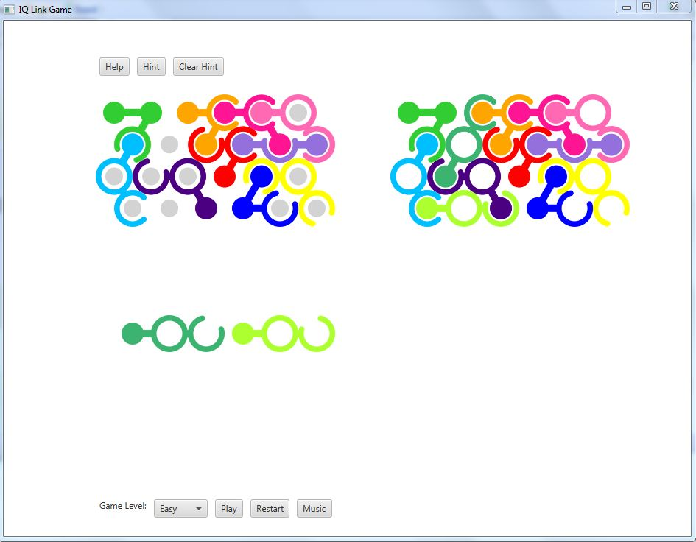

Slide 10
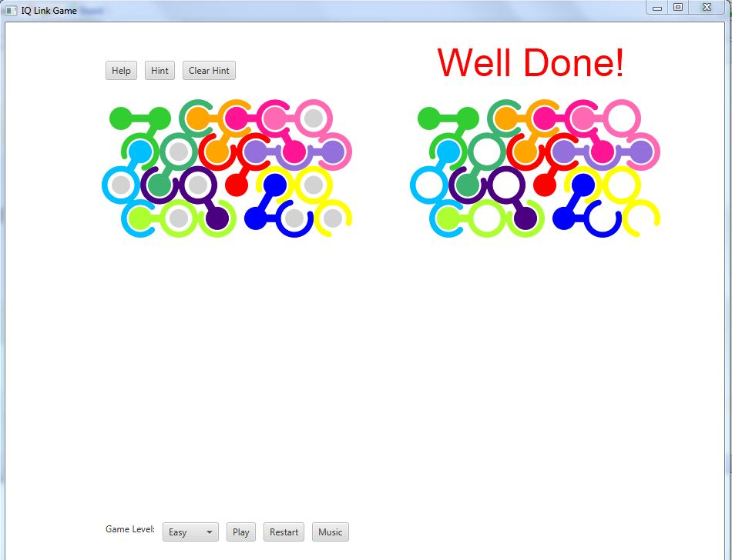

Slide 11
