Slide 1
MEDATHON
PICO-SR
AI-Powered Automated Systematic Review
& Meta-Analysis System
Turning 6–18 months of manual research into 10 minutes of AI automation
· AI Statistical Meta-Analysis · Living Review

Slide 2
WHAT IS THE PROBLEM?
When a doctor wants to know — "Does this treatment actually work?" — they cannot rely on a single study. One study can be wrong, biased, or too small.
The gold standard answer comes from a systematic review and meta-analysis — collecting all published studies on a topic, screening them for quality, extracting the key numbers, and statistically combining them into one reliable conclusion.
This is how clinical guidelines are written. This is how drugs get approved. This is how hospitals decide which treatments to use.
The problem is that this process is done entirely by hand — and it is broken.
18 months
$250K
Average time
Average cost
4–6
30%
Researchers needed
Human error rate
❗ The moment a review is published,
new papers make it outdated.
2

Slide 3
WHY IT IS IMPORTANT ?
Every year, over 1 million new medical research papers are published.
Doctors and policymakers cannot read all of them.
Systematic reviews exist to synthesis this flood of evidence into actionable conclusions.
Without them, medicine reverts to guesswork and opinion.
1 M
Publications per year
❗ When a systematic review is wrong, delayed, or outdated
patients receive the wrong treatment.
Drug approvals get delayed.
Clinical guidelines stay based on old evidence even when newer, better evidence exists.

Slide 4
Real-World Impact
Clinician
A doctor needs the latest evidence, but existing reviews are outdated.
With PICO-SR, she gets updated meta-analysis in minutes using new studies.
Impact: Better treatment decisions, updated in real time.
Researcher
A researcher spends months manually screening and extracting data.
With PICO-SR, this process is automated and completed in days.
Impact: Researchers focus on analysis and insights, not manual work.
Low-Resource Hospital
A hospital with limited resources cannot access updated research easily.
With PICO-SR, a doctor can generate meta-analysis and conclusions quickly using free tools.
Impact: Makes evidence-based medicine accessible to all.
Policymaker
Guidelines are often outdated due to slow review processes.
With PICO-SR, new evidence is automatically updated and analyzed.
Impact: Clinical guidelines stay current and evidence-based.

Slide 5
Project Objective & Target Users
To develop an AI-powered system that automates the process of systematic reviews and meta-analysis.
To reduce time and manual effort involved in searching, screening, and extracting research data.
To provide accurate and up-to-date evidence for decision-making using automated analysis.
To implement a Human-in-the-Loop (HITL) mechanism for improving reliability and validation.
To enable a Living Review system that continuously updates results with new research papers.
To make evidence-based medicine accessible, fast, and scalable for researchers, clinicians, and policymakers.
TARGET USERS
🔬
Medical Researchers
🏥
Hospital Clinicians
📊
Public Health Analysts
🎓
Academic Institutions
💊
Pharma / Drug Review Boards
📋
Health Policymakers
4

Slide 6
Existing Technologies and Their Gaps
✗
Covidence / Rayyan
Only screens papers — no extraction, no statistics
✗
RevMan (Cochrane)
Manual data entry — no automation whatsoever
✗
Abstrackr
Abstract screening only, no PDF parsing or meta-analysis
✗
General LLM Tools
No PICO schema, no statistical pooling, no confidence scoring
PICO-SR addresses ALL of these gaps in a single integrated pipeline.
5

Slide 7
PROPOSED SOLUTION — PICO-SR
An end-to-end AI pipeline that automates the entire systematic review process — from fetching papers to generating a publication-ready meta-analysis report.
1
2
3
4
5
6
Search
Screen
Extract
Validate
Analyse
Report
PubMed + OpenAlex + PMC Full Text
LLM include/exclude + confidence
12-field PICO JSON from full text
CI consistency + HITL flagging
Fixed + random effects meta-analysis
Forest plot + PDF + Living Review
6

Slide 8
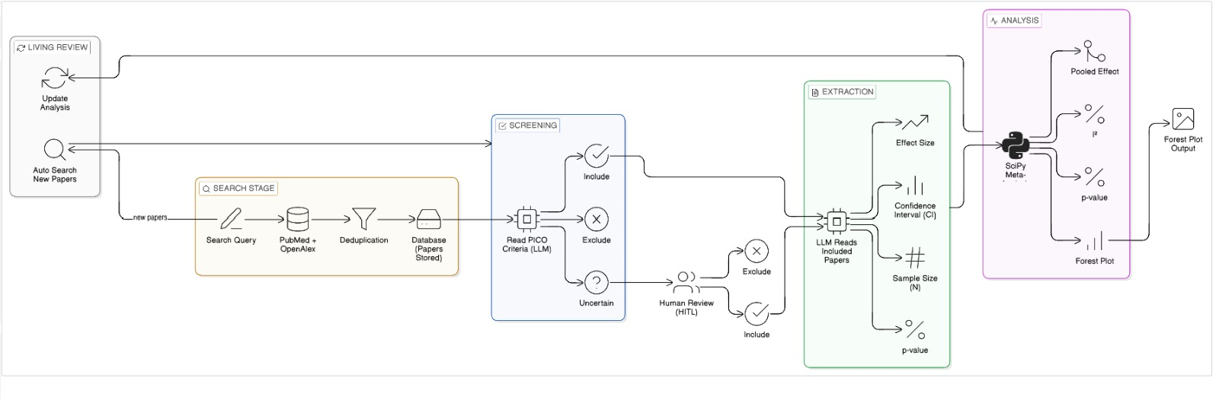
SYSTEM ARCHITECTURE & FLOW

Slide 9
TECHNOLOGY STACK
Data Sources
AI / ML
Backend / Stats
Frontend
· PubMed E-utilities API
· Groq API (Llama 3.1 8B Instant)
· FastAPI (Python REST API)
· Streamlit (Python web UI)
· OpenAlex API (250M papers)
· LLM screening + PICO extraction
· SQLAlchemy + SQLite
· matplotlib — forest plots
· PubMed Central OAI (full text)
· rapidfuzz — fuzzy deduplication
· scipy — statistical pooling
· HITL review interface
· Europe PMC full text XML
· pdfplumber — PDF text extraction
· numpy — matrix operations
· Real-time progress display
· Unpaywall (open-access PDFs)
· Confidence scoring (0.0–1.0)
· APScheduler — living review
· CSV / PDF export
· Semantic Scholar API
· JSON schema validation
· reportlab — PDF report gen
· Living review diff panel
8

Slide 10
KEY FEATURES
🔍
Multi-Source Search
🤖
LLM Screening
PubMed + OpenAlex + PMC full text in one query. Automatic deduplication by DOI and fuzzy title matching.
Groq Llama 3.1 8B screens each paper. Returns include/exclude decision, reason, and confidence score 0–1.
📊
PICO Extraction
✅
Auto Validation
12-field structured JSON extraction. Effect size, CI bounds, p-value, sample size — all with per-field confidence.
Programmatic CI consistency checks. Flags impossible values. Routes low-confidence fields to HITL review.
📈
Meta-Analysis
🔄
Living Review
Fixed + random effects pooling (DerSimonian-Laird). I² heterogeneity. Egger's publication bias test.
PubMed RSS polling every 24h. Auto re-runs pipeline on new papers. Diff report shows how evidence changed.
9

Slide 11
INNOVATION AND UNIQUE CONTRIBUTIONS
01 Explainable AI Screening:
02 AI-Driven Pipeline:
Provides clear reasons and confidence scores for including or excluding each paper, ensuring transparency and trust
Uses LLMs for both screening and data extraction, reducing manual effort
03 Human-in-the-Loop (HITL) Interface
04 Living Review Mode
Uncertain extractions open a side-by-side view: AI output on the left, source text on the right. Researchers correct only the uncertain 10% — AI handles the other 90%.
After a review completes, PubMed RSS is polled every 24 hours. New matching papers are automatically processed and a diff report shows how the pooled evidence has shifted.
10

Slide 12
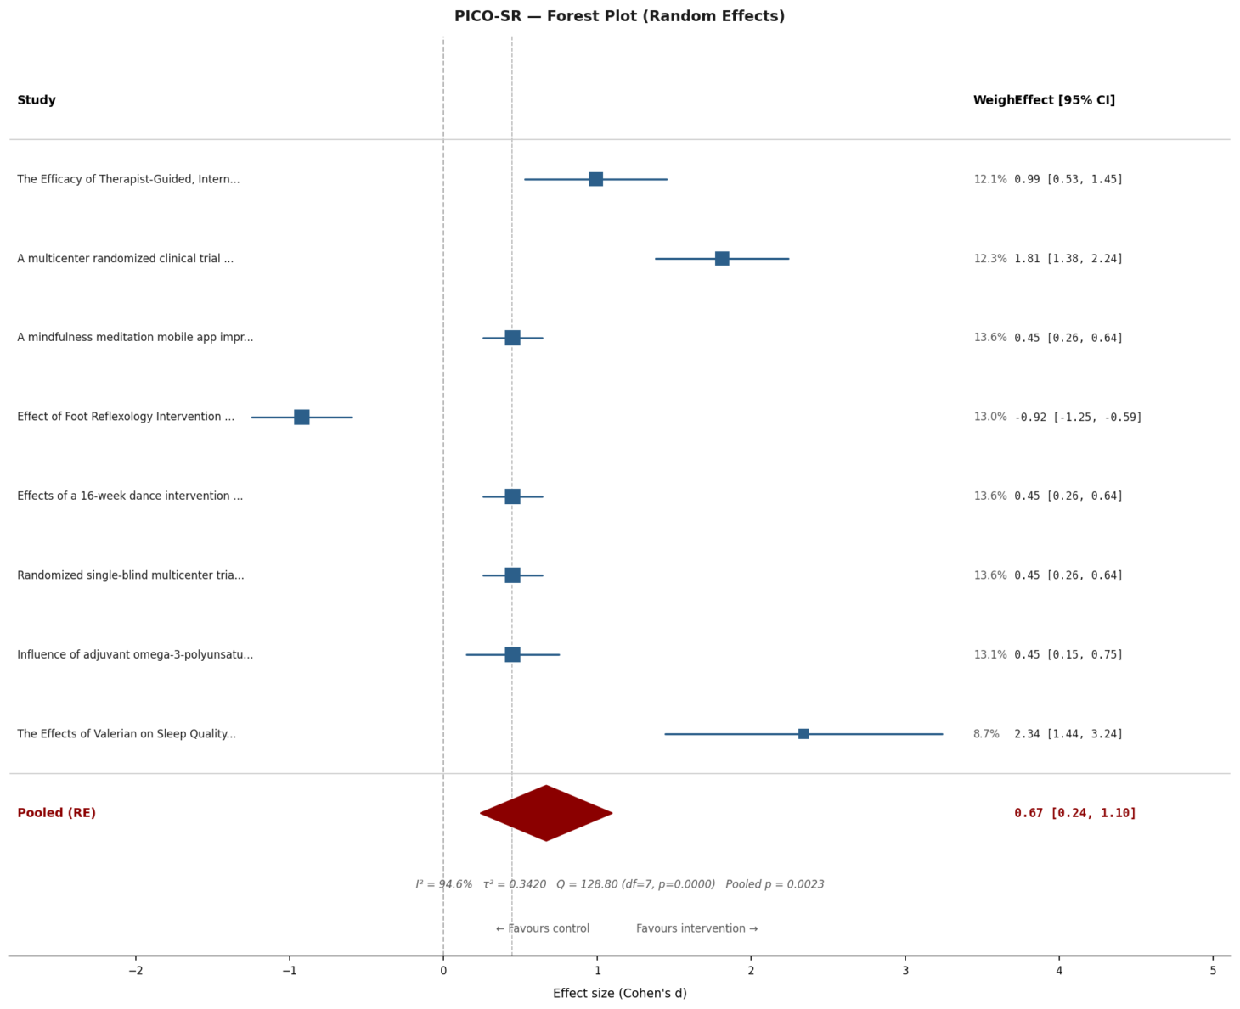
RESULTS & OUTPUT
11

Slide 13
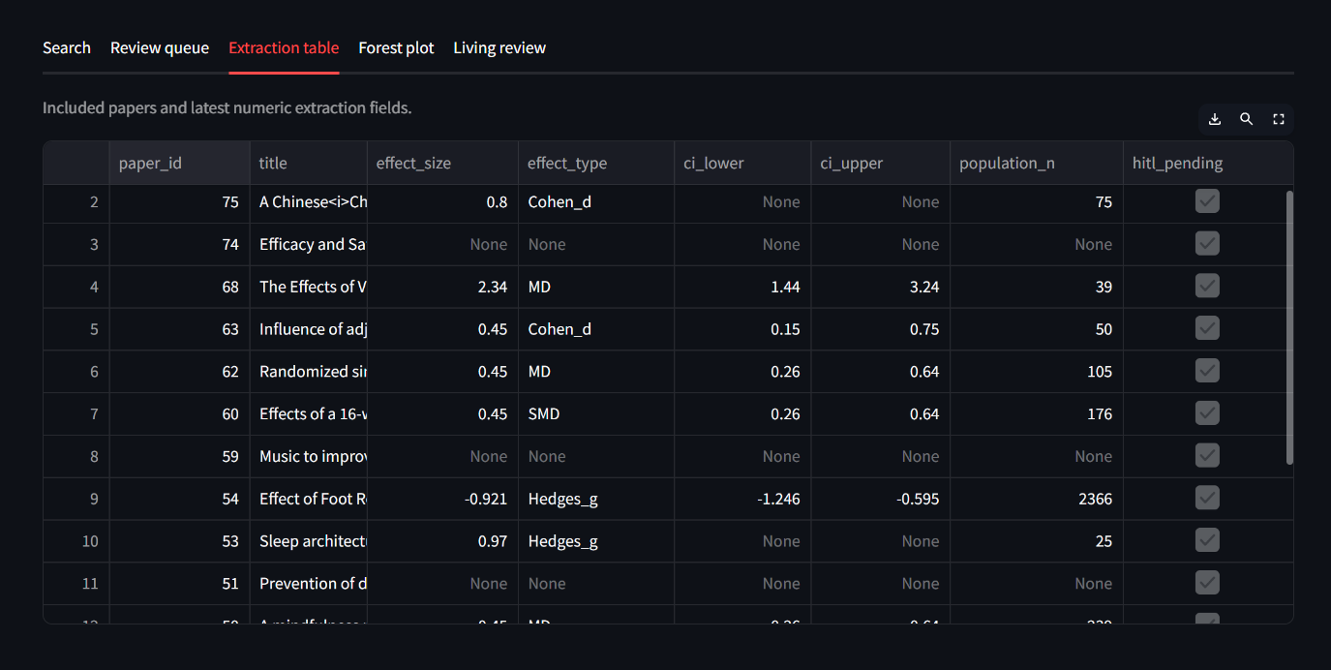

Slide 14
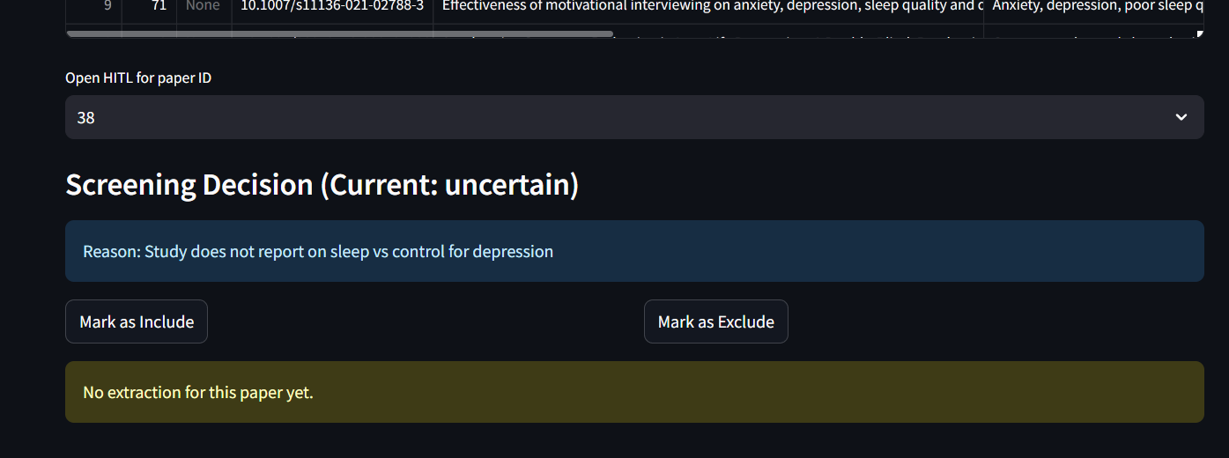

Slide 15
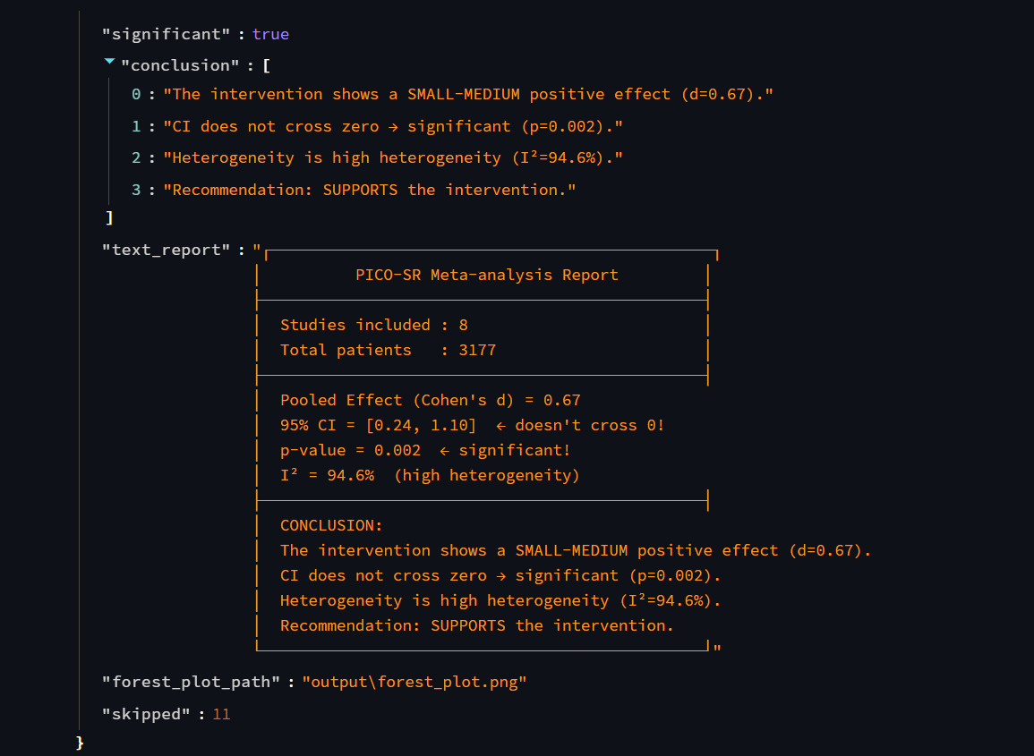

Slide 16
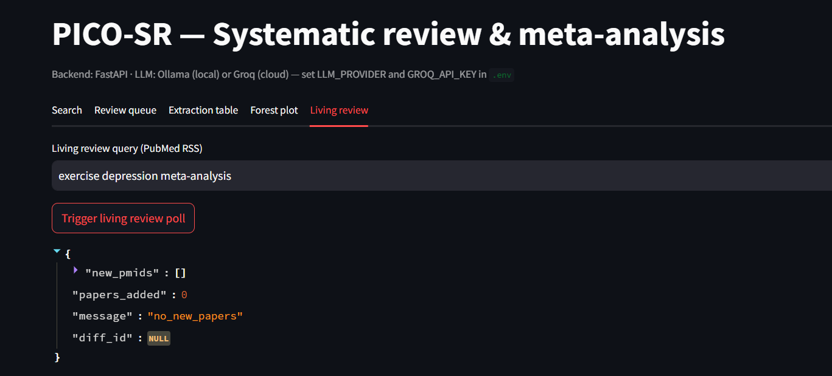

Slide 17
Security & Privacy
🔑
🗄️
🌐
API Key Management
Local SQLite Storage
Public Data Only
All API keys stored in .env file, never hardcoded. Loaded via python-dotenv at runtime only.
All paper data and extractions stored locally. No patient data — only published research metadata.
Sources are PubMed, OpenAlex, PMC — all publicly available academic databases. No private records.
🔒
✅
🛡️
No PHI Processed
Audit Trail
HTTPS APIs
System processes published research papers only. Zero personally identifiable or patient health information.
Every screening decision logged with reason and confidence. Full reproducibility for regulatory review.
All external API calls made over HTTPS. Groq API uses enterprise-grade encryption in transit.
12

Slide 18
Feasibility & Scalability
Scalability
Batch Processing: Handles large numbers of papers efficiently by processing them in smaller batches
Modular Design: Each stage (search, screening, extraction, analysis) can scale independently
Cloud Integration: Can be deployed on cloud platforms to process thousands of papers
Efficient Data Handling: Uses optimized pipelines to reduce time and API load
Living Review System: Continuously scales with new incoming research data
Cost Breakdown — Fully Free
PubMed / OpenAlex / PMC
Free (open APIs)
Groq API (Llama 3.1 8B)
Free tier — 6K tok/min
SQLite storage
Free, local
Streamlit UI
Free, open source
Total infrastructure cost
₹0 / month
13

Slide 19
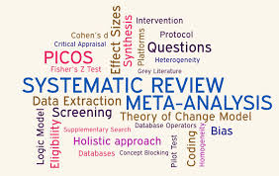
FUTURE WORKS
Advanced NLP Models: Improve extraction accuracy using domain-specific medical models
Better Screening Accuracy: Reduce uncertain cases using improved AI classification
Multi-Database Integration: Extend support to more sources like Scopus, Web of Science
Full PDF Understanding: Enhance deep reading of complete papers for richer data extraction
Automated Bias Detection: Identify study quality and risk of bias automatically
Clinical Integration: Integrate with hospital systems for real-time decision support
4

Slide 20
THANK YOU ☺

