Slide 1

WEBGL
New Technology

Slide 2

WAT IS WEBGL?
Javascript API
based on OpenGl ES 2.0
3D Graphics in <canvas>
GPU
Low-level
WebGl Libraries (three.js,…)

Slide 3
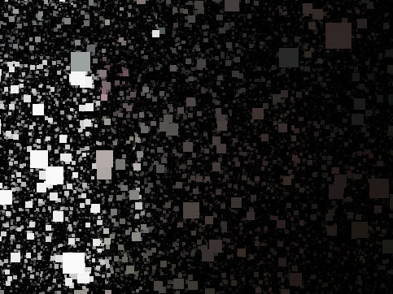
INSTANTIATE

Slide 4
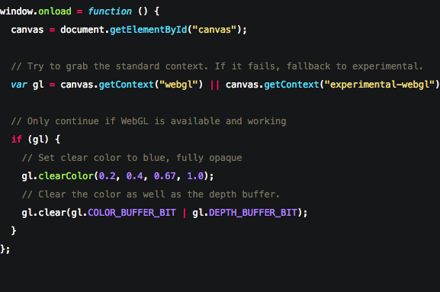
INSTANTIATE WEBGL
<canvas>
Provide fallback

Slide 5
THE RENDERING PIPELINE

Slide 6
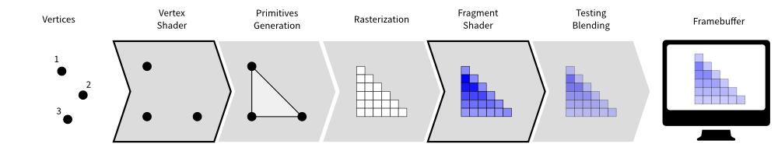
THE RENDERING PIPELINE
(Code to 3D)

Slide 7
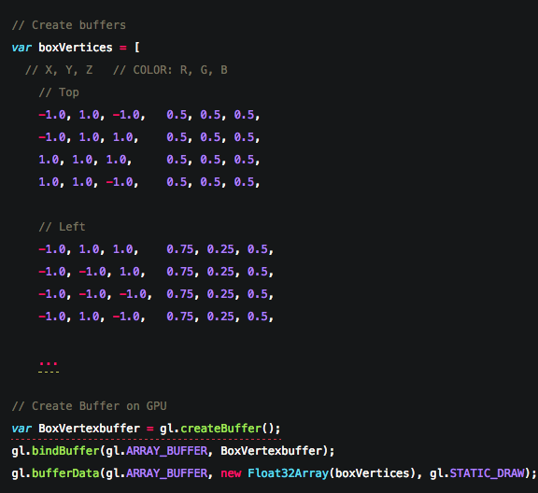
VERTICES
Vertex array
Attributes
Created on CPU
On GPU = vertex buffers
Index array
limit data transfer

Slide 8
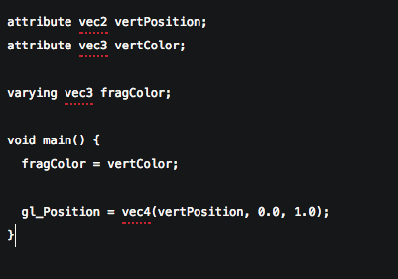
VERTEX SHADER
Use default or own vertex shaders
Calculates position,…

Slide 9
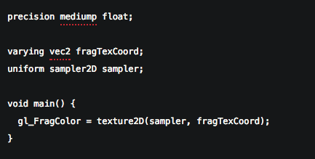
FRAGMENT SHADER
After rasterizer (pixels)
GLSL
Outputs color, lighting, texture mapping

Slide 10
FRAME BUFFER
Final destination
Screen

Slide 11
THE RENDERING PIPELINE
(Code to 3D)

Slide 12
SHADERS

Slide 13
SHADERS
Vertex shader and Fragment shader
Functions
Linked into program
Typically several programs per app
GLSL (Graphics Library Shader Language)

Slide 14
VERTEX SHADERS
clipspace coordinates
Called once per vertex
gl_Position
Needs data
  Attributes (pulled from buffers)
  Uniforms (data that stays the same)
  Textures (data from pixels)

Slide 15
FRAGMENT SHADERS
Provides color to pixel
Called once per pixel
gl_FragColor
Needs data
  Uniforms (data that stays the same)
  Textures (data from pixels)
  Varyings (data passed from the vertex shader)

Slide 16
CODE

