Slide 1
WebGl
VS
Canvas2D
VERGELIJKENDE STUDIE

Slide 2
Feiten

Slide 3
Feiten
WEBGL
Javascript API
<canvas> context
Low-level
2D & 3D
CANVAS 2D
Javascript API
<canvas> context
High-level
2D

Slide 4
BROWSER COMPATIBILITY
WEBGL
Chrome 9
Firefox 4
IE 11 (partially)
Opera 11
Safari 5.1
only 10% mobile support
CANVAS 2D
Chrome 1
Firefox 1.5
IE 9
Opera 9
Safari 9

Slide 5
Complexiteit

Slide 6
LEARNING CURVE
WEBGL
Hard & Long
Low-level
CANVAS 2D
Easy
High-level

Slide 7
EXAMPLE: DRAWING AN IMAGE
WEBGL
Draw A quad (2 triangles)
Provide x&y for every vertex
Attach texture
…
CANVAS 2D
Create image and set x&y coordinates

Slide 8
EXAMPLE: DRAWING AN IMAGE (CODE)
WEBGL
See webgl/sample_1
~140 lines of code
CANVAS 2D
See canvas2D/sample_1
~3 lines of code

Slide 9
PERFORMANCE

Slide 10
PERFORMANCE TEST
Add rectangles to scene
Until fps < 30

Slide 11
PERFORMANCE TEST
WEBGL
Stops at ~1000 objects (safari)=> Buffer data takes time
Stops at ~14000 objects (chrome) => without buffer:
GPU IS FAST! but sending data to it, not so much!
CANVAS 2D
Stops at ~2000 objects (safari)
Stops at ~2000 objects (Chrome)

Slide 12
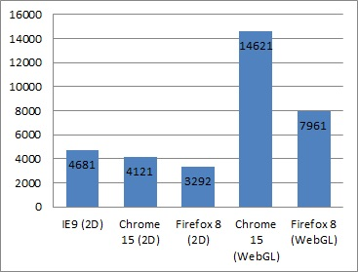
PERFORMANCE TEST (Externe bron)

Slide 13
DRAWING AN IMAGE (Voorbeeld)
WEBGL
See webgl/sample_2
CANVAS 2D
See canvas2D/sample_2

Slide 14
Besluit

Slide 15
Besluit
Canvas 2D is fast but WeBGl is king
Canvas 2D is easier to learn and use
Chrome beats all
GPU Drawing speed will always be faster then you are
WebGl not good for mobile

