Slide 1
Midterm Presentation
Ryman Wong Jens Dekker

Slide 2
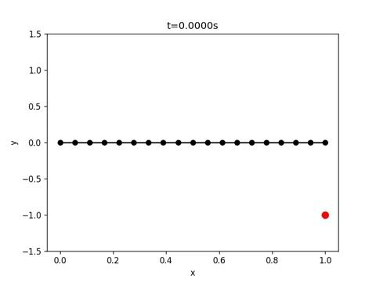
No Load
Notes:
Viscosity = 1000

Slide 3
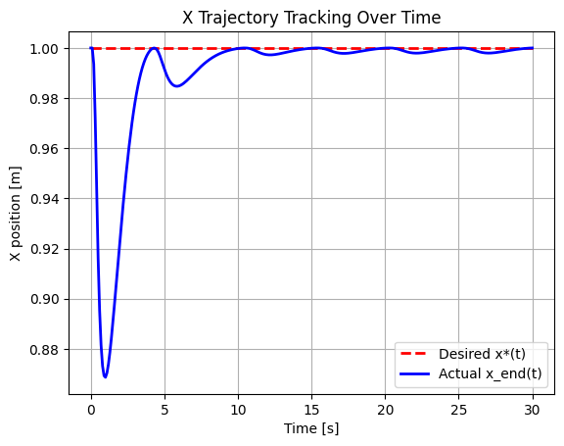
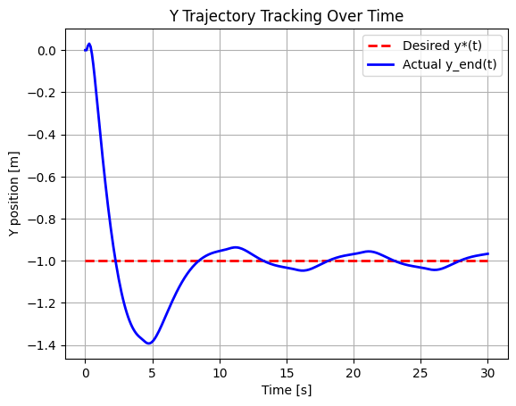
No Load

Slide 4
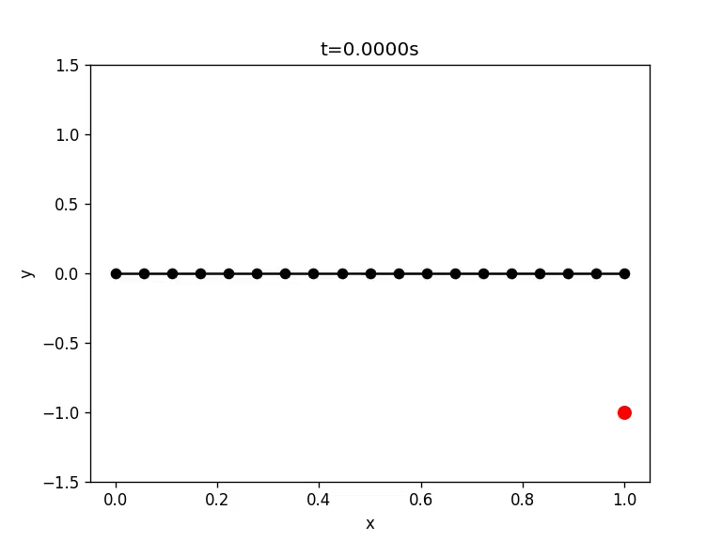
With Hydrodynamic (Low Reynolds Num)
Notes:
Low reynolds number

Slide 5
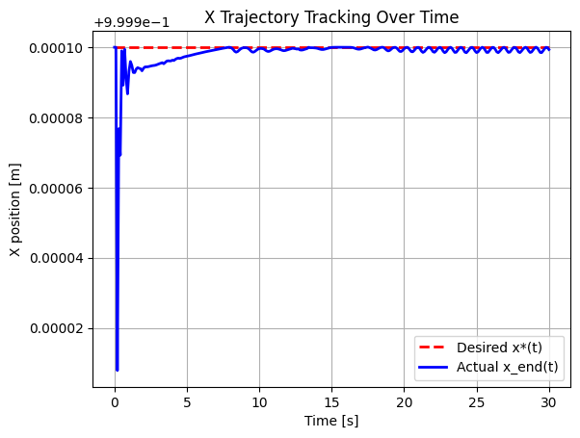
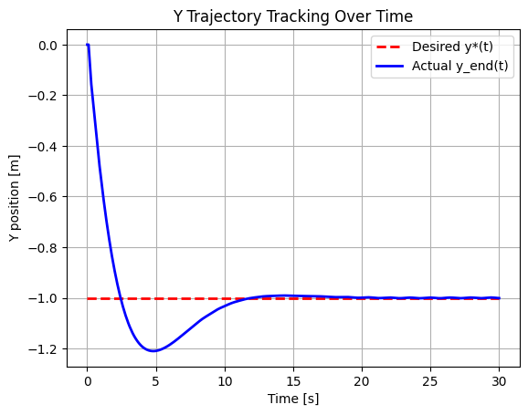
With Hydrodynamic (Low Reynolds Num)
Notes:
Low reynolds number

Slide 6

With Hydrodynamic (High Reynolds Num)
Notes:
rho = 1025
Cd = 1.1
U_f = [0, 1.2]

Slide 7
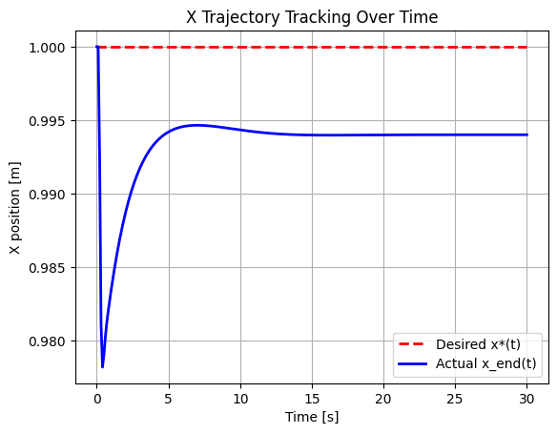
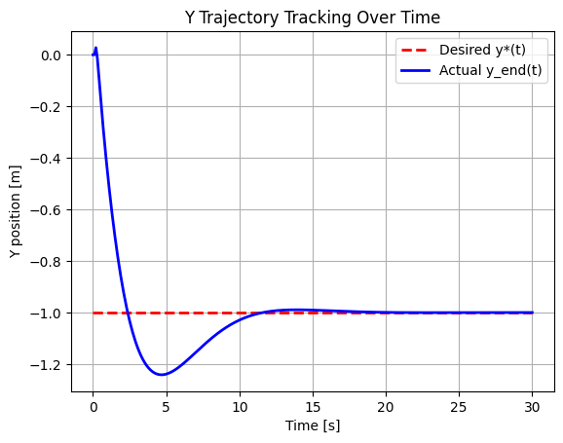
With Hydrodynamic (High Reynolds Num)
Notes:
Low reynolds number

Slide 8
Next Steps
Test and tune for:
Complex Rod Shapes
  Move to 3D
Non-Uniform Flows
  Superimpose multiple flows in 3D
Add Control for End Effector Deformation

