Slide 1
ASP.NET MVC 5
Mirela Gutica Comp 4952
Technical Programming
Computer Science Technology
BCIT

Slide 2
Learning Objectives
Entity Framework
MVC Pattern
ASP.NET MVC Methodology
Code First
Migrations

Slide 3
What is the Entity Framework?
ORM (Object-Relational Mapping) framework
.NET developers can work with relational data using domain-specific objects
Eliminates the need for most of the data-access code
LINQ (Language-Integrated Query) provides patterns for querying and updating data
Entity Framework allows .NET developers to:
issue queries using LINQ (Language-Integrated Query)
retrieve and manipulate data as strongly typed objects
http://msdn.microsoft.com/en-us/library/bb399567.aspx

Slide 4
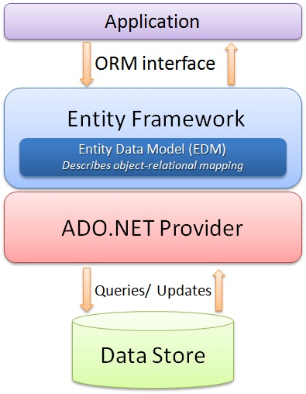
Diagram

Slide 5
Functions
Performs basic CRUD (Create, Read, Update, Delete) operations
Manages "1 to 1", "1 to many", and "many to many" relationships
Ability to have inheritance relationships between entities

Slide 6
Entity Data Model
Conceptual Model: classes and their relationships
This will be independent from your database table design
Storage Model: database design model which includes tables, views, stored procedures and their relationships and keys
Mapping: information about how the conceptual model is mapped to storage model
Readings: http://msdn.microsoft.com/en-us/library/gg696169(VS.103).aspx

Slide 7
Entity Lifecycle
During entity’s lifetime, each entity has an entity state based on operation performed on it via Context (ObjectContext)
The entity state is an enum of type System.Data.EntityState that declares the following values:
Added
Deleted
Modified
Unchanged
Detached
The Context holds the entity states and maintains modifications to the properties of the entity (Change Tracking)

Slide 8
Entity Framework Models
Code First
Model First
Database First

Slide 9
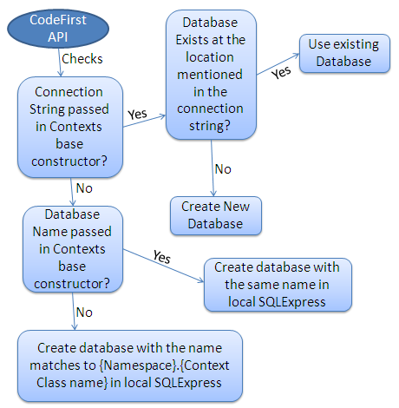
Code First API

Slide 10
Create the Data Access Layer
Create the models
Seed the database
Configure the application to use the database

Slide 11
What is MVC?
Model–view–controller (MVC) is a software architecture and pattern used in software engineering
The idea behind this pattern is to isolate the application logic (logic domain ) from the UI allowing for independent design, implementation, testing and maintenance of each
motivations of the MVC pattern is to make the model independent
This pattern is not new; MVC was first described in 1979 by Trygve Reenskaug, then working on Smalltalk

Slide 12
MVC (Model, View and Controller)
Model: represents the underlying, logical structure of data in a software application
Responds to requests for info about its state from the view
Responds to instructions to change the state (from the controller)
Controller: interprets mouse and keyboard inputs
Updates the model to reflect a change in state of the application
Informs the view of changes
View: receives information from controller and renders and displays that information on a user interface

Slide 13
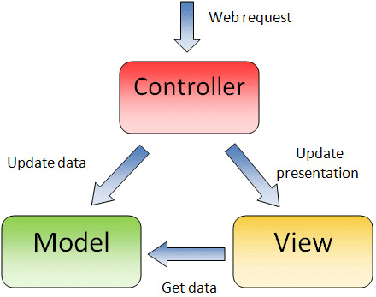
MVC Architecture
http://msdotnetsol.blogspot.ca/2013/10/mvc-model-view-controller-architecture.html

Slide 14
Considerations
Both the view and the controller depend on the model
The model depends on neither the view nor the controller
This separation allows the model to be built and tested independent
The separation between view and controller is secondary
In Web applications the separation between view (the browser) and controller (the code handling the HTTP request) is well defined

Slide 15
MVC Passive Model
The controller manipulates the model exclusively
The controller modifies the model and then informs the view that the model has changed and should be refreshed
The model in this scenario is completely independent of the view and the controller
The HTTP protocol is an example of this model
Browser display the view and respond to user input, but it does not detect changes in the data on the server

Slide 16
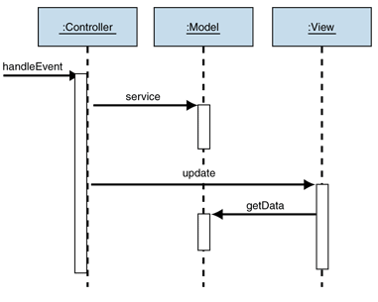
MVC Passive Model Diagram
http://msdn.microsoft.com/en-us/library/ff649643.aspx

Slide 17
MVC Active Model: Observer
The active model is used when the model changes state without the controller's involvement
other sources are changing the data and the changes must be reflected in the views
Therefore, the model must notify the views to refresh the display -> unwanted dependency model – view
Observer: alert other objects of state changes without introducing dependencies on them
This approach is often called “publish-subscribe”
The controller and the view implement the Observer interface and subscribe to model changes

Slide 18
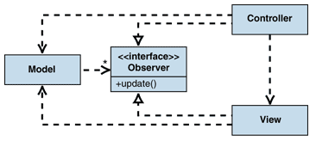
MVC Active Model: Observer Diagram
http://msdn.microsoft.com/en-us/library/ff649643.aspx

Slide 19
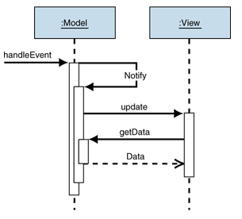
MVC Active Model: Observer Diagram (2)
http://msdn.microsoft.com/en-us/library/ff649643.aspx

Slide 20
ASP.NET MVC 5 Overview
The ASP.NET MVC framework provides an alternative to ASP.NET Web Forms http://www.asp.net/mvc
Lightweight, testable, integrated with existing ASP.NET features
Clean separation of concerns
Defined in System.Web.Mvc namespace (part of the System.Web namespace)
It is possible to combine Web Forms with MVC in one application (not recommended)

Slide 21
ASP.NET MVC
Model: model objects retrieve and store model state in a database
Product object: retrieve information from a database, operate on it, and write updated information back to a Products table
Controller: code that handle user interaction, work with the model, and select a view to render the information
I.e. controller handles query-string values
View: code that display the user interface
Textboxes, drop-down lists, gridview, listview, etc.

Slide 22
ASP.NET MVC Methodology
Create the Model
Create the database model: Create a set of classes to represent the database.
Use the Microsoft Entity Framework to generate the classes for the database model automatically
The three approaches are available:
Code-First
DB-First
Model-First
Create Controllers
Add Views
ASP.NET MVC 5 Overview:
http://www.youtube.com/watch?v=gxFtRdKr7CA

Slide 23
Exercise 1: Create a New Project
Create a new project
Observe that for MVC you can add folders and co-references (e.g., Web Forms)
Observe the controllers already created and their actions:
HomeController
Account
Run the application
Observe authentication
No/Individual/Organization accounts/Windows
Enable authentication with Google, Facebook, Twitter
Observe the responsive design

Slide 24
Exercise 1: Enable Authentication - Google Accounts
In App_Start in Startup.Auth.cs:
Uncomment the following code and add the values for ClientID and ClientSecret
app.UseGoogleAuthentication(new GoogleOAuth2AuthenticationOptions()
{
ClientId = "000000000000000.apps.googleusercontent.com",
ClientSecret = "000000000000000"
});
}
Run the application: observe login with Google account

Slide 25
Exercise 1: Add a Controller
Start with an MVC application
Notice the folders that have been crated: Content, Models, Scripts, Views
If you want to add a controller, just right click on “Controllers” and choose Add.
Add a new controller: DemoController
The new controller is a class (i.e. DemoController) and has an Index() action
When the user calls the DemoController from the browser, it will call the Index() function which returns a view

Slide 26
Controller Code
public class DemoController : Controller
{
//
// GET: Demo
public ActionResult Index()
{
return View();
}
}

Slide 27
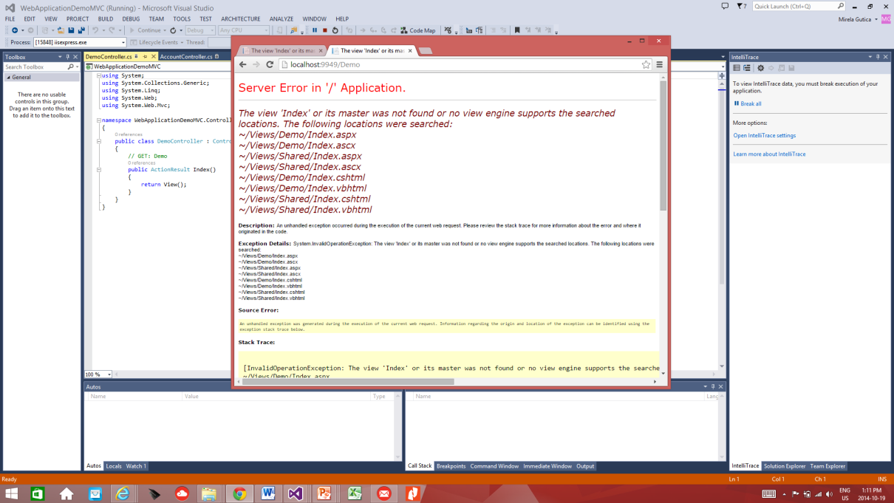
Exercise 1: Add a Controller (2)
Run the Application:
http://localhost:9949/Demo
Error: there is no view
Add a view

Slide 28
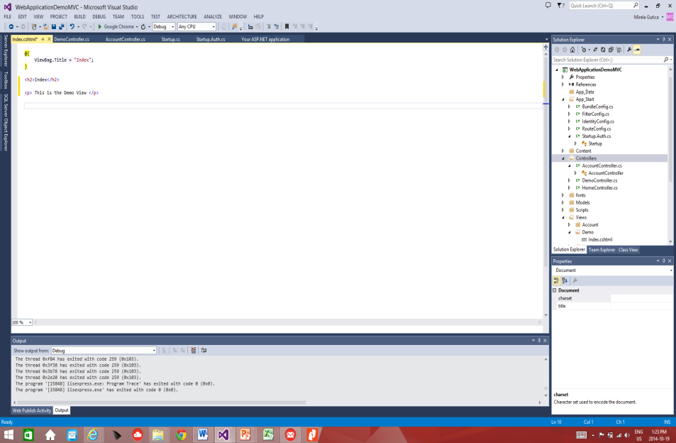
Exercise 1: Add a View
Right click on the ActionResult in the DemoController and select: Add View
Explore the templates
Select Empty (without model) – we do not have a model!
The view has an Index.aspx page which will be called when DemoController will be called:
Run the Application:
http://localhost:9949/Demo/Index

Slide 29
We Need Models
Code First/Model First/ DB First
Add models to the MVC application.
A model is a class containing the business logic
Then, an object of that class will be instantiated in the controller
The object’s data will be exposed with the View
You need the following classes:
Step 1: Classes that represent the entity classes (products, categories, sub-categories, etc.)
Step 2: A context class derived from DbContext
using System.Data.Entity;
Step 3: An initializer class
Used for DB initialization

Slide 30
Code-First Approach (1)
(1)Understand the problem and design the model
(2) Create the model classes
(3) Assign the classes that need to be tables in the database: create the Context Class (e.g. StudentContext) that extends DbContext (class in Entity Framework) with all classes that represent tables
Enables CRUD
Note: Some model classes are not intended to represent database tables: they are only business logic classes!

Slide 31
Code-First Approach (2)
(4) Set the location and name of the database
Local DB:
In the application Web.Config make a copy of the connection string
Replace DefaultConnection with the name of the context class (e.g. StudentContext)
Replace the mdf file with the database name (e.g., Student.mdf)
Useful site: http://www.connectionstrings.com/
(5) Initialize the data: create a class (e.g. InitializerDB.cs) that inherits from the EF class DropCreateDatabaseIfModelChanges
Override the Seed method of DropCreateDatabaseIfModelChanges
Create lists of objects and add to the context

Slide 32
Code-First Approach (3)
(6) Set the database initializer in Global.asax in Application_Start()
Database.SetInitializer<StudentContext>(new InitializerDB());
(7) Add the navigation links to Views/Shared/Layout
<li>@Html.ActionLink("Programs", "Index", "Programs")</li>
<li>@Html.ActionLink("Students", "Index", "Students")</li>
(8) Create the Controllers using the appropriate model class and context
Rebuild the application
Create new controllers or you can write code in an existing controller
The Index method will call the appropriate view
return View(db.Programs.ToList());
(9) Display data in the View
Automatically the default view is created when the controller is created

Slide 33
Code-First Approach (4)
The database will be created when the application is run
Click the icon “Show All Files” and view the database
Include the database in the project

Slide 34
In Class Activity
Create anASP.NET MVC 5 application that
Has two pages: Product and Category.
A Category can have several Products

Slide 35
In Class Activity: Add Models
Right-click the Model folder and add classes:
Product class
Category class
Context class
Initializer class

Slide 36
Entity Class Category
using System.ComponentModel.DataAnnotations;
public class Category
{
[ScaffoldColumn(false)]
public int CategoryID { get; set; }
[Required, StringLength(200), Display(Name = "Name")]
public string CategoryName { get; set; }
[Display(Name = "Product Description")]
public string Description { get; set; }
// collection of products
public virtual ICollection<Product> Products { get; set; }
}

Slide 37
Entity Class Product
using System.ComponentModel.DataAnnotations;
public class Product
{
[ScaffoldColumn(false)]
public int ProductID { get; set; }
[Required, StringLength(100), Display(Name = "Name")]
public string ProductName { get; set; }
[Required, StringLength(10000), Display(Name = "Product Description"), DataType(DataType.MultilineText)]
public string Description { get; set; }
public string ImagePath { get; set; }
[Display(Name = "Price")]
public double? UnitPrice { get; set; }
public int? CategoryID { get; set; }
// virtual property for the product
public virtual Category Category { get; set; }
}
}

Slide 38
Data Annotations
Data annotation attributes describe:
how to validate user input for that member
specify formatting
specify how the member is modeled
[ScaffoldColumn(false)]
False for columns like ID
Specifies whether a class or data column uses scaffolding
Scaffolding is the mechanism for generating web page templates (views) based on database schemas
[Required, StringLength(100), Display(Name = "Name")]
[Display(Name = "Product Description")]

Slide 39
Context Class
Manages the entity classes and provides data access to the database
public class ProductContext : DbContext
{
public ProductContext()
: base("ArtStore") { }
public DbSet<Category> Categories { get; set; }
public DbSet<Product> Products { get; set; }
}

Slide 40
Modify Web.Config
Set the location and name of the database
Local DB:
In the application Web.Config make a copy of the connection string
Replace DefaultConnection with the name of the context class (e.g. StudentContext)
Replace the mdf file with the database name (e.g., Student.mdf)
Useful site: http://www.connectionstrings.com/

Slide 41
DB Initializer Class
Custom logic to initialize the database for the first time when the context is used
Contains the Seed() class and static methods for content
Inherits DropCreateDatabaseIfModelChanges
To recognize if the model (schema) has changed before resetting the seed data
If no changes are made to the entity classes, the database will not be reinitialized with the seed data

Slide 42
Initializer Class (2)
using System.Data.Entity;
namespace ArtSupplyStore.Models
{
public class ProductDatabaseInitializer: DropCreateDatabaseIfModelChanges<ProductContext>
{
protected override void Seed(ProductContext context)
{
base.Seed(context);
}
private static List<Category> GetCategories()
{
var categories = new List<Category>
{
};
return categories;
}
private static List<Product> GetProducts()
{
var products = new List<Product>
{
};
return products;
}
}
}

Slide 43
Initializer Class (3)
using System.Data.Entity;
public class ProductDatabaseInitializer : DropCreateDatabaseIfModelChanges<ProductContext>
{
protected override void Seed(ProductContext context)
{
GetCategories().ForEach(c => context.Categories.Add(c));
GetProducts().ForEach(p => context.Products.Add(p));
}
private static List<Category> GetCategories()
{
var categories = new List<Category>
{
new Category
{
CategoryID = 1,
CategoryName = "Media"
}, ….
}

Slide 44
Add Controllers (2)
Add two Controllers: CategoriesController and ProductsController
Select MVC 5 Controllers with views using Entity Framework
Select the models that were created
Connect to the product context
in Data context class select: ProductContext (ArtStore.Models)

Slide 45
Asynchronous Controller
The AsyncController class enables developers to write asynchronous action methods
Asynchronous controllers avoid blocking the Web server from performing work while the request is being processed
A typical use for the AsyncController class is long-running Web service calls

Slide 46
Modify Global.asax
Set the database initializer in Global.asax in Application_Start()
Database.SetInitializer<StudentContext>(new InitializerDB());

Slide 47
Add links to the New Controllers
Add the navigation links to Views/Shared/Layout
<li>@Html.ActionLink("Categories", "Index", "Categories")</li>
<li>@Html.ActionLink("Products", "Index", "Products")</li>

Slide 48
Add Data
Add data using Create New
Observe the database content

Slide 49
Enable Code First Migrations
If data model changes, the model changes and gets out of sync with the database
Configure the Entity Framework to automatically drop and re-create the database each time you change the data model
When entity classes are added, removed, or changed, or the DbContext class is changed, the next time the application runs it automatically deletes the existing database, creates a new one, and seeds it with test data
http://www.asp.net/mvc/tutorials/getting-started-with-ef-using-mvc/migrations-and-deployment-with-the-entity-framework-in-an-asp-net-mvc-application

Slide 50
Enable Code First Migrations (2)
Use the Tools/NuGet Package Manager/ Package Manager Console
PM> enable-migrations
PM> update-database
You might need to set in Migrations/Configuration.cs:
AutomaticMigrationsEnabled = true;
AutomaticMigrationDataLossAllowed = true;

