Slide 1
The Windows Operating System
Concepts and Tools
Mirela Gutica
Technical Programming
BCIT

Slide 2
Textbook
Microsoft Windows Internals, 6th Edition Part 1 and Part 2; Mark E. Russinovich, David A. Solomon, Alex Ionescu, Microsoft Press, December 2012
http://materias.fi.uba.ar/7508/Windows/Windows%20Internals%20Part%201%20(6th%20Edition).pdf
http://longfiles.com/jg6unpk6uwfl/Windows_Internals_2C_6th_ed._2C_vol._2_-_2012.pdf.html

Slide 3
.NET Group
http://netbc.ca/DNCal/NetBcEvents.aspx

Slide 4
Windows OS Introduction
Windows history (see Table 1-1)
Windows application programming interface (API) is the user-mode system programming interface to the Windows operating system family:
Base Services
Component Services
User Interface Services
Graphics and Multimedia Services
Messaging and Collaboration
Networking
Web Services
Term service is ambiguous and context dependant: can refer to a callable routine in the operating system, a device driver, or a server process

Slide 5
Win32 API
Windows API is the primary programming interface to the Microsoft Windows Operating System
Each Windows OS (ME,CE,98,95, 2000, XP, 7, 8) implemented a different subset of Windows API
Windows has a superset of all implementations
Term Windows API refers to both the 32-bit and 64-bit programming interfaces to Windows
A comprehensive documentation can be found at msdn.microsoft.com or in the Platform SDK (e.g., Win32api.csv)

Slide 6
Programming Interfaces
Windows supports multiple programming interfaces with low-level access
Win32, Win64
POSIX (Portable Operating System Interface for Unix)
Win32/64 has the greatest access to system services
Windows applications don’t call native system services directly, rather they use API calls
Other Windows APIs:
Windows® API Code Pack for Microsoft®
.NET Framework
Direct X

Slide 7
Jobs, Processes, Threads and Fibers
A job is group of processes that are manipulated as a unit
A program is a static sequence of instructions
A process is a dynamic entity containing code, data, resources and the execution threads
A thread is an entity of execution inside a process
A fiber is a piece of a thread (unit of execution within a thread that can be scheduled by the application)

Slide 8
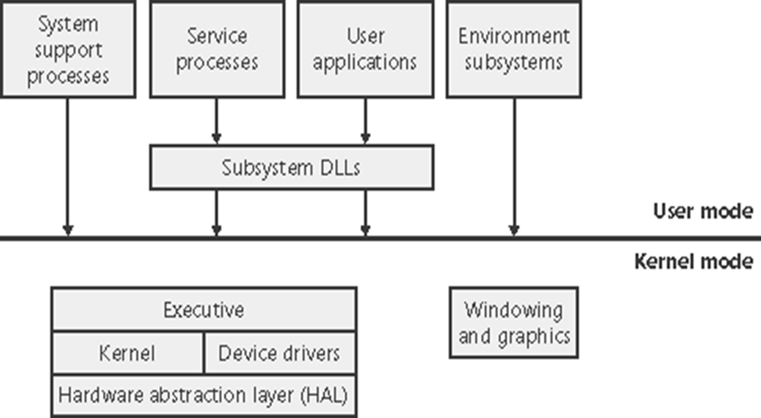
Simplified Windows Architecture
Simplified Windows architecture

Slide 9
Important Elements
The kernel is the “core” of any operating system
What the kernel incorporated depends on the OS (e.g., can include graphics)
Subsystem DLLs
Kernel32.dll
User32.dll
GDI32.dll
Executive
Design decision: separate the functionality between kernel, executive and device drivers
HAL – Hardware Abstraction Layer

Slide 10
Kernel Mode – User Mode (1)
Kernel Mode
Processor access mode
Higher privilege mode
Mode of execution that allows access to all registers (PC, IS, MAR, MDR, etc.) and to the system memory
OS executes in this mode
User Mode
Mode of execution with limited access
Applications execute in this mode
Important: During user mode execution, user level threads execute in kernel mode when made systems calls

Slide 11
Kernel Mode – User Mode (2)
System support processes, service processes, user applications, and environment subsystems each have their own private process address space
User-mode threads execute in a protected process address space (although while they are executing in kernel mode, they have access to system space)

Slide 12
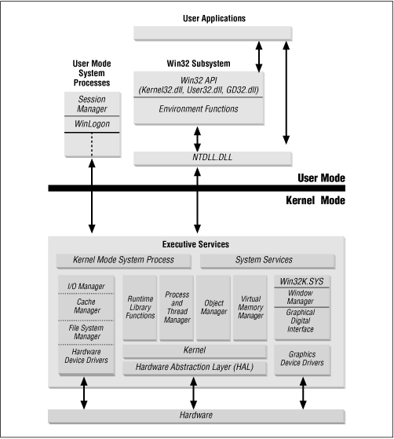
Detailed Windows Architecture

Slide 13
Universal App Platform
Windows 8
introduces a new core API called WinRT used to develop “Windows store” applications using C/C++, .NET, or JavaScript
Windows Store app APIs that are expressed as HTML or XAML elements are supported only in Windows Store apps and are not supported in desktop apps or browsers
Existing Silverlight and WPF applications can be ported to the new “Native XAML” libraries with minimal effort
Windows 10
Microsoft's new Windows 10 Universal App Platform: A 'superset of WinRT'
http://www.zdnet.com/article/microsofts-new-windows-10-universal-app-platform-a-superset-of-winrt/

Slide 14
Universal App Platform (2)
Enables a safe AppStore model for Windows
Has a simple UI programming model for Windows developers (You do not need to learn Win32, HDC, Windows messages, WndProc or LPARAM!)
The APIs are all designed to be asynchronous
The WinRT API definitions is exposed in the ECMA 335 metadata format (the same one that .NET uses, you can find those as ".winmd" files)
. winmd stands for Windows Meta Data
Developers can actually read these files with a tool such as ILDASM or Reflector, or of course, through .NET Reflection
System. Reflection namespace enable developers to obtain information about loaded assemblies

Slide 15
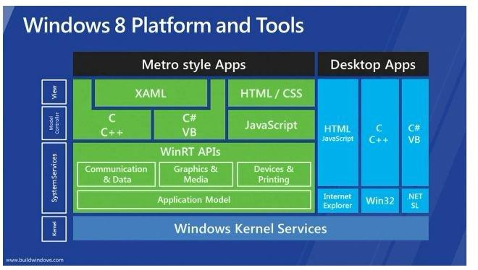
Windows 8

Slide 16
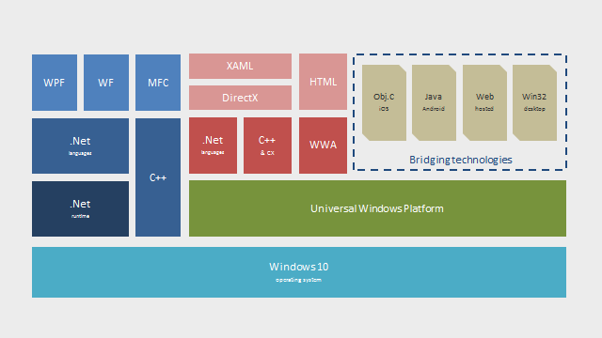
Windows 10

Slide 17
Exercise
Use the Performance Monitor from the Administrative Tools.
Select Add To Chart from the Edit menu
Add % User Time and % Privileged Time
for processor
for threads

Slide 18
Privilege Levels
Privilege levels are defined by hardware.
Original Intel x86 had four privilege levels (named rings)
Other hardware implementations have only two privilege levels.
Windowskernel mode (OS, drivers) runs on level 0 (ring 0) and the user mode runs on level 3 (ring 3)

Slide 19
Functions, Services and Routines
Win32 Functions
System Services – native OS functions available in the user mode
NtCreateProcess (called by CreateProcess)
NtCreateThread (called by CreateThread)
Kernel Functions - native OS functions available in the Kernel mode
ExAllocatePool
Win32 Services – processes started by the Control Manager
Task Scheduler
DLLs – callable subroutines linked together as a binary file
Kernel32.dll
User32.dll
GDI32.dll

Slide 20
Process
An executable program
A private virtual address space
A list of opened handles to resources (files, communication ports, printers, etc)
A security context called an access token that identifies the user, security group and the process’s privileges
A unique ID
At least one thread of execution

Slide 21
Exercise
EXPERIMENT: Viewing the Process Tree
One unique attribute about a process that most tools don’t display is the parent or creator process ID
You can retrieve this value with the Performance Monitor (or programmatically) by querying the Creating Process ID
The Tlist.exe tool (in the Debugging Tools for Windows) can show the process tree by using the /t switch

Slide 22
Thread
The contents of the CPU registers containing the state of the processor.
Two stacks: user stack and kernel stack.
Thread-local storage (TSL) used by run-time libraries, DLLs
Thread ID (internally called a client ID).
In some cases security context (normally the security context is inherited from process)

Slide 23
Fibers
Run on the context of a thread having access to the thread components (i.e. thread TLS and synchronization objects owned by the thread)
Available only in the user mode.
Similar with user level threads (lightweight threads)
Good for porting applications written in UNIX (normally written to schedule their own threads)
Fibers allow you to implement co-routines

Slide 24
Thread Context
Thread Context
Volatile registers contents
Private storage area
The stacks
GetThreadContext() is the only public data in Win32 API that is machine dependent.
Exercise: Read the documentation about GetThreadContext()

Slide 25
Multithreading Execution (1)
An application switches from user mode to kernel mode in the case of system calls
A user thread spends some time in user mode and in kernel mode
A transition from a thread to another is named context switch
A transition from user to kernel mode is named mode transition or mode switch

Slide 26
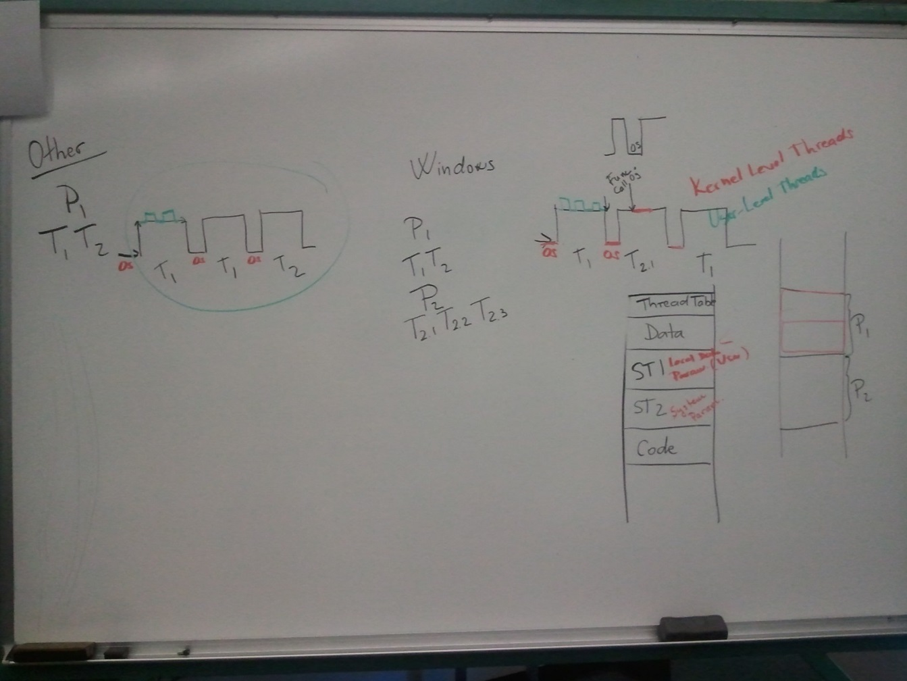
Multithreading Execution (2)

Slide 27
Important
Threads share the same address space, but processes don’t
However, a process can make available to other processes a part of its address space as a shared memory section
Exercise: Read the documentation about ReadProcessMemory(), WriteProcessMemory()

Slide 28
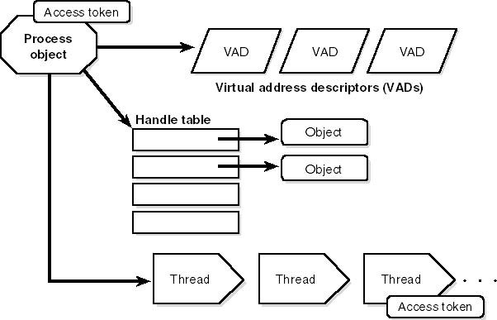
A Process and Its Resources (Solomon)

Slide 29
Security Token
A process has a security token
A thread inherits the security token from a process, but it can obtain one, thus allowing individual threads to impersonate the security context of another process

Slide 30
Virtual Memory
Windows implements a virtual memory system based on a flat (linear) address space
Provides each process with the illusion of having its own large, private address space
Windows implements a virtual memory system based on a 32-bit address space equivalent to 4GB of virtual memory
x0000000 to x7FFFFFFF unique private space for processes
x80000000 to xFFFFFFFF protected OS memory utilization
Address Windowing Extensions (AWE) allows a process to allocate up to 64GB of physical memory
64-bit Windows provides a much larger address space for processes: 7152 GB on IA-64 systems and 8192 GB on x64 systems
The virtual memory is organized in pages

Slide 31
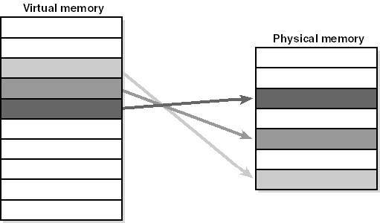

Slide 32
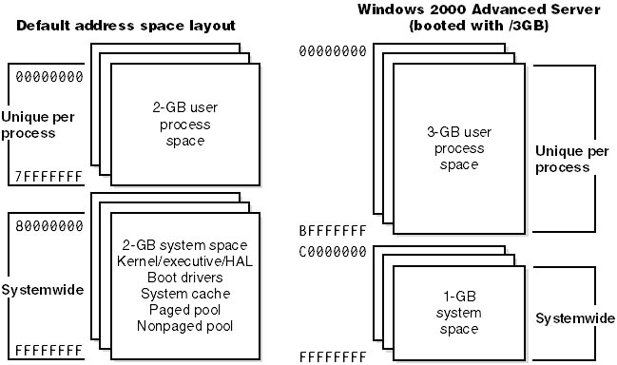

Slide 33
Windows runs on two types of 64-bit processor, identified as x64 and IA-64:
x64:
8192 GB
(8 TB) User
process space
8192 GB
System space
IA-64:
7152 GB
(7 TB) User
process space
7152 GB
System space

Slide 34
Operating System Address Space
Windows and the device drivers share a single virtual space
Virtual memory pages in the system space can be accessed only in kernel mode
There is no security implemented in kernel mode (OS code and device drive code in kernel mode have complete access to memory space and can bypass the Windows security – ring 0)
It is very important that the OS code and the device drivers code to be safe for the system (at third-party device drivers installation the user is informed that this is an unauthorized (unsigned) driver)

Slide 35
Windows Objects
An object is a single, run-time instance of a statically defined object.
Process
Thread
File
Event
Not all data structures in Windows are “Windows objects” – only the ones that needs to be shared, protected, named or made visible to the user
All these objects are low-level objects that Windows creates and manages
An object attribute is a field of data
Object methods usually read or change the object’s attributes
Objects involve data encapsulation

Slide 36
Security
Windows supports C2-level security as defined by the U.S. Department of Defense Trusted Computer System Evaluation Criteria (DoD 5200.28-STD, December 1985)
Windows NT 4 was formally evaluated at C2 level
Please read: http://www.radium.ncsc.mil/tpep/library/rainbow/5200.28-STD.html
http://msdn.microsoft.com/en-us/library/windows/desktop/aa376387(v=vs.85).aspx

Slide 37
TCSEC Levels
Rating Description
A1 Verified Design
B3 Security Domains
B2 Structured Protection
B1 Labeled Security Protection
C2 Controlled Access Protection
C1 Discretionary Access Protection (obsolete)
D Minimal Protection

Slide 38
Win32 Interface Security
The Win32 subsystem implements object-based security in the same way the operating system does
The Win32 subsystem protects shared Windows objects from unauthorized access by placing Windows security descriptors on them

Slide 39
C2 Certification
For C2 certification, a system must:
Have good documentation at both the user and administration level and have documentation on security testing
Authenticate all users as unique individuals
Not allow objects to be reused or recovered once deleted
Let systems administrators audit all security events and the actions of individual users
Protect all objects and processes from all others
Source: http://www.winntmag.com/Article/ArticleID/47/47.html

Slide 40
Registry
The Windows registry is the internal database that contains:
Information to boot or configure the system
System settings
The security database
Per-user configuration settings
The registry allow the system administrator to read the current status of the hardware/software components (similar with the performance counters).
There is normally no reason to look directly into the registry, because it can be accessed/viewed with administrative/performance tools.

