Slide 1

TMS Software
Introduktion and reportgeneration

Slide 2

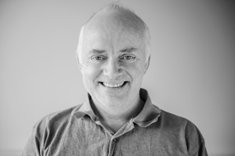
Presenter
Jens Fudge
Worked with Delphi since Delphi 1 in 1995
Embarcadero MVP since 2012
Work as consultant, freelancer, trainer
Jens.fudge@archersoft.dk

Slide 3
Agenda
Introduction to TMS Software Flexcel
Demo
Flexcel as reportgenerator
Demo
https://www.tmssoftware.com/site/flexcel.asp

Slide 5
THANK YOU
Thank you for attending.
Everything I did wrong, please tell me
Everything I did right, please tell everyone else
jens.fudge@archersoft.dk

