Slide 1

Tips and Tricks
With Delphi

Slide 2

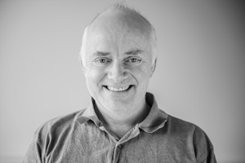
Presenter
Jens Fudge
Worked with Delphi since Delphi 1 in 1995
Embarcadero MVP since 2012
Work as consultant, freelancer, trainer
Jens.fudge@archersoft.dk

Slide 3
IDE Layouts
Multipaste
Evaluate/Modify running code

Slide 4
Change Componenttypes
Interface Completion

Slide 5
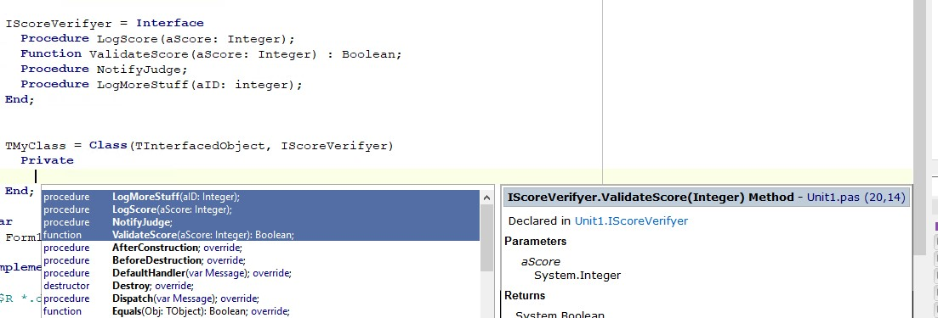
Interface Completion Delphi 10.2 Apparently not working in Delphi 11

Slide 6
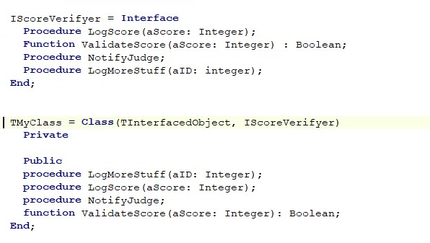
Interface Completion Delphi 10.2 Apparently not working in Delphi 11

Slide 7
Record/Class Helpers
RTTI (Run Time Type Information)

Slide 8
Execution Pointer
Thousands Separator

Slide 9
Stopwatch
Messaging

Slide 12
THANK YOU
Thank you for attending.
Everything I did wrong, please tell me
Everything I did right, please tell everyone else
jens.fudge@archersoft.dk

