Slide 1
ECE 667
Synthesis and Verification of Digital Circuits
Allocation
Resource Binding & Sharing
Notes:
ECE 667

Slide 2
Binding and Sharing Problem
Given: scheduled sequencing graph
  Operation concurrency well defined
Consider operation types independently
  Problem decomposition (natural)
  Perform analysis for each resource type
Operation compatibility
  Same type
  Non-concurrent
Conflicting operations
  Concurrent, different types
  Dual to compatibility
ECE 667 - Synthesis & Verification - HLS Allocation

Slide 3
Allocation (Binding)
Allocation = resource binding
  Spatial mapping between operations and resources
  Operators can be dedicated or generic (shared)
  Operators and registers need to be allocated
Sharing
  Assignment of a resource to more than one operation
Constrained resource binding
  Resource-dominated circuits
  Fixed number and type of resources available
NP-complete problem – need heuristics
ECE 667 - Synthesis & Verification - HLS Allocation

Slide 4
Binding in Resource-Dominated Circuits
Resource Compatibility Graph G₊(V,E)
  V represents operations
  E represents compatible operation pairs
Compatible operations
  (v_{i}, v_{j}) are compatible if they are not concurrent and can be implemented by resources of same type
  Note: concurrency depends on schedule
Partition the graph into minimum number of cliques in G₊(V,E)
  Clique = maximal complete subgraph
  Partition the graph into minimum number of cliques, or
  Clique cover number, κ(G₊(V,E))
ECE 667 - Synthesis & Verification - HLS Allocation

Slide 5
Compatibility Graph G₊(V,E)
Minimum Clique covers in G₊(V,E)
NOP
9
1
2
10
3
1
8
4
10
*
*
+
3
6
11
7
6
2
5
11
*
*
<
4
7
*
8
MULT
ALU
*
κ(G₊(V,E)) = 2
κ(G₊(V,E)) = 2
5
+
9
NOP
ECE 667 - Synthesis & Verification - HLS Allocation

Slide 6
Conflict Graph G₋(V,E)
Resource Conflict Graph G₋(V,E)
  V represents operations
  E represents conflicting operation pairs
Conflicting operations
  Two operations are conflicting if they are not compatible
Complementary to compatibility graph
Find independent set of G₋(V,E)
  A set of mutually compatible operations
  Coloring with minimum number of colors
  Chromatic number χ(G₋(V,E))
MULT
3
1
8
7
6
2
Conflict graph G₋(V,E)
3
1
8
7
6
2
Compatibility graph G₊(V,E)
ECE 667 - Synthesis & Verification - HLS Allocation

Slide 7
Conflict Graph G₋(V,E) - Example
Chromatic numbers in G₋(V,E)
NOP
3
1
8
4
10
9
7
6
2
5
11
*
1
*
2
+
10
MULT
ALU
3
6
11
*
*
<
χ(G₋(V,E)) = 2
χ(G₋(V,E)) = 2
4
7
*
8
*
5
+
9
NOP
ECE 667 - Synthesis & Verification - HLS Allocation

Slide 8
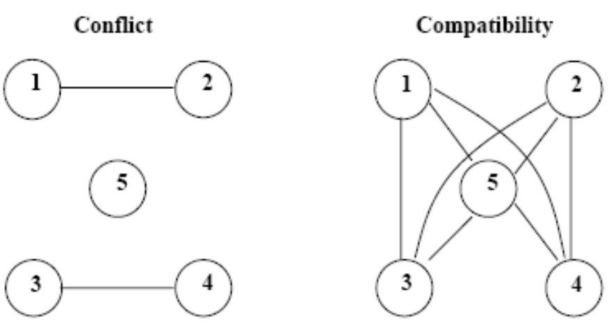
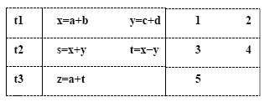
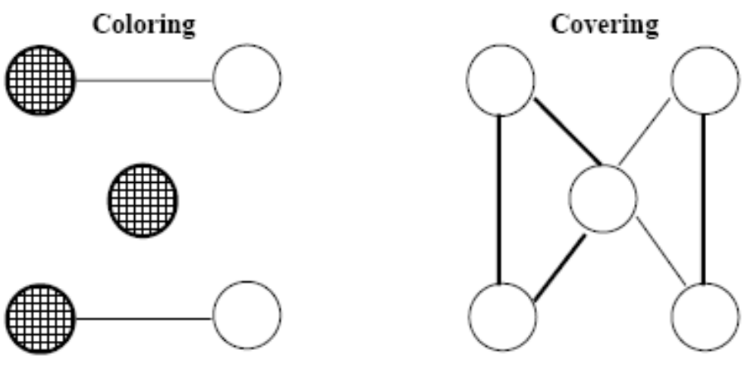
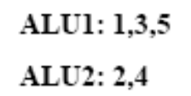
Clique vs Coloring - Example
ECE 667 - Synthesis & Verification - HLS Allocation

Slide 9
Special Graphs
Comparability graph
  Graph G(V,E) has an orientation (G(V,F) with transitive property:
    (v_{i}, v_{j}) ∈ F and (v_{j}, v_{k}) ∈ F ⇒ (v_{i}, v_{k}) ∈ F
Interval graph
  Vertices correspond to intervals
  Edges correspond to interval intersections
  Subset of chordal graphs
    Every loop with more than 3 edges has a chord
The compatibility/conflict graphs have special properties
  Compatibility ⇒ comparability graph
  Conflict ⇒ interval graph
ECE 667 - Synthesis & Verification - HLS Allocation

Slide 10
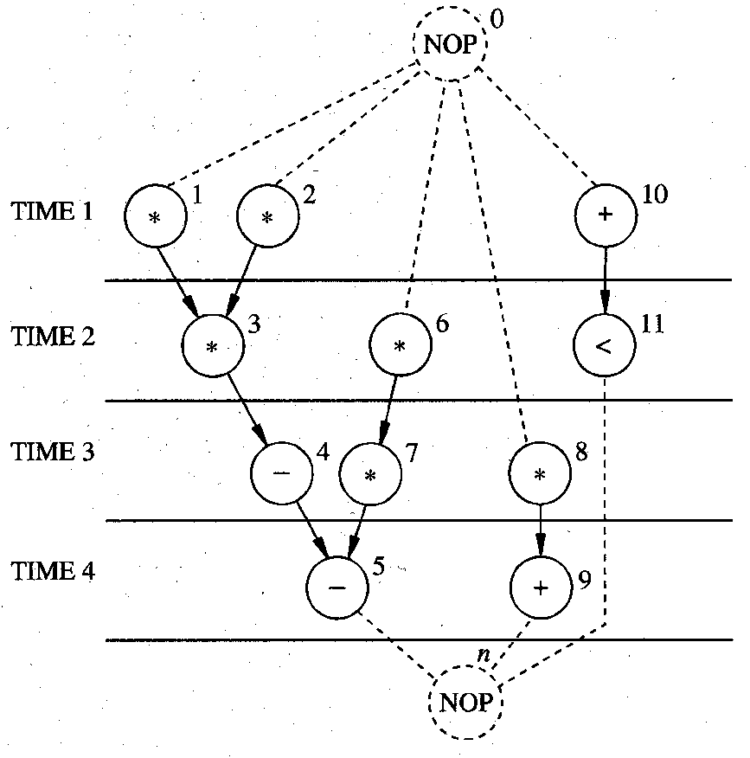
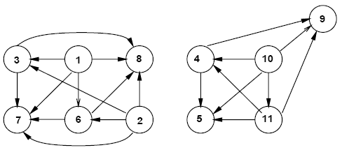
Comparability Graph
Representation of compatible relations
Note: sequencing graph is assumed to be scheduled
Note the orientation of edges,
compare to compatibility graph.
ECE 667 - Synthesis & Verification - HLS Allocation
Notes:
ECE 667

Slide 11
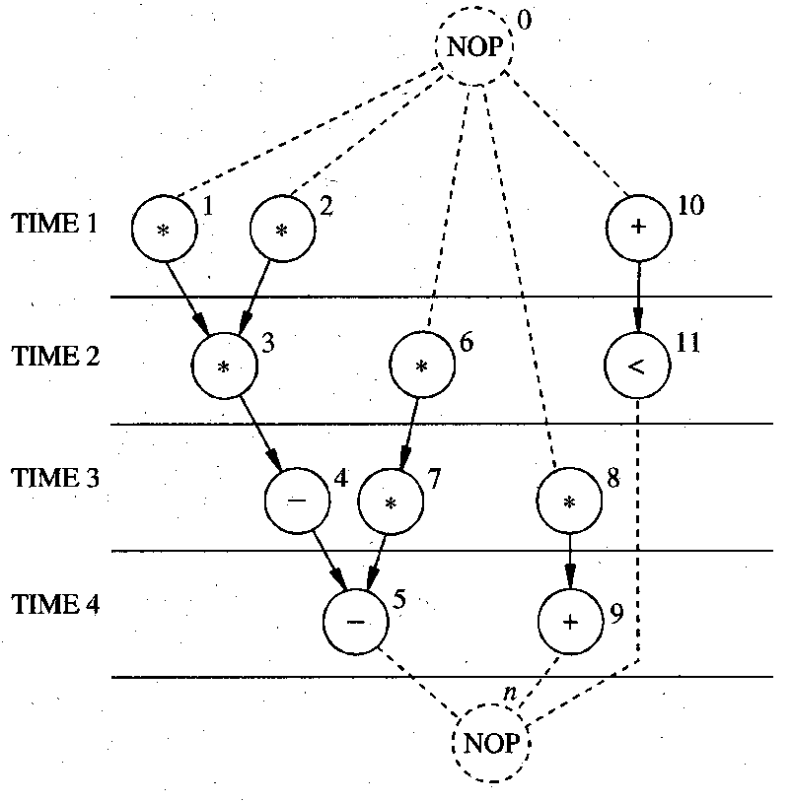
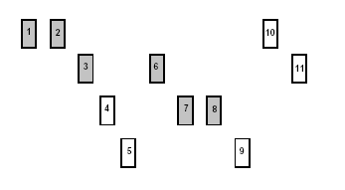
Interval Graph Representation
Interval representation of conflicting relation
Note: sequencing graph is assumed to be scheduled
Intervals with “Left” and “Right” coordinates
Compare with conflict graphs:
3
1
8
4
10
9
7
6
2
5
11
MULT
ALU
ECE 667 - Synthesis & Verification - HLS Allocation

Slide 12
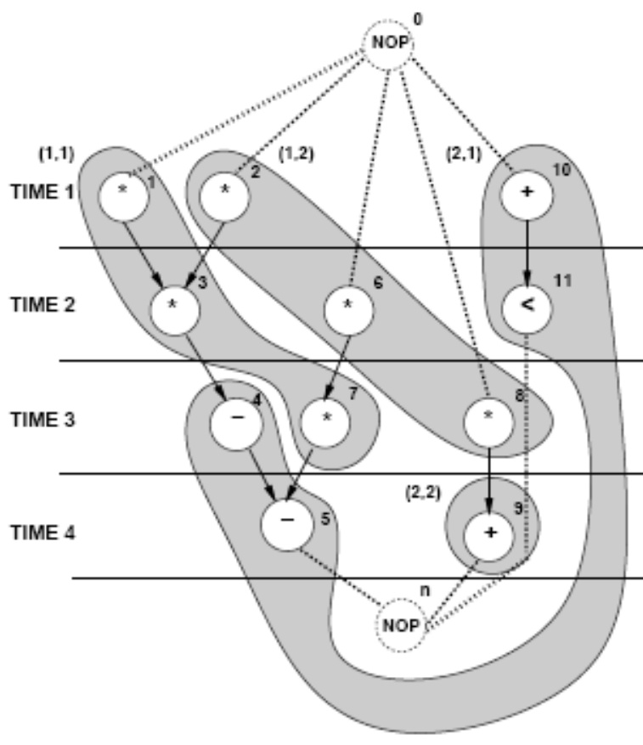
Operation Binding - Solution
Mult1: { 1, 3, 7 }, Mult2: { 2, 6, 8 }
ALU1: { 10,11, 4,5 }, ALU2: { 9 }
ECE 667 - Synthesis & Verification - HLS Allocation

Slide 13
Left-Edge Algorithm
Input
  Set of intervals sorted with left and right edge coordinates
Algorithm
  Sort intervals by their left edge coordinates
  Assign non-overlapping intervals to first track (color) using the sorted list
  When possible intervals are exhausted, increase track (color) counter and repeat.
Efficiency
  Simple, polynomial time algorithm
ECE 667 - Synthesis & Verification - HLS Allocation

Slide 14
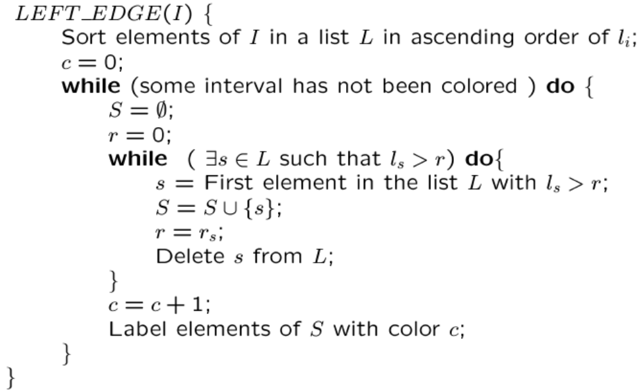
Left-Edge Algorithm
ECE 667 - Synthesis & Verification - HLS Allocation

Slide 15
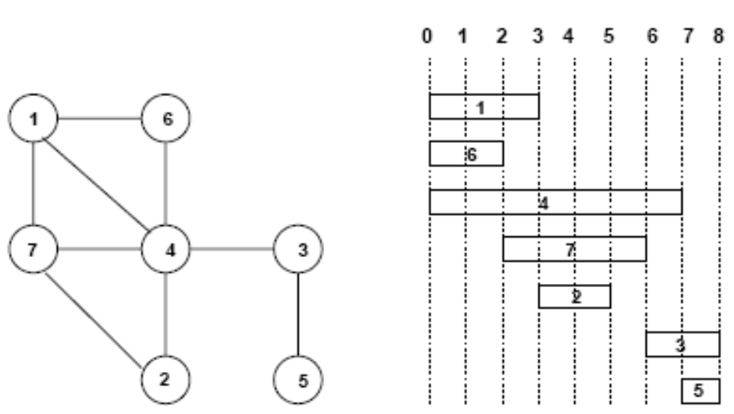
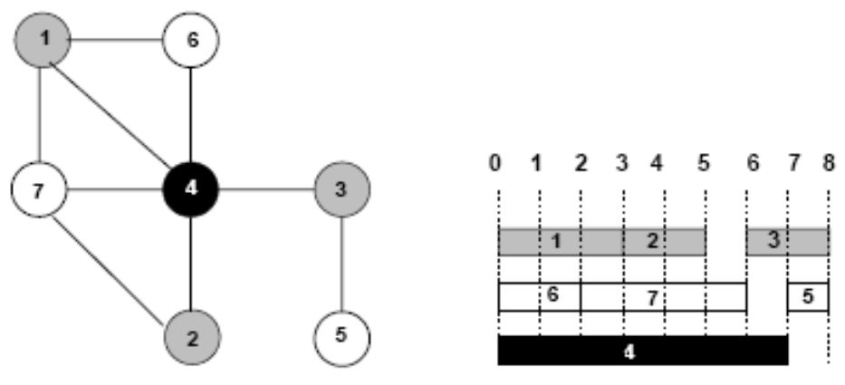
Left-Edge Algorithm - Example
Input
Solution
ECE 667 - Synthesis & Verification - HLS Allocation

Slide 16


ILP Formulation of Operation Binding
Boolean variables b_{ir}
  b_{ir} = 1 if operator i is bound to resource r
  0 otherwise
Boolean variables x_{il}
  x_{il} = 1 if operation i is scheduled to start at step l
Each operation is bound to one resource
(a = limit on resource r)
At each step l, at most one operation can be executing for a given resource (horizontal constraint)
ECE 667 - Synthesis & Verification - HLS Allocation

Slide 17
Operation Binding - Solution
Equations for two multipliers:
  b_{i1} + b_{i2} = 1, i={1,2,3,6,7,8}
MULT 1:
∑_{i={1,2,3,6,7,8}} b_{i1}x_{il} ≤ 1, l =1,2,…,5
MULT 2:
∑_{i={1,2,3,6,7,8}} b_{i2}x_{il} ≤ 1, l =1,2,…,5
Solution:
  b₁₁ = b₃₁ = b₇₁ = 1
  b₂₂ = b₆₂ = b₈₂ = 1
  all other b_{ij} =0
ECE 667 - Synthesis & Verification - HLS Allocation

Slide 18
Module Selection Problem
Resource-type (module) selection problem
  Generalization of the binding problem
Library of resources:
  More than one resource per type
Example:
  Ripple-carry adder vs. carry look-ahead adder
Resource modeling
  Resource subtypes with (area, delay) parameters
Solution
  ILP formulation:
    Decision variables: select resource subtype,
      determine (area, delay)
  Heuristic algorithms:
    Determine minimum latency with fastest resource subtypes
    Recover area by using slower resources on non-critical paths
ECE 667 - Synthesis & Verification - HLS Allocation

Slide 19
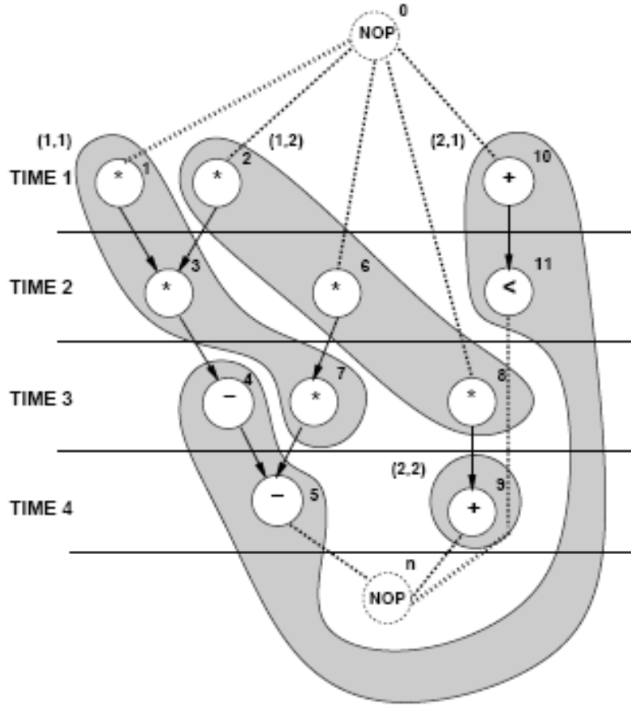
Module Selection Example 1
Latency bound: L = 4
  Fast multipliers for {v₁, v₂, v₃ }
  Slower multipliers can be used elsewhere
    less sharing
Minimum latency design
  used fast multipliers only.
Formulation:
  constraint satisfaction
  optimization problem
Area recovery
  On non-critical paths replace fast (large) multipliers by slow (small) ones
Area = 5+5+1+1=12
ECE 667 - Synthesis & Verification - HLS Allocation

Slide 20
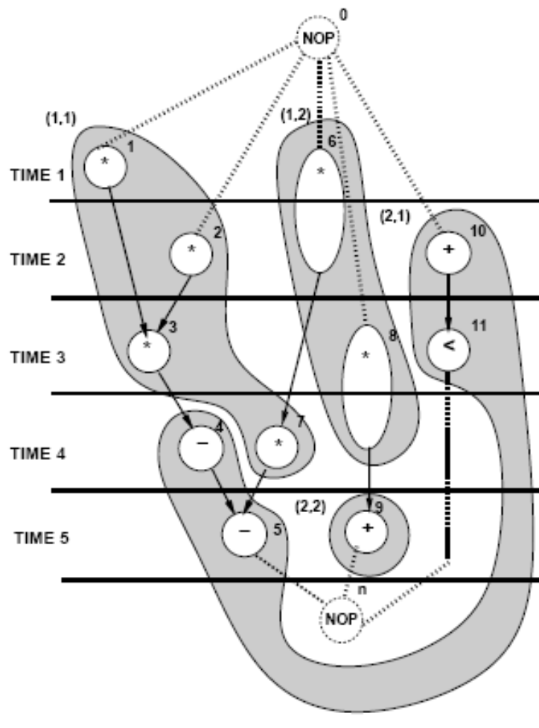
Module Selection - Example 2
Optimization problem:
  Minimize area cost F = c^{T} a
  s.to
    Resource constraints
    Additional precedence constraints
Area cost vector c = [5, 2, 1, 1]
Assume latency bound: L = 5
Two multipliers available
  MULT1 with (area, delay) = (5,1)
  MULT2 with (area, delay) = (2,2)
Two ALUs available:
  ALU with (area, delay) = (1,1) each
Area = 5+2+1+1 = 9
ECE 667 - Synthesis & Verification - HLS Allocation

Slide 21
Register Binding Problem
Registers are storage resources, holding variable values across control steps
Given a schedule, generate:
  Lifetime intervals for variables
  Lifetime overlaps
Construct a conflict graph (interval graph)
  Vertices V : variables (operations)
  Edges E: overlaps
  Build an interval graph
Compatibility graph (comparability graph)
  Complement of conflict graph
ECE 667 - Synthesis & Verification - HLS Allocation

Slide 22
Minimization of Register Costs
Given a scheduled sequencing graph
  Minimum set of registers required is given by the largest number of data arcs crossing a C-step boundary
Create storage operations, at output of any operation that transfers a value to a destination in a later C-step
Generate Storage DG for these “operations”
Length of storage operation depends on final schedule
1
s
s
2
s
0
1
3
d
2
3
4
d
d
4
5
Storage distribution for S
ASAP Lifetime
MAX Lifetime
ALAP Lifetime
ECE 667 - Synthesis & Verification - HLS Allocation

Slide 23
Register Binding Problem
Given
  Variable lifetime conflict graph
Find
  Minimum number of registers storing all variables
Simple case
  Non-iterative designs: Interval graph
    Solve using left-edge algorithm (polynomial time)
ECE 667 - Synthesis & Verification - HLS Allocation

Slide 24
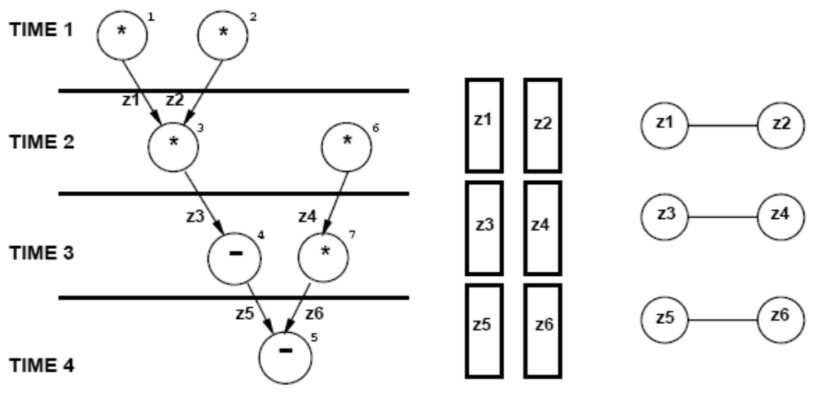
Register Binding Problem – Example 1
Non-iterative designs
  Create variable compatibility graph or conflict graph
  Use left-edge algorithm to minimize the number of registers
ECE 667 - Synthesis & Verification - HLS Allocation

Slide 25
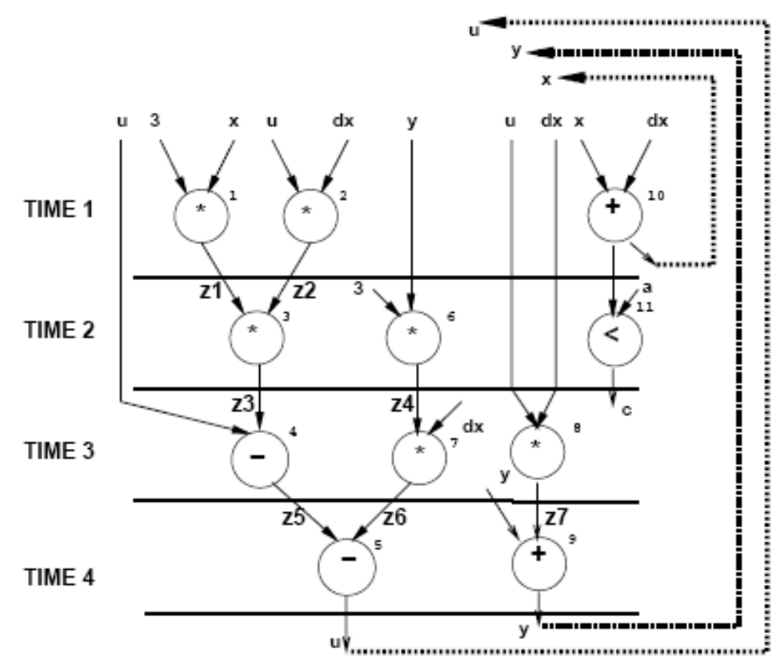
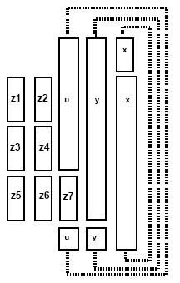
Register Binding – Example 2
Iterative designs
  Sequencing graph and variable lifetimes
ECE 667 - Synthesis & Verification - HLS Allocation

Slide 26
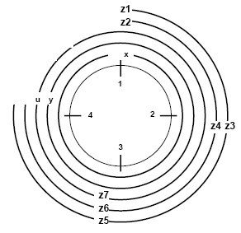
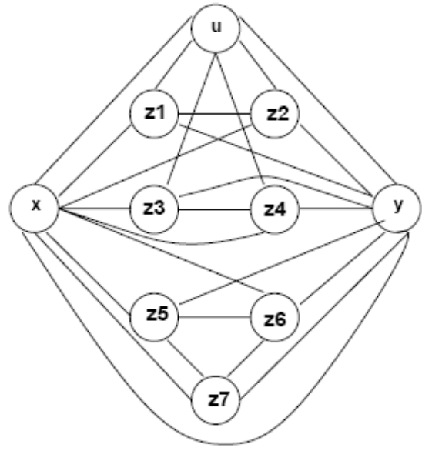
Circular Arc Conflict Graph
Overlapping lifetimes of variables represent conflicts
Variable lifetimes as arcs
Variable lifetimes
Circular-arc conflict graph
ECE 667 - Synthesis & Verification - HLS Allocation

Slide 27
Register Sharing – General Case
Iterative constructs
  Preserve values across iterations
  Circular-arc conflict graph (not simple intervals)
    Coloring is intractable
Hierarchical graphs:
  General conflict graphs
    Coloring is intractable
Heuristic algorithms required
ECE 667 - Synthesis & Verification - HLS Allocation

Slide 28
Bus Sharing and Binding
Buses act as transfer resources
  See architecture produced by GAUT
Find the minimum number of buses to accommodate all data transfer
Find the maximum number of data transfers for a fixed number of buses
Similar to memory binding problem
Possible solutions
  ILP formulation
  Heuristic algorithms
ECE 667 - Synthesis & Verification - HLS Allocation

Slide 29
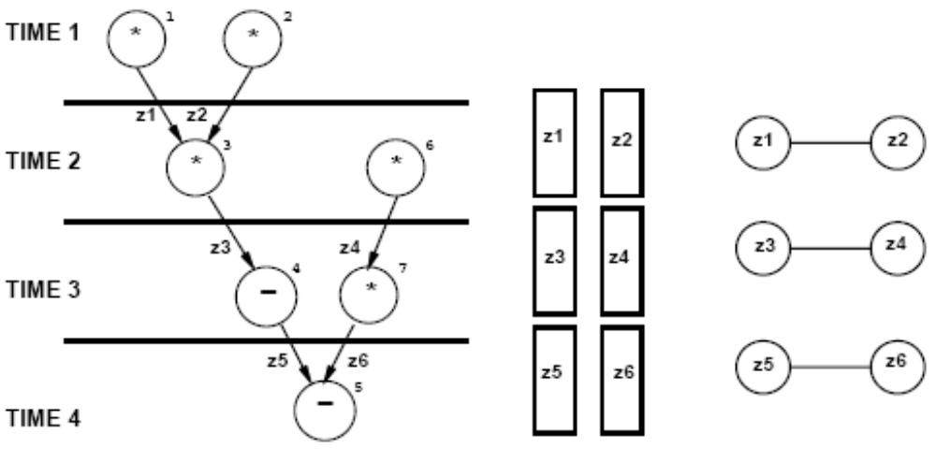
Bus Sharing and Binding - Example
One bus
  3 variables
Two buses
  All variables can be transferred
ECE 667 - Synthesis & Verification - HLS Allocation

Slide 30
Summary
Resource sharing and binding is reducible to coloring or clique covering
Simple for flat (non-hierarchical) graphs
Intractable in general case, but still easy in practice for other graphs
More complicated for non resource-dominated circuits
Extension: module selection
ECE 667 - Synthesis & Verification - HLS Allocation

