Slide 1
ECE 667
Synthesis and Verification
of Digital Circuits
Scheduling Algorithms
Notes:
ECE 667

Slide 2
Architectural Optimization
Optimization in view of design space flexibility
A multi-criteria optimization problem:
  Determine schedule φ and binding β.
  Under area Α, latency L and cycle time τ objectives
Solution space tradeoff curves:
  Non-linear, discontinuous
  Area / latency / cycle time (more?)
Evaluate (estimate) cost functions
Unconstrained optimization problems for resource dominated circuits:
  Min area: solve for minimal binding
  Min latency: solve for minimum L scheduling
HLS - Scheduling

Slide 3
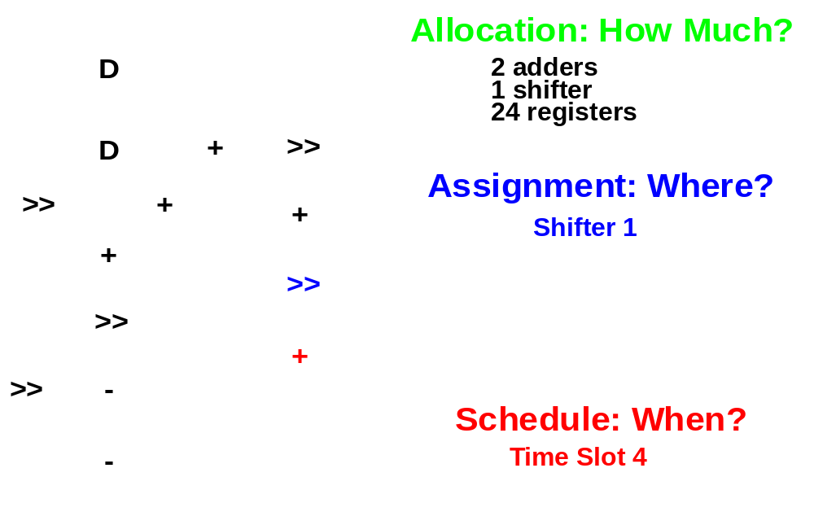
Scheduling, Allocation and Assignment
Techniques are well understood and mature
HLS - Scheduling
Copyright 2003 © Mani Srivastava

Slide 4
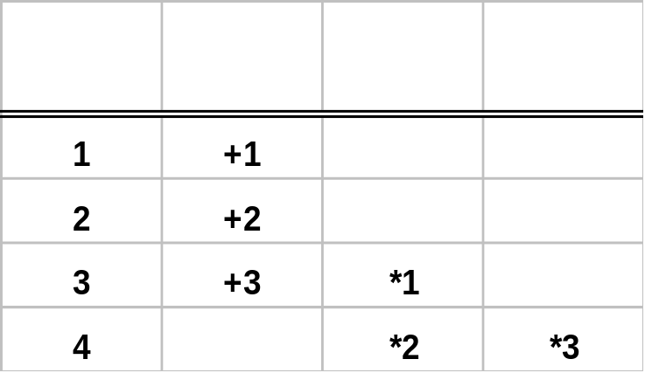
Scheduling and Assignment - Overview
F1 = (a + b + c) * d
F2 = (x + y) * z F3 = (x + y)* w
a
b
4 control steps, 1 Add, 2 Mult
Schedule 1
+1
s1
Control
Step
c
+
*
*
+2
s2
d
x
y
*1
s3
+3
s3
z
w
*2
s4
*3
s4
F1
F2
F3
HLS - Scheduling
Copyright 2003 © Mani Srivastava

Slide 5
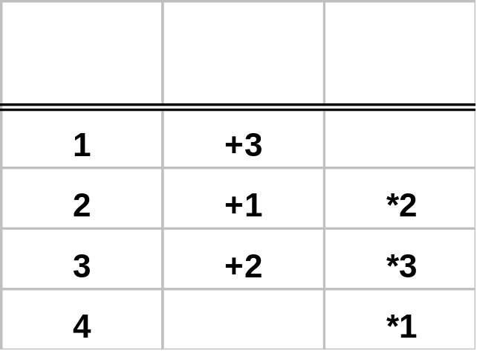
Scheduling and Assignment - Overview
F1 = (a + b + c) * d
F2 = (x + y) * z F3 = (x + y)* w
Schedule 2
x
y
4 control steps, 1 Add, 1 Mult
+3
s1
a
b
z
Control
Step
+1
*2
+
*
s2
s2
c
w
F2
+2
s3
*3
s3
d
F3
*1
s4
F1
HLS - Scheduling
Copyright 2003 © Mani Srivastava

Slide 6
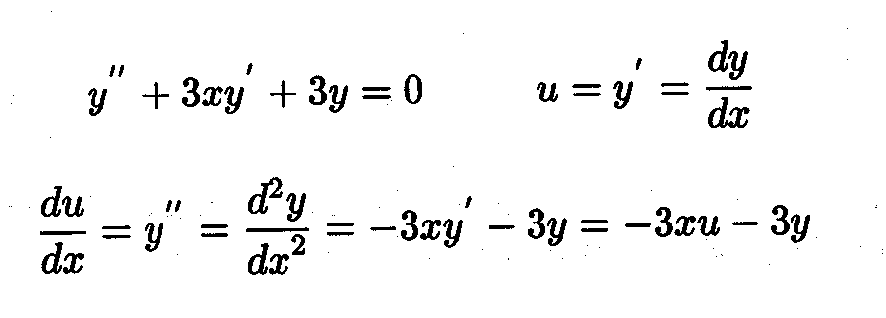
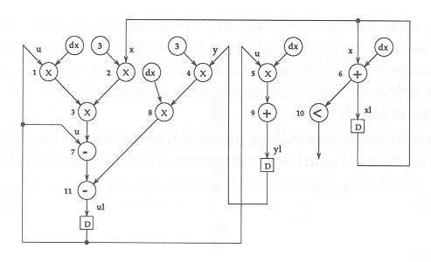
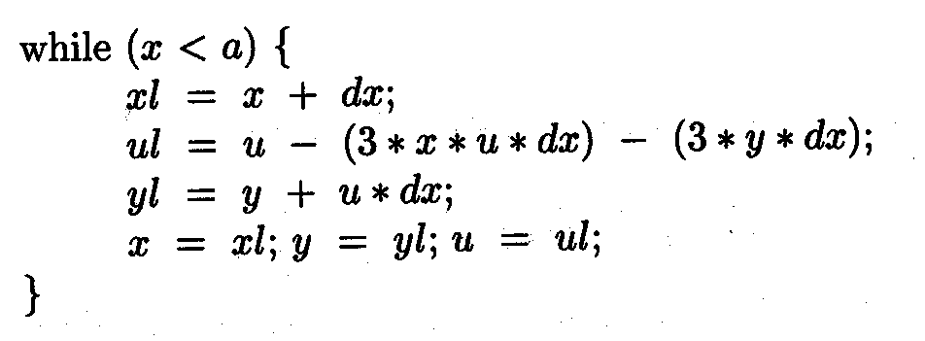
Algorithm Description → Data Flow Graph
HLS - Scheduling

Slide 7
Data Flow Graph (DFG)
HLS - Scheduling

Slide 8
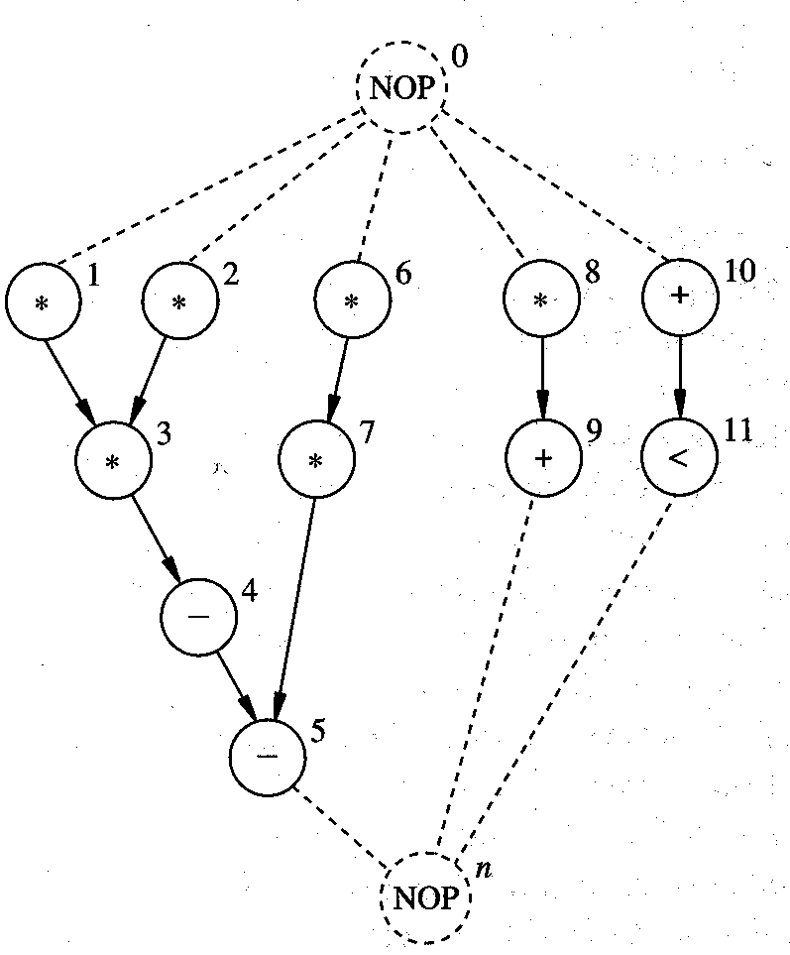
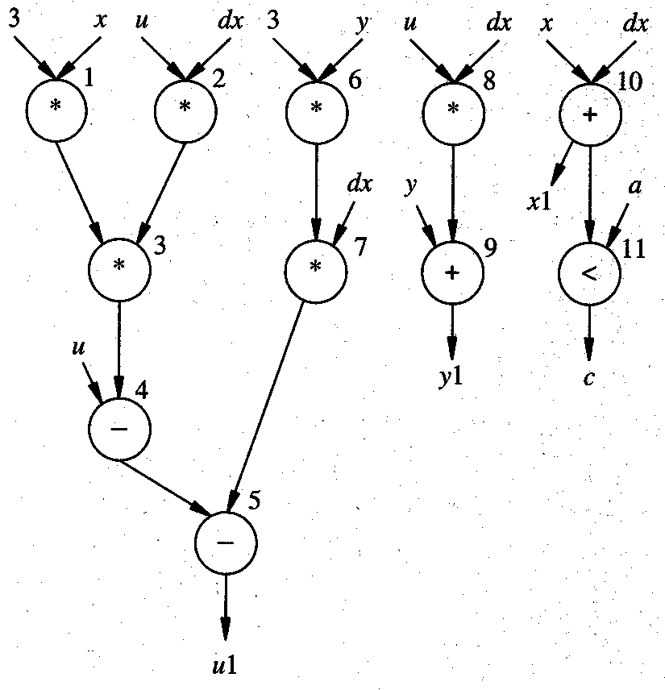
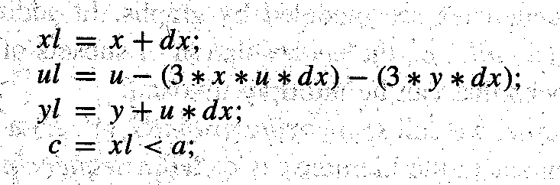
Sequencing Graph
Add source and sink nodes
HLS - Scheduling

Slide 9
Sequencing Graph
Add source and sink nodes (NOP) to the DFG
NOP
*
*
*
*
+
*
*
*
*
+
*
*
+
<
*
*
+
<
Data Flow Graph (DFG)
NOP
Sequencing Graph
HLS - Scheduling

Slide 10
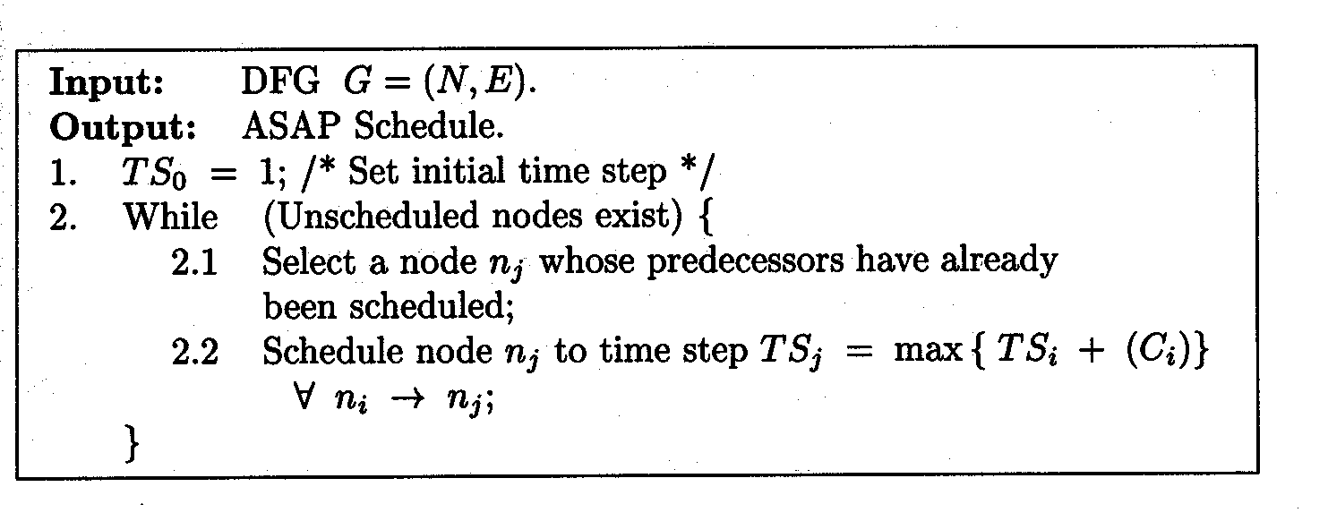
ASAP Scheduling Algorithm
As Soon as Possible scheduling
  Unconstrained minimum latency scheduling
  Uses topological sorting of the sequencing graph (polynomial time)
  Gives optimum solution to scheduling problem
  Schedule first the first node n_{o} → T1 until last node n_{v} is scheduled
  C_{i} = completion time (delay) of predecessor i of node j
HLS - Scheduling

Slide 11
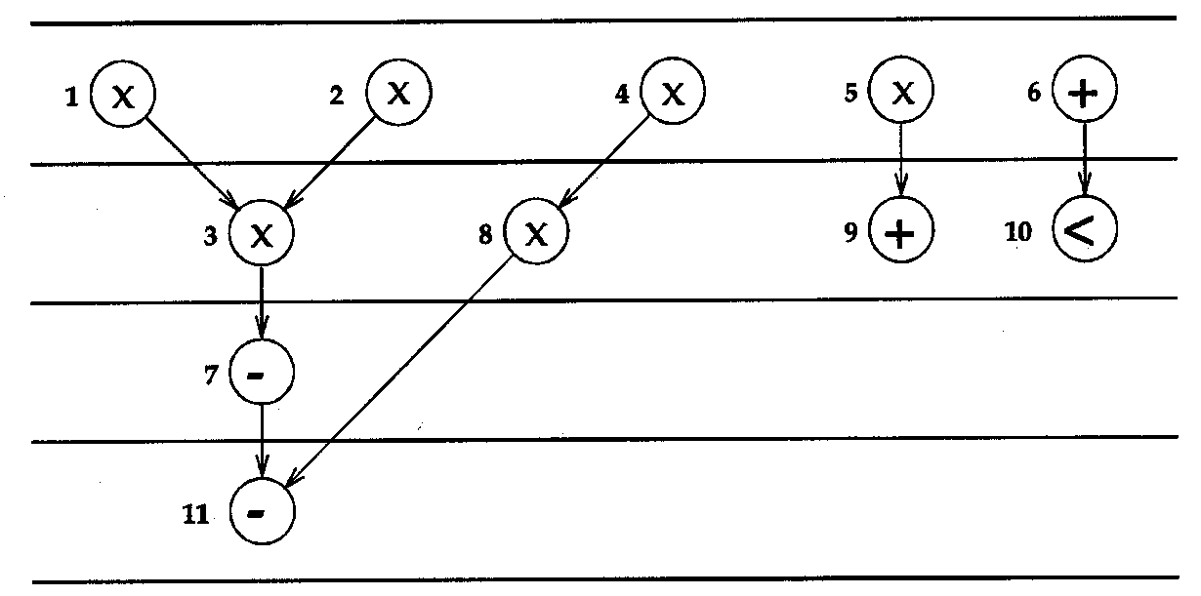
ASAP Scheduling Algorithm - Example
Assume C_{i} = 1
TS = 1
start
TS = 2
TS = 3
finish
TS = 4
HLS - Scheduling

Slide 12
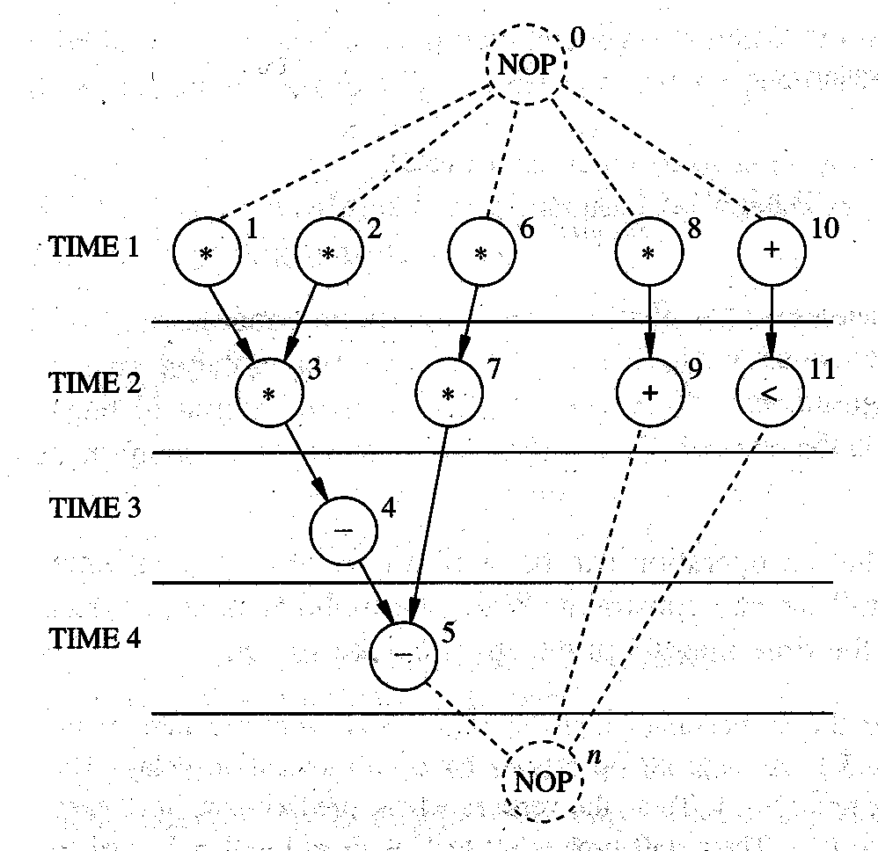
ASAP Scheduling Example
How many Add, Mult are needed ?
Sequence Graph
ASAP Schedule
HLS - Scheduling

Slide 13
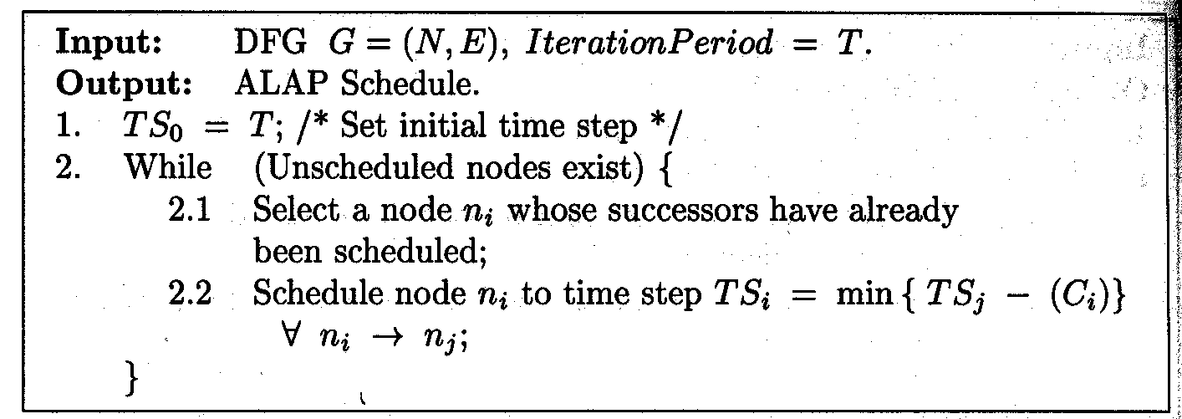
ALAP Scheduling Algorithm
As late as Possible scheduling
  Latency-constrained scheduling (latency is fixed)
  Uses reversed topological sorting of the sequencing graph
  If over-constrained (latency too small), solution may not exist
  Schedule first the last node n_{v} → T, until first node n₀ is scheduled
  C_{i} = completion time (delay) of predecessor i of node j
(Latency)
HLS - Scheduling

Slide 14
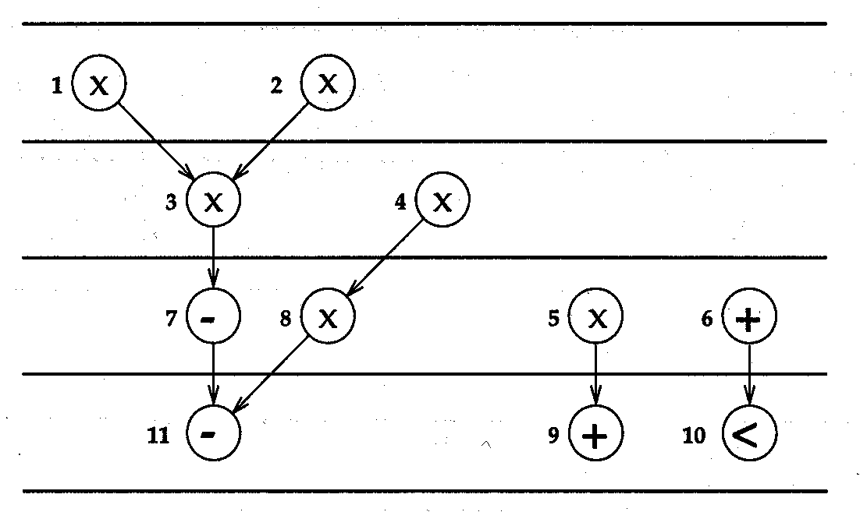
ALAP Scheduling Algorithm - example
Assume C_{i} = 1
TS = 1
finish
TS = 2
TS = 3
start
TS = 4 = T
HLS - Scheduling

Slide 15
ALAP Scheduling Example
0
NOP
1
2
*
*
3
*
6
*
4
7
*
8
+
10
*
5
+
9
11
<
n
NOP
How many Add, Mult are needed ?
ALAP Schedule
(latency constraint = 4)
Sequence Graph
HLS - Scheduling

Slide 16
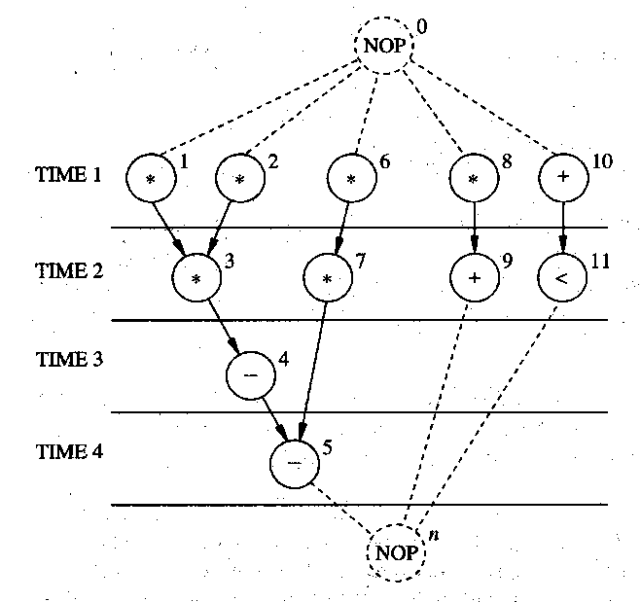
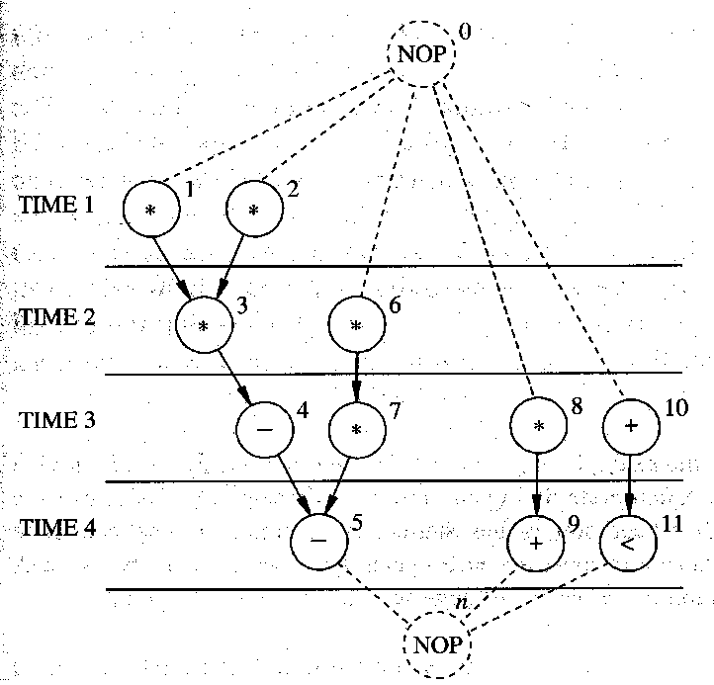
ASAP & ALAP Scheduling
No Resource
Constraint
ASAP Schedule
ALAP Schedule
Slack
Critical
Path=4
Sequence Graph
HLS - Scheduling

Slide 17
ASAP & ALAP Scheduling
No Resource
Constraint
ASAP Schedule
Having determined the minimum latency,
what can we do with the slack?
  Adds flexibility to the schedule
  Determine the minimum # resources
ALAP Schedule
Slack
What if you want to find
Min. latency given fixed resources?
Min resources given a latency?
HLS - Scheduling

Slide 18
Computing Slack (mobility)
Slack of Operator i: S_{i} = TS_{i}^{ALAP} – TS_{i}^{ASAP}
  Defines mobility of the operators
S₆ = 2-1 = 1
S₇ = 2-1 = 1
S₈ = 3-1 = 2
S₉ = 4-2 = 2
S₁₀ = 3-1 = 2
S₁₁ = 4-2 = 2
NOP
0
0
NOP
1
2
6
8
10
1
2
*
*
*
*
+
*
*
3
7
9
11
3
6
*
*
+
<
*
*
4
4
7
*
8
+
10
*
5
5
+
9
11
<
n
n
NOP
NOP
HLS - Scheduling

Slide 19
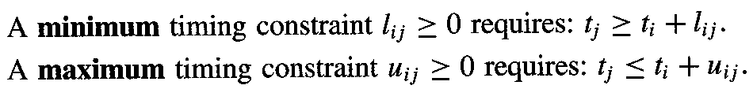
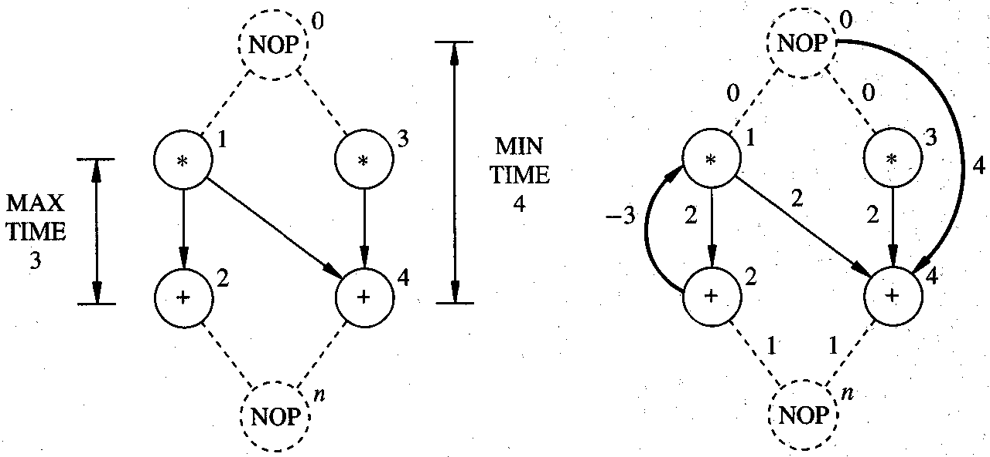
Timing Constraints
Time measured in cycles or control steps
Imposing relative timing constraints between operators i and j
  max & min timing constraints
Node number
(name)
Required delay
HLS - Scheduling

Slide 20
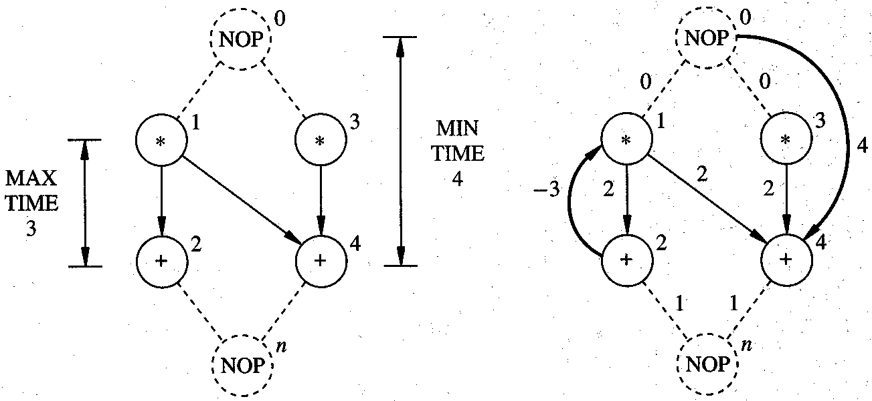
Constraint Graph G_{c}(V,E)
MULT delay =2
ADD delay = 1
HLS - Scheduling

Slide 21
Existence of Schedule under Timing Constraints
Upper bound (max timing constraint) is a problem
Examine each max timing constraint (i, j):
  Longest weighted path between nodes i and j must be ≤ max timing constraint u_{ij}.
  Any cycle in G_{c} including edge (i, j) must be negative or zero
Necessary and sufficient condition:
  The constraint graph G_{c} must not have positive cycles
Example:
  Assume delays: ADD=1, MULT=2
  Path {1 → 2} has weight 2 ≤ u₁₂=3, that is
  cycle {1,2,1} has weight = -1, OK
  No positive cycles in the graph, so it has a consistent schedule
HLS - Scheduling

Slide 22
Existence of schedule under timing constraints
Example: satisfying assignment
  Assume delays: ADD=1, MULT=2
  Feasible assignment:
  Vertex Start time
    v₀ → step 1
    v₁ → step 1
    v₂ → step 3
    v₃ → step 1
    v₄ → step 4
    v_{n} → step 5
HLS - Scheduling

Slide 23
Scheduling – a Combinatorial Optimization Problem
NP-complete Problem
Optimal solutions for special cases and ILP
Heuristics - iterative Improvements
Heuristics – constructive
Various versions of the problem
    Unconstrained, minimum latency
    Resource-constrained, minimum latency
    Timing-constrained, minimum latency
    Latency-constrained, minimum resource
If all resources are identical, problem is reduced to multiprocessor scheduling (Hu’s algorithm)
HLS - Scheduling

Slide 24
Observation about ALAP & ASAP
No consideration given to resource constraints
No priority is given to nodes on critical path
As a result, less critical nodes may be scheduled ahead of critical nodes
  No problem if unlimited hardware is available
  However if the resources are limited, the less critical nodes may block the critical nodes and thus produce inferior schedules
List scheduling techniques overcome this problem by utilizing a more global node selection criterion
HLS - Scheduling

Slide 25
Hu’s Algorithm
Simple case of the scheduling problem
  Each operation has unit delay
  Each operation can be implemented by the same operator (multiprocessor)
Hu’s algorithm
  Greedy, polynomial time
  Optimal for trees and single type operations
  Computes minimum number of resources for a given latency (MR-LCS), or
  computes minimum latency subject to resource constraints (ML-RCS)
Basic idea:
  Label operations based on their distances from the sink
  Try to schedule nodes with higher labels first
  (i.e., most “critical” operations have priority)
HLS - Scheduling

Slide 26
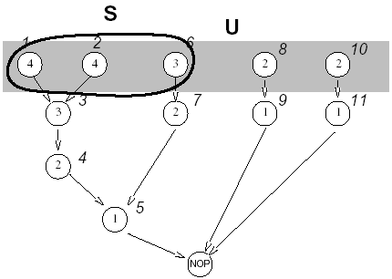
Hu’s Algorithm (for Multiprocessors)
Labeling of nodes
  Label operations based on their distances from the sink
Notation
  α_{I} = label of node i
  α = max_{i} α_{i}
  p(j) = # vertices with label j
Theorem (Hu)
  Lower bound on the number of resources to complete schedule with latency L is
a_{min} = max_{γ} ⎡∑ ^{γ} _{j=1} p(α +1- j) / (γ+L-α )⎤
where γ is a positive integer (1 ≤ γ ≤ α +1)
In this case: a_{min}= 3 (number of operators needed)
HLS - Scheduling

Slide 27
Hu’s Algorithm (min Latency s.t. Resource Constraint)
  HU (G(V,E), a) {
  Label the vertices // a = resource constraint (scalar)
  // label = length of longest path
  passing through the vertex
  l = 1
  repeat {
  U = unscheduled vertices in V whose
  predecessors have been already scheduled
  (or have no predecessors)
  Select S ⊆ U such that |S| ≤ a and labels in S are maximal
  Schedule the S operations at step l by setting
  t_{i}= l, ∀ v_{i} ∈ S;
  l = l + 1;
  } until v_{n} is scheduled.
  }
HLS - Scheduling

Slide 28
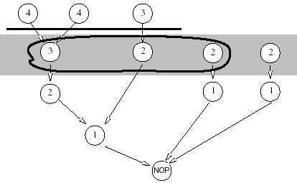
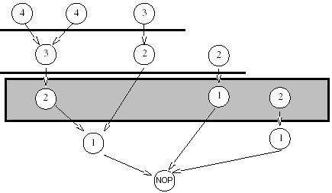
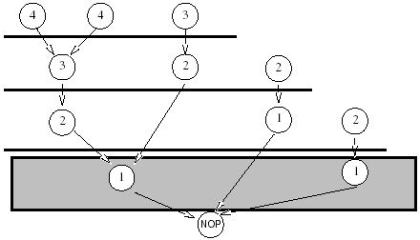
Hu’s Algorithm: Example (a=3)
HLS - Scheduling
[©Gupta]

Slide 29
List Scheduling (arbitrary operators)
Extend the idea to several operators
Greedy algorithm for ML-RCS and MR-LCS
  Does NOT guarantee optimum solution
Similar to Hu’s algorithm
  Operation selection decided by criticality
  O(n) time complexity
Considers a more general case
  Resource constraints with different resource types
  Multi-cycle operations
  Pipelined operations
HLS - Scheduling

Slide 30
List Scheduling Algorithms
Algorithm 1: Minimize latency under resource constraint (ML-RC)
  Resource constraint represented by vector a (indexed by resource type)
    Example: two types of resources, MULT (a₁=1), ADD (a₂=2)
Algorithm 2: Minimize resources under latency constraint (MR-LC)
  Latency constraint is given and resource constraint vector a to be minimized
Define:
The candidate operations U_{l,k}
  those operations of type k whose predecessors have already been scheduled early enough (completed at step l):
    U_{l,k} = { v_{i} ⊆ V: type(v_{i}) = k and t_{j} + d_{j} ≤ l, for all j: (v_{j}, v_{i}) ⊆ E
The unfinished operations T_{l,k}
  those operations of type k that started at earlier cycles but whose execution has not finished at step l (multi-cycle opearations):
    T_{l,k} = { v_{i} ⊆ V: type(v_{i}) = k and t_{i} + d_{i} > l
Priority list
  List operators according to some heuristic urgency measure
  Common priority list: labeled by position on the longest path in decreasing order
HLS - Scheduling

Slide 31
List Scheduling Algorithm 1: ML-RC
  Minimize latency under resource constraint
  LIST_L (G(V,E), a) { // resource constraints specified by vector a
  l = 1
  repeat {
  for each resource type k {
  U_{l,k} = candidate operations available in step l
  T_{l,k} = unfinished operations (in progress)
  Select S_{k} ⊆ U_{l,k} such that |S_{k}| + |T_{l,k}| ≤ a_{k}
  Schedule the S_{k} operations at step l
  }
  l = l + 1
  } until v_{n} is scheduled
  }
  Note: If for all operators i, d_{i} = 1 (unit delay), the set T_{l,k} is empty
HLS - Scheduling

Slide 32
List Scheduling ML-RC – Example 1 (a=[2,2])
Minimize latency under resource constraint (with d = 1)
Assumptions
  All operations have unit delay (d_{i} =1)
  Resource constraints:
    MULT: a₁ = 2, ALU: a₂ = 2
Step 1:
  U_{1,1} = {v₁,v₂, v₆, v₈}, select {v₁,v₂}
  U_{1,2} = {v₁₀}, select + schedule
Step 2:
  U_{2,1} = {v₃,v₆, v₈}, select {v₃,v₆}
  U_{2,2} = {v₁₁}, select + schedule
Step 3:
  U_{3,1} = {v₇,v₈}, select + schedule
  U_{3,2} = {v₄}, select + schedule
Step 4:
  U_{4,2} = {v₅,v₉}, select + schedule
0
NOP
1
2
10
T1
*
*
+
3
6
11
T2
*
*
<
4
7
8
T3
*
*
T4
5
9
+
n
NOP
HLS - Scheduling

Slide 33
List Scheduling ML-RC – Example 2a (a = [3,1]) Minimize latency under resource constraint (with d₁=2, d₂=1 )
Assumptions
  Operations have different delay:
    del_{MULT} = 2, del_{ALU} = 1
  Resource constraints:
    MULT: a₁ = 3, ALU: a₂ = 1
MUTL ALU start time
U= {v₁, v₂, v₆} v₁₀ 1
T= {v₁, v₂, v₆} v₁₁ 2
U= {v₃, v₇, v₈} -- 3
T= {v₃, v₇, v₈} -- 4
-- v₄ 5
-- v₅ 6
-- v₉ 7
Latency L = 8
NOP
T1
1
2
6
+
10
*
*
*
T2
<
11
T3
3
7
8
*
*
*
T4
T5
4
T6
5
T7
9
+
n
HLS - Scheduling
NOP

Slide 34
List Scheduling ML-RC – Example 2b (Pipelined)
Minimize latency under resource constraint (a₁=3 MULTs, a₂=3 ALUs )
Assumptions
  Multipliers are pipelined
  Sharing between first and second pipeline stage allowed for different multipliers
MULT ALU start time
{v₁, v₂, v₆} v₁₀ 1
v₈ v₁₁ 2
{v₃, v₇} -- 3
-- v₉ 4
-- v₄ 5
-- v₅ 6
L=7, Compare to multi-cycle case
NOP
T1
1
2
6
+
10
*
*
*
T2
<
11
*
T3
3
7
8
*
*
9
T4
+
T5
4
T6
5
n
NOP
HLS - Scheduling

Slide 35
List Scheduling Algorithm 2: MR-LC
  LIST_R (G(V,E), λ’) {
  a = 1, l = 1
  Compute latest possible starting times t ^{L} using ALAP algorithm
  repeat {
  for each resource type k {
  U_{l,k} = candidate operations;
  Compute slacks { s_{i} = t_{i}^{L} - l, ∀ v_{i}∈ U_{l,k} };
  Schedule operations with zero slack, update a;
  Schedule additional S_{k} ⊆ U_{l,k} requiring no additional resources;
  }
  l = l + 1
  } until v_{n} is scheduled.
  }
HLS - Scheduling

Slide 36
List Scheduling MR-LC – Example 4 (d_{i}=1)
Minimize resources under latency constraint
Assumptions
  All operations have unit delay (d_{i}=1)
  Latency constraint: L = 4
Use slack information to guide the scheduling
  Schedule operations with slack=0 first
  Add other operations only if current resource count allows
    e.g. add *6 with *3, without exceeding current Mult=2
  The lower the slack the more urgent it is to schedule the operation
0
NOP
1
2
10
T1
*
*
+
3
6
11
T2
*
*
<
4
7
8
T3
*
*
T4
5
9
+
n
NOP
HLS - Scheduling

Slide 37
Scheduling – a Combinatorial Optimization Problem
NP-complete Problem
Optimal solutions for special cases (trees) and ILP
Heuristics
  iterative Improvements
  constructive
Various versions of the problem
    Minimum latency, unconstrained (ASAP)
    Latency-constrained scheduling (ALAP)
    Minimum latency under resource constraints (ML-RC)
    Minimum resource schedule under latency constraint (MR-LC)
If all resources are identical, problem is reduced to multiprocessor scheduling (Hu’s algorithm)
    Minimum latency multiprocessor problem is intractable for general graphs
    For trees greedy algorithm gives optimum solution
HLS - Scheduling

