Slide 1
ECE 667
Spring 2011
Synthesis and Verification of Digital Circuits
High-Level (Architectural)
Synthesis

Slide 2
High Level Synthesis (HLS)
The process of converting a high-level description of a design to RTL
  Input:
    High-level languages (C, system C, system Verilog)
    Behavioral hardware description languages (Verilog, VHDL)
    Structural HDLs (VHDL, Verilog)
    State diagrams / logic networks
  Tools:
    Parser
    Library of modules
  Constraints:
    Resource constraints (no. of modules of a certain type)
    Timing constraints (Latency, delay, clock cycle)
  Output:
    Operation scheduling (time) and binding (resource)
    Control generation and RTL architecture

Slide 3
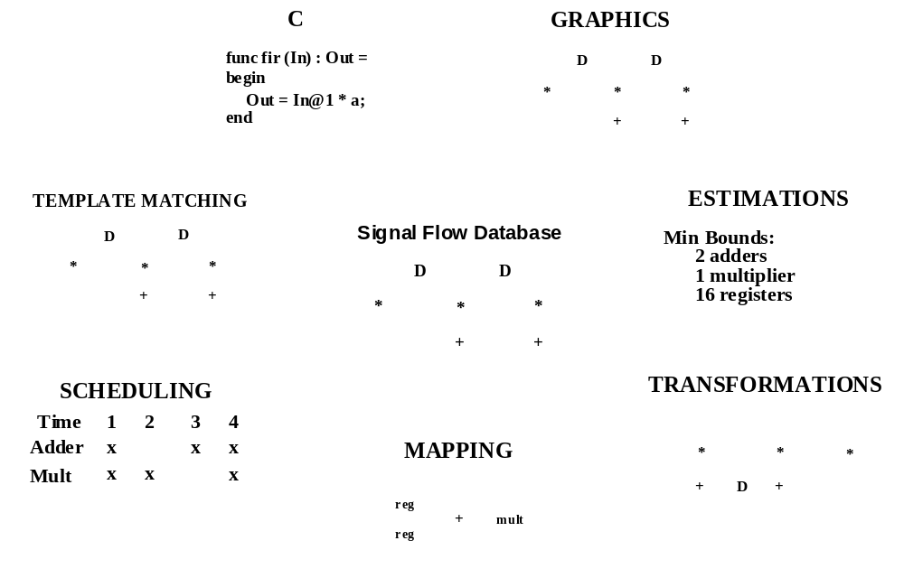
High Level Synthesis

Slide 4
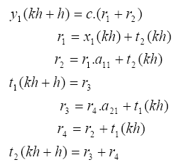
Example – Digital Filter design
A second-order digital filter
Verilog code:
/* A behavioral description of a digital filter
module digital_filter(x1,y1);
input x1;
output y1;
wire [7:0] r1,r2,r3,r4,t1,t2,c,a11,a21;
assign r1 = x1 + t2;
assign r2 = r1 * a11 + t2;
assign r4 = r2 + t1;
assign r3 = r4 + a21 + t1;
assign y1 = c* (r1 + r2);
assign t1 = r3;
assign t2 = r3 + r4;
endmodule
Algorithm:

Slide 5
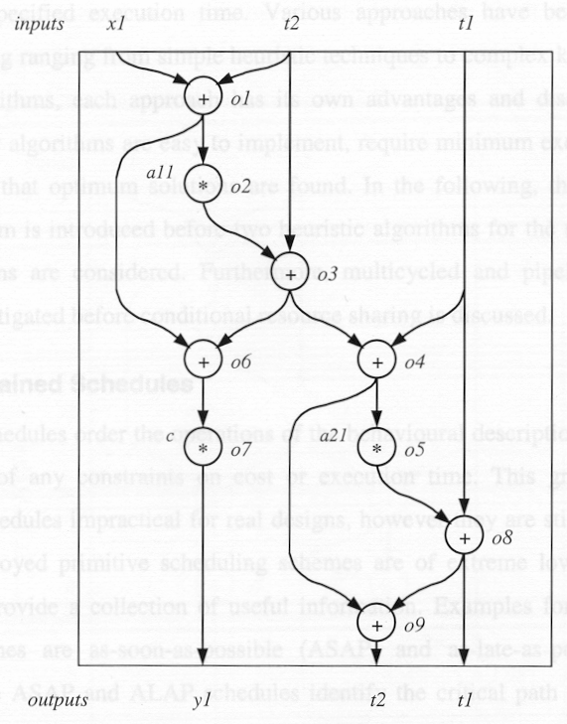
Example – Unscheduled DFG

Slide 6
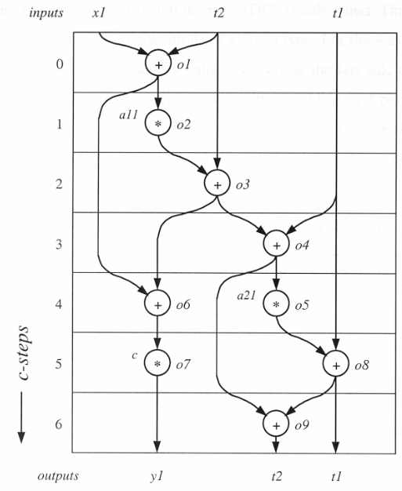
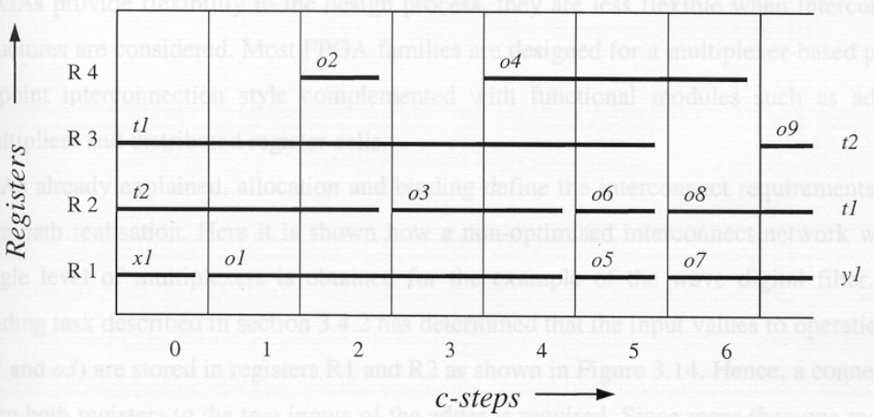
Example – Scheduling and Regs mapping
Register mapping (left-edge algorithm)
Resource-constraint scheduling ( 1 adder , 1 multiplier)

Slide 7
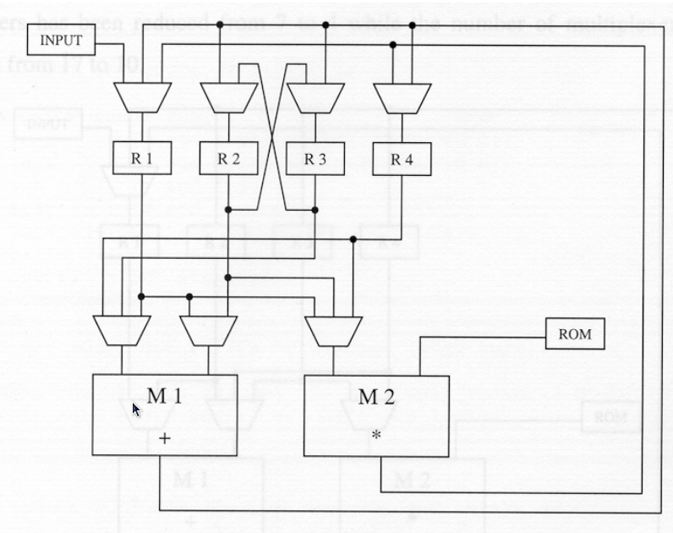
Example – Final Architecture
x1
FSM
controller
c1
c2
c3
c4
y1
const c
c5
c6
c7
n3
n4
n5
n1
n2

Slide 8
High-Level Synthesis Compilation Flow
Lex
x = a + b × c + d
Compilation
front-end
Parse
+
+
Behavioral
Optimization
Intermediate
form
+
+
×
×
a
d
b
c
a
b
c
d
Arch synth
Logic synth
HLS backend
Lib Binding

Slide 9
Behavioral Optimization
Techniques used in software compilation
  Expression tree height reduction
  Constant and variable propagation
  Common sub-expression elimination
  Dead-code elimination
  Operator strength reduction (e.g., *4 → << 2)
Typical Hardware transformations
  Conditional expansion
    If (c) then x=A else x=B
    ➔ compute A and B in parallel, x=(C)?A:B
  Loop unrolling
    Instead of k iterations of a loop, replicate the loop body k times
c
A
x
B

Slide 10
Optimization in Temporal Domain
Scheduling and binding can be done in different orders or together
Schedule:
  Mapping of operations to time slots (cycles)
  A scheduled sequencing graph is a labeled graph
NOP
NOP
1
×
×
×
×
+
1
×
×
+
2
×
×
+
<
2
×
×
<
3
-
3
-
×
×
-
-
+
4
4
NOP
NOP
[©Gupta]
Notes:
In the left schedule, how many multipliers do we need? How many ALU’s?
What about the schedule on the right?

Slide 11
Scheduling in Spatial Domain
Resource sharing
  More than one operation bound to same resource
  Operations have to be serialized
  Can be represented using hyperedges (define vertex partition)
NOP
1
×
×
×
×
+
2
×
×
+
<
3
-
-
4
NOP
[©Gupta]

Slide 12
Architectural Optimization
Optimization in view of design space flexibility
A multi-criteria optimization problem:
  Determine schedule φ and binding β.
  Under area Α, latency L and cycle time τ objectives
Find non-dominated points in solution space
Solution space tradeoff curves:
  Non-linear, discontinuous
  Area / latency / cycle time (more?)
Evaluate (estimate) cost functions
Unconstrained optimization problems for resource dominated circuits:
  Min area: solve for minimal binding
  Min latency: solve for minimum L scheduling
[©Gupta]

Slide 13
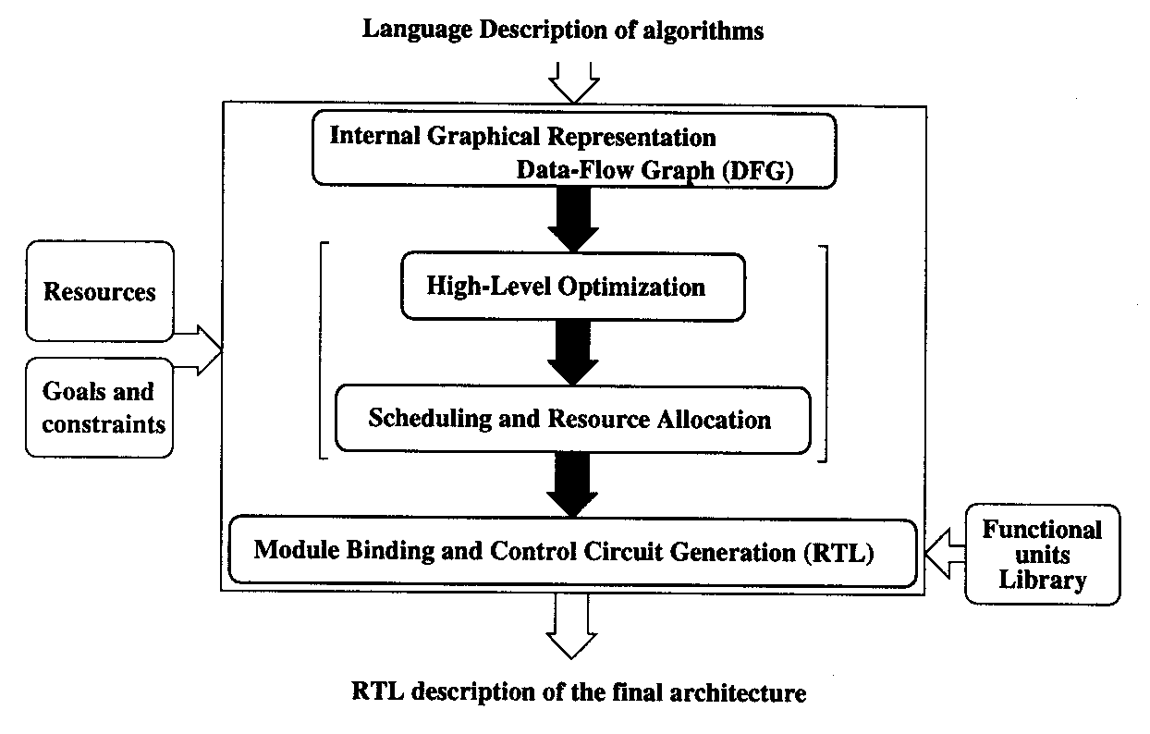
Typical High-Level Synthesis System

Slide 14
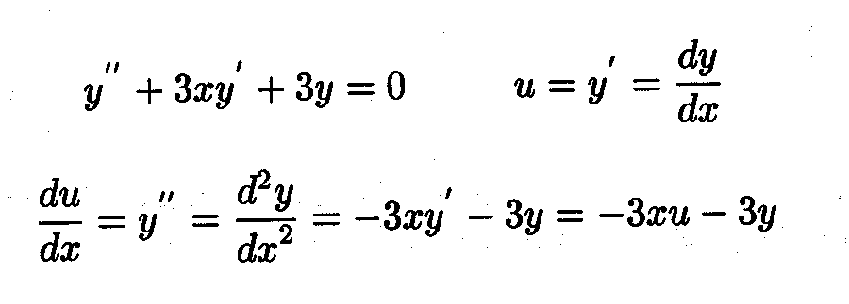
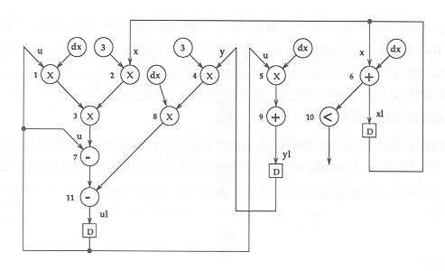
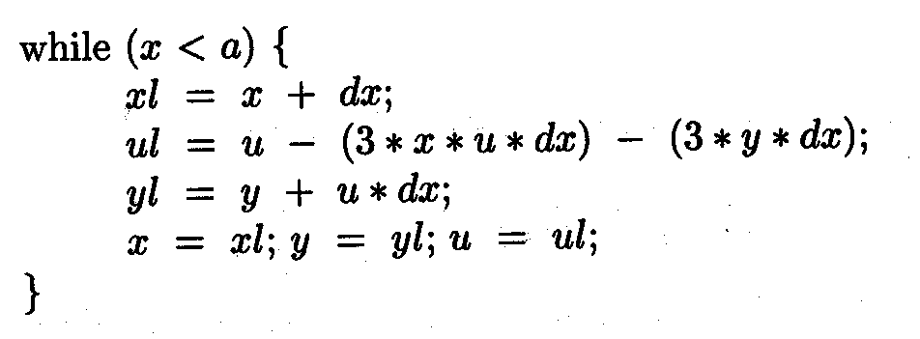
Algorithm Description

Slide 15
Control Data Flow Graph (CDFG)

Slide 16
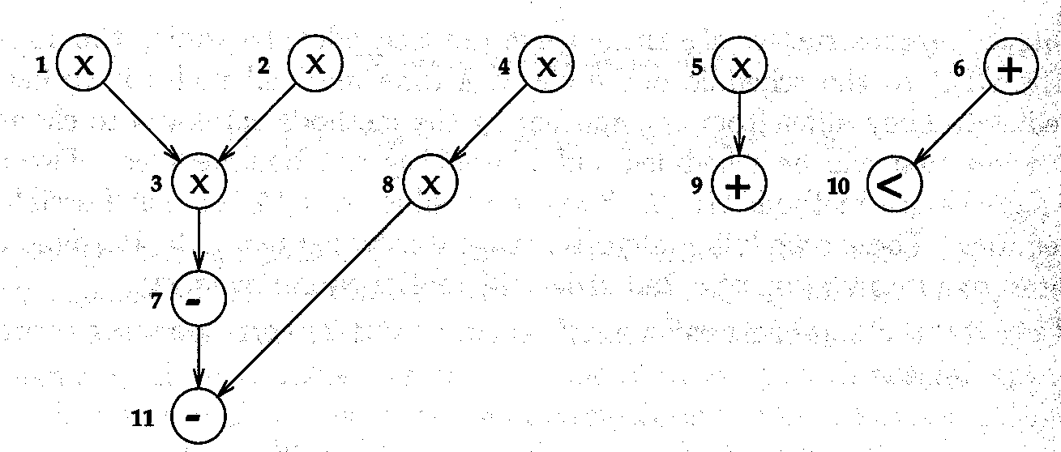
Precedence Graph

Slide 17
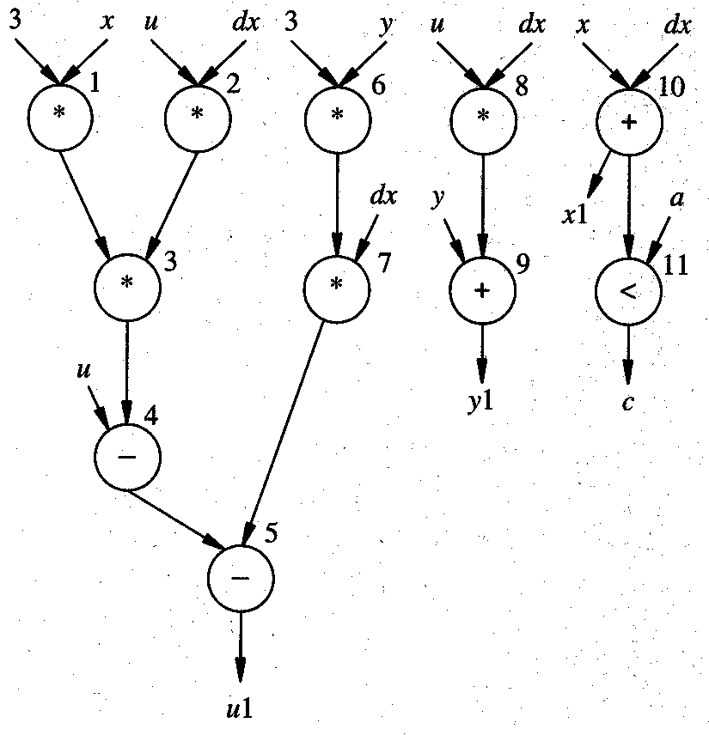
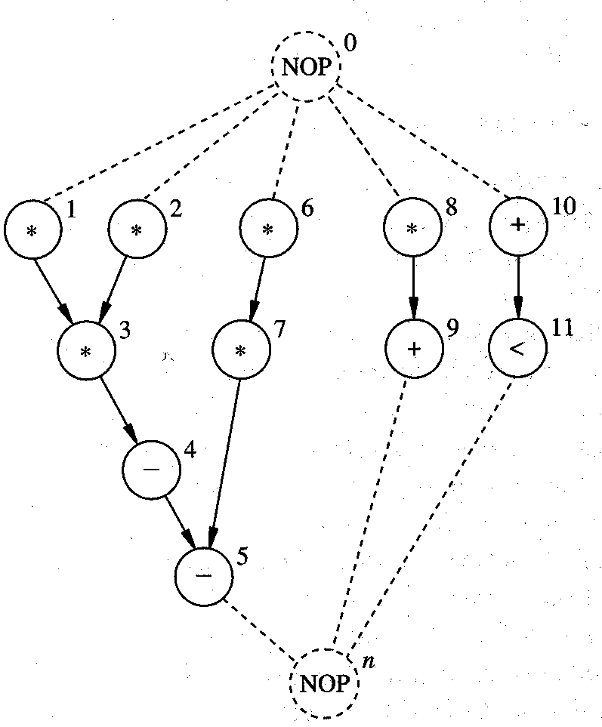
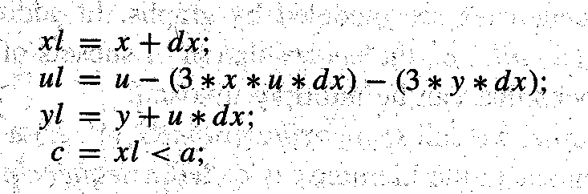
Sequence Graph: Start and End Nodes

Slide 18
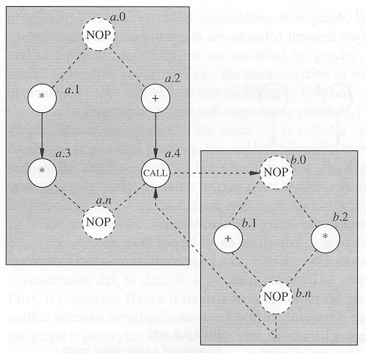
Hierarchy in Sequence Graphs

Slide 19
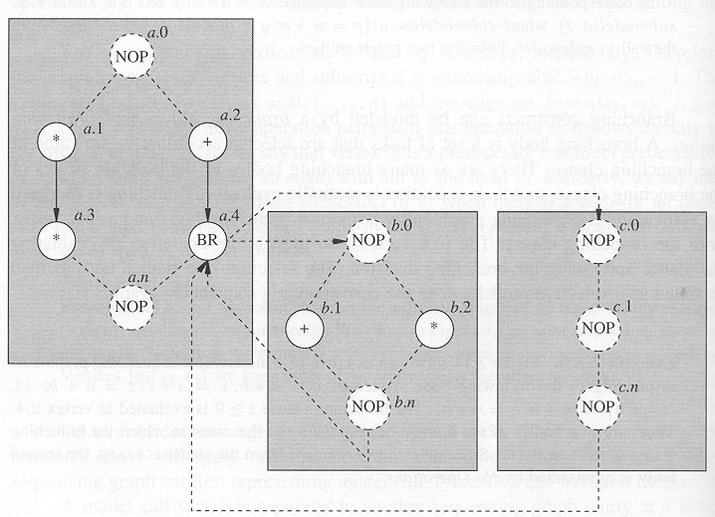
Hierarchy in Sequence Graphs (contd.)

Slide 20
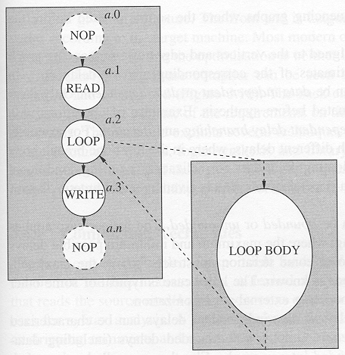
Hierarchy in Sequence Graphs (contd.)

Slide 21
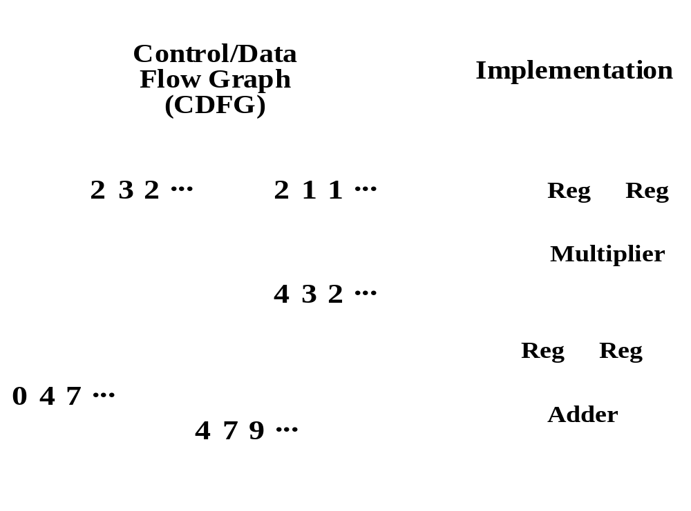
Implementation

Slide 22
Synthesis Flow – mapping & optimization steps
Original specification
HDL
Un-scheduled DFG: one-to-one mapping from HDL spec.
DFG₁
DFG₂
DFG_{n}
RTL optimized for particular objective
RTL₁
RTL₂
Physical Implementation
Circuit, SoC

Slide 23
Data Flow Graph (DFG)
Precedence graph for computation F
Transformation
F = a*(b + c)
F = a*b + a*c
a
b
c
b
a
c
+
x
x
x
+
F
F

Slide 24
DFG Scheduling
a
b
c
b
a
c
+
x
x
X
+
F=a(b+c)
F=ab+ac
b
a
c
a
b
c
b
a
c
x
+
s0
s0
s0
x
x
s1
x
s1
X
s1
+
s2
+
F
F
F
L=2, 1 Add, 1 Mult
L=2, 1 Add, 2 Mult
L=3, 1 Add, 1 Mult

Slide 25
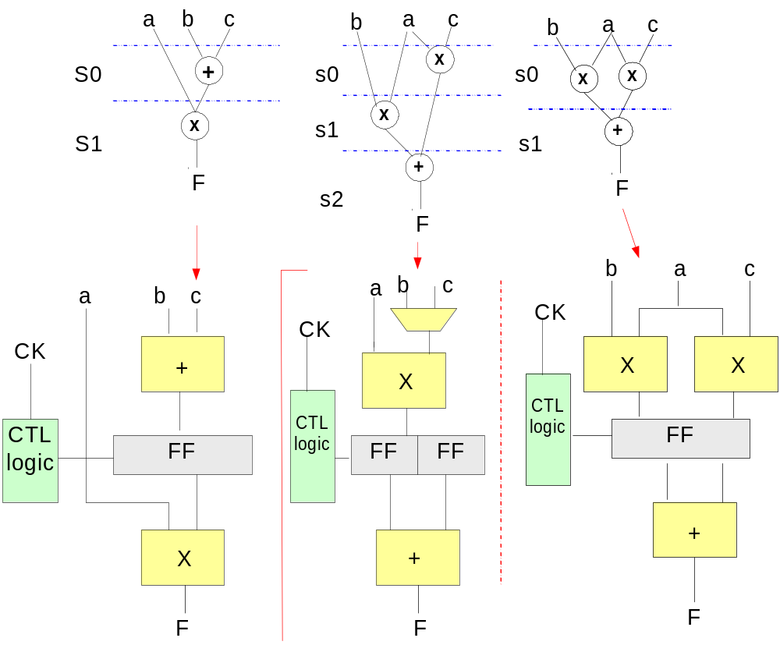
Scheduling affects RTL

Slide 26
Resources: Datapath Library
Operators available from datapath library
  pre-synthesized, pre-characterized
  different layout, etc
(+):
(4x1)
(2x2)
(x):
(3x5)
(4x4)
(mux):
(2x1)
(FF):
(4x1)
(2x2)

Slide 27
Floorplan Estimation
b
c
mux
a
+
FF2
CK
X
x
FF1
CTL
logic
FF
FF
mux
+
FF2
F
+
X
FF1
Evaluate: area, wirelength, congestion, interconnect, …

