Slide 1
ECE 667
Synthesis and Verification of Digital Circuits
Scheduling Algorithms
Analytical approach - ILP
Notes:
ECE 667

Slide 2
Scheduling – a Combinatorial Optimization Problem
NP-complete Problem
Optimal solutions for special cases and for ILP
  Integer linear program (ILP)
  Branch and bound
Heuristics
  iterative Improvements, constructive
Various versions of the problem
    Minimum latency, unconstrained (ASAP)
    Latency-constrained scheduling (ALAP)
    Minimum latency under resource constraints (ML-RC)
    Minimum resource schedule under latency constraint (MR-LC)
If all resources are identical, problem is reduced to multiprocessor scheduling (Hu’s algorithm)
    In general, minimum latency multiprocessor problem is intractable under resource constraint
    Under certain constraints (G(VE) is a tree), greedy algorithm gives optimum solution
ECE 667 - Synthesis & Verification - LP Scheduling

Slide 3
Integer Linear Programming (ILP)
Given:
  integer-valued matrix A_{m x n}
  variables: x = ( x₁, x₂, … , x_{n} )^{T}
  constants: b = ( b₁, b₂, … , b_{m} )^{T} and c = ( c₁, c₂, … , c_{n} )^{T}
Minimize: c^{T} x
subject to:
A x ≤ b
x = ( x₁, x₂, … , x_{n} ) is an integer-valued vector
If all variables are continuous, the problem is called linear (LP)
Problem is called Integer LP (ILP) if some variables x are integer
  special case: 0,1 (binary) ILP
ECE 667 - Synthesis & Verification - LP Scheduling

Slide 4
Linear Programming – example
Variables: x = [x₁, x₂]^{T}
Objective function: max F = -x₁ + x₂ = [-1 1] [x₁, x₂]^{T}
Constraints: -2x₁ + x₂ ≤ 1
x₁ + 2x₂ ≤ 5
x₂
F * =1.6
3
F=1
F=0
2
F *= 1.6
(x₁=0.6, x₂=2.2)
1
x₁
1
2
3
4
5
ECE 667 - Synthesis & Verification - LP Scheduling

Slide 5
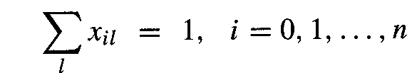
ILP Model of Scheduling
Binary decision variables x_{il}
x_{il} = 1 if operation v_{i} starts in step l,
otherwise x_{il} = 0
i = 0, 1, …, n (operations)
l= 1, 2, … λ+1 (steps, with limit λ )
Start time of each operation vi is unique:
l=t_{i} ^{L}
Note:
∑_{l} x_{il} = ∑ x_{il}
l=t_{i} ^{S}
where:
t _{i}^{S} = time of operation I computed with ASAP
t _{i}^{L} = time of operation I computed with ALAP
ECE 667 - Synthesis & Verification - LP Scheduling

Slide 6
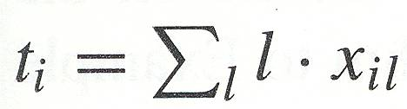
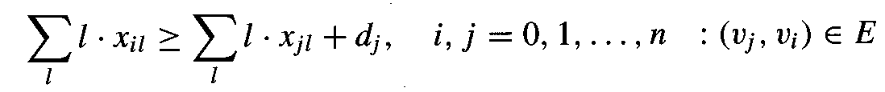
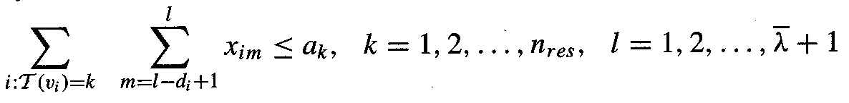
ILP Model of Scheduling - constraints
Start time for v_{i}:
Precedence relationships must be satisfied
Resource constraints must be met
  let upper bound on number of resources of type k be a_{k}
ECE 667 - Synthesis & Verification - LP Scheduling

Slide 7
Latency Minimization - Objective Function
Function to be minimized: F = c^{T}t, where
Minimum latency schedule: c = [0, 0, …, 1]^{T}
  F = t_{n} = ∑_{l} l x_{nl}
  where t_{n} refers to the start time of last node (NOP) !
  if sink has no mobility (x_{n,s} = 1), any feasible schedule is optimum
ASAP: c = [1, 1, …, 1]^{T}
  finds earliest start times for all operations ∑_{i} ∑_{l} x_{il}
  or equivalently:
ECE 667 - Synthesis & Verification - LP Scheduling

Slide 8
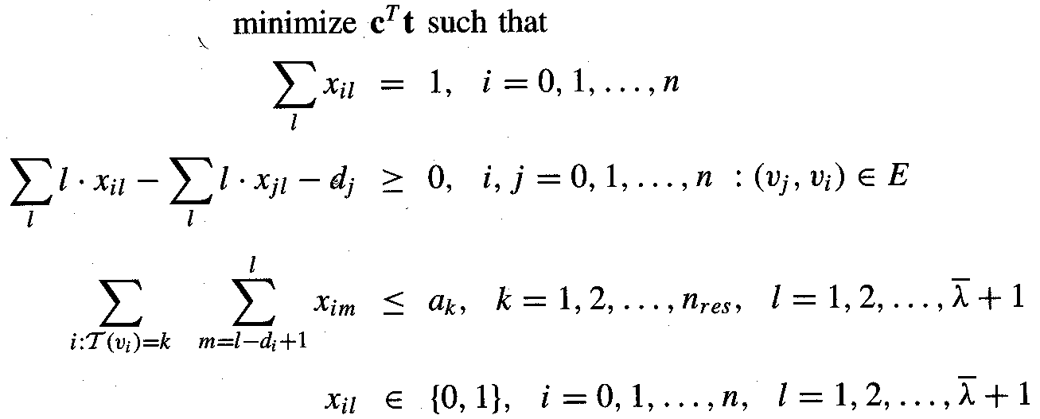
Minimum-Latency Scheduling under Resource Constraints (ML-RC)
Let t be the vector whose entries are start times
  t = [ t₀, t₁,…., t_{n} ]
Formal ILP model
ECE 667 - Synthesis & Verification - LP Scheduling

Slide 9
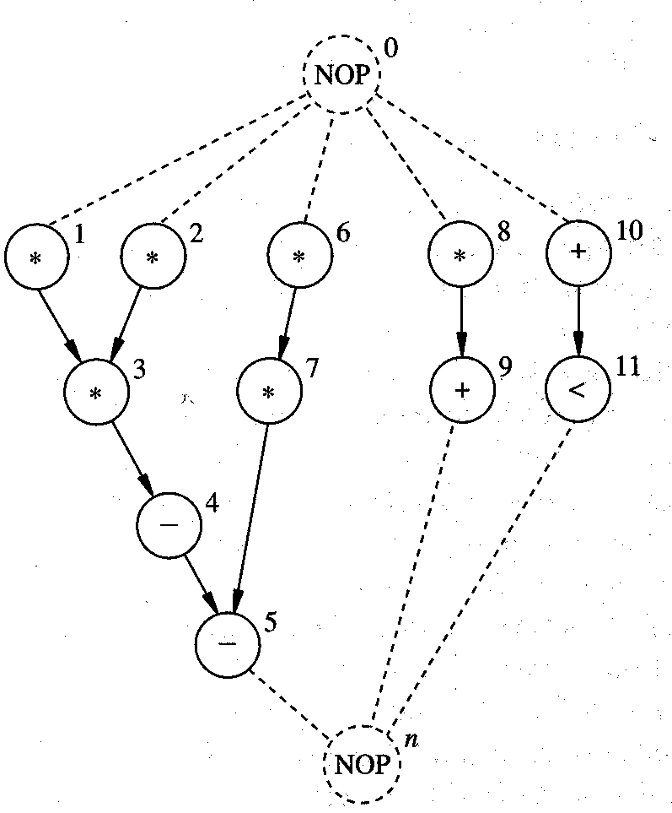
Example 1 – multiple resources
Two types of resources
  MULT
  ALU
    Adder, Subtractor
    Comparator
Each take 1 cycle of execution time
Assume upper bound on latency, L = 4
Use ALAP and ASAP to derive bounds on start times for each operator
ECE 667 - Synthesis & Verification - LP Scheduling

Slide 10
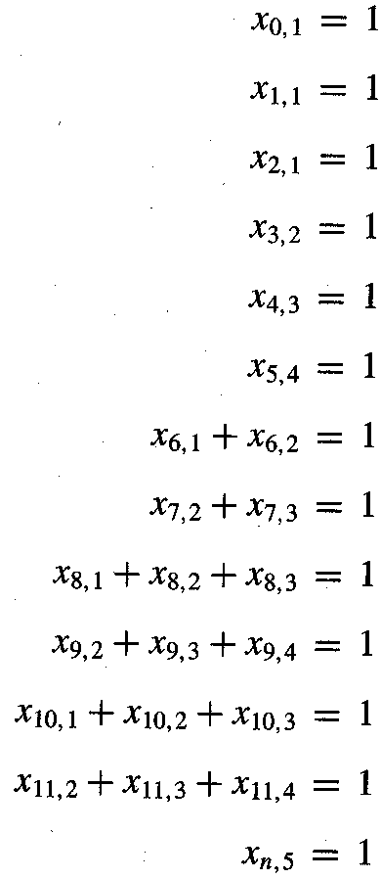

Example 1 (cont’d.)
Start time must be unique
l=t_{i} ^{L}
Recall:
∑_{l} x_{il} = ∑ x_{il}
where:
t _{i}^{S} = t_{i} computed with ASAP
t _{i}^{L} = t_{i} computed with ALAP
l=t_{i} ^{S}
ECE 667 - Synthesis & Verification - LP Scheduling

Slide 11
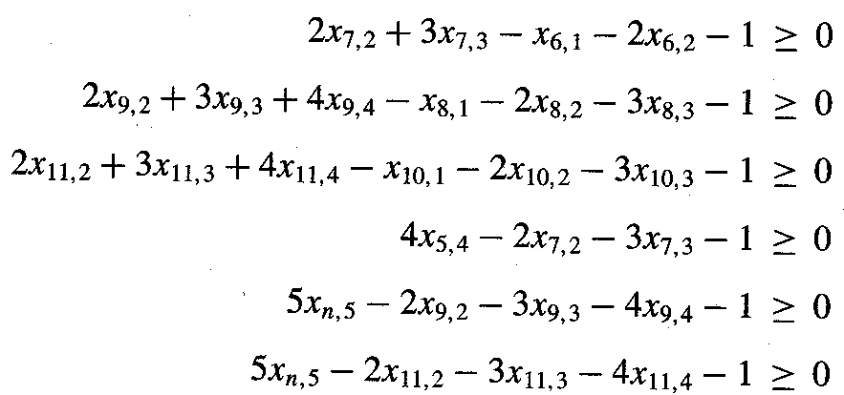

Example 1 (cont’d.)
Precedence constraints
  Note: only non-trivial ones listed
ECE 667 - Synthesis & Verification - LP Scheduling

Slide 12
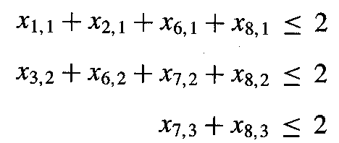
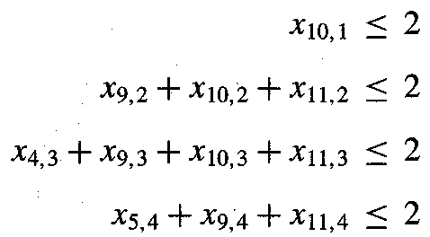
Example 1 (cont’d.)
Resource constraints
MULT
a1=2
ALU
a2=2
ECE 667 - Synthesis & Verification - LP Scheduling

Slide 13
Example 1 (cont’d.)
Objective function (some possibilities): F = c^{T}t
F1: c = [0, 0, …, 1]^{T}
  where last entry refers to the last node (NOP) !
  Minimum latency schedule
  since sink has no mobility (x_{n,5} = 1), any feasible schedule is optimum
F2: c = [1, 1, …, 1] ^{T}
  finds earliest start times for all operations ∑ _{i} ∑ _{l} x_{il}
  or equivalently:
ECE 667 - Synthesis & Verification - LP Scheduling

Slide 14
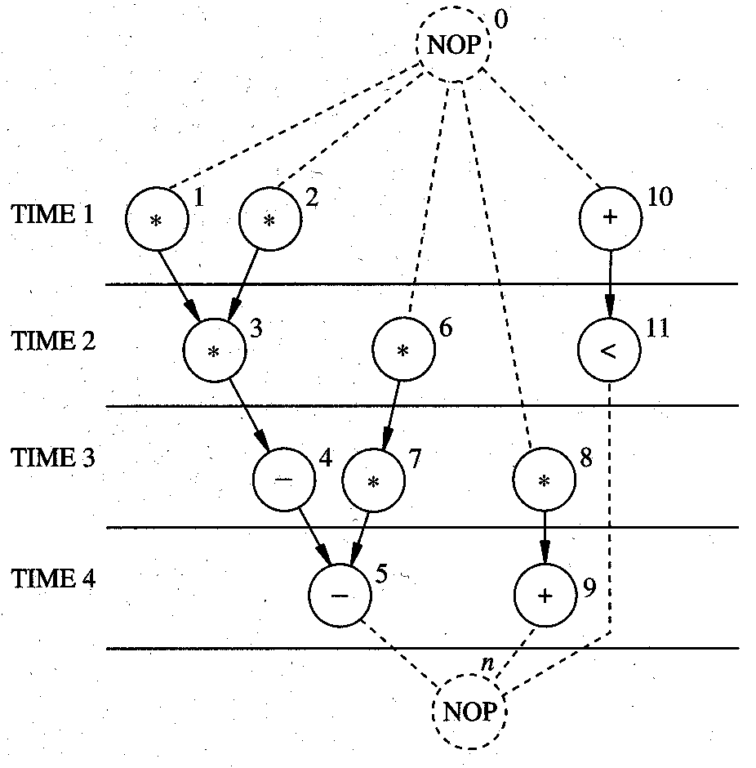
Example Solution 1:
Min. Latency Schedule Under Resource Constraint
ECE 667 - Synthesis & Verification - LP Scheduling
Notes:
ECE 667

Slide 15
Minimum Resource Scheduling under Latency Constraint (MR-LC)
Special case
  Identical operations, each executing in one cycle time
Given a set of operations {v₁,v₂,...,v_{n}},
  find the minimum number of operation units needed to complete the execution in k control steps (MR-LC problem)
Integer Linear Programming (ILP):
  Let y₀ be an integer variable (# units to be minimized)
  for each control step l =1, …, k, define variable x_{il} as
x_{il} = 1, if computation v_{i} is executed in the l-th control step
0, otherwise
  define variable y_{l} (number of units in control step l ) for each l y_{l} = x_{1l} + x_{2l} + ... + x_{nl} = Σ_{i} x_{il}
ECE 667 - Synthesis & Verification - LP Scheduling

Slide 16
ILP Scheduling – simple MR-LC
Minimize: y₀
Subject to:
Each computation v_{i} can start only once:
  x_{il}= 1 f or only one value of l (control step) (“vertical” constraint)
For each precedence relation:
  If v_{j} has to be executed after v_{i}
x_{j1} + 2 x_{j2}+ ... + k x_{jk} ≥ x_{i1} + 2 x_{i2} + ... + k x_{ik}+ d(i)
y_{l} ≤ y₀ for all l= 1,…, k (steps)
Meaning of y0:
  upper bound on the number of units, to be minimized
ECE 667 - Synthesis & Verification - LP Scheduling

Slide 17
Example 2 - Formulation
n = 6 computations
k = 3 control steps
d(i) = 1
v₁
v₂
v₃
v₄
v₅
Execution constraints:
x_{i1} + x_{i2} + x_{i3} = 1 for i = 1,…, 6
v₆
Resource constraints:
y_{l} = x_{1l} + x_{2l} + x_{3l}+ x_{4l} + x_{5l} + x_{6l} for l = 1,…, 3 (steps)
Dependency constraints: e.g. v₄ executes after v₁
  x₄₁ + 2x₄₂+ 3x₄₃ ≥ x₁₁ + 2x₁₂ + 3x₁₃ +1
  . . . . . . . etc.
ECE 667 - Synthesis & Verification - LP Scheduling

Slide 18
Example 2 – Simplified Formulation
Minimize y₀
v₁
v₂
v₃
v₄
v₅
Execution constraints:
x₃₁ + x₃₂ = 1
x₅₂ + x₅₃ = 1
x₁₁, x₂₁, x₄₂, x₆₃ = 1
v₆
Resource constraints:
y₁ = x₁₁ + x₂₁ + x₃₁
y₂ = x₄₂ + x₃₂ + x₅₂
y₃ = x₆₃ + x₅₃
Dependency constraints:
  2 x₄₂ ≥ x₁₁ + 1
  2 x₄₂ ≥ x₂₁ + 1
  3 x₆₃ ≥ 2 x₄₂ + 1
  3 x₆₃ ≥ x₃₁ +2 x₃₂ + 1
  2 x₅₂ +3 x₅₃ ≥ x₃₁ +2 x₃₂ + 1
y₁ ≤ y₀
y₂ ≤ y₀
y₃ ≤ y₀
ECE 667 - Synthesis & Verification - LP Scheduling

Slide 19
Example 2 - Solution
Minimize: y₀
Subject to:
  y_{l} ≤ y₀ for l = 1,…, 3
  Starting time constraints …
  Precedence constraints …
One possible solution:
y₀ = 2
x₁₁ = 1, x₂₁ = 1,
x₃₂ = 1, x₄₂ = 1,
x₅₃ = 1, x₆₃ = 1.
all other x_{il} = 0
v₁
v₂
v₄
v₃
v₆
v₅
ECE 667 - Synthesis & Verification - LP Scheduling

Slide 20
Minimum Resource Scheduling under Latency Constraint – general MR-LC
General case: several operation units (resources)
Given
  vector c = [c₁, …, c_{r}] of resource costs (areas)
  vector a = [a₁, …, a_{r}] of number of resources (unknown)
Minimize total cost of resources
min c^{T}a
Resource constraints are expressed in terms of variables a_{k} = number of operators of type k
ECE 667 - Synthesis & Verification - LP Scheduling

Slide 21
Example 3 – Min. Resources under Latency Constraint
Let c = [5, 1]
  MULT costs = 5 units of area, c₁ = 5
  ALU costs = 1 unit of area, c₂ = 1
Starting time constraint – as before
Sequencing constraints - as before
Resource constraints – similar to ML-RC, but expressed in terms of unknown variables a₁ and a₂
    a₁ = number of multipliers
    a₂ = number of ALUs (add/sub)
Objective function:
c^{T}a = 5·a₁ + 1·a₂
ECE 667 - Synthesis & Verification - LP Scheduling

Slide 22
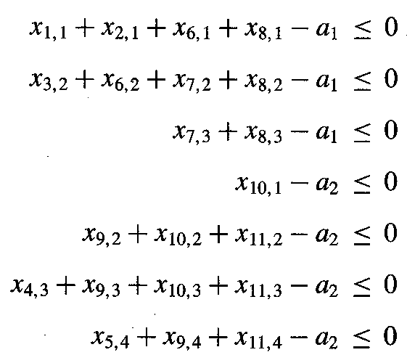
Example 3 (contd.)
Resource constraints
MULT
ALU
ECE 667 - Synthesis & Verification - LP Scheduling

Slide 23
Example 3 - Solution
Minimize
c^{T}a = 5·a₁ + 1·a₂
Solution with cost = 12
  a1 = 2
  a2 = 2
ECE 667 - Synthesis & Verification - LP Scheduling

Slide 24
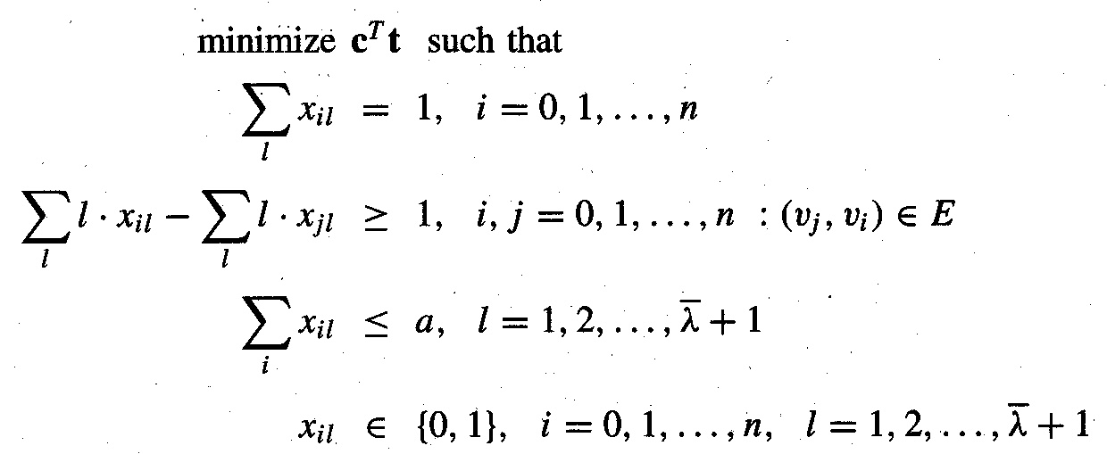
Precedence-constrained
Multiprocessor Scheduling
All operations performed by the same type of resource
  intractable problem; even if operations have unit delay
  except when the G_{c} is a tree (then it is optimal and O(n))
    Hu’s algorithm
ECE 667 - Synthesis & Verification - LP Scheduling

