Slide 1

Introduction
Jordi Cortadella
jordi.cortadella@upc.edu
Department of Computer Science
Omega building, office 242

Slide 2
Objectives
Understand the main stages of IC design flows
Study core data structures and algorithms for Electronic Design Automation (EDA)
Formulate mathematical models for complex optimization problems
Evaluate trade-offs between QoR and computational complexity
Transfer acquired optimization techniques to other engineering domains

Slide 3
Organization
Lectures: Mon, Thu (12:00-14:00)
Evaluation:
  Exercises:
    physical synthesis (15%)
    logic synthesis (15%)
  Course project: EDA tool (35%)
    One or two students per project
    Presentation at the end of the course
  Final exam (35%)
    A reduced set of notes allowed (few pages on paper)

Slide 4
Projects
Graph drawing
Floorplanning
Cell placement
  Global placement
  Detailed placement
Routing:
  Channel
  Global
  Detailed
Boolean minimization (Quine-McCluskey)
Algebraic factorization
Any algorithmic challenge proposed by the students (to be discussed)

Slide 5

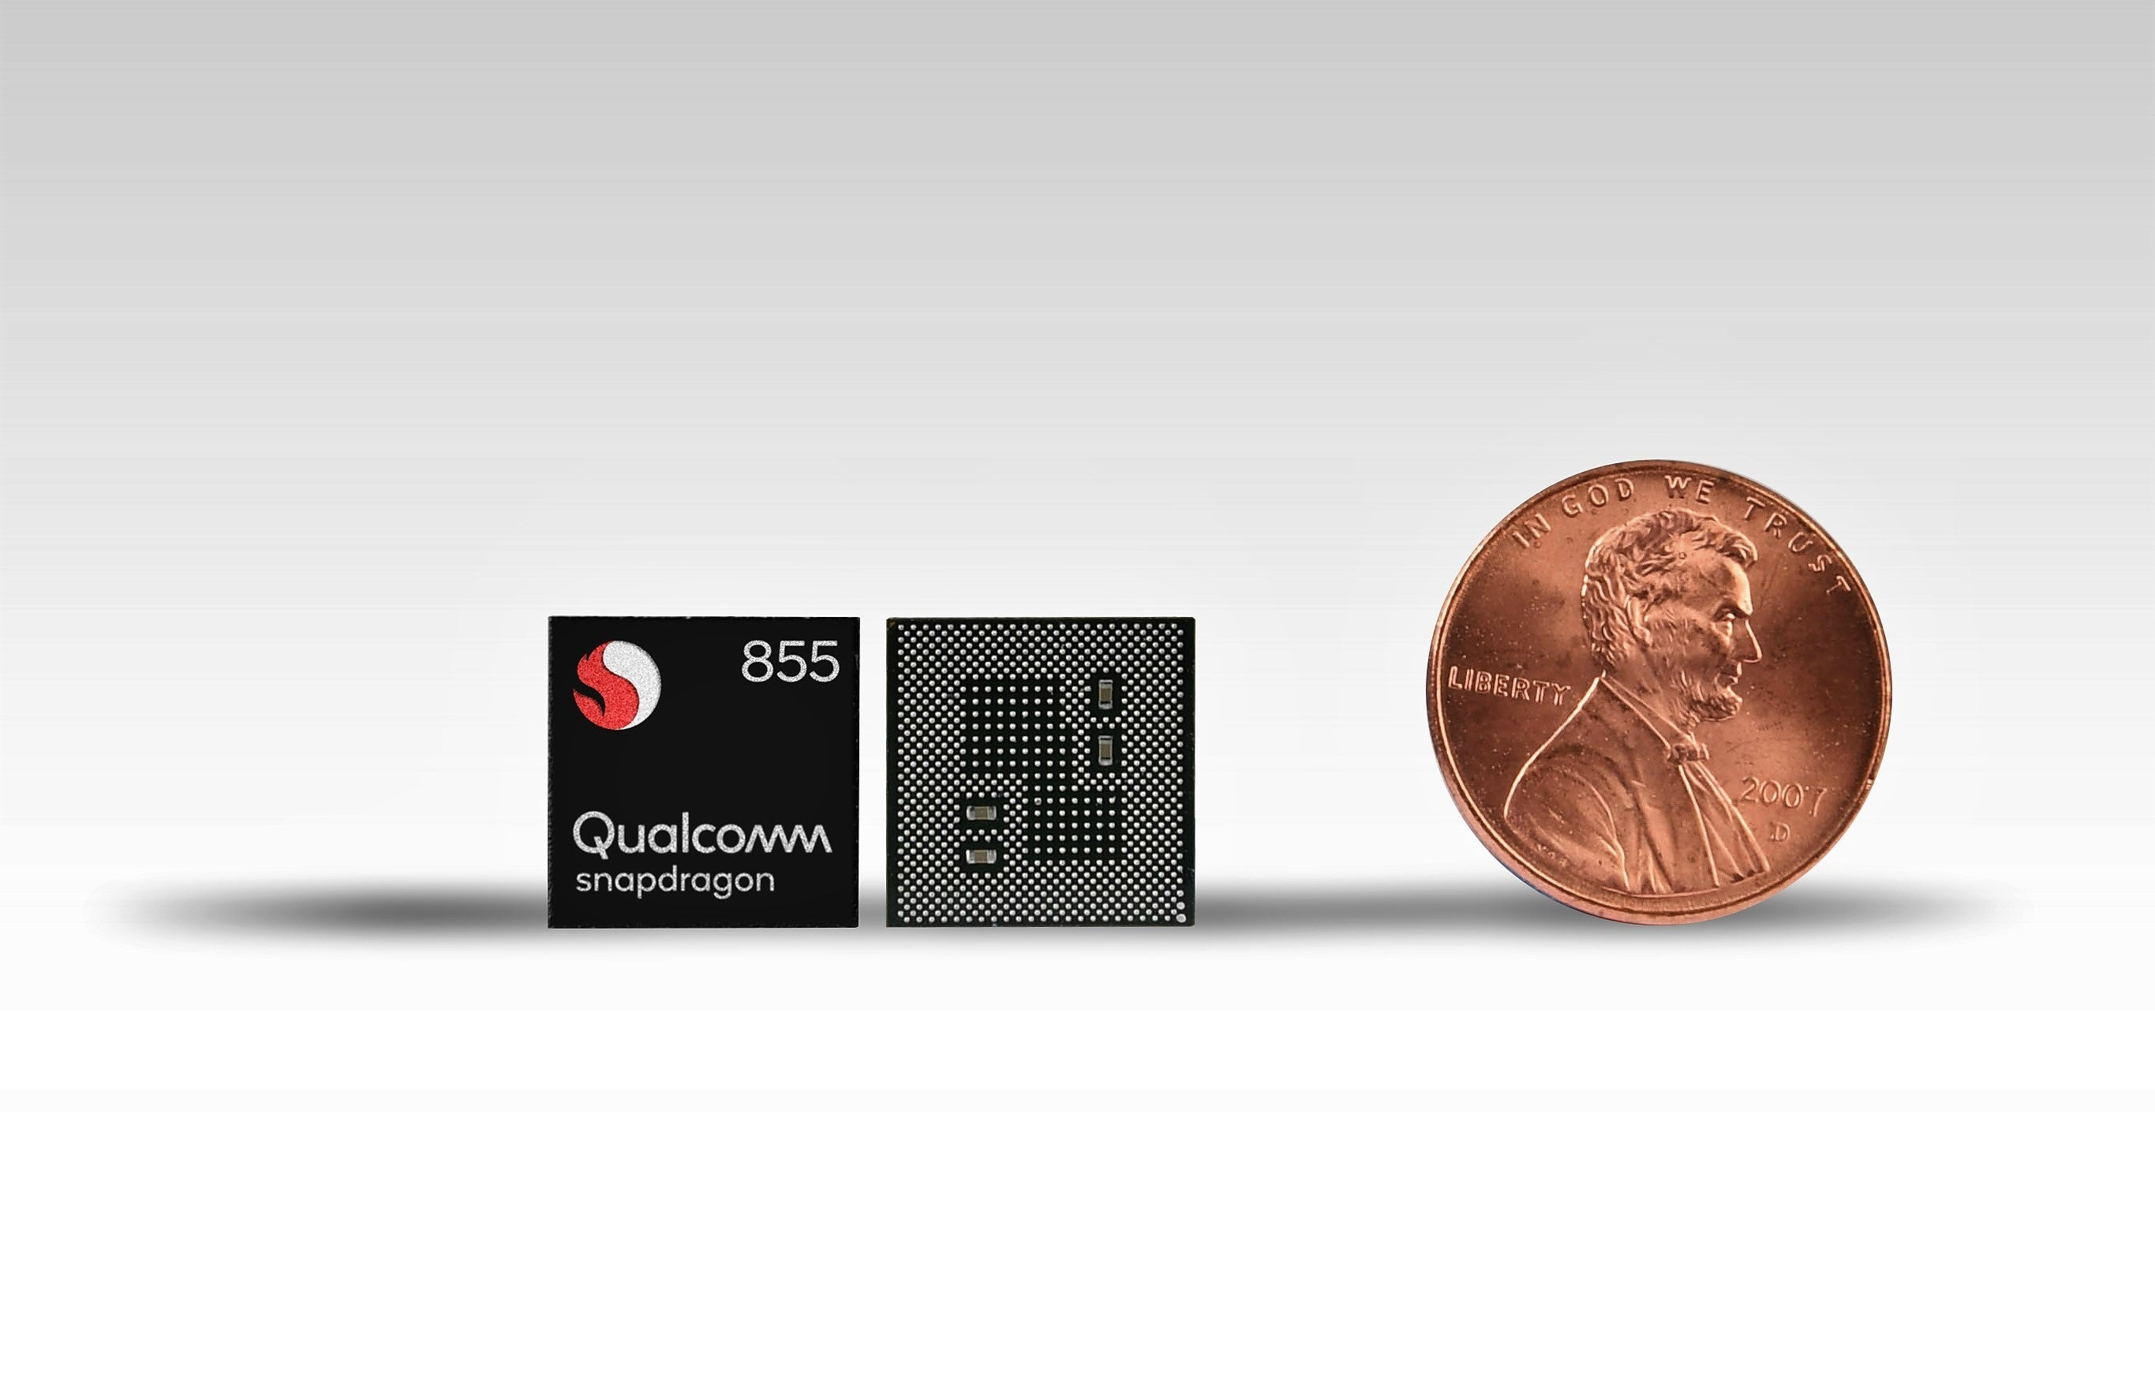

Slide 6
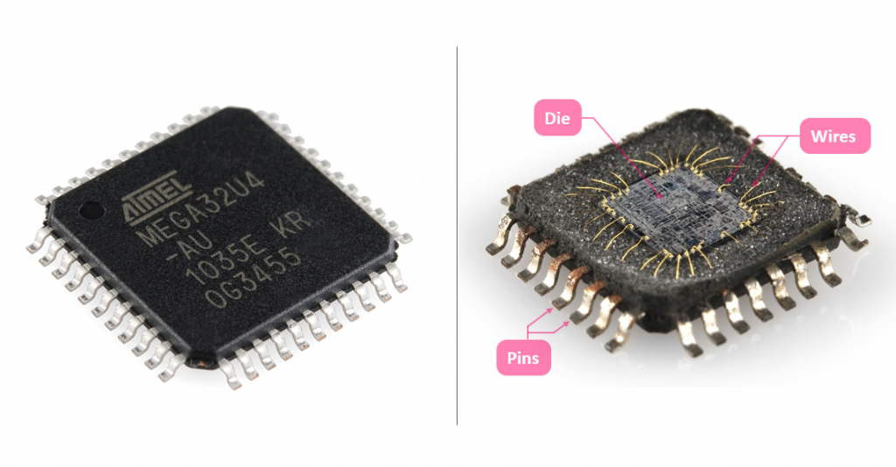

Slide 7
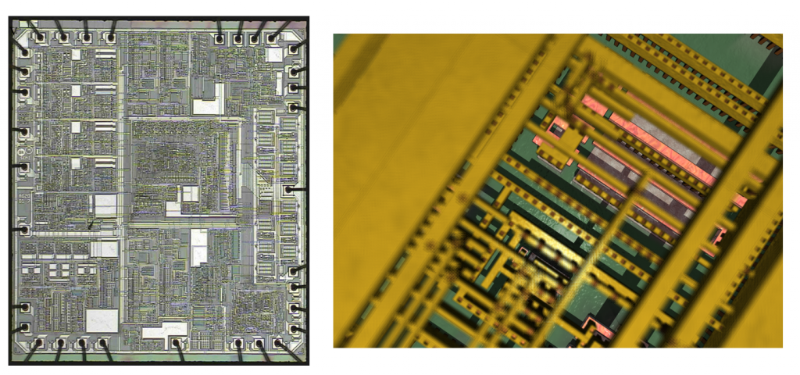

Slide 8
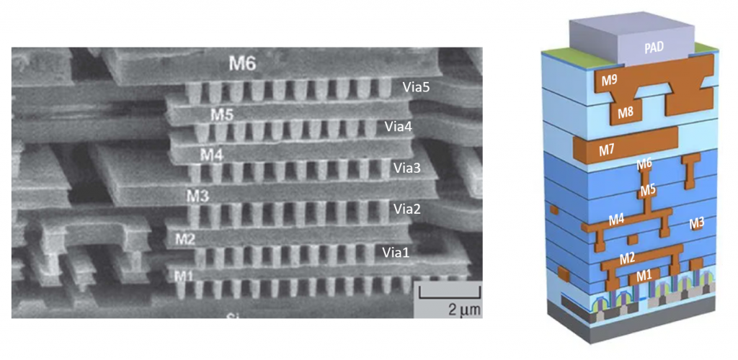

Slide 9
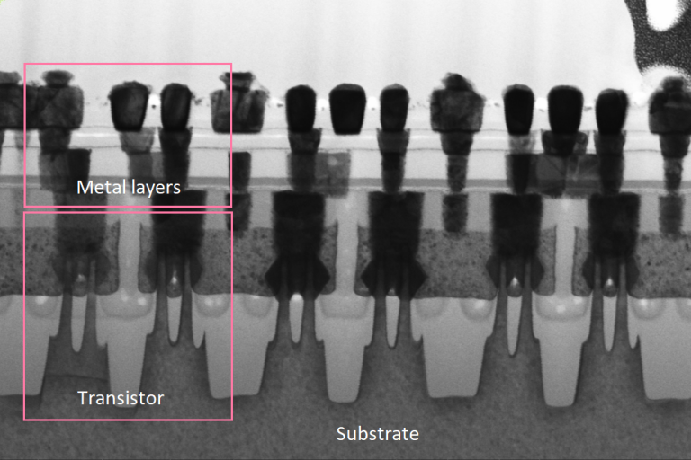

Slide 10
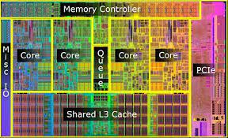
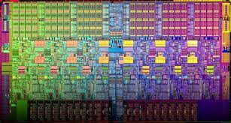
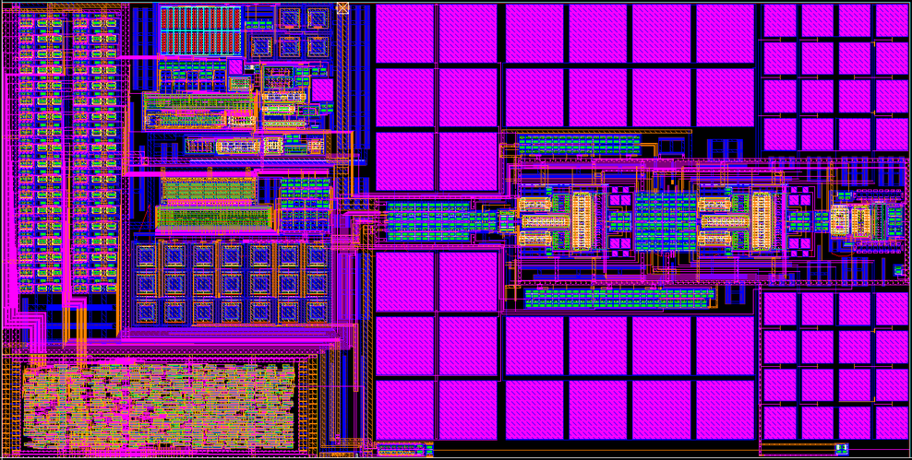

Slide 11
Outline
How transistors are built and work
How logic circuits are designed
How masks are generated for photolithographic processes

Slide 12
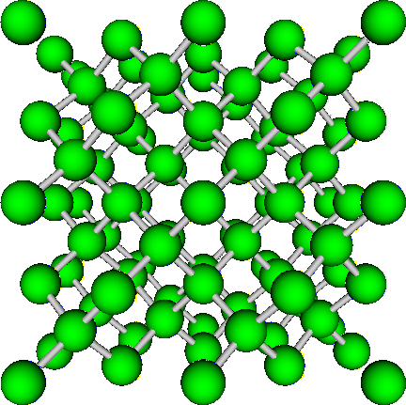
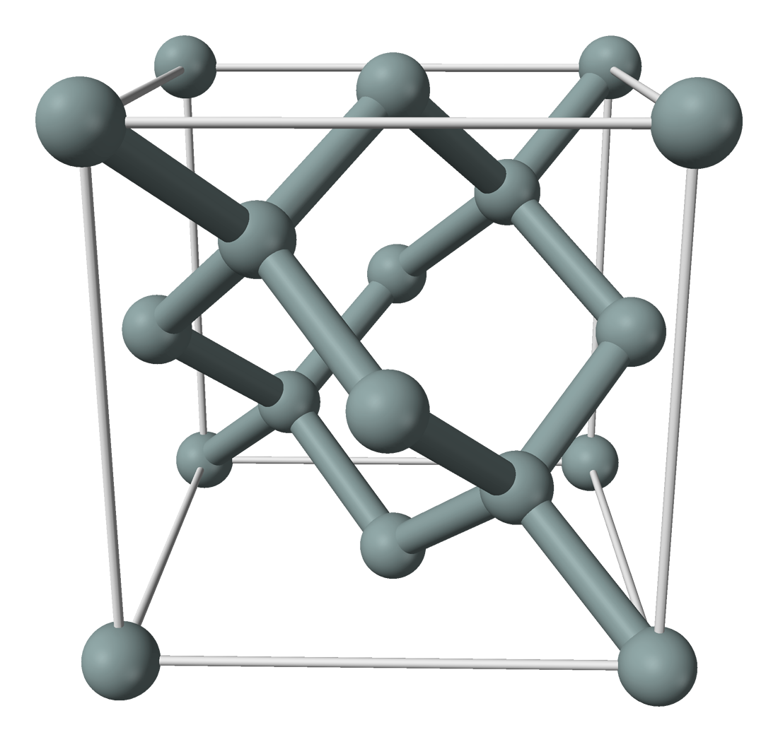
Crystalline silicon

Slide 13
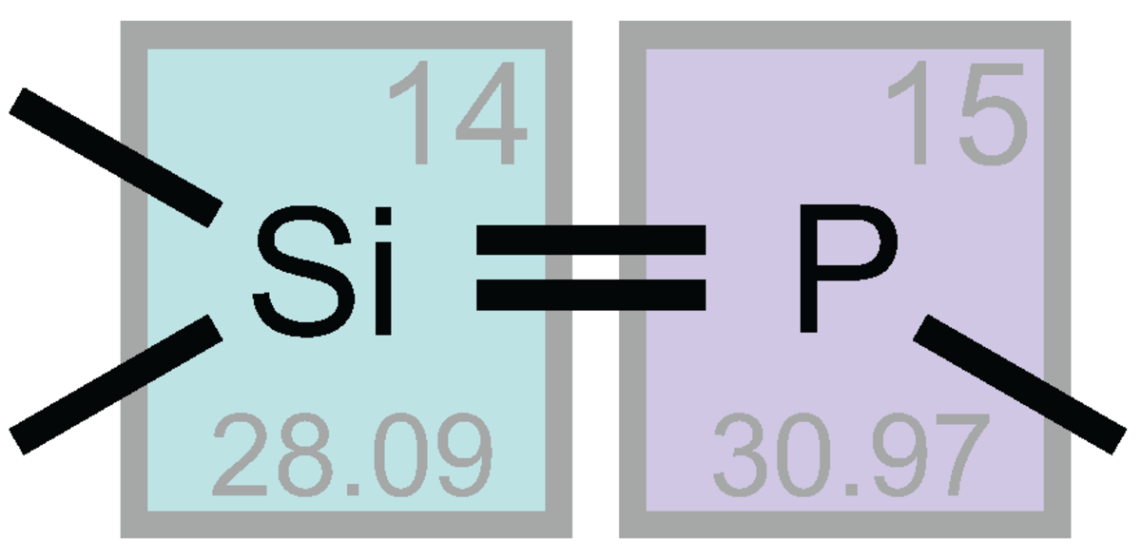
Silicon and Phosphorus: similar size
4 electrons
5 electrons

Slide 14
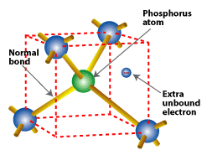
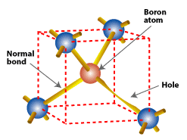
Doped silicon: Phosphorus and Boron

Slide 15
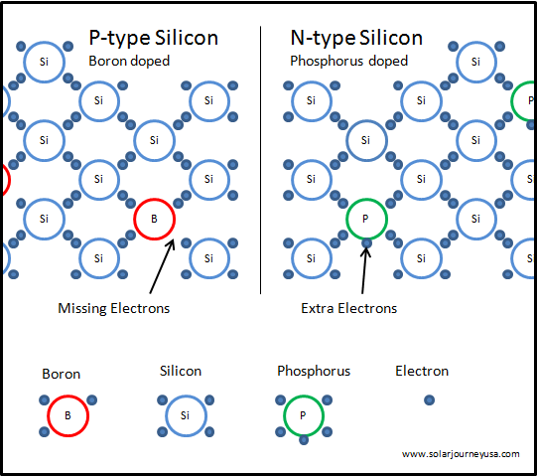
Doped silicon

Slide 16
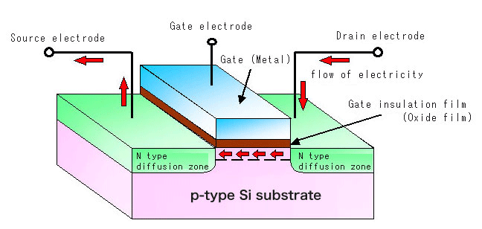
n-type transistor

Slide 17
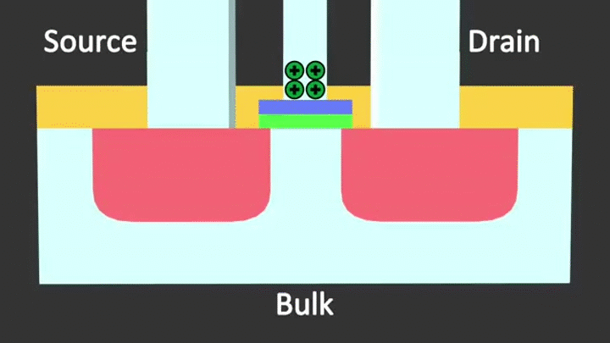
Note: be patient and wait for the animation

Slide 18
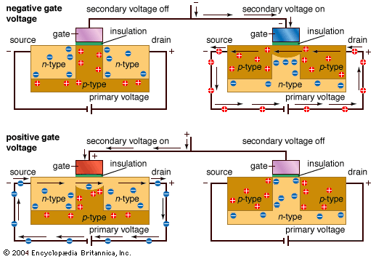

Slide 19
Transistor as a switch
G
G
S
D
S
D
n-type
p-type
0
1
1
0

Slide 20
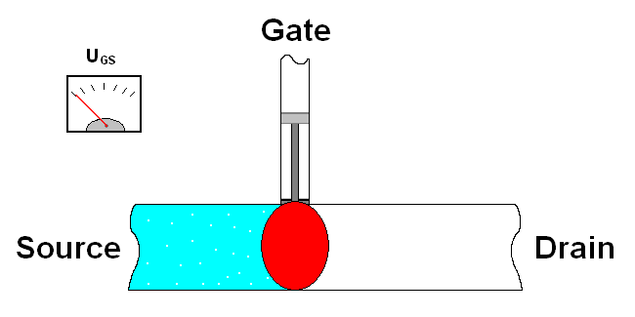

Slide 21
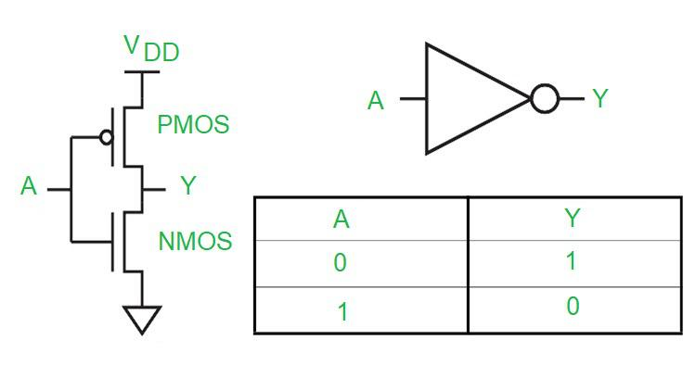
The inverter (NOT)
Vdd (1)
Vdd (1)
0
1
1
0
Gnd (0)
Gnd (0)

Slide 22
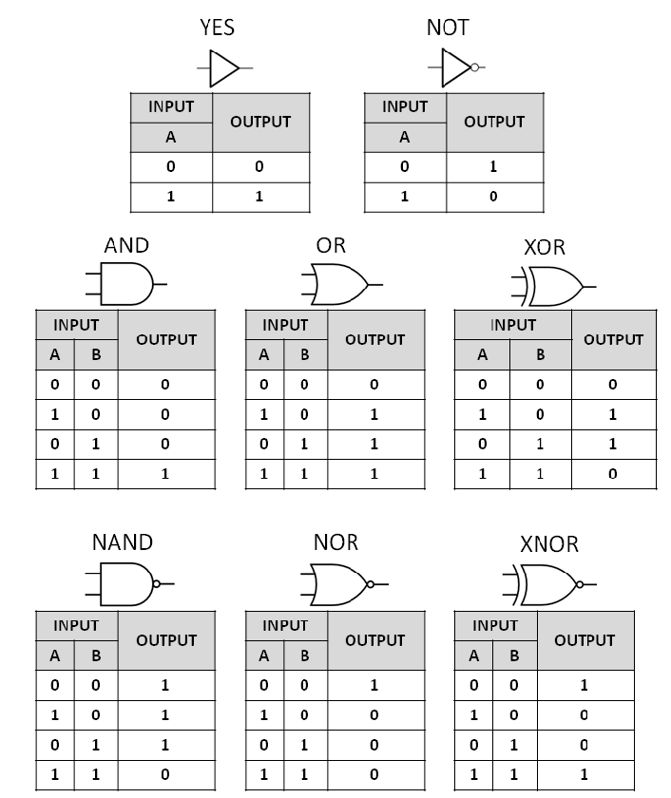

Slide 23
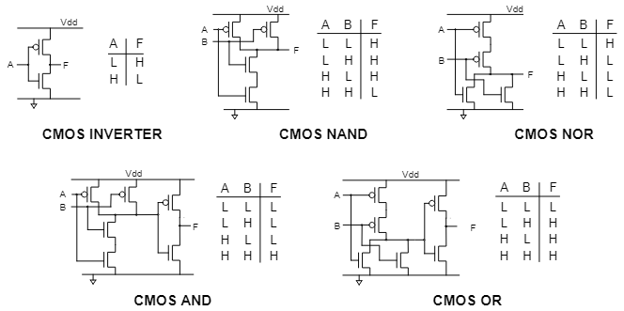

Slide 24
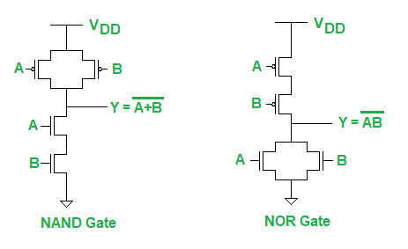
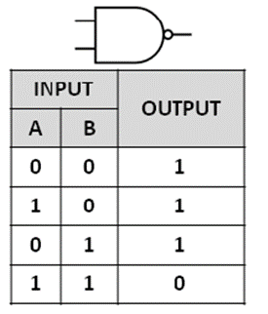
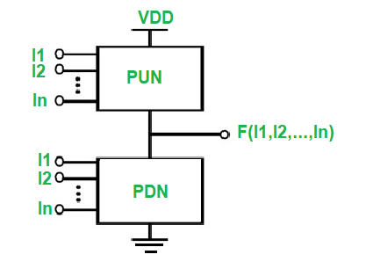




CMOS logic
$$Y=\overline{A∧B}$$
$$Y=\overline{A∨B}$$
$$Y=\overline{AB}$$
$$Y=\overline{A+B}$$

Slide 25

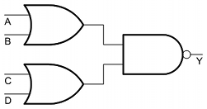
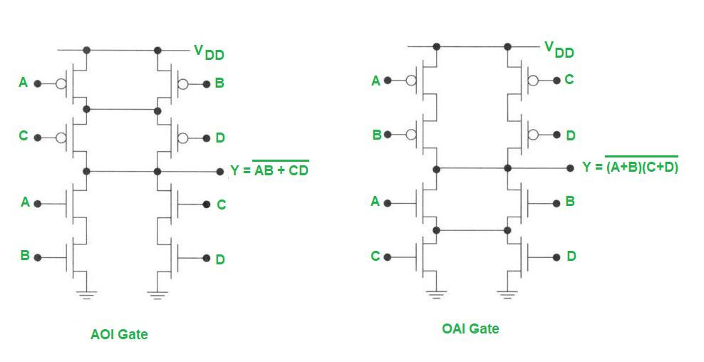
A
B
Y
C
D

Slide 26
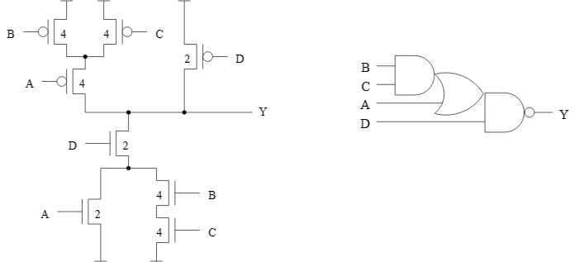
Y = ?

Slide 27





Adder
01010100
+ 00110101
84
+ 53
1
0
0
0
1
0
0
1
137
$$a$$
$$b$$
1-bit
adder
$$c_{out}$$
$$c_{in}$$
$$s$$

Slide 28
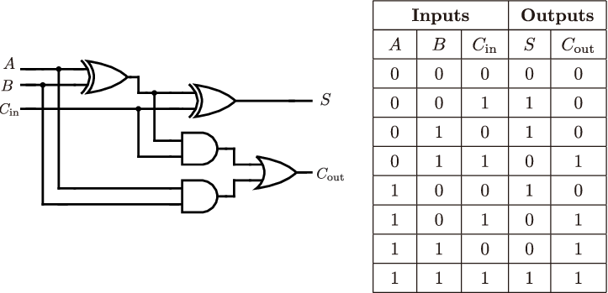
Adder

Slide 29


















$n$-bit adder
$$a_{n−1}$$
$$b_{n−1}$$
$$a_{3}$$
$$b_{3}$$
$$a_{2}$$
$$b_{2}$$
$$a_{1}$$
$$b_{1}$$
$$a_{0}$$
$$b_{0}$$
1-bit
adder
1-bit
adder
1-bit
adder
1-bit
adder
1-bit
adder
$$c_{n}$$
$$c_{0}$$
$$s_{n−1}$$
$$s_{3}$$
$$s_{2}$$
$$s_{1}$$
$$s_{0}$$

Slide 30
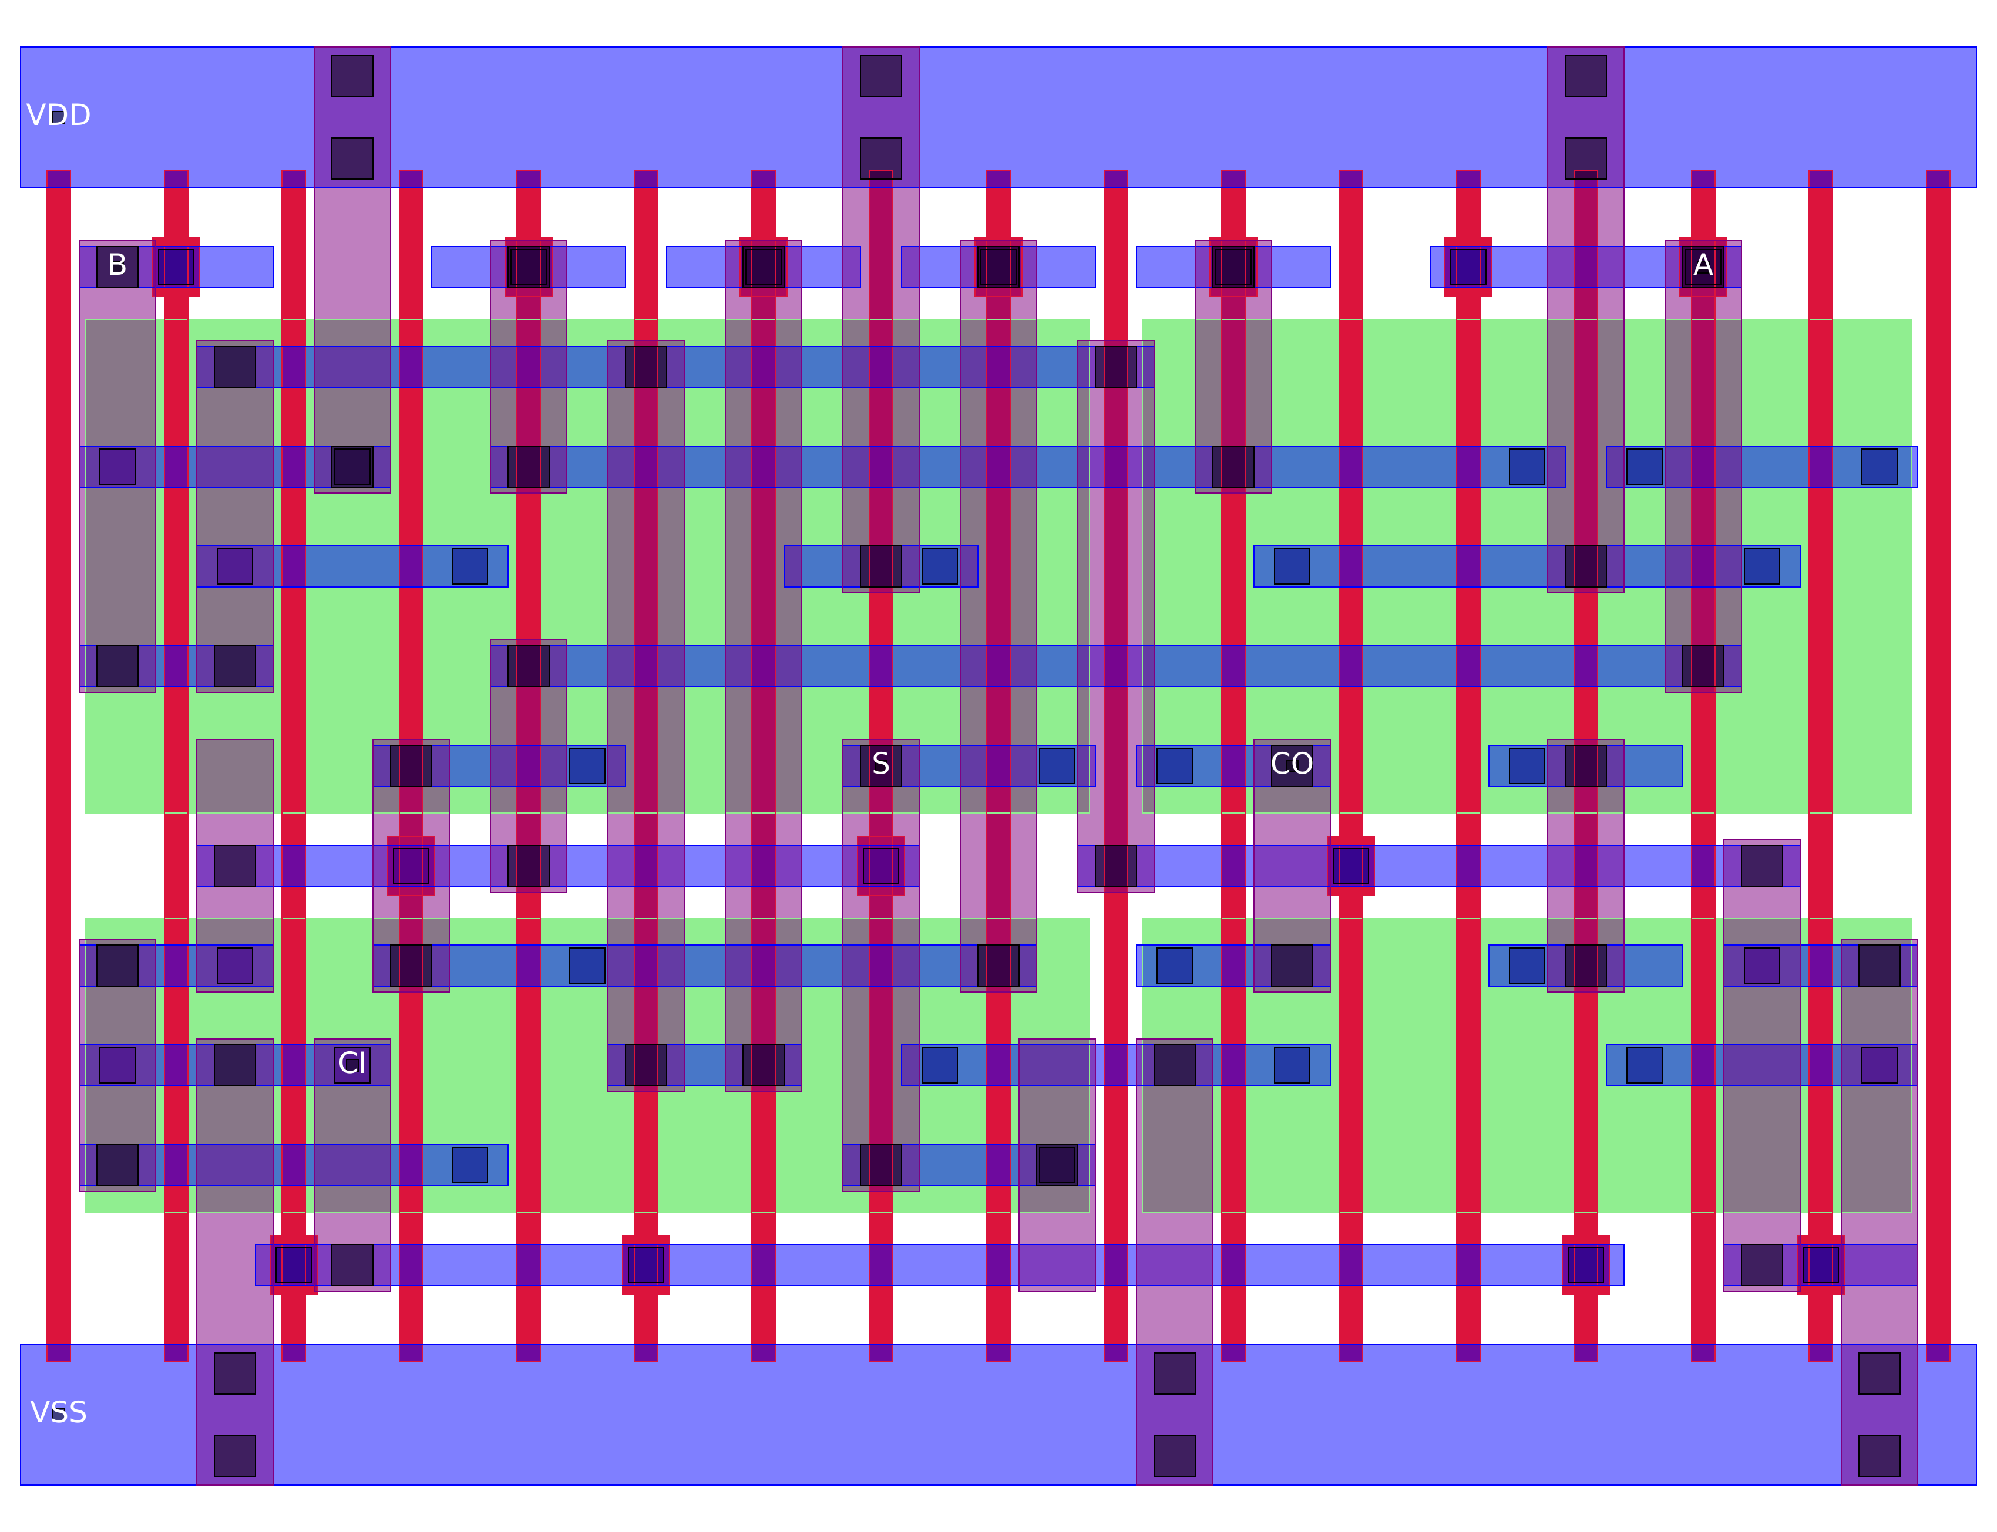
Layout of a 1-bit adder

Slide 31
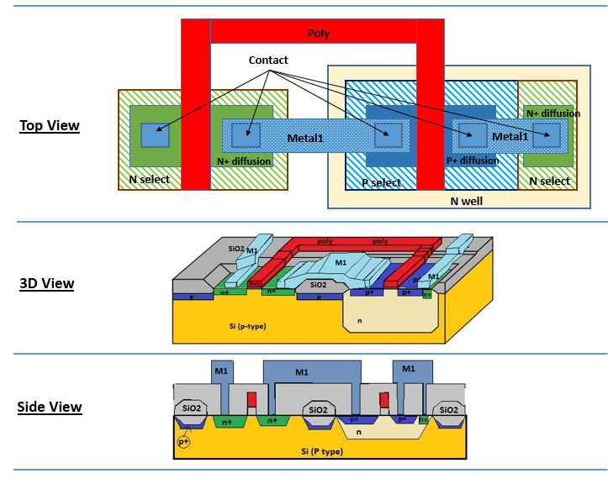
The inverter: layout
Vdd
In
Out
Gnd

Slide 32
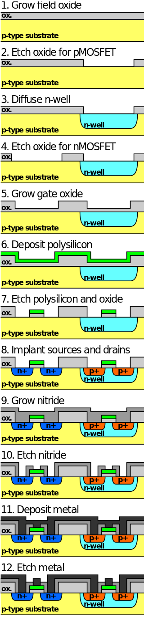
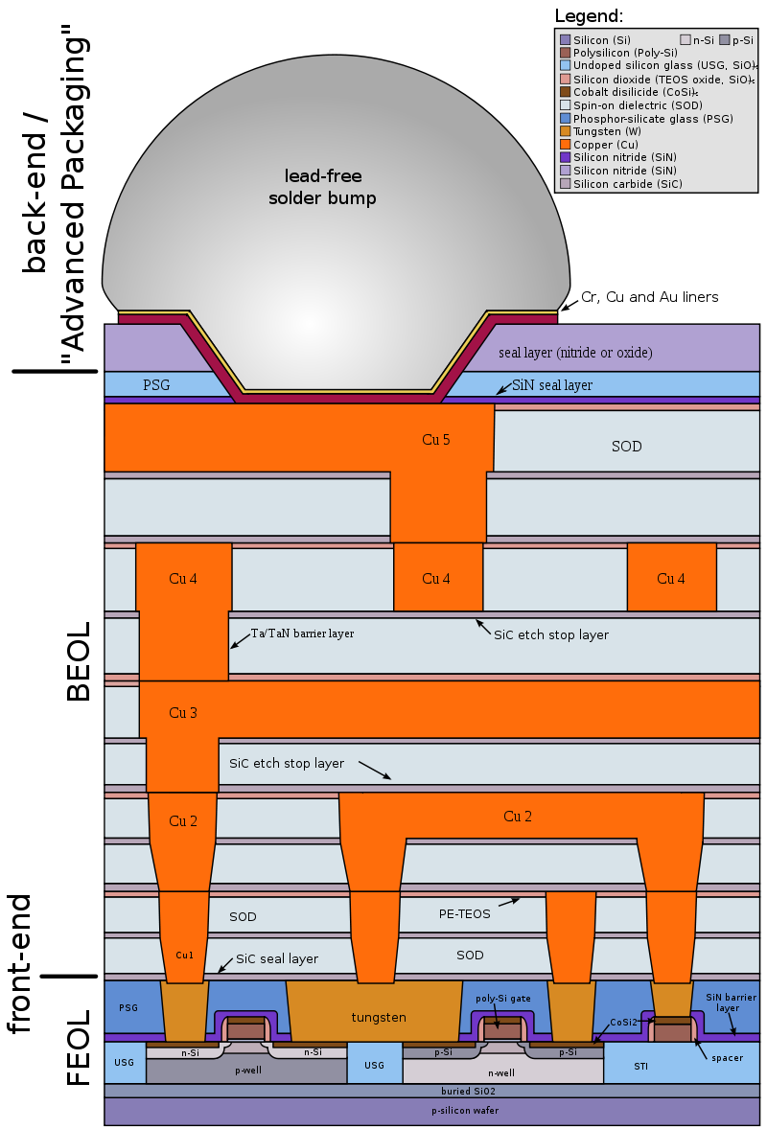

Slide 33
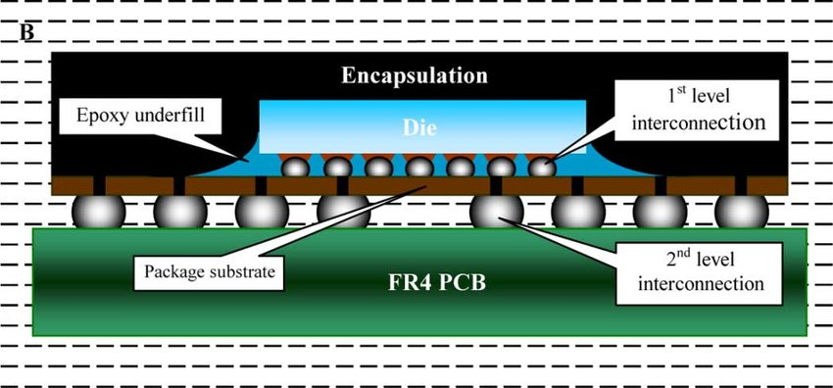
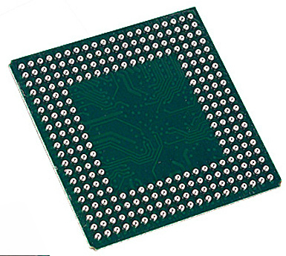

Slide 34
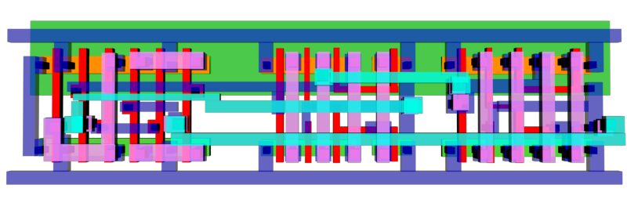
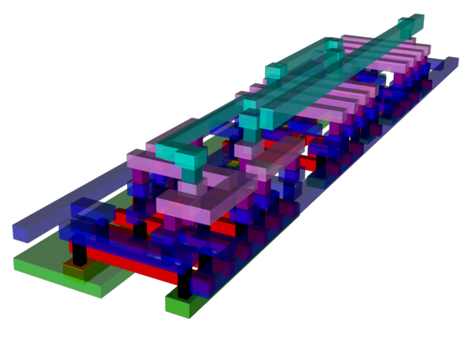
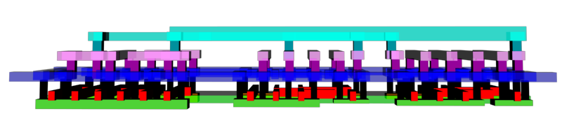

Slide 35
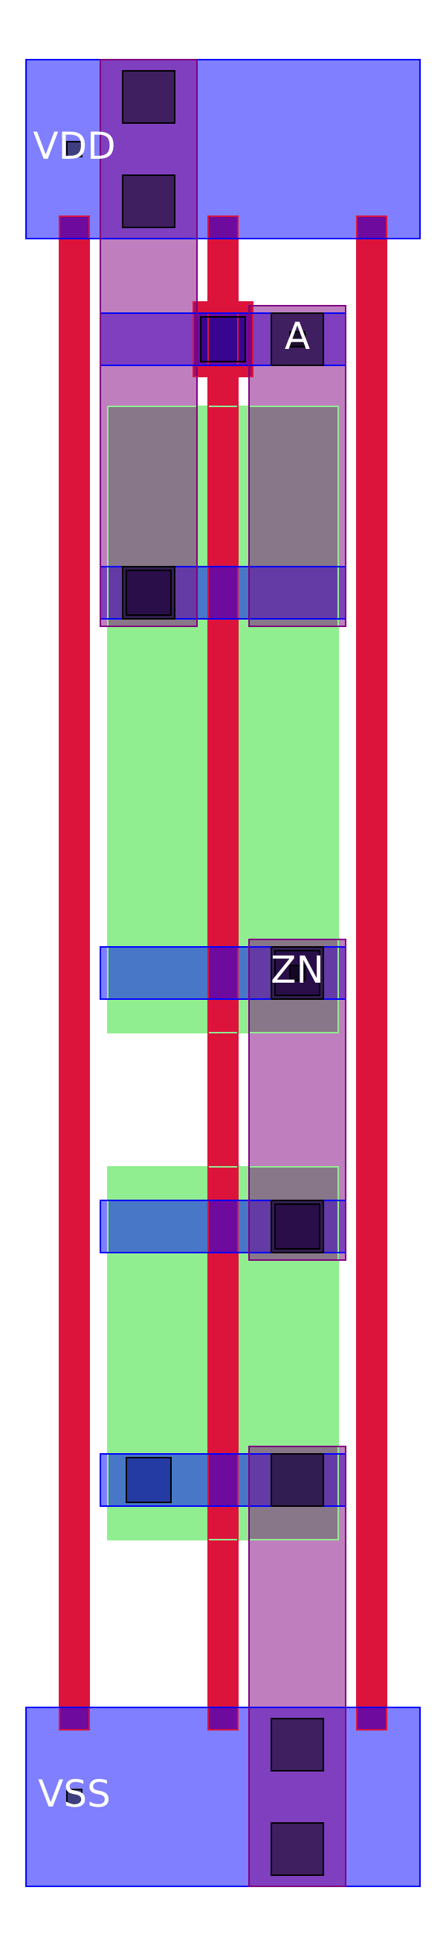
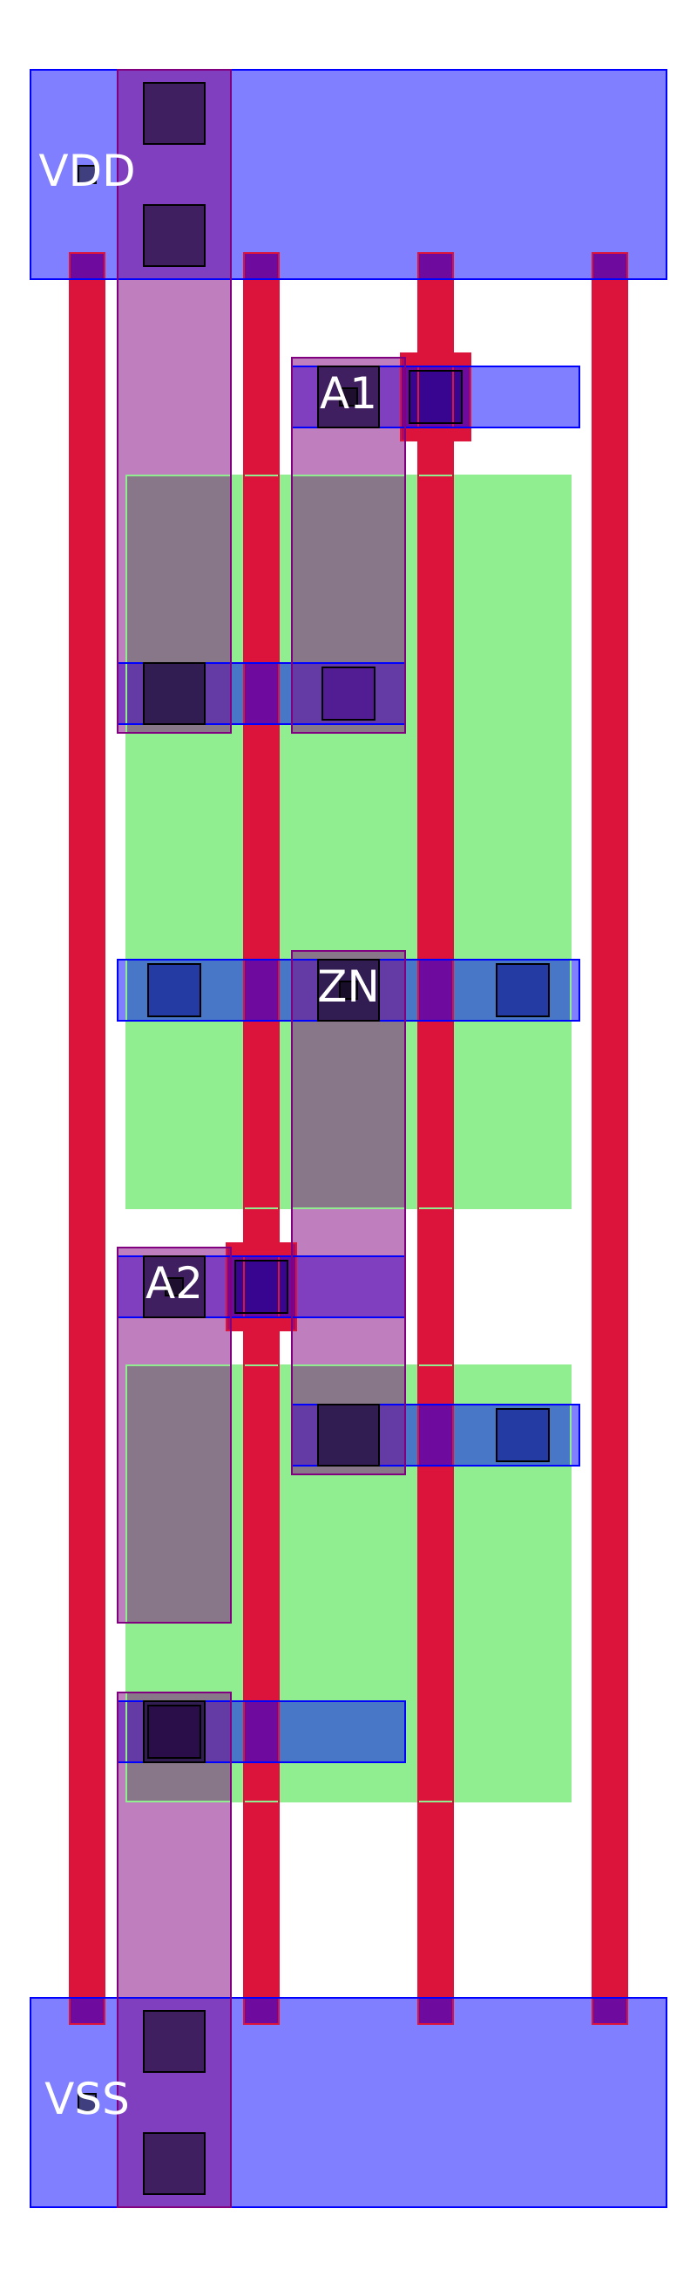
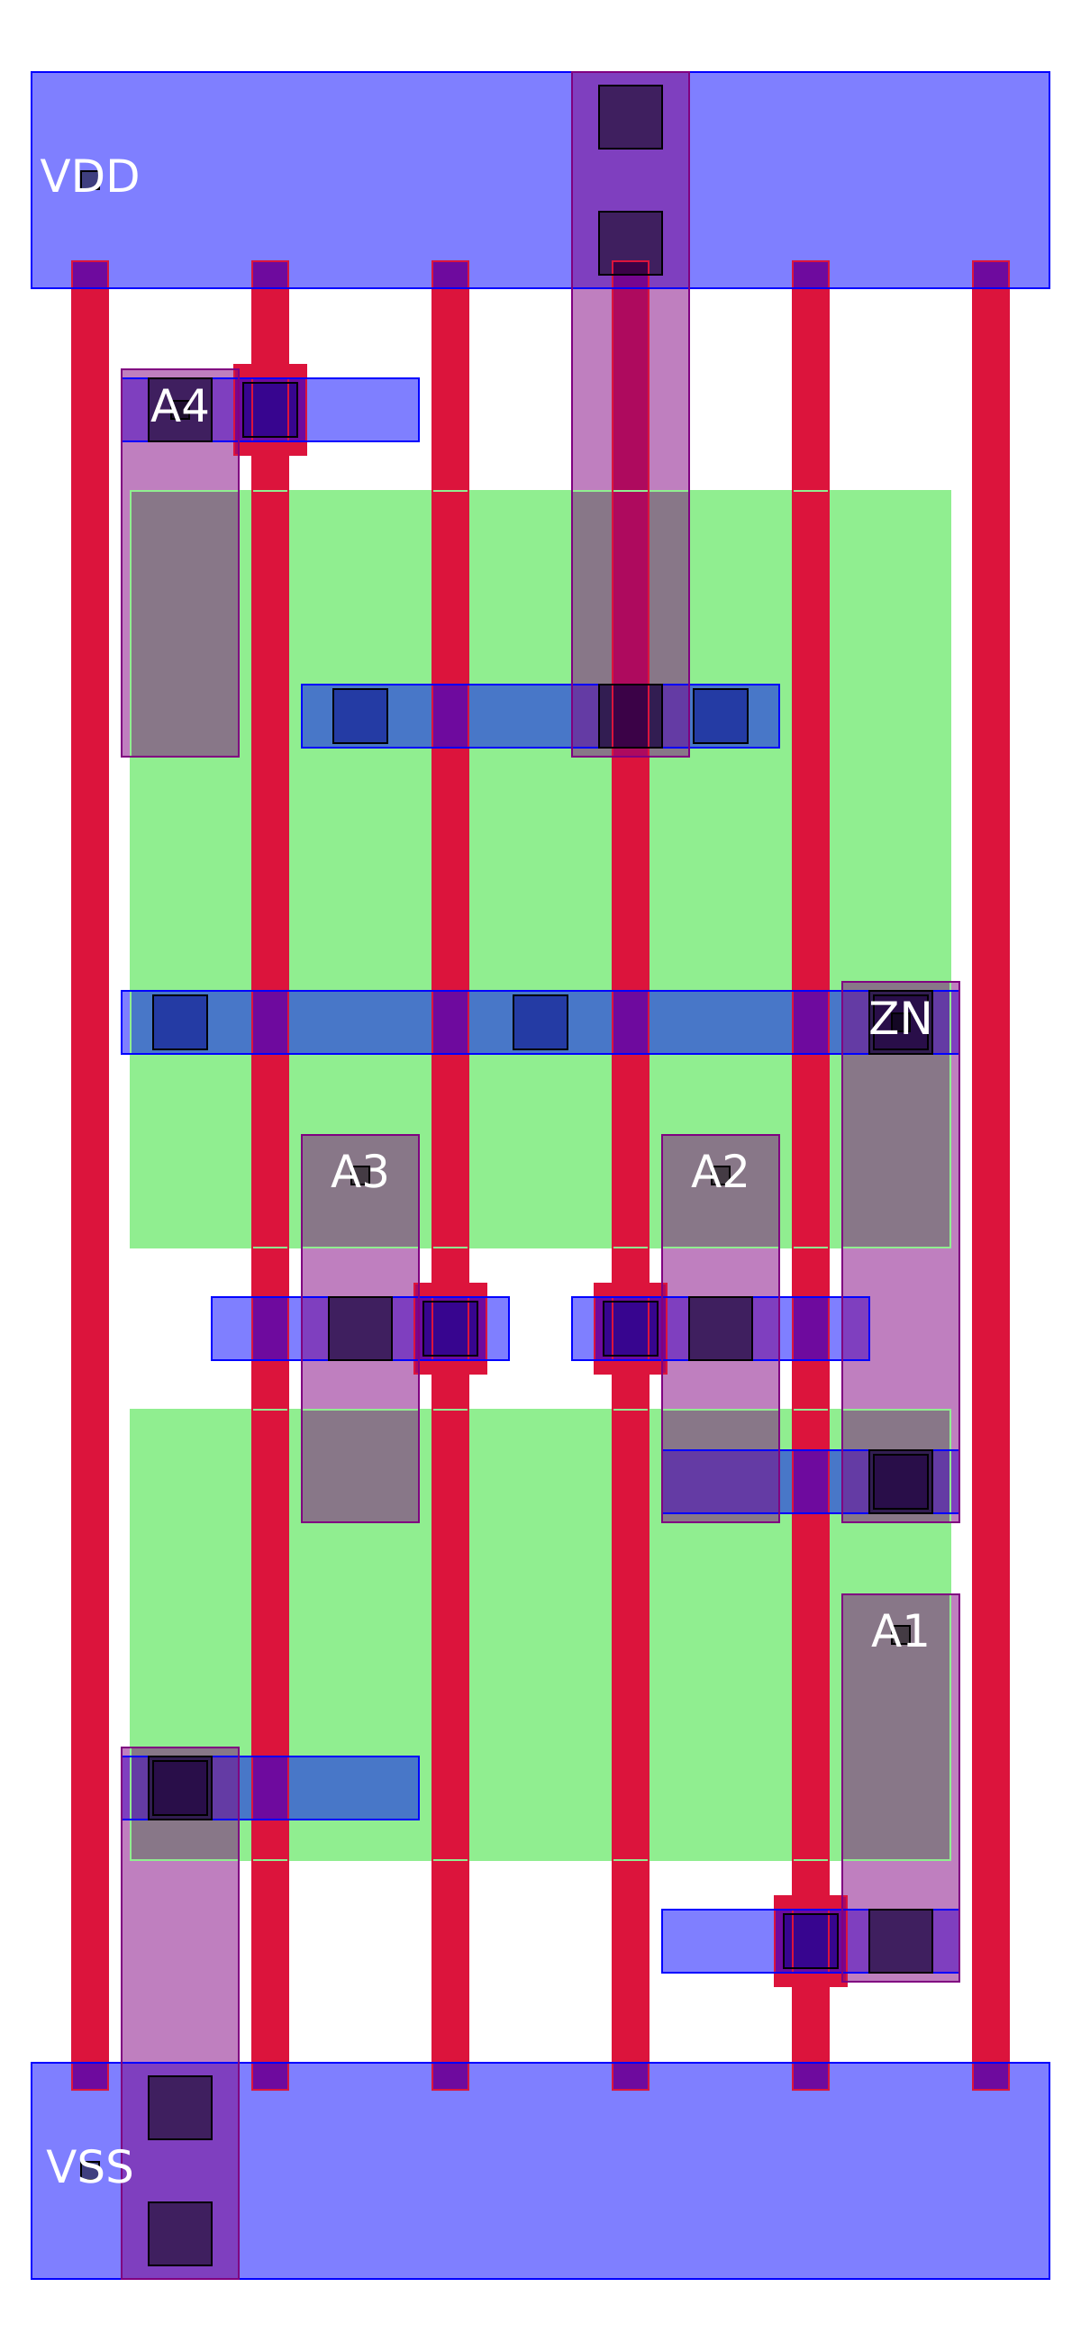

Slide 37
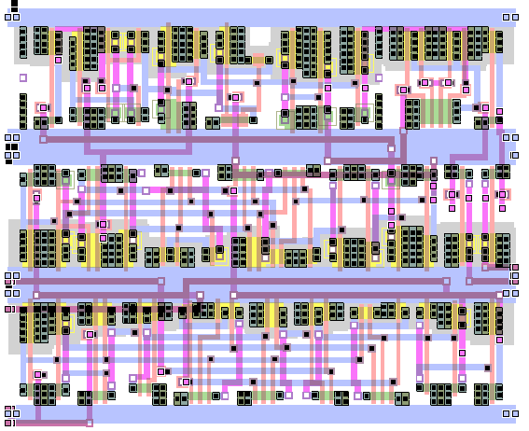
VDD
pMOS
nMOS
GND
nMOS
pMOS
VDD
pMOS
nMOS
GND

Slide 38

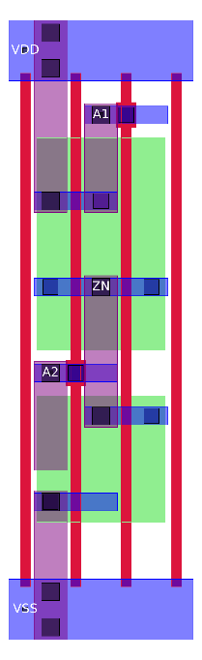
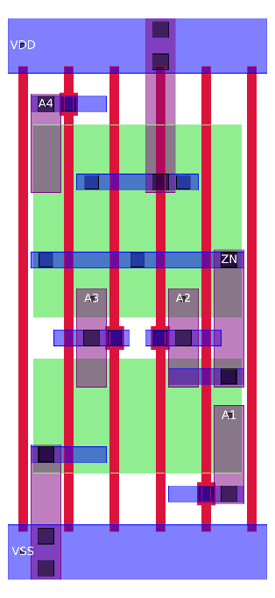
Gridded layout

Slide 39
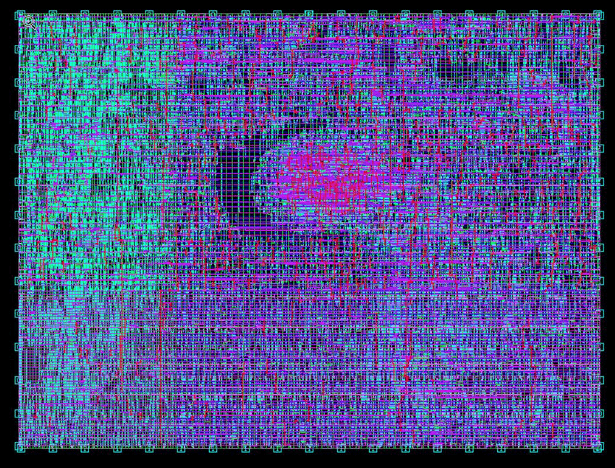
After routing

Slide 40
Gridded layout

Slide 41
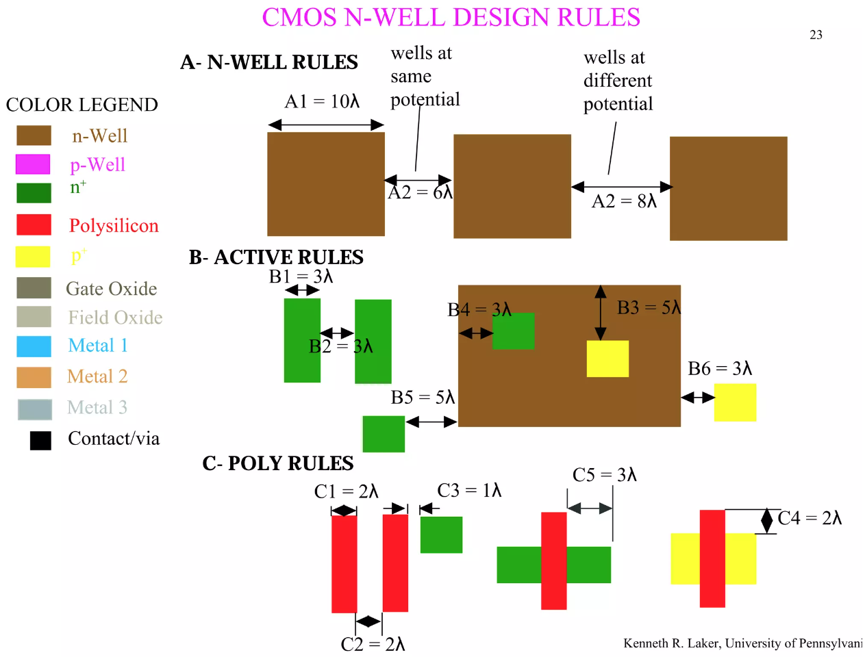

Slide 42
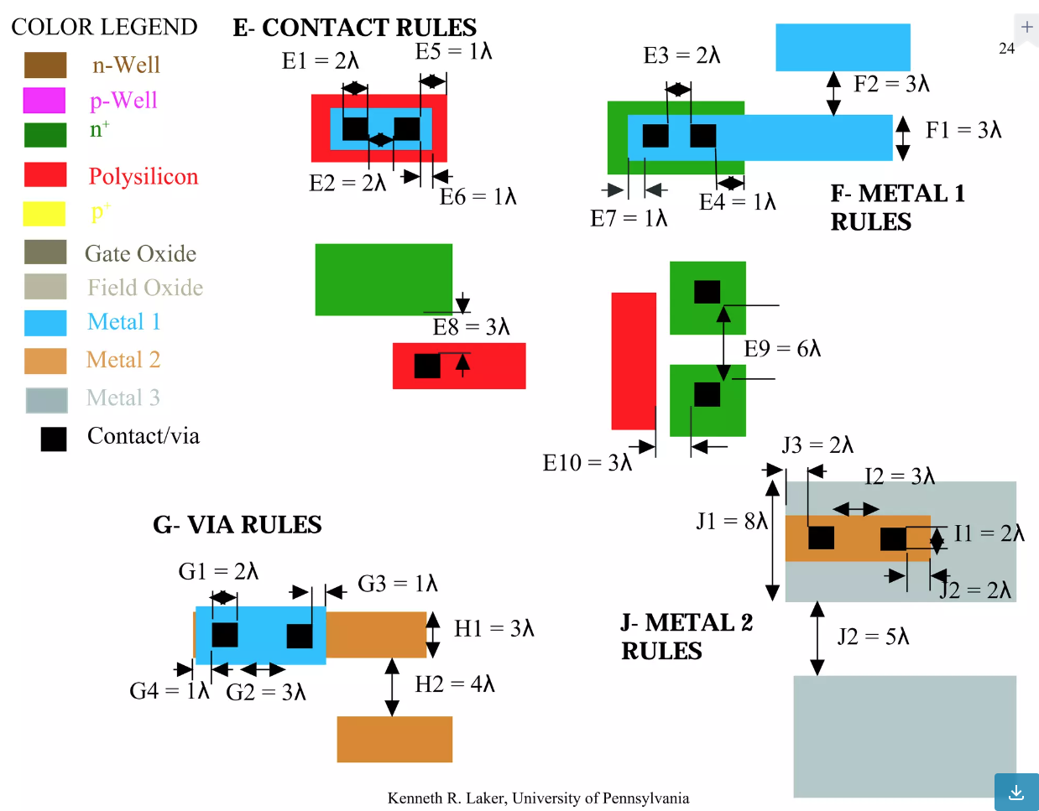

Slide 43
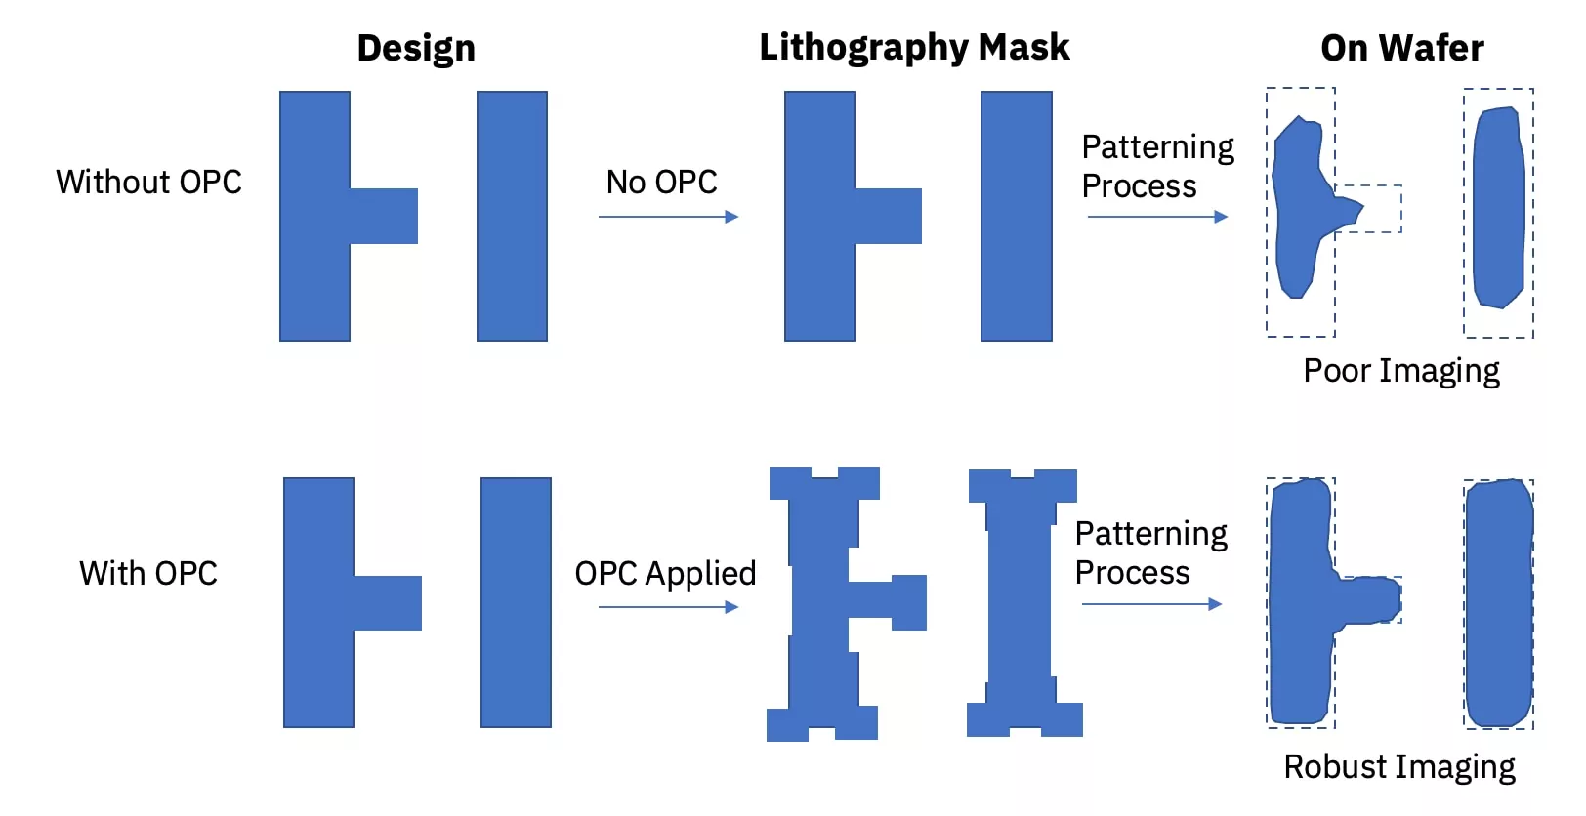
Optical Proximity Correction (OPC)

Slide 44
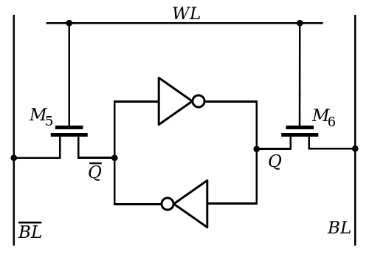
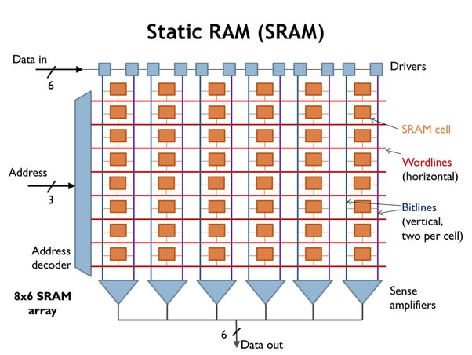
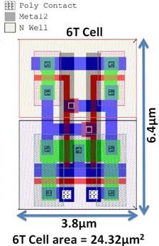

Slide 45
Introduction: CMOS videos
How the transistor works*
CMOS transistor
Photolithography*
How Billions Of Microchips Are Made Inside The World’s Most Advanced Factory*
How Are Microchips Made?
VLSI fabrication process (Global Foundries)
Semiconductor Manufacturing Process (Samsung)
Fabrication of Integrated Circuits (Intel)
Intel: The Making of a Chip with 22nm/3D Transistors

