Slide 1
Lecture 8
Network Flow Based Modeling
Mustafa Ozdal

Slide 2
Flow Network Definition
Given a directed graph G = (V, E):
  Each edge (u, v) has capacity c(u,v) ≥ 0
  Each edge (u, v) has flow f(u, v) ≥ 0
  A special source vertex s
  A special sink vertex t
2/5
2/6
6/9
Flow f and capacity c
values for each edge
shown as f/c
4/5
5/5
7/9
s
t
1/2
4/7
2/4
3/5
1/5

Slide 3
Flow Constraints
Capacity constraints: 0 ≤ f(u, v) ≤ c(u, v) for each edge (u, v)
Flow conservation: For all u ∈V − {s, t}, we must have:
Total incoming flow to u = Total outgoing flow from u
2/5
2/6
6/9
Flow f and capacity c
values for each edge
shown as f/c
4/5
5/5
7/9
s
t
1/2
4/7
2/4
3/5
1/5

Slide 4
Network Flow
The total flow through the network is defined as:
  the net flow out of source vertex s
  or equivalently:
  the net flow to the sink vertex t
2/5
2/6
6/9
4/5
5/5
7/9
Total flow = 10
s
t
1/2
4/7
2/4
3/5
1/5

Slide 5
Max Flow Problem
Given a flow network, determine the flow values through each edge such that:
  The capacity constraints are satisfied
  The flow conservation constraints are satisfied
  The total flow value is maximized
Integrality theorem: If all edge capacities are integers, then it is guaranteed that there exists an optimal solution with integer flow values.

Slide 6
Max Flow Problem
Max flow problem is polynomial-time solvable.
In practice, we can model it as a linear programming (LP) problem, and make use of efficient linear solvers.
If all edge capacities are integers, it is guaranteed that the corresponding LP model is unimodular
⟹ Linear solver will return a solution with integer values
In practice, can handle reasonably large problems.

Slide 7
Bipartite Matching Problem
Many practical problems can be modeled as max flow problems.
Exercise:
There are n students who want to do internship, and there are m companies. Each student marks 3 companies as his/her preference. Your task is to assign the students to companies such that:
Each student is assigned to 1 company, and vice versa.
A student is not assigned to a company (s)he doesn’t prefer.
The number of students assigned is maximized.
Use network flow to model your algorithm.

Slide 8
Solution
a vertex u for
each student
a vertex v for
each company
An edge from source s to each student vertex u.
An edge from company vertex v to sink t.
Create edge (u, v) iff student u prefers company v.
All edge capacities are 1.
s
t

Slide 9
Solution
a vertex u for
each student
a vertex v for
each company
Compute the max flow from source s to sink t.
Total flow = # of assignments
If edge (u,v) has non-zero flow, assign student u to company v.
s
t

Slide 10
Optimality Proof
Any student assignment with size |A| can be mapped to a flow solution with size |A|.
Any flow solution with size |F| can be mapped to a student assignment with size |F|.
The max-flow algorithm returns the solution with max total flow |F_{max}|. This solution can be mapped to a student assignment with the same size due to (2).
If there was a better student assignment with size |A_{max}|, where |A_{max}| > |F_{max}|, we would be able to map it to a flow solution with size |A_{max}| due to (1). But, this would be a contradiction because |F_{max}| is the maximum flow achievable.
Hence, the assignment obtained by mapping the max-flow solution must be optimal.

Slide 11
Exercise
There are n students and m courses. Each student indicates preference for 8 courses. You are supposed to assign courses to all students such that:
  A student is not assigned more than 5 courses.
  A course does not contain more than 20 students.
  A student is not assigned a course that (s)he doesn’t prefer.
  The number of courses assigned to all students is maximized.
Use network flow to model your algorithm.

Slide 12
Solution
a vertex u for
each student
a vertex v for
each course
An edge from source s to each student vertex u with capacity 5.
An edge from course vertex v to sink t with capacity 20.
Create edge (u, v) with capacity 1 iff student u prefers course v.
s
t

Slide 13
Solution
a vertex u for
each student
a vertex v for
each course
Compute the max flow from source s to sink t.
Total flow = # of assignments
If edge (u,v) has non-zero flow, assign student u to course v.
s
t

Slide 14
Proof: (1) Assignment → Flow
(1) Show that any assignment can be mapped to a valid flow with the same size
Given an assignment of size |S|:

Slide 15
Proof: (1) Assignment → Flow
Create a network as suggested in the solution. For flow to be valid, we need to satisfy 2 conditions: 1) flow conservation, 2) capacity constraints
s
t

Slide 16
Proof: (1) Assignment → Flow
Flow conservation:
Set the flow value from any student node i to the course node j to be 1.
Set the flow value from s to any student node i to be the # of courses i is assigned to.
Set the flow value from any course node j to t to be the # of students j is assigned to.
s
t

Slide 17
Proof: (1) Assignment → Flow
Capacity constraints:
Flow through and capacity of any (student → course) edge is 1
Student i can be assigned to at most 5 courses, and capacity(s → i) = 5
Course j can be assigned to at most 20 students, and capacity(j → t) = 20
s
t

Slide 18
Proof: (1) Assignment → Flow
Solution size: The size of the flow going out of source s is the sum of flow values (s → i), which is equal to the # of student-to-course assignments.
s
t

Slide 19
Proof: (2) Flow → Assignment
(1) Show that any flow solution can be mapped to a valid assignment with the same size
Given a flow solution of size |F|:
s
t

Slide 20
Proof: (2) Flow → Assignment
Create an assignment solution as described in the solution. For a solution to be valid:
A student is not assigned to a non-preferred course (trivial to prove)
A student is not assigned to more than 5 courses
A course is not assigned to more than 20 students
s
t

Slide 21
Proof: (2) Flow → Assignment
Student i is not assigned to more than 5 courses:
Incoming flow cannot be more than 5 (capacity constraint)
Outgoing flow cannot be more than 5 (flow conservation)
Course j is not assigned to more than 20 students (similar to above)
s
t

Slide 22
Extension for Vertex Capacities
The original flow network model can be extended to define vertex capacities.
v_{cap}
v
v₁
v₂
Original
vertex
Replace v with v₁ and v₂
Vertex capacity v_{cap} for vertex v can be handled by splitting v
into v₁ and v₂, and setting the edge capacity between them as v_{cap}.

Slide 23
Min-Cost Max-Flow
Define a real-valued weight w for each edge e in the flow network.
Objective: Compute the maximum flow in the network that minimizes the total weight W, where:
Most max-flow algorithms can be extended easily to handle the
weight minimization objective.

Slide 24
Exercise: Escape Routing Problem
n pins inside a chip.
Each pin needs to be routed
to a boundary point.
A routing grid is defined.
Each grid edge has a
predefined routing cost.
Pins need to be routed to
the boundary of the chip.

Slide 25
Exercise: Escape Routing Problem
Primary objective: Route as many pins as possible to the boundary.
Secondary objective: Minimize the total edge cost.
Describe a network flow model to solve this problem.

Slide 26
Solution: Network Flow Model for Escape Routing
Create a vertex for each grid point with capacity 1.
Create an edge between each neighbor grid point with the corresponding cost.
Create an edge from source s to each internal pin with zero cost.
Create an edge from each boundary pin to sink t with zero cost.
Solve min-cost max-flow.
s
t

Slide 27
Solution: Network Flow Model for Escape Routing
For any grid-edge with non-zero flow: create a routing edge.
All pins p with non-zero flow entering from s are routed to the boundary.
s
t

Slide 28
Proof: (1) Routing → Flow
(1) Show that any routing solution can be mapped to a valid flow with the same size and same cost
Given a routing solution, create a flow network as described in the solution.
Set the flow values as follows:
  Set the flow of each routed grid edge to be 1
  Set the flow of each (s, p) edge to 1 if a route starts from pin p
  Set the flow of each (b, t) edge to 1 if a route ends at boundary point b
Need to show that:
  Capacity constraints are satisfied
  Flow conservation constraints are satisfied
  Size of flow is equal to the number of routed nets
  Total cost of flow is equal to the total routing cost

Slide 29
Proof: (1) Routing → Flow
Capacity constraints are satisfied:
  No edge has more than 1 unit flow by definition
  All edges have capacity of 1
Flow conservation constraints are satisfied:
  For any vertex corresponding to a routed pin p:
    One unit flow enters p from s and exits through a routing edge
  For any vertex corresponding to a routed boundary point b:
    One unit flow enters b through a routing edge and exits to t
  For any other vertex v that has a route passing through it:
    One unit flow enters v through a routing edge and exits it through another routing edge.

Slide 30
Proof: (1) Routing → Flow
Size of flow = # of routed nets:
  By definition, an edge (s, p) has unit flow iff a route begins at p
  Hence the flow size is equal to # of routed nets
Total flow cost= total routing cost:
  The cost of any edge (s, p) or (b, t) is zero
  Total flow cost is the sum of edge-weight * flow
  By definition, a unit flow passes through a grid edge iff there is a route passing through that edge.
  Hence, total flow cost = total routing cost

Slide 31
Proof: (2) Flow → Routing
(2) Show that any flow solution can be mapped to a valid routing solution with the same size and the same cost
Given a flow solution, construct routes as described in the solution.
Need to show that:
  A route must start at a pin p and end at a boundary point b without splitting or merging
  No two routes can share a vertex or edge
  The flow size is equal to the # of routed nets
  The total routing cost is equal to the total flow cost

Slide 32
Proof: (2) Flow → Routing
A route must start at a pin p and end at a boundary point b without splitting
  From capacity constraints, an edge/vtx can have at most one unit of flow
  Since all capacities are integers, all flow values must be integer.
  So, flow through each edge/vtx is either 0 or 1.
  Source s is connected to vertices corresponding to pins
  Sink t is connected to vertices corresponding to boundary points.
  From flow conservation, if a unit flow enters a vertex, it must exit the vertex through another edge (except for s and t).
  Hence, each route must start from p and end at t without splitting.

Slide 33
Proof: (2) Flow → Routing
No two routes can share a vertex or edge
  From capacity constraints, an edge/vtx can have at most one unit of flow
  Flow size = # of routed nets
  Already showed that a unit flow starting at source s corresponds to routing of one net from pin p to boundary b.
  So, flow size is equal to the number of routed nets.
  The total routing cost is equal to the total flow cost
  The cost of any edge (s, p) or (b, t) is zero
  Total flow cost is the sum of edge-weight * flow
  By definition, a unit flow passes through a grid edge iff there is a route passing through that edge.
  Hence, total flow cost = total routing cost
Proof is complete.

Slide 34
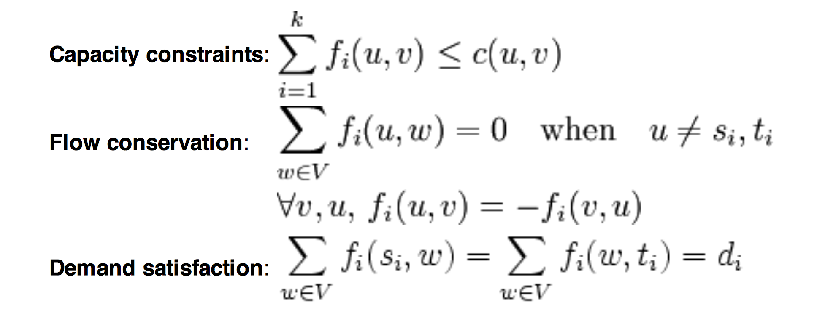
Multi-Commodity Flow
Define different types of flows, and enforce the conservation constraints for each flow separately.
Optional:
Source: Wikipedia

Slide 35
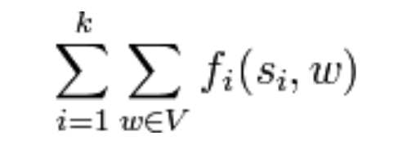
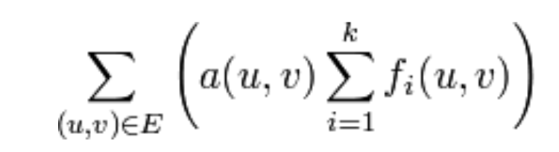
Multi-Commodity Flow
Max multi-commodity flow problem:
Min-cost multi-commodity flow problem
maximize
minimize
Both problems are NP-complete for integer flows.

Slide 36
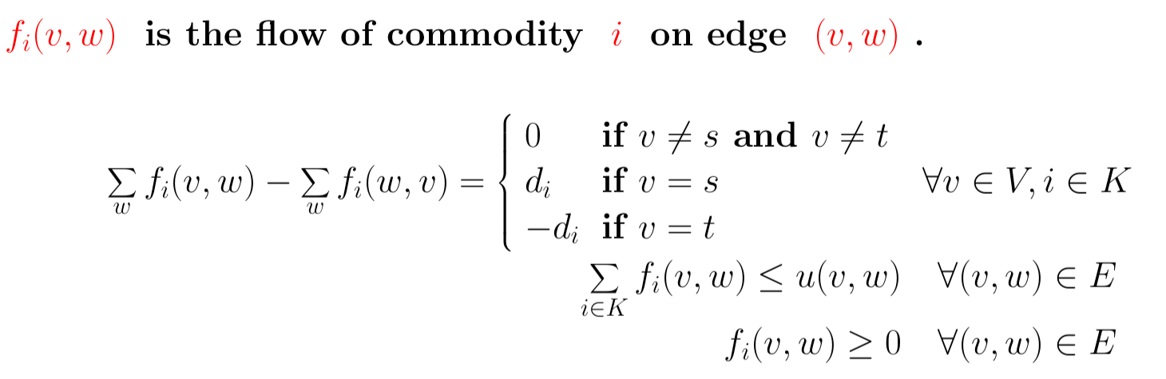
Multi-Commodity Flow
Define different types of flows, and enforce the conservation constraints for each flow separately.

Slide 37
Exercise: Single Layer Routing
There are n 2-pin nets that
need to be routed on a grid.
Objective: Route as many
nets as possible and
minimize the total wirelength.
Use multi-commodity
network flow to model this
problem.
2
1
1
3
3
2

Slide 38
Solution: Single Layer Routing
Grid network similar
to escape routing.
Create an edge from source s to each pin i that allows only flow commodity f_{i}.
Create an edge from each pin i to sink t that allows only flow commodity f_{i}.
Solve the min-cost multi-commodity flow.
2
f₂
1
f₁
f₁
t
s
1
3
f₃
f₃
f₂
3
2

Slide 39
Simultaneous Pin Assignment and Routing
Pin assignment problem:
  Consider a macro block B with a fixed outline
  We have the netlist available for B
  We need to assign the pin locations at the block boundaries before placement
Routing between two macro blocks B₁ and B₂
  Each pin {a₁, b₁, c₁, …} of B₁ needs to be connected to the corresponding pins {a₂, b₂, c₂, …} of B₂.

Slide 40
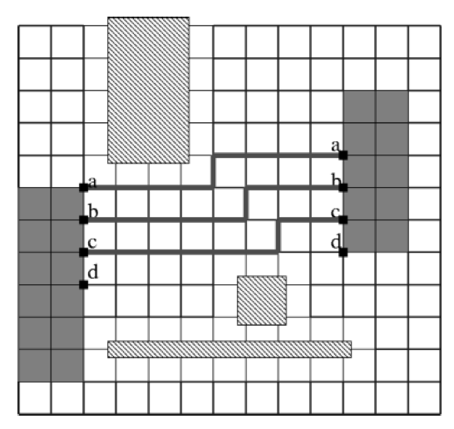
Pin Assignment Followed By Routing
Step 1: Perform pin assignment
in such a way that the pins to
be connected are as close as
possible.
Step 2: Perform routing between
the pins.
Problem: Net d cannot be routed.
Xiang, H. et. al., “Min-Cost Flow-Based Algorithm for Simultaneous Pin Assignment and Routing”,
IEEE Transactions on Computer-Aided Design, Vol. 22, No. 7, July 2003

Slide 41
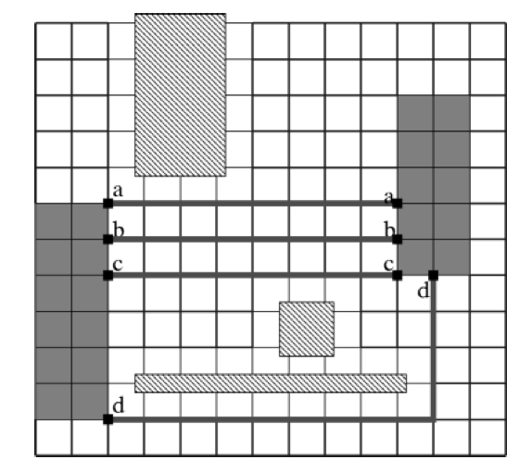
Simultaneous Pin Assignment and Routing
Simultaneous pin assignment and
routing assigns all pins and routes
all connections.
Xiang, H. et. al., “Min-Cost Flow-Based Algorithm for Simultaneous Pin Assignment and Routing”,
IEEE Transactions on Computer-Aided Design, Vol. 22, No. 7, July 2003

Slide 42
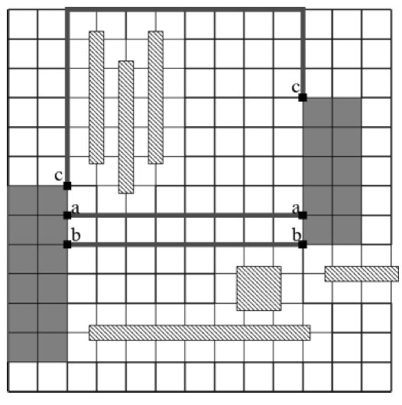
Simultaneous Pin Assignment and Routing: Greedy
Perform pin assignment and routing one net at a time in a greedy way.
Xiang, H. et. al., “Min-Cost Flow-Based Algorithm for Simultaneous Pin Assignment and Routing”,
IEEE Transactions on Computer-Aided Design, Vol. 22, No. 7, July 2003

Slide 43
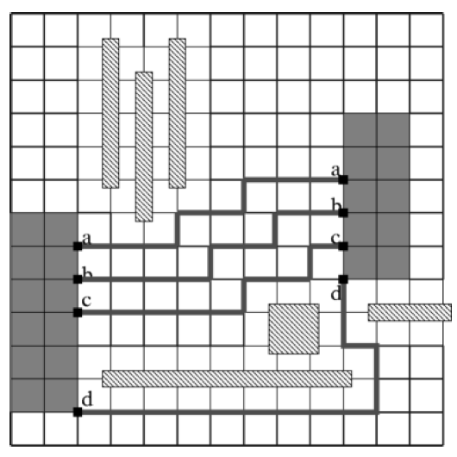
Simultaneous Pin Assignment and Routing: Optimal
Optimal solution routes all connections with min cost.
Is there a polynomial time optimal algorithm for this problem?
Xiang, H. et. al., “Min-Cost Flow-Based Algorithm for Simultaneous Pin Assignment and Routing”,
IEEE Transactions on Computer-Aided Design, Vol. 22, No. 7, July 2003

Slide 44
Solution: Simultaneous Pin Assignment and Routing
Grid network similar to escape routing. Remove edges overlapping blockages.
Create an edge from source s to vertex s’ with capacity equal to the number of pins.
Create an edge from s’ to each boundary point in the first block, with capacity equal to 1.
Create an edge from each boundary point in the second block to sink t, with capacity equal to1.
Solve the min-cost max flow.
t
s
s'

