Slide 1
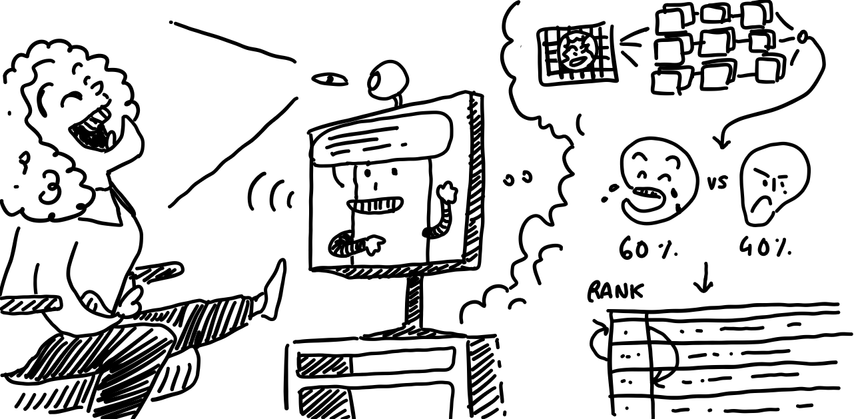
Can I joke on you?
Anicet Nougaret, Lena Ebner, Jens De Bock
9/10/2023

Slide 2
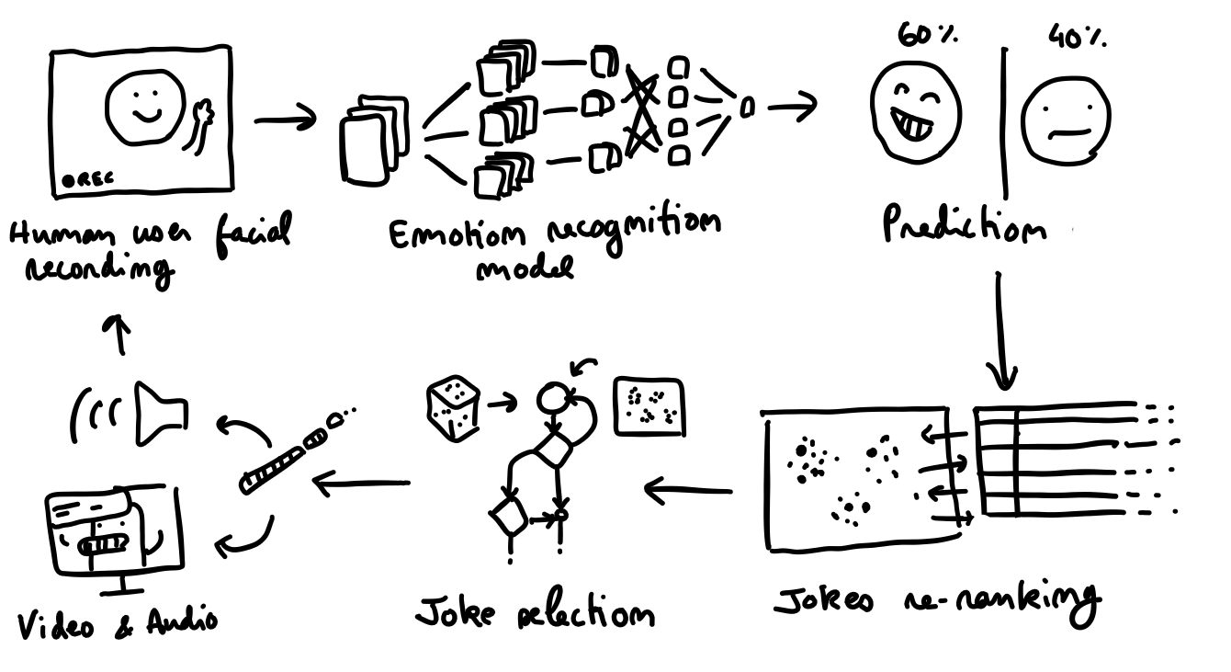
Idea
A robot that tells jokes to the user. Able to detect the user’s facial expressions, he learns to pick jokes the user seems to like.

Slide 3
Goals
Making the user happy and entertained with good jokes.
Exploring the ability of a system to learn based on user’s emotions and act on them in a positive reinforcement loop.
https://tenor.com/view/dance-emoji-meme-smiley-happy-gif-23672361

Slide 4
Target Group
English-speaking students Why?
English: dataset of English jokes
Students: more accessible

Slide 5
Parts of the project
Identify emotions and gestures via camera
Recommender system for jokes
UI with virtual robot for user interaction
Jens
Anicent
Lena

Slide 6
Planning
Project Presentation (Midterm)
Status Update: What have we done so far and what are our next steps?
Project Presentation (Rehearsal)
Status Update: How is everything going? What’s left to do?
Project Presentation (Idea)
Final Presentation
Start Ideation Phase
01.11
01.12
05.01.2024
26.09
09.10
06.11
18.12
08.01.2024
Create Basic Components
Find Emotion Dataset + Train CNN + Classification Find Jokes Dataset + Train RS + Predict Jokes Find UI Engine + Create UI Robot + User Interactions
Connecting Components
Connect Emotion with Jokes and UI Robot to a complete UX
Final Project
Improve individual components by finetuning models and UI
Conduct experiment and analyze results

Slide 7
Methodology
Notes:
Explain the methodology you plan to follow for you experimentation
#Lena

Slide 8
User Experiment
Before
find possible participants (~5)
schedule meeting
informed consent (needed?)
During
prepare setup on one of our own laptops
let user sit down in front of laptop
give user task to start the application
record user interactions with robot
video + audio recording
manual observation + notes taking
stop after max. 5min
give user standardized questionnaire

Slide 9
Project Evaluation
Results from User Study
analyze results obtained from user experiments
gather statistics about user feelings towards robot
Results from Project itself
evaluate performance of project
how well is joke prediction working?
how well is emotion detection via facial expression working?

Slide 10
Resources
Joke Dataset: https://www.kaggle.com/datasets/abhinavmoudgil95/short-jokes
Smile Dataset: https://www.kaggle.com/datasets/chazzer/smiling-or-not-face-data https://www.kaggle.com/datasets/ananthu017/emotion-detection-fer

Slide 11
Feedback?

