Slide 1
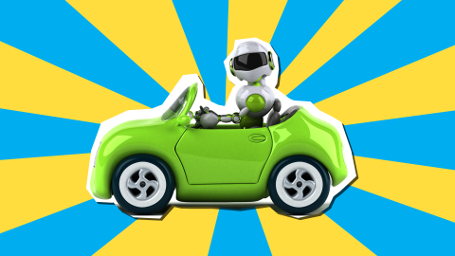
Why did the robot sleep under a car?
He wanted to wake up oily!
😂

Slide 2
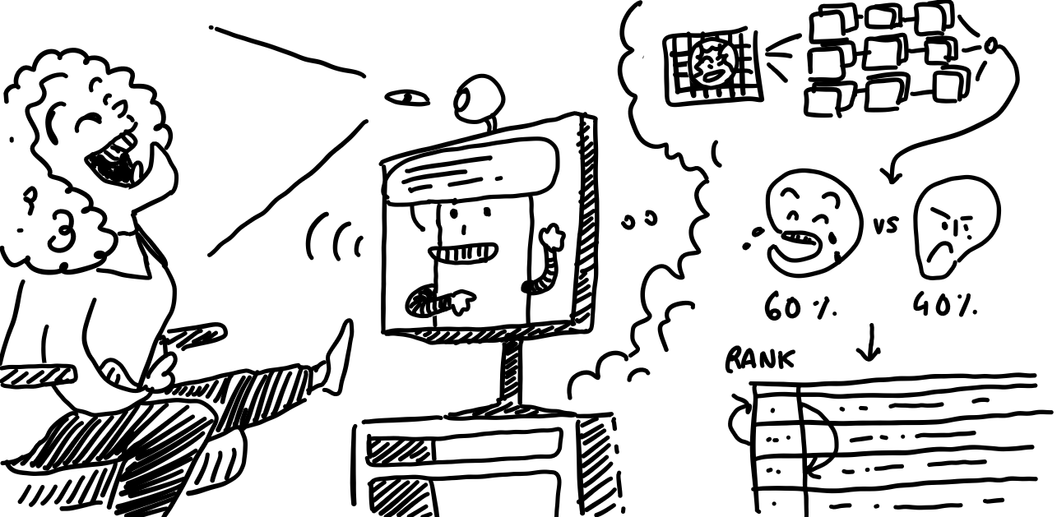
Can I joke on you?
Anicet Nougaret, Lena Ebner, Jens De Bock
6/11/2023
Notes:
A good, hearty laugh relieves physical tension and stress, leaving your muscles relaxed for up to 45 minutes afterwards In fact, one study suggests that healthy children may laugh as much as 400 times per day, but adults tend to laugh only 15 times per day.

Slide 3
Recap

Slide 4
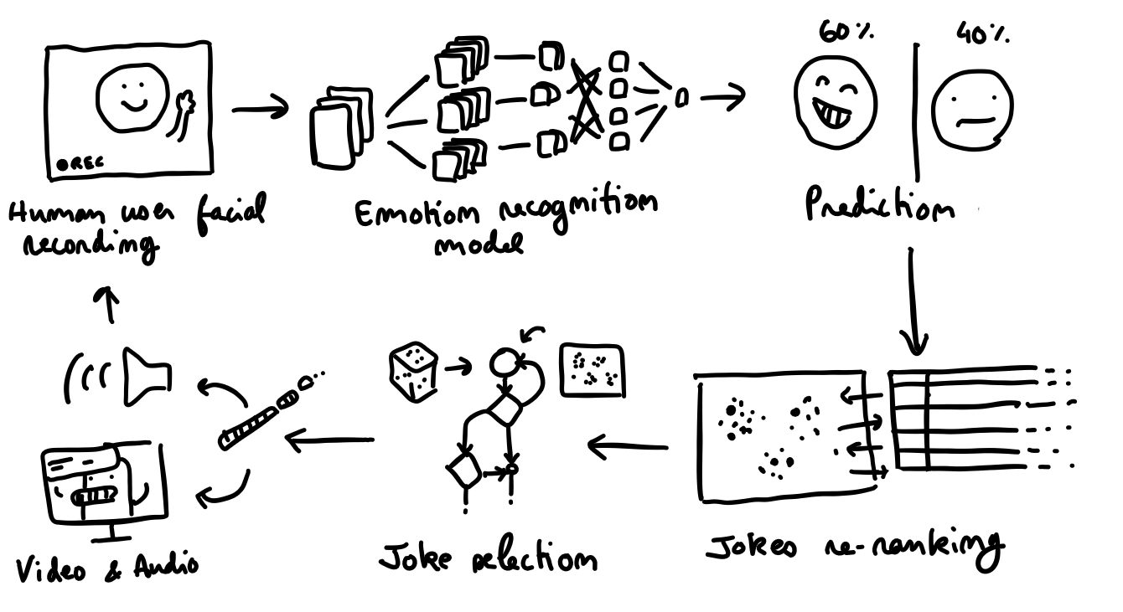
Idea
A robot that tells jokes to the user. Able to detect the user’s facial expressions, he learns to pick jokes the user seems to like.

Slide 5
Planning
Project Presentation (Midterm)
Status Update: What have we done so far and what are our next steps?
Project Presentation (Rehearsal)
Status Update: How is everything going? What’s left to do?
Project Presentation (Idea)
Final Presentation
Start Ideation Phase
01.11
01.12
05.01.2024
26.09
09.10
06.11
18.12
08.01.2024
Create Basic Components
Find Emotion Dataset + Train CNN + Classification Find Jokes Dataset + Train RS + Predict Jokes Find UI Engine + Create UI Robot + User Interactions
Connecting Components
Connect Emotion with Jokes and UI Robot to a complete UX
Final Project
Improve individual components by finetuning models and UI
Conduct experiment and analyze results
Notes:
that’s where we are right now

Slide 6
Research Question
Notes:
we tried to define our research question

Slide 7
Research Question
Does a robot UI with laughing detecting make the overall UX more enjoyable to use for the user than a random joke telling UI?
Notes:
2 user groups in the experiment
one with laughing detecting, recommender and robot in ui
one with just telling random jokes without robot ui just jokes and yes or no buttons in UI
measure time a person spends
how often a person laughs
did you feel the jokes were becoming more towards your likings

Slide 8
Variables
3 options
UI: Empty UI with jokes written on the screen
Facial expression: Same UI with added like/dislike buttons
(Recommender system: jokes.random())
Notes:
2 user groups in the experiment
one with laughing detecting, recommender and robot in ui
one with just telling random jokes without robot ui just jokes and yes or no buttons in UI with recommender
UI: Empty UI with jokes written
Recommender system: jokes.random()
Facial expression: Same with UI + yes/no buttons

Slide 9
Status Update

Slide 10
Parts of the project
Identify emotions and gestures via camera
Recommender system for jokes
UI with virtual robot for user interaction
Jens
Anicet
Lena

Slide 11
Emotion Detection
Use MediaPipe to create facial keypoints
Different models (NN) on different datasets
90% accuracy between non smile and smile classes
Confidence interval to estimate the degree of smiling
Real life video can still be tricky to detect
Notes:
Let’s start with the first part of this project: the emotion detection system.
We started with extracting the relevant features from the pictures using MediaPipe.
MediaPipe can be used for a variety of purposes in the machine vision environment, but here it was used to extract the facial keypoints, which can be thought as dots on your face representing the important muscles.
These features then become the input a neural network and this is where the iterative process began.
We tried out different models and also different datasets and reached an accuracy of 90%, being able to distinguish between smiles and non-smiles.
On top of this we can extract the confidence of the model in it’s prediction and by subtracting the confidence of both classes we can get a feeling of the degree of smiling.
However, testing this with real life video seems to be a bit more tricky.
Small smirks from users are hard to detect and it seems like the model is focussed on big smiles.
Let’s show this in a short demonstration.

Slide 12

Emotion Detection
https://youtu.be/-uFzYbnb7Lg

Slide 13
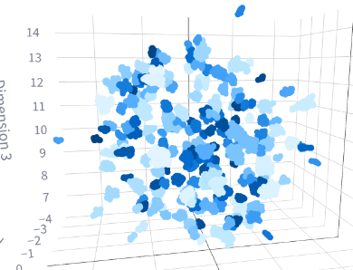
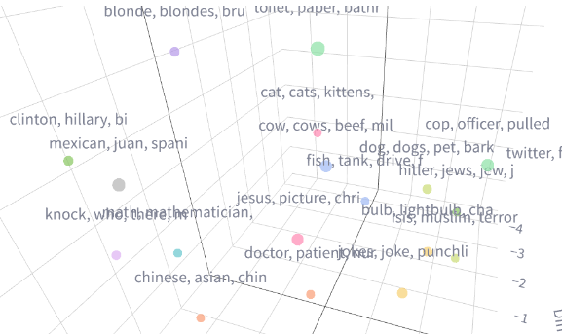
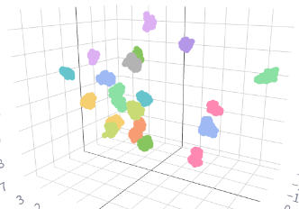
Joke Recommender
✔ Jokes classification using semantic clustering (+ filtering)
Recommender as a stationary k-armed bandit problem
classic reinforcement learning
epsilon-greedy algorithm for initial exploration
joke type repetition penalty to avoid a unique category to be spammed

Slide 14
Robot UI
Created basic UI with Three.js and React
Searched for a 3D models
Looking cute
With slight animation
TTS Web API
Cross-Browser Support is difficult -> depends also on OS
Multiple voices possible - finding one that does fit the robot and sound natural hard
Working on Firefox
Create basic interactions with displaying jokes to user in UI
Jokes loop & random joke selection

Slide 15
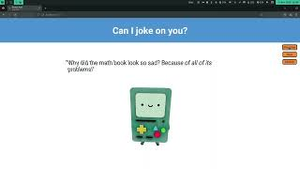
https://youtu.be/zcNCcSRsIZg

Slide 16
Outlook

Slide 17
Next Steps
Combine parts to have a complete working project
Create user flow in UI to be able to interact
Use camera input from laptop to detect emotions real-time
Use jokes from recommender in UI
Compare and measure k-armed bandits solutions for the recommender

Slide 18
Questions? Feedback?

