Slide 1
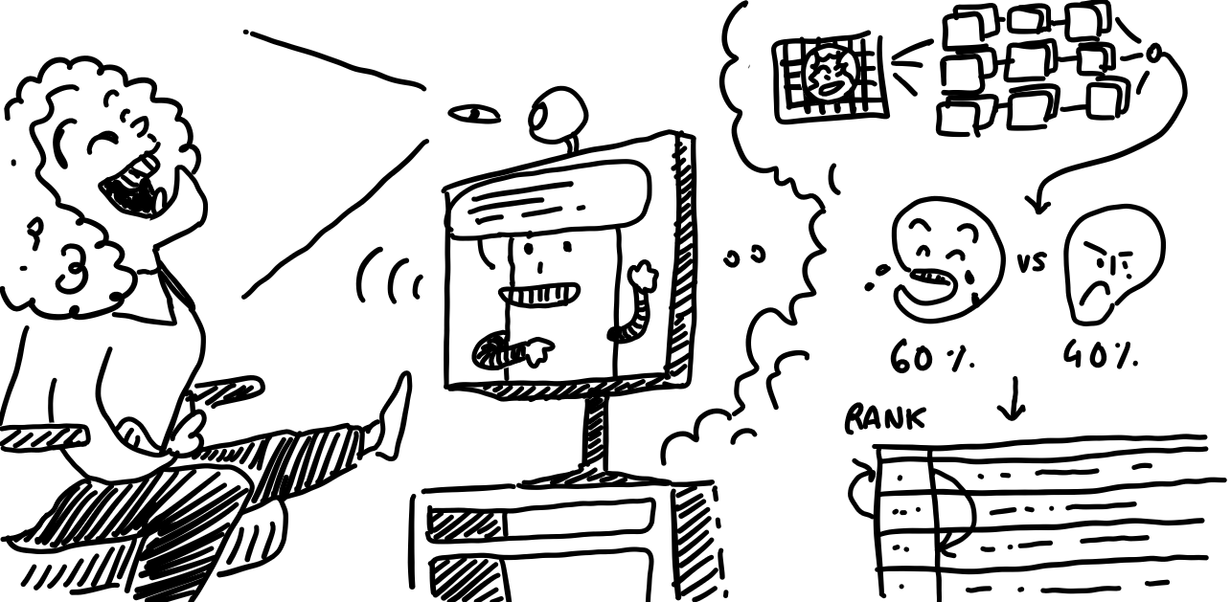
Can I joke on you?
Anicet Nougaret, Lena Ebner, Jens De Bock
6/11/2023
Notes:
A good, hearty laugh relieves physical tension and stress, leaving your muscles relaxed for up to 45 minutes afterwards In fact, one study suggests that healthy children may laugh as much as 400 times per day, but adults tend to laugh only 15 times per day.

Slide 2
Overview
Goals & Concept
Research Question & Target group
Project description
Demo
Evaluation
Results
Conclusions

Slide 3
Goals & Concept

Slide 4

Goals
Making the user happy and entertained with good jokes.
Exploring the ability of a system to learn based on user’s emotions and act on them in a positive reinforcement loop.

Slide 5
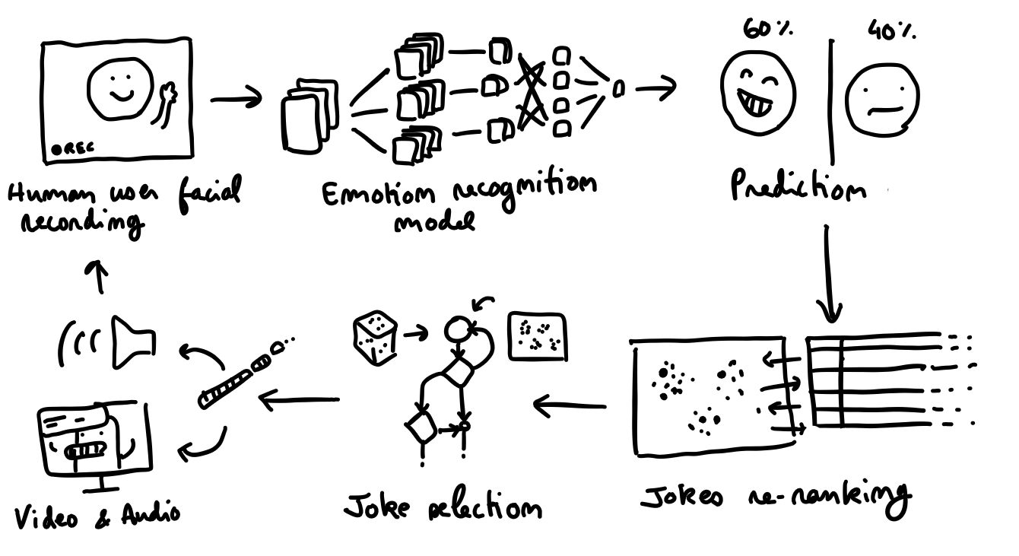
Concept
A robot that tells jokes to the user. Able to detect the user’s facial expressions, he learns to pick jokes the user seems to like.

Slide 6
Planning
Project Presentation (Midterm)
Status Update: What have we done so far and what are our next steps?
Project Presentation (Rehearsal)
Status Update: How is everything going? What’s left to do?
Project Presentation (Idea)
Final Presentation
Start Ideation Phase
01.11
01.12
05.01.2024
26.09
09.10
06.11
18.12
08.01.2024
Create Basic Components
Find Emotion Dataset + Train CNN + Classification Find Jokes Dataset + Train RS + Predict Jokes Find UI Engine + Create UI Robot + User Interactions
Connecting Components
Connect Emotion with Jokes and UI Robot to a complete UX
Final Project
Improve individual components by finetuning models and UI
Conduct experiment and analyze results
Notes:
that’s where we are right now

Slide 7
Research Question & Target group

Slide 8
Research Question
Is a robot UI with recommender more fun to use than telling random jokes?
Notes:
So we have a few interests in this study, but the central research question is “Is a robot UI with recommender more fun to use than telling random jokes?”
This will be conducted by asking each person to perform an experiment with the recommender system active and without it being active.
And we than later compared these with the actual data from the experiments and the feedback with a questionnaire, which we will be discussing a the result section.

Slide 9
Variables
3 Variables
Recommender is active or not (independent)
Facial expressions (independent)
User experience (dependent)
Notes:
For the variables we have 3 variables.
First one two independent variables being if the recommender system is active or not and the facial expressions that we will investigate and use as input for the recommender system.
Finally there is also the user experience in which we are interested

Slide 10
Target Group
English-speaking students Why?
English: dataset of English jokes
Students: more accessible
Notes:
For the target group, we choose English speaking student. The main reason for this is because 1. we found a dataset containing over 60000 english jokes and 2. student are quite general, accessible and suitable for test persons.

Slide 11
Project Description
Notes:
Let’s move on to the project description

Slide 12
Parts of the project
Identify smile degree via camera
Recommender system for jokes
UI with virtual robot for user interaction
Jens
Anicet
Lena
Notes:
We can divide this project into 3 main parts.
The smile detection module, as I like to call it, which is responsible for identifying the emotion and gestures via the camera.
This is followed by the recommender system that will try to find the likings of the user.
Finally, we created a UI with a virtual robot that support the whole user interaction and is responsible for the logging of the experiment values.

Slide 13
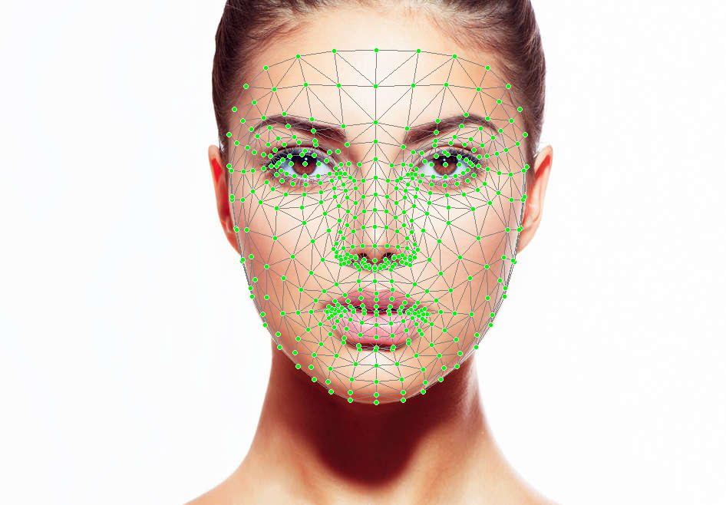
Smile Detection
Facial keypoints from MediaPipe
Input to Convolution Neural Network
90% accuracy between non smile and smile
Real world is however harder
Search better and more explainable
Notes:
Let’s start with the smile detection module. The initial approach consisted out of using Mediapipe to extract facial keypoints, which are x,y,z coordinates on your face that represent facial muscles movements. This was getting used as input for a CNN and resulted in a great accuracy. However, in real tests, it did not perform so good and we would like to find a more explainable way to approach this problem.

Slide 14
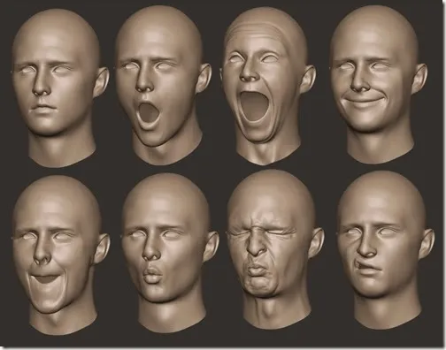
Smile Detection
No more usage of keypoints
Use blendshapes to estimate laughing
Can be used directly in the front-end
2 calibration phases
Finetune and normalize output
Notes:
And we discovered that blendshapes are also something that mediapipe is offering.
These blendshapes are the result of a pretrained model on these keypoints and represent certain facial regions.
An example of this is the upper corner of your mouth or the movement of your eyes.
Working with this is extremely easy, not only because it is way more explainable but also because it can be integrated into the front-end directly.
The final step was to finetune the values, by introducing 2 calibration phases: one for a neutral face and one for a smiling face and normalize these values as an input to the recommender system.

Slide 15
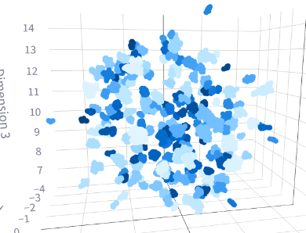
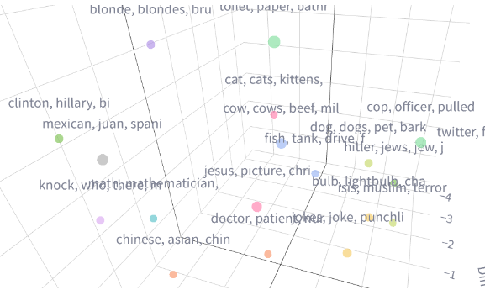
Joke Dataset
English dataset of jokes on internet -> embeddings -> UMAP -> clustering -> semantic categories
Cleaning + keeping 26 categories

Slide 16
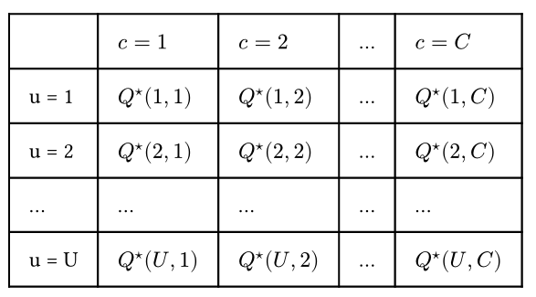
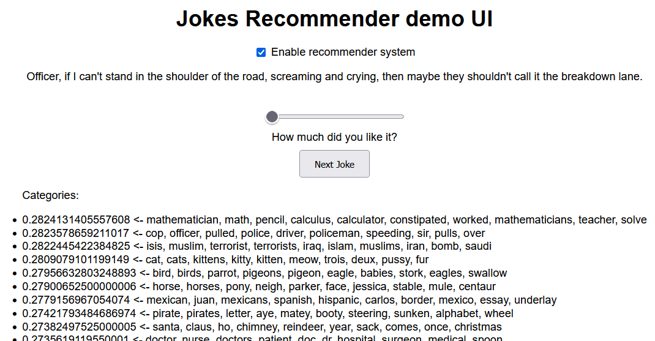
Joke Recommender
similar to tabular Q-learning (Barto & Sutton, 1998)
Fast convergence to pool of categories
Good at filtering
Tested in dedicated UI

Slide 17
Robot UI
Create UI with Next.js using Three.js for rendering 3D Model
Looking for an appropriate 3D Model, smiley, cute, with slight animations
TTS Web API for telling jokes
Automatic Logging of Smile Detection
Implementing User Flow according Study Design
Deployment
Connecting UI with recommender and Smile Detection
REST API calls to recommender
directly doing smile detection in frontend with @mediapipetasks-vision
Notes:
lena

Slide 18
Demo

Slide 19
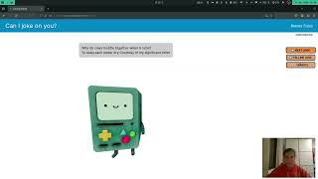
https://youtu.be/S_HRdiZi24g

Slide 20
Evaluation

Slide 21
What we wanted to evaluate?
How well learns the recommender system
Smile detection accuracy
User experience differences
Notes:
lena Based on this, we want to evaluate the following questions.
First is seeing how the recommender system learns over time. The longer the user interacts with the system, the better the jokes should get, and the more the user should laugh.
Next, we want to estimate, how accurate our smile detection module is by comparing this to our own estimation of smile degrees.
Lastly, we want to find out if there are any difference in the user experience observed by the user, and especially if we can make him laugh more often.

Slide 22
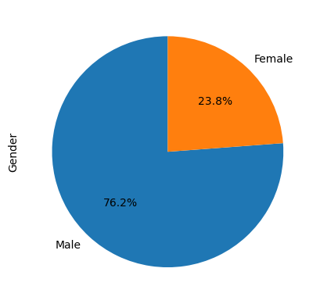
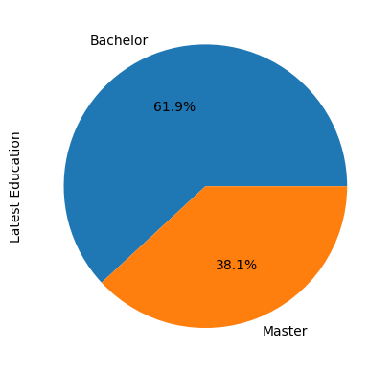
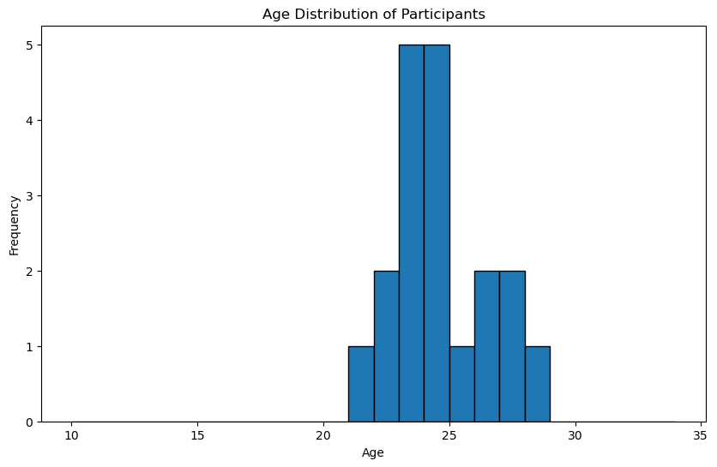
Participants
21 Participants
Notes:
some statistics about our participants, more than ⅔ were male so we have a little gender bias, the age speaks for our target group of students, and we can see the spread between bachelor and master degrees

Slide 23
Study Procedure
Testing 2 times with each user
with recommender (A)
without recommender (B)
Remote
Interaction time 5-15 min
Fill out questionnaires 2x
Notes:
lena Remote with screen recording and screen sharing, each user doing 2 rounds, the minimum interaction

Slide 24
Results
Notes:
Now that the experiment have been executed, it is time to analyse the data.

Slide 25
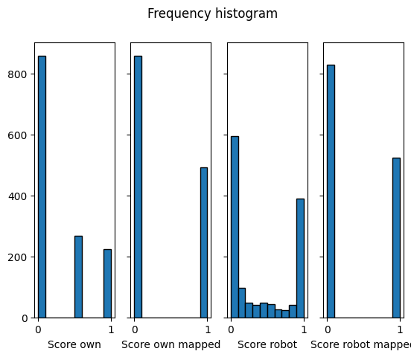
Smile Accuracy
Categorical values vs numerical values
Solution: map values to smile or no smile
Result: non-significant difference
Overall accurate detection
MSE: 13%
Notes:
Before going into other details, we should check if our first module, the smile detection, is actually performing alright. If we rate the smiles of the user, is this similar to smiles detection by the robot.
The first problem with this is that our values are in classes, namely: neutral, slight smile and smile and the robot values are ranging from 0 to 1.
To solve this, we decided to map them to smile or no smile. So slight smile gets mapped to smile and everything above 0.5 gets mapped to smile as well.
Comparing this we saw that there is not a significant difference between these the sets of values, which means that overall this modules does an excellent job at detection.
Finally, we also calculated the mean squared error, which resulted in around 13%.

Slide 26
Using a recommender system or not
Compare detected values from both experiments
Result: non-significant difference
Recommender system does not have a big influence
Reasons:
Recommender system based on themes
Dataset has a lot of flawed jokes
Notes:
A first attempt to answer our research question is to compare the values from both experiments. Sadly, this resulted in a non-significant difference, which means that the recommender system did not have an immediate effect on the smile-degree and average values of both runs are very similar.
We figured that this can be because of different reason.
The first one being that the recommender system is based on themes instead of actually looking at the linguistic context. People might not be interested in a specific theme but maybe more in the fact that a certain punchline is funny to them.
Another issue is that the dataset contains some strangely constructed jokes which are often hard to understand.

Slide 27
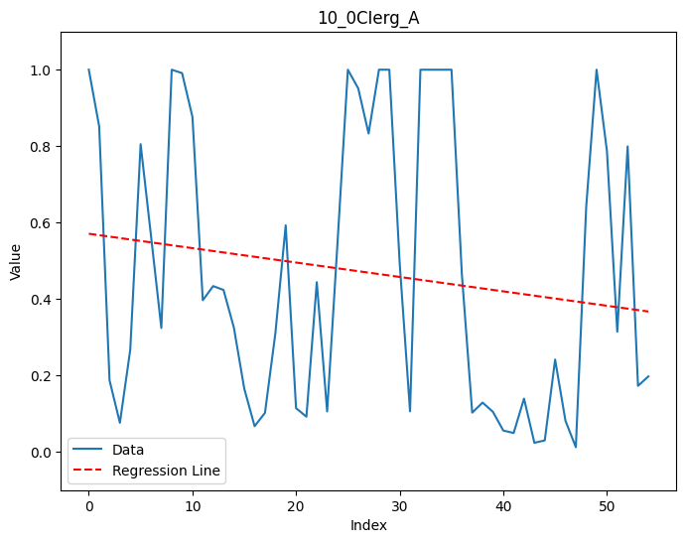
How well learns the recommender system
Compare first part to second part
Result: significant difference
Second part performs worse overall
0.17% vs 0.23%
Possible reasons:
Recommender system minimal influence
Tired towards the end
Similar jokes are not funny twice
Notes:
Initially we expected that using the recommender system, the users would smile more often over time.
But as we saw in the previous job, the recommender system is not making a difference, which means that comparing the first to the second part we can see a significant different. We can see that the overall smile degree decreases over time.
This can be due to users being tired over time or seeing similar jokes (because the recommender system will be focussed on certain themes) for the second time, which will of course not be so funny anymore.

Slide 28
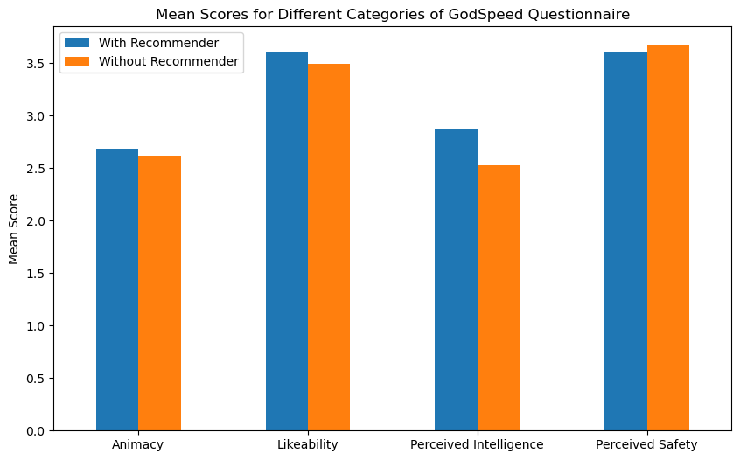
User Experience Differences I
Notes:
we did a alpha cronbach test for testing the internal consistency of our questionnaire which was above 0.7 (acceptable) in first 3 categories, so those 3 will be considered further
This graphic shows the mean within category scores obtained and we can see that in the first three, especially likability and perceived intelligence the study round with the recommender enabled was able to achieve a better score

Slide 29
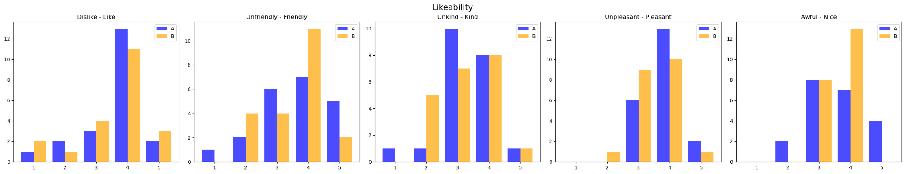
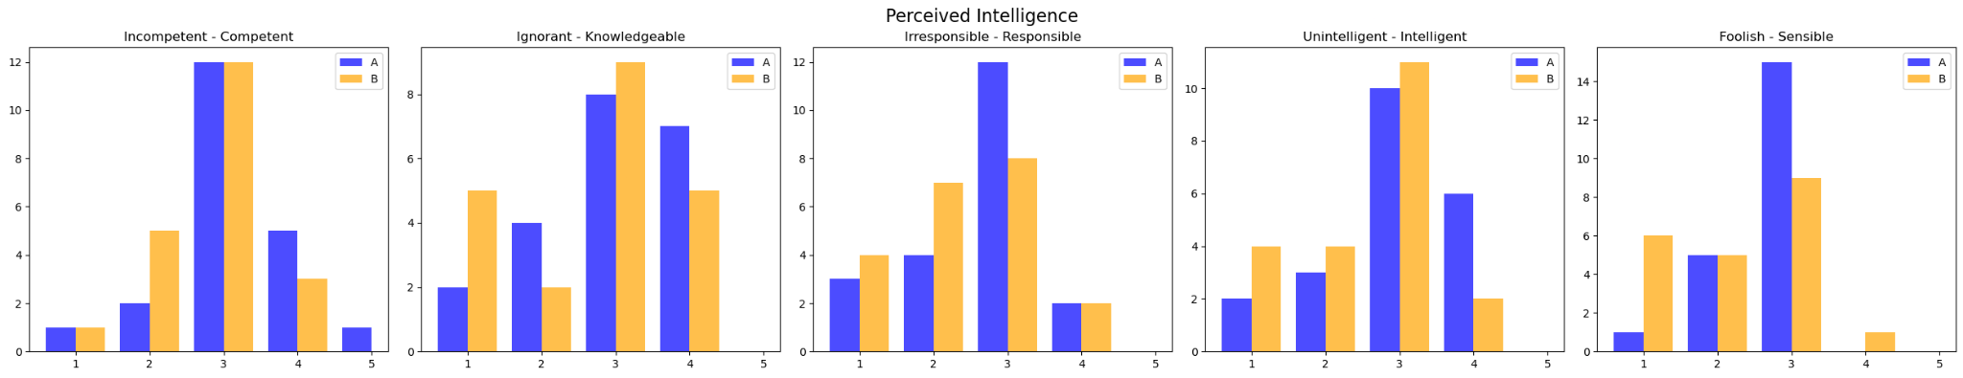
User Experience Differences II
With recommender slightly more likeable, intelligent, knowledgeable, pleasant
Notes:
if we take a close look at the likability and perceived intelligence, because in those categories there was the biggest difference between the 2 study rounds, we see that with recommender enabled the robot was considered to be slightly more likable, pleasant to use, intelligent and knowledgeable

Slide 30
Conclusions

Slide 31
Conclusions
Recommender does not lead to a happier user in our application in terms of smile detection
Longer interaction periods with application would help to get more accurate results, but interaction is also very monotonous (always the same)
Improvements needed for better results
Cleaning the dataset would help a lot
Using different recommendation approach (not just classes)
Notes:
the negative part

Slide 32
Conclusions II
Application was fun to build
Smile detection works well, but strongly depends on individual and calibration
UX differences indicate that an application with recommender enabled makes a more intelligent, competent and fun impression to user
Notes:
the positive part plus reflection

Slide 33
Questions? Feedback?

